Slide 1
Justification for the Hire of a Part-Time Assistant Athletic Trainer
Cindy Jimenez, MA, ATC, CSCS
Kinesiology, Athletics, and Dance Department

Slide 2
Why?
To meet the needs of the growth of the Athletics Department and better serve the student-athletes of Cañada College
Building 1 renovations
Addition of a new sport
Participation in the non-traditional season of sport

Slide 3
Background Info
Athletic Trainer duties
  Emergency Response – injury evaluation and treatment, infection control, practice and game medical coverage
  Preventative Care – baseline concussion testing, pre-participation physicals, athlete education
  Rehabilitation Services – physical therapy
  Adminstrative Responsibilities – creating emergency action plans and standing operating procedures, injury documentation, insurance claims, physician referrals, supply order and budget management
California Community College Athletic Association
  Bylaw 9 – Medical Policies
  Bylaw 3 – Contests and Seasons of Sport
Notes:
One of the recent duties added to the ATCs load that has not been mandated before is the baseline concussion testing. Each student-athlete is required to undergo a two-part concussion baseline test prior to their participation. One part requires me to meet with each student-athlete individually for cognitive and balance testing.

Slide 4
With Only 1 ATC on Staff…
Increase in # of Athletes Served
Increase in Comp Time Totals
Year | Total Athletes (In-season)
2006-07 | 130
2007-08 | 117
2008-09 | 110
2009-10 | 128
2010-11 | 140
2011-12 | 142
2012-13 | 134
2013-14 | 153
Year | Total Hours Accrued
2006-07 | 292
2007-08 | 96
2008-09 | 184.5
2009-10 | 153
2010-11 | 193.5
2011-12 | 216.5
2012-13 | 300
2013-14 | 329
Notes:
Data unavailable for current year as baseball has not been accounted for yet (Spring season), but the number of athletes has decreased due to women’s soccer being put on hiatus for 1 year. However, that sport will be reinstated along with the addition of another female sport beginning the 2015-16 academic year.
As you can see, there has been a steady increase in both total athletes and comp time, especially with the reinstatement of volleyball last year.

Slide 5
Growth & Development of Athletics
Student-athletes – serving a population of the college that has higher than average graduation and transfer rates
  Training and working to better themselves all year round – currently have no medical support during their offseason conditioning classes and non-traditional seasons
Building 1 renovations - teams moving off-campus for estimated 1.5 years
  Still require medical coverage
  Conflicts in game scheduled in close time proximity
Anticipated addition of a new sport - increases number of athletes to be served
Updates in medical coverage legislation – non-traditional seasons

Slide 6
Non-Traditional Season Participation
Bylaw 3 (Contests and Seasons of Sport) of CCCAA Constitution establishes “TRADITIONAL” and “NON-TRADITIONAL” seasons of sport
CCCAA: Bylaw 9 applies to all sanctioned CCCAA contests including traditional season games, traditional season scrimmages, AND non-traditional season scrimmages – additional 21 scrimmages played
Represents a legal duty for ATC to be present at defined events
Currently we are treating out-of-season teams as fitness classes and sending all injuries through the insurance process via the Health Center
  Increase in medical costs and insurance premiums on injuries that could be handled in-house
Notes:
NTS – defined time and number of scrimmages outside of the regular intercollegiate season where the teams are allowed to participate. For example, fall for baseball, spring for soccer and volleyball
This mandate increases the workload for the existing athletic trainer by increasing number of games and scrimmages to cover, and increased responsibility to provide year-round medical coverage (versus only in-season coverage)
In addition, the need to be on campus for NTS activity decreases the opportunities for ATC to use up comp time and maxed vacation time, which is already difficult to use up

Slide 7
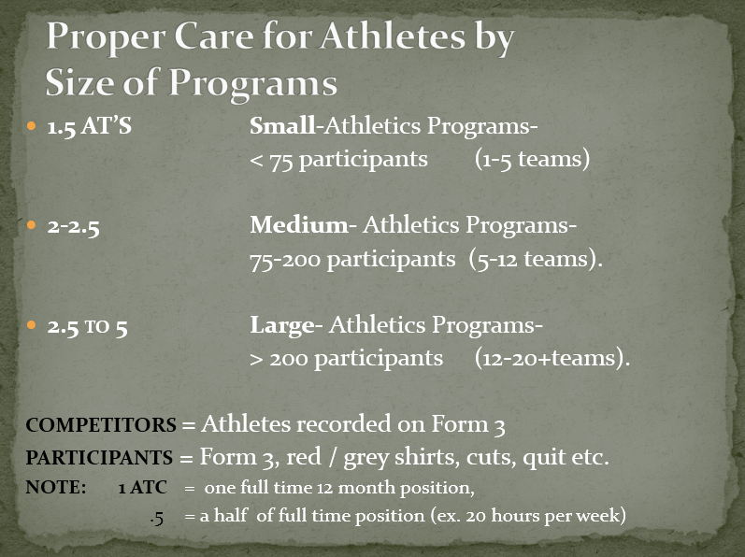
Recommendations from CCCATA
Notes:
CCCATA is an organization within the CCCAA that provides recommendations regarding best practices for medical coverage. They are recommending, for our program size, a staff of 2-2.5 ATCs. We understand that it may not be financially viable, and are only asking at this time for another part-timer to bring our staff to 1.5.

Slide 8
Conclusion
Benefits of an additional staff member outweighs the additional salary:
  Cost containment in medical bills and insurance premiums
  Continuity of in-house care all year round
  Compliance with intercollegiate athletics’ governing body to avoid liability
Our student-athletes are training off-season and in…we have a responsibility to provide adequate medical coverage

