Slide 1
New Biology Faculty
investing in non-majors

Slide 2
We have the need

Slide 3
Staffing
4 FT + 13 PT
Notes:
average PT load is 0.2 to 0.36 (3-4 unit course); new FT will reduce 3-5 PT

Slide 4
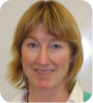
?
Allied Health
Non-Majors
Majors

Slide 5
We are not STEM
24 of 26 sections do not directly benefit from STEM grant-funded support
Notes:
2 sections are majors

Slide 6
We are not STEM
efforts to improve retention and success fall solely upon current faculty

Slide 7
We are not STEM
Two-thirds of sections have no FT faculty to drive innovations to improve success
Notes:
16 sections of 24 are taught by PT; 2 sections are majors
2/3rds of non-STEM sections are taught by PT

Slide 8
We have the capacity

Slide 9
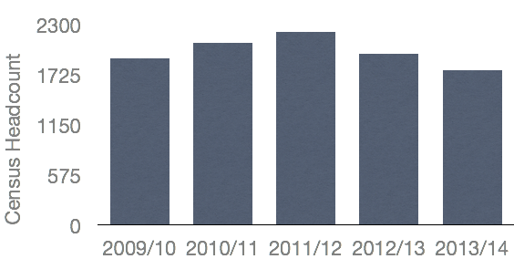
Enrollments
5-year low
20% fewer sections

Slide 10
but even at these historic lows…

Slide 11
Staffing
8.3 Total FTEF
2.16 PT-FTEF in allied health
1.84 PT-FTEF in non-majors
5 year average: 9.45 FTEF
Notes:
Over 4.0 FTEF worth of load to fund 1 FT position

Slide 12
Non-Majors
94% Fill Rate (n=10)
5 year average: 88%
College average: 78%
Notes:
College 5-year average: 78%

Slide 13
Allied Health
87% Fill Rate (n=14)
5 year average: 88%
College average: 78%

Slide 14
LOAD
561
College 5-year average: 546
Notes:
Our load this semester is 561; our 5 year load data is skewed due to elimination of HBA

Slide 15
We have the potential

Slide 16
Growth Opportunities
GE Thematic Pathways
Honors in GE courses
ADT in Nutrition and Dietetics
ADT in Biology
Online courses: general biology and nutrition

