Slide 1
English Department Hiring Justification
Spring 2015

Slide 2
Again?
Didn’t English just get a new hire?

Slide 3
Yes
Fall 2014 full-time hire increased our department to seven full-timers
Better, but still far fewer than the twelve full-timers we had when the grandma among us was hired, 16 years ago
Our department FTEF (productivity) has increased from 9.27 in Fall 2009 to 11.83 in fall 2013, meaning we have the load for 11.83 FT faculty

Slide 4
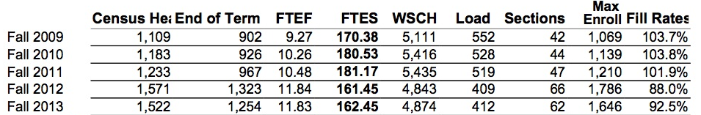
Productivity by Semester

Slide 5
Why Not Adjuncts?
We love adjuncts! We have wonderful adjuncts, which is a good thing as they teach more than half of students taking English courses.
However . . .

Slide 6
Full-Time English Faculty Chair and Staff Committees
Professional Development
ACES
Honors’ Advisory
Sustainability
Pathways to Transfer
Distance Education
AFT
Academic Grievance Committee
Puente
Multiple Measures Assessment Placement Pilot Project (MMAP)
Inter-departmental and Student Services Screening Hiring Committees (2)

Slide 7
Full-Time English Faculty Develop Initiatives
Creating a writing center
Participating in GED Jam pilot and other ACCEL projects
Developing and assessing learning communities
Developing online supplemental instruction
Developing honors’ courses
Coordinating events including poetry slam, People’s History, field trips and speakers
Running Word Jam
Creative writing club
Implementing programs for underserved students (Puente, Milestones)

Slide 8
State and Federal Push to Accelerate Student Progress
Our department has developed accelerated/integrated English courses that require faculty who are:
versed in reading and composition pedagogy
able to teach higher-unit accelerated/integrated courses
In high demand (and therefore scarce)

Slide 9
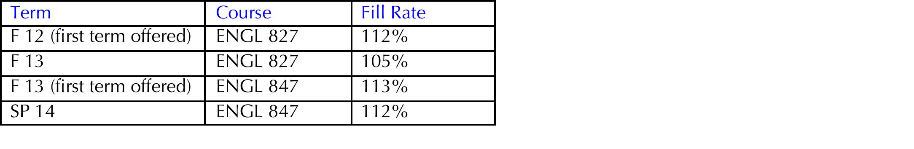
Our Accelerated Courses Are Packed

Slide 10
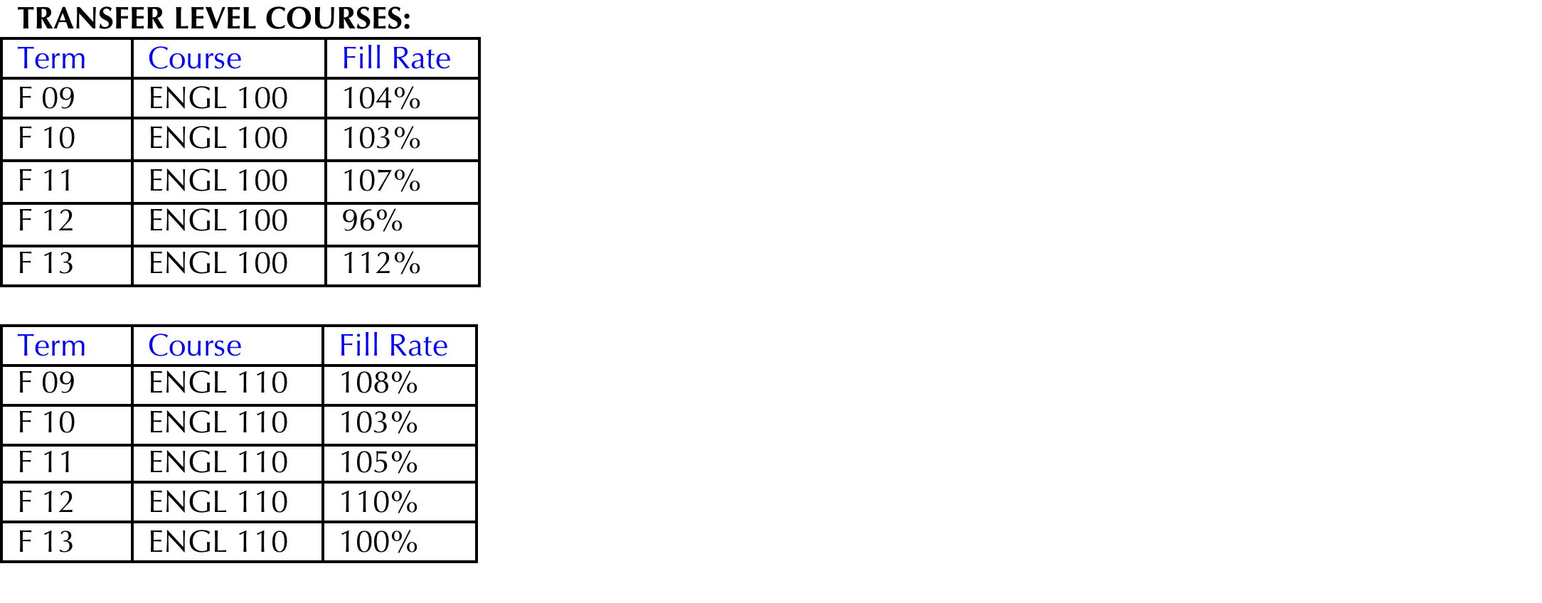
Our Transfer-Level Courses are Packed

Slide 11
Cañada Needs More Fulltime Faculty
Given our productivity, fill rates, and the scarcity of qualified specialized English adjuncts, we feel one of these new fulltime faculty members should be in English.

Slide 12
Sources
Hsieh, Chialin. Data Packet (English). Office of Planning, Research, and Institutional Effectiveness. Cañada College. 2014-15.
Johnson, David. Dean of Humanities and Social Sciences. Cañada College.

