Slide 1
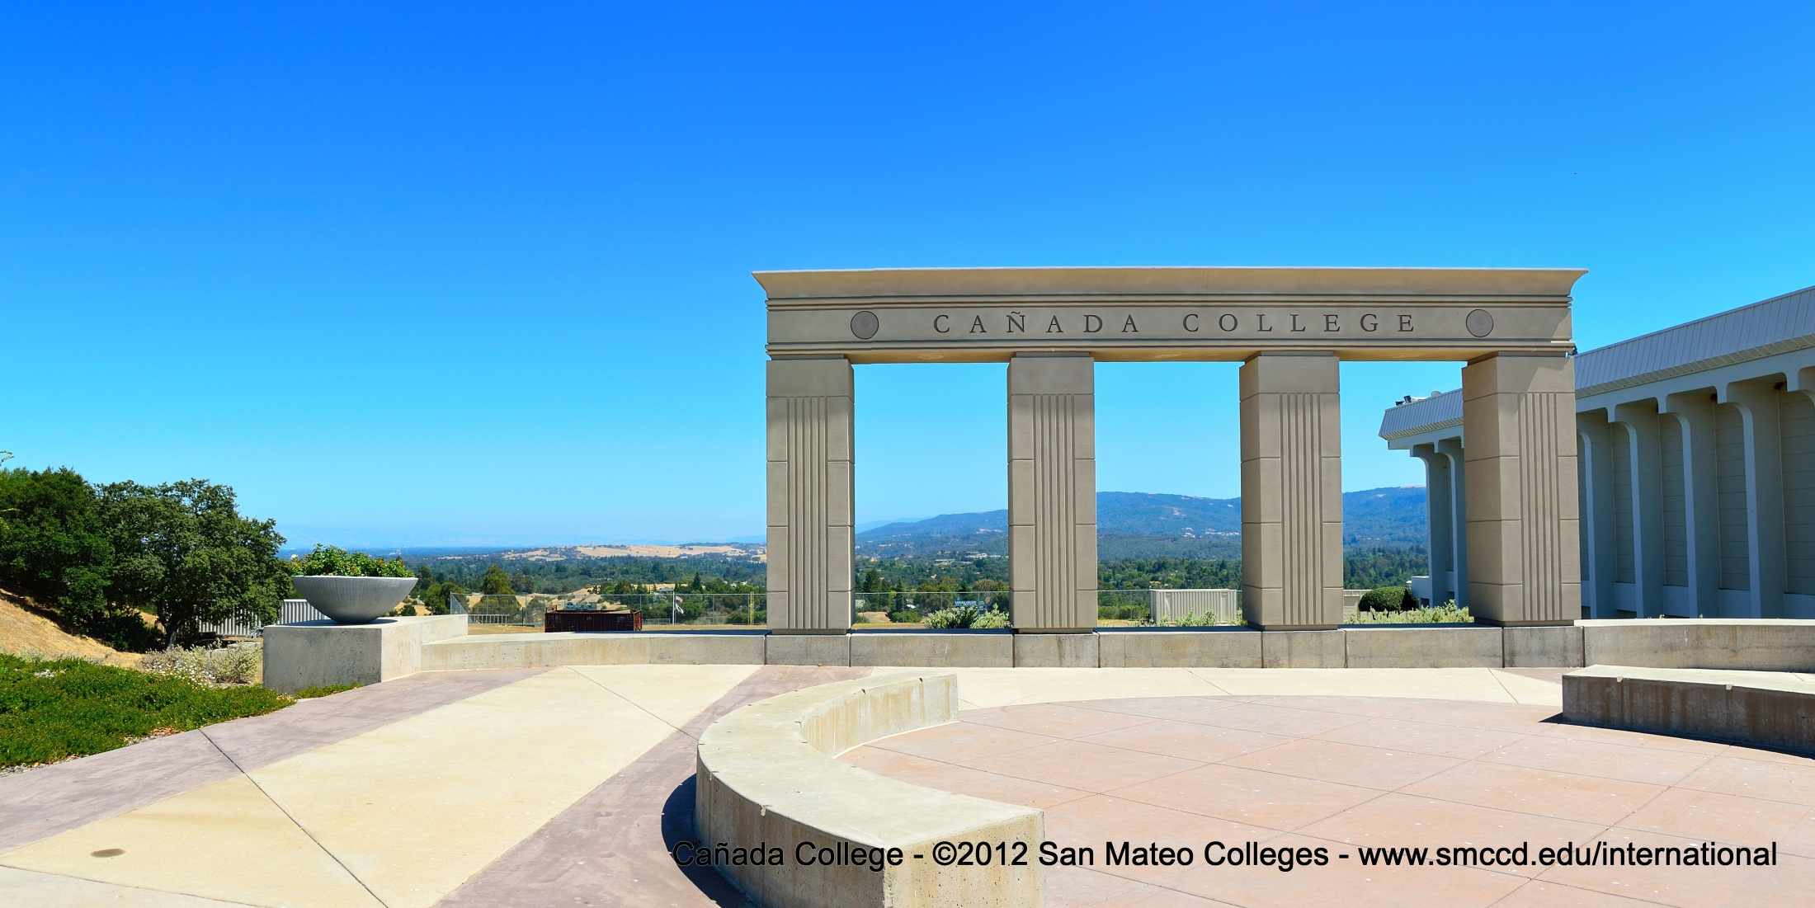
Cañada College
From here you can go anywhere
International Student Center
Supinda Sirihekaphong ● sirihekaphongs@smccd.edu ● 1-650-304-3440

Slide 2
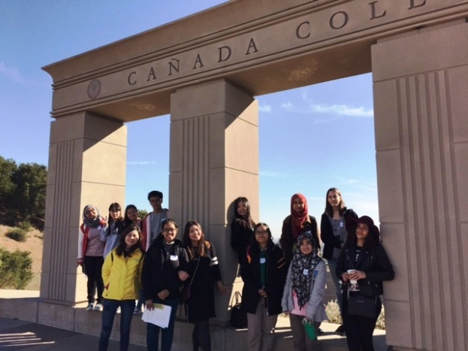
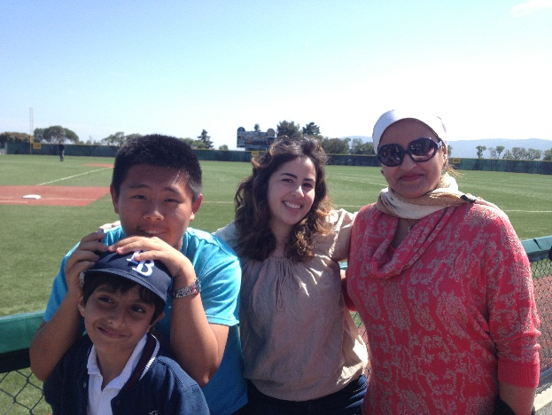
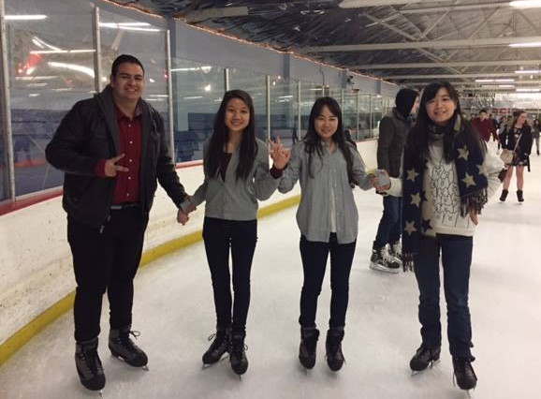
Mission Statement
Provide individualized services to students, so they can achieve their personal, educational, and professional goals.
Promote understanding and respect for community engagement and cultural exchange.

Slide 3
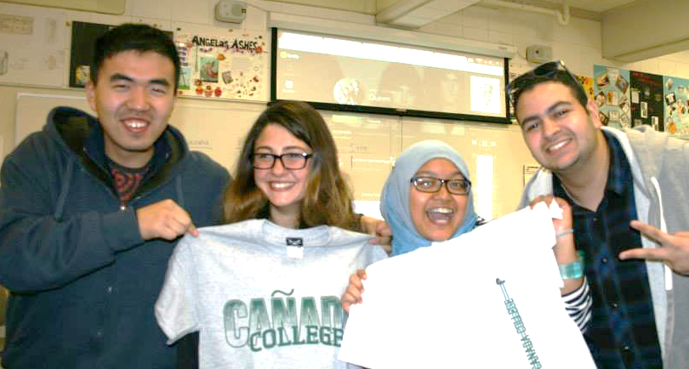
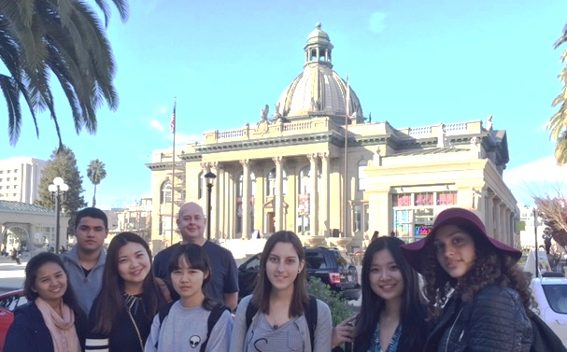
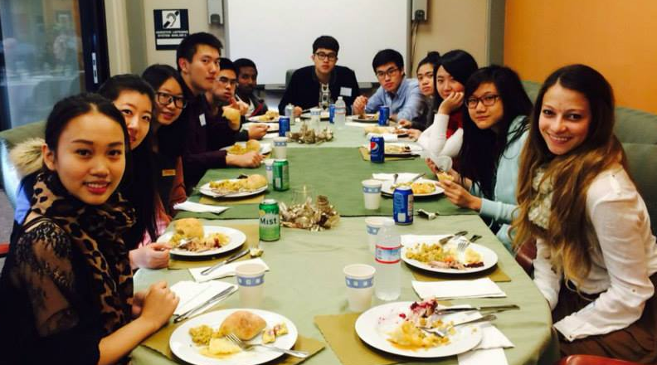
Student Learning Outcomes
1. International students will understand and maintain their F-1 immigration rights and responsibilities.
2. International students will increase their knowledge of services and tools available to reach their education goal (complete a program of study or transfer to a 4-year university).
3. International students will become an active member of the Canada College community. ISC must help international students understand the importance of engagement in achieving their education goals.

Slide 4
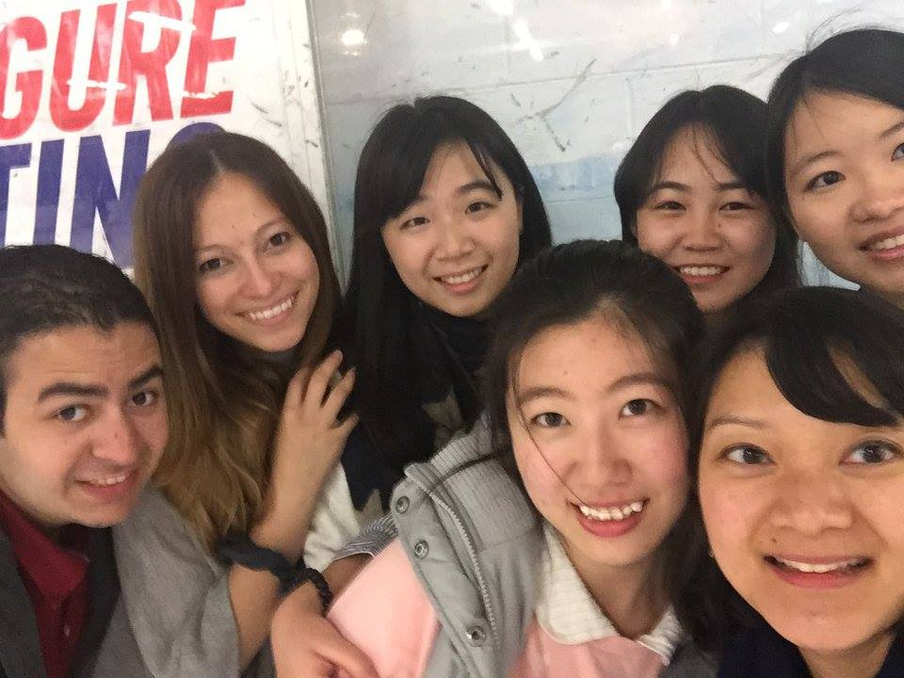
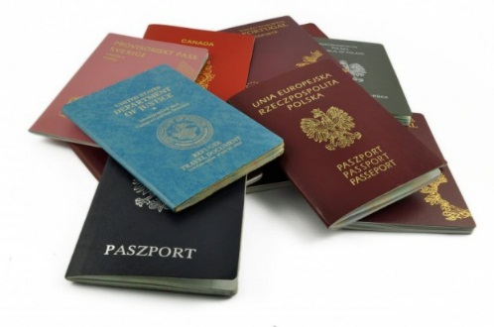
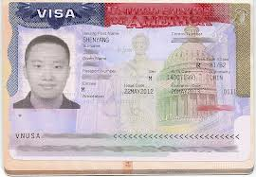
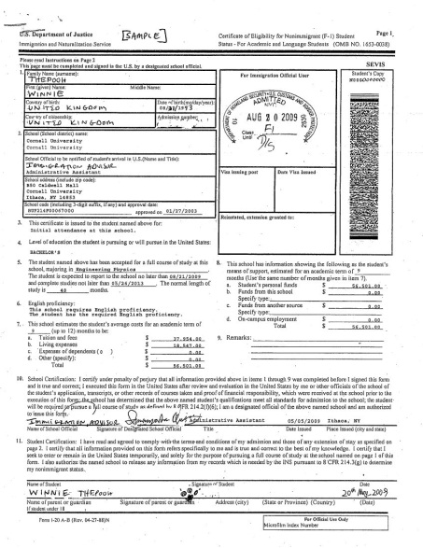


Activities & Services
Recruitment & Outreach
Admissions
3-day Orientation
Immigration Advising
Academic Advising
Employment Advising
Student Life
Study Abroad
U.S. Customs &
Border Protection

Slide 5
Admissions Application Trends
63% take rate
53%
38%
73%
27%
82%
44%
40%
79%

Slide 6
International Enrollment Trends
120
100
Projected Trend (conservative)

Slide 7
International Services Trends

Slide 8
International Student Impact
New sections of ESL
Fall 2014: Opened up a section of ESL 923 (6 internationals of 28 students)
Spring 2015: Opened up a section of ESL 400 & LIBR 100 (8 of 20 students)
Student Employment
AY 2013-204: 8 employment on campus (Ambassadors, Bookstore, Tutors)
AY 2014-2015: 17 employment on campus
ISC Collaborations
Transfer, Class Participation, and Employment Workshops are open to all international and ESL students
Student Life
ASCC Service of international students doubled from AY13-14 to AY 14-15
International Culture Exchange Club (Foreign Film Nights, Language Exchange), Glee Club, Career Club, Business & Entrepreneurship Club

Slide 9


ISC Staffing
Dean of Counseling Services
Administrative oversight
Full-time International Program Manager
Fairy godmother, paper pusher, enforcer, etc.
(50 hours per week)
4 International Student Ambassadors
Peer mentor and answer email inquiries
(5 hours per week x 4 = 20 hours)
Part-time Program Services Coordinator
International admissions
Students services
(20 hours per week)
Student
We are District funded!!!!

Slide 10
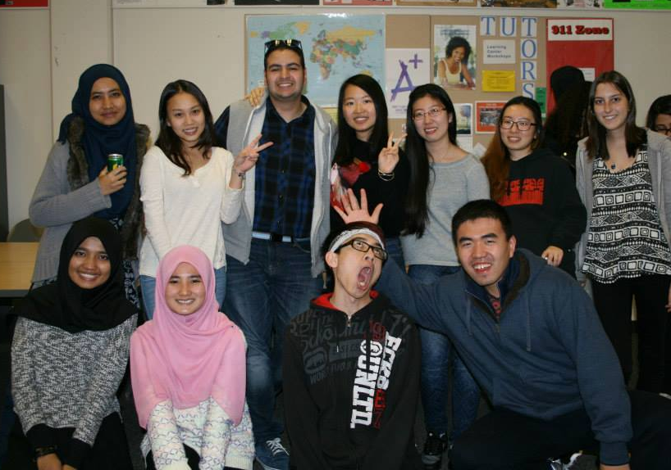
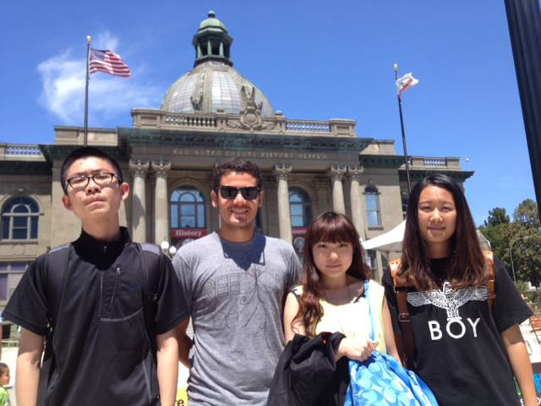
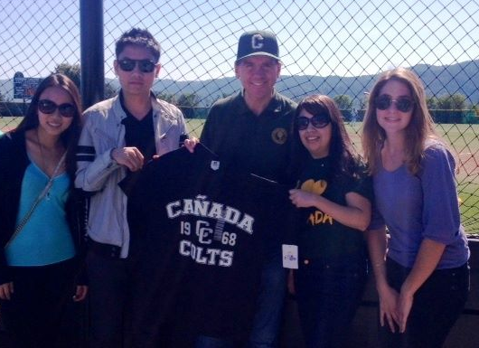
Questions?
Thank You.

