Slide 1
Math Department Position Justification Spring 2015
Nearly every student at Cañada College takes at least one math class!!

Slide 2
Main Points
Demand for math classes is large and the numbers of students in transfer-level classes continues to grow.
6 FT and 17PT teach ~50 sections.
Common Core implementation will trigger re-design of math sequence here.

Slide 3
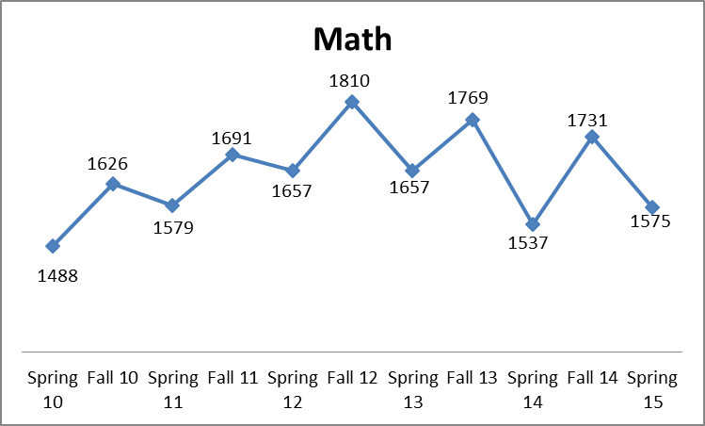
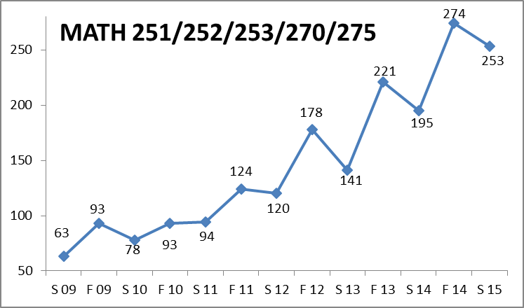
Overall enrollment in math classes follows the enrollment in the school, which is declining
However, enrollment in transfer-level classes (calculus shown here) continues to grow, even while overall enrollment is down

Slide 4
NEED
We have 6 full time math instructors: Rich Follansbee, Michael Hoffman, Denise Hum, Evan Innerst, Ray Lapuz and Po Tong
In spring 2015, full timers teach 41% of the classes, but only 12.5% of pre-transfer level math classes and none of the sections of statistics.
Total FTEF for the spring 2015 semester is 13.03, so the maximum that FT faculty can teach is only 46% of math classes. (6/13.03)
Notes:
#2 For consistency and predictability, students have asked that FT faculty teach calculus and above.
#3 If no math instructor has release time

Slide 5
Department Initiatives
In recent years our focus has been on improving our success in the basic skills courses and we will continue to try and improve our results.
Mastery level testing
Increased student contact hours
In-class tutoring (EPIC)
We are constantly trying to improve retention and success of the all students , but particularly STEM students
STEM Center and MathJam
Acceleration – Path to Stats and Fast Track to Calculus
We are particularly concerned about the coming need to revamp the algebra sequence in light of Common Core.

Slide 6
Statewide and Regional Leadership
Multiple Measures Assessment Project
San Mateo County Regional Math Collaboration (CalPASS)
California Acceleration Project
Reading Apprenticeship STEM network
Basic Skills and Student Equity (ACES)

Slide 7
To be successful and meet the needs of our students, we need additional full-time faculty

