Slide 1
New Biology Faculty
investing in non-majors

Slide 2
We have the VISION

Slide 3
Strategic Directions
Educational Master Plan
Improve entry by identifying clear student pathways for basic skills, career/technical, general transfer, specific majors, and courses/programs.
Student Engagement Plan
Focussed - Every student who enrolls to pursue a certificate, degree, or who plans to transfer will work with college personnel to create a Student Success Pathway – A Roadmap to Completion.
Sustainability Plan
Utilize different pathways to integrate sustainability in the curriculum.

Slide 4
GE Thematic Pathways
Sustainability, Social Justice, Honors
BIOL 100: Intro to Life Sciences
BIOL 110: General Principles of Biology
HSCI 100: General Health Science
(HSCI 116: Women’s Health)

Slide 5
Growth Opportunities
ADT in Nutrition and Dietetics
ADT in Biology
ADT in Kinesiology
Online - Intro to Life Sciences
Online - Nutrition

Slide 6
We have the need

Slide 7
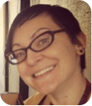
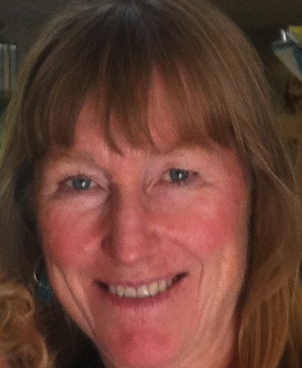
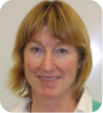
?
Allied Health
Non-Majors
Majors
Notes:
No dedicated FT faculty to non-majors

Slide 8
Reflection & Innovation
Courses without a dedicated FT faculty often lack consistent SLO analysis & subsequent experimentation in pedagogy

Slide 9
% CRNs taught by PT
60% of sections have no FT faculty to drive long-term innovations to improve success
Notes:
22 of 33 sections are taught by PT

Slide 10
We are less than 10% STEM
92% of sections do not directly benefit from STEM grant-funded support
Notes:
2 sections of 26 (biol+hsci) are majors

Slide 11
We are less than 10% STEM
efforts to improve retention and success fall solely upon current faculty

Slide 12
We have the capacity

Slide 13
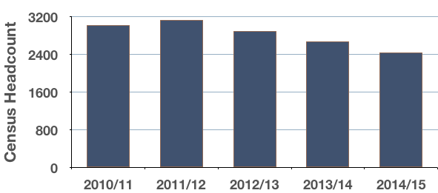
Annual Enrollments
Nursing shortage delayed due to economic downturn
Historically low regional unemployment
Notes:
Last economic downturn decreased nursing retirements and new hiring opportunities.
Nursing ranks 14 in the list of occupations with the highest number of total job openings from 2012-2022 in SMC

Slide 14
Staffing Spring 2016
7.88 Total FTEF
-4.0 Full Time
3.88 Part Time
5 year average: 10 FTEF/semester
4FT + 12 PT faculty
Notes:
We manage our staffing efficiently and can still support over 3 FT-worth of PT faculty
2.12 of the PT-FTEF is in BIOL 100, 110 and 130/2

Slide 15
Student Demand will Increase

Slide 16
2012-22 Forecasts
Healthcare practitioners will increase 15% in SMC
Approximately 600 new and over 800 replacement positions every year in SMC!
Registered Nurse ranks 14 in list of occupations with the highest number of total projected job openings in SMC
Notes:
http://www.labormarketinfo.edd.ca.gov/data/employment-projections.html
RN: 96% as many as the number of openings for system software developers (need the same number of RN as system developers)
RN: 66% as many as the number of openings for software application developers (need two-thirds as many RNs as application developers)
RN: 132% as the number of openings for lawyers! (need 32% more RNs as new lawyers)

Slide 17
We are efficient
Notes:
Supporting college’s load balancing efforts

Slide 18
Fill Rate Spring 2016
91%
Our 5 year average: 88%
College average: 78%

Slide 19
LOAD Spring 2016
535
College LOAD: 483

