Slide 1
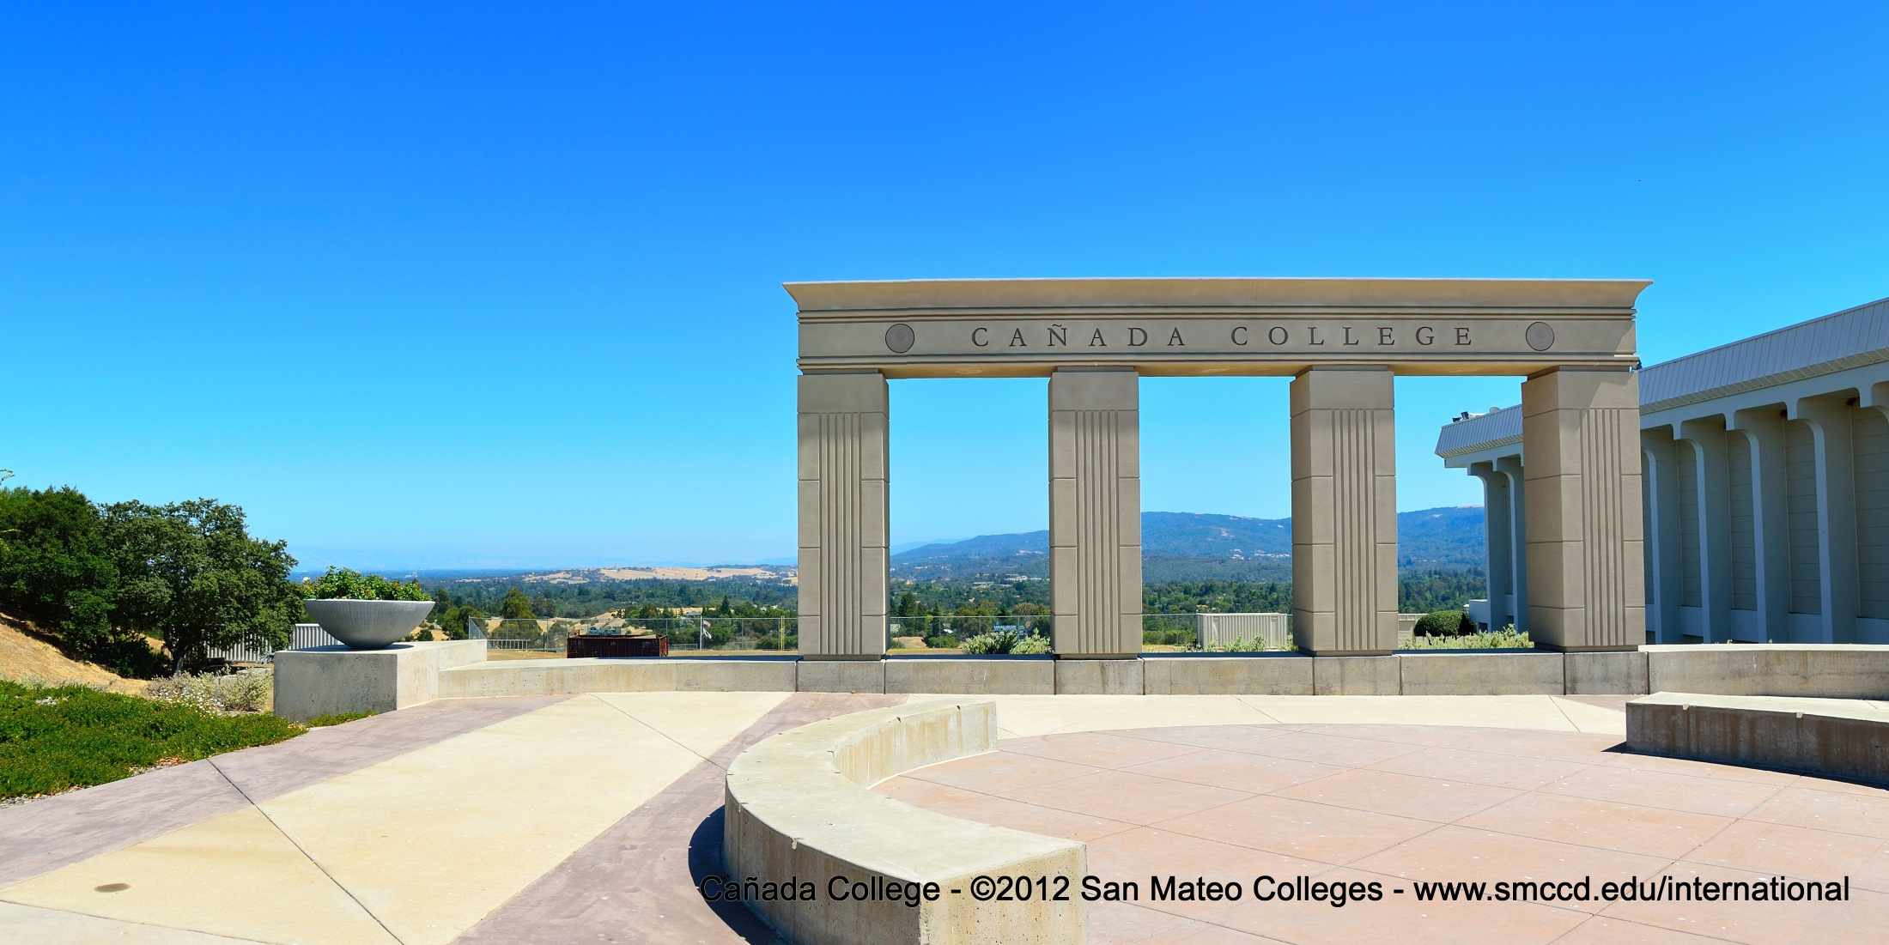
Cañada College
From here you can go anywhere
International Student Center
Supinda Sirihekaphong ● sirihekaphongs@smccd.edu ● 1-650-304-3440

Slide 2
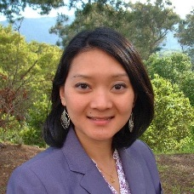
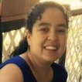
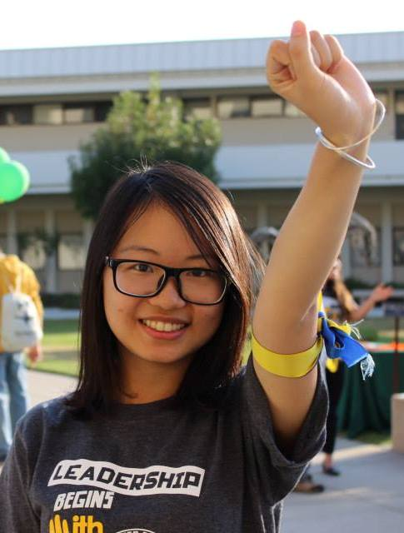

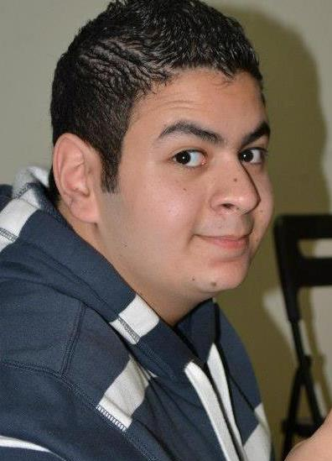
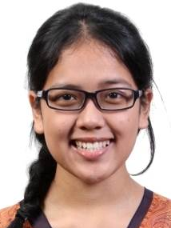
Staffing Request
Full-time Classified Program Services Coordinator
Responsibilities:
  Process international student admissions and maintain international student records in SEVIS
  Provide international student support services including implementing orientation and workshops, referrals to other student services
  Recruit international students through outreach from email inquiries and ESL partner schools

Slide 3
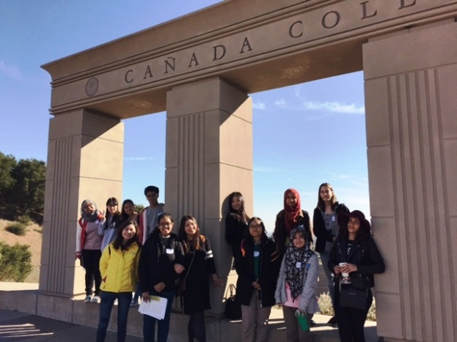
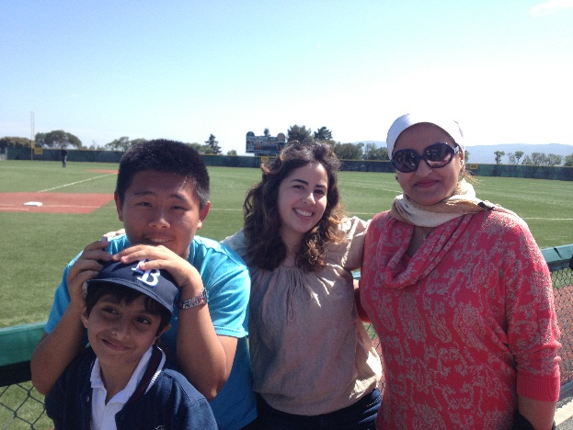
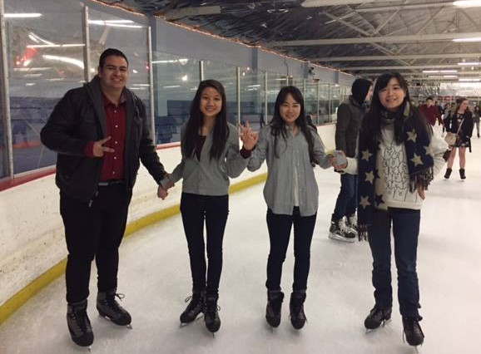
Mission Statement
Provide individualized services to students, so they can achieve their personal, educational, and professional goals.
Promote understanding and respect for community engagement and cultural exchange.

Slide 4
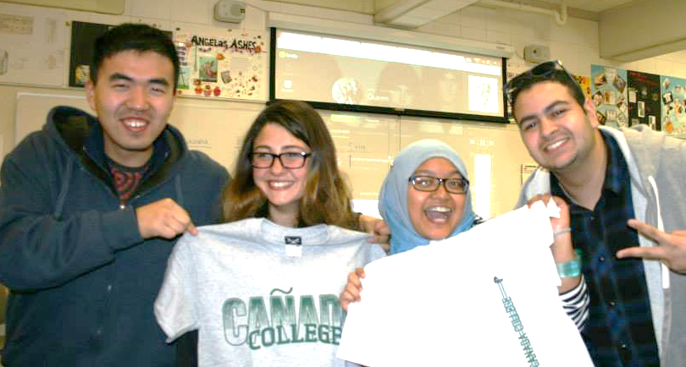
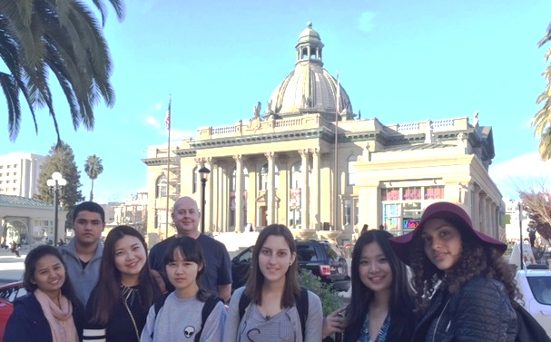
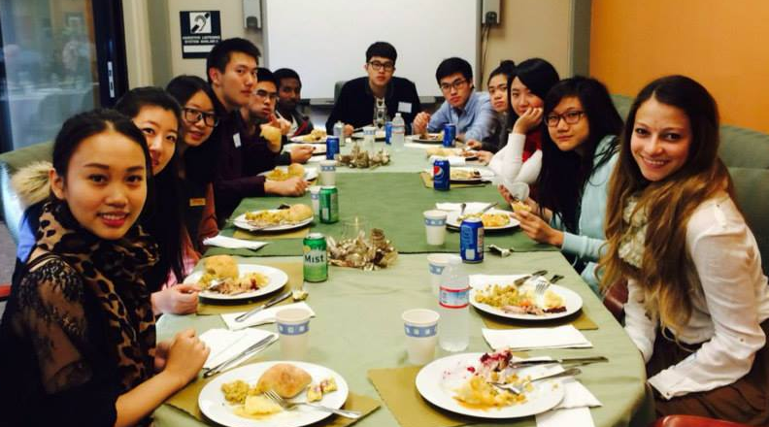
Student Learning Outcomes
1. Understand and maintain their F-1 status immigration rights and responsibilities.
2. Increase knowledge of services and tools available to reach their education goal (complete a program of study or transfer to a 4-year university).
3. Become an active member of the Cañada College community. ISC must help international students understand the importance of engagement in achieving their education goals.

Slide 5
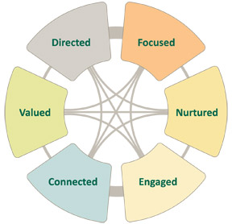
Activities to achieve SLOs
Student Success (Re)defined
Orientation, Transfer,
Class Participation, Employment Workshops,
Referrals to other student services/workshops/events
Mid-term Progress Reports
Weekly Enrollment Checks
Bi-weekly Newsletter
Open Door Policy
Student Ambassadors/ New Student Mentees
Birthday Cards
Thanksgiving and
Beginning & End of Year Party
Social activities/media
(orientation, bowling, ice skating)
MAP Club & other clubs, ASCC, on campus employment, etc.

Slide 6
Admissions Application Trends

Slide 7
International Enrollment Trends

Slide 8
International Services Trends
*Data from SARS. If counselors do not input "International" as a reason code, appointments for international students are not tracked.

Slide 9
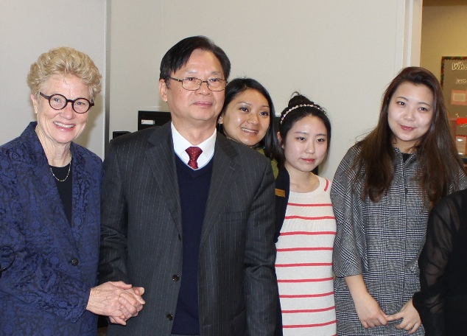
Considerations
1. SMCCD Community & Corporate Education
Silicon Valley Intensive English Program, Fall 2016
2. International Student Budget
2015-2016 international student tuition provided $3 million in revenue to SMCCD
3. SMCCD International Student Recruitment
Colleges are now able to recruit overseas at the expense of SMCCD. Supinda will be going to 5 cities in Mexico in mid-April and will do more targeted outreach in the Fall with feedback from the International Advisory Group.
Redwood City Sister and Friendship City Partnerships in China.
4. Cañada Mission & Vision
“understand and appreciate different points of view within a diverse community.”
“prepare students for the university, the modern workplace, and the global community.”

Slide 10
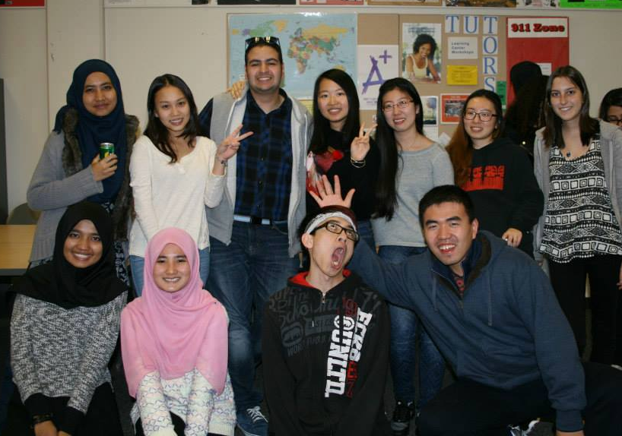
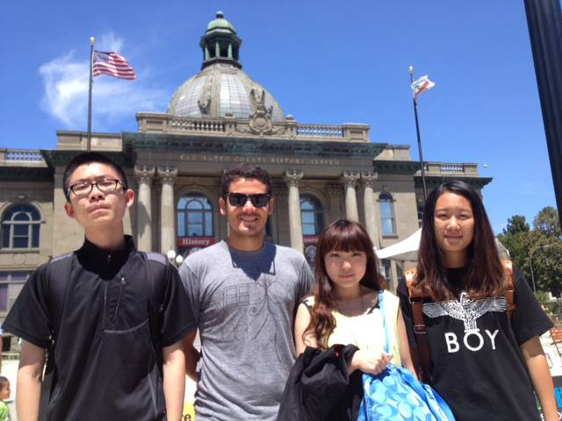
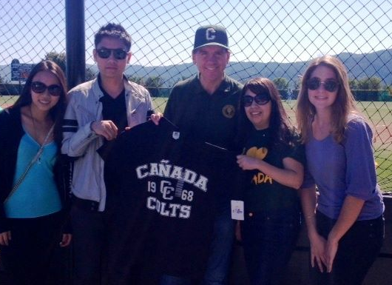
Questions?
Thank You.

