Slide 1
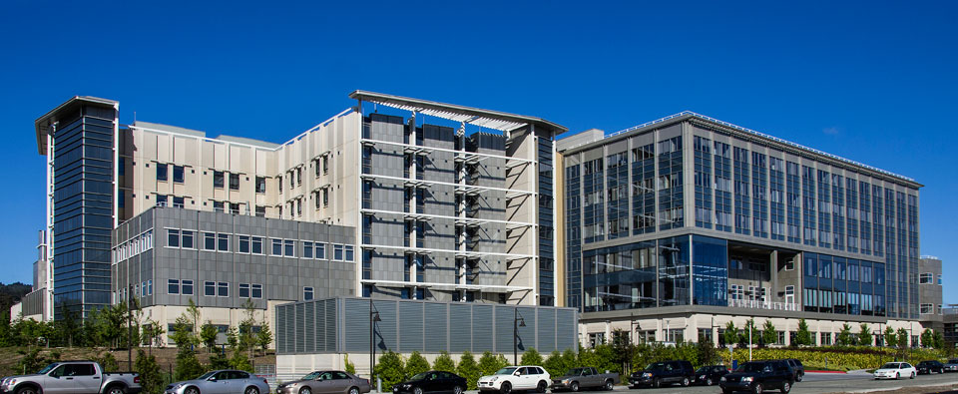
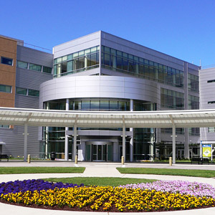
New Medical Facilities

Slide 2

Medical Assisting Program
Cañada College

Slide 3
We All Utilize Health Care
Preventive Services:
Physical Immunization
Chronic Disease Management:
Diabetes Hypertension
Acute Illness:
Cancer Stroke Brain Tumor

Slide 4
Careers In Medical Assisting
Medical Administrative Assistant
Medical Assistant
Medical Coding Specialist
Medical Billing Specialist

Slide 5
Careers In Allied Health
Cañada
Medical Assisting, Path Package, Radiologic Technology A.S.
BSN SFSU program offered at Cañada
CSM
Fire Technology, Nursing A.S.
Skyline
Central Processing, EMT, Surgical Technology, Respiratory Therapy A.S.

Slide 6
Medical Assisting as a Gateway to
Allied Health Careers
More than one career in a lifetime.
Can take several attempts to get into an impacted Health program.
Medical Assisting Certificate allows you to work while completing prerequisites for other Allied Health program.

Slide 7
Enrollment Patterns in MEDA
Consistent FTEs
First-Time Students retention/success rate 88% to 100%
Continue and Return Student retention/success rate 80s to 90s percentage
More students earning multiple certificates and working toward advancement in Allied Health careers

Slide 8

Full-Time Faculty
Continued Stability
Structure
Coordination

