Slide 1

Puente OAII

Slide 2
Agenda
Background
Contract
Program Growth
Next Steps

Slide 3
Fall 2015

Slide 4
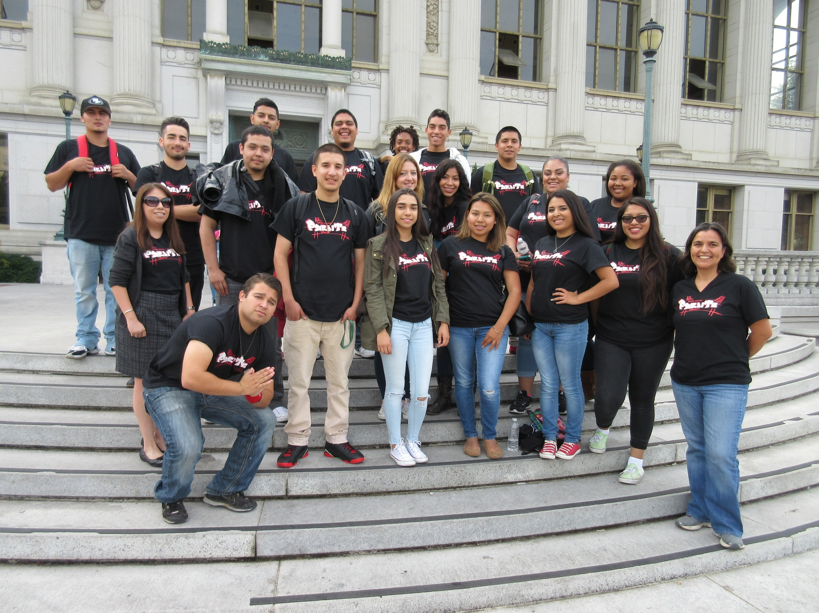

Slide 5
Clerical assistance for 10 hours/week

Slide 6


Slide 7
Program Growth

Slide 8
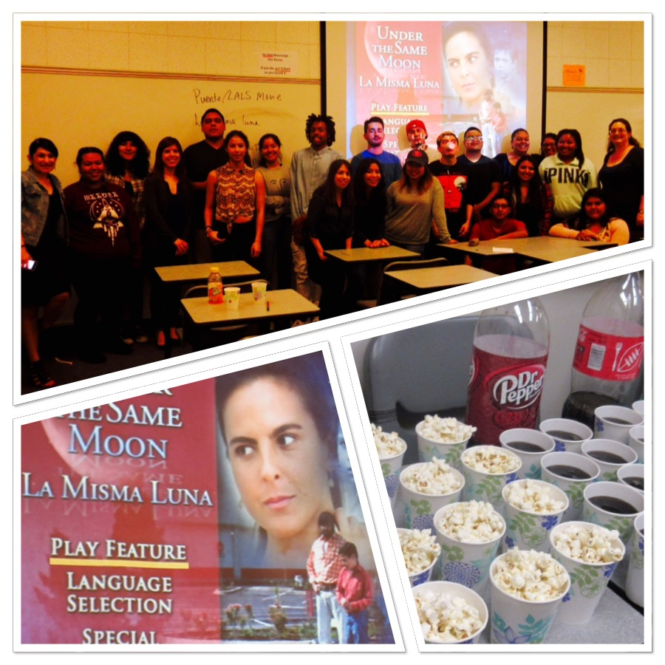

Slide 9
Next Steps

Slide 10
