Slide 1


Leadership Retreat
August 11, 2021

Slide 2
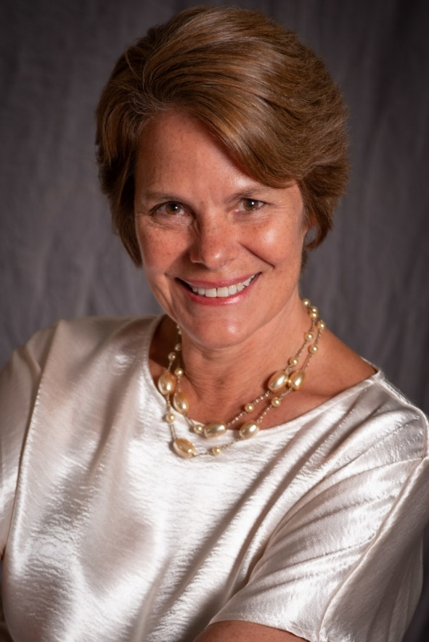
Welcome & Introductions
Kim Lopez
Interim President
Cañada College

Slide 3
Retreat Objectives
Campus leaders re-connect with each other and with the mission, vision, values and strategic goals of the College
Campus leaders are familiar with College goals and plans for how to achieve them, as well as the unique challenges and opportunities the new academic year brings
Campus leaders collaborate to discuss and provide input on the strategic priorities for the next academic year.

Slide 4
Retreat Agenda Overview
DAY 1 |  | DAY 2
Hear from our student leaders |  | Preparing for a new 5-year Educational Master Plan
Review progress we made last year |  | Reviewing our college goals and progress we have made in achieving them
Prepare to return to campus |  | Based on our existing goals and strategic initiatives – what should be our focus in 2021-22?
Consider the impacts of the pandemic on our community and imagine what “Recovery with Equity” might look like |  | Breakout groups refine our strategic priorities and action items for 2021-22
Facilitated Workshop: Clarify as a community what racial and cultural equity systems and barriers need to be clearly named and addressed |  | Outcome: a new Annual Plan for the coming academic year

Slide 5
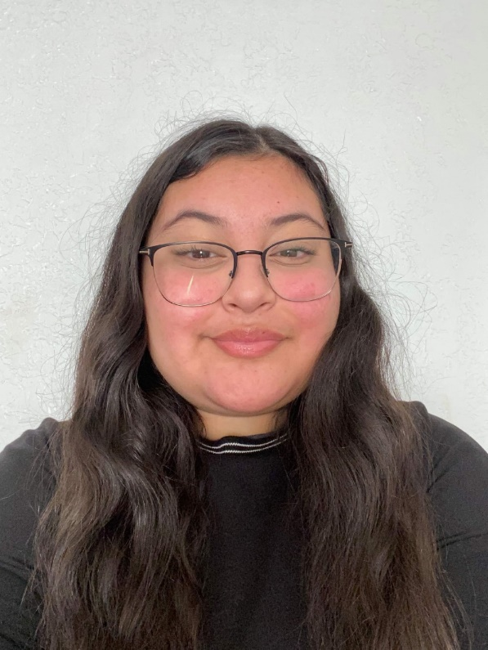
Student Perspectives & Priorities: 2021-22
Xitlali Curincita
Student Senate President
Middle College Student

Slide 6
Associated Students of Cañada College 2021-2022
Leadership Retreat
Notes:
Xitlali
Introduction -
Hello Faculty and Staff of Cañada College. My Name is Xitlaili Curincita , I use she/her/ella pronouns, and I am the 2021-2022 President of the Associated Students of Cañada College. I am currently a Middle College Senior and have had the privilege to work with the Associated Students since 2020. The amazing senate members and I are so excited to be here to get the opportunity to meet you all a bit more and show what we have in store for this academic year. Thank you for having us and without further ado this is the ASCC 2021-2022 Leadership Retreat Presentation.

Slide 7
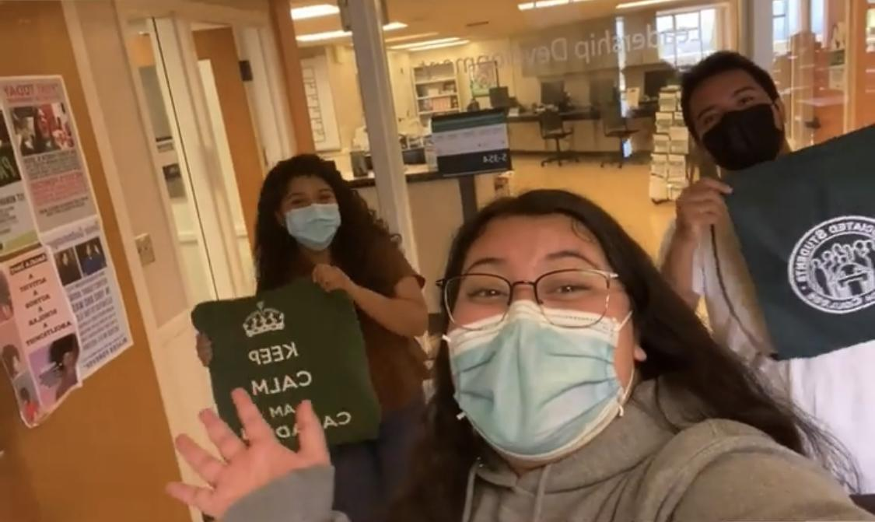
What is ASCC?
Notes:
Xitlali
Who is ASSC-
According to the Cañada College Website ASCC are elected and appointed student representatives who organize and promote campus wide programs, protect student rights, and represent the student voice on campus committees. The Student Senate is seen as the official voice of students on campus.
But ASCC is so much more. We are family, somos family. If I had to give a personal definition of what ASCC is- it would be that
Senate is an environment filed with passionate and dedicated, students who lead and work together as a team to spark change at Canada college. We as a senate use our voices and leadership to foster inclusion, positivity, and community to student life.

Slide 8
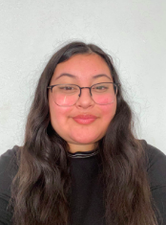
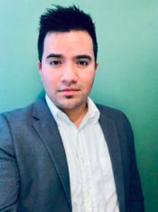
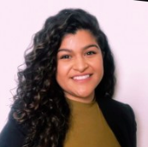
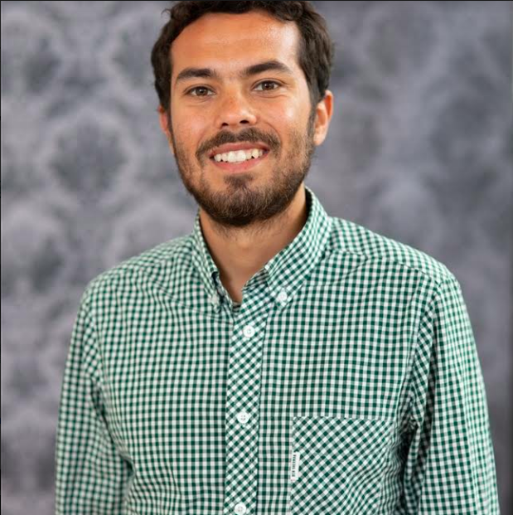
Meet The Team!
President:
Xitlali Curincita
Senate Advisor: Griselda Paredes
Vice President: Jesion Velasquez
Student Life and Leadership Assistant:
Joshua Forman-Ortiz

Slide 9
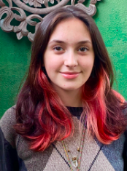
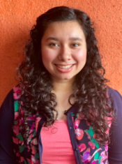
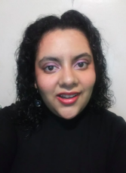
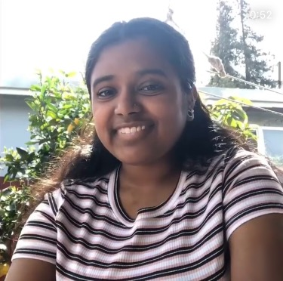
Meet The Team!
Commissioner of Public Records: Bellamy Cramer
Commissioner of Publicity: Brittney Samora Delgadillo
Commissioner of Finances: Diana Castro
Commissioner of Activities: Upashana Prakash

Slide 10

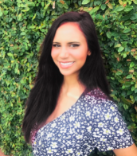
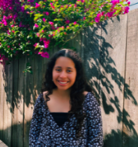
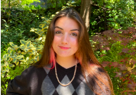
Meet The Team!
Senator at Large of Concurrent Enrollment and Middle College: Mira Rubio
Senator: Marisa Gutierrez
Senator: Emma Roginski
Senator: Yamini Prasad

Slide 11

Environmental Sustainability Initiative
Ongoing Plans
New Initiatives
Get Involved
Use more sustainable packaging in food services
Energy conservation and efficiency
Campus and community awareness and involvement
Move towards zero waste
More EV charging stations
Update sustainability plan
Environmental club
Energize Colleges internships
Notes:
Committee members:

Slide 12
Housing & Facilities Improvement Initiative
Action:
Goals:
Identify and inquire about vacant college dormitories in the area
Assess how many students require housing by working with cross campus partners
Look for sponsors or make housing scholarships
Make moves towards establishing a Canada Housing Plan
Secure Housing for Students
Alleviate Housing insecurity on campus
Notes:
Introduce Members -Xitlali
Chairs: Xitlali Curincita, Jeison Velasquez & Upashana Prakash
Members: Diana Castro, Yamini Prasad
Action- Upashana
Goals: Xitlali

Slide 13
Mental Health Initiative
Goals
Connect students to mental health services on campus
Spread resource awareness
Create open discourse about mental health
Create spaces for mental health relief
Identifying the Issue
Mental health crisis in light of pandemic
Expect students to require mental health services as we transition back to in-person learning
Notes:
Continuation of last year’s environmental and mental health initiative, but we decided to separate them to give proper emphasis to these two important causes.

Slide 14
Campus Inclusion Initiative
What is the issue?
Action plan:
Goals:
Students who have been away from campus, haven’t formed relationships with their peers or professors.
Can prevent them from having proper communication and networking connections in the future.
Have an on-campus program that will help students get used to being on campus
Work with the website that was established by the former senate to provide students with outlets and access to resources
Have an on-campus program that will help students get used to being on campus
Use previous website to provide students with outlets and access to resources
Notes:
Goals: Recreate the environment that Cañada students built and make it a place that welcomes students as well as provides resources. We want to make an environment where students feel that they can ask questions and get the answers that they need and make sure that our students aren’t intimidated by the shift back on to campus and can comfortably return to the school dynamic.
Rengage students back to campus
Issues: Students who are struggling with getting back on campus or who haven’t been on campus, haven’t formed relationships with their peers or professors which can prevent them from having proper communication and networking connections in the future.
Action: Moving to potentially have an on-campus program that will help students get used to being on campus as well as work with the website that was established by the former senate to provide students with outlets and access to resources that they may need.

Slide 15
Campus Resources Awareness Initiative
Issue:
Cañada has many highly beneficial programs (that are especially important in light of the pandemic) that students are unaware of.
We are also excluded from UC Davis’ Transfer Opportunity Program (TOP).
Goal:
To make our campus resources known and easily accessible for all members of the Cañada community.
To maximize on campus resources by gaining access to UC Davis’ TOP.
Steps:
Connecting with the Welcome Center and Sarah Cortez for support and input.
Creating and distributing both a digital and physical method of accessing/learning about campus resources to all members of the Cañada community.
Pushing for access to UC Davis’ TOP.

Slide 16
ASCC Events
-Programming board meetings begin August 9th, 2021
Welcome & Professor Connection Day*
Fall Club Rush*
Bay Area History
National Coming Out Day
Indigenous People's Day
Campus Movie-Fest
Halloween Bash
Dia de Los Muertos
Notes:
These are the fall events we have lined up. The first two are our upcoming events, taking place on the 27th and 15th. Our programming board meetings, which are our planning meetings, began this Monday and allows the groups in charge to discuss many factors of an event, like the decorations, food, and swag. We’re all really excited to get the year started and we want our students to be just as enthusiastic as we kick off these first events.

Slide 17
Vacant Positions
Commissioner of Design and Marketing
Senator at Large for STEM
Senator at Large for Humanities/Social Sciences
Senator at Large for Business, Design and Workforce
Senator at Large for Kinesiology, Athletics and Dance
Up to 17 Senators

Slide 18

Thank you

Slide 19
Q&A

Slide 20
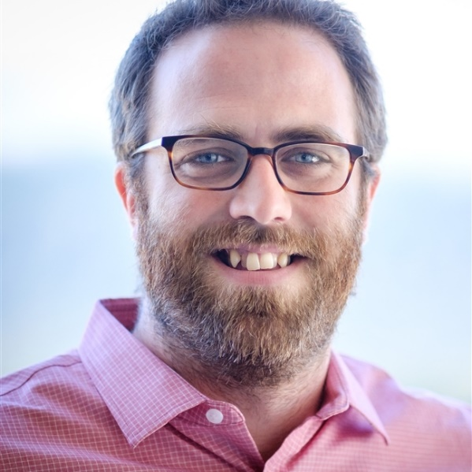
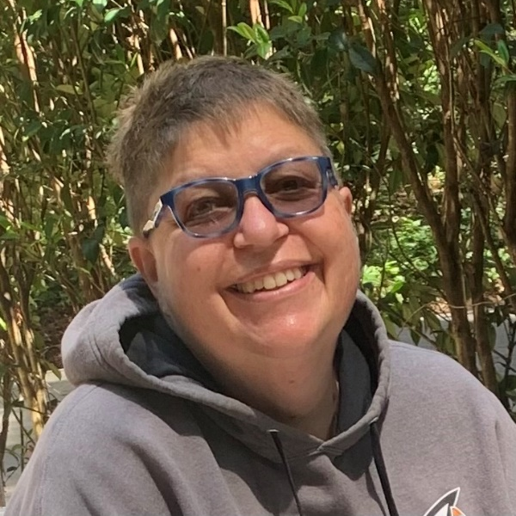
2020-21 Highlights and Progress
Insert photo of Roz
David Eck Academic Senate President Professor, Philosophy | Roslind Young Classified Senate President Lab Technician (Sciences)

Slide 21
Total graduates: 2020-21
Note: The number of degree and certificate awards for 2020-21 are not yet final. Some award petitions are still under review. Therefore the number of graduates may still change slightly.

Slide 22
Degree Awards
Certificate Awards

Slide 23
2020-21 Priority | Status | Highlighted Accomplishments
Improve Student Completion |  | CRM live for counseling. All support services now online.
K-12 & Adult School Partnerships |  | Two CRER and 3 ECE sections will be offered at high schools this fall.
Enhance Marketing |  | Student-led website redesign. Enrollment campaigns in two languages.
Implement Professional Learning Plan |  | 72 faculty completed QOTL. 21 faculty and staff participated in USC Racial Equity Alliance e-convenings and shared learnings at Flex. CORA Learning.
Promote a Climate of Inclusivity |  | Monthly Community Read events. New Employee Orientation. Interest Area Success Team pilot.
Institutionalize Effective Structures to Reduce Obligation Gaps |  | Interest Area Success Team pilot. Colts Con expansion. Retention Specialists formed a “community of practice” to align supports.

Slide 24
Additional Highlights
Ethnic Studies program
  All submitted courses were transfer approved
  FT Faculty search re-starting this Fall semester
  Special thanks to Profs. Gaines, Iyenagar, Ware, Palmer, and Tedone-Goldstone. And also to former President Moore and VPAS Mendoza.
Umoja program
  Flex Day session (August 17, 1-2:30pm): Tom Dewit on “How to Umoja-ify Your Teaching”
  Special thanks to Profs. Ware, Hoffman, Terzakis, and Aranyukal. And also to Dean Carranza and VPI Robinson.
Notes:
Faculty led the launch of a new Ethnic Studies program of study and CSU approved courses for transfer
Faculty led the launch of a new Umoja program which is actively enrolling students now

Slide 25
BREAK
10:15 – 10:30 am

Slide 26
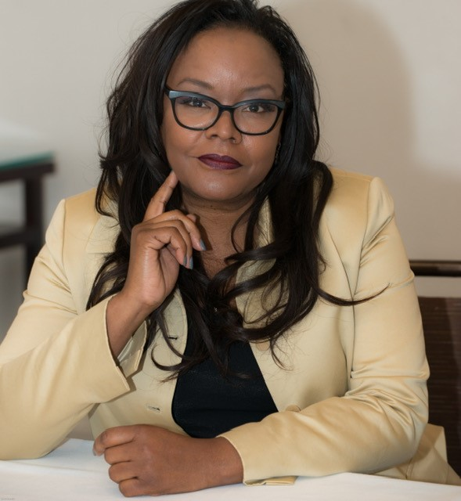
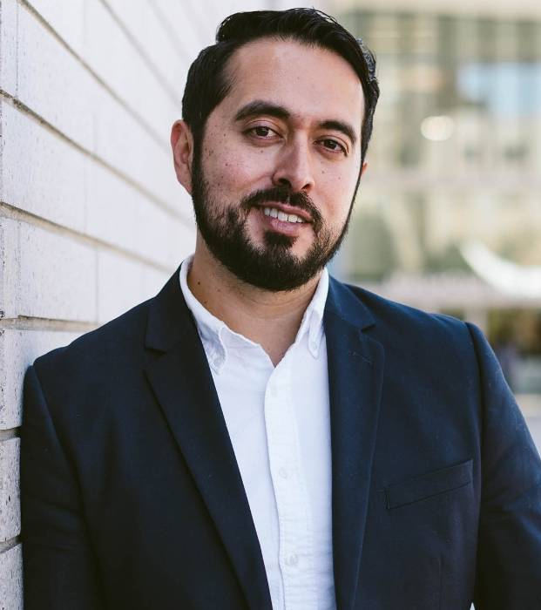
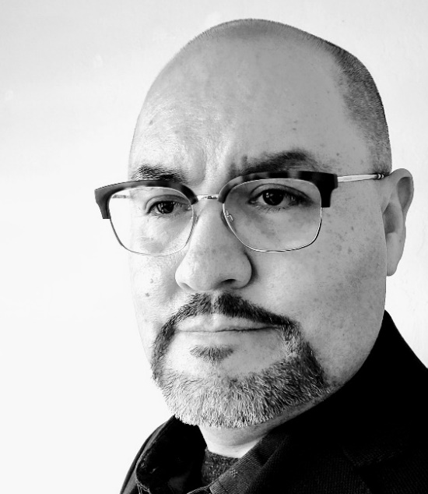
Return & Recovery
Tammy Robinson Vice President of Instruction | Manuel Alejandro Pérez Vice President of Student Services | Graciano Mendoza Vice President of Administrative Services

Slide 27
Return to Campus
Returning On-site.
  Administrators, Managers and Supervisors
  Classified Personnel
  Faculty
Vaccines are Required.
Face Coverings are Required.
Buildings are Cal/OSHA Compliant and Clean.
Personal Protective Equipment available from the campus Public Safety Office.
Requesting Accommodations.
DISTRICT Return to Campus website: https://smccd.edu/return-to-campus/index.php

Slide 28
Temperature Check: 3 breakouts
What are campus leaders hearing from their constituents about returning to campus?

Slide 29
VP’s Report Out

Slide 30
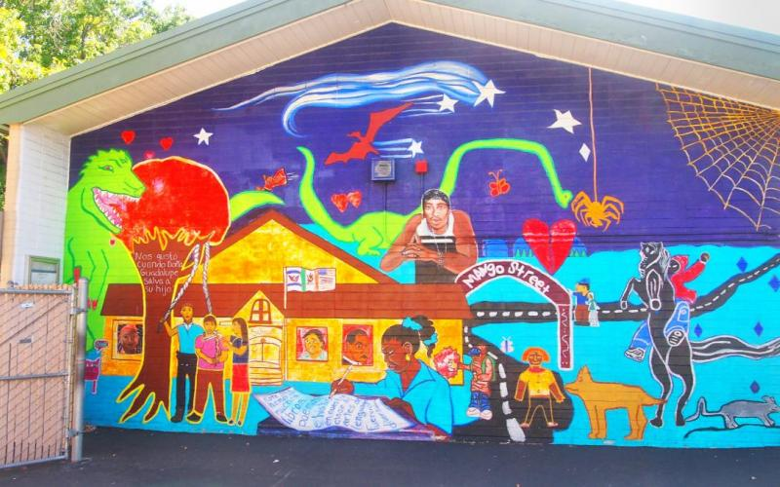
Our Community
A two-tiered pandemic
  Upper income workers mostly remained employed and are now seeing dramatic wage increases
  Lower income workers saw steep employment declines and now more modest wage increases
  13.7% of San Mateo County rental households were behind on paying rent as of early July.*
North Fair Oaks Mural depicting the history of the area
Source: https://patch.com/california/sanbruno/time-bomb-ticking-see-rental-arrears-san-mateo-county

Slide 31
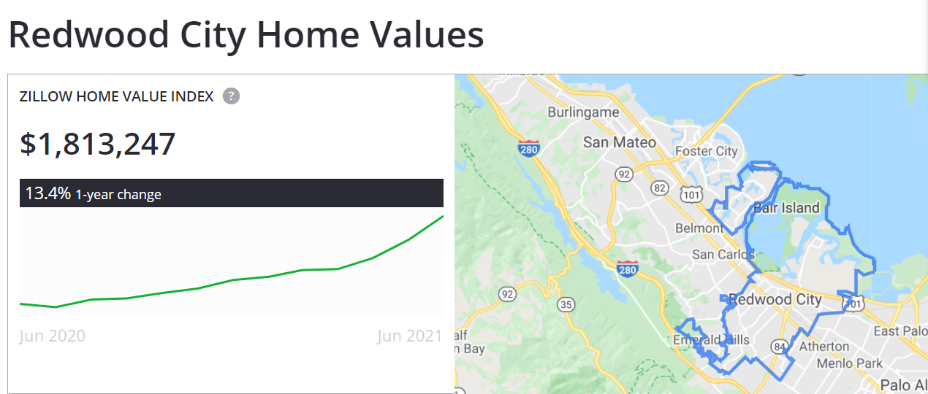

Slide 32
Redwood City & North Fair Oaks Community Needs Assessment
Key Takeaways
HEALTHCARE INSECURITY
Always has been high (20-25%) but has not increased as much as other unmet needs since COVID.
FOOD INSECURITY
Increased dramatically and remains relatively high (15%), despite widespread awareness of multiple services.
HOUSING INSECURITY
Affects one-third of renters (30-35%), with a small but meaningful portion (7%) under eviction threat.
Spanish language respondents are six times as likely to be food insecure and twice as likely to be housing insecure
Source: Community Survey conducted spring 2021

Slide 33
Redwood City & North Fair Oaks Community Needs Assessment
Key Takeaways
DIGITAL DIVIDE
Most pronounced for high-quality technology, for example:
Lack of installed internet (15-30%)
Lack of a home computer (20-40%)
DISTANCE LEARNING
Top challenges include:
Lack of private workspace (22%)
Insufficient support from teachers or school staff (20%)
Source: Community Survey conducted spring 2021

Slide 34

Redwood City & North Fair Oaks Community Needs Assessment
Key Takeaways
SECOND SHIFT
Most full-time workers (55%) are caring for children more than 8 hours a day.
INCOME
Unemployment and furlough rates have doubled since COVID.
Source: Community Survey conducted spring 2021

Slide 35
Cañada: changing enrollment patterns during COVID…
Of our home campus students, changes from Fall 2019 to Fall 2021:
ESL | 3% down from 12% (149 total in Fall 21)
Low Income | 36% down from 48%
First Time | 13% down from 16%
Continuing | 66% up from 55%
Female | 66% up from 60%; Male: 30% down from 37%
Degree/Transfer Seeking | 66% up from 60%
Exploratory | 15% down from 22%
K-12 Students | 6% down from 8%
Overall, no significant shifts or disproportionate impact by age or race/ethnicity.
However, our low income students are disproportionately Black and/or Latinx
Home campus is defined by the SMCCCD college from which the student is seeking a degree or certificate.

Slide 36
Recovery with Equity: Guidance
State & System Guidance
Cañada College Guidance
Recovery with Equity
Vision for Success: Call to Action
Diversity, Equity & Inclusion Integration Plan
Guided Pathways: more $$ and time
Student Equity & Achievement Program:
  more $$
  Center for Urban Education (CUE) feedback for our 2022-25 SEAP
College Mission, Vision & Values
Guided Pathways implementation
Student Equity & Achievement Plan
College Antiracism Task Force Recommendations
Cultural Center Focus Group Recommendations
Faculty, Staff, Student Survey Results
National Assessment of Collegiate Campus Climates (NACCC) student survey results (expected September)

Slide 37
Equity & Antiracism Area of Focus | Recovery with Equity (CA) | Chancellor’s Call to Action | College & District Antiracism TF Recs | Cultural Center Focus Group Recs | Guided Pathways | Student Equity & Achvmnt Plan | EMP Strategic Initiative | Progress last year
Hiring | X | X | X | X |  |  |  | X
Professional Development | X | X | X | X |  |  |  | X
Create a sense of belonging | X |  |  | X | X | X |  | X
Ensure channels for safe reporting and addressing instances of microaggression, harassment or discrimination | X |  | X | X
Re-envision curricula across disciplines to be antiracist and equity-centered | X | X | X
Integrate work-based learning throughout the disciplines | X |  |  |  | X | X
Work with our K12 partners to identify and dismantle barriers to A-G and early college course completion for all learners | X |  |  |  | X | X | X | X

Slide 38
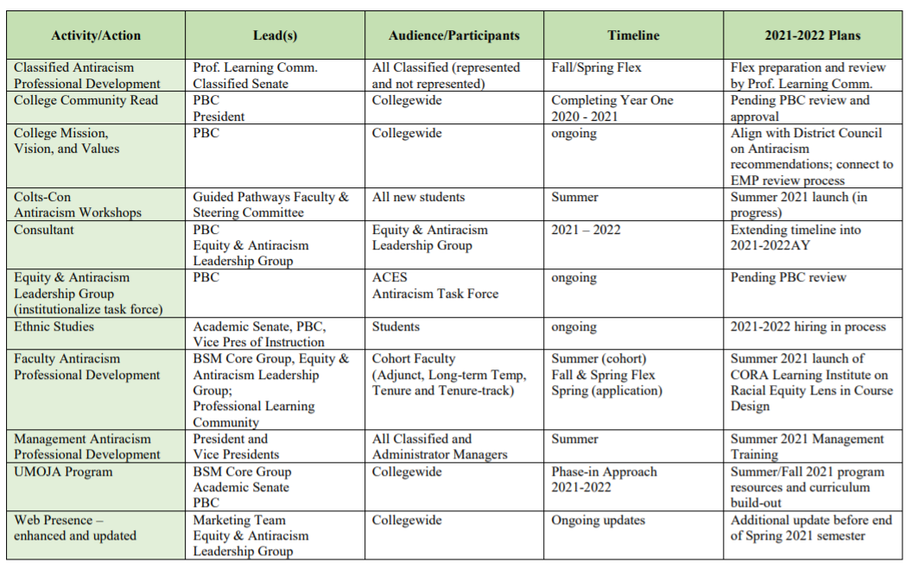
Cañada Antiracism Task Force Recommended Actions (approved by PBC)

Slide 39
District Antiracism Council
The SMCCCD Antiracism Council is focusing on three areas:
District Policies and Procedures like the District’s mission, vision statement and common antiracism glossary.
Curriculum, infusing cultural relevant teaching in curriculum, audit of curriculum courses.
Equal Employment Opportunity focusing on antiracism professional development courses for employees known as IDEAL – Inclusion, Diversity, Equity, Antiracism Leadership. Employees will be able to take courses that enrich their understanding of the above areas and how to incorporate them into practice.

Slide 40
CLP-led focus groups held Feb-March 2021
Seven focus groups with students, faculty and staff populations in groups that focused on the experiences of these sub-populations at Cañada :
  Hispanic/Latinx
  Immigrant/migrant/international
  Black/African American (2)
  Native American, Asian American, Pacific Islander (AANAPI), and
  LGBTQ
  A general population/non-specific focus group open to all
The primary goal of the focus groups was to gather information from the diverse community to shape the goals, activities, aesthetic, and values of the cultural center that Cañada College is developing over the next year. The questions in the focus groups sought to better understand when students felt supported, if and where they felt unsupported, and how a cultural center might help to provide intentional programs, activities, professional development, and anti-racist training to better support the diverse community at Cañada College.

Slide 41
Focus Group General Recommendations
Recommendation 1: Explore ways to make the college campus more visually welcoming and inviting to the diverse community through murals and activities that represent and appreciate the cultures of the student body.
Recommendation 2: Dedicate resources for faculty professional development on supporting diverse students in the classroom.
Recommendation 3: Explore ways to revise faculty and staff hiring practices that recognize both traditional and nontraditional experiences and qualifications to ensure a diverse pool of faculty and staff applicants.

Slide 42
Other campus efforts
Antiracism Foundational Workshop for Students (Colts Con 2021)
ACES Professional Development Cohort about “Course Design on Racial Equity” by Center for Organizational Responsibility and Advancement (CORA)
To build a culture of inclusion:
  Latinx Heritage Month month-long programming (2020 and 2021)
  Black Heritage Month programming (Dr. Cornel West)
  Personal pronouns updates for rosters and Banner platforms
  Antiracism Community Read
  Expanded Safe Zone to include student sessions in addition to faculty/staff/managers, and intentional focus on antiracism
New Ethnic Studies program and faculty hire
New Umoja program
Antiracism Task Force at College; Connection to District Antiracism Council
Year-long participation (2020-21) in the California Community College Race and Equity Alliance organized by USC Race and Equity Center: e-convenings in which 35 faculty and staff participated

Slide 43
Discussion

Slide 44
LUNCH
12:00 – 1:00 pm

Slide 45
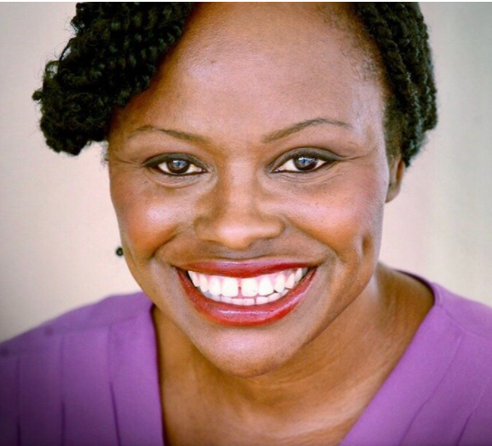
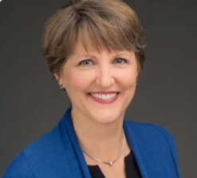
Workshop: What are we trying to solve?
Nancy Moricette (she/her) Equity, Diversity and Inclusion Facilitator and Strategist Founder, Áse Power Consult | Kendra Carpenter (she/they) Co-founder & Lead Facilitator Beyond Binary Consulting LLC

Slide 46
Workshop: What are we trying to solve?
FACILITATION INTENTION/ PURPOSE: Facilitators will provide Cañada College leaders with an introduction to cultural competency. Leaders will explore how an awareness of dominant and non-dominant groups can impact internal systems.
What are we trying to solve? Cañada College stakeholders further clarify as a community what racial and cultural equity systems and barriers need to be clearly named and addressed

Slide 47
Preparing for Day 2

Slide 48
Recovery with Equity: Guidance
State & System Guidance
Cañada College Guidance
Recovery with Equity
Vision for Success: Call to Action
Diversity, Equity & Inclusion Integration Plan
Guided Pathways: more $$ and time
Student Equity & Achievement Program:
  more $$
  Center for Urban Education (CUE) feedback for our 2022-25 SEAP
College Mission, Vision & Values
Guided Pathways implementation
Student Equity & Achievement Plan
College Antiracism Task Force Recommendations
Cultural Center Focus Group Recommendations
Faculty, Staff, Student Survey Results
National Assessment of Collegiate Campus Climates (NACCC) student survey results (expected September)

Slide 49
Close of Day 1

