Slide 1


Leadership Retreat
August 12, 2021

Slide 2
Welcome: Day 2 Objectives and Format
Creating our 2021-22 Annual Plan
Sets forth the activities to be implemented in one year to support the achievement of the five-year goals articulated in the Education Master Plan, which are in support of achieving the College Mission.
Is a synthesis of objectives, strategic initiatives, and activities of other college plans, grant deliverables, and recent mandates from the State Chancellor’s Office.
Collaborating in Breakout Groups to refine our strategic priority projects for 2021-22

Slide 3
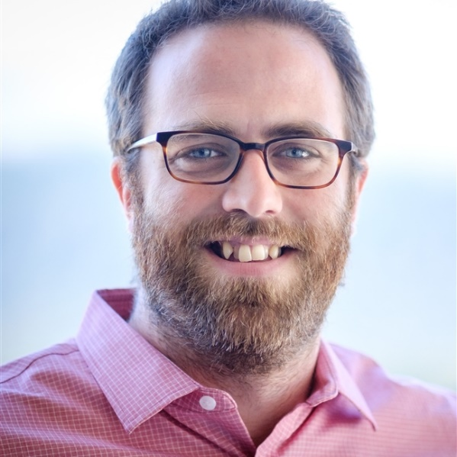
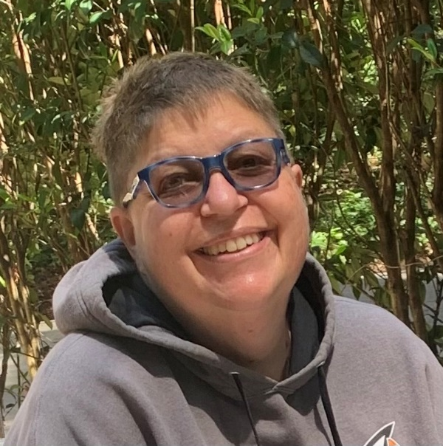
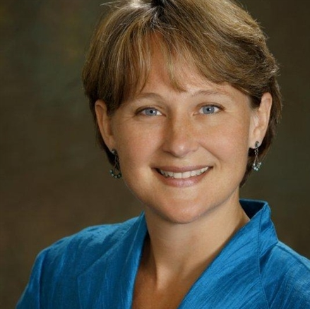
Developing a new 5-year Educational Master Plan
David Eck Academic Senate President Professor, Philosophy | Roslind Young Classified Senate President Lab Technician (Sciences) | Karen Engel Dean of Planning, Research, Innovation & Effectiveness (PRIE)
Tri-Chairs, Educational Master Planning Task Force 2021-22

Slide 4
Education Master Plan: 2017-2022
Year 1
2017-18
Year 2
2018-19
Year 3
2019-20
Year 4
2020-21
Year 5
2021-22
Strategic Enrollment Planning Strategic Enrollment Management Plan: 2020-23
Year 1
2020-21
Year 2
2021-22
Year 3
2022-23
College Committee Planning
Align 3-year planning as appropriate per committee
Annual Strategic Plan
(operational)
Annual Strategic Plan
(operational)
Annual Strategic Plan
(operational)
Where we are now

Slide 5
Mission and Vision
Mission
Cañada College provides our community with a learning-centered environment, ensuring that all students have equitable opportunities to achieve their transfer, career education, and lifelong learning educational goals. The College cultivates in its students the ability to think critically and creatively, communicate effectively, reason quantitatively, and understand and appreciate different points of view within a diverse community.
Vision
Cañada College is committed to being a preeminent institution of learning, renowned for its quality of academic life, its diverse culture and practice of personal support and development, extraordinary student success, and its dynamic, innovative programs that prepare students for the university, the modern workplace, and the global community.

Slide 6
Values
Transforming Lives
High Academic Standards
Diverse and Inclusive Environment
Student Success in Achieving Educational Goals
Community, Education, and Industry Partnerships
Communication and Collaboration
Engaging Student Life
Accountability
Sustainability
Transparency

Slide 7
Cañada Ed. Master Plan Goals:
Student Completion/Success
To provide educational and student services programs that help students meet their unique academic goals; minimize logistical and financial barriers to success; and highlight inclusivity, diversity and equity.
Community Connections
To build and strengthen collaborative relationships and partnerships that support the needs of, reflect and enrich our diverse and vibrant local community.
Organizational Development
To invest institutional resources on the structures, processes and practices that focus on a diverse student and staff population, promote excellence, equity, inclusion and transformative learning.

Slide 8
Educational Master Planning Process & Timeline
PBC names EMP Task Force Members
EMP Task Force evaluates 2017-22 EMP
SCUP Training in Strategic Planning
Mission, Vision, Values Update
EMP TF considers “Internal Scan”
EMP TF considers “External Scan”
College Councils provide input on challenges and opportunities
Town Hall
Winter 2021
Spring 2021
September 2021
October 2021
EMP Retreat: Set goals and new strategies
Campus constituents provide input on draft EMP
PBC considers draft EMP
PBC adopts new EMP for 2022-27
October 2021
November 2021
December 2021
February 2022
February 2022
March 2022
April 2022
May 2022

Slide 9
EMP Task Force Information
All meetings open to everyone
Agendas, Zoom links, meeting materials and minutes are posted here: https://canadacollege.edu/emp/meetings.php
Data and other resources EMP Task Force will be considering are posted here: https://canadacollege.edu/emp/emp-data.php

Slide 10
Educational Master Planning: Considerations
Changes in our external environment
Socio-economic shifts
Demographic shifts
Changing student preferences
Technology and the future of online teaching and learning
Understanding our internal environment
Cañada’s enrollment
Who are our students? Understanding different student journeys
Key factors to effectively serve the changing needs of our community

Slide 11
Changes in our external environment
COVID has exacerbated unsustainable trends in our service area:
  Housing is even less affordable (displacement is real)
  Employment is resurging but more slowly for low and middle-income workers
  Types of occupations in demand in our region are changing
  Wages are rising slightly, but so is the Consumer Price Index.
  Childcare is less available
  Student preferences regarding higher education are shifting
Sources: https://jointventure.us10.list-manage.com/track/click?u=de8174c18d33b244186d3aca8&id=f2ad194493&e=17cef07094; https://www.smdailyjournal.com/news/local/san-mateo-county-leaders-seek-more-child-care-solutions/article_bfec1a78-ca6d-11eb-8984-1bf8d035f692.html

Slide 12
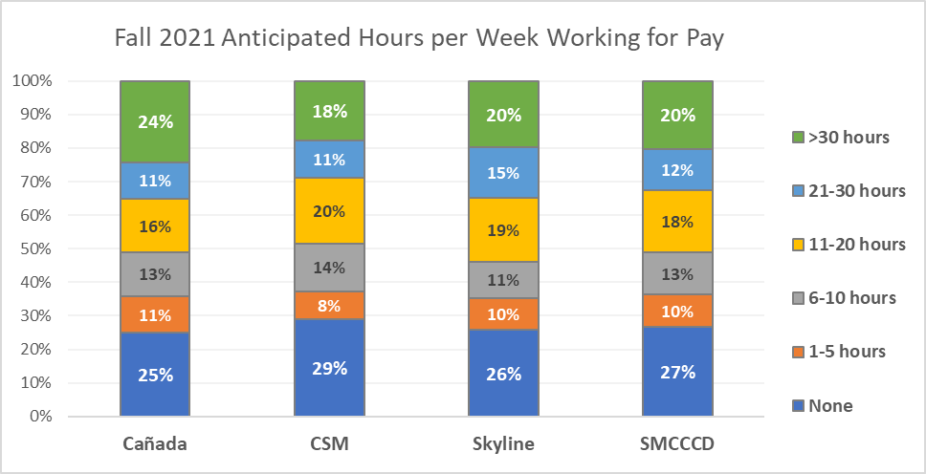
Approximately 1/3 of SMCCCD students expect to work more than 20 hours per week in Fall 2021
Q: If you do return to college in the Fall of 2021, how many hours do you anticipate working for pay?
Weekly Work for Pay
Source: SMCCCD PRIE Survey of Enrolled Students, Spring 2021 (#1)

Slide 13
Student anticipated work hours are directly and strongly correlated with their preference for instructional modality.
The more students anticipate working, the more likely they are to prefer taking most of their classes online.
Similarly, the less students anticipate working, the more likely they are to prefer taking most of their classes face-to-face.

Slide 14
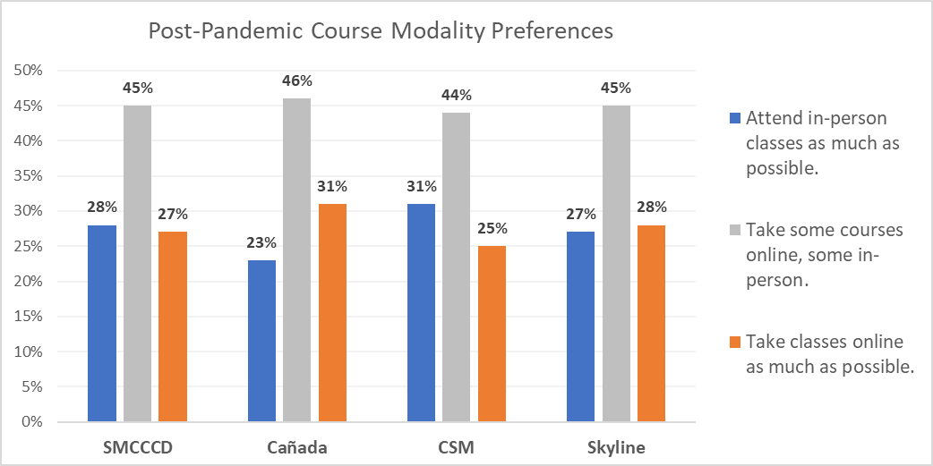
Students’ post-COVID course modality preferences are split between on-line and in person
Q: In the future, once the pandemic is behind us, which most accurately describes your preference for how to attend college?
Source: SMCCCD PRIE Survey of Enrolled Students, Spring 2021 (#1)
Notes:
Differences between Canada and CSM are statistically significant (p<.05)

Slide 15
Students who stopped out during the pandemic
More likely to Stop Out
Less likely to Stop Out
Returning students
K-12 students
Low income students
Older students
Continuing students
There were no major differences on the basis of race/ethnicity, first generation status, or gender between the Stopped Out student group and our overall population (districtwide) pre-pandemic (2019-20)

Slide 16
We've noticed you have not re-enrolled at the San Mateo County Community Colleges (Cañada, CSM, or Skyline) during the COVID pandemic. Could you please share your reasons for not returning?
 | # of survey respondents
I had to prioritize my job/work | 196
I prefer not to enroll in online classes | 190
Other | 172
I am attending college elsewhere | 135
I needed to prioritize my care for children/family | 101
I am taking a break from school for now | 95
I needed to focus on my mental health/wellness | 81
I could not (and cannot) afford to attend right now | 81
I moved out of the area | 80
I needed to focus on my physical health/wellness | 55
I do not have a quite place to study | 47
I did not feel supported while I was enrolled | 40
My Wifi and internet access are unreliable | 29
I could not find a program | 27
Students were able to select as many or as few items as they liked. Five main themes of the “Other” responses were: They had completed course requirements/graduated/transferred, they were waiting to be in person, college processes had created an impediment to their re-enrolling, various life reasons, and a lack of classes that they were interested in.
Notes:
Source: SMCCCD PRIE Districtwide survey of students who had been enrolled at any point in 2019-20 but who had not re-enrolled at any point during the pandemic (through spring 2021)

Slide 17
Demographic Breakdown of Students Selecting
“I prefer not to enroll in online classes”

Slide 18
If you had both face-to-face and online/virtual options for all of the classes you might want to take, what are the three biggest obstacles to your re-enrolling at the SMCCCD Colleges next fall?
 | # of survey respondents
I need to prioritize my job/work | 134
I moved out of the area | 100
Other | 86
The course(s) I need are not offered at the time(s) I need them | 79
I need to focus on my mental health/wellness | 66
I cannot find a program of study that interests me | 64
I need to prioritize my care for children/family | 55
I need to focus on my physical health/wellness | 52
I cannot afford to attend college right now | 51
Students were able to select up to three options, of those who indicated No or Not Sure to re-enrolling. The main themes for those that selected other were transferred/graduated/completed course requirements, they have switched schools, or they prefer in person instruction.

Slide 19
What are the top 3 things the San Mateo Colleges could do to support your return to college in the future?
 | # of survey respondents
More scheduling options: getting the courses I want when I want them | 328
Financial Support | 323
Help choosing courses programs etc. | 203
Personal counseling | 152
Help with registering for courses | 146
Other | 130
Transportation to/from campus | 88
Support with technology | 86
Support with accessing food and/or housing | 82
Support with childcare | 51
Students were able to select up to three options. Of those who selected Other, over half indicated None/Not applicable, a minority indicated a return to in person instruction, and finally more diverse course offerings.

Slide 20

Cañada College goals and progress toward those goals
Karen Engel Dean of Planning, Research, Innovation & Effectiveness (PRIE) | Alex Claxton Planning & Research Analyst (PRIE)

Slide 21
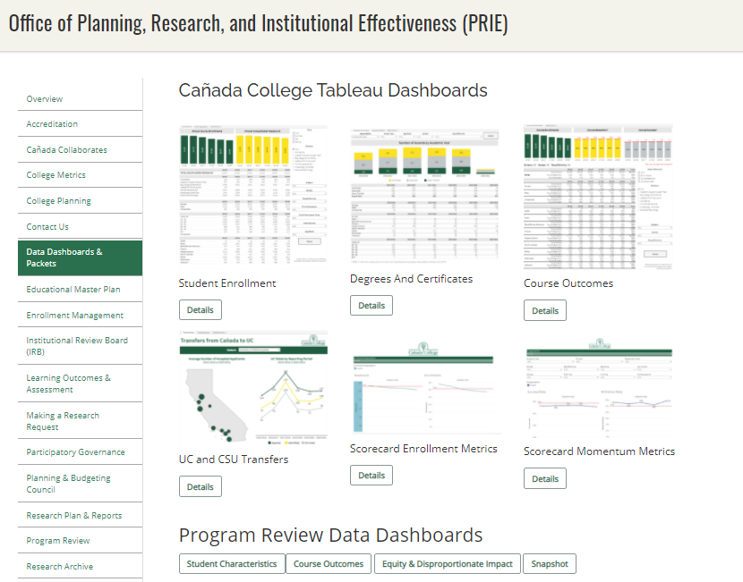
We track our progress via our newly adopted College Scorecard as well as our
Data Dashboards

Slide 22
District Goals
Key New
Districtwide Strategies
District Goal #1 | Develop and Strengthen Educational Offerings, Interventions, and Support Programs that Increase Student Access, Success and Completion | Support the work of the District Anti-Racism Council … Increase enrollment of San Mateo County residents through coordinated efforts, including the implementation of the Free Community College initiative.
District Goal #2 | Establish and Expand Relationships With School Districts, 4-year College Partners, And Community-based Organizations to Increase Higher Education Attainment and Economic Mobility In San Mateo County | Continue to expand and support Middle College and Early College opportunities. Expand dual enrollment opportunities and make processes more efficient and accessible for secondary schools and their students.
District Foal #3 | Promote Innovation and Excellence in Instruction to Support Student Learning and Success | Expand program delivery options, including accelerated completion options, for all students including online students, e.g., College for Working Adults; short-term classes; intersession classes; cohort classes; and continuing, corporate and community education. Promote strategic development of online education to increase the development and delivery of quality, fully online certificate and degree programs. Ensure instruction is delivered in multiple modalities, including in-person, hybrid, and hyflex, to increase access to higher education and meet the needs of different student populations.
District Goal #4 | Ensure Necessary Resources are Available to Implement This Strategic Plan Through Sound Fiscal Planning And Management Of Allocations and Protection of Community-supported Status | Free Community College: Strategies of this plan include the accelerated expansion of Dual Enrollment, the Promise Scholars Program (PSP), and Open Educational Resources (OER) for Zero Textbook Cost (ZTC) degree programs, all within a Guided Pathways framework.

Slide 23
Enrollment Metrics

Slide 24
Until this term, Cañada’s headcount has been stable

Slide 25
Enrollments continue to drop: -20%

Slide 26
However, the number of units our students take is extremely low
Compared to 38 of its peers, Cañada has the lowest % of
full time equivalent students
Source: IPEDS Report Data
Notes:
IPEDS Report Data College Headcount: 2019-20 FTE: 2019-20 Ratio Canada College 9575 2382 25% Skyline College 14900 4394 29% College of San Mateo 12649 4120 33% Allan Hancock College 16609 6654 40% College of the Canyons 32974 12473 38% Chabot College 19951 7966 40% Cıtrus College 18592 9611 52% Cıty College of San Francısco 35153 13833 39% Cosummes Rıver College 21511 9172 43% Cuesta College 15810 6214 39% De Anza College 28029 13982 50% College of the Dessert 15367 7764 51% Diablo Valley College 29307 12876 44% Glendale Community College 18781 11602 62% Golden West College 18515 7556 41% Grossmont College 23927 10076 42% Irvine Valley College 18862 8494 45% Reedley College 19189 6736 35% Los Angeles Pierce College 28007 11819 42% Los Angeles Trade Technical College 21565 7286 34% Los Angeles Valley College 26867 9476 35% Los Angeles City College 26967 9476 35% Merced College 15302 7469 49% Moorpark College 20631 9487 46% Mt. San Jacinto Community College 21606 10057 47% Orange Coast College 26295 12663 48% Saddleback College 33140 12621 38% San Diego City College 22977 7357 32% San Diego Miramar College 23038 7066 31% San Joaquin Delta 26150 15238 58% Santa Barbara City College 20624 10254 50% Santa Rosa Junior College 27223 10801 40% College of the Sequias 16379 8581 52% Sierra College 25731 11966 47% San Bernandino Valley College 20297 9178 45% Southwestern College 26197 12541 48% Ventura College 18487 7669 41% Victor Valley 17862 8365 47% Norco College 17543 6319 36% Averege of 38 similar CCCs 22185 9453 43% Total 843014 359212 43%

Slide 27
During the pandemic, our home campus students are taking fewer units here at Cañada

Slide 28
During the pandemic, more students are “swirling”

Slide 29
A smaller share of Cañada students are seeking a degree or certificate from Cañada
Total: 6,223
Total: 6,048
Total: 4,334
Home campus is defined by the college from which the student is seeking a degree or certificate.

Slide 30
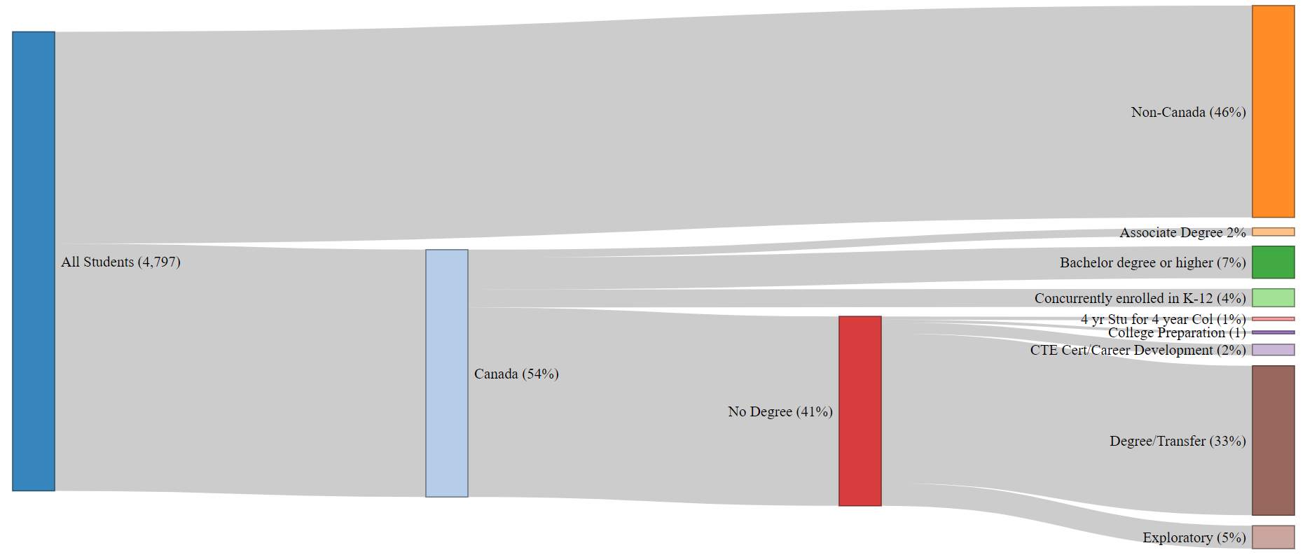
Fall 2020 CAN Enrolled Students by Home Campus,
Education Level & Education Goal
Notes:
file:///C:/Users/engelk/OneDrive%20-%20San%20Mateo%20County%20Community%20College%20District/Enrollment%20Management/FA19FA20%20Sankey.html

Slide 32
Access for Low Income Students

Slide 33
Student Momentum Metrics

Slide 34
Students completing a comprehensive Ed. Plan

Slide 35
Part-time students less likely to complete any SEP

Slide 36
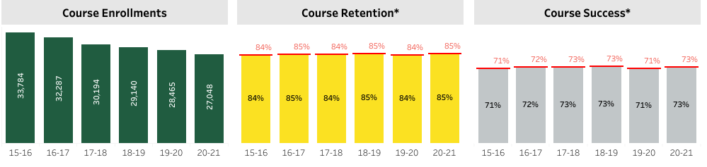
Overall Course Completion Rates

Slide 37
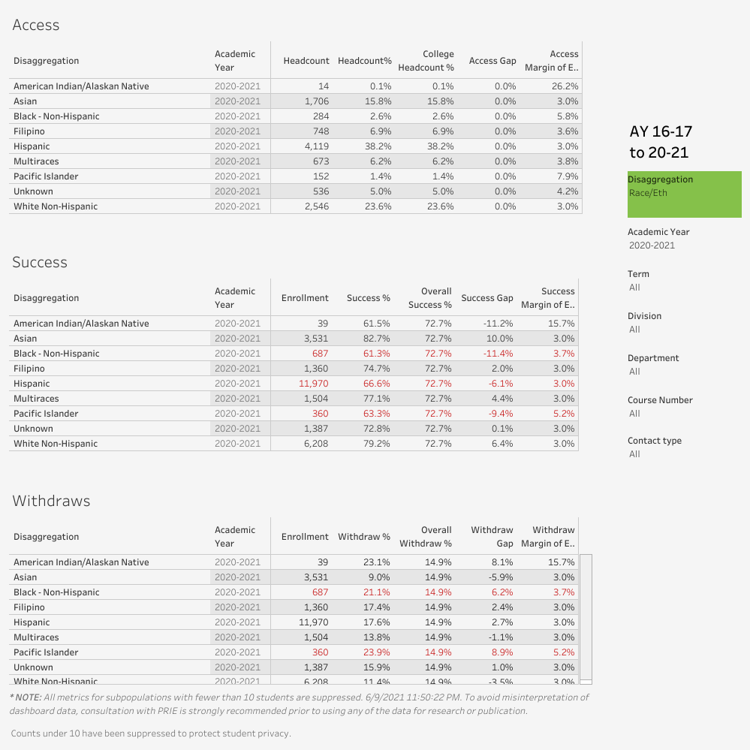

Slide 38
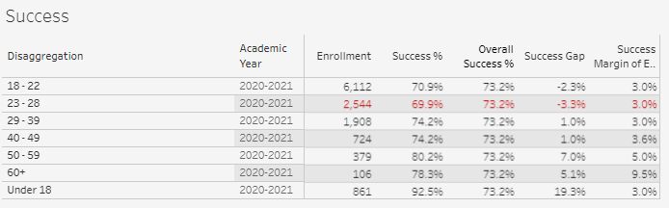
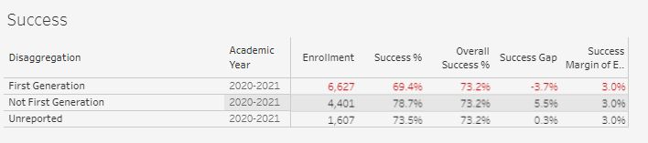

Slide 40
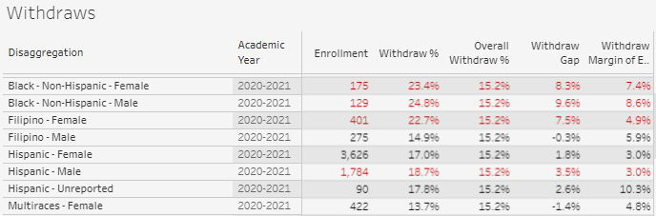

Slide 41

Students completing transfer level math and English within one year of enrolling

Slide 42
Persistence
 | Fall 2020 to Spring 2021 | Fall 2020 to Fall 2021
Overall persistence rates | 64% | 40%
Term Ethnicity Desc | SP21 | FA21
American Indian/Alaskan Native | 50% | 50%
Asian | 63% | 37%
Black - Non-Hispanic | 47% | 35%
Filipino | 56% | 39%
Hispanic | 65% | 41%
Multiraces | 69% | 42%
Pacific Islander | 63% | 38%
Unknown | 64% | 44%
White Non-Hispanic | 64% | 37%
Student Low Income | SP21 | FA21
Yes | 66% | 42%
No | 62% | 37%
Enrollment Status Desc | SP21 | FA21
Continuing Student | 66% | 41%
First-Time Student | 76% | 55%
First-Time Transfer Student | 55% | 33%
Not Applicable, Currently K-12 | 62% | 33%
Returning Student | 45% | 29%
Returning Transfer Student | 46% | 21%
‡ Spring 2020, Summer 2020, Fall 2020, and Spring 2021 were impacted by Covid 19 and may not be representative of a typical academic year

Slide 43
Students persist from fall to spring at higher rates with the support of special programs (Promise, EOPS, College for Working Adults, ESO Adelante, Puente, COLTS)
 | Persistence
 | Special Program | No Special Program
Full Time | 95% | 79%
Part Time | 83% | 52%
Low Income | 95% | 71%
Asian | 100% | 67%
Black - Non-Hispanic | 100% | 25%
Filipino | 100% | 100%
Hispanic | 91% | 61%
Multiraces | 100% | 67%
Pacific Islander | 100%
Unknown | 100% | 75%
White Non-Hispanic | 100% | 71%
Fall 2020 first time cohort

Slide 44
Students are able to succeed in a higher number of units with the support of special programs (Promise, EOPS, College for Working Adults, ESO Adelante, Puente, COLTS)
 | % of Units Taken Successful
 | Special Program | No Special Program
Full Time | 55% | 53%
Part Time | 52% | 47%
Low Income | 55% | 45%
Asian | 54% | 60%
Black - Non-Hispanic | 100% | 43%
Filipino | 61% | 86%
Hispanic | 51% | 44%
Multiraces | 58% | 48%
Pacific Islander | 100%
Unknown | 76% | 61%
White Non-Hispanic | 61% | 56%
Fall 2020 first time cohort

Slide 45
Completion Metrics

Slide 46
Degree Completion

Slide 47
# of unduplicated students who earn an associate degree within

Slide 48
Transfer Outcomes
Student groups under-represented in the transfer group in 2019-20
Source: National Student Clearinghouse. CAN PRIE Analysis. ‡ Spring 2020, Summer 2020, Fall 2020, and Spring 2021 were impacted by COVID 19 and may not be representative of a typical academic year

Slide 49
Research & Evaluation
AB 705
Career Exploration and Work Based Learning
Dual Enrollment
Guided Pathways
  First Year Experience
  Colts-Con
  Interest Areas and Success Teams
  Peer Mentoring
  Student Supports Aligned with Academic Pathways
Promise
Student-first Schedule
Tutoring

Slide 50
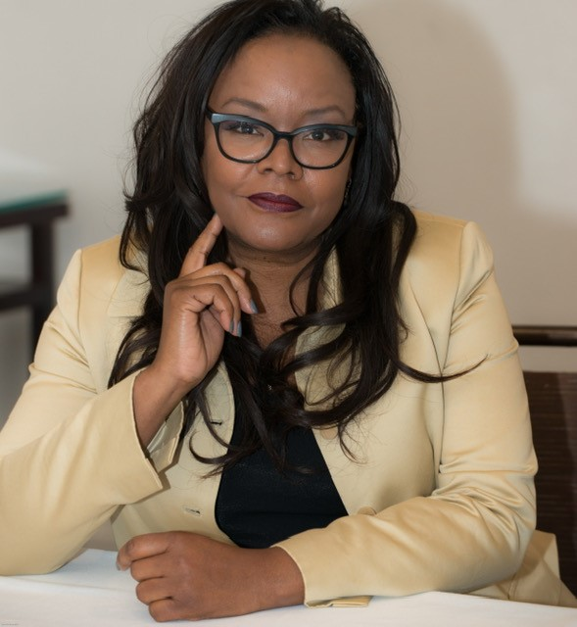
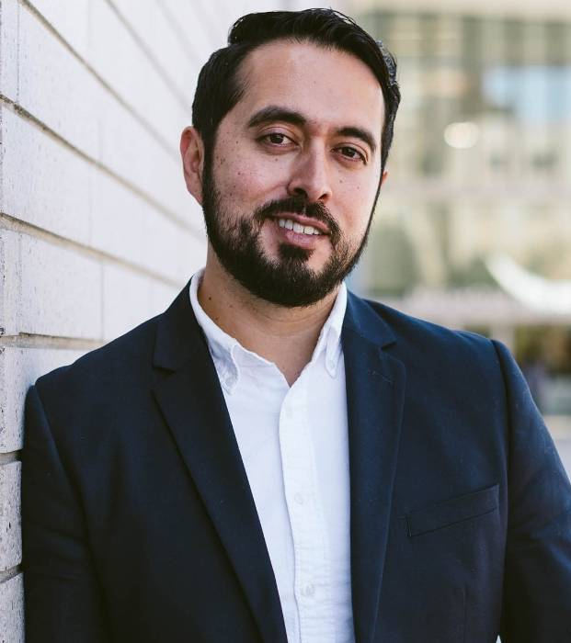
Cañada College Strategic Priorities Proposed for 2021-22
Tammy Robinson Vice President of Instruction | Manuel Alejandro Pérez Vice President of Student Services

Slide 51


Each year we review our existing college goals and strategic plans
Education Master Plan (EMP)
Provides long-range vision and goals for the institution
Strategic Enrollment Management (SEM) Plan
Helps the College sustain and grow enrollment while supporting the College’s goals for student success and equity.
College Committee Plans
Operationalizes and helps implement the goals and strategic initiatives established in the EMP and SEM by topic (work done in college committees)
Student Equity & Achievement Plan
Environmental Sustainability Plan
Online Education Plan
Professional Development Plan
Safety Plan
Technology Plan
See also our Canada Collaborates and College Planning websites

Slide 52
This year we propose a focus on
“Recovery with Equity” that, with equity and antiracism as our overarching priority, builds on and helps fully implement our existing strategic initiatives

Slide 53
Proposed priority…
supports these EMP strategic initiatives
Improve our internal policies and processes
Promote a climate of inclusivity
Institutionalize effective structures to reduce obligation gaps
Fully implement all aspects of Guided Pathways
Implement Guided Pathways
Develop clear pathways
Focus on key aspects of strategic enrollment management to enhance equity in access and completion
Improve student completion
Institutionalize effective structures to reduce obligation gaps
Implement professional learning plan
Improve student completion
K-12 & Adult School partnerships; Partner with 4-year colleges & universities
Institutionalize effective structures to reduce obligation gaps
Create process for innovation
Connect students with Internships, etc; Build relationships with employers
EMP Goal 3
EMP Goals 1,2,3
EMP Goals
1 & 3

Slide 54
Cañada College Strategic Priorities Proposed for 2021-22
CONCURRENT SESSION #1:
Equity and Antiracism: Internal Policies and Processes
Implementing our College Antiracism Task Force and Cultural Center Focus Group Recommendations
Where Racist Policies May Lie
Reflect on policies and procedures in your area at Cañada College we might identify as potentially racist. How can we identify areas for improvement in our own systems (looking at the life cycle of the student)?
CONCURRENT SESSION #2:
Equity and Antiracism: Guided Pathways Full Implementation – PART 1
Creating a sense of belonging and connection
  First Year Experience
    Interest Areas and the matriculation process
    Success Teams & Special Programs
      Using the CRM
      Connecting students to community
      Monitoring enrollments
      Early Alert
      Mid-Term Program Reports
      Supporting re-enrollment (persistence)
Beyond the First Year
LEAD FACILITATOR: VPI Robinson
LEAD FACILITATOR: VPSS Pérez

Slide 55
Cañada College Strategic Priorities Proposed for 2021-22
CONCURRENT SESSION #3:
Equity and Antiracism: Guided Pathways Full Implementation – PART 2
Pathways from K-12 to career
  How do we ensure success and scalability of Early College Experience and Dual Enrollment?
  How do we facilitate students moving through and beyond Programs of Study
    Transfer and Work-based Learning and Career Exploration
  How do we better create connections across instructional and student services areas?
    How might we better align divisions, services, and interest areas?
CONCURRENT SESSION #4:
Equity and Antiracism: Strategic Enrollment Mgmt
Expanding and coordinating course offerings and services to maximize course taking opportunities and educational goal completion
  How do we determine the right balance between F2F, hybrid and online courses and programs?
  What implications for campus life and student engagement do you see in offering 40%+ online?
  How do we identify degree and/or certificate programs that should be offered 100% online?
  How do we decide which degree and/or certificate programs should be offered nights and weekends?
  What are the implications for student services?
LEAD FACILITATOR: VPSS Pérez
LEAD FACILITATOR: VPI Robinson

Slide 56
Breakout Group Format
Each breakout will have its own Zoom link
Each breakout will:
  Review the background on this topic
  Provide information on existing efforts related to this topic (short-term and long-term)
  Facilitate group discussion on the following discussion prompts:
    Critically reflect and offer feedback on the proposed priorities
    Radically imagine and contribute ideas that inform these priorities
    Choose no more than 3 specific priorities for college-wide implementation in 2021-22 to present back to the whole group. Develop concise statements.
  Prepare for Report Out to the main group – who will present?

Slide 57
BREAK
10:15 – 10:30 am

Slide 58
BREAKOUT GROUPS (round 1)
10:30 am – 11:30 pm

Slide 59
CONCURRENT SESSION #1:
Internal policies and processes
Review college, district and state guidance and actions (short term actions in progress)
Consider list of where racist policies might lie in a college
Reflect on policies and procedures in your area at Cañada College we might identify as potentially racist. How can we identify areas for improvement in our own systems (looking at the life cycle of the student)?

Slide 60
Recovery with Equity: Guidance
State & System Guidance
Cañada College Guidance
Recovery with Equity
Vision for Success: Call to Action
Diversity, Equity & Inclusion Integration Plan
Guided Pathways: more $$ and time
Student Equity & Achievement Program:
  more $$
  Center for Urban Education (CUE) feedback for our 2022-25 SEAP
College Mission, Vision & Values
Guided Pathways implementation
Student Equity & Achievement Plan
College Antiracism Task Force Recommendations
Cultural Center Focus Group Recommendations
Faculty, Staff, Student Survey Results
National Assessment of Collegiate Campus Climates (NACCC) student survey results (expected September)

Slide 61
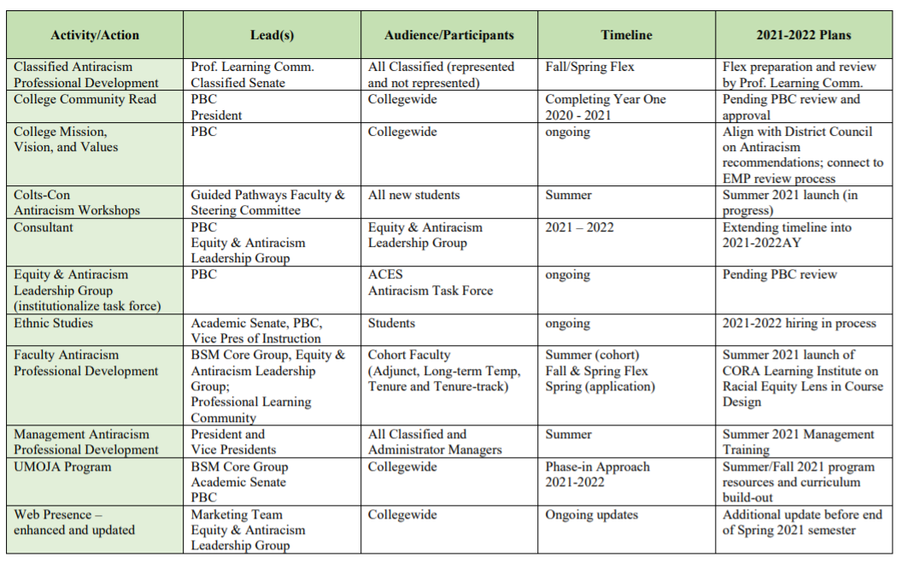
Cañada Antiracism Task Force Recommended Actions (approved by PBC)

Slide 62
District Antiracism Council
The SMCCCD Antiracism Council is focusing on three areas:
District Policies and Procedures like the District’s mission, vision statement and common antiracism glossary.
Curriculum, infusing cultural relevant teaching in curriculum, audit of curriculum courses.
Equal Employment Opportunity focusing on antiracism professional development courses for employees known as IDEAL – Inclusion, Diversity, Equity, Antiracism Leadership. Employees will be able to take courses that enrich their understanding of the above areas and how to incorporate them into practice.

Slide 63
CLP-led focus groups held Feb-March 2021
Seven focus groups with students, faculty and staff populations in groups that focused on the experiences of these sub-populations at Cañada :
  Hispanic/Latinx
  Immigrant/migrant/international
  Black/African American (2)
  Native American, Asian American, Pacific Islander (AANAPI), and
  LGBTQ
  A general population/non-specific focus group open to all
The primary goal of the focus groups was to gather information from the diverse community to shape the goals, activities, aesthetic, and values of the cultural center that Cañada College is developing over the next year. The questions in the focus groups sought to better understand when students felt supported, if and where they felt unsupported, and how a cultural center might help to provide intentional programs, activities, professional development, and anti-racist training to better support the diverse community at Cañada College.

Slide 64
Focus Group Recommendations
Recommendation 1: Dedicate resources to support the Black/African American community through intentional academic support, a dedicated space to discuss their experiences both inside and outside the college, and dedicated activities, workshops, and speakers that support the college in addressing anti-blackness experienced by the Black/African American community at the college.
Recommendation 2: Plan programming, speakers, discussions, and workshops that intentionally address the issues of racial bias and racial discrimination.
Recommendation 3: Hire and train a team of diverse student ambassadors or mentors to support the cultural center.
Recommendation 4: Hire dedicated staff who can support the cultural center to foster a welcoming community atmosphere, to hold events that celebrate the diverse community, and to create a space in which to share and learn about the cultures of students, staff, and faculty at the college.

Slide 65
Focus Group Recommendations
Recommendation 5: Provide all faculty and staff with diversity and inclusion training that equips them with strategies to manage situations here anti-blackness and racial microaggressions are occurring.
Recommendation 6: Leverage the cultural center as a place for activism and the development of student leadership.
Recommendation 7: Gather more feedback and input on the visual representations of cultures for the cultural center and campus. Some suggestions included murals, flags, and other artwork that celebrate individual cultures.
Recommendation 8: With a cross-functional and racially diverse team of students, faculty, and staff, launch a learning journey to explore other cultural centers on college campuses to gather ideas about aesthetic, programming, values, and management.
Recommendation 9: Explore ways to appreciate and represent cultures throughout the year, not just on dedicated appreciation months.
Recommendation 10: Develop a cultural center steering committee or group composed of student leaders from the cultural, racial, and ethnic communities at the college, along with faculty, staff, and administrators who can guide and support the students in the development and continued programming of the center.

Slide 66
Focus Group General Recommendations
Recommendation 1: Explore ways to make the college campus more visually welcoming and inviting to the diverse community through murals and activities that represent and appreciate the cultures of the student body.
Recommendation 2: Dedicate resources for faculty professional development on supporting diverse students in the classroom.
Recommendation 3: Create an Equity and Antiracism Leadership Group to help monitor and support the implementation of the Antiracism Task and Cultural Center focus group’s recommendations

Slide 67
Other campus efforts
Cultural Center, the programming for which may include:
  Antiracism: provide programming and co-curricular opportunities to explore and apply antiracism theory, framework and practice at Cañada.
  Equity and Identity: create a safe and brave space for the exploration of identity (cross-cultural, intersectional, and multicultural); International Students and their experiences are reflected here.
  Critical Leadership Development: in the context of GP, explore the ways students (and faculty and staff) develop a sense of belonging and voice on the campus; opportunity to further align leadership, antiracism, and equity.
  Student-Focused: an open and inclusive environment that is centered on student experiences, agency and sharing truth to power.
Year-long participation (2020-21) in the California Community College Race and Equity Alliance organized by USC Race and Equity Center: e-convenings in which 35 faculty and staff participated
CORA Learning
Umoja Program
Ethnic Studies – new program of study
Faculty Learning Program

Slide 68
Where racist policies at a college might lie…
Human Resources | Curriculum | Access & Affordability | Governance | Public Safety
Hiring | Assignments | Financial Aid | Student Government | Policing
Evaluations | Grading Policies | Work Study/Employment | Academic Senate positions or resolutions
Tenure | Prerequisites | Registration requirements
Discipline | Placement | Student Debt Policies
 | Program requirements | Student Discipline
 | Majors/Pathways
Source: RSS Consulting

Slide 69
Discussion Prompts
Critically reflect and offer feedback on the proposed priorities
Radically imagine and contribute ideas that inform these priorities
Choose no more than 3 specific priorities for college-wide implementation in 2021-22 to present back to the whole group. Develop concise statements.

Slide 70
CONCURRENT SESSION #2: Guided Pathways (Part 1) Creating a Sense of Belonging & Connection
Creating a sense of belonging and connection
First Year Experience
  Interest Areas and the matriculation process – do students feel like they belong to an Interest Area?
  Success Teams & Special Programs
    Using the CRM
    Connecting students to community
    Monitoring enrollments
    Early Alert
    Mid-Term Program Reports
    Supporting re-enrollment (persistence)
Beyond the First Year

Slide 71
HSS Division
BDW Division
STEM Division
KAD Division
An Interest Area is a group of academic degree and certificate programs that share common core required courses and which may be similar in terms of the career interests students may have.
Human Behavior & Culture
Business
Art, Design & Performance
Science & Health
Interest Area Work Group
Interest Area Work Group
Interest Area Work Group
Interest Area Work Group
A Success Team is a small group of college faculty, staff and administrators who monitor student-level data in the Interest Area (and build and manage relationships with each student in the Interest Area) to help each student with:
Onboarding and matriculation
Retention and persistence
Completion of education goals
IA Success Team may include:
Dean
Counselor
Retention Specialist
Program Services Coordinator
Peer Mentors (students)
Data Coach
IA Success Team may include:
Dean
Counselor
Retention Specialist
Program Services Coordinator
Peer Mentors (students)
Data Coach
IA Success Team may include:
Dean
Counselor
Retention Specialist
Program Services Coordinator
Peer Mentors (students)
Data Coach
IA Success Team may include:
Dean
Counselor
Retention Specialist
Program Services Coordinator
Peer Mentors (students)
Data Coach
Counseling Division
ASLT Division
Notes:
PBC approved framework for Interest Areas and Success Teams

Slide 72
Success team: retention specialist
Areas of Impact
Create channels for frequent and consistent communication to students (text, email, phone, etc.)
Daily maintenance of system for all interest area student contacts from point of application (CRM, Banner, Canvas, etc.)
Maintain regular contact with students for them to enter and stay on the Interest Area pathway

Slide 73
Success team: retention specialist
Areas of Impact
Create channels for frequent and consistent communication to students (text, email, phone, etc.)
Daily maintenance of system for all interest area student contacts from point of application (CRM, Banner, Canvas, etc.)
Maintain regular contact with students for them to enter and stay on the Interest Area pathway
Approx. 10 - 20 hrs/week
Weekly Success Team Mtgs (16 hrs/sem)
Develop initial message bundles (text, email, Canvas posts, etc.) by need or event
Establish system for regular contact with students (could be one-on-one case mgmt. and could be group sessions by milestone)
Coordination with special program retention specialists (Promise, ESL, EOPS, etc.)
Integration of Banner, CRM, & Canvas tools to help students stay on the path

Slide 74
Retention Specialist Work Timeline: proposed spring 2021
 | Goals | Data | Activities
June-July | Summer session | Receive data on students who have not registered for Fall
August | Fall semester
 | Welcome message and/or activity/event/information session |  | Collaborative workshops, Scholarships, Interpersonal Communication with Faculty, etc.
September | Early Alert, promote progress report
October | Disseminate and analyze Mid-Semester Progress Report
November | Promote registration for Spring | Receive data on students who have not registered for Spring
December | Finals
 | Follow-up with new students to see if they qualify for special programs (EOPS, Promise, ¡ESO Adelante, STEM)
January | Spring semester |  | Outreach to students on probation
 | Welcome message and/or activity/event/information session
February | Early Alert, promote progress report
March | Disseminate and analyze Mid-Semester Progress Report
April | Promote Summer and Fall registration | Receive data on students who have not registered for Summer/Fall (April & May) | Transfer information session for new students (April/May)
May | Finals
 | Follow-up with new students to see if they qualify for special programs (EOPS, Promise, ¡ESO Adelante, STEM)

Slide 75
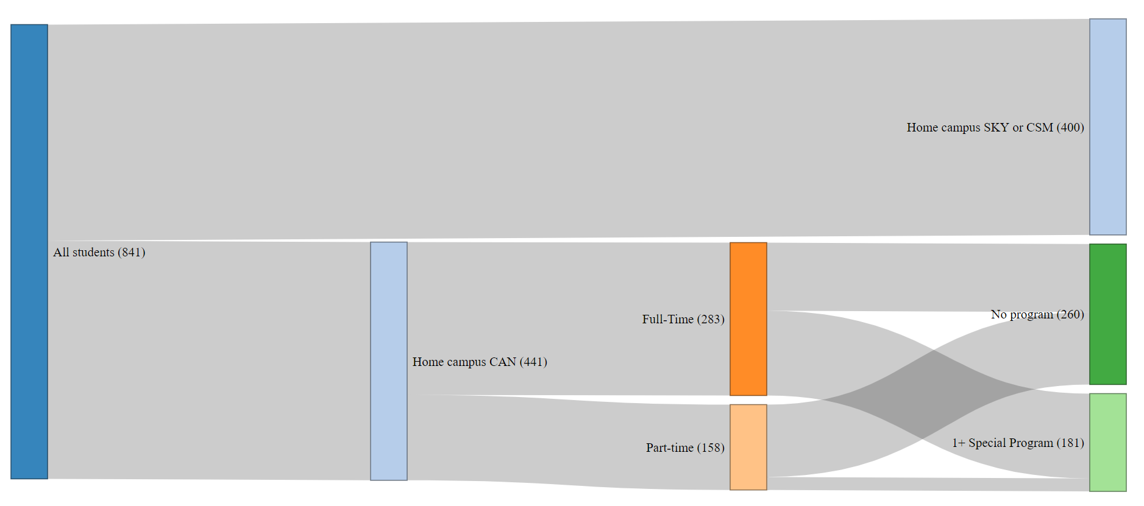
CAN Enrolled First-Time Students Fall 2020
Notes:
file:///C:/Users/engelk/AppData/Local/Microsoft/Windows/INetCache/Content.Outlook/DTZTF8UJ/Fall_2020_Sankey.html

Slide 76
Discussion Prompts
Critically reflect and offer feedback on the proposed priorities
Radically imagine and contribute ideas that inform these priorities
Choose no more than 3 specific priorities for college-wide implementation in 2021-22 to present back to the whole group. Develop concise statements.

Slide 77
BREAKOUT GROUPS: REPORT OUT
11:30 – 12:00 pm

Slide 78
LUNCH
12:00 – 1:00 pm

Slide 79
BREAKOUT GROUPS (round 2)
1:00 – 2:00 pm

Slide 80
Cañada College Strategic Priorities Proposed for 2021-22
CONCURRENT SESSION #3:
Equity and Antiracism: Guided Pathways Full Implementation – PART 2
Pathways from K-12 to career
  How do we ensure success and scalability of Early College Experience and Dual Enrollment?
  How do we facilitate students moving through and beyond Programs of Study
    Transfer and Work-based Learning and Career Exploration
  How do we better create connections across instructional and student services areas?
    How might we better align divisions, services, and interest areas?
CONCURRENT SESSION #4:
Equity and Antiracism: Strategic Enrollment Mgmt
Expanding and coordinating course offerings and services to maximize course taking opportunities and educational goal completion
  How do we determine the right balance between F2F, hybrid and online courses and programs?
  What implications for campus life and student engagement do you see in offering 40%+ online?
  How do we identify degree and/or certificate programs that should be offered 100% online?
  How do we decide which degree and/or certificate programs should be offered nights and weekends?
  What are the implications for student services?
LEAD FACILITATOR: VPSS Pérez
LEAD FACILITATOR: VPI Robinson

Slide 81
CONCURRENT SESSION #3:
Guided Pathways: Pathways from K-12 to Career
How do we ensure success and scalability of Early College Experience and Dual Enrollment?
How do we facilitate students moving through and beyond Programs of Study
  Transfer and Work-based Learning and Career Exploration
How do we better create connections across instructional and student services areas?
  How might we better align divisions, services, and interest areas?

Slide 82
Currently planned dual enrollment sections
CRN Course number High School
96767 CRER 137 Redwood High School
90682 CRER 137 Oxford Day Academy
94348 ECE 210 Hillsdale High School
95965 ECE 210 Hillsdale High School
89973 ECE 210 Hillsdale High School
Sections are showing “0” enrollment in the system

Slide 83
Specially Admitted K-12 Students

Slide 84
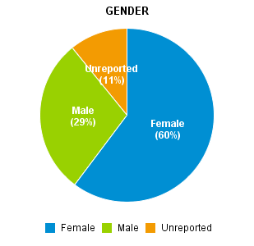
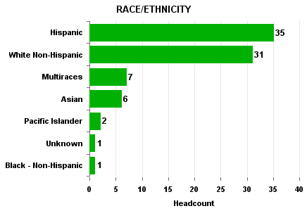
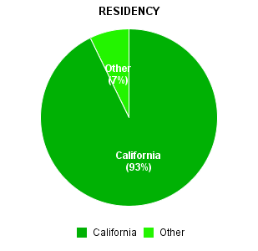
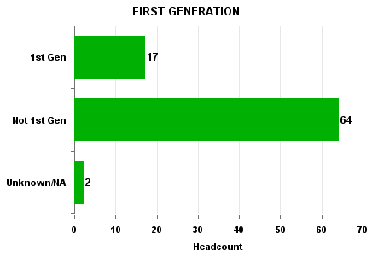
Profile of our Middle College students Fall 2021

Slide 85


Scale of Adoption Guidance
Program learning outcomes are aligned with the requirements for success in the further education and employment outcomes targeted by each program.
Program Learning Outcomes (to be updated)
Instruction across programs (especially in program introductory courses) engages students in active and applied learning, encouraging them to think critically, solve meaningful problems, and work and communicate effectively with others.
English contextualized for STEM programs
(not systematic)
Course Outlines aligned to ILOs
Students have ample opportunity to apply and deepen knowledge and skills through projects, internships, co-ops, clinical placements, group projects outside of class, service learning, study abroad and other experiential learning activities that program faculty intentionally embed into coursework.
Career exploration courses and activities for all students across Interest Areas (under development)

Slide 86
Discussion Prompts
Critically reflect and offer feedback on the proposed priorities
Radically imagine and contribute ideas that inform these priorities
Choose no more than 3 specific priorities for college-wide implementation in 2021-22 to present back to the whole group. Develop concise statements.
Who will report out?

Slide 87
CONCURRENT SESSION #4:
Strategic Enrollment Management
Expanding and coordinating course offerings and services to maximize course taking opportunities and educational goal completion
  How do we determine the right balance between F2F, hybrid and online courses and programs?
  What implications for campus life and student engagement do you see in offering 40%+ online?
  How do we identify degree and/or certificate programs that should be offered 100% online?
  How do we decide which degree and/or certificate programs should be offered nights and weekends?
  What are the implications for student services?

Slide 88
Pre COVID: % of Enrollments Online
Notes:
We have more online relative to face to face. Also given the slopes of the two graphs it appears that either the other college’s face to face sections fill better than ours OR our online fills better than theirs
Which in turn increases the proportion of enrollments.

Slide 89
Pre-COVID: % of Course Sections Online

Slide 90
Post-COVID Sections by Modality: Fall 2021
Active Sections by Modality | # Sections | % of Active Sections | Median Class Size | Average Class Size
COVID Synchronous | 229 | 52% | 17 | 19
Face to Face | 28 | 6% | 13 | 12
Hybrid | 10 | 2% | 13 | 15
HyFlex | 5 | 1% | 11 | 15
Online (asynchronous) | 167 | 38% | 18 | 21

Slide 91
Course Conflicts by Time Block (synchronous sections as of Fall 2020)
Key Takeaways:
“Crossing” days (e.g., MTWR) leads to more opportunity to conflict with other courses
Late start (short) courses have greater impacts on student’s schedules than normal length courses
Single day courses are better scheduled in the afternoon or evening, if we don’t want to block a majority of sections offered in a given semester
These conflicts are amplified when we have more densely scheduled times of day

Slide 92
Subjects with the most conflicts (as of spring 2021)
Subject | Start Time | End time | Schedule | Units | Conflicts
ESL | 910 | 1225 | MTWR | 5 | 110
ESL | 945 | 1200 | T | 5 | 68
MATH | 935 | 1040 | MTWR | 5 | 64
MATH | 945 | 1100 | MTWR | 6 | 63
VARS | 1810 | 1925 | MTWRF | 1.5 | 53
MATH | 1010 | 1120 | MWF | 4 | 52
MATH | 1110 | 1215 | MTWR | 5 | 48
INTD | 910 | 1200 | W | 3 | 47
FASH | 910 | 1200 | W | 3 | 47

Slide 93
Average conflicts | MW | TR | T | R | M | W | MTWR | MWF | S | F | MTWRF | TWF
810 | 30 | 30 | 22 |  |  |  |  | 26
830 | 56 | 57 |  |  |  |  |  |  | 7
835 | 39 | 41
910 | 56 | 71 | 80 | 65 | 83 | 83 |  | 76 | 6 | 10
930 |  |  |  |  | 80
935 |  | 58 |  |  |  |  | 89
945 | 47 | 44 | 40 | 55 | 43 | 76 | 89 | 52 |  | 8
1010 |  | 50 |  |  | 101 |  |  | 51
1110 | 45 | 38 |  |  | 37 | 37 | 73 | 42
1130 |  |  | 33
1210 | 61 | 42 | 47 |  | 57 |  |  | 63 |  | 7
1230 |  |  |  |  |  |  |  |  | 3
1245 | 32 | 23 |  | 23 | 31 | 24 | 52
1310 | 37 |  | 23 | 21 | 38 |  |  | 39 |  |  | 58
1410 | 19 | 13 | 13 |  | 18 |  |  |  |  |  |  | 22
1440 | 17
1510 |  |  | 10 | 10 | 13 | 10 |  |  |  |  | 29
1530 |  |  |  |  | 11
1535 |  |  |  |  |  |  |  |  |  | 5
1545 |  | 12
1610 |  | 8 |  |  |  |  |  |  |  |  | 18
1710 |  |  |  |  | 15
1730 |  |  |  | 18
1810 |  | 29 | 18 | 18 | 11 | 16
1830 | 21 | 32 | 18 | 20 | 11 | 16
1910 | 21 | 30
2010 |  |  |  | 12
Count of sections | 93 | 90 | 23 | 22 | 21 | 19 | 9 | 8 | 8 | 7 | 4 | 1

Slide 94
Discussion Prompts
Critically reflect and offer feedback on the proposed priorities
Radically imagine and contribute ideas that inform these priorities
Choose no more than 3 specific priorities for college-wide implementation in 2021-22 to present back to the whole group. Develop concise statements.
Who will report out?

Slide 95
BREAKOUT GROUPS: REPORT OUT
2:00 – 2:30 pm

Slide 96
BREAK
2:30 – 2:45 pm

Slide 97
Retreat Synthesis and Next Steps
FOCUS FOR 2021-22: Recovery with Equity
  Equity and Antiracism: Internal Policies and Processes
  Equity and Antiracism: Guided Pathways Full Implementation
    Creating a sense of belonging and connection
    Pathways from K-12 to Career
  Equity and Antiracism: Strategic Enrollment Management

Slide 98
Equity and Antiracism: Internal Policies and Processes
PRIORITY ACTION 1: Address diversification of faculty and staff hiring practices that recognize both traditional and nontraditional experiences and qualifications and reach out to a broader pool of applicants to ensure a diverse pool of faculty and staff applicants.
PRIORITY ACTION 2: Support faculty to re-envision curricula and pedagogy across disciplines to be antiracist and equity-centered in order to support diverse students in the classroom.
PRIORITY ACTION 3: Create an Equity and Antiracism Leadership Group to help monitor and support the implementation of the Antiracism Task Force and Cultural Center focus group’s recommendations and to remove barriers to students’ registration and enrollment, with a strong emphasis on BIPOC, LGBTQIA+, low income, disabled, undocumented and historically marginalized/minoritized students.

Slide 99
Equity and Antiracism: Guided Pathways
Creating a sense of belonging and connection
PRIORITY ACTION 1: Fully implement the Success Teams and the ability of lead faculty, retention specialists, counselors and others to ensure all students with a strong emphasis on BIPOC, LGBTQIA+, low income, disabled, undocumented and historically marginalized/minoritized students (communities disproportionately impacted during the pandemic) get consistent support and messaging across special programs and Interest Areas
PRIORITY ACTION 2: Reimagine pathways for our part-time students to ensure they feel as connected and supported as full-time students
PRIORITY ACTION 3: Support a variety of student journeys and adopt a student-centered approach to defining access and success.

Slide 100
Equity and Antiracism: Guided Pathways
Pathways from K-12 to Careers
PRIORITY ACTION 1: Orient more Cañada, K-12 and community partners about the benefits of early college experiences and dual enrollment and scale opportunities for both.
PRIORITY ACTION 2: Develop dual enrollment and early college outreach campaigns and courses to match the needs of our feeder school districts with high concentrations of Black, Indigenous and People of Color communities.
PRIORITY ACTION 3: Bring more folks to campus: Kindergarteners, Middle School students, High School students, and community members. Programs such as KinderCaminata, Cal Day, and other community oriented events build connections to the community

Slide 101
Equity and Antiracism:
Strategic Enrollment Management
PRIORITY ACTION 1: Create a student-first course schedule that creates course taking options and flexibility (and reduces course conflicts so that students can get the courses they need). Explore course modality choices; explore moving to two, 8-week sessions per term rather than one, long 17.5 week term).
PRIORITY ACTION 2: Create more degree and certificate programs available nights, weekends, and 100% online/hyflex for cohorts of students who we support like we do College for Working Adults students
PRIORITY ACTION 3: Bolster our ability to increase the number of our home campus students who receive Pell grants. (We have about 2500 CCPG B students (2500 low income students) yet only 800 receive Pell grants).

Slide 102
Next Steps
Priorities identified will be presented by Interim President Lopez on College Flex Day
PBC will consider them and discuss in September – to adopt a new “Annual Plan” for 2021-22
We move to implementing our Annual Plan!

Slide 103
Retreat Evaluation
Please take a moment to provide your input (anonymously) –
see link in the chat.

Slide 104
Retreat Closure
THANK YOU!

