Slide 1
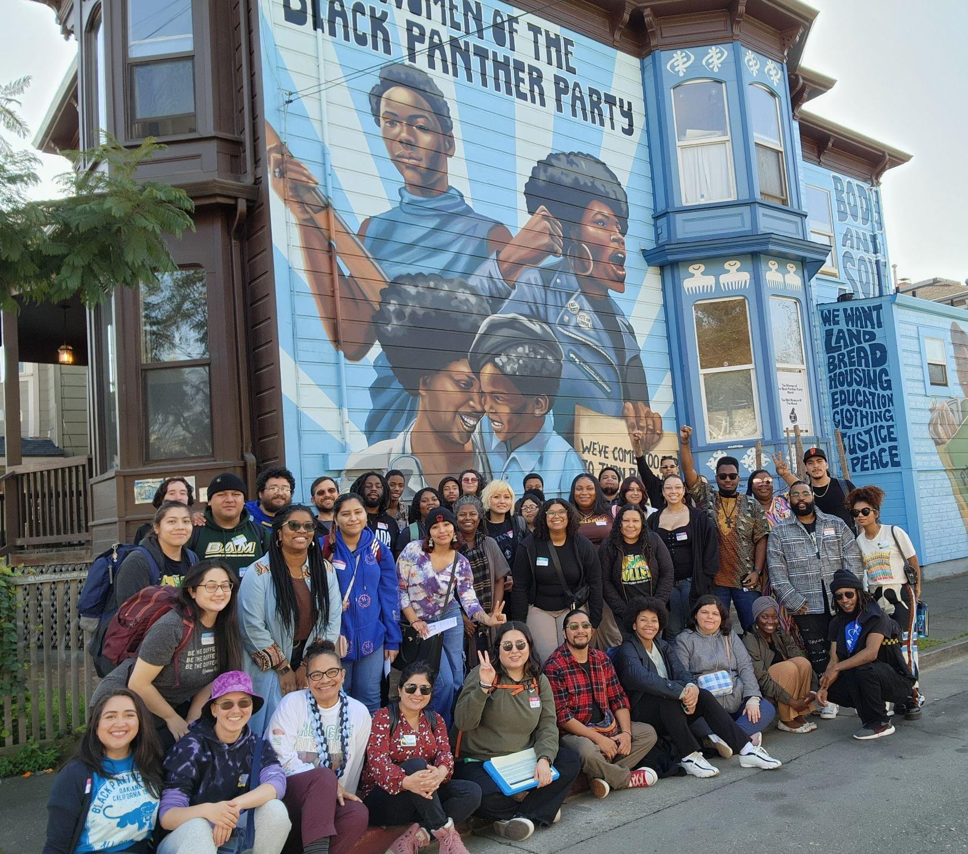
Student Equity and Achievement Program
Year 2 of 3 Updates
Planning and Budgeting Council Presentation
May 2024
Karen Engel
Michiko Kealoha
Kiran Malavade
Notes:
Michiko

Slide 2
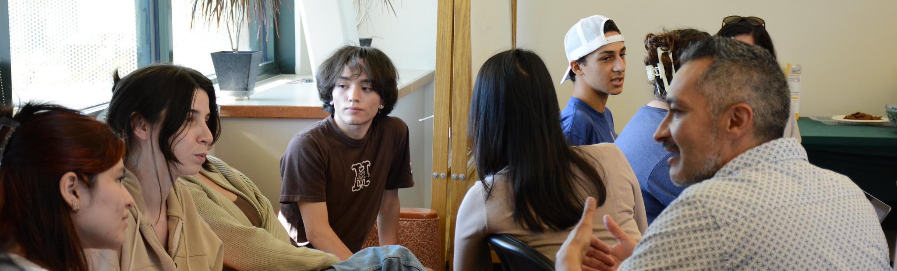
Hxstory
Created by the state Chancellor’s Office in 2018
Combined the statewide initiatives:
  “Student Success and Support Program”
  “Basic Skills Initiative”
  “Student Equity”
What is the Plan?
Actions we will take to improve achievement for disproportionately impacted student groups
Benchmarks to meet each year towards equity
Context
We get $1.8 million from the state
The state wants to see how we boost achievement
Annually, we review how we’re doing
What is the
Student Equity and Achievement Program?
Notes:
Hxstory and definition of plan - Kiran
Context -Miciko
Once we get more things that we need to focus on for SEAP - that’s where other items (like welcome center) can be moved to fund 1.

Slide 3
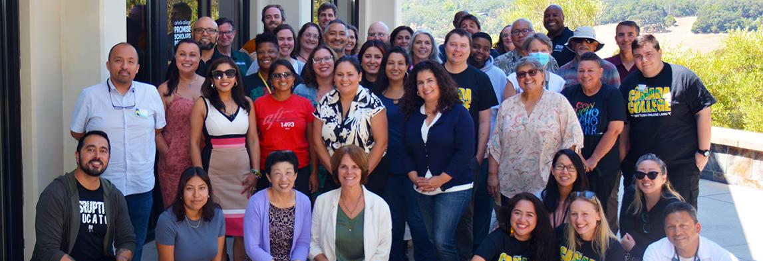
ALL OF US support student equity and achievement!
Our Roles
The following metrics and actions were written by a planning group of VPSS, Deans of Counseling, ASLT and PRIE, and ACES leadership, based on college feedback through participatory governance, submitted to and approved by the state.
Our current Director of Equity and Faculty Equity Coordinator lead the reporting out to the college and state.
We reached out to many of you on the status of the following goals.
Full Data Packet
This has the latest data pull–and the college is waiting for this term to end to get more data.
(We need to also document this progress for accreditation.)
If we have more to add–please kindly let us know.
Who “does”
SEAP?
Notes:
Kiran - Roles
Data and More - Michiko
Kiran as Faculty Equity Coordinator = supports in
Karen as Dean of Planning, Research, Innovation and Effectiveness = supports in gathering data
Manuel as VPSS = supports in guiding to see big picture, and too much in the red here
Michiko as Director of Equity = supports in
Ludmila as Vice President of Administrative Services = ensuring we are spending correctly, in compliance, and too much in the red here
Everyone on campus is tied to these metrics!

Slide 4
01
Successful Enrollment for Black Students
02
Complete Transfer-Level Math & English for Latine Students
03
Persist from First Primary Term to Secondary Term for Filipine Students
04
Increased Transfer Rates for Latine Students
05
Complete a Degree for Latino Males
Cañada Equity
Goals

Slide 5
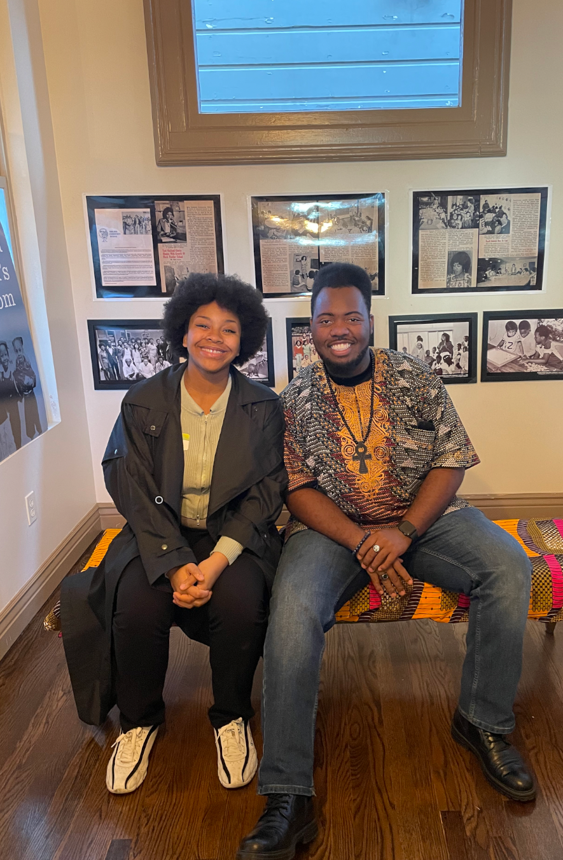
Metric #1
Black Students SuccessfullyEnroll
Notes:
Michiko

Slide 6
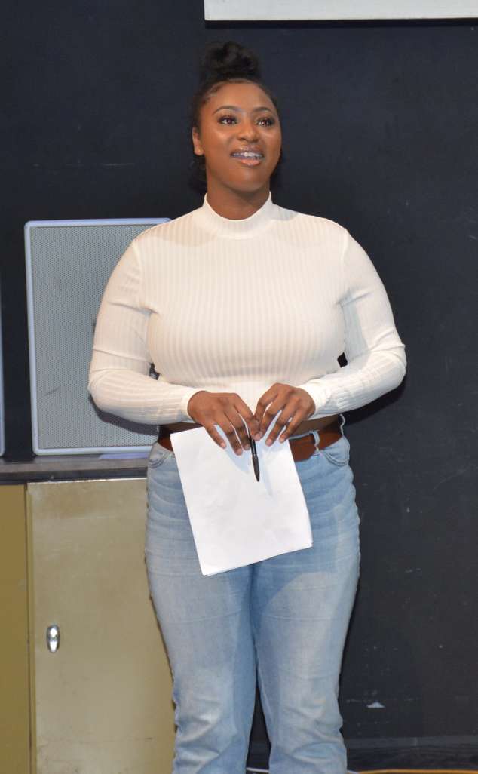
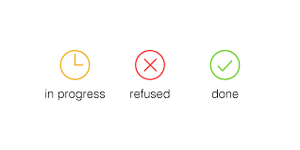
In 3 Years…
Increase percentage of Black students who enroll in Cañada by 5 percentage points each year.
Goal
Sustained!
Notes:
MIchiko
5% points versus 5%
Goal sustained means that we have reached that goal and we need to sustain it

Slide 7
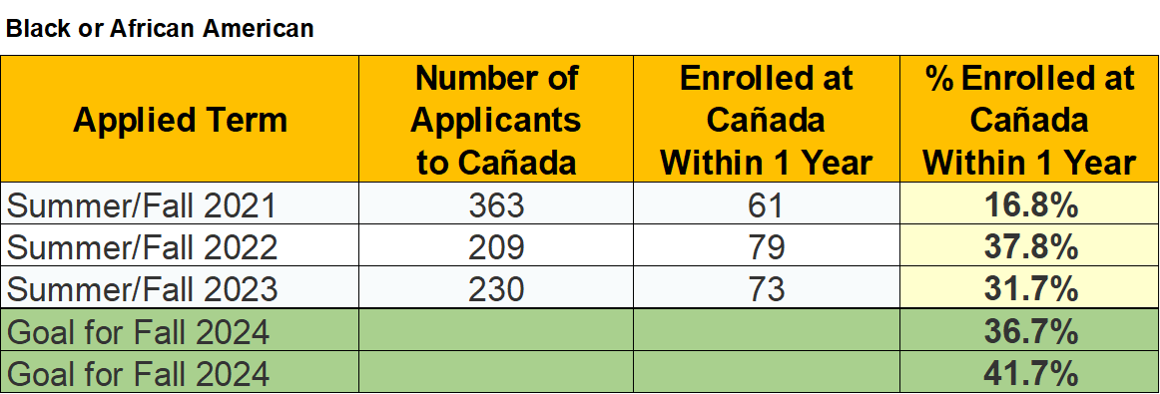
Metric 1 Data
Increase percentage of Black/African American applicants who enroll in the first year after applying by 5 percentage points each year, from a baseline Summer/Fall 2021
Source: SAP SEAP Reports (Access)
Notes:
Michiko

Slide 8
Employee Affinity Spaces
Financial Barriers
Sub-Metrics #1
Equity and Antiracism Council co-led creation of district-wide procedure for affinity groups.
Implement SB 893 (free college) to identify and eliminate financial barriers related to enrollment.
Notes:
Michiko

Slide 9
Outreach
Cultural Events Shared
Sub-Metrics #1
Supporting Umoja
Assessment
Institutionalize strategic plans for outreach and recruitment of Black students in East Palo Alto with UMOJA and College Recruiters.
EMP 3.2 top goal this year.
North Fair Oaks Listening Session.
Highlighted events:
HBCU visits!
50 person Black Panther Equity Excursion
Black History Month w/high schools
Equity Lens:
133 less Black students applying
Spring Flex Day Presentation: Increase support for Umoja program to institutionalize program deliverables, including having full-time positions in the program.
Implement regular quantitative and qualitative assessments to document the Black experience at Cañada.
Planning to implement
Planning to implement
Notes:
Michiko
The reason we still need to do this work is although we’ve reached the 5%...

Slide 10
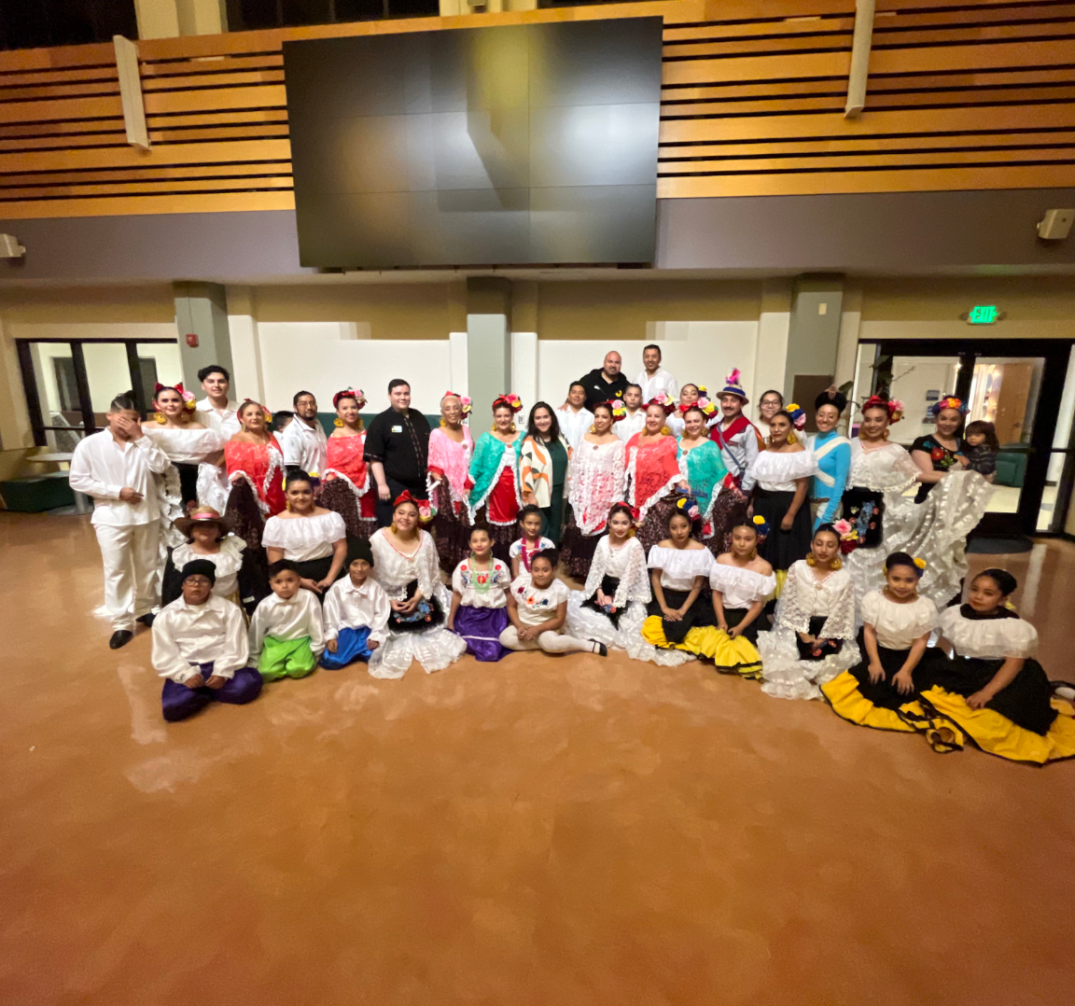
Metric #2
Latine Students Completion of Math & English
Notes:
Kiran

Slide 11
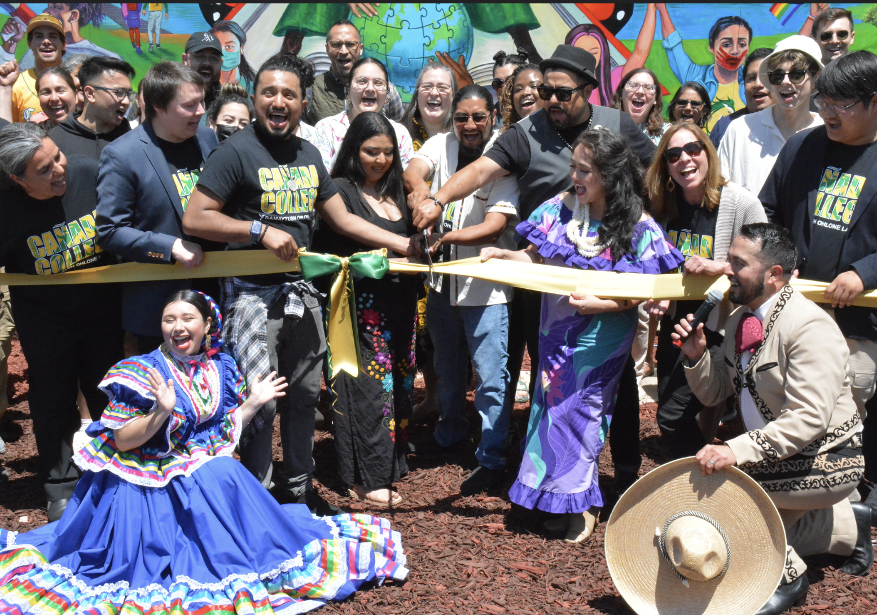
In 3 Years…
Increase first-time, transfer-seeking Latine students completing transfer-level Math and English in their first year by 3 percentage points each year.
Need approx.
16% increase to reach goal next year for Math
Need approx.
13% increase to reach goal next year for English
*The % numbers listed indicates percentage point goals.
Per cent means one hundredth of something.
Percentage point is used when comparing percentages to one another.
Notes:
Kiran

Slide 12
Metric 2 Data
Increase the percentage of first-time, transfer-seeking Latine students (Cañada College home campus) completing transfer-level math and English in their first year by 3 percentage points each year, from a Fall 2021 baseline.
Outcome for Latine Students | Cohort | Fall 2021 First-Time Student Cohort | Fall 2022 First-Time Student Cohort | Fall 2023 GOAL | Fall 2024 GOAL
% Completed Transfer-Level ENGLISH within the first year | Full-time | 61% | 57% | 64% | 67%
 | Part-time (6-11.99 units) | 22% | 15% | 25% | 28%
% Completed Transfer-Level MATH within the first year | Full-time | 54% | 47% | 57% | 60%
 | Part-time (6-11.99 units) | 13% | 6% | 16% | 19%
Source: SAP Strategic Plan Metrics

Slide 13
Inclusive Curriculum and Teaching Practices
Supplemental Instruction
Sub-Metrics
#2:
Additional Support + Assessment
Support Services at Night
Math & English faculty “Pod” are ongoing that reflect on current practices and establishes best practices moving forward
Mexican American literature class to be offered in Fall 2024.
Puente Professional Development opportunities scheduled for the 2024-25 year.
Increasing use of embedded tutors and highly qualified Instructional Aides in the LC; day and evening; working to expand embedded tutoring program and peer mentor supports.
Establish Learning Communities for English 105 aligned with Ethnic Studies/History to provide culturally responsive instruction and peer support.
Evaluate the co-requisite support courses in Math and 5-unit English.
Establish guidance for first-time students placed into corequisite math and English to take one course at a time (but to start in their first term).
Planning to implement
Support services available in alignment with course offerings for day, evening, and part-time students. Cañada de Noche launched!
Notes:
Kiran

Slide 14
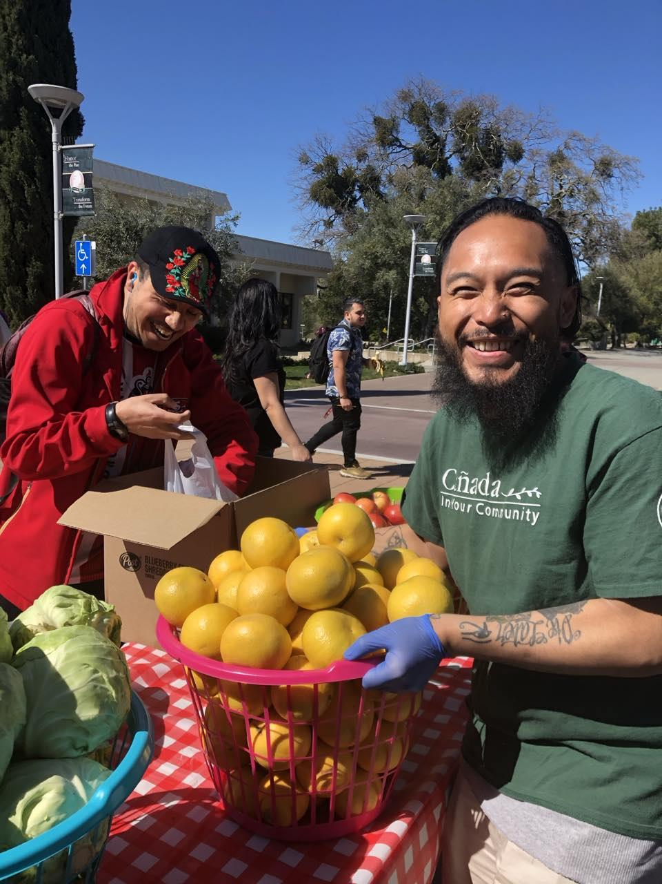
Metric #3
Filipine Students Persist from 1st Semester to 2nd Semester
Notes:
Michiko

Slide 15
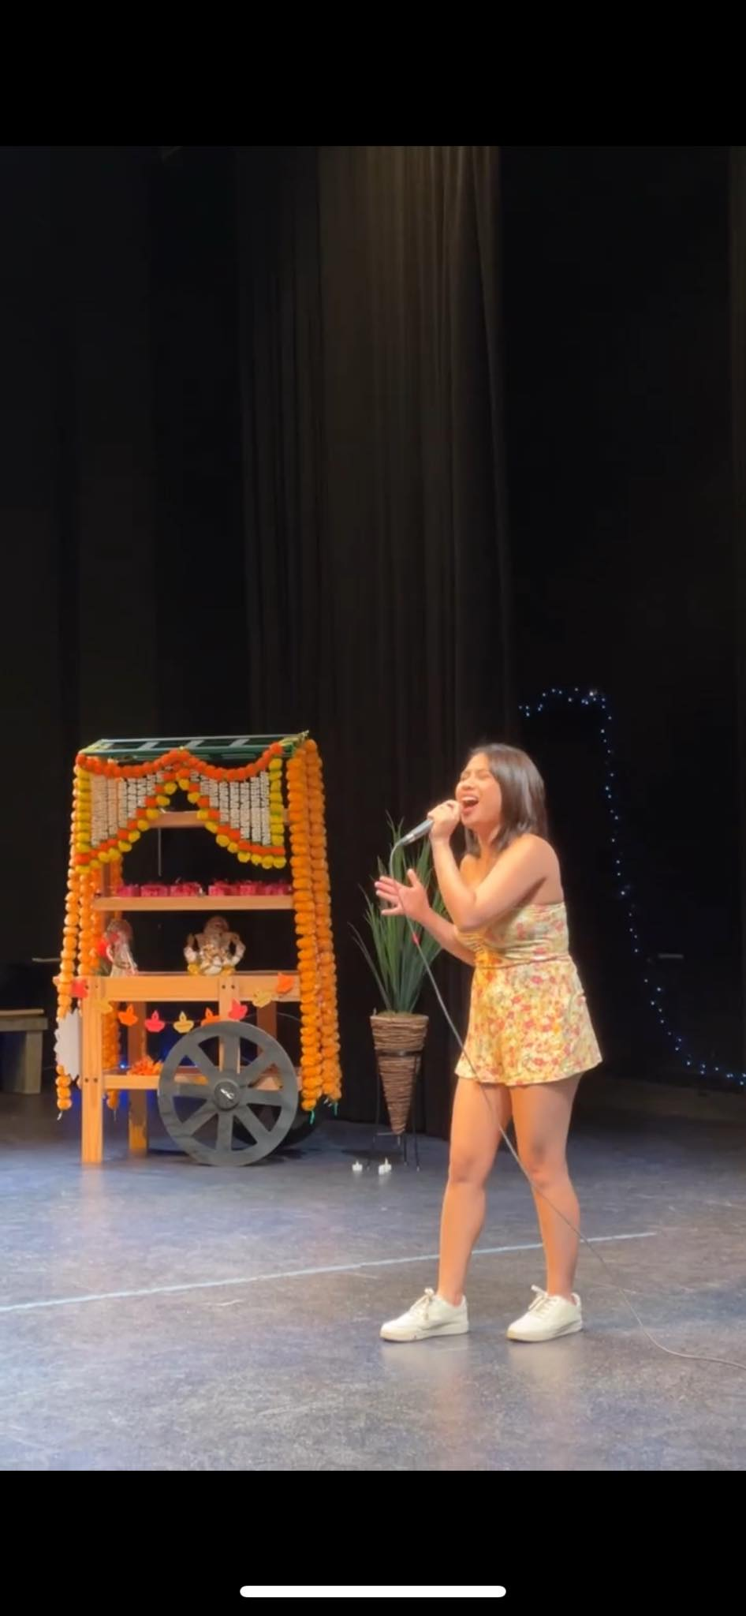
In 3 Years…
Increase Filipine students persisting from their first primary term to a second primary term by 3% percentage points each year.
Need 9% increase for part-time students
Need
17% increase
for full-time students
Notes:
Michiko

Slide 16
Metric 3 Data
Increase the percentage of Filipino students (Cañada College home campus) persisting from their first primary term to a second primary term by 3 percentage points each year from a baseline in Fall 2021
Outcome for Filipino Students | Cohort | Fall 2021 First-Time Student Cohort (15 FT; 6 PT) | Fall 2022 First-Time Student Cohort (15 FT; 6 PT) | Fall 2023 GOAL | Fall 2024 GOAL
Fall to Spring Persistence | Full-time | 73% | 80% | 79% | 82%
 | Part-time (6-11.99 units) | 83% | 67% | 86% | 89%
Annual Persistence (Fall to Spring to Fall) | Full-time | 60% | 73% | 63% | 66%
 | Part-time (6-11.99 units) | 67% | 50% | 70% | 73%
Source: SAP Strategic Plan Metrics

Slide 17
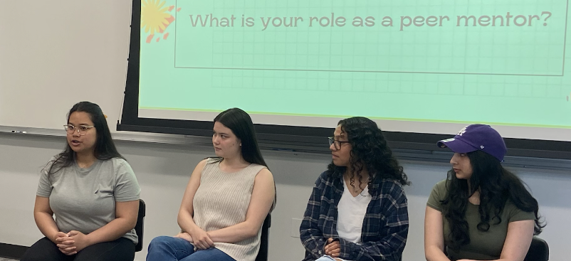
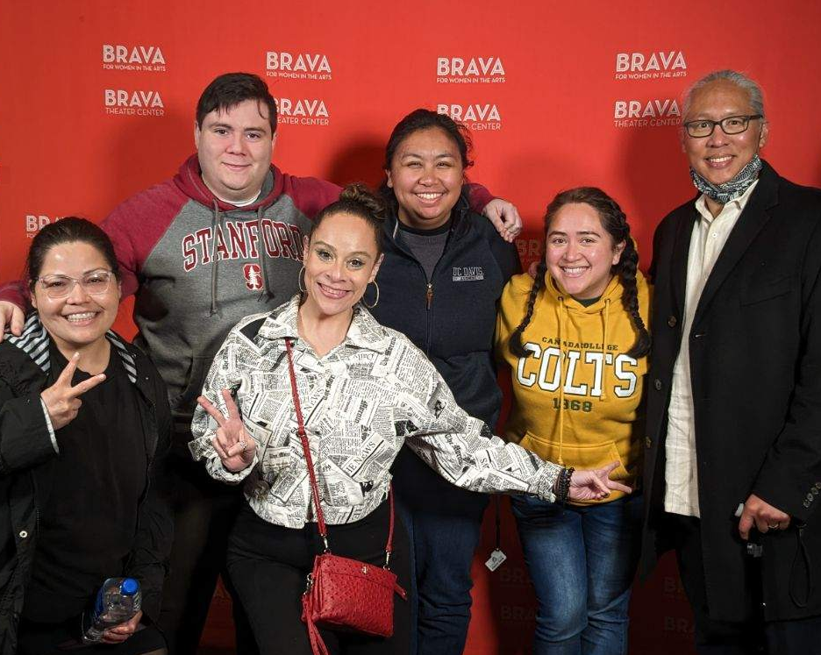
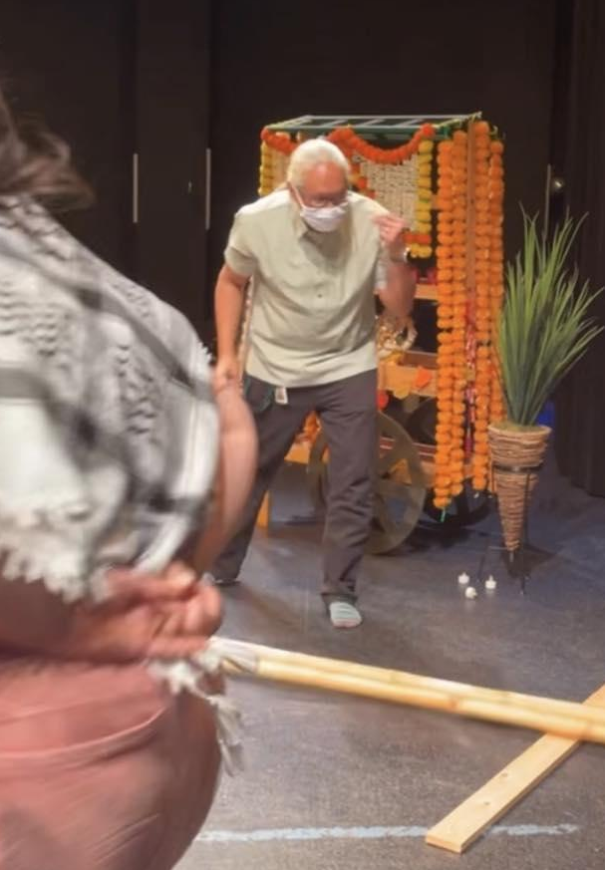
AAPI Focus Support & Services
Cultural Programming
Enrollment
Sub-Metrics
#3
The Cultural Center and AANAPISI STAR held the first FilipinX event on campus together, where students, faculty and staff shared their hxstories.
The Office of Equity also held an Equity Excursions to Larry the Musical, highlighting FilipinX leadership in the farmworkers movement.
The Cultural Center and AANAPISI STAR also held the first AANHPI Showcase, highlighting FilipinX performances and a tininkling closing workshop.
Peer mentoring program is off the ground, successfully supporting students, and growing!
With mentors presenting at Flex and National conferences.
Notes:
Michiko

Slide 18
Enrollment
Equity & Antiracist PD
Outreach & Enrollment
Sub-Metrics
#3
Streamline proactive registration to address Filipino student persistence between terms.
Earlier outreach to Filipino students about Ethnic Studies classes and curriculum; learning community with Ethnic Studies
Strengthen antiracism in teaching, learning, and service through the STAR/ARC to dispel problematic assumptions and bias that show up in the classroom and support services through professional development opportunities.
Increase in the use of equity- minded and antiracist curriculum and effective andragogical methods.
Planning to implement
Planning to implement
Notes:
Michiko

Slide 19
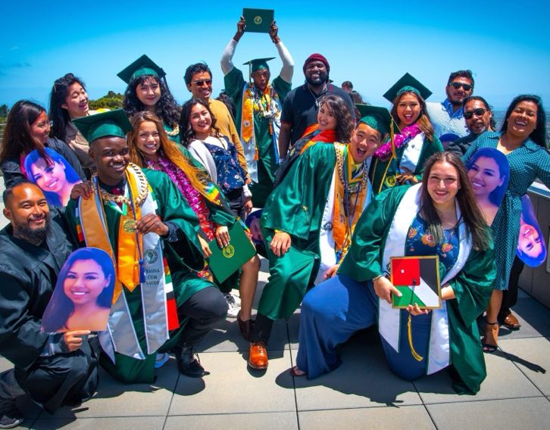
Metric #4
Latine Students Have Increased Transfer Rates
Notes:
Michiko

Slide 20
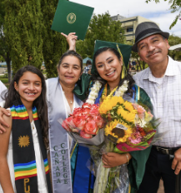
In 3 Years…
Increase Latine students transferring to a 4-year institution within 3 years by 4 percentage points each year.
Need 11% increase to reach goal next year
Notes:
Michiko

Slide 21
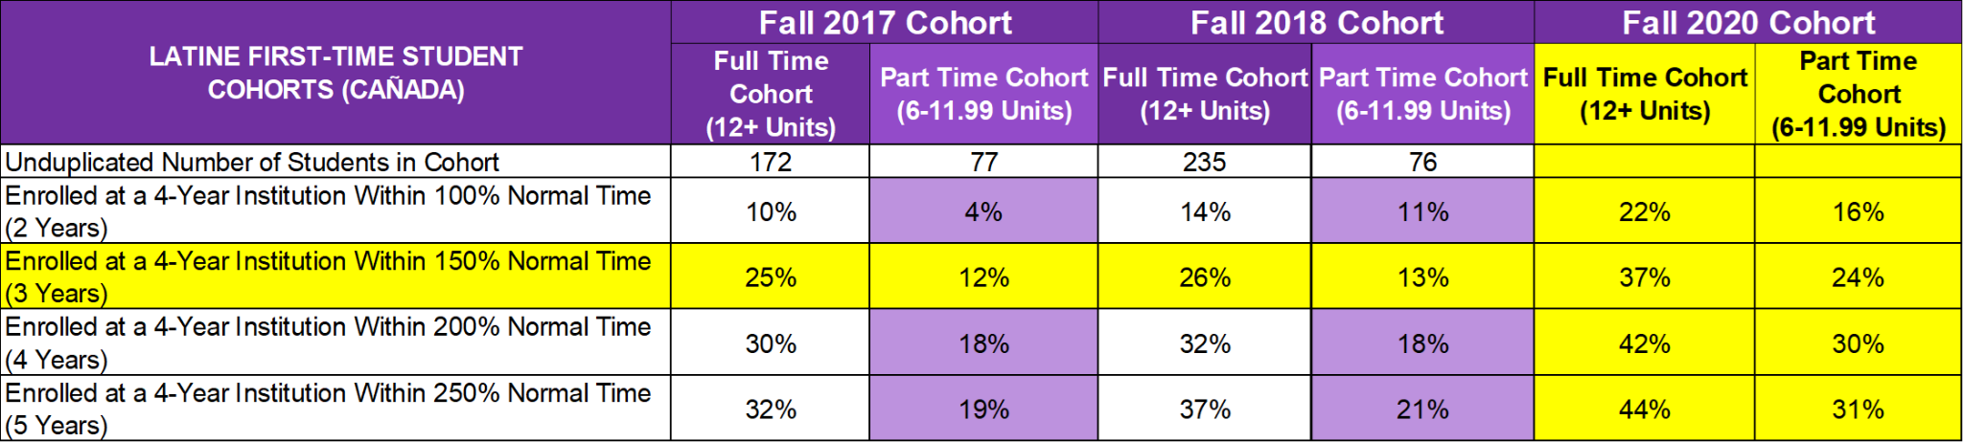
Metric 4 Data
Increase the percentage of Hispanic students transferring to a four-year institution within three years by 4 percentage points each year from Fall 2017 First-time Cohort
Source: SAP Report: 4-Year Institution Transfer Rates
Notes:
Michiko

Slide 22
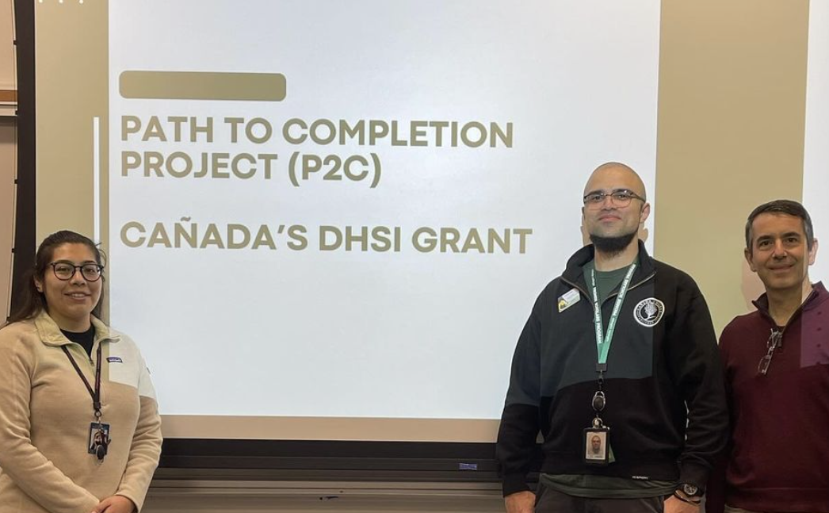
Career Education
Improve Transit
Sub-Metrics
#4
Interest Area Success
First Spanish Language Entrepreneurship program based in Menlo Park, and it was well attended. (Primarily women.)
The new water program has been doing very well at Menlo Park.
Provided approximately 12,000 Lyft rides to and from campus to East Palo Alto, Belle Haven, North Fair Oaks
Retention specialists hired, they are actively case managing our Latine students to ensure they are making progress towards completion.
New Developing Hispanic Serving Institutions DHSI mini grant process established.
Notes:
Michiko

Slide 23
Course Schedule
Technology Loans
Sub-Metrics
#4
Intentionally built out each program of study to be completable in two years across in as many modalities as possible. New instructional program map linked here.
New mini-mester!
Have increased 100 new hotspots this academic year through one-time funds, and using SEAP dollars to cover student assistants who help loan out these materials.
Chromebook/PC = Latine students make up 69% of population borrowing.
Hotspot = Latine students make up 71% of population borrowing.
Notes:
Kiran

Slide 24
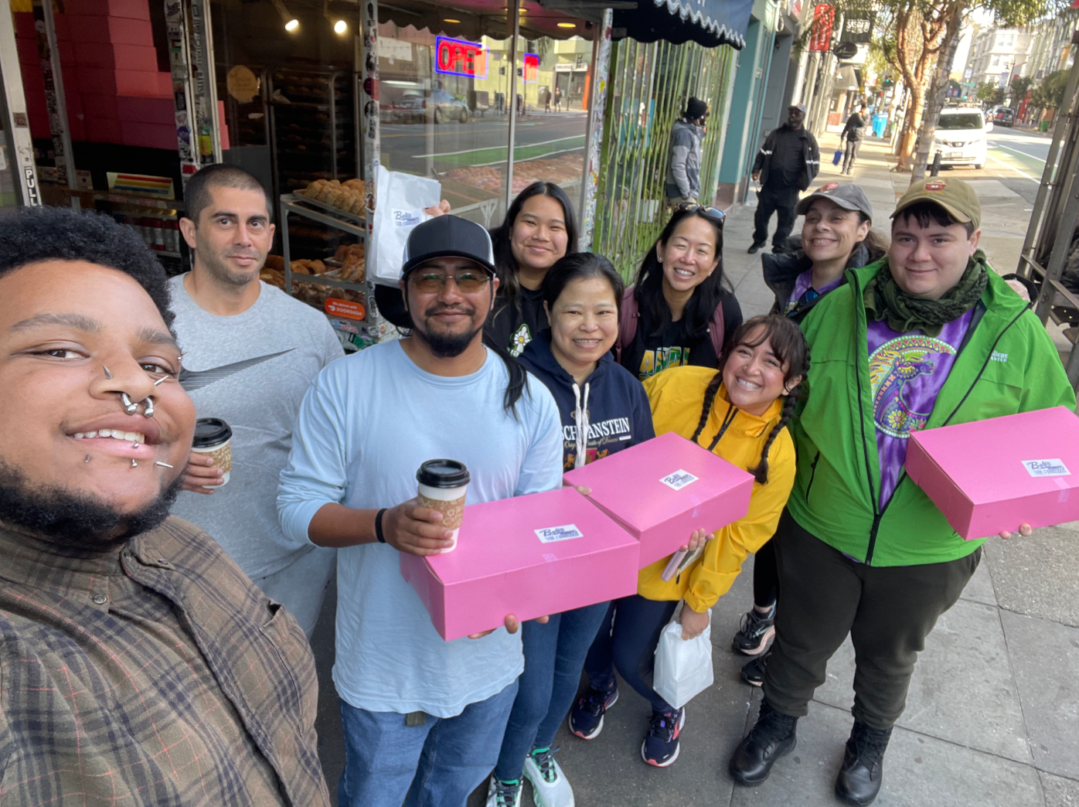
Metric #5
Latino Degree Completion
Notes:
Kiran

Slide 25
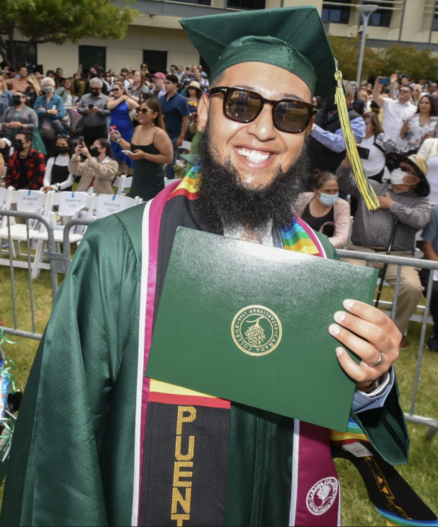
In 3 Years…
Increase Latino (Male) students completing a degree within 3 years by 2 percentage points.
Goal
Sustained for Full Time Students!
Need 11% increase for part-time students to reach goal next year
Notes:
Kiran

Slide 26
Metric 5 Data
Increase the percentage of Latino (Hispanic Male) students attaining the Vision for Success and completing a degree within three years by 2 percentage points each year from baseline of the the 2018 full-time cohort.
Outcome for Latino Male (Degree Seeking) Students | First-Time Cohort | Fall 2018 Cohort (94 FT; 20 PT) | Fall 2019 Cohort (105 FT; 34 PT) | Fall 2020 Cohort GOAL
Completing an AA, AS, or AD-T within 3 years | Full-time | 18% | 23% | 22%+
 | Part-time (6-11.99 units) | 5% | 0% | 9%
Source: SAP Strategic Plan Metrics
Notes:
Kiran

Slide 27
Colts-U Transfer Center
Integrated Support
Sub-Metrics
#5
Race Conscious Programming
Expanding Key Programs
NDNU BA completion program offers culturally responsive counseling and mentoring for Latinx students
ARC program in partnership with SFSU also serves first-gen Latinx students.
Collaboration with Promise, TRIO, EOP through University Visits Planning Group.
The Constituent Relationship Management (CRM) System can show in an integrated system of support for students for transfer.
Welcome Center team gets people through matriculation, and SEAP currently funds the Welcome Center.
Speaker Series Interest Areas support Latine narratives.
Transfer Center developed new Service Area Outcome to include Latine narratives in transfer workshops and campus visits. Cultural Center and DHSI grant working together to create culturally responsive workshops and activities.
Puente flex day training sessions for faculty, staff, and student leaders.
Expansion of EOPS and Promise, including financial literacy workshops.
When SB893 started in Spring 2023, it only paid for tuition and fees. Now, it has expanded to additional resources.
Notes:
Kiran

Slide 28
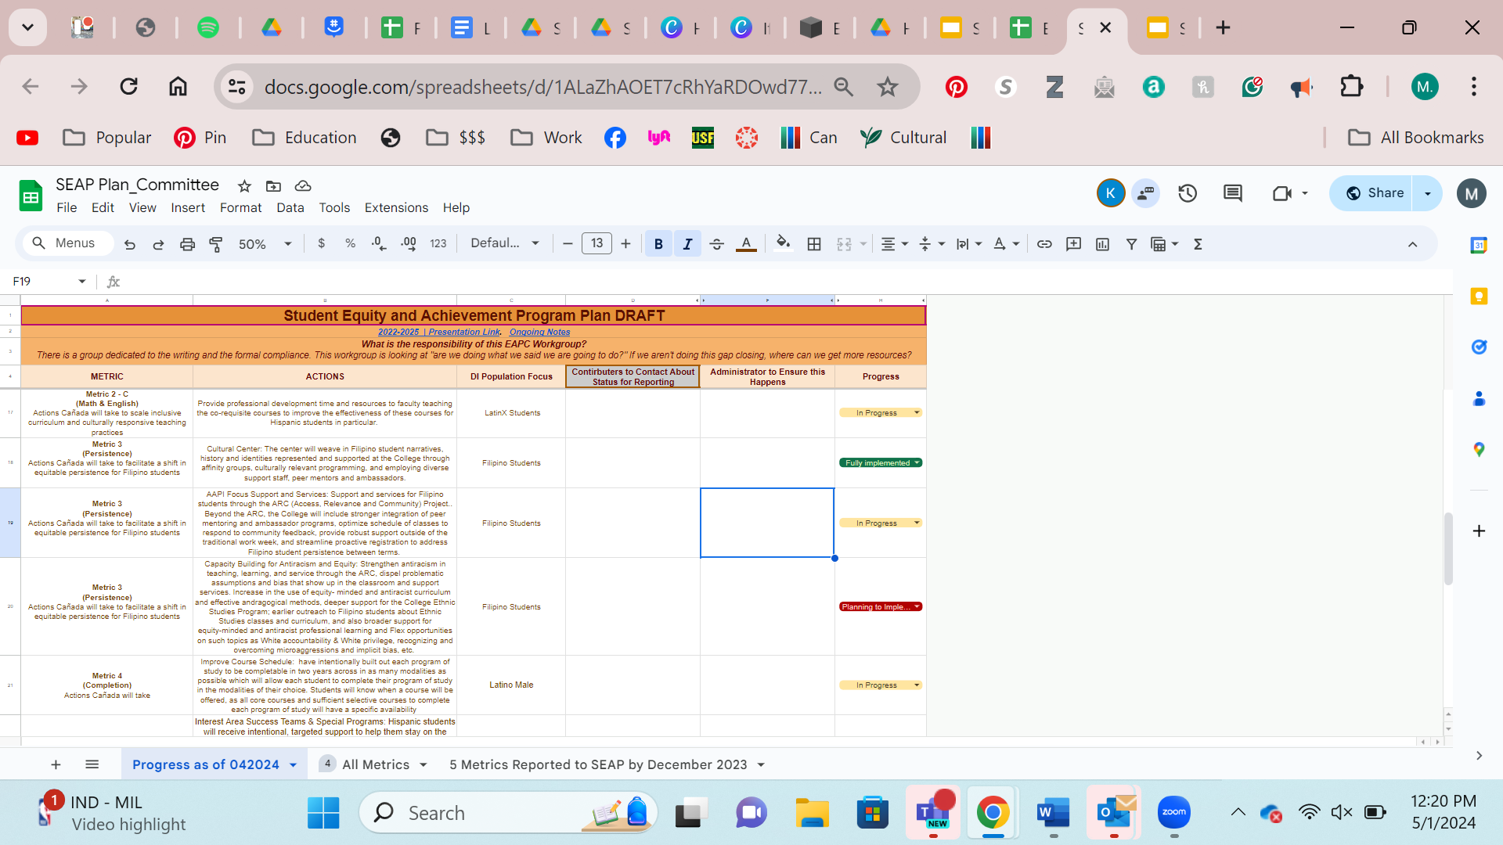
How are we continuing this work?
Notes:
Kiran

Slide 29
Q&A
Notes:
Michiko
might be some changes around English because AB1705 plenary is saying it’s not working and very restrictive
President PBC comment, “This is the most clear presentation I’ve ever seen and it’s clear where our work is focused on”
Is the data really clean?
Manuel - the intervention and the identified things we have done is increased the same thing we’ve done well and earned us this achievement data rate, have to shock the system with an intervention like pods and addressing Latine-d study approach for Math or English? More culturally responsive and we’ve never done that before and is that permissible?
Ludmila is constantly updating the SEAP budget and
7 counselors - FTE 3.85 average
EOPC (.8),
Kiran Equity Coordinator
Puente and Umoja Coordinators
Director of Equity
Welcome Center Full Time 2 full time
UCC, Foster Youth, Skills Matriculation, Welcome Center
Guided Pathways
Adjunct Counselors
Legal Clinics
EAPC Summer hours ($3179.57 faculty overtime management functions)
Library student assistants
Operational - Puente, Umoja, Cultural Center, DRC, UCC
No professional development
Ludmila, Manuel, –transition the SEAP plan and we all understand

