Slide 1

Transportation & Modality Preferences Student Survey: Fall 2022
Office of Planning, Research, and Institutional Effectiveness (PRIE)
November 2, 2022

Slide 2
Results reported for students reporting coming to Cañada at least once per week

Slide 3
How do you currently get to the college(s) you indicated? (Check all that apply)

Slide 4
What type of assistance to and from campus would be most helpful to you?

Slide 5
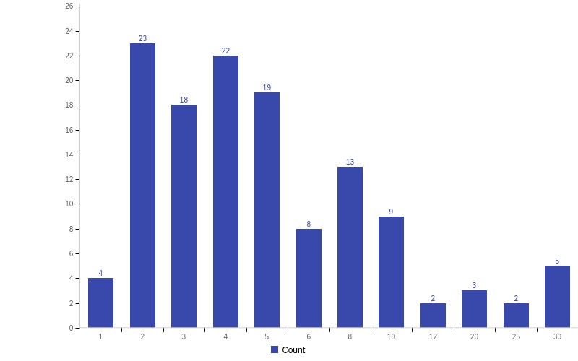
About how many Lyft rides per week would you need to get to campus?
Minimum | Maximum | Mean | Std Deviation | Count
1 | 30 | 6.2 | 6.2 | 117

Slide 6
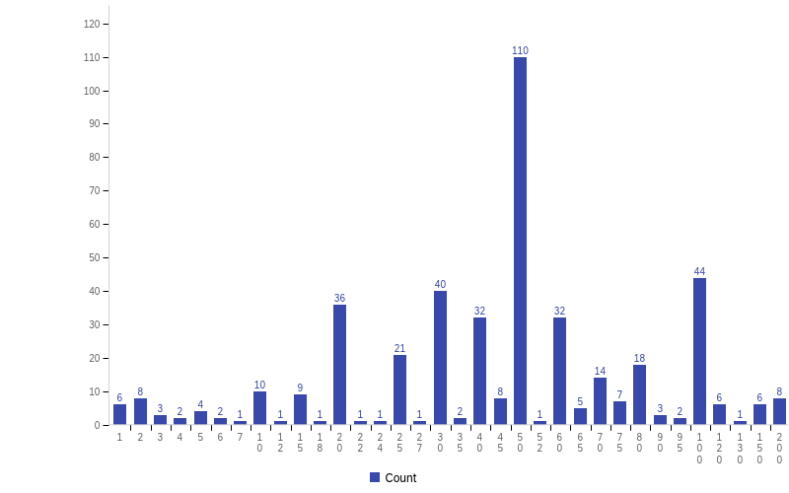
About how much in gas card per week would you need to get to campus?
Minimum | Maximum | Mean | Std Deviation | Count
1 | 200 | 53 | 36 | 446

Slide 7
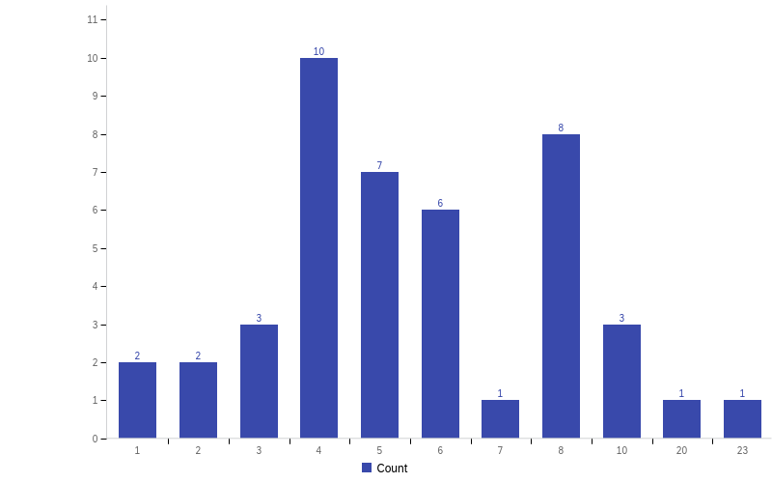
About how many public transit rides per week would you need to get to campus?
Minimum | Maximum | Mean | Std Deviation | Variance | Count
1 | 23 | 6 | 4 | 16 | 44

Slide 8
Of those who did not choose rideshare or driving as an option, they were asked, "If free ride share support were available, would you take a ride share service, such as Lyft, to campus?"

Slide 9
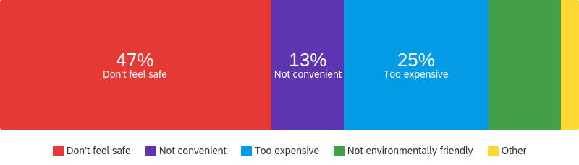
Of those who said they would not use rideshare, they were asked, "What are your main reasons for not using a ride share service? (Check all that apply)"
13%

Slide 10
Student Services and Instructional Modality Preferences

Slide 11
When do you most prefer to access in-person student services (financial aid, counseling, and admissions)?

Slide 12
How would you prefer to attend classes in future semesters?

Slide 13
What time frame do you most prefer for courses that have fixed meeting times?

