Slide 1
Reimagining Student Access to Career Opportunities Work Group Recommendations to PBC December 6, 2023

Slide 2
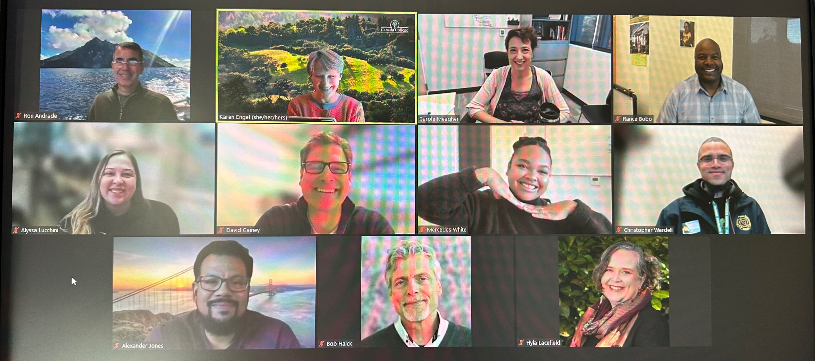
Work Group Participants
Karen Engel | Dean of Planning, Research, Innovation & Effectiveness
Hyla Lacefield | Dean of Business, Design & Workforce
Carole Meagher | Interim Workforce Development Director
Max Hartman | Dean of Counseling
David Gainey | Project Director of Apprenticeships
Bob Haick | Program Supervisor (Career Center)
Christopher Wardell | Program Services Coordinator, Financial Aid
Alyssa Lucchini | Career Center (and Welcome Center)
Mercedes White | Program Services Coordinator - Menlo Park
Ron Andrade | Guided Pathways Director
Rance Bobo | Program Services Coordinator, STEM Center
Alex Jones | Adjunct Faculty - Cooperative Education
Stephen Redmond | Executive Director – Middle College

Slide 3
Who will do what on Priority #4?
Priority #4: Reimagine how we support students’ accessing career opportunities
Work Group Lead: Dr. Karen Engel
Desired Outcomes: Recommend to PBC on how we can better serve our students (organizational changes, programmatic changes, communication). Consider the bigger picture and make recommendations for aligning our relationships with employers to improve and scale career opportunities for students.
Timing: Report recommendations to PBC before the end of the Fall 2023 term.

Slide 4
What does it mean to reimagine something?
Different outcomes for students

Slide 5
Work Group Process
Defined terms
Gathered information about our of current employer engagement practices (and data management)
Identified all “Career On-Ramp” programs on campus
Shaped a Vision: “If the College is successful in providing career opportunities for students, what does it look like?”
Conducted a “focus group” with 7 students to hear their perspectives
Refined our Vision
Finalized our recommendations

Slide 6
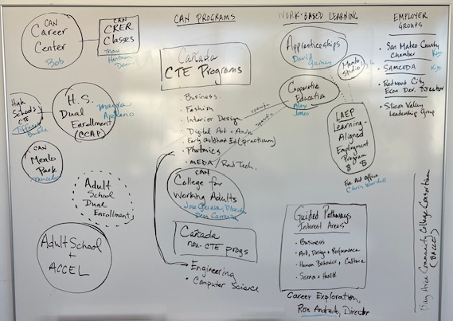
Career On-Ramp Constellation of Services
Helping students jump-start career exploration

Slide 7
What does it look like if it’s working?
The Director of Workforce Development, in close collaboration with the Career Center, ensures all programs that are part of the “career on-ramp” constellation of services at the College work together to:
share information and data tools
leverage employer relationships to scale opportunities for students
leverage and optimize the college job board: College Central
coordinate their calendars and services
communicate in a cohesive way
engage community partners and members (including those who are members of our Community Fitness program) to provide opportunities for students

Slide 8
What does it look like if it’s working?
Students are supported in developing their portfolio of work readiness
a LinkedIn Profile (linked with Cañada College so they can remain part of our alumni network);
a resume;
at least one mock interview and “elevator pitch”
practice in conducting themselves professionally (soft skills), and;
digital copies of any work products or evidence of capstone projects or other learning outcomes of interest to potential employers.

Slide 9
What does it look like if it’s working?
Students have experienced several forms of work-based learning
(career on-ramps)
Speakers who are knowledgeable about working in the field(s) in which students have interest
Informational interviews
Employer site visits/industry tours
Field-based research experience
Service learning and/or volunteer opportunities
Job shadows
Internships (paid and unpaid)
Summer jobs (paid and unpaid)
Paid on-campus work related to their field of study (perhaps via the Learning Aligned Employment Program (LAEP))
Cooperative Education (Co-op Ed)
Pre-apprenticeship and apprenticeship
Job placement assistance (Career Fairs as well as other opportunities to connect to employers and apply for employment)

Slide 10
What does it look like if it’s working?
Career exploration is a seamless experience for students from “undecided” inquiry through meeting with experts in their chosen field and employment: a collective pipeline of career consciousness
Communication about career on-ramps, work, and work-based learning opportunities is clear, consistent, part of our mainstream college experience via our:
Outreach and Recruitment Ambassadors
Website
Catalog
Interest Area Canvas Shells
Career Center Canvas Shell
LinkedIn Pro helps build our alumni network and communicate with students
Print materials
Event calendar
Dual enrollment program
Employer partners (Chambers, Business and Industry Associations)
The college culture shifts so that everyone is aware of the opportunities listed above (career on-ramps) and helps students connect to them.
Such that:

Slide 11
What does it look like if it’s working?
Interest Areas are the focal point for career exploration and work-based learning
Career On-Ramp programs are present in each Interest Area OR
Each Interest Area is utilizing all of the career on-ramp opportunities and communicating effectively with faculty and students and monitoring student participation in career exploration activities.

Slide 12
What does it look like if it’s working?
Academic Counselors refer students to career exploration opportunities in a way that helps inform their education goals
Career On-Ramp staff and programs (Career Persons) meet with the Counseling Division regularly to provide up-to-date information about career exploration opportunities, educational pathways, and “talking points”

Slide 13
What does it look like if it’s working?
Our not-for-credit students have access to all the same career on-ramp services… as well as more support to transition to credit programs
Menlo Park program students are better connected to the main campus and services.
Our not-for-credit programs transition to non-credit to ensure student access to District services.
Our not-for-credit pre-apprenticeship and other programs transition to a for-credit program.
Not-for-credit program completers transition directly to employment.

Slide 14
What does it look like if it’s working?
Career pathway programs start in high school, adult school, and in partner programs
Career awareness and knowledge of “on-ramps” starts in High School, starting with dual enrollment and summer on-campus opportunities to explore pathways and careers.
Adult School students have seamless access to career pathway programs at SMCCCD.
The College works well with our WIOA partners (NOVA Works) to support job seekers, including youth and those with significant barriers to employment, access education, employment and training, and support services to succeed in the labor market.

Slide 15
What does it look like if it’s working?
The College Alumni Network is strong and transparent in LinkedIn
All completers and graduates join the network before they leave.
College career on-ramp programs are able to tap the network to provide all of the work and work-based learning opportunities listed above.

Slide 16
Recommendations
Ensure the Director of Workforce Development, in close collaboration with the Career Center, is able to enact the Vision above.
Align and coordinate all of the “Career On-Ramp” programs and services at the College more formally.
Ensure that college career “on-ramp” services are accessible, comprehensive, and coordinated and there is a nexus of information sharing.
Develop database tools to facilitate information sharing and employer relationship management between College’s Career On-Ramp programs and services.
Develop non-credit CTE programs and pathways as a way to provide better college services to our not-for-credit students.
Inform the College’s efforts with the Governor’s August 31st Career Education Executive Order

