Slide 1
Transfer Taskforce Recommendations to PBC
December 6, 2023
Transfer Taskforce Members
Presenters:
Lezlee Ware
Lisa Palmer
Gloria Darafshi
Anniqua Rana
Chialin Hsieh
Notes:
Chialin: slide 1 through 6 (2 min)

Slide 2
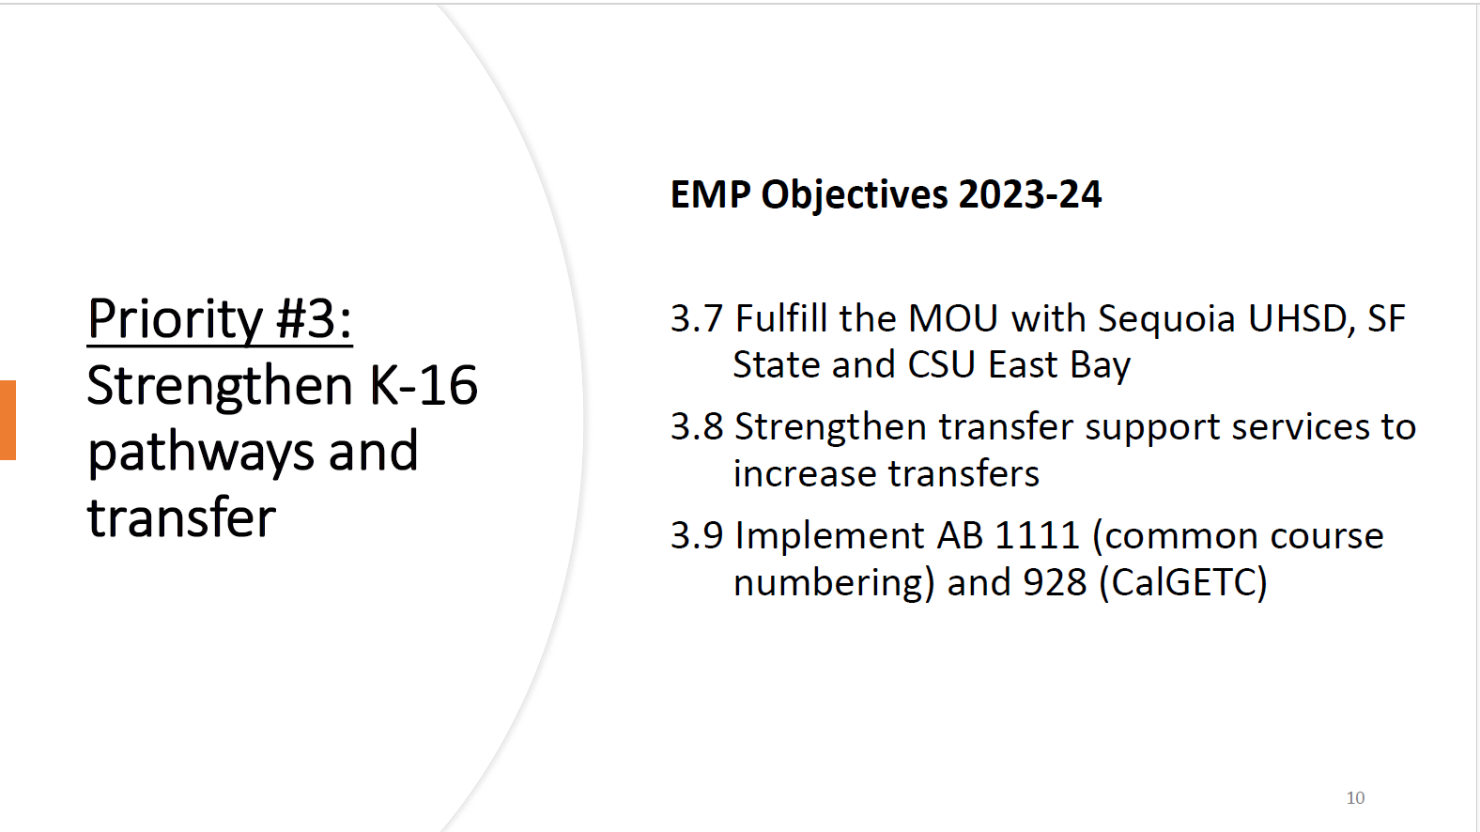
EMP Objectives

Slide 3
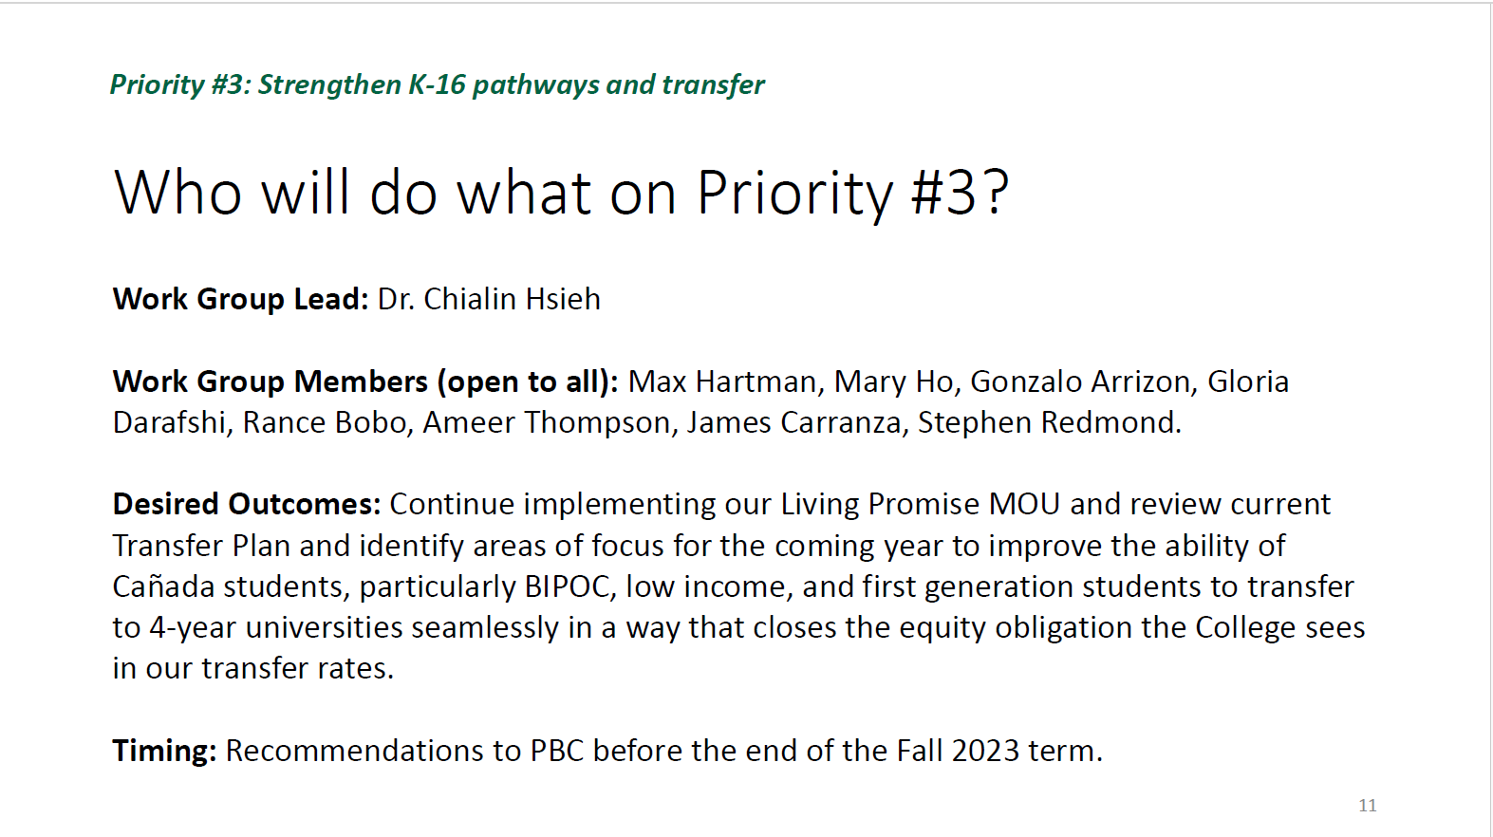

Slide 4
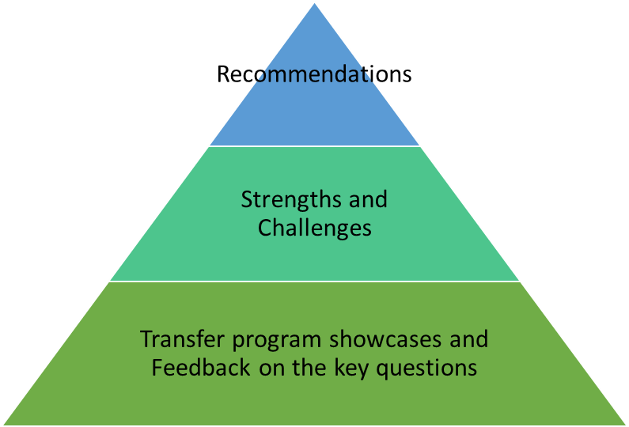

Notes:
Chialin

Slide 5
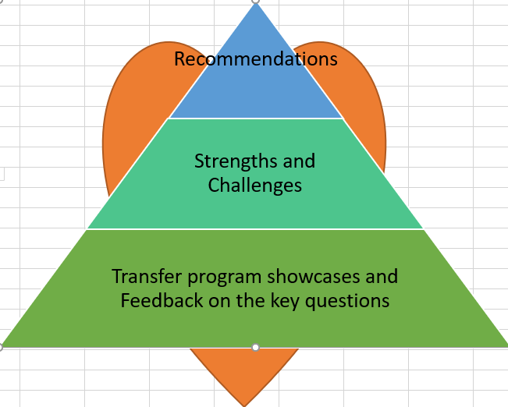
Process
Meeting 1: October 13
Guided Pathway
AB1705
Middle College
Promise
Puente
Living Promise MOU
Meeting 2: November 3
STEM/NSF
HTP
PTK
Umoja
Transfer Plan
Transfer Center
EOPS
TRIO
Athletics
Curriculum Committee
Meeting 3: November 17
Discussion
Recommendation
Three Meetings
October 13 from 11:00 to 1:00
November 3 from 1:00 to 3:00
November 17 from 1:00 to 3:00
3-4 Questions:
How does your program/services support transfer? (Please highlight 1-2 things).
What was the outcome?
What did we learn?
What do we need to enhance our transfer services? (i.e., better collaboration)
Membership: see the last slide. ~63 members
Notes:
Chialin
Forward-looking Framework for Reflection (feel free to pick and choose which questions you can answer)
How does your program/services support transfer? (Please highlight 1-2 things).
What was the outcome?
What did we learn?
What do you need to enhance your transfer services? (i.e., better collaboration)

Slide 6
Members
A total of 60+ members were invited
Each meeting had approximately 30 to 40 attendees, comprising both in-person and Zoom participants.
Faculty, Classified Professionals, and Managers
Student: Student Senate
Transfer Center: Max, Gloria, Mary, Gonzalo, James (PSC)
Transfer Plan responsible parties: Max, Gloria, Mary, Gonzalo, James (PSC), Soraya, Manuel
STEM/NSF: Rance, Sumathi, Ramakrishnan
Academic Senate leaders: David Eck, Gampi
Classified Senate leaders: Maria H, Alex C, Jeanne S
HTP: Rebekah, Susan, Sarah
PTK: Paul R, Gampi, Autumn
GP: David M, Denise, David M, Gampi, Ron, Retention Specialists (John, Diego, Jackie, Autumn), Counselors (Chris Rico, Daryan, Sandra Rodrigues, Gloria)
Middle College: Stephen
Promise: Mayra, Counselors (Danny Lynch, Kassie Alexander, Jessica Boyle), PSC (Ariela Villalpando, Mahitha Rao)
Umoja: Lezlee W, PSC (Lezlee Ta), Autumn, Mahitha, James
Puente: Yolanda, Sandra Mendez
EOPS: Lorraine Barrales-Ramirez, Jos Romero, Sarah Aranyakul
TRIO: Maria Huning, Candice Johnson
Athletics: Kat, Nick Martine, Erik Gaspar
Curriculum: Lisa P, Bob Lee, David M, Gloria, Frank
AB1705: Ray, Lisa Palmer, Michael Hoffman, Sumathi, Anniqua
EAPC rep: Kiran, Michiko, Krystal
Deans: James, Ameer, Anniqua, Karen, Hyla, Kat, Max, Wissem
A&R: Maria
Notes:
Chialin

Slide 7
Equity for Transfer
Mattering as a Core Concept
  Attendance Tracking and Communication
Decolonized Approaches
  Holistic Support for the Whole Student
Diversity and Relationship-building
  Faculty and Staff
Inclusive Campus Environment
  Cultural Center and Advertising
Notes:
Lezlee
Lezlee’s Equity Framing Summary
Mattering as a Core Concept: Lezlee emphasized the importance of mattering in education, defined as a dual concept involving feeling valued and adding value. This concept is integral to creating a supportive environment for students.
Attendance Tracking and Communication: Lezlee shared a practical strategy for actively tracking student attendance and sending emails to absent students. This approach proved effective in promoting attendance and emphasizing the importance of student voices.
Holistic Support for the Whole Student: The discussion highlighted the need for a holistic approach to supporting the entire student body, considering factors such as enrollment, campus connections, and affiliations with programs like Umoja, Puente, Promise, and others.
Diversity and Relationship Building: Lezlee underscored the significance of recruiting diverse faculty, especially those from underrepresented backgrounds. She emphasized the importance of establishing relationships with academic departments and neighboring universities to enhance diversity in teaching staff.
Inclusive Campus Environment: Strategies to create a welcoming and inclusive campus included proactive communication about available resources, such as free transportation and food pantries, and the use of banners and signage to celebrate diverse identities and communities. Lezlee also proposed the formation of a mental health team with diverse representation to address equity in mental health support.

Slide 8

Equity: Mattering Theme
Years of institutionalized educational inertia can cause students in general and Black students in particular to feel that they don’t matter to education and education doesn’t matter to them. We encourage our students to reclaim mattering and exercise agency as people who matter. Our curriculum fuses awareness of ongoing oppression, identity, and freedom, increases context, reflects what is urgent in the moment, and sees students themselves as a critical resource for our classes and program. (UMEF)
It’s a two-part definition: feeling valued and adding value. (NY Times – Dr. Flett - Psychology)
Mattering is a core, universal human need, a necessary component for well-being. (NY Times – Dr. Flett)

Slide 9
Recommendations—with Equity Lens
Our goal is to “decolonize transfer” and strengthen our support services so that our disproportionately impacted students including Black, Latinx, Polynesian, Native American, and first- generation as well as undocumented students, succeed in the transfer process.
Notes:
Lezlee

Slide 10
To Accomplish this, We will:
Enhance Collaboration and Streamline Administrative Processes:
  Foster improved communication and collaboration among departments, faculty, and programs
  Improve campus visibility through signage such as banners and electronic billboards
  Streamline administrative processes among programs to create a more efficient workflow
  Create better relationships with universities, including private and out-of-state, to create an alumni network for students
2. Establish Metrics and Data-Informed Decision-Making Processes:
  Measure and assess transfer-related initiatives and outcomes
  Use data-informed decision-making to guide program improvements
  Enhance the work with university partners, including private and out-of-state, to capture student transfer patterns
Notes:
Lisa/Gloria

Slide 11
To Accomplish this, We will:
3. Experiment with Course Time Frames:
  Continue implementing and assessing semester variations such as 8-week (“minimester”) or 12-week models
4. Support Transcript Evaluation Services:
  Advocate for resources to augment transcript evaluation service (TES), such as additional personnel and technological resources
Overall Theme:
The recommendations aim to address various aspects of the transfer process including collaboration, data utilization, course structure, and support for essential services like transcript evaluation. We emphasize a holistic approach to improving the overall transfer experience for students.
Notes:
Lisa/Gloria

Slide 12
Strengths—with Equity Lens
Early College Access Focus
Diversifying University Exposure
Enhancing Faculty Involvement
Data-Informed Decision Making
Alumni Network and Mentorship
Notes:
Just in case if PBC has questions on Strengths: Anniqua
Early College Access Focus:
There is strong support for initiatives related to early college access, particularly reaching out to first-year students intentionally.
This includes exposing them to transfer options in the first semester and creating expectations around transfer from the beginning.
Diversifying University Exposure:
The suggestion was made to broaden the exposure to transfer access by including more universities beyond UCs and Cal States.
This involves introducing students to a variety of programs, private schools, and HBCUs to provide a more comprehensive understanding of transfer options.
Enhancing Faculty Involvement:
There was a call for deeper collaboration with faculty members, especially in the context of faculty pods. This involves integrating discussions about college, transfer, and local institutions into the curriculum to better prepare students for the transfer process.
Data-Informed Decision Making:
The need for universal metrics and comprehensive data collection for transfer-related programs was emphasized.
This includes establishing benchmarks and goals for transfer success, analyzing programmatic comparisons, and regularly referring to these metrics to identify best practices.
Alumni Network and Mentorship:
Consideration was given to the creation of an alumni network to support students after they transfer.
This involves connecting students with mentors who have already transferred to provide guidance and support in the new academic environment.
These takeaways highlight key themes discussed in the meeting, encompassing early access strategies, diverse university exposure, faculty collaboration, data-driven decision-making, and post-transfer support through an alumni network.

Slide 13
Challenges—with Equity Lens
Communication Gap
Collaboration Gap
Transcript Evaluation Delays
Alignment of Local Degrees
Notes:
Just in case if PBC has questions on Challenges: Anniqua
1. Communication Gap:
There is a need for improved communication both internally among programs and externally with students.
Suggestions include better signage on campus, social marketing emphasizing transfer possibilities, and a shared vision for communication practices.
2. Collaboration Gap:
Collaboration among programs needs improvement, and there is an opportunity to share specific best practices for achieving transfer goals.
The importance of a shared goal and coordinated efforts was emphasized.
3. Transcript Evaluation Delays:
The delay in transcript evaluations, particularly for transfer-bound students, is a significant challenge.
The wait time for students to get their transcripts evaluated and placed on degree works was mentioned as being as long as 12 months.
Advocacy for improving this process, considering it a top priority, was suggested.
4. Alignment of Local Degrees:
There is a challenge in aligning local degrees, and the need for better alignment of courses within the district to streamline the evaluation process was highlighted.
Aligning courses more closely within the district was suggested as a potential solution to expedite the transcript evaluation process.
Overall Theme: The challenges discussed are interconnected, and addressing them requires a coordinated effort and shared commitment among faculty, programs, and the institution to enhance the transfer process for students.

Slide 14
Questions

Slide 15

Transfer taskforce
Fall 2023
Update 10.16.2023
Update 11.3.2023
Update 11.17.2023

Slide 16
OUTLINE
EMP Objectives
Process
Group slides followed by audience questions

Slide 17
EMP Objectives

Slide 19
Process
Meeting 1: October 13
Guided Pathway
AB1705
Middle College
Promise
Puente
Living Promise MOU
Meeting 2: November 3
STEM/NSF
HTP
PTK
Umoja
Transfer Plan
Transfer Center
EOPS
TRIO
Athletics
Curriculum Committee
Meeting 3: November 17
Discussion
Recommendation
Three Meetings
October 13 from 11:00 to 1:00
November 3 from 1:00 to 3:00
November 17 from 1:00 to 3:00
3-4 Questions:
How does your program/services support transfer? (Please highlight 1-2 things).
What was the outcome?
What did we learn?
What do you need to enhance your transfer services? (i.e., better collaboration)
Membership: see the last slide. ~63 members
Notes:
Forward-looking Framework for Reflection (feel free to pick and choose which questions you can answer)
How does your program/services support transfer? (Please highlight 1-2 things).
What was the outcome?
What did we learn?
What do you need to enhance your transfer services? (i.e., better collaboration)

Slide 20
Directions
Please scroll to the slide for your designated area and respond to the following questions: (Feel free to choose any questions you would like to showcase.)
How does your program/services support transfer? (Please highlight 1-2 things).
What was the outcome?
What did we learn?
What do you need to enhance your transfer services? (i.e., better collaboration)

Slide 21
Meeting 1: October 13
Introduction 2 min
Framing 10 min
Transfer Data sharing 10 min
Guided Pathway (5 min presentation & 5 min Q&A)
AB1705 (5 min presentation & 5 min Q&A)
Middle College (5 min presentation & 5 min Q&A)
Promise (5 min presentation & 5 min Q&A)
Puente (5 min presentation & 5 min Q&A)
Living Promise MOU (5 min presentation & 5 min Q&A)
Closing 5 min

Slide 22
Equity: Mattering Theme
Years of institutionalized educational inertia can cause students in general and Black students in particular to feel that they don’t matter to education and education doesn’t matter to them. We encourage our students to reclaim mattering and exercise agency as people who matter. Our curriculum fuses awareness of ongoing oppression, identity, and freedom, increases context, reflects what is urgent in the moment, and sees students themselves as a critical resource for our classes and program. (UMEF)
It’s a two-part definition: feeling valued and adding value. (NY Times – Dr. Flett - Psychology)
Mattering is a core, universal human need, a necessary component for well-being. (NY Times – Dr. Flett)

Slide 23
Framing
The opening remarks at the meeting covered several key points and actions to be taken during the discussion. These included:
Acknowledgment of Discussion Topics: Chialin introduced four questions for participants to consider during the meeting.
Program Invitations: Mention of programs and their invitations for the showcase was made, with a request for attendees to inform if any were missed so that they could be included.
Structured Timeline: A structured timeline for upcoming events was outlined, including plans for November presentations and recommendations.
Collaboration and Information Sharing: Emphasis was placed on gathering all relevant information in one place for ease of access and collaboration. An appreciative mention of Anniqua’s model for this purpose was made.
Connection to Transfer: The importance of connecting discussions and activities to transfer initiatives, particularly highlighting AB 1705 programs, was noted. Ray also highlighted the role of faculty in reflecting on their teaching and learning.
Focus on Equity and Professional Development: A commitment to incorporating equity and anti-racism considerations into discussions and an emphasis on professional development for improving practices and responding to student needs were discussed.
Inclusivity and Information Sharing: The importance of inclusive and informative conversations to facilitate growth and the need for considerations regarding flex days and the inclusion of additional presenters and sharing were highlighted.
The opening remarks set the tone for the meeting, stressing the importance of collaboration, structured timelines, data-driven decision-making, equity, and professional development in the context of transfer services.

Slide 24
Equity Framing
How can we decolonize our approaches to support transfer? Whole Student!
Applying what we already know and do . . . Student First
  College Theme: Mattering (Umoja)
  Layers of Equity/Student – What are we asking ourselves about students and transfer?
    High rates of success and retention leads to high rates of transfer
    If we help BIPOC/marginalized students, then we help all students (ie. Umoja, Puente, Promise)
  Creating a welcoming/inclusive environment for all
    Equity Trainings
    Staff Diversity – Recruiting Efforts through Relationship Building
    Cultural Center
    Really knowing our students and sharing that information:
      Faculty Layer: Providing student enrollment list with student's campus connections including academic counselor
      Counseling Layer: Intrusive and connected counseling
    Commuinication: Banners and Signage (ie Programs, Cultural/Identity Celebrations, Free Transportation)
    Mental Health Team (Redesign) - Representation

Slide 25
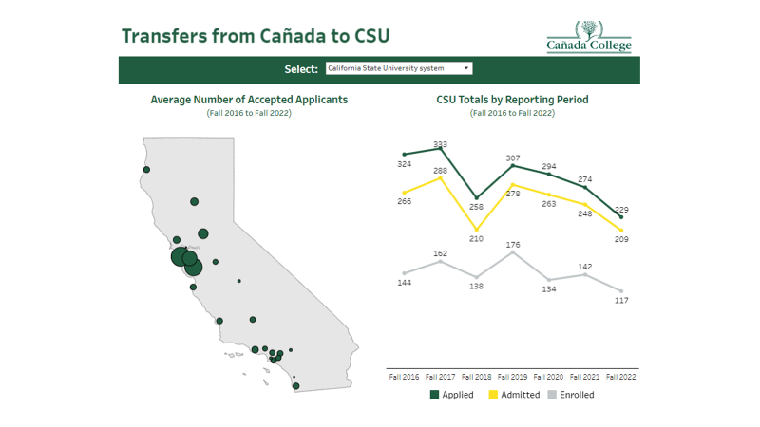
Transfer Data Sharing

Slide 26
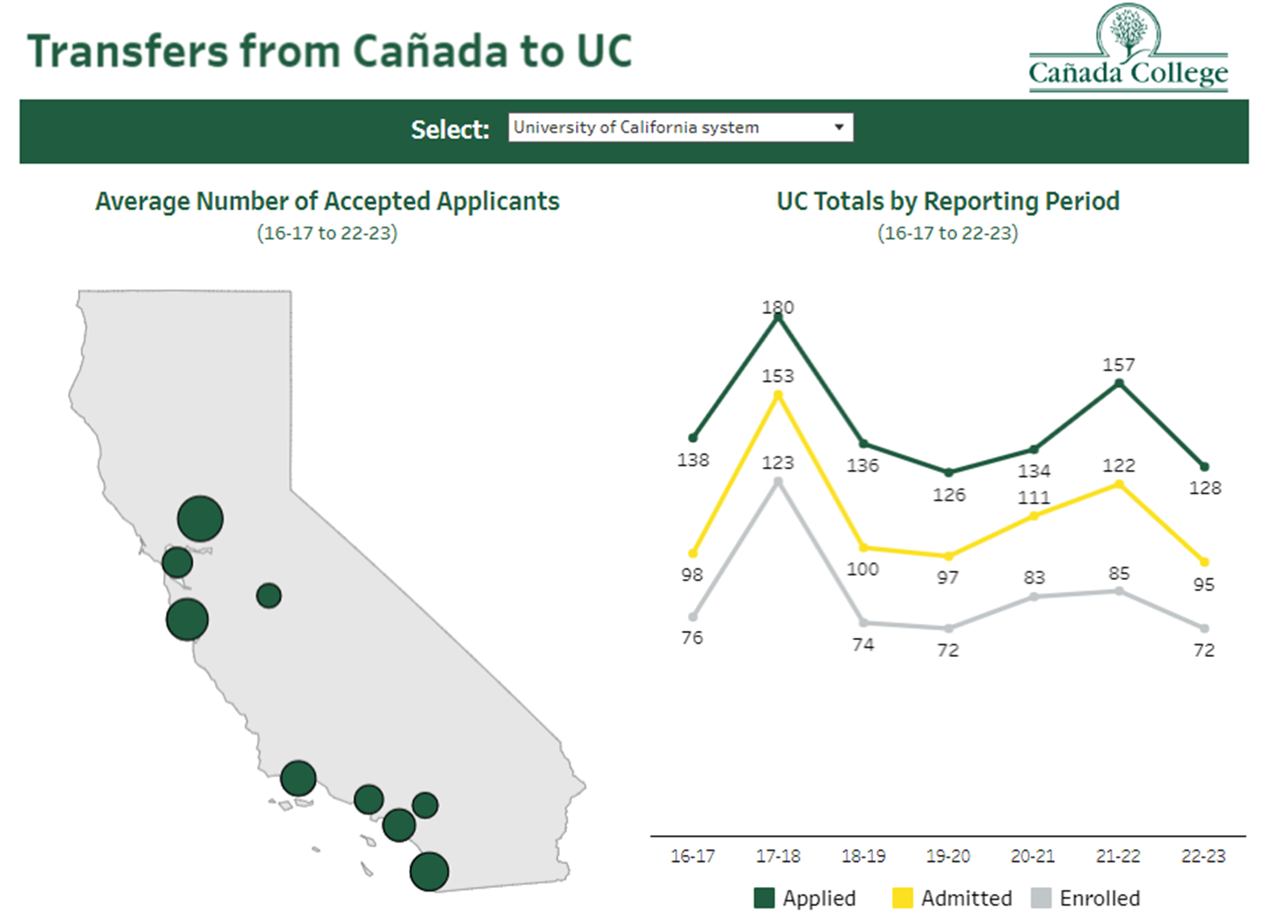

Slide 27
Total Annual Transferring Students
 | 2019-2020 | 2020-2021 | 2021-2022 | 2022-23
CSU Total | 176 | 134 | 142 | 117
UC Total | 72 | 83 | 85 | 72
In State Private | 27 | 18 | 15 | N/A
Out of State | 39 | 38 | 46 | N/A
TOTAL | 314 | 273 | 288
Sources: CSU and UC Transfer dashboards; CCCCO Data Mart/NSC for Private and Out of State data. The latter is not yet available for 2022-23.

Slide 29
Demographics of Transfer-Seeking Students: Fall 2023
Race/Ethnicity | % of all Transfer-seeking Students Fall 2023
American Indian/Alaskan Native | 0.2%
Asian | 7.0%
Black - Non-Hispanic | 3.5%
Filipino | 2.1%
Hispanic | 59.2%
Multiraces | 4.5%
Pacific Islander | 1.4%
Unknown | 3.7%
White Non-Hispanic | 18.5%
Gender | % of all Transfer-seeking Students Fall 2023
Female | 51.8%
Male | 44.6%
Unreported | 3.5%
Age | % of all Transfer-seeking Students Fall 2023
Age Under 18 | 1.2%
Age 18 - 22 | 60.2%
Age 23 - 28 | 17.0%
Age 29 - 39 | 13.0%
Age 40 - 49 | 5.7%
Age 50 - 59 | 2.2%
Age 60 + | 0.7%

Slide 30
Notes:
Of the 4,644 home campus students enrolled in Fall 2023, 1,950 (42%) are degree and transfer seeking. Those seeking a degree but not transfer are left out of this analysis.

Slide 31
Units Earned as of Fall 2023 | American Indian/ Alaskan Native | Asian | Black - Non-Hispanic | Filipino | Hispanic | Multi-races | Pacific Islander | Unknown | White Non-Hispanic
0.5 - 11.9 Units | 0% | 6% | 5% | 0% | 59% | 5% | 1% | 4% | 20%
12.0 - 23.9 Units | 0% | 8% | 3% | 2% | 61% | 5% | 1% | 4% | 17%
24.0 - 31.9 Units | 0% | 9% | 4% | 2% | 59% | 4% | 1% | 4% | 18%
32.0 - 44.9 Units | 0% | 10% | 2% | 3% | 56% | 4% | 2% | 2% | 21%
45.0 - 59.9 Units | 0% | 6% | 5% | 3% | 56% | 4% | 1% | 4% | 21%
60.0 - 64.9 Units | 0% | 7% | 3% | 2% | 55% | 3% | 2% | 3% | 24%
65.0 - 74.9 Units | 0% | 4% | 3% | 1% | 57% | 6% | 6% | 3% | 20%
75+ Units | 1% | 7% | 4% | 4% | 58% | 5% | 2% | 5% | 14%
Grand Total | 0.15% | 6.97% | 3.54% | 2.05% | 59.23% | 4.51% | 1.38% | 3.69% | 18.46%

Slide 32
Notes:
This slide compares the students who actually transferred in 2021-22 with all of those who had a transfer goal in the academic years 2018-2019 through 2020-2021.

Slide 33
Hispanic Transfer-Seeking Students are
disproportionately less likely to transfer
 | 2019-2020 |  |  | 2020-2021 |  |  | 2021-2022
Term Ethnicity Desc | Population | Transfers | Percent of pop who transfer | Population | Transfers | Percent of pop who transfer | Population | Transfers | Percent of pop who transfer | Equity Gap (PPG) | MoE
American Indian/ Alaskan Native | 15 | 1 | 6.7% | 15 | 1 | 6.7% | 11 | 2 | 18.2% | 8.8% | 29.5%
Asian | 1480 | 93 | 6.3% | 1676 | 161 | 9.6% | 1410 | 146 | 10.4% | 1.1% | 3.0%
Black - Non-Hispanic | 281 | 16 | 5.7% | 282 | 17 | 6.0% | 237 | 16 | 6.8% | -2.7% | 6.4%
Filipino | 571 | 51 | 8.9% | 744 | 55 | 7.4% | 660 | 62 | 9.4% | 0.0% | 3.8%
Hispanic | 4208 | 323 | 7.7% | 4183 | 287 | 6.9% | 3707 | 281 | 7.6% | -3.0% | 3.0%
Multiraces | 502 | 56 | 11.2% | 668 | 63 | 9.4% | 603 | 90 | 14.9% | 5.9% | 4.0%
Pacific Islander | 138 | 8 | 5.8% | 152 | 12 | 7.9% | 141 | 12 | 8.5% | -0.9% | 8.3%
Unknown | 725 | 28 | 3.9% | 528 | 42 | 8.0% | 420 | 27 | 6.4% | -3.1% | 4.8%
White Non-Hispanic | 2219 | 216 | 9.7% | 2481 | 257 | 10.4% | 2235 | 250 | 11.2% | 2.3% | 3.0%
Source: National Student Clearinghouse. Each year sums all students who transferred at any point within 4 years after leaving Cañada.

Slide 34
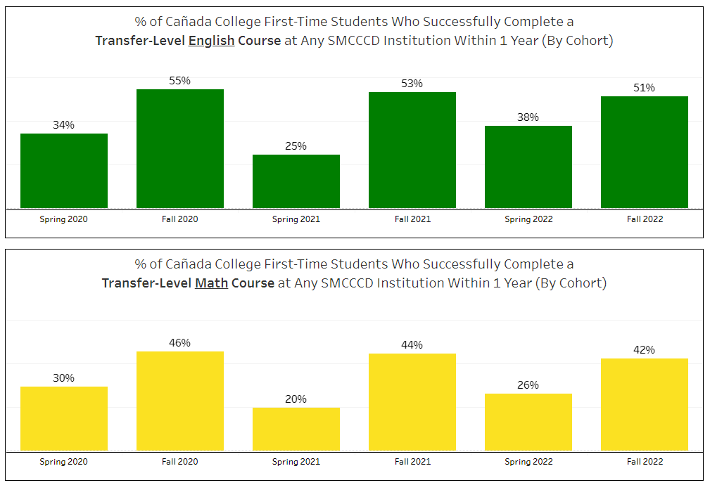
Transfer-seeking Students Only

Slide 35
TRANSFER ENGLISH
Race/Ethnicity | GPA Based on EH Test Codes | Number Enrolled in Fall 2021 | Completed Transfer Level Within 3 Terms of Fall 2021 | 1-Year Throughput Rate
Hispanic | Less Than 1.90 | 12 | 4 | 33.3%
Pacific Islander | Less Than 1.90 | 1 | 0 | 0.0%
Multiraces | Less Than 1.90 | 1 | 0 | 0.0%
Less Than 1.90 Subtotal |  | 14 | 4 | 28.6%
Asian | 1.90 - 2.59 | 2 | 1 | 50.0%
Black - Non-Hispanic | 1.90 - 2.59 | 4 | 1 | 25.0%
Filipino | 1.90 - 2.59 | 2 | 1 | 50.0%
Hispanic | 1.90 - 2.59 | 42 | 17 | 40.5%
Pacific Islander | 1.90 - 2.59 | 1 | 1 | 100.0%
White Non-Hispanic | 1.90 - 2.59 | 8 | 4 | 50.0%
Multiraces | 1.90 - 2.59 | 4 | 1 | 25.0%
Unknown | 1.90 - 2.59 | 2 | 0 | 0.0%
1.90 - 2.59 Subtotal |  | 65 | 26 | 40.0%
American Indian/Alaskan Native | 2.60 + | 1 | 1 | 100.0%
Asian | 2.60 + | 10 | 8 | 80.0%
Black - Non-Hispanic | 2.60 + | 3 | 2 | 66.7%
Filipino | 2.60 + | 8 | 3 | 37.5%
Hispanic | 2.60 + | 149 | 97 | 65.1%
Pacific Islander | 2.60 + | 4 | 4 | 100.0%
White Non-Hispanic | 2.60 + | 63 | 47 | 74.6%
Multiraces | 2.60 + | 13 | 12 | 92.3%
Unknown | 2.60 + | 4 | 2 | 50.0%
2.60 + Subtotal |  | 255 | 176 | 69.0%
Asian | Unknown | 17 | 16 | 94.1%
Filipino | Unknown | 4 | 3 | 75.0%
Hispanic | Unknown | 46 | 28 | 60.9%
Pacific Islander | Unknown | 1 | 0 | 0.0%
White Non-Hispanic | Unknown | 25 | 17 | 68.0%
Multiraces | Unknown | 2 | 2 | 100.0%
Unknown | Unknown | 16 | 9 | 56.3%
Unknown Subtotal |  | 111 | 75 | 67.6%

Slide 36
SLAM TRANSFER MATH
Race/Ethnicity | GPA Based on MH Test Codes | Number Enrolled in Fall 2021 | Completed Transfer Level Within 3 Terms of Fall 2021 | 1-Year Throughput Rate
Hispanic | Less Than 2.30 | 19 | 5 | 26.3%
Pacific Islander | Less Than 2.30 | 1 | 0 | 0.0%
White Non-Hispanic | Less Than 2.30 | 1 | 0 | 0.0%
Multiraces | Less Than 2.30 | 2 | 1 | 50.0%
Less Than 2.30 Subtotal |  | 23 | 6 | 26.1%
Asian | 2.30 - 2.90 | 2 | 1 | 50.0%
Black - Non-Hispanic | 2.30 - 2.90 | 2 | 1 | 50.0%
Hispanic | 2.30 - 2.90 | 22 | 7 | 31.8%
Pacific Islander | 2.30 - 2.90 | 2 | 0 | 0.0%
White Non-Hispanic | 2.30 - 2.90 | 7 | 6 | 85.7%
Multiraces | 2.30 - 2.90 | 1 | 0 | 0.0%
Unknown | 2.30 - 2.90 | 1 | 0 | 0.0%
2.30 - 2.90 Subtotal |  | 37 | 15 | 40.5%
American Indian/Alaskan Native | 3.00 + | 1 | 1 | 100.0%
Asian | 3.00 + | 3 | 2 | 66.7%
Black - Non-Hispanic | 3.00 + | 2 | 0 | 0.0%
Filipino | 3.00 + | 6 | 2 | 33.3%
Hispanic | 3.00 + | 57 | 31 | 54.4%
Pacific Islander | 3.00 + | 1 | 1 | 100.0%
White Non-Hispanic | 3.00 + | 20 | 12 | 60.0%
Multiraces | 3.00 + | 2 | 2 | 100.0%
Unknown | 3.00 + | 1 | 0 | 0.0%
3.00 + Subtotal |  | 93 | 51 | 54.8%
Asian | Unknown | 9 | 9 | 100.0%
Black - Non-Hispanic | Unknown | 4 | 1 | 25.0%
Filipino | Unknown | 6 | 5 | 83.3%
Hispanic | Unknown | 37 | 24 | 64.9%
Pacific Islander | Unknown | 1 | 1 | 100.0%
White Non-Hispanic | Unknown | 28 | 25 | 89.3%
Multiraces | Unknown | 6 | 4 | 66.7%
Unknown | Unknown | 3 | 1 | 33.3%
Unknown Subtotal |  | 94 | 70 | 74.5%

Slide 37
Notes:
This slide compares the students who actually transferred in 2021-22 with all of those who had a transfer goal in the academic years 2018-2019 through 2020-2021.

Slide 38
Notes:
This slide compares the students who actually transferred in 2021-22 with all of those who had a transfer goal in the academic years 2018-2019 through 2020-2021.

Slide 39
Notes:
This slide compares the students who actually transferred in 2021-22 with all of those who had a transfer goal in the academic years 2018-2019 through 2020-2021.

Slide 40
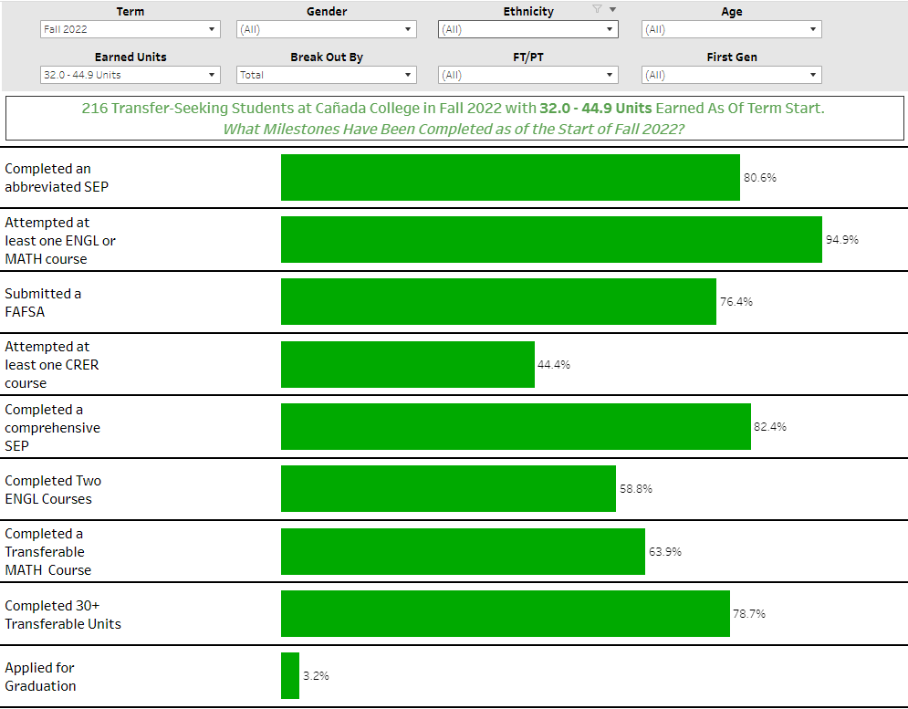
https://public.tableau.com/app/profile/smcccd/viz/CaadaTransferMilestones/TermSummary

Slide 41
Data Sharing Discussion Audience Questions/Comments
The conversation shifted towards a discussion on student transfers, the application and enrollment processes, potential barriers, and the need for follow-up support during transitions. Specific points covered included the decline in CSU applications in Fall 2018, the importance of PE requirements for some degree programs, and the challenge of tracking student transfers accurately. There was also mention of a need for mentorship programs to support students during their initial year at the transferring institution. Additionally, the question of scope in terms of institutional responsibility was raised, particularly regarding whether the responsibility extends to enrolled students or just those who are admitted.
How does your program/services support transfer?
Application Support: The institutions discussed how they assist students with the transfer application process, including guidance on required courses, eligibility, and degree plans.
Program and Major Alignment: Programs and services ensure alignment with the major requirements at the transfer institutions, particularly for high-unit majors such as engineering.
What was the outcome?
Challenges in Tracking Students: It was noted that tracking student transfers accurately can be complicated, and some students apply to multiple institutions, which can skew data.
PE Requirement Impact: The discussion highlighted that PE (Physical Education) requirements for some degrees might be acting as a barrier to students obtaining an associate degree.
What did we learn?
Mentorship and Transition Support: The importance of providing mentorship and support during the transition period from community college to a four-year institution was underscored.
Scoping Responsibility: There is a need to clarify the scope of responsibility in terms of whether it extends to enrolled students, admitted students, or both.
What do you need to enhance your transfer services?
Mentorship Programs: Consider implementing mentorship programs to support students during their initial year at transferring institutions, providing information on resources, financial aid, and enrollment.
Clarify Scope: Institutions need to clarify their scope of responsibility, including whether it extends to students who are admitted or enrolled in four-year institutions.
Better Data Tracking: Improving data tracking systems to accurately monitor student transfers and outcomes. Enhancing collaboration among institutions, particularly during the transition period, may also be beneficial to support students more effectively.

Slide 42
Data Sharing Discussion Audience Questions/Comments
Possible actionable steps based on the discussion:
How does your program/services support transfer?
Action 1: Enhanced Application Support: Improve and expand application support services for students by providing clearer guidance on the transfer application process, including eligibility criteria, required courses, and deadlines.
Action 2: Major Alignment Enhancement: Ensure that academic programs align closely with the requirements of transfer institutions, especially for high-unit majors like engineering, to facilitate a smoother transition.
What was the outcome?
Action 3: Improved Tracking Mechanisms: Enhance the tracking system for transferred students to account for those who apply to multiple institutions, allowing for more accurate data analysis.
Action 4: Address PE Requirement Barrier: Examine the impact of PE (Physical Education) requirements on degree completion and consider potential alternatives or adjustments to reduce this barrier for students.
What did we learn?
Action 5: Mentorship and Support Programs: Implement mentorship and support programs for students during the transition from community college to four-year institutions, ensuring they are well-informed about available resources, financial aid, and enrollment processes.
Action 6: Define Scope of Responsibility: Clarify the scope of responsibility regarding the level of support provided by community colleges, whether it extends to admitted students, enrolled students, or both.
What do you need to enhance your transfer services?
Action 7: Data Tracking System Improvements: Invest in and develop more effective data tracking systems to accurately monitor student transfers and outcomes, helping institutions make data-driven decisions.
Action 8: Collaboration Enhancement: Foster closer collaboration among community colleges, four-year institutions, and other relevant stakeholders, particularly during the transition period, to provide holistic support to students.

Slide 43
Interest Area Retention Support (Guided Pathways)
Retention support team acts as a conduit for information, leveraging the relationship with the student.
  Outreach to students to connect them with resources that supports their success like tutoring, or technology loans
  Encourage participation in enrichment activities like Honors Transfer, PTK, ASCC
  Utilize enrollment data to encourage students at unit milestones to connect with Counseling and Colts-U and get on the path to transfer.
The need is for greater integration of the Retention Team earlier in the onboarding process of students so that we can build those relationships with students in our areas.

Slide 44
Guided Pathway: Audience Questions/Comments
How does the program/service support transfer?
The program supports transfer by using retention specialists to build relationships with students, guide them through their academic journey, and connect them with resources for success, including transfer support. Additionally, they have an early alert system to identify struggling students and proactively offer assistance.
What was the outcome?
The outcome is active engagement with students, particularly those at risk of not meeting their transfer goals. It involves efforts to build relationships and communicate with students.
What did we learn?
The program learned the importance of establishing relationships with students early in their academic journey to gain their trust and provide effective support. Clear communication is crucial to improve student engagement in early alert systems.
What do you need to enhance your transfer services?
To enhance transfer services, the program needs to improve communication to ensure students are aware of who their retention specialist is and how to reach out for help. They should also consider ways to make students feel more comfortable seeking assistance, such as creating opportunities for faculty to connect with students outside of class. Additionally, ongoing research and strategies to improve student success in critical courses like English 105 are essential for better transfer services.
Possible Actions based on the provided information:
Improved Communication and Awareness: Develop a comprehensive communication plan to ensure students are aware of their assigned retention specialists and how to contact them. Provide clear and positive messaging about early alert systems to encourage students to seek assistance without fear of negative consequences.
Faculty-Student Engagement: Encourage faculty members to make themselves available to students before and after class for questions and support, as these interactions can foster relationships and better guidance. Implement strategies to address challenges related to stacked classes, where personal interactions may be limited, to ensure that all students have access to faculty support.
Research and Data-Driven Approaches: Continue research efforts to identify factors contributing to low success rates in critical courses like English 105. Use data and research findings to develop targeted interventions and strategies for improvement in these courses, potentially involving curriculum adjustments or additional support resources.
Integration and Collaboration: Promote better collaboration between retention specialists, faculty, counselors, and support services to create a more holistic and coordinated approach to student success. Consider the integration of early alert systems with other support programs and services to ensure a seamless and well-coordinated response when students are identified as needing help.
Student Outreach and Engagement Initiatives: Develop creative initiatives to engage students outside of academics, such as events and activities that are not solely focused on academics, to foster positive relationships. Leverage incentives like gift cards to encourage student participation and attendance, which can be an effective way to connect students with support services.

Slide 45
2. AB1705
Students need to succeed in math and English to transfer.
Post AB 705/1705, all students are placed into transfer-level English and math courses, but success rates for certain demographics are low (44% overall in English 105).
Faculty leads are formulating plans to improve student outcomes.
In spring 2024, the Faculty Learning Program (FLP) and AB 1705 support grant will be leveraged to enable faculty to research, design, implement, and assess innovative instructional and student support practices.
Our plans are collaborative, interdisciplinary, intra-district, and iterative.
They include collaborating with counselors, retention specialists, and instructional assistants to achieve our mutual goal of improving student success.

Slide 46
AB1705 Audience Questions/Comments
Scheduling observations:
  There is only one section of ENGL 105 offered in the evening?
  ENGL 105 is offered online at CSM and SKY?
  Students who are able to find a section that works with their schedule will take ENGL 100 or the online option at CSM or SKY.
  How about creating a LC ENGL 105 with CRER 401?
  Why do we no longer offer MATH 841 (for MATH 241)?

Slide 47
AB 1705 Audience Questions/Comments
How does the program/service support transfer?
Objective: The primary objective is to improve the success rate of students in math and English courses and facilitate their transfer post-Ab. 1705.
Challenges: The presentation highlighted a low success rate of only 44% in English 105 courses, indicating a need for improvement.
Initiatives: To address this issue, the program has secured funding from the Ab. 1705 support grant and the faculty learning program. They are actively working on strategies to improve success rates.
Collaboration: The program is collaborating with counselors, support services, and faculty to devise strategies to enhance the transfer experience for students.
What was the outcome?
The presentation did not explicitly mention specific outcomes or results. However, it is implied that the initiative is in its early stages of implementation, focusing on developing and implementing strategies to address the low success rates.
What We Learned:
Emphasis on the need for change and improvement in student success rates.
Recognition of the importance of collaboration between faculty, counselors, and support services.
Acknowledgment that student-faculty relationships play a crucial role in student success.
Enhancements Needed for Transfer Services:
Acknowledgment that faculty availability after class is effective.
Suggested giving faculty time to interact with students before and after classes.
Addressing challenges when classes are stacked, hindering student-faculty interactions.
Improved Collaboration:
Mentioned collaboration with counselors and support services, but the specific strategies need further enhancement.
Identifying areas where collaboration can be strengthened to better support students.
In summary, the program is focused on addressing the low success rates of students in math and English courses and improving transfer outcomes. They have received funding and are actively collaborating with various stakeholders to develop effective strategies. However, the presentation did not provide specific data on the outcome of these efforts or details on any additional enhancements needed for transfer services.

Slide 48
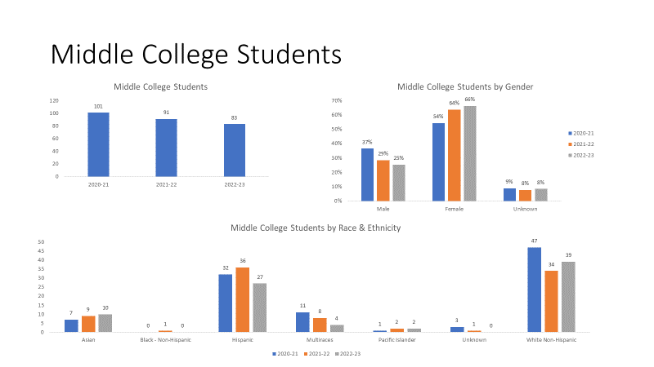
3. Middle College

Slide 49
Middle College Audience Questions/Comments
How does it support transfer?
The Middle College program, a collaboration with the Sequoia Union High School District, targets eleventh and twelfth graders. It allows students to earn college credits while completing their high school diploma, enabling them to graduate with 40 to 50 college credits. The goal is to expand the program, thereby increasing the number of students introduced to early college experiences. The program focuses on fostering a positive perception of transfer as an advantageous pathway for students.
What was the outcome?
The Middle College program successfully provides high school students with the opportunity to accumulate college credits before entering higher education. In the previous year, the program had 83 students, and it aims to add 10 more students in the coming semester.
What did we learn?
One key insight is the need to change the perception of transfer. Many students view transfer as a negative outcome, which the program aims to transform into a positive opportunity. This requires educating students about the benefits of transfer and creating awareness about available transfer pathways.
What do you need to enhance your transfer services?
To enhance their transfer services, the Middle College program should work on better integrating with Cañada College and improving communication about the program's benefits. The program should also expand its dual enrollment and history courses, expose students to more college opportunities, and ensure that high school students understand the requirements and advantages of early college participation. Additionally, the program should proactively engage with students in underrepresented areas, such as East Palo Alto and Belhaven, and actively target adult schools to provide more specific programs for adults interested in higher education. As the program expands, it should consider acquiring more suitable space on the Kenyatta College campus to improve integration and accessibility for participating students.
Possible Actions based on the provided information:
Promote the Benefits of Transfer: Develop an outreach strategy to educate high school students about the advantages of transfer, emphasizing that transfer is a valuable option even if they don't gain direct admission to a four-year institution. This includes conducting workshops, informational sessions, and partnering with high schools to facilitate these conversations.
Expand and Improve Communication: Enhance communication efforts between the Middle College program and high school students, their families, and local communities. This includes creating pathways and course plans early on, clearly articulating the value of college courses, and clarifying how students can benefit from college-level coursework. Improved communication can change the perception of college readiness among high school students.
Diversify Course Offerings: Expand dual enrollment and early college opportunities, introducing a variety of courses, including history courses, that appeal to high school students. The goal is to provide a wider range of options, making it more attractive for students to participate in early college programs, ultimately increasing the likelihood of transferring to a higher education institution.
Proactive Engagement in Underserved Areas: Initiate targeted outreach in underrepresented areas, such as East Palo Alto and Belhaven, to ensure that students in these regions are aware of and have access to the Middle College program. This may involve collaborating with local schools, community organizations, and creating specific programs tailored to the needs of students in these areas.
Optimize Space for Expansion: As the Middle College program plans to double its enrollment, the program should consider acquiring more suitable space on the Kenyatta College campus. This space should be strategically located to improve integration and accessibility for participating students, ensuring they feel part of the college community.
Leverage Transfer Guarantees: Ensure that students are aware of transfer guarantee programs offered by universities. Facilitate communication with high schools to inform students about these programs, where they can secure admission to a four-year institution from the beginning of their college journey, provided they meet specific criteria.

Slide 50
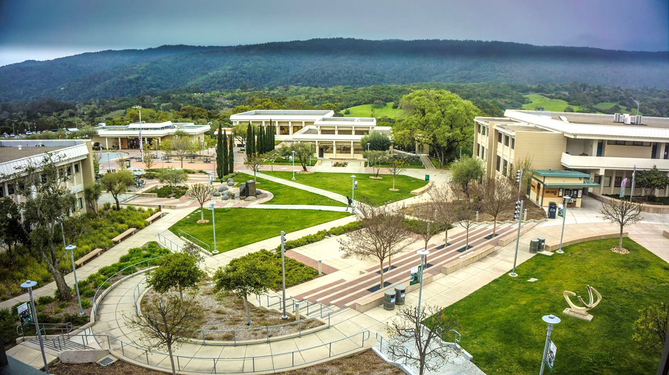


Slide 51
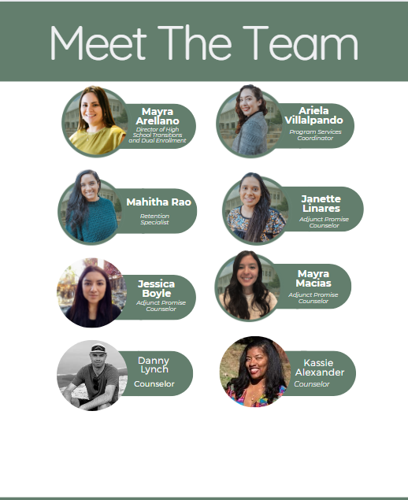


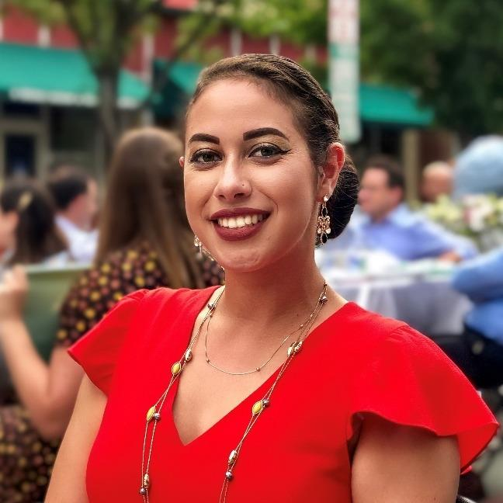
Promise Scholars Team
Daryan
Chan
Counselor
Jilian
Gomez
Counselor
Notes:
Mayra

Slide 52
Evolution of PSP
Enrollment Numbers | Fall 2018 | Fall 2023
 | 327 - FT Program | Total: 617 576 - FT Program 27 - Leave of Absence 41 - PT Program 6 - Leave of Absence
Notes:
Mayra

Slide 53

Demographics
AY 2022-2023 | PT Promise | FT Promise | College Comparison
American Indian/Alaskan Native | 0% | 0% | < 1%
Asian | 0% | 5% | 14%
Black Non-Hispanic | 12% | 5% | 3%
Filipino | 4% | 1% | 6%
Hispanic | 60% | 65% | 41%
Multiraces | 0% | 4% | 6%
Pacific Islander | 4% | 2% | 2%
Unknown | 8% | 2% | 4%
White Non-Hispanic | 12% | 16% | 24%
Notes:
Karen

Slide 54
Demographics
AY 2022-2023 | PT Promise | FT Promise | College Comparison
Average Age | 38.6 | 20.0 | 27.8
Median Age | 35.5 | 19.0 | 23.0
Female | 88% | 52% | 57%
Male | 4% | 44% | 40%
Low Income | 48% | 48% | 23%
First Generation | 80% | 72% | 48%
College for Working Adults (CWA) | 58% | 1% | < 1%
Avg. Units Entering | 38.0 | 16.8 | 35.7
Avg. Units Attempted | 11.7 | 21.9 | 14.1
Avg. Units Completed | 7.2 | 14.2 | 10.0
Notes:
Karen

Slide 55
Programs of Study by Interest Area
AY 2022-2023 | PT Promise | FT Promise | College Comparison
Art, Design, and Performance | 8% | 14% | 6%
Business | 31% | 18% | 11%
Human Behavior and Culture | 50% | 21% | 17%
Science and Health | 8% | 36% | 14%
CSM/SKY Program | 0% | 6% | 16%
Undecided/University Transfer | 4% | 4% | 37%
Notes:
Karen

Slide 56
Pillars of Promise Scholars Program
Counseling
First Year
Experience
Graduation/
Transfer Support
Career/
Major Exploration
Probation Students/
Early Alert
CRER 401:
College Success
Welcome Day
First Year Workshops by Promise Counselors and Cañada Departments
Time Management/
Study schedule check-ins with RS
CRER 110:
Transfer center workshops
Scholarship Support
Alumni panels
Field Trips
Job search resources
CRER 137
Career Center Job Fair/
Internship Fair
Promise hosted Interest Area workshops
Speaker series
Retention Specialist Support
Probation workshops
Tutoring referrals
Other student services
The Root of our Work: Anti-Racism and Equity Practices
Notes:
Mahitha

Slide 57
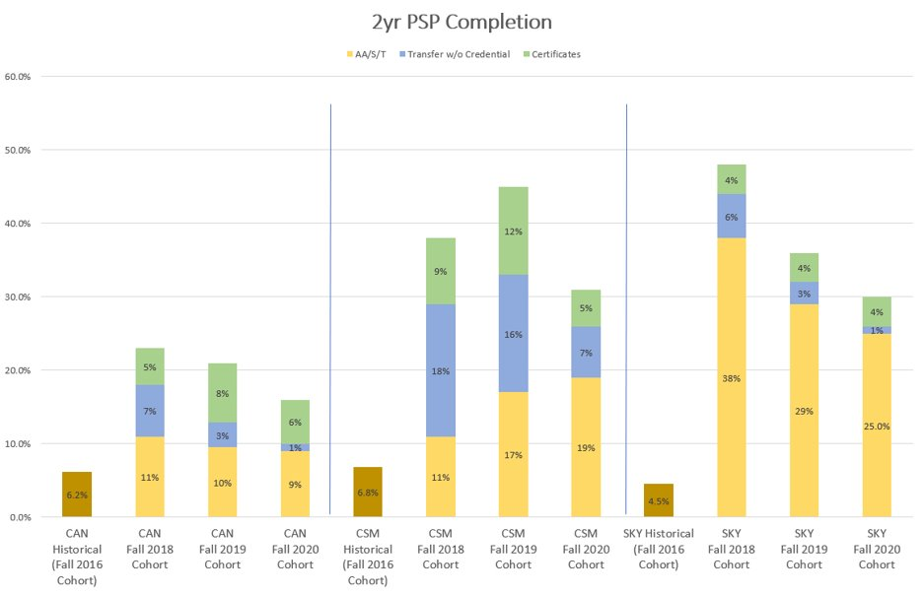
Early Successes​- 2 year Completion Rates
Notes:
Janette

Slide 58
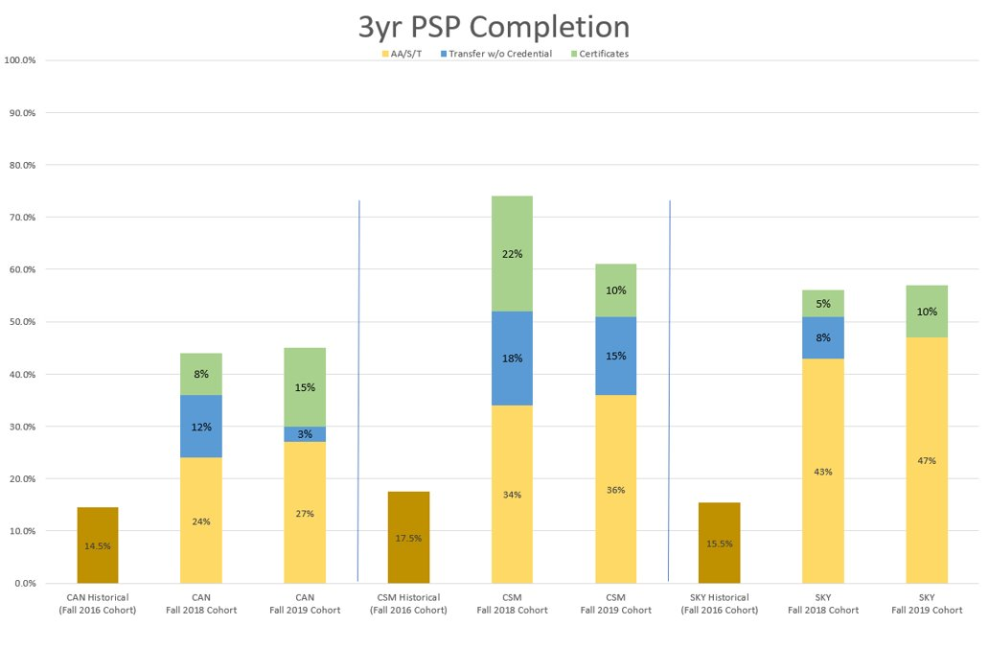
Early Successes​- 3 year Completion Rates
Notes:
Janette

Slide 59

Caseload Management for Counselors
Need based, student-centered approach
Data driven
Emphasis on retention and engagement
Specific benchmarks (i.e career, transfer, financial, etc.)
Culturally responsive programming
CRER 410: Transfer Essentials
Notes:
Janette

Slide 60
Promise Audience Questions/Comments
How does your program/services support transfer?
The Promise Program at Cañada College offers various services and support for transfer students, including career courses, transfer workshops, scholarship support, alumni engagement, field trips, internship opportunities, and job assistance.
What was the outcome?
The completion rates for Promise students have shown improvement over the years, with a 2-year completion rate of 6% for Fall 2020 and a 3-year completion rate of 15% for Fall 2019.
What did we learn?
The program takes a student-centered approach, uses data to inform decision-making, and focuses on retention and engagement to ensure students complete their degrees or certificates on time.
What do you need to enhance your transfer services?
The presentation highlights a need for better collaboration with other programs and departments to ensure that Promise students have access to resources and support beyond the program's offerings. Additionally, there is a suggestion to investigate the success of Promise students in their initial English and math courses and consider replicating this model for non-Promise students.
Possible Actions based on the provided information:
Analyze First-Year Success: Evaluate the success rates of Promise Program students in their initial English and math courses compared to non-Promise Program students. This analysis can provide insights into the impact of the program and help identify strategies that can benefit a broader student population.
Long-Term Tracking: Continue to track Promise Program students beyond the expected 3-year completion period. Analyze the outcomes for students who don't complete within the expected timeline. Explore ways to support these students, including potential transfer pathways, additional support services, or alternative education plans.
Collaboration and Data Sharing: Foster greater collaboration between the Promise Program and other departments, such as the Transfer Program or EOPS, to ensure a holistic approach to student success. Share data and insights to identify opportunities for shared support services, workshops, and resources.
Further Improve Undecided and Transfer Support: Given that some students remain undecided about their majors and transfer pathways, develop strategies to assist them in making informed decisions. Offer resources, workshops, and counseling to guide students toward suitable majors and prepare them for successful transfers.
Early Alert and Retention Strategies: Continue to focus on early alert systems and retention strategies to proactively address students who may be struggling or at risk of not completing within the expected time frame. Implement interventions to support their academic progress and personal development.
Continuous Program Evaluation: Regularly evaluate the Promise Program's effectiveness and adjust strategies based on the evolving needs and demographics of the student population. Ensure that the program remains adaptable and responsive to student needs.

Slide 61
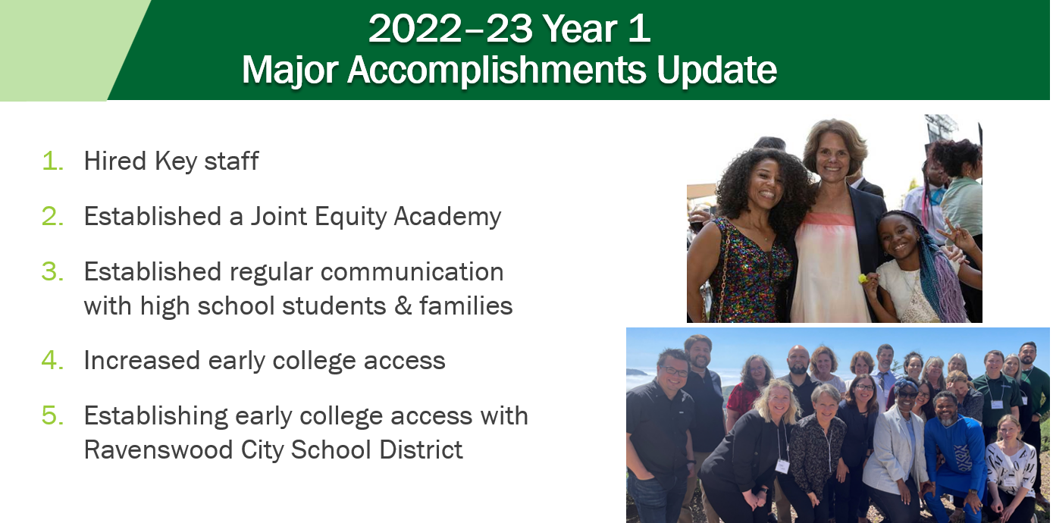
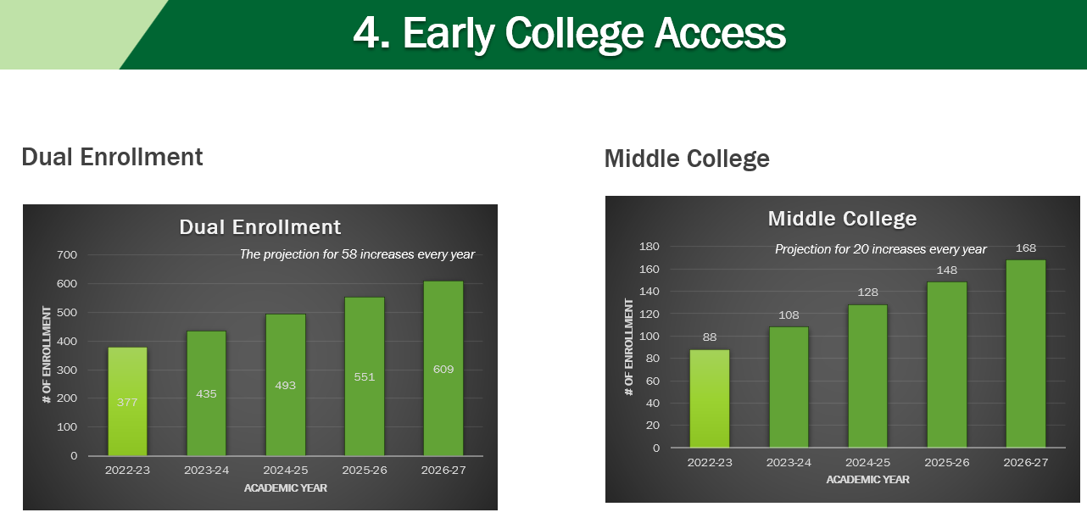
8. Living Promise MOU
Notes:
July 2022: Executive Director Middle College/College and Career, Stephen Redmond
July 2022: Student Success Liaison, Louisa Song
July 2023: Counselor, Lisa McCahon
•Spring 2022: Two-day retreat with 15 participants
• Spring 2023: Two-day retreat with 20 participants
• Fall 2023: Two-day retreat with 80 participants
• Spring 2024: Two-day retreat
• Summer 2024: Two-day retreat
·Graduating Seniors (2,200) received an acceptance letter from Cañada College
·Juniors and Seniors (4,400) received a letter from Cañada College to participate in the Concurrent Enrollment Program
·Seniors submitted FAFSA or DREAM Act
Applications for 2020-21, 2021-22, and 2022-23
o2022–23: 73% submitted
o2021–22: 58% submitted
o2020–21: 57% submitted
2023-24: Year Two
§Continuing work from Year One
§Establishing early college access to Ravenswood City School District students
2024-25: Year Three
§Continuing work from Year One and Year Two
§Developing pathway with Sequoia District Adult School
§Developing transfer pathway from Cañada to SFSU and CSU East Bay

Slide 62
Living Promise MOU Audience Questions/Comments
Program/Services Supporting Transfer:
The program, called the Living Promise MOU, is a collaboration between Cañada College, Sequoia Union High School District, Ravenswood City Schools, San Francisco State, and Cal State East Bay. Its primary focus is on early college access for high school students, particularly through dual enrollment and middle college programs. These programs aim to expose high school students to college-level courses and provide them with a head start on the transfer route.
What was the outcome?
It was to double of the size for Middle College and increase 2 dual enrollment courses every academic year. It is clear that there has been progress in implementing the dual enrollment and middle college programs, as well as an increase in the number of students participating. Success rates for students in the dual enrollment program are notably high, with an 83% completion rate. The program is moving toward its goal of doubling the Middle College program within the next 3 to 4 years.
What We Learned:
The conversation highlights the importance of early intervention and support for high school students. It emphasizes that many high school students do not have a clear plan for their educational path and may benefit from early exposure to college coursework. There is recognition that these students need guidance on what is required to succeed in college, including understanding assignments outside the classroom. Additionally, there is an understanding that collaborative efforts are necessary to ensure the success of these programs.
Enhancements Needed for Transfer Services:
To enhance transfer services, the following areas need attention:
Space Planning: As the middle college program expands, there is a need for early planning to accommodate the growing number of high school students on the college campus. This includes finding appropriate, integrated space for these students.
Communication and Integration: Efforts should be made to better integrate dual enrollment students into the Cañada College community and ensure they are aware of the college's offerings. More proactive communication is required to establish Cañada as a primary choice for these students.
Resource Allocation: As the programs grow, allocate additional resources, such as staff and support services, to meet the needs of an increasing number of students.
Student Outreach: Continue efforts to promote the benefits of dual enrollment and early college access to high schools and students, emphasizing that college is a viable path for a wide range of students.
Planning and Evaluation: Develop a clear plan for program expansion, including timelines and resource allocation. Regularly assess the success of the dual enrollment program and make adjustments as needed to improve outcomes.

Slide 63
Closing
In the closing remarks, Paul expressed gratitude for the positive reception of Ray's input and emphasized the challenges in improving transfer services. Key points in the closing remark include:
Acknowledgment of Challenges: The speaker recognized the difficulties in making decisions about programs and services, often involving trade-offs and the need to choose strategically.
Historical Perspective: The speaker, with 30 years of experience, reflected on the numerous initiatives and efforts that have been tried in the past to improve transfer rates.
The Need for Evidence: There was an emphasis on the importance of measuring the effectiveness of these initiatives and the challenge in finding the necessary data to assess their impact.
Openness to Change: The speaker encouraged a willingness to reconsider traditional approaches that may no longer be effective.
Collective Goal: Highlighted the shared goal of increasing transfer rates and recognized it as a challenge not limited to a specific institution but a statewide issue.
The closing remarks underscored the importance of reevaluating approaches, measuring outcomes, and working collaboratively to address the challenge of improving transfer rates in a broader context.

Slide 64
Meeting 2: November 3
Introduction 2 min
Framing 10 min
STEM/NSF/TRABAJO (5 min presentation & 5 min Q&A)
HTP (5 min presentation & 5 min Q&A)
PTK (5 min presentation & 5 min Q&A)
Umoja (5 min presentation & 5 min Q&A)
Transfer Plan (5 min presentation & 5 min Q&A)
Colts-U Transfer Center (5 min presentation & 5 min Q&A)
  (a) Transfer services and support, (b) Articulation, and (c) University Programs: AANAPISI ARC Transfer Pathway to SF State and NDNU B.A. Degree Completion programs
EOPC (5 min presentation & 5 min Q&A)
TRIO (5 min presentation & 5 min Q&A)
Athletics (5 min presentation & 5 min Q&A)
Curriculum Committee (5 min presentation & 5 min Q&A)
Closing 2 min

Slide 65
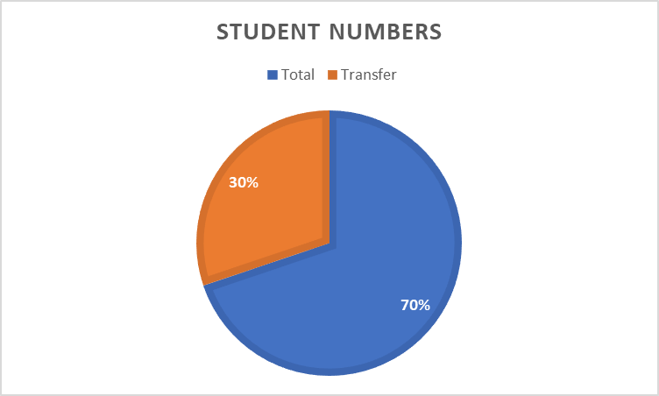
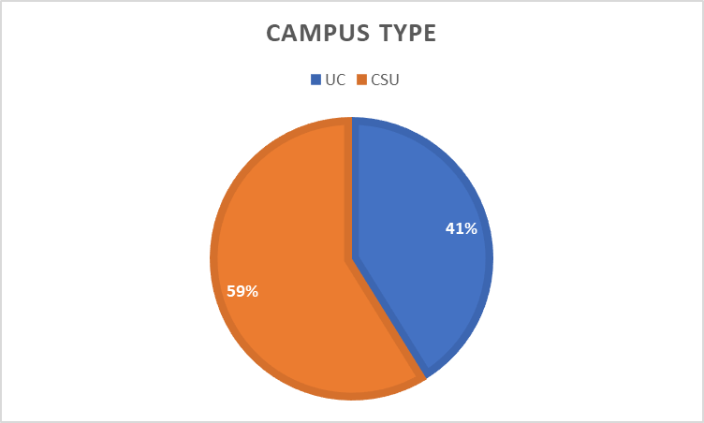
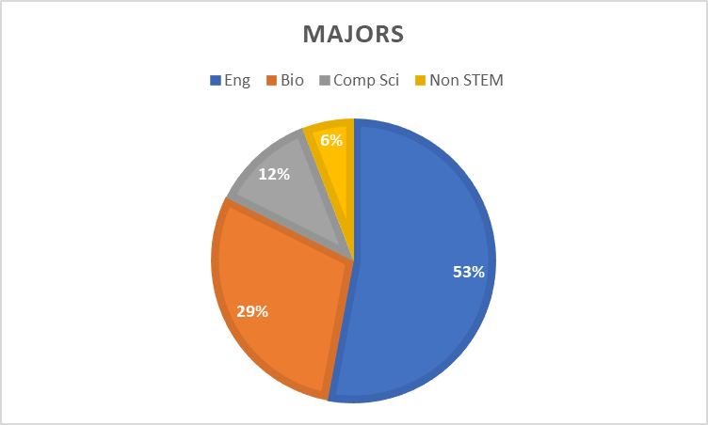
1. STEM/NSF/TRABAJO
TRABAJO – Training and Research Activities to Better Access Job Opportunities

Slide 66
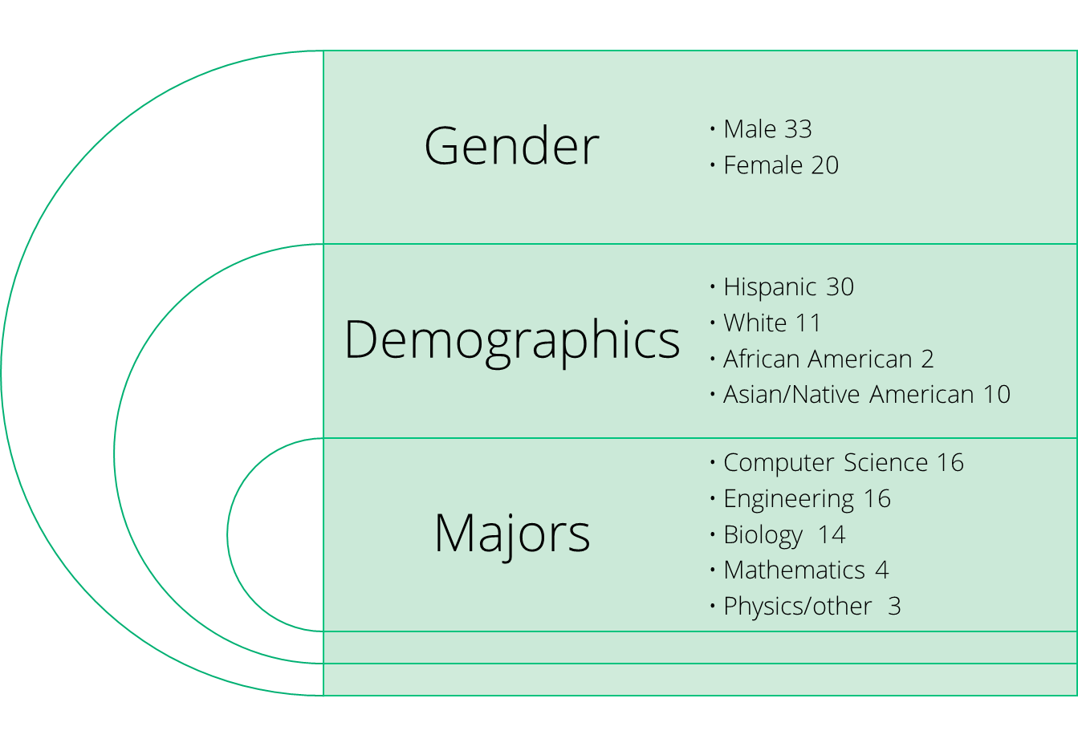
STEM/NSF(ASCENT)/TRABAJO
NSF ASCENT (Achieving Success in College through Education, Network and Transfer​
Project Accomplishments
53 Scholars so far
43 Transferred to UC/ CSU
7 getting ready to transfer in Spring 2024
https://canadacollege.edu/nsfscholar/

Slide 67
STEM/NSF/TRABAJO Questions/Comments
STEM/NSF/TRABAJO
1. How does your program/services support transfer? (Please highlight 1-2 things).
The meeting discussed a program funded by the National Science Foundation (NSF) aimed at increasing the number of students from low-income backgrounds and underrepresented minorities in STEM fields who complete their education and transfer to four-year universities. The program provides financial support in the form of scholarships to reduce the need for students to work long hours, thus enabling them to focus on their studies. This financial aid has led to a decrease in the number of hours students work and an increase in their GPAs. Additionally, the program pairs students with faculty mentors and provides them with a retention specialist who offers one-on-one support, helps with resumes, identifies resources, and assists with applying for colleges, scholarships, and internships.
2. What was the outcome?
The program has seen positive outcomes, with a significant number of students successfully transferring to four-year institutions. The meeting mentioned that out of 53 students in the program, 43 had already transferred to either CSUs or UCs, and seven more students were preparing to transfer. The financial support, faculty mentorship, and retention specialist assistance have contributed to these successful outcomes.
3. What did we learn?
The meeting emphasized the effectiveness of the program in reducing financial barriers and supporting students in their STEM education. It showed that financial aid, mentorship, and one-on-one support can help students not only complete their education but also transfer to higher-level institutions. The presentation also highlighted the importance of providing resources and opportunities for students, such as scholarships and internships, to further their education and careers.
4. What do you need to enhance your transfer services? (i.e., better collaboration)
The meeting didn't explicitly address this question, but it's essential to consider that continued funding and support for the program will be necessary to maintain and expand its success in helping students transfer to four-year universities. Additionally, ongoing collaboration with faculty mentors, retention specialists, and other relevant stakeholders is essential to provide students with the best possible support.

Slide 68
2. Honors Transfer Program (HTP): How does the program/service support transfer?​
Opportunities for all students to be engaged in high caliber meaningful honors projects -signature assignments key for minoritized students
Notation on transcript of Honors course work for all students. “Evidence of enhanced rigor” for transfer institutions
Student individual work with faculty in honors courses and contracts often leads to strong letters of recommendation for transfer applicants
Honors work can be discussed in the personal insight questions contributing to the strength of student applications for transfer
Student completion of HTP significantly increases their chances of transfer
Student completion of HTP significantly increases access to scholarships and financial aid at transfer institutions
Notes:
Course Enrollments (at census)
2017/18: 215
2018/19: 202
2019/20: 246
2020/21: 177
2021/22: 219
F22: 65 sp?
Fall 23: 68 spring not in yet
Honors Contract Proposals
2017/18: 54
2018/19: 67
2019/20: 59
2020/21: 51
2021/22: 41
Fall 23: 36 (only the fall. Spring not in)
HTP Student Membership
Sp18: 52
Sp19: 78
Sp21: 100
Sp22: 108
Sp 23: 120?
Fall 23 88 (spring 24 not in)
With new GPA 433 eligible students

Slide 69
2. HTP: What do you need to enhance your transfer services?​
More support for faculty doing contracts so students have more options – Honors Contract Faculty Professional Development Mentor Program
More honors only courses so honors students have the benefit of a cohort*
Continued funding of Honors Student Ambassador to help share information via office hours, events, presentations, flyers, videos, & social media with Promise, Puente, Umoja, EOPS, TRIO, Athletics, ESL, International Student Center, Undocumented CC, and STEM and Latinx events, and BIPOC students across the college and at local high schools.
Continued promotion and two sections of IDST 150 Honors Research Seminar
  IDST Video by Honors student Arya Shadan. IDST Video by HTP Coordinator
Better tracking and systems in collaboration with others in Transfer and PRIE
  Intent to transfer form, Calendly, formstock, canhonors, google sheets,
  Help from PRIE sorting applicant info. Reconsideration of CC and IPC
  Dedicated Honors Counselor and Program Assistant (maybe with others in Transfer?)
  *Marketing for honors courses (Newsletter, flyers, social media, planning a year ahead)

Slide 70
Honor’s Program Audience Questions/Comments
Honor’s Program
1. How does your program/services support transfer? (Please highlight 1-2 things).
The Honors Transfer Program provides opportunities for all students to engage in high-caliber, meaningful honors projects. These projects offer students choices that are meaningful, relate to their lives, and enhance their applications to transfer institutions. When students complete honors work, they receive notations on their transcripts, signifying enhanced rigor, which gives them an advantage during the transfer process. Additionally, individual work with faculty often leads to strong letters of recommendation, contributing to the strength of students' applications.
2. What was the outcome?
Completing the Honors Transfer Program significantly increases students' chances of transfer. Students who complete the program have higher acceptance rates at transfer institutions, including prestigious universities such as UCLA, Uc Irvine, and Yale. Furthermore, completion of the program enhances students' access to scholarships and financial aid, significantly benefiting those seeking to close the equity gap for transfer.
3. What did we learn?
The program has learned that offering signature assignments and individual faculty support through honors projects leads to increased success in transferring. It has also found that the program's enhanced rigor notation on transcripts and strong letters of recommendation positively impact students' transfer prospects. Moreover, the program's partnership with various colleges and universities allows students to benefit from increased financial aid and scholarship opportunities.
4. What do you need to enhance your transfer services? (i.e., better collaboration).
To enhance the transfer services, the program needs more support for faculty to assist students in completing quality honors contracts. This includes a request for a faculty professional development mentorship program that will offer compensation to faculty members involved in supporting students through contracts. Additionally, more honors-only courses are needed to provide students with a cohort experience. The program aims to continue funding the honor student ambassador role and emphasizes the importance of reaching out to various student groups and collaborating with other programs to ensure that honors is accessible to all students. Improved tracking and systems are also in development, with an emphasis on efficient administrative work and better marketing strategies to attract more students to the program.

Slide 71
3. Phi Theta Kappa PROGRAM - PTK

Slide 72
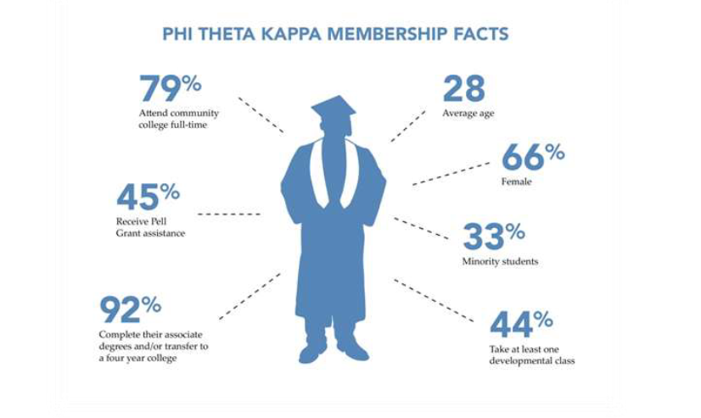
Typical PTK Honors Student

Slide 73

PTK HONORS Program
  SMCCD District-wide #s for TRANSFER
A recent study revealed that Phi Theta Kappa members have a student success rate of 92% (85% completion rate and 7% transfer-out rate), which is three times higher than that of the average community college student. Moving forward, Phi Theta Kappa will continue to seek ways to strengthen its support of transfer-bound students.***
*** https://www.insidehighered.com/sites/default/files/files/Completion_high_achieving_community_college_completion_transfer_outcomes_020216.pdf
Notes:
Recommended re-wording of agenda:
1.)Where we are now
Impasse Declared by district
2 Unfair Labor Practices (ULPs)
What action(s) can be taken moving forward
Make a decision on ratification
Union Steward System and its benefits (especially at this point in negotiations!)
How can we make the stewart- facilitate communication work in your department?
Sign up to be a steward!

Slide 74
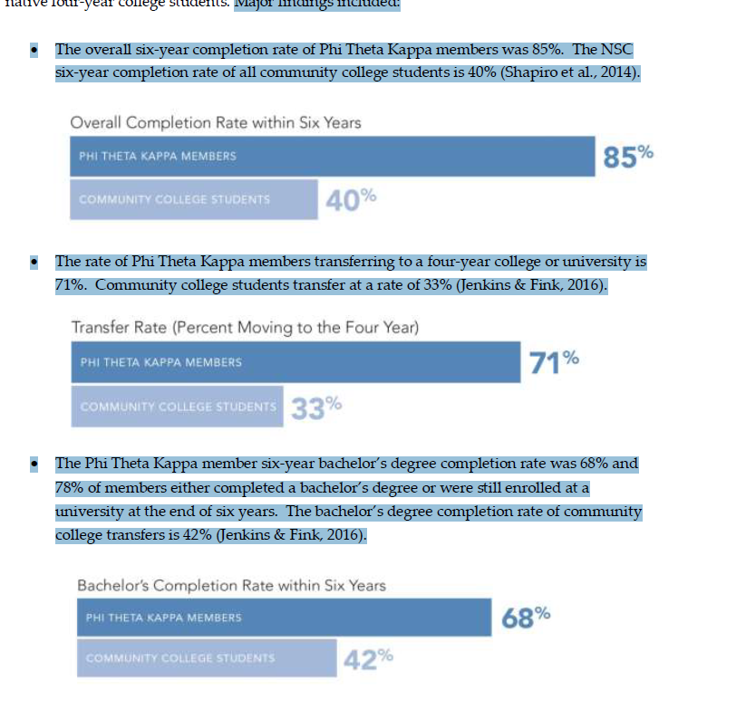
PTK Info – sample data points

Slide 75
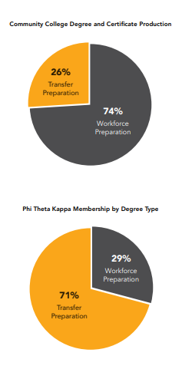
PHI THETA KAPPA (PTK) HONORS Program
PTK Info – sample data points

Slide 76
PHI THETA KAPPA (PTK) HONORS Program
How can we help bolster TRANSFER RATES on multiple fronts, including PTK?
AWARENESS :
  Recognize the value to our learners
  Encourage our learners to join & be active
  Encourage involvement from all campus stakeholders (faculty/staff/administrators)
Systemic-SUPPORT
It is “volunteer”-driven right now ☺
College-funded
Questions / Comments?!

Slide 77
PTK Audience Questions/Comments
PTK
1. How does your program/services support transfer? (Please highlight 1-2 things).
The Phi Theta Kappa (PTK) program is dedicated to supporting student transfer. It prioritizes scholarship, fellowship, and leadership as key components to prepare students for successful transfer. The program provides an encouraging environment that motivates students to actively seek transfer opportunities, apply for scholarships, and become well-prepared for their future careers. PTK stands out with its remarkable success in fostering students' academic growth and their successful transfer to four-year institutions.
2. What was the outcome?
The outcome of the PTK program has been significantly positive. When compared to the district's average transfer rate, PTK's success rate stands out. The program's completion rates, transfer rates, and the percentage of students who complete bachelor's degrees after transferring all illustrate the program's effectiveness in supporting students throughout the transfer process. These statistics confirm that PTK is making a substantial difference in the students' academic and transfer journeys.
3. What did we learn?
One of the key lessons learned from the PTK program is that a comprehensive approach encompassing scholarship, fellowship, and leadership is effective in preparing students for successful transfer. PTK's impact on transfer rates and success is notable, particularly in the areas of obtaining scholarships and completing bachelor's degrees. However, there is a need for systemic support and increased awareness of the program, especially among all stakeholder groups within the college, including students, faculty, administration, and staff. Achieving this broader awareness can lead to more widespread student participation and success in transfer-related activities.
4. What do you need to enhance your transfer services? (i.e., better collaboration).
To enhance their transfer services, PTK needs to increase awareness across all levels of the college community. This involves reaching out to students, faculty, administration, and staff to ensure that everyone is informed about the program's benefits. Currently, the program faces challenges related to funding and resources, as there is no dedicated budget or personnel assigned to PTK. There's a clear need for systemic support that can help integrate PTK into the existing college framework.
Collaboration with other programs, such as the Honors Transfer Program, is recommended to optimize marketing efforts and raise overall awareness about transfer opportunities. Joint marketing strategies can be a cost-effective way to reach more students and foster a culture of academic excellence and transfer readiness. Moreover, there is potential to offer funding or support for student memberships in PTK, increasing the accessibility of the program and its impact on the broader student population. These enhancements can lead to more significant outcomes in promoting successful transfer and academic achievement.

Slide 78

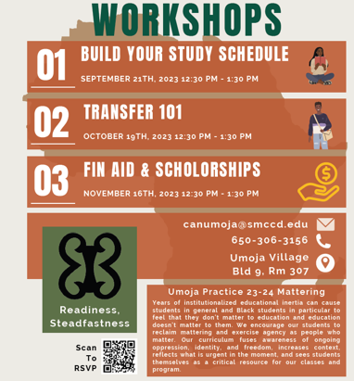
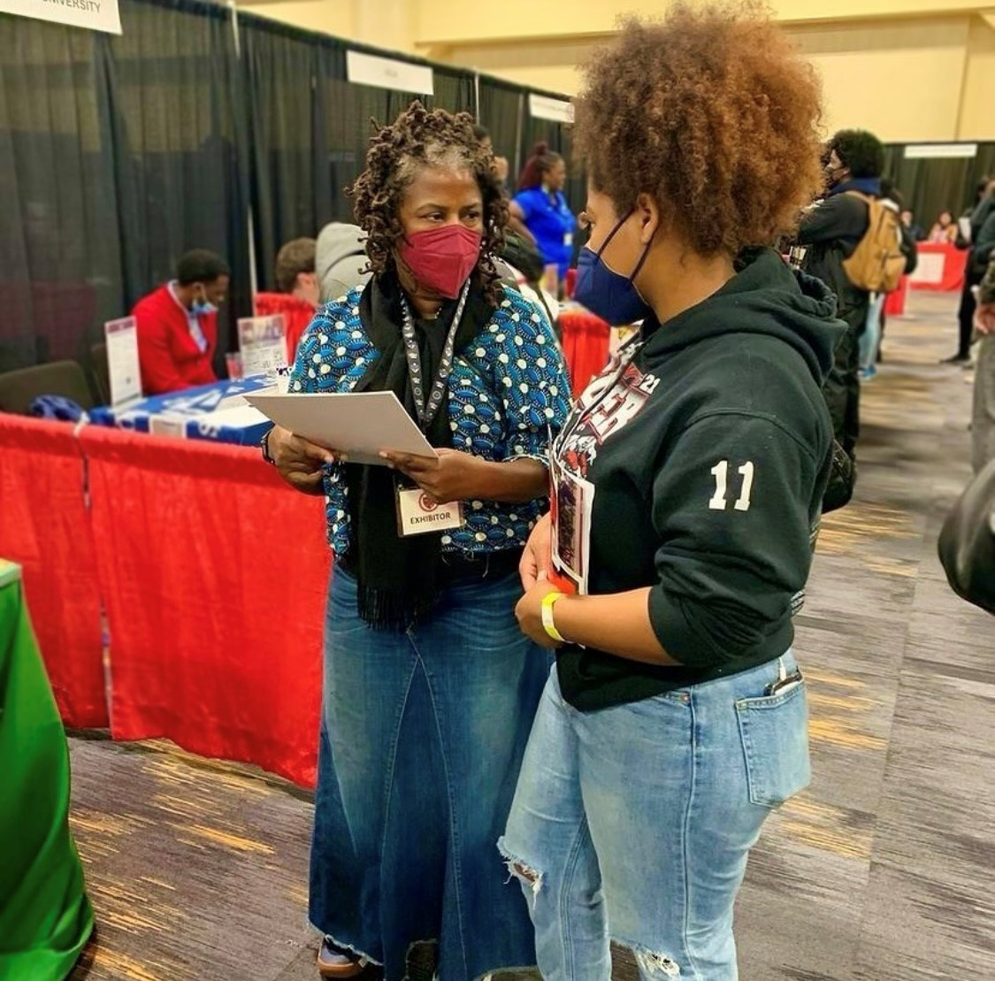
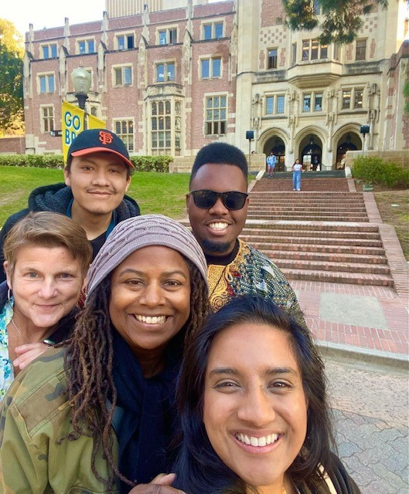
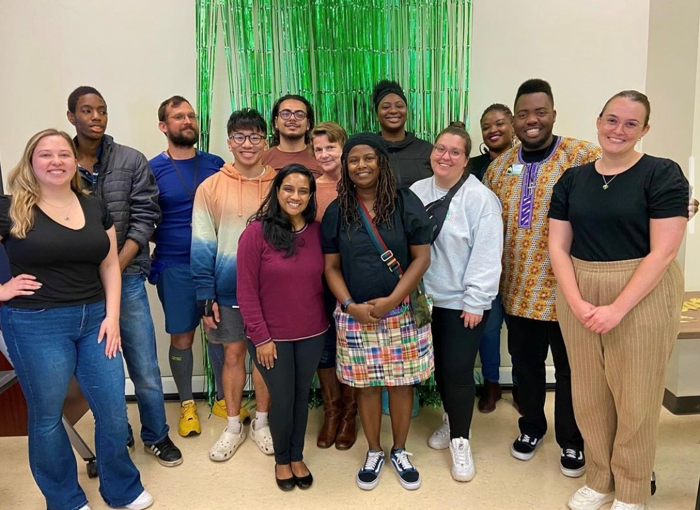
Umoja Cohort Classes
  Fulfill General Education Classes for Transfer
    Fall: ENGL 100, PLSC 210
    Spring: ENGL 110, PLSC 310, MATH 200
Campus visits
  Partnership with HBCU’s
  Collaboration with conferences (SF State, UCLA, Black College Expo)
  Connection to Black Student Services on transfer campuses
Transfer Counseling Services
  Transfer workshops
  CSU/UC/HBCU application assistance
  Student Education Plans working towards transfer goal
Student Engagement College Community
  Black Student Union
  Black Students Matter Committee

Slide 79
Umoja Audience Questions/Comments
Umoja
1. How does your program/services support transfer? (Please highlight 1-2 things).
The Umoja program provides significant support for Black students. It operates on a cohort model with a curriculum that focuses on Black history, Black ideology, and Black authors. This program actively works towards helping students reach their transfer goals. It includes organizing campus visits to various universities, including HBCUs, providing students with the opportunity to explore campuses and connect with other Black students. Collaboration with other student services and programs, such as Promise and TRIO, further enhances the support provided to Umoja participants. The program recognizes the importance of building a sense of community among students from diverse backgrounds.
2. What was the outcome?
While specific transfer data was not provided in the meeting, it was emphasized that the Umoja program has shown notable success in improving the success rates of Black students in English, math, and political science classes when compared to non-Umoja Black students. This program aims to offer holistic support that goes beyond the classroom, with the understanding that students' lives and various factors impact their learning. The success rates demonstrate the effectiveness of this comprehensive approach.
3. What did we learn?
The success of the Umoja program underscores the significance of community building and providing holistic support for students. It emphasizes that fostering connections and a sense of belonging among students from diverse backgrounds can have a profound impact on their educational journey. Collaboration between different student services and programs, along with a flexible and creative approach to assessment methods, are crucial for students' learning and growth. The meeting highlighted the value of reconsidering the definition of success to include not just grades but also personal development and resilience.
4. What do you need to enhance your transfer services? (i.e., better collaboration).
To further enhance transfer services, the Umoja program should continue its community-building efforts, creating a supportive environment for students. There should be a focus on exploring creative assessment methods that allow students to demonstrate their knowledge in various ways, rather than relying solely on traditional testing. Collaboration with other student services and programs is pivotal in offering a comprehensive network of support. Moreover, a more flexible perspective on success, which acknowledges the importance of learning and personal growth, is essential for the holistic development of students. This approach may redefine success beyond merely grade-based achievements.

Slide 80
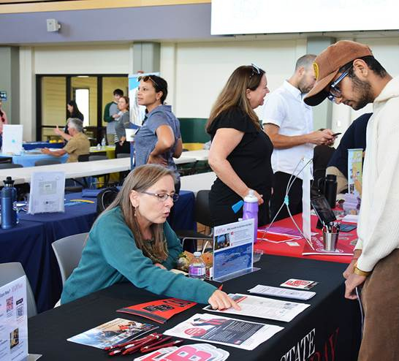
5 & 6: Transfer Plan and
COLTS-U Transfer Center
Fall 2023
Updated 11.3.2023

Slide 81
5. Transfer Plan
College-wide committee designated by PBC to “develop, promote, and scale up college activities that promote transfer success”*
Objective #1: Identify the support, milestones, and gaps in the transfer journey for students.
Objective #2: Build and strengthen relationships with universities and high school partners.
Objective #3: Identify and address equity gaps in transfer support services.
Objective #4: Create a campus culture, across all levels and functions, that actively commits to supporting the transfer success of our students.
*Source: Cañada College Transfer Services Plan 2021-2024, PBC Transfer Planning Task Force, May 5, 2021

Slide 82

Located in Building 9, Room 106, We offer...
* Transfer Counseling
*Articulation
* Transfer Services and Support
* University Programs: AANAPISI ARC Transfer Pathway to SF State and NDNU B.A. Degree Completion programs

Slide 83
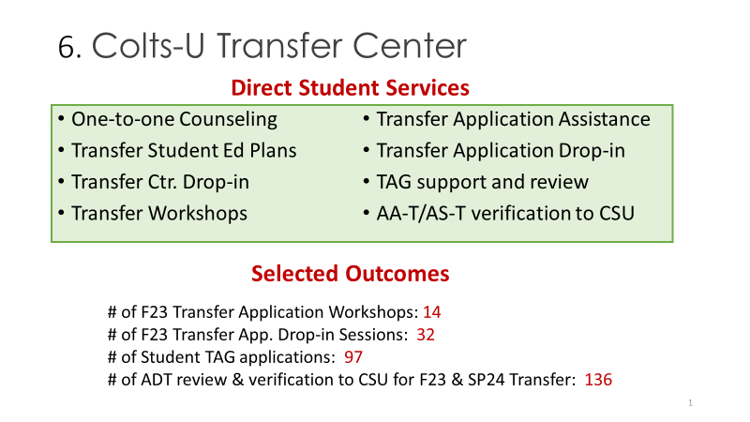

Slide 84
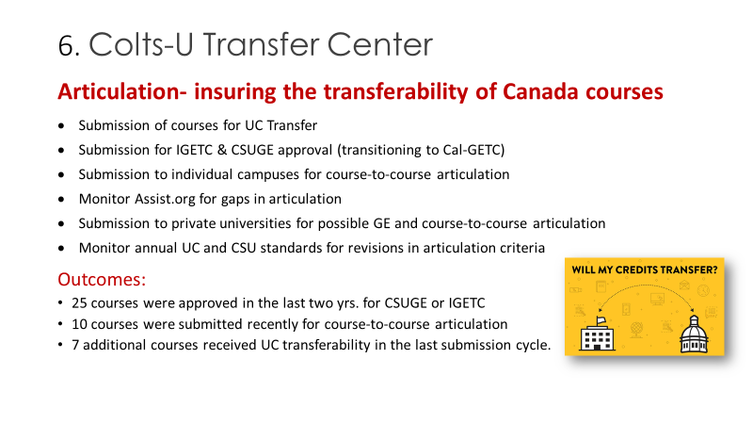

Slide 85
Transfer Services and Support
Transfer Communication Strategy
Transfer Center website
Transfer Milestone Dashboard
NEW program Canvas shell
Outcomes:
New links on website, including university partnerships and programs
# of students with transfer as an educational goal: 1,941 (as of 10.30.23)
# of students in program Canvas shell: 755 (as of 11.3.23)

Slide 86
Transfer Services and Support
Transfer Student Engagement
Transfer Day
University field trips
NEW Transfer Student Club
Outcomes:
# of universities participating at Transfer Day: 40
# of students at Transfer Day: 58+
# of students total for university visits: 25 (4 trips)
# of students interested in joining the new student club: 15

Slide 87

AANAPISI ARC Initiative
Title 3: Asian American and Native American Pacific Islander Serving Institution grant
  At least 10% identified as Asian American and Native American Pacific Islander at least 50% are Pell eligible
Supports Asian American, Pacific Islander, first-generation and low-income students (historically underserved population)
At Cañada College (2022-2023 Headcount)
  Asian - 15% (1489)
  Filipinx - 6% (579)
  Pacific Islander- Less than 1% (150)
Launched this Fall 2023
Partnership with San Francisco State University in collaboration with CSM & Skyline

Slide 88
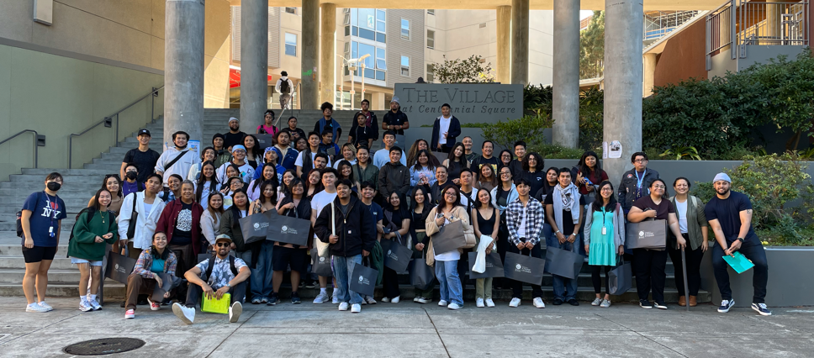
AANAPISI ARC Initiative
ARC Transfer pathway program
  Case management
  Peer mentoring
  Campus visits
  Culturally responsive activities and transfer pathway workshops

Slide 89


NDNU x SMCCCD Partnership
NDNU Bachelor’s Degree Completions: Business Administration (100% online) and Psychology (hybrid)
    AS-T Business & AA-T Psychology
Full-wrap around services
  Graduate mentoring program
  Academic support
  High-touch career readiness
  Financial literacy peer-coaching
  The program also offers personal counseling and health services to the students

Slide 90
NDNU x SMCCCD Partnership
Addressing Equity:
  $10,000 institutional aid for Pell eligible students
  No textbook cost
  Accessible (evening programs) online & hybrid
  High-touch and wrap around support
Key Takeaways
  Alternative option for students – small class sizes & high-touch 1:1 faculty and staff support
  Proactive outreach to students who completed ADTs in Business Administration and Psychology but never transferred
  Similar enrollment struggles with other small liberal arts colleges

Slide 91
5 & 6: Transfer Plan and COLTS-U Transfer Center Audience Questions/Comments
Transfer Plan and Colts-U Transfer Center
We did ask to combine the transfer plan as well as the services that the Colts-U transfer center provides.
How does your program/services support transfer? (Please highlight 1-2 things).
(Colts-U Transfer Center) plays a pivotal role in supporting students' successful transfer from community college to four-year institutions. They provide a broad range of services to help students navigate the complex process of transferring, two of which are particularly noteworthy:
Comprehensive Counseling: The center offers one-on-one counseling to students. This counseling is instrumental in creating personalized transfer student education plans, which are essential for identifying the right courses, requirements, and milestones on the path to transferring. Moreover, the counseling services extend to various aspects of transfer, including helping students with their transfer applications and providing information and guidance on Transfer Admission Guarantees (TAG). Their holistic approach ensures that students are well-prepared for the transfer journey.
Articulation Efforts: Articulation is a crucial aspect of transfer success. The center's staff actively works on articulation efforts to ensure that courses taken at the community college are recognized as equivalent to those at the intended four-year institutions. By submitting courses for approval and maintaining a keen eye on any gaps in articulation, they are instrumental in streamlining the transfer process and ensuring that students' credits will be accepted by the receiving institutions.
2. What was the outcome?
The outcomes achieved by the Colts-U Transfer Center are a testament to the effectiveness of their services in supporting students through the transfer process. Here are some noteworthy outcomes:
During the critical months of October and November, the center conducted 14 transfer application workshops. These workshops provide invaluable assistance to students who are navigating the intricacies of transferring to four-year universities. It's an example of how their direct student engagement efforts translate into practical support for applicants.
In the same period, the center organized 32 drop-in sessions, both in-person and through Zoom. These sessions were specifically focused on assisting students with their Transfer Admission Guarantee (TAG) applications. The high number of sessions reflects the center's commitment to providing accessible resources for students during the crucial application period.
A significant part of the center's work is the review of TAG applications. During the recent semester, they reviewed a total of 97 TAG applications. This shows the real impact of their efforts in ensuring students meet the requirements for a guaranteed admission to one of the six University of California (UC) campuses.
Another critical responsibility involves verifying Associate Degrees for Transfer (ADTs). In the last two years, the center has verified a total of 136 ADTs. This process is crucial for confirming that students are on the right path to earn their ADTs and secure smooth transfers.
These outcomes reflect the tangible and positive influence of the Coltsu Transfer Center on students' transfer journeys.

Slide 92
5 & 6: Transfer Plan and COLTS-U Transfer Center Audience Questions/Comments
3. What did we learn?
The presentation by the Colts-U Transfer Center highlights several important insights:
Effective Use of Digital Tools: The center has recognized the importance of utilizing digital communication tools to engage students. Their introduction of the Canvas shell is a testament to their adaptability and innovation. The Canvas shell serves as a powerful platform for communicating timely information to students, especially given the wealth of information that universities send out regarding transfer. It's a reminder of how technology can be harnessed to improve student support.
Challenges in Transcript Evaluation: One of the key learnings is the challenge associated with transcript evaluation. The center revealed that the evaluation of transcripts from external institutions currently takes a year. This extended evaluation process can be a source of frustration for students, as they aren't guaranteed that their previous coursework will be recognized without this formal evaluation. Understanding this challenge highlights the importance of streamlining such processes to ensure a smoother transfer experience.
4. What do you need to enhance your transfer services? (i.e., better collaboration).
The presentation indicates several areas where the Colts-U Transfer Center seeks improvement in order to enhance their services:
Better Collaboration for University Visits: The center is keen on institutionalizing regular university visits for students. These visits offer crucial insights into prospective institutions, help students establish connections with universities, and foster a sense of belonging. The desire for better collaboration with campus partners in organizing these visits underscores the importance of cooperation between different entities to enrich students' transfer experiences.
Formation of a Transfer Student Club: The center is in the process of forming a new transfer student club. This initiative aims to create peer-to-peer connections among students. Such connections have been proven to significantly contribute to student success. The creation of this club highlights the importance of peer support and the need for additional resources that facilitate this interaction.
Enhanced Collaboration with Notre Dame de Namur University: The partnership with Notre Dame de Namur University demonstrates the value of collaborating with four-year institutions to expand resources and opportunities for students. While the partnership has already enrolled 14 students, the center intends to continue building upon this relationship to provide even more options and support to students.

Slide 93
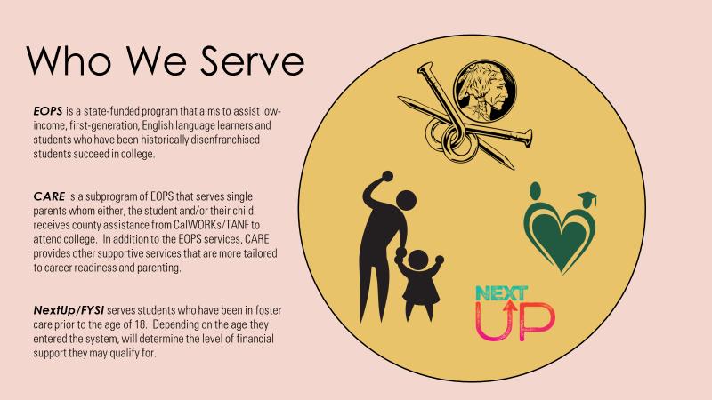
7. EOPS/CARE/NextUp/FYSI

Slide 94
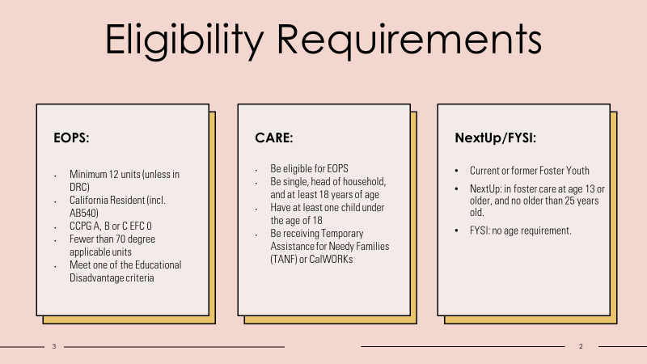

Slide 95
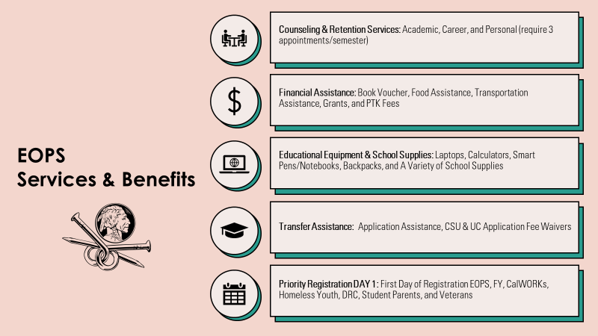

Slide 96
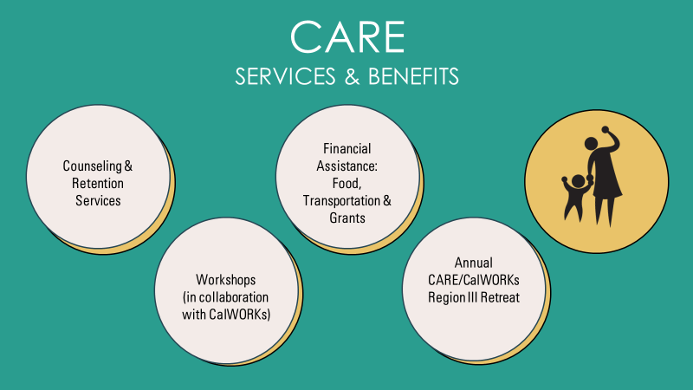

Slide 97
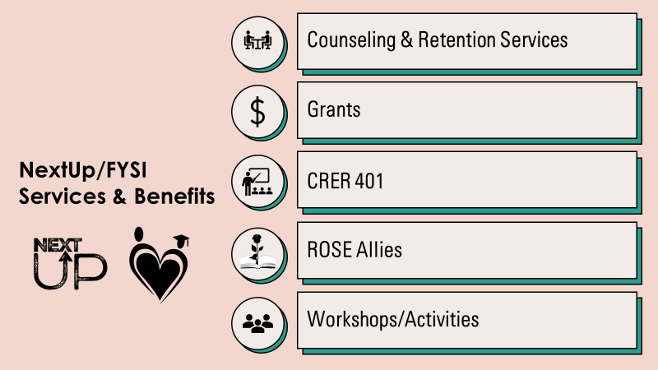

Slide 98
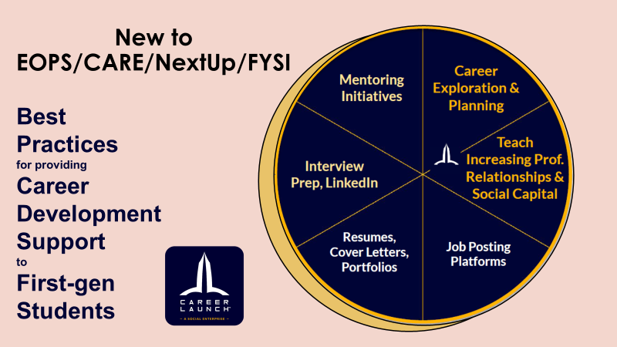

Slide 99
EOPS/CARE/NextUp/FYSI
Transfer Supports & Information
Transfer application fee waivers
  4 CSU
  4 UC
  Assist with private universities
  Can pay for more if budget allows.
Group Counseling Sessions
  Collaborate with the Transfer Center
  CSU Dual Enrollment Assistance
Campus Tours
  Collaboration with programs on campus
  Souther California Tours collaboration with districtwide EOPS
Counseling
  Additional counseling appointments available
  Graduation Petitions
  Drop-in every Monday
  Drop-in Nov 30
2022-23 Graduates Stats
  45 Graduates/Transfer Students
  31 students earned 33 ADTs and 30 Transferred

Slide 100
EOPS Audience Questions/Comments
EOPS
1. How does your program/services support transfer?
EOPS is committed to helping students transition successfully from community college to four-year institutions. The program provides a comprehensive range of services and resources that play a pivotal role in facilitating students' transfer goals. Notably, EOPS offers specialized counseling services, which are instrumental in guiding students through their academic journey and ensuring they meet the necessary requirements for transfer. The program's counseling component assists students with creating educational plans, selecting appropriate courses, and making informed decisions about their academic and career paths.
Financial assistance is another vital aspect of EOPS support. Students often face financial barriers that can hinder their academic progress, but EOPS alleviates these challenges by offering financial aid in addition to any other support services students receive. This financial aid can encompass covering the costs of course materials, which is a fundamental aspect of ensuring students have access to the resources they need to excel academically.
Moreover, EOPS goes a step further by providing application fee waivers for California State Universities (CSUs) and University of California (UC) institutions. These fee waivers are valuable for students applying to transfer to these four-year universities, as they alleviate some of the financial burdens associated with the application process. In a practical sense, this support can significantly reduce the financial barriers faced by many students on their transfer journey.
Group counseling sessions are yet another valuable resource EOPS offers. These sessions provide students with a sense of community and connection, facilitating collaboration and knowledge-sharing among peers. Group counseling can serve as a source of motivation and empowerment, making the transfer process less daunting. Students can learn from one another's experiences and gain valuable insights into the transfer process.
Assistance with EOP (Educational Opportunity Program) applications is a unique feature of EOPS. Students aiming to transfer to CSUs can receive help with their EOP program applications, which is an additional layer of support specifically designed for low-income, historically disadvantaged students. This support ensures that students can access all available resources and opportunities.
2. What was the outcome?
The presentation did not delve into specific outcomes or statistics. However, it did highlight the comprehensive services and benefits that EOPS offers to students to enhance their readiness and success in transferring to four-year institutions. The focus was on the extensive support provided by EOPS rather than quantitative outcomes.
3. What did we learn?
From the presentation, we learned that EOPS has a rich history, with the program having its roots at the College of San Mateo (CSM) in 1969. This historical context highlights the enduring commitment to supporting historically disenfranchised and low-income students in their educational journeys.
Additionally, we learned about the importance of innovation in continuously supporting students effectively. EOPS seeks to adapt and grow by providing additional transfer-related workshops and services. This commitment to innovation underscores the program's dedication to improving and expanding its support for students.
4. What do you need to enhance your transfer services?
To further enhance their transfer services, EOPS identified several areas of improvement. One key aspect is the need for greater staffing support. The program highlighted the importance of having additional staff members, potentially including a PSC (Part-time Support Counselor) or a retention specialist. These professionals can contribute to the effective management of administrative duties, coordination of program activities, and provision of support services to students.
Another crucial area for enhancement is the prioritization and streamlining of transfer evaluation services (TES). The efficient evaluation of transfer students' coursework is essential to expedite their progress toward their educational goals. Improving the TES process can significantly benefit students by reducing delays and ensuring a smooth transition.

Slide 101
8. TRIO
TRIO Student Support Services (SSS) is a program funded by the United States Department of Education. Our goal is to provide an academic, social, and personal support system for first-generation, low-income, and/or students with disabilities, to assist them with certificate and degree college requirements, the transfer process, and to motivate them towards successful completion of their college education.
Services offered specifically related to Transfer:
  Workshops on Transfer (hybrid, video available for students after event)
  Counseling (offered on phone, zoom, and in-person, evening hours)
  College/University Tours (in partnership with Colts U Transfer Center & others)
  Data Per the Dept. Of Education Annual Performance Report on our TRIO SSS at Cañada. AY 22-23 numbers will become available in December 2023.
What did we learn? Higher completion rates during the pandemic, possible correlation between access (courses, workshops, etc.) and completion.
What do we need? Strategic partnerships, funding, & students enrolling to Cañada.
TRIO Student Support Services APR Objective | AY 19-20 | AY 20-21 | AY 21-22
Degree or Certificate Completion | 33% | 41% | 33%
Degree or Certificate Completion + Transfer | 28% | 23% | 27%

Slide 102
Audience Questions/Comments

Slide 103
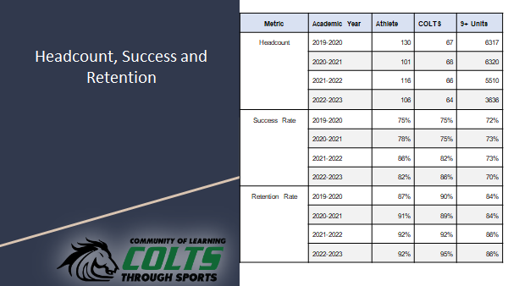
9. COLTS Learning Community

Slide 104
COLTS Learning Community Audience Questions/Comments
Colts Learning Community
How does your program/services support transfer?
The Colts Learning Community is a specialized program tailored for first-year student-athletes. It provides a unique educational experience by offering cohort-restricted courses during the fall and spring semesters. The curriculum includes transferable courses that align with the University of California (UC) and California State University (CSU) systems. In addition to academic support, the program extends its reach by offering extra assistance through coaches, instructors, and academic counseling. It's important to note that the program is actively considering expanding its course offerings by including English classes, such as English 100 and English 110, for the fall and spring semesters in 2024 and 2025.
What was the outcome?
Nicholas Martin presented data that underscored the positive impact of the Colts Learning Community. The success rates for students in the program have shown consistent improvement since 2019, especially when compared to general athletes. Additionally, their retention rates have remained stable or exhibited positive trends when contrasted with general athletes and the general student population. This data highlights the program's effectiveness in supporting student-athletes and enhancing their academic success and persistence.
What did we learn?
From the presentation, it's evident that the Colts Learning Community has played a crucial role in fostering academic success and retention among student-athletes. The specialized nature of the program, including its tailored curriculum and support systems, has proven to be highly beneficial for this student group. The data presented reaffirms the value of offering dedicated support for student-athletes and the positive impact it can have on their educational journeys.
What do you need to enhance your transfer services? (i.e., better collaboration)
To further enhance their transfer services, the Colts Learning Community has identified specific areas where improvements are necessary. The program has grown organically, with dedicated faculty members taking on administrative roles, such as leadership, faculty collaboration, administrative duties, meetings, scheduling, and marketing. However, to continue their valuable work and expand their offerings, the program requires additional staffing support. This support might come in the form of a Part-time Support Counselor (PSC) or a retention specialist who can assist in administrative tasks, coordination, and the provision of support services to student-athletes.
Furthermore, the program envisions the creation of a dedicated space in Building One for student-athletes. This initiative would improve accessibility and foster a sense of community among student-athletes. However, establishing such a space also necessitates additional staffing and resources.
Lastly, the program recognizes the need to prioritize and streamline Transfer Evaluation Services (TES). Student-athletes often transfer from other colleges or universities and need a swift evaluation of their previous coursework to meet their academic and eligibility requirements. Streamlining TES and making it a higher priority at the district level would significantly benefit student-athletes by reducing delays and ensuring a smoother transition to their next academic institution.

Slide 105
10. Curriculum Committee
The articulation officer and curriculum committee support transfer by:
articulating our courses
ensuring that, to the extent possible, our transfer courses align with Cal-GETC (the single UC/CSU transfer path)
identifying courses appropriate for transfer or GE as courses come through curriculum
working with CSM and SKY to increase district alignment of courses
adding curriculum updates to Program Maps to ensure students have current information
(counselors) placing all non-UC bound students who indicate "transfer" as their goal on an AD-T
enabling units earned across the district, rather than just those earned at Cañada, to be applied toward degrees (F 24 catalog update)
nudging faculty to assess and offer credit for prior learning as earned by exams, military experience, and work

Slide 106
Curriculum Committee Outcomes
We have achieved district alignment in course numbers (SPAN, ENVS, ANTH) and implemented a new policy to allow students to take courses in their major at any of the three district colleges.
We have formulated a district workgroup to collaborate on the implementation of ABs 928 (Cal-GETC single transfer path) and 1111 (Common Course Numbering).
We updated the use of Defense Language Proficiency Exam (DLPE) scores as follows [in red]: "San Mateo County Community College District may award three units (semester) in CSU GE Breadth Area C2 (Humanities); or 3 units for the associate degree general education Area C2 (Humanities) at Skyline College and Cañada College, or Area E5C (Humanities) at College of San Mateo; utilizing credit recommendations from the American Council on Education (ACE)."
We are creating a single transfer GE pattern, in accordance with AB 928

Slide 107
We have learned that:
Now: the articulation officer and chair need to explain these changes to faculty, as they will affect course offerings and CORs
Soon: we will need substantial clerical assistance to update all of our courses to the common course numbers, descriptions, and other elements required by AB 1111 (beginning SP 24; likely full implementation by F 27)
Soon: Cañada will need to revisit our local associate degrees to determine what is now required by Title 5 and the Chancellor's office and whether or not we want our local degrees to emulate the Cal-GETC transfer path

Slide 108
Curriculum Committee Audience Questions/Comments
Curriculum Committee
How does your program/services support transfer? (Please highlight 1-2 things).
The Curriculum Committee plays a pivotal role in supporting transfer by meticulously reviewing and guiding the development of new and revised course curricula. This involves assessing each course's potential approval for UC transfer or alignment with General Education (GE) areas, ensuring they meet transferability requirements. They also evaluate whether changes in prerequisites or course structures align with the California Community Colleges Intersegmental Committee of Academic Senates (ICAS) descriptors. The committee also strives for district-wide alignment in courses and degrees, promoting consistency in education delivery across the district's colleges.
Their efforts extend to adapting to major statewide changes, such as the impending implementation of the CalGetai GE pattern, aimed at streamlining transfer requirements across the state. The Curriculum Committee has been proactively preparing for the full implementation of CalGetai, ensuring that students have a clear, unified path to follow when transferring. They also focus on the AB 1111 common course numbering initiative, which seeks to standardize course numbers and essential content elements across California community colleges. This ensures that the content and numbering of courses are consistent, simplifying transfer for students.
What was the outcome?
The Curriculum Committee's dedication has yielded several positive outcomes. One notable achievement is the alignment of course numbering and unit counts across the district, making it easier for students to understand and navigate course offerings. This harmonization ensures that students receive consistent information and opportunities, regardless of the college they attend within the district. Additionally, students can benefit from the application of units earned across the district toward their degrees, a change approved by the committee and set to be implemented in the next catalog. Furthermore, their efforts support expanding credit options for prior learning, including military experience, exams, and work experience.
The committee's involvement in the implementation of the single transfer GE pattern (CalGetai) and the common course numbering (AB 1111) reflects their commitment to making curriculum more accessible and transfer-friendly for students. By actively shaping the course offerings and requirements, the Curriculum Committee contributes to an environment that fosters efficient and effective transfer pathways.
What did we learn?
Through their extensive involvement in these significant changes, the Curriculum Committee has learned that there is a critical need for clear and comprehensive communication to explain the upcoming modifications to the college community. As many changes are forthcoming from the State, including CalGetai and common course numbering, ensuring that faculty, staff, and students understand these changes and can adapt to them is paramount. Additionally, the implementation of these changes will require a substantial clerical effort to update every single course, highlighting the importance of adequate administrative support.
The committee has recognized that local associate degree programs will need to be revisited to align with the evolving transfer landscape. Traditionally aligned with CSU requirements, these local degrees may need to adapt to accommodate the new CalGetai path. It's essential to consider how these degrees can remain relevant and valuable for students seeking a transfer education.
What do you need to enhance your transfer services? (i.e., better collaboration)
To further enhance their transfer services, the Curriculum Committee anticipates the need for clerical assistance to efficiently manage the considerable administrative workload required for updating every course in response to the impending changes. Coordinating and communicating these updates to the college community is a crucial part of their strategy to ensure a smooth transition. This also involves clarifying how changes will impact faculty and students and creating a support system for adaptation.
Furthermore, there is a pressing need for local associate degree programs to be revisited and potentially restructured to align with the changing transfer requirements and patterns. This effort will require collaboration between faculty, administrators, and counselors to develop degree programs that benefit students seeking to transfer to various institutions. Coordination across departments and campuses will be key in successfully navigating these changes and making transfer services more efficient and effective.

Slide 109
Closing
In the meeting's closing remarks, it was emphasized that the group should focus on generating ideas and recommendations within a manageable scope, as there isn't enough time and resources to address all issues. The next meeting, scheduled for November 17th, will focus on consolidating the feedback received on the numerous slides presented in this meeting. The goal is to create draft recommendations, which will be discussed, refined, and potentially sent to the PBC (Planning and Budgeting Council) for guidance.

Slide 110
Meeting 3: November 17, 2023
Introduction 2 min (slide 93)
Framing – Lezlee 10 min
Transfer efforts: Strengths- Anniqua 20 min
Transfer efforts: Challenges – Anniqua 20 min
Puente - Yolanda and Sandra(5 min presentation, 5 min Q&A)
Transfer efforts: Possible Recommendations- Anniqua 60 min
Closing 2 min

Slide 111
Process
Meeting 1: October 13
Guided Pathway
AB1705
Middle College
Promise
Puente
Living Promise MOU
Meeting 2: November 3
STEM/NSF
HTP
PTK
Umoja
Transfer Plan
Transfer Center
EOPS
TRIO
Athletics
Curriculum Committee
Meeting 3: November 17
Discussion
Recommendations
Outcome:
Report the recommendations to PBC
December 6, 2023
Three Meetings
October 13 from 11:00 to 1:00
November 3 from 1:00 to 3:00
November 17 from 1:00 to 3:00
3-4 Questions:
How does your program/services support transfer? (Please highlight 1-2 things).
What was the outcome?
What did we learn?
What do you need to enhance your transfer services? (i.e., better collaboration)
Membership: see the last slide. ~63 members
Notes:
Forward-looking Framework for Reflection (feel free to pick and choose which questions you can answer)
How does your program/services support transfer? (Please highlight 1-2 things).
What was the outcome?
What did we learn?
What do you need to enhance your transfer services? (i.e., better collaboration)

Slide 112
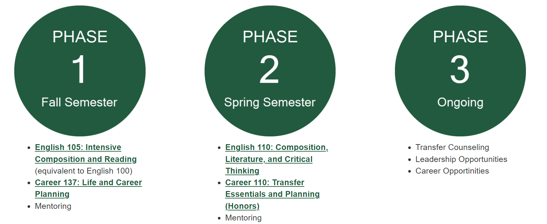
5. Puente
Puente Project Mission Statement
The mission of the Puente Project is to increase the number of educationally underserved students who enroll in four-year colleges and universities, earn degrees, and return to the community as leaders and mentors to succeeding generations.

Slide 113
Puente Audience Questions/Comments
1. How does your program/services support transfer?
The Puente program supports transfer through the creation of a learning community with a counselor and an English instructor working together.
The close-knit community helps students build relationships organically, creating a supportive environment.
Puente organizes various events and field trips, including transfer-focused activities like the Bunte Student Transfer Motivational Conference.
Puente provides transfer-focused workshops, study groups, and mentorship to help students succeed in challenging courses.
2. What was the outcome?
Data from the comprehensive program review indicates that 45% of Puente students from the 2015-2016 cohort transferred to a 4-year university by 2019-2020.
This transfer success rate is higher than the percentage of non-Puente Hispanic students (27%) and higher than the overall percentage of all Cañada College students (37%).
3. What did we learn?
The success of Puente in facilitating transfer is attributed to the intentional creation of a supportive community, mentorship, and transfer-focused activities.
The program's emphasis on relationships, strategies, and consistency, especially in challenging courses, contributes to the success of Puente students in transferring to 4-year universities.
4. What do you need to enhance your transfer services?
The counselor plays a crucial role in the later stages of the transfer process, requiring significant time and effort to ensure students are on track.
Funding challenges exist, such as difficulties in obtaining funds for student applications and graduation-related expenses.
Additional Notes:
Puente's success is highlighted in the higher transfer rates compared to non-Puente Hispanic students and the overall college student population.
There is an intention to expand services, such as university tours, but challenges like staffing and funding need to be addressed.
The Puente program has a comprehensive approach, including support in challenging courses, mentorship, and activities beyond the classroom to foster a sense of community and support for transfer-bound students.

Slide 114
Strengths
Early College Access: Many of the programs emphasize early college access, enabling high school students to earn college credits and experience the benefits of higher education before transferring.
Diverse Range of Support Programs: The college has a wide variety of programs and services dedicated to supporting student transfer, including Promise, AB1705, TRIO, Middle College, Guided Pathway, Puente, Living Promise MOU, STEM initiatives, Honors programs, PTK, Umoja, EOPS, the Colts Learning Community, Colts-U Transfer Center, and the Curriculum Committee. This diversity provides tailored support for students with different needs and backgrounds.
Data-Informed Decision-Making: The programs recognize the importance of data analysis to measure their effectiveness and make informed decisions about improvements.
Commitment to Equity: These programs have a commitment to addressing issues related to equity and ensuring that underrepresented students have access to educational opportunities.
Holistic Approach: Many of these programs offer comprehensive support that goes beyond academics, addressing financial, counseling, mentoring, and community-building needs. This holistic approach recognizes that students' lives and various factors impact their transfer journeys.
Success Outcomes: Several programs have demonstrated positive outcomes, including increased transfer rates, higher GPAs, and improved retention rates. These achievements reflect the effectiveness of the support provided to students.
Ongoing Adaptation: The college and its programs are proactive in adapting to changes in the educational landscape, such as the implementation of the Cal-GETC GE pattern and AB 1111. This adaptability ensures that students have clear and updated pathways for transfer. The Curriculum Committee's involvement in aligning courses with transfer requirements and numbering facilitates consistency and communication across the district.
Notes:
Based on these 16 showcased transfer support programs and the feedback and comments from participants, the following highlights the strengths of our transfer efforts (additions or ways to strengthen)

Slide 115
Feedback on Strengths
Early College Access Focus:
There is strong support for initiatives related to early college access, particularly reaching out to first-year students intentionally.
This includes exposing them to transfer options in the first semester and creating expectations around transfer from the beginning.
Diversifying University Exposure:
The suggestion was made to broaden the exposure to transfer access by including more universities beyond UCs and Cal States.
This involves introducing students to a variety of programs, private schools, and HBCUs to provide a more comprehensive understanding of transfer options.
Enhancing Faculty Involvement:
There was a call for deeper collaboration with faculty members, especially in the context of faculty pods. This involves integrating discussions about college, transfer, and local institutions into the curriculum to better prepare students for the transfer process.
Data-Informed Decision Making:
The need for universal metrics and comprehensive data collection for transfer-related programs was emphasized.
This includes establishing benchmarks and goals for transfer success, analyzing programmatic comparisons, and regularly referring to these metrics to identify best practices.
Alumni Network and Mentorship:
Consideration was given to the creation of an alumni network to support students after they transfer.
This involves connecting students with mentors who have already transferred to provide guidance and support in the new academic environment.
These takeaways highlight key themes discussed in the meeting, encompassing early access strategies, diverse university exposure, faculty collaboration, data-driven decision-making, and post-transfer support through an alumni network.

Slide 116
Challenges
Communication Gaps: Improved communication and outreach strategies are needed to ensure that students are aware of the programs and their benefits.
Collaboration Gaps: In addition, programs need to collaborate and communicate to leverage their resources to support students holistically.
Transfer Evaluation Delays: Several programs have identified a challenge in the timely evaluation of transfer coursework. The long evaluation process can be frustrating for students and delay their transfer plans.
Alignment of Local Degrees: The need to revisit and adapt local associate degree programs to align with evolving transfer requirements poses a significant challenge, as this requires extensive coordination and restructuring.
Notes:
Based on these 16 showcased transfer support programs and the feedback and comments from participants, the following highlights the challenges of our transfer efforts.

Slide 117
Feedback on Challenges
1. Communication Gap:
There is a need for improved communication both internally among programs and externally with students.
Suggestions include better signage on campus, social marketing emphasizing transfer possibilities, and a shared vision for communication practices.
2. Collaboration Gap:
Collaboration among programs needs improvement, and there is an opportunity to share specific best practices for achieving transfer goals.
The importance of a shared goal and coordinated efforts was emphasized.
3. Transcript Evaluation Delays:
The delay in transcript evaluations, particularly for transfer-bound students, is a significant challenge.
The wait time for students to get their transcripts evaluated and placed on degree works was mentioned as being as long as 12 months.
Advocacy for improving this process, considering it a top priority, was suggested.
4. Alignment of Local Degrees:
There is a challenge in aligning local degrees, and the need for better alignment of courses to streamline the evaluation process was highlighted.
Aligning courses more closely was suggested as a potential solution to expedite the transcript evaluation process.
Overall Theme: The challenges discussed are interconnected, and addressing them requires a coordinated effort and shared commitment among faculty, programs, and the institution to enhance the transfer process for students.

Slide 118
Transfer: Possible Recommendations (1 of 2)
The "how" will be informed by capturing participants' feedback on effective approaches.
Enhancing Collaboration:
  Foster collaboration among Transfer Support to share best practices, share resources, and identify areas for collaboration. This can help eliminate duplicated services and streamline the support process.
  Streamline communication efforts to minimize the volume of emails students receive.
Streamline administrative processes:
  Assess and optimize administrative workflows.
  Streamline transfer evaluation processes to reduce delays in the transfer plans of students.
Notes:
Drawing insights from the 16 showcased transfer support programs, participant feedback and comments, the strengths and challenges in our transfer efforts, the following outlines potential recommendations to enhance our support for students and improve internal processes. It's important to note that these recommendations focus on what we need to better serve our students and streamline our internal procedures.

Slide 119
Transfer: Possible Recommendations (2 of 2)
The "how" will be informed by capturing participants' feedback on effective approaches.
C. Establish Metrics and Data-Informed Decision-Making Process:
  Set clear performance metrics.
  Create a consistent data collection and tracking system to monitor student transfers.
D. Curriculum Support:
  Continue streamlining curriculum alignment: Continue efforts to simplify curriculum alignment across the district, reducing complexity for students and ensuring consistent transfer pathways. (AB1111 and AB928).
Notes:
Drawing insights from the 16 showcased transfer support programs, participant feedback and comments, the strengths and challenges in our transfer efforts, the following outlines potential recommendations to enhance our support for students and improve internal processes. It's important to note that these recommendations focus on what we need to better serve our students and streamline our internal procedures.

Slide 120
Feedback on Recommendations
1. Enhance Collaboration and Streamline Administrative Processes:
Foster improved collaboration among departments and programs.
Streamline administrative processes to create a more efficient workflow.
2. Establish Metrics and Data-Informed Decision-Making Processes:
Implement metrics to measure and assess transfer-related initiatives and outcomes.
Emphasize data-informed decision-making to guide program improvements and enhance student success.
3. Experiment with Course Time Frames:
Consider experimenting with different course time frames, such as a 12-week semester model.
Focus on workforce-related programs and humanities, language arts, and social sciences as potential areas for experimentation.
4. Support Transcript Evaluation Services:
Recognize challenges faced by the transcript evaluation department, including staff shortages and added responsibilities.
Explore ways to support the department, such as hiring additional personnel and providing technological resources.
Acknowledge ongoing efforts, such as testing a new system for automated transcript evaluation, and encourage continued collaboration and improvement.
Overall Theme:
The recommendations aim to address various aspects of the transfer process, including collaboration, data utilization, course structures, and support for essential services like transcript evaluation. They emphasize a holistic approach to improving the overall transfer experience for students, faculty, and staff.

Slide 121
Members
Student: Student Senate (?)
Transfer Center: Max, Gloria, Mary, Gonzalo, James (PSC),
Transfer Plan responsible parties: Max, Gloria, Mary, Gonzalo, James (PSC), Soraya, Manuel
STEM/NSF: Rance, Sumathi, Ramakrishnan
Academic Senate leaders: David Eck, Gampi,
Classified Senate leaders: Maria H, Alex C, Jeanne S
HTP: Rebekah, Susan, Sarah
PTK: Paul R, Gampi, Autumn
GP: David M, Denise, David M, Gampi, Ron, Retention Specialists (John, Diego, Jackie, Autumn), Counselors (Chris Rico, Daryan, Sandra Rodrigues, Gloria)
Middle College: Stephen
Promise: Mayra, Counselors (Danny Lynch, Kassie Alexander, Jessica Boyle), PSC (Ariela Villalpando, Mahitha Rao)
Umoja: Lezlee W, PSC (Lezlee Ta), Autumn, Mahitha, James
Puente: Yolanda, Sandra Mendez
EOPS: Lorraine Barrales-Ramirez, Jos Romero, Sarah Aranyakul
TRIO: Maria Huning, Candice Johnson
Athletics: Kat, Nick Martine, Erik Gaspar
Curriculum: Lisa P, Bob Lee, David M, Gloria, Frank
AB1705: Ray, Lisa Palmer, Michael Hoffman, Sumathi, Anniqua
EAPC rep: Kiran, Michiko, Krystal
Deans: James, Ameer, Anniqua, Karen, Hyla, Kat, Max, Wissem
A&R: Maria

