Slide 1
Transfer taskforce
Fall 2023
Update 10.16.2023
Update 11.3.2023

Slide 2
OUTLINE
EMP Objectives
Process
Group slides followed by audience questions

Slide 3
EMP Objectives

Slide 5
Process
Meeting 1: October 13
Guided Pathway
AB1705
Middle College
Promise
Puente
Living Promise MOU
Meeting 2: November 3
STEM/NSF
HTP
PTK
Umoja
Transfer Plan
Transfer Center
EOPS
TRIO
Athletics
Curriculum Committee
Meeting 3: November 17
Discussion
Recommendation
Three Meetings
October 13 from 11:00 to 1:00
November 3 from 1:00 to 3:00
November 17 from 1:00 to 3:00
3-4 Questions:
Feel free to choose any questions you would like to show case.
How does your program/services support transfer? (Please highlight 1-2 things).
What was the outcome?
What did we learn?
What do you need to enhance your transfer services? (i.e., better collaboration)
Notes:
Forward-looking Framework for Reflection (feel free to pick and choose which questions you can answer)
How does your program/services support transfer? (Please highlight 1-2 things).
What was the outcome?
What did we learn?
What do you need to enhance your transfer services? (i.e., better collaboration)

Slide 6
Directions
Please scroll to the slide for your designated area and respond to the following questions: (Feel free to choose any questions you would like to show case.)
How does your program/services support transfer? (Please highlight 1-2 things).
What was the outcome?
What did we learn?
What do you need to enhance your transfer services? (i.e., better collaboration)

Slide 7
Meeting 1: October 13
Introduction 2 min
Framing 10 min
Transfer Data sharing 10 min
Guided Pathway (5 min presentation & 5 min Q&A)
AB1705 (5 min presentation & 5 min Q&A)
Middle College (5 min presentation & 5 min Q&A)
Promise (5 min presentation & 5 min Q&A)
Puente (5 min presentation & 5 min Q&A)
Living Promise MOU (5 min presentation & 5 min Q&A)
Closing 5 min

Slide 8
Framing
The opening remarks at the meeting covered several key points and actions to be taken during the discussion. These included:
Acknowledgment of Discussion Topics: Chialin introduced four questions for participants to consider during the meeting.
Program Invitations: Mention of programs and their invitations for the showcase was made, with a request for attendees to inform if any were missed so that they could be included.
Structured Timeline: A structured timeline for upcoming events was outlined, including plans for November presentations and recommendations.
Collaboration and Information Sharing: Emphasis was placed on gathering all relevant information in one place for ease of access and collaboration. An appreciative mention of Anniqua’s model for this purpose was made.
Connection to Transfer: The importance of connecting discussions and activities to transfer initiatives, particularly highlighting AB 1705 programs, was noted. Ray also highlighted the role of faculty in reflecting on their teaching and learning.
Focus on Equity and Professional Development: A commitment to incorporating equity and anti-racism considerations into discussions and an emphasis on professional development for improving practices and responding to student needs were discussed.
Inclusivity and Information Sharing: The importance of inclusive and informative conversations to facilitate growth and the need for considerations regarding flex days and the inclusion of additional presenters and sharing were highlighted.
The opening remarks set the tone for the meeting, stressing the importance of collaboration, structured timelines, data-driven decision-making, equity, and professional development in the context of transfer services.

Slide 9
Transfer Data Sharing

Slide 11
Total Annual Transferring Students
 | 2019-2020 | 2020-2021 | 2021-2022 | 2022-23
CSU Total | 176 | 134 | 142 | 117
UC Total | 72 | 83 | 85 | 72
In State Private | 27 | 18 | 15 | N/A
Out of State | 39 | 38 | 46 | N/A
TOTAL | 314 | 273 | 288
Sources: CSU and UC Transfer dashboards; CCCCO Data Mart/NSC for Private and Out of State data. The latter is not yet available for 2022-23.

Slide 13
Demographics of Transfer-Seeking Students: Fall 2023
Race/Ethnicity | % of all Transfer-seeking Students Fall 2023
American Indian/Alaskan Native | 0.2%
Asian | 7.0%
Black - Non-Hispanic | 3.5%
Filipino | 2.1%
Hispanic | 59.2%
Multiraces | 4.5%
Pacific Islander | 1.4%
Unknown | 3.7%
White Non-Hispanic | 18.5%
Gender | % of all Transfer-seeking Students Fall 2023
Female | 51.8%
Male | 44.6%
Unreported | 3.5%
Age | % of all Transfer-seeking Students Fall 2023
Age Under 18 | 1.2%
Age 18 - 22 | 60.2%
Age 23 - 28 | 17.0%
Age 29 - 39 | 13.0%
Age 40 - 49 | 5.7%
Age 50 - 59 | 2.2%
Age 60 + | 0.7%

Slide 14
Notes:
Of the 4,644 home campus students enrolled in Fall 2023, 1,950 (42%) are degree and transfer seeking. Those seeking a degree but not transfer are left out of this analysis.

Slide 15
Units Earned as of Fall 2023 | American Indian/ Alaskan Native | Asian | Black - Non-Hispanic | Filipino | Hispanic | Multi-races | Pacific Islander | Unknown | White Non-Hispanic
0.5 - 11.9 Units | 0% | 6% | 5% | 0% | 59% | 5% | 1% | 4% | 20%
12.0 - 23.9 Units | 0% | 8% | 3% | 2% | 61% | 5% | 1% | 4% | 17%
24.0 - 31.9 Units | 0% | 9% | 4% | 2% | 59% | 4% | 1% | 4% | 18%
32.0 - 44.9 Units | 0% | 10% | 2% | 3% | 56% | 4% | 2% | 2% | 21%
45.0 - 59.9 Units | 0% | 6% | 5% | 3% | 56% | 4% | 1% | 4% | 21%
60.0 - 64.9 Units | 0% | 7% | 3% | 2% | 55% | 3% | 2% | 3% | 24%
65.0 - 74.9 Units | 0% | 4% | 3% | 1% | 57% | 6% | 6% | 3% | 20%
75+ Units | 1% | 7% | 4% | 4% | 58% | 5% | 2% | 5% | 14%
Grand Total | 0.15% | 6.97% | 3.54% | 2.05% | 59.23% | 4.51% | 1.38% | 3.69% | 18.46%

Slide 16
Notes:
This slide compares the students who actually transferred in 2021-22 with all of those who had a transfer goal in the academic years 2018-2019 through 2020-2021.

Slide 17
Hispanic Transfer-Seeking Students are
disproportionately less likely to transfer
 | 2019-2020 |  |  | 2020-2021 |  |  | 2021-2022
Term Ethnicity Desc | Population | Transfers | Percent of pop who transfer | Population | Transfers | Percent of pop who transfer | Population | Transfers | Percent of pop who transfer | Equity Gap (PPG) | MoE
American Indian/ Alaskan Native | 15 | 1 | 6.7% | 15 | 1 | 6.7% | 11 | 2 | 18.2% | 8.8% | 29.5%
Asian | 1480 | 93 | 6.3% | 1676 | 161 | 9.6% | 1410 | 146 | 10.4% | 1.1% | 3.0%
Black - Non-Hispanic | 281 | 16 | 5.7% | 282 | 17 | 6.0% | 237 | 16 | 6.8% | -2.7% | 6.4%
Filipino | 571 | 51 | 8.9% | 744 | 55 | 7.4% | 660 | 62 | 9.4% | 0.0% | 3.8%
Hispanic | 4208 | 323 | 7.7% | 4183 | 287 | 6.9% | 3707 | 281 | 7.6% | -3.0% | 3.0%
Multiraces | 502 | 56 | 11.2% | 668 | 63 | 9.4% | 603 | 90 | 14.9% | 5.9% | 4.0%
Pacific Islander | 138 | 8 | 5.8% | 152 | 12 | 7.9% | 141 | 12 | 8.5% | -0.9% | 8.3%
Unknown | 725 | 28 | 3.9% | 528 | 42 | 8.0% | 420 | 27 | 6.4% | -3.1% | 4.8%
White Non-Hispanic | 2219 | 216 | 9.7% | 2481 | 257 | 10.4% | 2235 | 250 | 11.2% | 2.3% | 3.0%
Source: National Student Clearinghouse. Each year sums all students who transferred at any point within 4 years after leaving Cañada.

Slide 18
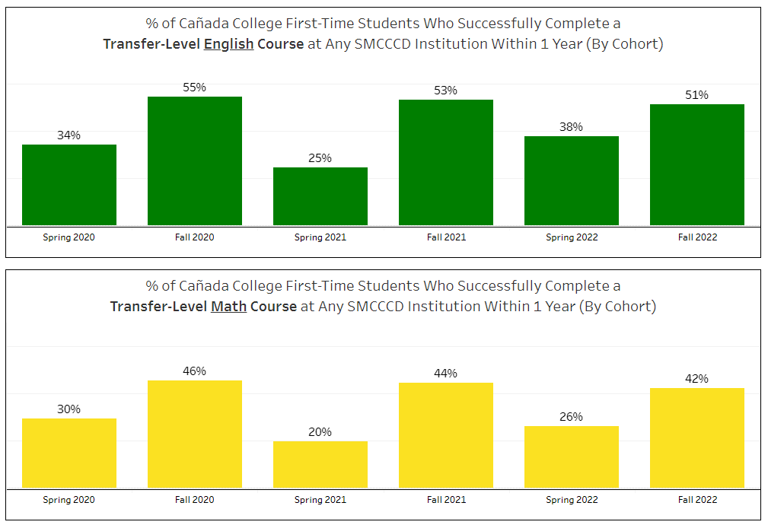
Transfer-seeking Students Only

Slide 19
TRANSFER ENGLISH
Race/Ethnicity | GPA Based on EH Test Codes | Number Enrolled in Fall 2021 | Completed Transfer Level Within 3 Terms of Fall 2021 | 1-Year Throughput Rate
Hispanic | Less Than 1.90 | 12 | 4 | 33.3%
Pacific Islander | Less Than 1.90 | 1 | 0 | 0.0%
Multiraces | Less Than 1.90 | 1 | 0 | 0.0%
Less Than 1.90 Subtotal |  | 14 | 4 | 28.6%
Asian | 1.90 - 2.59 | 2 | 1 | 50.0%
Black - Non-Hispanic | 1.90 - 2.59 | 4 | 1 | 25.0%
Filipino | 1.90 - 2.59 | 2 | 1 | 50.0%
Hispanic | 1.90 - 2.59 | 42 | 17 | 40.5%
Pacific Islander | 1.90 - 2.59 | 1 | 1 | 100.0%
White Non-Hispanic | 1.90 - 2.59 | 8 | 4 | 50.0%
Multiraces | 1.90 - 2.59 | 4 | 1 | 25.0%
Unknown | 1.90 - 2.59 | 2 | 0 | 0.0%
1.90 - 2.59 Subtotal |  | 65 | 26 | 40.0%
American Indian/Alaskan Native | 2.60 + | 1 | 1 | 100.0%
Asian | 2.60 + | 10 | 8 | 80.0%
Black - Non-Hispanic | 2.60 + | 3 | 2 | 66.7%
Filipino | 2.60 + | 8 | 3 | 37.5%
Hispanic | 2.60 + | 149 | 97 | 65.1%
Pacific Islander | 2.60 + | 4 | 4 | 100.0%
White Non-Hispanic | 2.60 + | 63 | 47 | 74.6%
Multiraces | 2.60 + | 13 | 12 | 92.3%
Unknown | 2.60 + | 4 | 2 | 50.0%
2.60 + Subtotal |  | 255 | 176 | 69.0%
Asian | Unknown | 17 | 16 | 94.1%
Filipino | Unknown | 4 | 3 | 75.0%
Hispanic | Unknown | 46 | 28 | 60.9%
Pacific Islander | Unknown | 1 | 0 | 0.0%
White Non-Hispanic | Unknown | 25 | 17 | 68.0%
Multiraces | Unknown | 2 | 2 | 100.0%
Unknown | Unknown | 16 | 9 | 56.3%
Unknown Subtotal |  | 111 | 75 | 67.6%

Slide 20
SLAM TRANSFER MATH
Race/Ethnicity | GPA Based on MH Test Codes | Number Enrolled in Fall 2021 | Completed Transfer Level Within 3 Terms of Fall 2021 | 1-Year Throughput Rate
Hispanic | Less Than 2.30 | 19 | 5 | 26.3%
Pacific Islander | Less Than 2.30 | 1 | 0 | 0.0%
White Non-Hispanic | Less Than 2.30 | 1 | 0 | 0.0%
Multiraces | Less Than 2.30 | 2 | 1 | 50.0%
Less Than 2.30 Subtotal |  | 23 | 6 | 26.1%
Asian | 2.30 - 2.90 | 2 | 1 | 50.0%
Black - Non-Hispanic | 2.30 - 2.90 | 2 | 1 | 50.0%
Hispanic | 2.30 - 2.90 | 22 | 7 | 31.8%
Pacific Islander | 2.30 - 2.90 | 2 | 0 | 0.0%
White Non-Hispanic | 2.30 - 2.90 | 7 | 6 | 85.7%
Multiraces | 2.30 - 2.90 | 1 | 0 | 0.0%
Unknown | 2.30 - 2.90 | 1 | 0 | 0.0%
2.30 - 2.90 Subtotal |  | 37 | 15 | 40.5%
American Indian/Alaskan Native | 3.00 + | 1 | 1 | 100.0%
Asian | 3.00 + | 3 | 2 | 66.7%
Black - Non-Hispanic | 3.00 + | 2 | 0 | 0.0%
Filipino | 3.00 + | 6 | 2 | 33.3%
Hispanic | 3.00 + | 57 | 31 | 54.4%
Pacific Islander | 3.00 + | 1 | 1 | 100.0%
White Non-Hispanic | 3.00 + | 20 | 12 | 60.0%
Multiraces | 3.00 + | 2 | 2 | 100.0%
Unknown | 3.00 + | 1 | 0 | 0.0%
3.00 + Subtotal |  | 93 | 51 | 54.8%
Asian | Unknown | 9 | 9 | 100.0%
Black - Non-Hispanic | Unknown | 4 | 1 | 25.0%
Filipino | Unknown | 6 | 5 | 83.3%
Hispanic | Unknown | 37 | 24 | 64.9%
Pacific Islander | Unknown | 1 | 1 | 100.0%
White Non-Hispanic | Unknown | 28 | 25 | 89.3%
Multiraces | Unknown | 6 | 4 | 66.7%
Unknown | Unknown | 3 | 1 | 33.3%
Unknown Subtotal |  | 94 | 70 | 74.5%

Slide 21
Notes:
This slide compares the students who actually transferred in 2021-22 with all of those who had a transfer goal in the academic years 2018-2019 through 2020-2021.

Slide 22
Notes:
This slide compares the students who actually transferred in 2021-22 with all of those who had a transfer goal in the academic years 2018-2019 through 2020-2021.

Slide 23
Notes:
This slide compares the students who actually transferred in 2021-22 with all of those who had a transfer goal in the academic years 2018-2019 through 2020-2021.

Slide 24
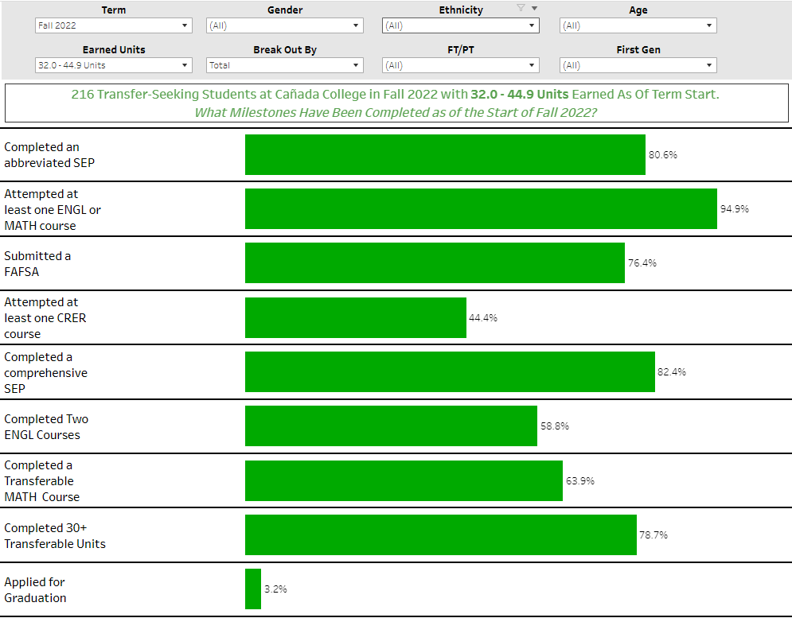
https://public.tableau.com/app/profile/smcccd/viz/CaadaTransferMilestones/TermSummary

Slide 25
Data Sharing Discussion Audience Questions/Comments
The conversation shifted towards a discussion on student transfers, the application and enrollment processes, potential barriers, and the need for follow-up support during transitions. Specific points covered included the decline in CSU applications in Fall 2018, the importance of PE requirements for some degree programs, and the challenge of tracking student transfers accurately. There was also mention of a need for mentorship programs to support students during their initial year at the transferring institution. Additionally, the question of scope in terms of institutional responsibility was raised, particularly regarding whether the responsibility extends to enrolled students or just those who are admitted.
How does your program/services support transfer?
Application Support: The institutions discussed how they assist students with the transfer application process, including guidance on required courses, eligibility, and degree plans.
Program and Major Alignment: Programs and services ensure alignment with the major requirements at the transfer institutions, particularly for high-unit majors such as engineering.
What was the outcome?
Challenges in Tracking Students: It was noted that tracking student transfers accurately can be complicated, and some students apply to multiple institutions, which can skew data.
PE Requirement Impact: The discussion highlighted that PE (Physical Education) requirements for some degrees might be acting as a barrier to students obtaining an associate degree.
What did we learn?
Mentorship and Transition Support: The importance of providing mentorship and support during the transition period from community college to a four-year institution was underscored.
Scoping Responsibility: There is a need to clarify the scope of responsibility in terms of whether it extends to enrolled students, admitted students, or both.
What do you need to enhance your transfer services?
Mentorship Programs: Consider implementing mentorship programs to support students during their initial year at transferring institutions, providing information on resources, financial aid, and enrollment.
Clarify Scope: Institutions need to clarify their scope of responsibility, including whether it extends to students who are admitted or enrolled in four-year institutions.
Better Data Tracking: Improving data tracking systems to accurately monitor student transfers and outcomes. Enhancing collaboration among institutions, particularly during the transition period, may also be beneficial to support students more effectively.

Slide 26
Data Sharing Discussion Audience Questions/Comments
Possible actionable steps based on the discussion:
How does your program/services support transfer?
Action 1: Enhanced Application Support: Improve and expand application support services for students by providing clearer guidance on the transfer application process, including eligibility criteria, required courses, and deadlines.
Action 2: Major Alignment Enhancement: Ensure that academic programs align closely with the requirements of transfer institutions, especially for high-unit majors like engineering, to facilitate a smoother transition.
What was the outcome?
Action 3: Improved Tracking Mechanisms: Enhance the tracking system for transferred students to account for those who apply to multiple institutions, allowing for more accurate data analysis.
Action 4: Address PE Requirement Barrier: Examine the impact of PE (Physical Education) requirements on degree completion and consider potential alternatives or adjustments to reduce this barrier for students.
What did we learn?
Action 5: Mentorship and Support Programs: Implement mentorship and support programs for students during the transition from community college to four-year institutions, ensuring they are well-informed about available resources, financial aid, and enrollment processes.
Action 6: Define Scope of Responsibility: Clarify the scope of responsibility regarding the level of support provided by community colleges, whether it extends to admitted students, enrolled students, or both.
What do you need to enhance your transfer services?
Action 7: Data Tracking System Improvements: Invest in and develop more effective data tracking systems to accurately monitor student transfers and outcomes, helping institutions make data-driven decisions.
Action 8: Collaboration Enhancement: Foster closer collaboration among community colleges, four-year institutions, and other relevant stakeholders, particularly during the transition period, to provide holistic support to students.

Slide 27
Interest Area Retention Support (Guided Pathways)
Retention support team acts as a conduit for information, leveraging the relationship with the student.
Outreach to students to connect them with resources that supports their success like tutoring, or technology loans
Encourage participation in enrichment activities like Honors Transfer, PTK, ASCC
Utilize enrollment data to encourage students at unit milestones to connect with Counseling and Colts-U and get on the path to transfer.
The need is for greater integration of the Retention Team earlier in the onboarding process of students so that we can build those relationships with students in our areas.

Slide 28
Guided Pathway: Audience Questions/Comments
How does the program/service support transfer?
The program supports transfer by using retention specialists to build relationships with students, guide them through their academic journey, and connect them with resources for success, including transfer support. Additionally, they have an early alert system to identify struggling students and proactively offer assistance.
What was the outcome?
The outcome is active engagement with students, particularly those at risk of not meeting their transfer goals. It involves efforts to build relationships and communicate with students.
What did we learn?
The program learned the importance of establishing relationships with students early in their academic journey to gain their trust and provide effective support. Clear communication is crucial to improve student engagement in early alert systems.
What do you need to enhance your transfer services?
To enhance transfer services, the program needs to improve communication to ensure students are aware of who their retention specialist is and how to reach out for help. They should also consider ways to make students feel more comfortable seeking assistance, such as creating opportunities for faculty to connect with students outside of class. Additionally, ongoing research and strategies to improve student success in critical courses like English 105 are essential for better transfer services.
Possible Actions based on the provided information:
Improved Communication and Awareness: Develop a comprehensive communication plan to ensure students are aware of their assigned retention specialists and how to contact them. Provide clear and positive messaging about early alert systems to encourage students to seek assistance without fear of negative consequences.
Faculty-Student Engagement: Encourage faculty members to make themselves available to students before and after class for questions and support, as these interactions can foster relationships and better guidance. Implement strategies to address challenges related to stacked classes, where personal interactions may be limited, to ensure that all students have access to faculty support.
Research and Data-Driven Approaches: Continue research efforts to identify factors contributing to low success rates in critical courses like English 105. Use data and research findings to develop targeted interventions and strategies for improvement in these courses, potentially involving curriculum adjustments or additional support resources.
Integration and Collaboration: Promote better collaboration between retention specialists, faculty, counselors, and support services to create a more holistic and coordinated approach to student success. Consider the integration of early alert systems with other support programs and services to ensure a seamless and well-coordinated response when students are identified as needing help.
Student Outreach and Engagement Initiatives: Develop creative initiatives to engage students outside of academics, such as events and activities that are not solely focused on academics, to foster positive relationships. Leverage incentives like gift cards to encourage student participation and attendance, which can be an effective way to connect students with support services.

Slide 29
2. AB1705
Students need to succeed in math and English to transfer.
Post AB 705/1705, all students are placed into transfer-level English and math courses, but success rates for certain demographics are low (44% overall in English 105).
Faculty leads are formulating plans to improve student outcomes.
In spring 2024, the Faculty Learning Program (FLP) and AB 1705 support grant will be leveraged to enable faculty to research, design, implement, and assess innovative instructional and student support practices.
Our plans are collaborative, interdisciplinary, intra-district, and iterative.
They include collaborating with counselors, retention specialists, and instructional assistants to achieve our mutual goal of improving student success.

Slide 30
AB1705 Audience Questions/Comments
Scheduling observations:
There is only one section of ENGL 105 offered in the evening?
ENGL 105 is offered online at CSM and SKY?
Students who are able to find a section that works with their schedule will take ENGL 100 or the online option at CSM or SKY.
How about creating a LC ENGL 105 with CRER 401?
Why do we no longer offer MATH 841 (for MATH 241)?

Slide 31
AB 1705 Audience Questions/Comments
How does the program/service support transfer?
Objective: The primary objective is to improve the success rate of students in math and English courses and facilitate their transfer post-Ab. 1705.
Challenges: The presentation highlighted a low success rate of only 44% in English 105 courses, indicating a need for improvement.
Initiatives: To address this issue, the program has secured funding from the Ab. 1705 support grant and the faculty learning program. They are actively working on strategies to improve success rates.
Collaboration: The program is collaborating with counselors, support services, and faculty to devise strategies to enhance the transfer experience for students.
What was the outcome?
The presentation did not explicitly mention specific outcomes or results. However, it is implied that the initiative is in its early stages of implementation, focusing on developing and implementing strategies to address the low success rates.
What We Learned:
Emphasis on the need for change and improvement in student success rates.
Recognition of the importance of collaboration between faculty, counselors, and support services.
Acknowledgment that student-faculty relationships play a crucial role in student success.
Enhancements Needed for Transfer Services:
Acknowledgment that faculty availability after class is effective.
Suggested giving faculty time to interact with students before and after classes.
Addressing challenges when classes are stacked, hindering student-faculty interactions.
Improved Collaboration:
Mentioned collaboration with counselors and support services, but the specific strategies need further enhancement.
Identifying areas where collaboration can be strengthened to better support students.
In summary, the program is focused on addressing the low success rates of students in math and English courses and improving transfer outcomes. They have received funding and are actively collaborating with various stakeholders to develop effective strategies. However, the presentation did not provide specific data on the outcome of these efforts or details on any additional enhancements needed for transfer services.

Slide 32
3. Middle College

Slide 33
Middle College Audience Questions/Comments
How does it support transfer?
The Middle College program, a collaboration with the Sequoia Union High School District, targets eleventh and twelfth graders. It allows students to earn college credits while completing their high school diploma, enabling them to graduate with 40 to 50 college credits. The goal is to expand the program, thereby increasing the number of students introduced to early college experiences. The program focuses on fostering a positive perception of transfer as an advantageous pathway for students.
What was the outcome?
The Middle College program successfully provides high school students with the opportunity to accumulate college credits before entering higher education. In the previous year, the program had 83 students, and it aims to add 10 more students in the coming semester.
What did we learn?
One key insight is the need to change the perception of transfer. Many students view transfer as a negative outcome, which the program aims to transform into a positive opportunity. This requires educating students about the benefits of transfer and creating awareness about available transfer pathways.
What do you need to enhance your transfer services?
To enhance their transfer services, the Middle College program should work on better integrating with Cañada College and improving communication about the program's benefits. The program should also expand its dual enrollment and history courses, expose students to more college opportunities, and ensure that high school students understand the requirements and advantages of early college participation. Additionally, the program should proactively engage with students in underrepresented areas, such as East Palo Alto and Belhaven, and actively target adult schools to provide more specific programs for adults interested in higher education. As the program expands, it should consider acquiring more suitable space on the Kenyatta College campus to improve integration and accessibility for participating students.
Possible Actions based on the provided information:
Promote the Benefits of Transfer: Develop an outreach strategy to educate high school students about the advantages of transfer, emphasizing that transfer is a valuable option even if they don't gain direct admission to a four-year institution. This includes conducting workshops, informational sessions, and partnering with high schools to facilitate these conversations.
Expand and Improve Communication: Enhance communication efforts between the Middle College program and high school students, their families, and local communities. This includes creating pathways and course plans early on, clearly articulating the value of college courses, and clarifying how students can benefit from college-level coursework. Improved communication can change the perception of college readiness among high school students.
Diversify Course Offerings: Expand dual enrollment and early college opportunities, introducing a variety of courses, including history courses, that appeal to high school students. The goal is to provide a wider range of options, making it more attractive for students to participate in early college programs, ultimately increasing the likelihood of transferring to a higher education institution.
Proactive Engagement in Underserved Areas: Initiate targeted outreach in underrepresented areas, such as East Palo Alto and Belhaven, to ensure that students in these regions are aware of and have access to the Middle College program. This may involve collaborating with local schools, community organizations, and creating specific programs tailored to the needs of students in these areas.
Optimize Space for Expansion: As the Middle College program plans to double its enrollment, the program should consider acquiring more suitable space on the Kenyatta College campus. This space should be strategically located to improve integration and accessibility for participating students, ensuring they feel part of the college community.
Leverage Transfer Guarantees: Ensure that students are aware of transfer guarantee programs offered by universities. Facilitate communication with high schools to inform students about these programs, where they can secure admission to a four-year institution from the beginning of their college journey, provided they meet specific criteria.

Slide 34
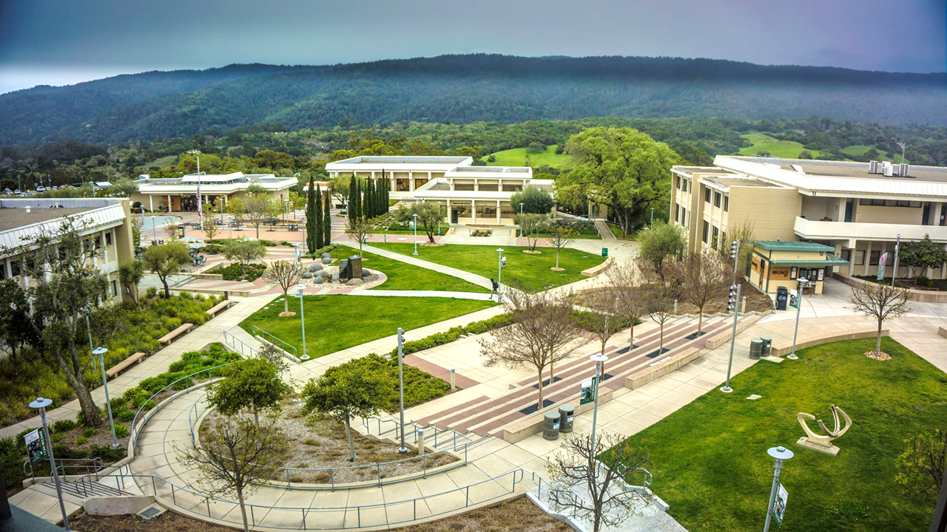

Slide 35
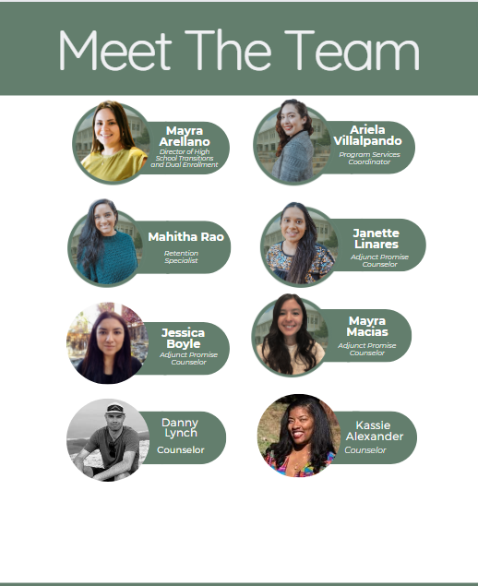
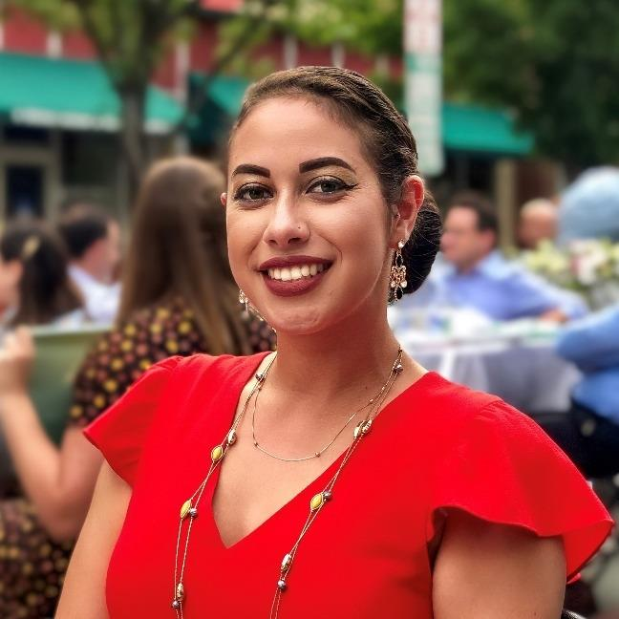
Promise Scholars Team
Daryan Chan
Counselor
Jilian
Gomez
Counselor
Notes:
Mayra

Slide 36
Evolution of PSP
Enrollment Numbers | Fall 2018 | Fall 2023
 | 327 - FT Program | Total: 617 576 - FT Program 27 - Leave of Absence 41 - PT Program 6 - Leave of Absence
Notes:
Mayra

Slide 37
Demographics
AY 2022-2023 | PT Promise | FT Promise | College Comparison
American Indian/Alaskan Native | 0% | 0% | < 1%
Asian | 0% | 5% | 14%
Black Non-Hispanic | 12% | 5% | 3%
Filipino | 4% | 1% | 6%
Hispanic | 60% | 65% | 41%
Multiraces | 0% | 4% | 6%
Pacific Islander | 4% | 2% | 2%
Unknown | 8% | 2% | 4%
White Non-Hispanic | 12% | 16% | 24%
Notes:
Karen

Slide 38
Demographics
AY 2022-2023 | PT Promise | FT Promise | College Comparison
Average Age | 38.6 | 20.0 | 27.8
Median Age | 35.5 | 19.0 | 23.0
Female | 88% | 52% | 57%
Male | 4% | 44% | 40%
Low Income | 48% | 48% | 23%
First Generation | 80% | 72% | 48%
College for Working Adults (CWA) | 58% | 1% | < 1%
Avg. Units Entering | 38.0 | 16.8 | 35.7
Avg. Units Attempted | 11.7 | 21.9 | 14.1
Avg. Units Completed | 7.2 | 14.2 | 10.0
Notes:
Karen

Slide 39
Programs of Study by Interest Area
AY 2022-2023 | PT Promise | FT Promise | College Comparison
Art, Design, and Performance | 8% | 14% | 6%
Business | 31% | 18% | 11%
Human Behavior and Culture | 50% | 21% | 17%
Science and Health | 8% | 36% | 14%
CSM/SKY Program | 0% | 6% | 16%
Undecided/University Transfer | 4% | 4% | 37%
Notes:
Karen

Slide 40
Pillars of Promise Scholars Program
Counseling
First Year
Experience
Graduation/
Transfer Support
Career/
Major Exploration
Probation Students/
Early Alert
CRER 401:
College Success
Welcome Day
First Year Workshops by Promise Counselors and Cañada Departments
Time Management/ Study schedule check-ins with RS
CRER 110:
Transfer center workshops
Scholarship Support
Alumni panels
Field Trips
Job search resources
CRER 137
Career Center Job Fair/ Internship Fair
Promise hosted Interest Area workshops
Speaker series
Retention Specialist Support
Probation workshops
Tutoring referrals
Other student services
The Root of our Work: Anti-Racism and Equity Practices
Notes:
Mahitha

Slide 41
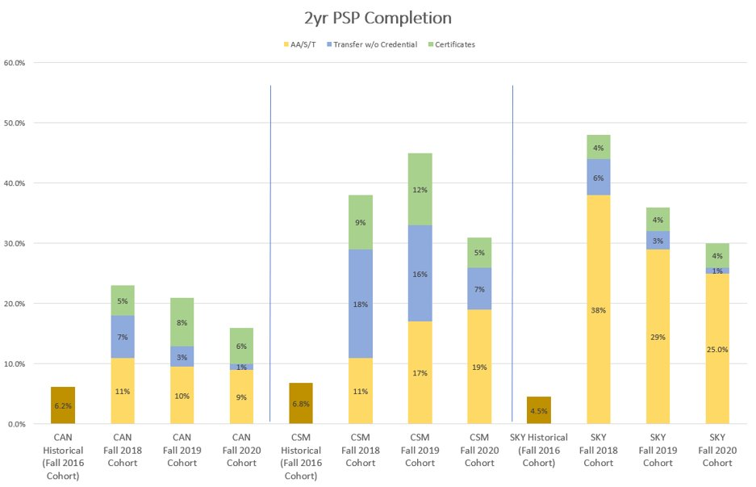
Early Successes​- 2 year Completion Rates
Notes:
Janette

Slide 42
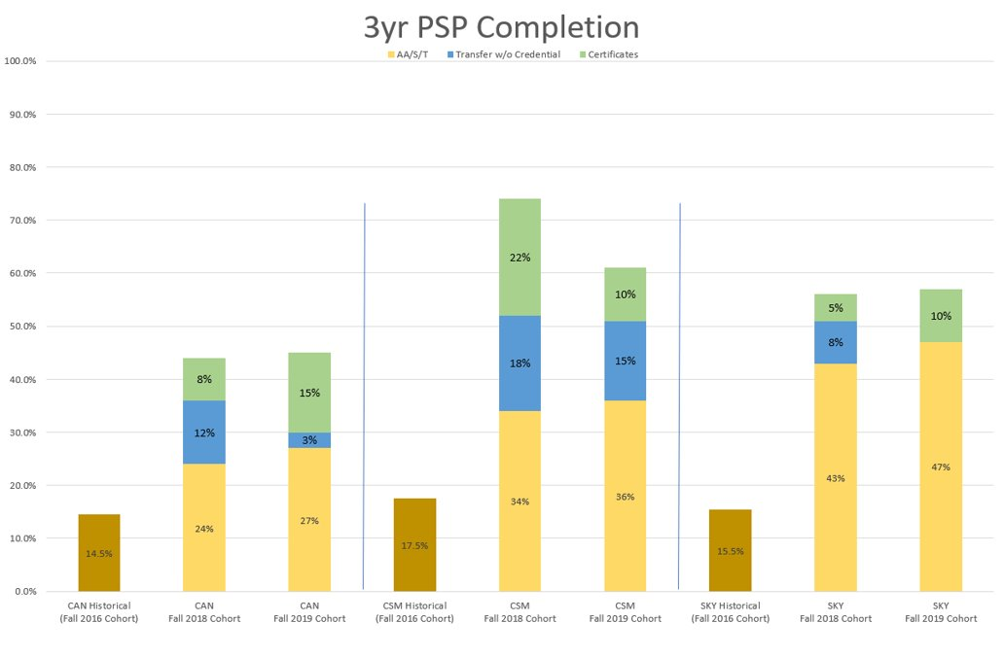
Early Successes​- 3 year Completion Rates
Notes:
Janette

Slide 43
Caseload Management for Counselors
Need based, student-centered approach
Data driven
Emphasis on retention and engagement
Specific benchmarks (i.e career, transfer, financial, etc.)
Culturally responsive programming
CRER 410: Transfer Essentials
Notes:
Janette

Slide 44
Promise Audience Questions/Comments
How does your program/services support transfer?
The Promise Program at Cañada College offers various services and support for transfer students, including career courses, transfer workshops, scholarship support, alumni engagement, field trips, internship opportunities, and job assistance.
What was the outcome?
The completion rates for Promise students have shown improvement over the years, with a 2-year completion rate of 6% for Fall 2020 and a 3-year completion rate of 15% for Fall 2019.
What did we learn?
The program takes a student-centered approach, uses data to inform decision-making, and focuses on retention and engagement to ensure students complete their degrees or certificates on time.
What do you need to enhance your transfer services?
The presentation highlights a need for better collaboration with other programs and departments to ensure that Promise students have access to resources and support beyond the program's offerings. Additionally, there is a suggestion to investigate the success of Promise students in their initial English and math courses and consider replicating this model for non-Promise students.
Possible Actions based on the provided information:
Analyze First-Year Success: Evaluate the success rates of Promise Program students in their initial English and math courses compared to non-Promise Program students. This analysis can provide insights into the impact of the program and help identify strategies that can benefit a broader student population.
Long-Term Tracking: Continue to track Promise Program students beyond the expected 3-year completion period. Analyze the outcomes for students who don't complete within the expected timeline. Explore ways to support these students, including potential transfer pathways, additional support services, or alternative education plans.
Collaboration and Data Sharing: Foster greater collaboration between the Promise Program and other departments, such as the Transfer Program or EOPS, to ensure a holistic approach to student success. Share data and insights to identify opportunities for shared support services, workshops, and resources.
Further Improve Undecided and Transfer Support: Given that some students remain undecided about their majors and transfer pathways, develop strategies to assist them in making informed decisions. Offer resources, workshops, and counseling to guide students toward suitable majors and prepare them for successful transfers.
Early Alert and Retention Strategies: Continue to focus on early alert systems and retention strategies to proactively address students who may be struggling or at risk of not completing within the expected time frame. Implement interventions to support their academic progress and personal development.
Continuous Program Evaluation: Regularly evaluate the Promise Program's effectiveness and adjust strategies based on the evolving needs and demographics of the student population. Ensure that the program remains adaptable and responsive to student needs.

Slide 45
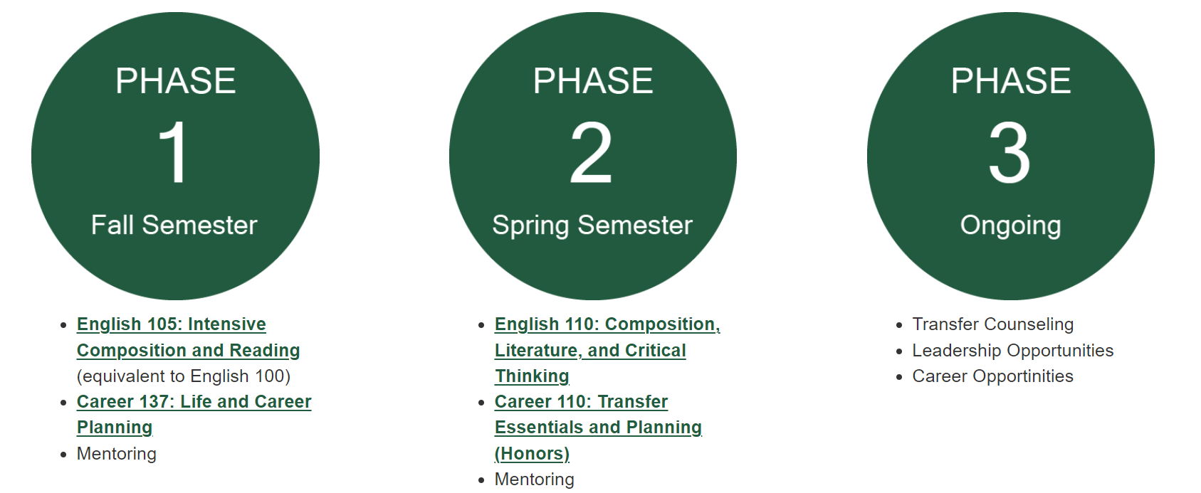
5. Puente
Puente Project Mission Statement
The mission of the Puente Project is to increase the number of educationally underserved students who enroll in four-year colleges and universities, earn degrees, and return to the community as leaders and mentors to succeeding generations.

Slide 46
Audience Questions/Comments

Slide 47
8. Living Promise MOU
Notes:
July 2022: Executive Director Middle College/College and Career, Stephen Redmond
July 2022: Student Success Liaison, Louisa Song
July 2023: Counselor, Lisa McCahon
•Spring 2022: Two-day retreat with 15 participants
• Spring 2023: Two-day retreat with 20 participants
• Fall 2023: Two-day retreat with 80 participants
• Spring 2024: Two-day retreat
• Summer 2024: Two-day retreat
·Graduating Seniors (2,200) received an acceptance letter from Cañada College
·Juniors and Seniors (4,400) received a letter from Cañada College to participate in the Concurrent Enrollment Program
·Seniors submitted FAFSA or DREAM Act Applications for 2020-21, 2021-22, and 2022-23
o2022–23: 73% submitted
o2021–22: 58% submitted
o2020–21: 57% submitted
2023-24: Year Two
§Continuing work from Year One
§Establishing early college access to Ravenswood City School District students
2024-25: Year Three
§Continuing work from Year One and Year Two
§Developing pathway with Sequoia District Adult School
§Developing transfer pathway from Cañada to SFSU and CSU East Bay

Slide 48
Living Promise MOU Audience Questions/Comments
Program/Services Supporting Transfer:
The program, called the Living Promise MOU, is a collaboration between Cañada College, Sequoia Union High School District, Ravenswood City Schools, San Francisco State, and Cal State East Bay. Its primary focus is on early college access for high school students, particularly through dual enrollment and middle college programs. These programs aim to expose high school students to college-level courses and provide them with a head start on the transfer route.
What was the outcome?
It was to double of the size for Middle College and increase 2 dual enrollment courses every academic year. It is clear that there has been progress in implementing the dual enrollment and middle college programs, as well as an increase in the number of students participating. Success rates for students in the dual enrollment program are notably high, with an 83% completion rate. The program is moving toward its goal of doubling the Middle College program within the next 3 to 4 years.
What We Learned:
The conversation highlights the importance of early intervention and support for high school students. It emphasizes that many high school students do not have a clear plan for their educational path and may benefit from early exposure to college coursework. There is recognition that these students need guidance on what is required to succeed in college, including understanding assignments outside the classroom. Additionally, there is an understanding that collaborative efforts are necessary to ensure the success of these programs.
Enhancements Needed for Transfer Services:
To enhance transfer services, the following areas need attention:
Space Planning: As the middle college program expands, there is a need for early planning to accommodate the growing number of high school students on the college campus. This includes finding appropriate, integrated space for these students.
Communication and Integration: Efforts should be made to better integrate dual enrollment students into the Cañada College community and ensure they are aware of the college's offerings. More proactive communication is required to establish Cañada as a primary choice for these students.
Resource Allocation: As the programs grow, allocate additional resources, such as staff and support services, to meet the needs of an increasing number of students.
Student Outreach: Continue efforts to promote the benefits of dual enrollment and early college access to high schools and students, emphasizing that college is a viable path for a wide range of students.
Planning and Evaluation: Develop a clear plan for program expansion, including timelines and resource allocation. Regularly assess the success of the dual enrollment program and make adjustments as needed to improve outcomes.

Slide 49
Closing
In the closing remarks, Paul expressed gratitude for the positive reception of Ray's input and emphasized the challenges in improving transfer services. Key points in the closing remark include:
Acknowledgment of Challenges: The speaker recognized the difficulties in making decisions about programs and services, often involving trade-offs and the need to choose strategically.
Historical Perspective: The speaker, with 30 years of experience, reflected on the numerous initiatives and efforts that have been tried in the past to improve transfer rates.
The Need for Evidence: There was an emphasis on the importance of measuring the effectiveness of these initiatives and the challenge in finding the necessary data to assess their impact.
Openness to Change: The speaker encouraged a willingness to reconsider traditional approaches that may no longer be effective.
Collective Goal: Highlighted the shared goal of increasing transfer rates and recognized it as a challenge not limited to a specific institution but a statewide issue.
The closing remarks underscored the importance of reevaluating approaches, measuring outcomes, and working collaboratively to address the challenge of improving transfer rates in a broader context.

Slide 50
Meeting 2: November 3
Introduction 2 min
Framing 10 min
STEM/NSF/TRABAJO (5 min presentation & 5 min Q&A)
HTP (5 min presentation & 5 min Q&A)
PTK (5 min presentation & 5 min Q&A)
Umoja (5 min presentation & 5 min Q&A)
Transfer Plan (5 min presentation & 5 min Q&A)
Colts-U Transfer Center (5 min presentation & 5 min Q&A)
(a) Transfer services and support, (b) Articulation, and (c) University Programs: AANAPISI ARC Transfer Pathway to SF State and NDNU B.A. Degree Completion programs
EOPC (5 min presentation & 5 min Q&A)
TRIO (5 min presentation & 5 min Q&A)
Athletics (5 min presentation & 5 min Q&A)
Curriculum Committee (5 min presentation & 5 min Q&A)
Closing 2 min

Slide 51
Framing

Slide 52
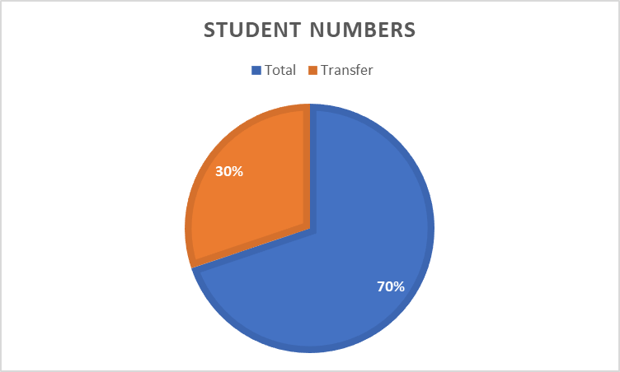
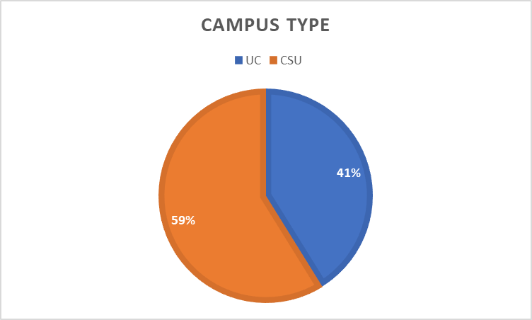
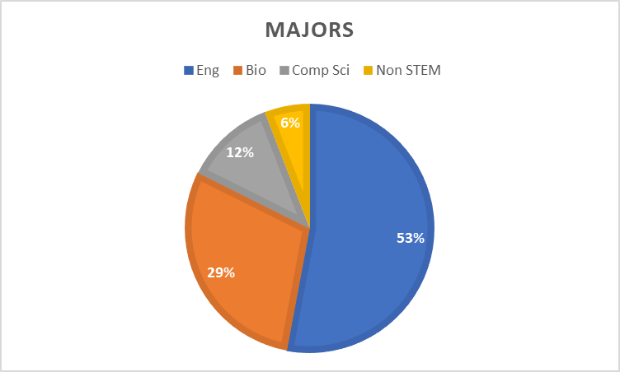
1. STEM/NSF/TRABAJO
TRABAJO – Training and Research Activities to Better Access Job Opportunities

Slide 53
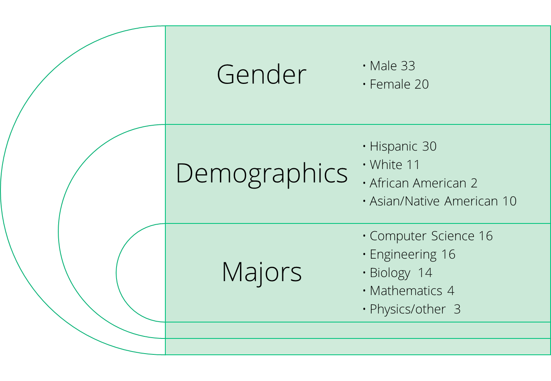
STEM/NSF(ASCENT)/TRABAJO
NSF ASCENT (Achieving Success in College through Education, Network and Transfer​
Project Accomplishments
53 Scholars so far
43 Transferred to UC/ CSU
7 getting ready to transfer in Spring 2024
https://canadacollege.edu/nsfscholar/

Slide 54
Audience Questions/Comments

Slide 55
2. Honors Transfer Program (HTP): How does the program/service support transfer?​
Opportunities for all students to be engaged in high caliber meaningful honors projects -signature assignments key for minoritized students
Notation on transcript of Honors course work for all students. “Evidence of enhanced rigor” for transfer institutions
Student individual work with faculty in honors courses and contracts often leads to strong letters of recommendation for transfer applicants
Honors work can be discussed in the personal insight questions contributing to the strength of student applications for transfer
Student completion of HTP significantly increases their chances of transfer
Student completion of HTP significantly increases access to scholarships and financial aid at transfer institutions
Notes:
Course Enrollments (at census)
2017/18: 215
2018/19: 202
2019/20: 246
2020/21: 177
2021/22: 219
F22: 65 sp?
Fall 23: 68 spring not in yet
Honors Contract Proposals
2017/18: 54
2018/19: 67
2019/20: 59
2020/21: 51
2021/22: 41
Fall 23: 36 (only the fall. Spring not in)
HTP Student Membership
Sp18: 52
Sp19: 78
Sp21: 100
Sp22: 108
Sp 23: 120?
Fall 23 88 (spring 24 not in)
With new GPA 433 eligible students

Slide 56
2. HTP: What do you need to enhance your transfer services?​
More support for faculty doing contracts so students have more options – Honors Contract Faculty Professional Development Mentor Program
More honors only courses so honors students have the benefit of a cohort*
Continued funding of Honors Student Ambassador to help share information via office hours, events, presentations, flyers, videos, & social media with Promise, Puente, Umoja, EOPS, TRIO, Athletics, ESL, International Student Center, Undocumented CC, and STEM and Latinx events, and BIPOC students across the college and at local high schools.
Continued promotion and two sections of IDST 150 Honors Research Seminar
IDST Video by Honors student Arya Shadan. IDST Video by HTP Coordinator
Better tracking and systems in collaboration with others in Transfer and PRIE
Intent to transfer form, Calendly, formstock, canhonors, google sheets,
Help from PRIE sorting applicant info. Reconsideration of CC and IPC
Dedicated Honors Counselor and Program Assistant (maybe with others in Transfer?)
*Marketing for honors courses (Newsletter, flyers, social media, planning a year ahead)

Slide 57
Audience Questions/Comments
How does the program/service support transfer?
What was the outcome?
What did we learn?
What do you need to enhance your transfer services?
Possible Actions based on the provided information:

Slide 58
3. Phi Theta Kappa PROGRAM - PTK

Slide 59
Audience Questions/Comments

Slide 60
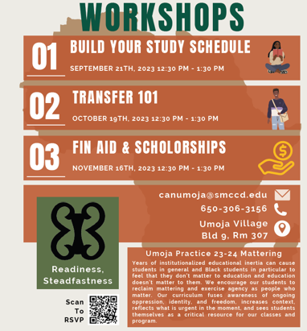
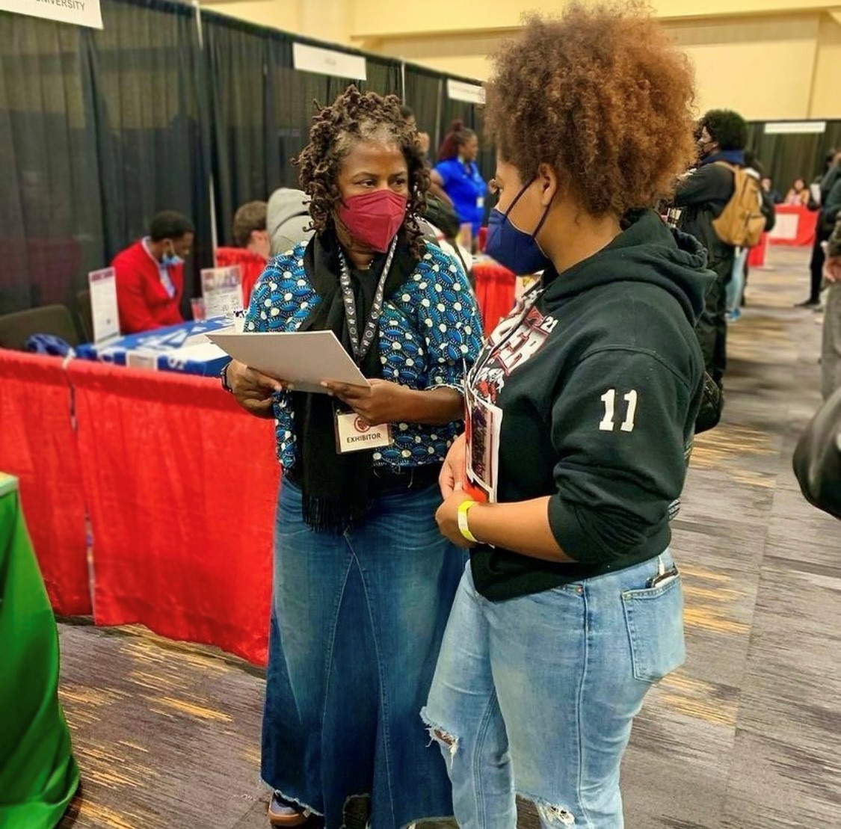
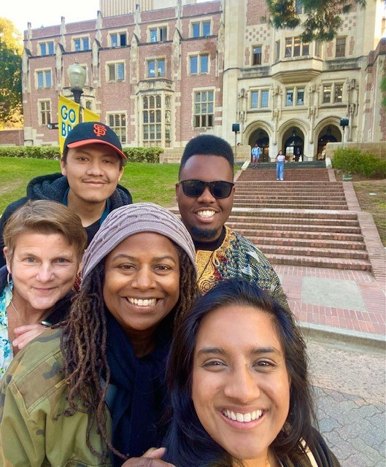
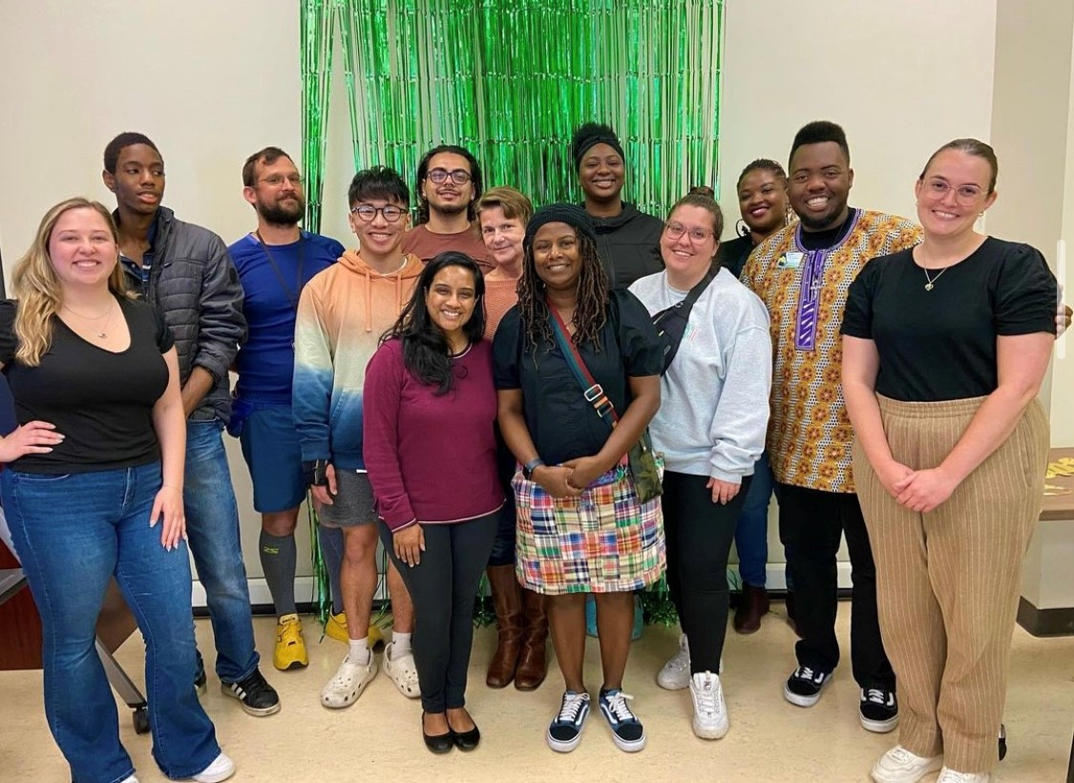
Umoja Cohort Classes
Fulfill General Education Classes for Transfer
Fall: ENGL 100, PLSC 210
Spring: ENGL 110, PLSC 310, MATH 200
Campus visits
Partnership with HBCU’s
Collaboration with conferences (SF State, UCLA, Black College Expo)
Connection to Black Student Services on transfer campuses
Transfer Counseling Services
Transfer workshops
CSU/UC/HBCU application assistance
Student Education Plans working towards transfer goal
Student Engagement College Community
Black Student Union
Black Students Matter Committee

Slide 61
Audience Questions/Comments

Slide 62
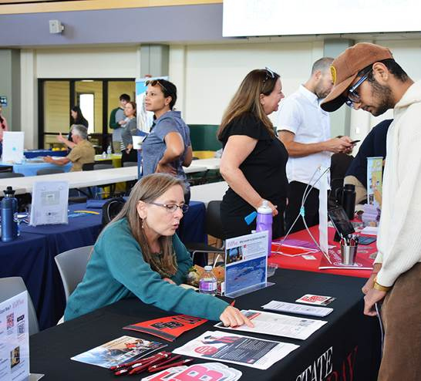
5 & 6: Transfer Plan and
COLTS-U Transfer Center
Fall 2023
Updated 11.3.2023

Slide 63
5. Transfer Plan
College-wide committee designated by PBC to “develop, promote, and scale up college activities that promote transfer success”*
Objective #1: Identify the support, milestones, and gaps in the transfer journey for students.
Objective #2: Build and strengthen relationships with universities and high school partners.
Objective #3: Identify and address equity gaps in transfer support services.
Objective #4: Create a campus culture, across all levels and functions, that actively commits to supporting the transfer success of our students.
*Source: Cañada College Transfer Services Plan 2021-2024, PBC Transfer Planning Task Force, May 5, 2021

Slide 64
Located in Building 9, Room 106, We offer... * Transfer Counseling
*Articulation * Transfer Services and Support * University Programs: AANAPISI ARC Transfer Pathway to SF State and NDNU B.A. Degree Completion programs

Slide 67
Transfer Services and Support
Transfer Communication Strategy
Transfer Center website
Transfer Milestone Dashboard
NEW program Canvas shell
Outcomes:
New links on website, including university partnerships and programs
# of students with transfer as an educational goal: 1,941 (as of 10.30.23)
# of students in program Canvas shell: 755 (as of 11.3.23)

Slide 68
Transfer Services and Support
Transfer Student Engagement
Transfer Day
University field trips
NEW Transfer Student Club
Outcomes:
# of universities participating at Transfer Day: 40
# of students at Transfer Day: 58+
# of students total for university visits: 25 (4 trips)
# of students interested in joining the new student club: 15

Slide 69
AANAPISI ARC Initiative
Title 3: Asian American and Native American Pacific Islander Serving Institution grant
At least 10% identified as Asian American and Native American Pacific Islander at least 50% are Pell eligible
Supports Asian American, Pacific Islander, first-generation and low-income students (historically underserved population)
At Cañada College (2022-2023 Headcount)
Asian - 15% (1489)
Filipinx - 6% (579)
Pacific Islander- Less than 1% (150)
Launched this Fall 2023
Partnership with San Francisco State University in collaboration with CSM & Skyline

Slide 70
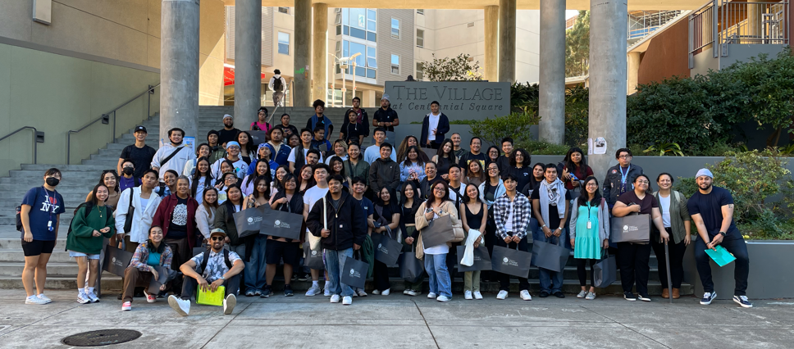
AANAPISI ARC Initiative
ARC Transfer pathway program
Case management
Peer mentoring
Campus visits
Culturally responsive activities and transfer pathway workshops

Slide 71
NDNU x SMCCCD Partnership
NDNU Bachelor’s Degree Completions: Business Administration (100% online) and Psychology (hybrid)
AS-T Business & AA-T Psychology
Full-wrap around services
Graduate mentoring program
Academic support
High-touch career readiness
Financial literacy peer-coaching
The program also offers personal counseling and health services to the students

Slide 72
NDNU x SMCCCD Partnership
Addressing Equity:
$10,000 institutional aid for Pell eligible students
No textbook cost
Accessible (evening programs) online & hybrid
High-touch and wrap around support
Key Takeaways
Alternative option for students – small class sizes & high-touch 1:1 faculty and staff support
Proactive outreach to students who completed ADTs in Business Administration and Psychology but never transferred
Similar enrollment struggles with other small liberal arts colleges

Slide 73
Audience Questions/Comments

Slide 74
Audience Questions/Comments

Slide 75
7. EOPS/CARE/NextUp/FYSI

Slide 76
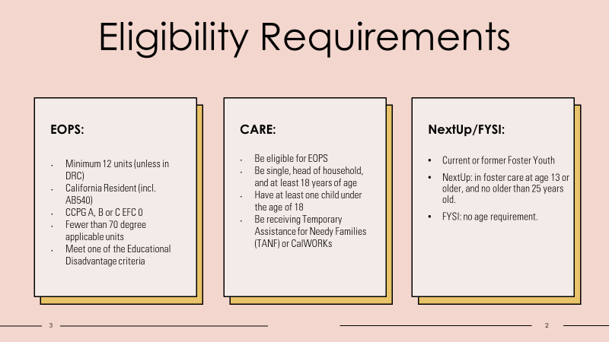

Slide 77
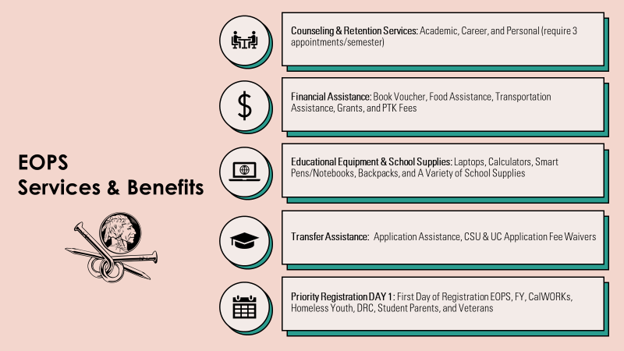

Slide 79
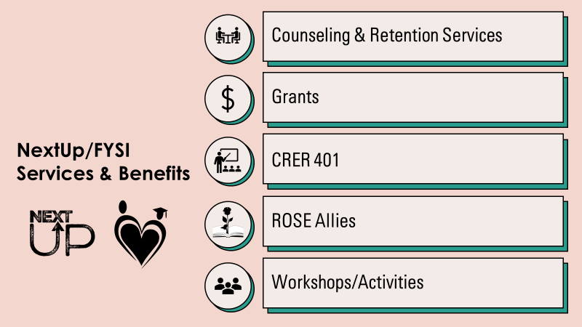

Slide 81
EOPS/CARE/NextUp/FYSI Transfer Supports & Information
Transfer application fee waivers
4 CSU
4 UC
Assist with private universities
Can pay for more if budget allows.
Group Counseling Sessions
Collaborate with the Transfer Center
CSU Dual Enrollment Assistance
Campus Tours
Collaboration with programs on campus
Souther California Tours collaboration with districtwide EOPS
Counseling
Additional counseling appointments available
Graduation Petitions
Drop-in every Monday
Drop-in Nov 30
2022-23 Graduates Stats
45 Graduates/Transfer Students
31 students earned 33 ADTs and 30 Transferred

Slide 82
Audience Questions/Comments

Slide 83
8. TRIO
TRIO Student Support Services (SSS) is a program funded by the United States Department of Education. Our goal is to provide an academic, social, and personal support system for first-generation, low-income, and/or students with disabilities, to assist them with certificate and degree college requirements, the transfer process, and to motivate them towards successful completion of their college education.
Services offered specifically related to Transfer:
Workshops on Transfer (hybrid, video available for students after event)
Counseling (offered on phone, zoom, and in-person, evening hours)
College/University Tours (in partnership with Colts U Transfer Center & others)
Data Per the Dept. Of Education Annual Performance Report on our TRIO SSS at Cañada. AY 22-23 numbers will become available in December 2023.
What did we learn? Higher completion rates during the pandemic, possible correlation between access (courses, workshops, etc.) and completion.
What do we need? Strategic partnerships, funding, & students enrolling to Cañada.
TRIO Student Support Services APR Objective | AY 19-20 | AY 20-21 | AY 21-22
Degree or Certificate Completion | 33% | 41% | 33%
Degree or Certificate Completion + Transfer | 28% | 23% | 27%

Slide 84
Audience Questions/Comments

Slide 85
9. Athletics

Slide 86
COLTS Learning Community

Slide 87
Audience Questions/Comments

Slide 88
10. Curriculum Committee
The articulation officer and curriculum committee support transfer by:
articulating our courses
ensuring that, to the extent possible, our transfer courses align with Cal-GETC (the single UC/CSU transfer path)
identifying courses appropriate for transfer or GE as courses come through curriculum
working with CSM and SKY to increase district alignment of courses
adding curriculum updates to Program Maps to ensure students have current information
(counselors) placing all non-UC bound students who indicate "transfer" as their goal on an AD-T
enabling units earned across the district, rather than just those earned at Cañada, to be applied toward degrees (F 24 catalog update)
nudging faculty to assess and offer credit for prior learning as earned by exams, military experience, and work

Slide 89
Curriculum Committee Outcomes
We have achieved district alignment in course numbers (SPAN, ENVS, ANTH) and implemented a new policy to allow students to take courses in their major at any of the three district colleges.
We have formulated a district workgroup to collaborate on the implementation of ABs 928 (Cal-GETC single transfer path) and 1111 (Common Course Numbering).
We updated the use of Defense Language Proficiency Exam (DLPE) scores as follows [in red]: "San Mateo County Community College District may award three units (semester) in CSU GE Breadth Area C2 (Humanities); or 3 units for the associate degree general education Area C2 (Humanities) at Skyline College and Cañada College, or Area E5C (Humanities) at College of San Mateo; utilizing credit recommendations from the American Council on Education (ACE)."
We are creating a single transfer GE pattern, in accordance with AB 928

Slide 90
We have learned that:
Now: the articulation officer and chair need to explain these changes to faculty, as they will affect course offerings and CORs
Soon: we will need substantial clerical assistance to update all of our courses to the common course numbers, descriptions, and other elements required by AB 1111 (beginning SP 24; likely full implementation by F 27)
Soon: Cañada will need to revisit our local associate degrees to determine what is now required by Title 5 and the Chancellor's office and whether or not we want our local degrees to emulate the Cal-GETC transfer path

Slide 91
Audience Questions/Comments

Slide 92
Closing

Slide 93
Members
Student: Student Senate
Transfer Center: Max, Gloria, Mary, Gonzalo, James (PSC), Soraya,
Transfer Plan responsible parties: Max, Gloria, Mary, Gonzalo, James (PSC), Soraya, Manuel
STEM/NSF: Rance Bobo, Sumathi,
Academic Senate leaders: David Eck, Gampi,
Classified Senate leaders: Maria H, Alex C, Jeanne S
HTP: Rebekah, Susan, Sarah
PTK: Paul R, Gampi, Autumn
GP: David M, Denise, David M, Gampi, Ron, Retention Specialists (John, Diego, Jackie, Autum), Counselors (Chris Rico, Daryan, Sandra Rodrigues, Gloria)
Middle College: Stephen, teachers?
Promise: Mayra, Counselors (Danny Lynch, Kassie Alexander, Jessica Boyle), PSC (Ariela Villalpando, Mahitha Rao)
Umoja: Lezlee W, PSC (Lezlee Ta), Autumn, Mahitha
Puente: Yolanda, Sandra Mendez
EOPS: Lorraine Barrales-Ramirez, Jos Romero, Sarah Aranyakul
TRIO: Maria Huning, Candice Johnson
Athletics: Kat, Nike Martine, Erik Gaspar
Curriculum: Lisa P, Bob Lee, David M
AB1705: Ray, Lisa Palmer, Michael Hoffman, Sumathi
EAPC rep: Kiran, Michiko, Krystal
Deans: James, Ameer, Anniqua, Karen, Hyla, Kat

