Slide 1

Annual Plan for EMP Implementation
Planning & Budgeting Council
September 3, 2025

Slide 2


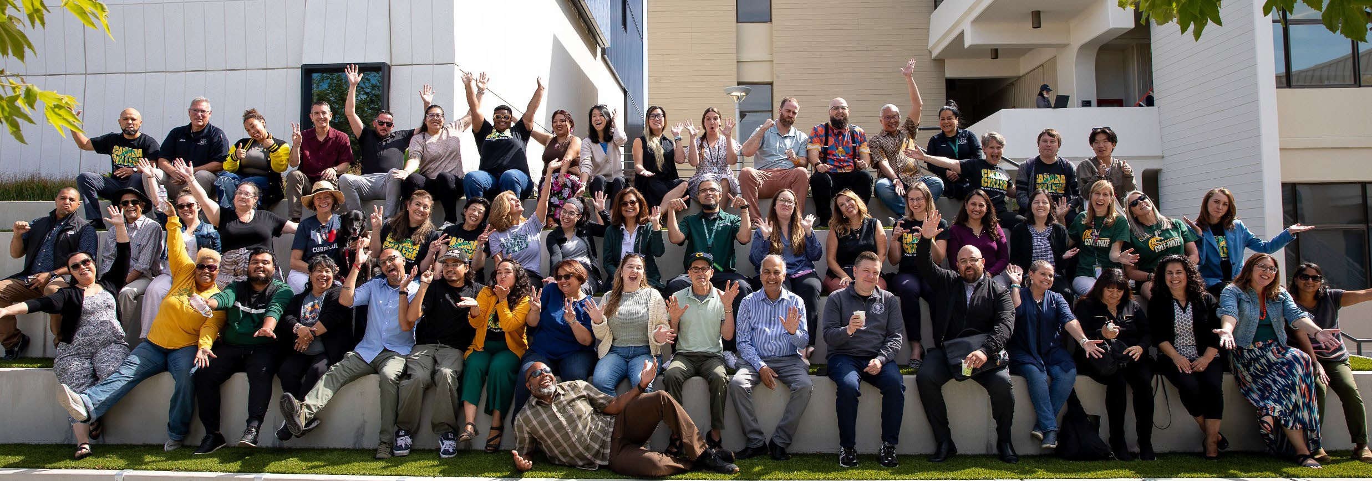
60+ students, faculty, classified staff and administrators participated
4 breakout sessions focused on choosing the top priorities for 2025-65
Check https://canadacollege.edu/plans/leadership-retreat.php for more info

Slide 3

20
18
16
14
12
10
8
6
4
2
0
19
15
15
14
12
12
9
7
4
4
3
3
Goal 1
Goal 2
Remaining as of 2024
Goal 3
Remaining as of 2025
Goal 4
Original total

Slide 4



Goal 1: Student Access, Success, and Completion
Goal 2: Equity-Minded and Antiracist College Culture
1.15 Create and scale the First Year Experience Program
1.8 Ensure academic program viability
2.6 Improve faculty and staff hiring practices to ensure a diverse pool of applicants
Goal 3: Community Connections
Goal 4: Accessible Infrastructure and Innovation
3.11 Create and expand career exploration experiences for students
4.1 Improve access to campus via public transit, rideshare

Slide 5
Goal 1: Remaining Initiatives
EMP Strategic Initiative # | Initiative Title | Initiative Description
1.8 | Ensure academic program viability | Ensure all academic degree and certificate programs remain viable and strong and that they adapt to the changing needs of students and employers in Cañada’s service area.
Notes:
Chialin/David Eck/Gampi

Slide 6
1.8 Momentum or Accomplishment
The Academic Senate approved the Program Improvement and Viability (PIV) Process (Sept. 2024) as college's official process.
The college utilized the PIV process to review and recommend discontinuing the Funeral Service Education Degree and Certificates.
The Academic Senate will revisit the PIV process based on the experience to consider possible improvements during the 2025-2026 academic year.
Notes:
Chialin/David Eck/Gampi

Slide 7
1.8 Challenges in implementation
Ownership: Faculty are the program. Their buy-in is essential for successful change, but their personal stakes make this difficult.
Expertise vs. Market Needs: Their deep expertise might be in areas no longer in high demand, creating a fundamental misalignment.
Data and Market Uncertainties: there can be insufficient or conflicting data when forecasting the future of a program, especially a new program.
Governance: the PIV process is time intensive, which creates a challenge as a faculty-led process.
Enacting Program Improvements: if substantial changes are recommended, success hinges on faculty possessing or acquiring the necessary skills to implement.
Notes:
Chialin/David Eck/Gampi

Slide 8
1.8 Discussion and Recommendations
Some possible revisions to the current PIV process
  Review committee report through IPC and Academic Senate simultaneously rather than in sequence. --Current process effectively requires an entire semester to complete the participatory governance review, which is separate from the committee's public meetings.
Finalize Academic Senate project of New Program Development process. --Could create better goals for new programs, simplifying the PIV process for any new programs.
Other ideas?
Notes:
Chialin/David Eck/Gampi

Slide 9
Goal 1: Remaining Initiatives
EMP Strategic Initiative # | Initiative Title | Initiative Description
1.15 | Create and scale the First Year Experience Program | Create (by 2023) and scale (by 2025) the First Year Experience program for all incoming students, including default course schedules for some first-time cohorts.
Notes:
Ron/Anniqua

Slide 10
1.15 Momentum or Accomplishment
Cañada Retention and Engagement Work Group (CREW) documentation of activities
  Super Registration events
  First semester Counseling and SEP
  Pre-semester orientation, classes, and workshops
Identified gaps lead to piloting new activities e.g. Welcome Week workshops
Working collaboratively
Notes:
Ron/Anniqua

Slide 11
1.15 Challenges in implementation
Ambiguity regarding the meaning of "First Year Experience" in our specific college context
Even with CREW, coordination can be complicated as we are also working towards individual program goals
Notes:
Ron/Anniqua

Slide 12
1.15 Discussion and Recommendations
What are the primary goals of the FYE program?
  Clarify whether the focus is on increasing retention, improving academic readiness, building a sense of belonging, or supporting student navigation of college systems
To what extent do we envision a FYE program integrated into the larger institutional structure?
  How might a program connect with academic departments, student services, Interest Areas, and other existing initiatives to avoid duplication and ensure coherence
Notes:
Ron/Anniqua

Slide 13
Goal 1: Remaining Initiatives
EMP Strategic Initiative # | Initiative Title | Initiative Description
3.11 | Create and expand career exploration experiences for students | Create and expand career exploration experiences (such as work-based learning, internships, and job shadow opportunities) for students during their time at Cañada, particularly during their First Year (in each Interest Area), as they choose a program of study and refine their education goals. Close racial equity gaps in access to career development and job placement opportunities.
Notes:
Ron/Anniqua

Slide 14
3.11 Momentum or Accomplishment
  College Central platform centralizes employer data, improving tracking, communication, and event coordination.
  2,000 employers and 3,200 students actively use the job board.
  Career Center prepares students for job/internship searches (resumes, interviews, etc.) and guides them on workforce development tools.
  Some Career Education programs offer internships, externships, and observational learning opportunities.
  Regular engagement includes 250–300 students served annually, weekly hiring/info sessions (40 employers, 60+ students), and job fairs (~60 employers, 170–200 students).
  Creation of Lead IA Counselor Reassigned time positions creates an opportunity to expand intentional career exploration efforts aligned with programs of study

Slide 15
3.11 Challenges in implementation
No major challenges explicitly noted, but areas for improvement include:
  Boosting student engagement beyond current participation levels.
  Expanding campus awareness and use of centralized employer data.
  Balancing personalized student support with growing employer and opportunity volume.
  CRER 137 no longer a selective in CALGETC

Slide 16
Goal 1: Remaining Initiatives
EMP Strategic Initiative # | Initiative Title | Initiative Description
2.6 | Improve faculty and staff hiring practice to ensure a diverse pool of applicants | Revise and improve faculty and staff hiring practices that recognize both traditional and nontraditional experiences and qualifications to ensure the hiring of a diverse pool of faculty and staff applicants.
Notes:
Ron/Anniqua

Slide 17
2.6 Momentum or Accomplishment
  New Equal Employment Opportunity Plan (EEO) at the District level
  The District EEOAC, Equal Employment Opportunity Advisory Committee, in which our Academic Senate President and Director of Equity are a part of, reviewed and revised a new plan to improve faculty and staff hiring practices that ensure hiring a diverse pool.
  College Professional Development progress in this area:
    Leading from the Middle Cohort for 2025-26 is working on a framework
    Our Professional Development Planning Committee is focused on this in the context of implementing our new college Professional Development Plan

Slide 18
2.6 Challenges in implementation
??

Slide 19
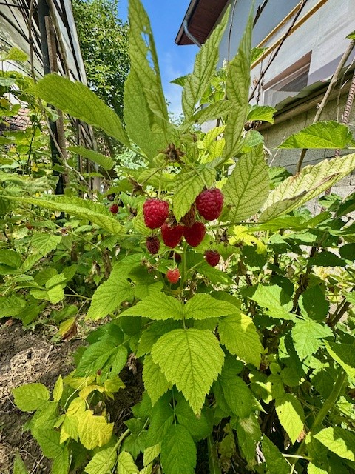
4.1 - Improve access to campus via public transit, shuttles, and additional partners such as
Lyft and Cruise.

Slide 20


History of Efforts:
Shuttle Services
Semester | Cost
Spring 2019 | $294K
Fall 2019 & Spring 2020 | $107K
Fall 2020 & Spring 2021 (Covid-19) | $0
Fall 2021 & Spring 2022 | $82K
Fall 2022 & Spring 2023 | $173K
Total | $657K
Low Ridership, serving no more that 10 students
Funding Source: Fund 1

Slide 21
10-12
Students supported by the Shuttle Services

Slide 22
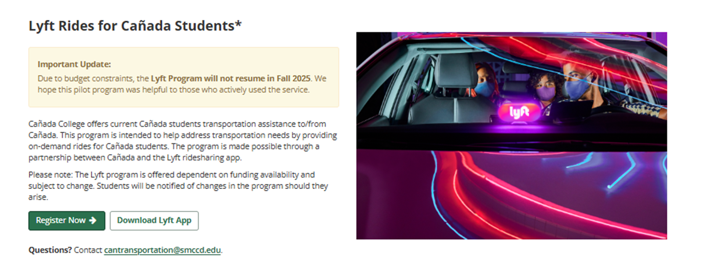
History of Efforts:
Lyft Services

Slide 23
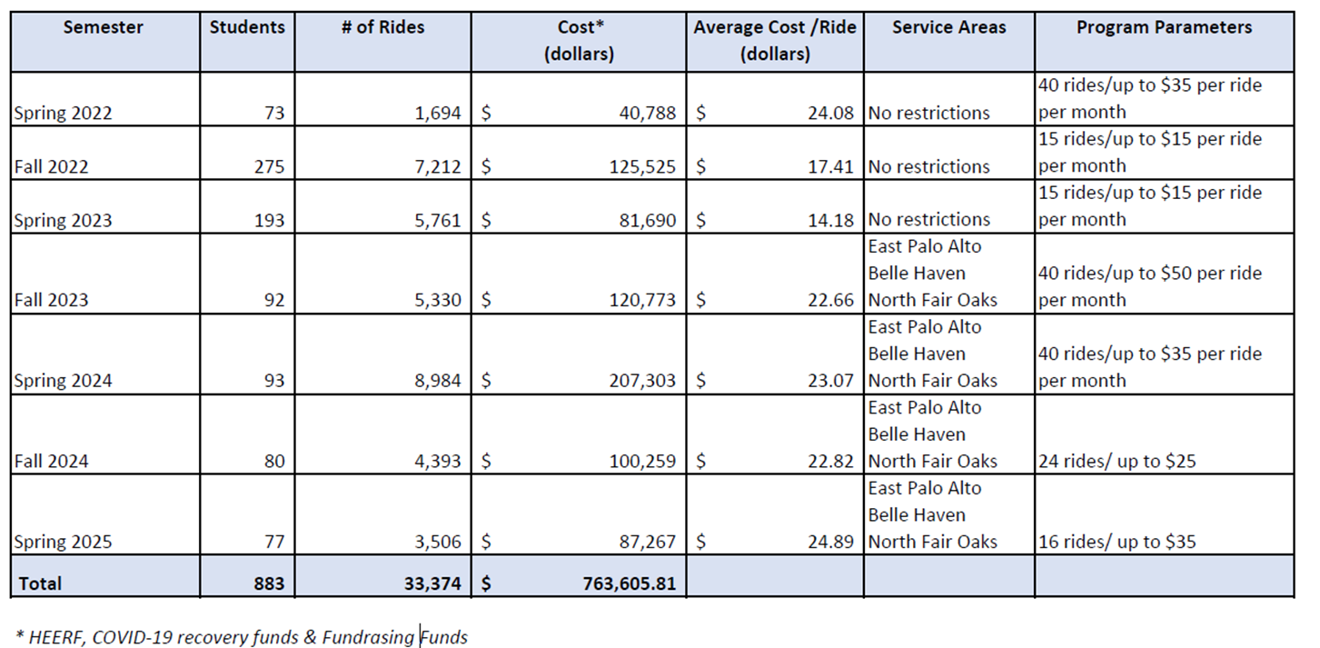
History of Efforts:
Lyft Services
23

Slide 24
History of Efforts:​
Lyft Services ​

Slide 25
883
Students supported by the Lyft
Pilot Programs

Slide 26
Lyft Challenges in Implementation
Funding Requirements:
  Estimated annual cost ranges from $250,000 to $500,000.
  Requires unrestricted funds (e.g., donations, grants, or special allocations).
  No existing budget line to support the program at this scale.
Sustainability Concerns:
  Need to ensure long-term funding beyond a pilot phase.
  Risk of starting a program without a secure multi-year funding commitment.
Equity and Access:
  Need to determine eligibility criteria (who qualifies and how often rides can be used).
  Must ensure the program benefits those with the highest need without creating disparities.

Slide 27
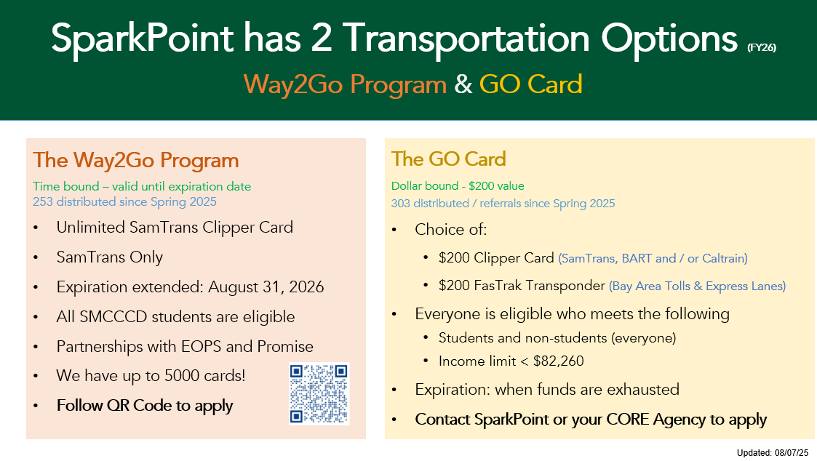
History of Efforts:
Spark Point

