Slide 1
Class Size Trends
Prepared by the Office of Planning, Research & Institutional Effectiveness (PRIE)
August, 2020

Slide 2
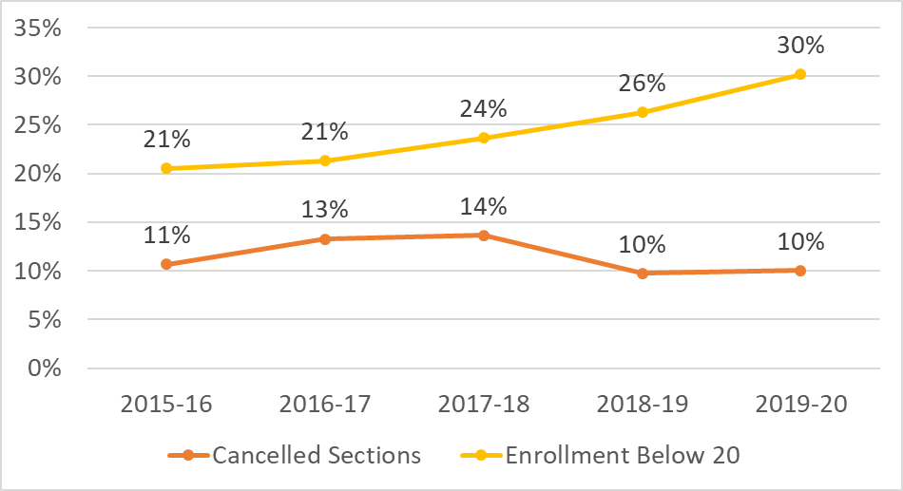
Cancelled and Low Enrolled Sections
Notes:
Cancelled and low enrollment courses
Over the past 5 years fewer class sections have been cancelled and more courses have been run with enrollments under 20.

Slide 3
Class Sizes: scheduled v. actual
Academic Year: 2018-19 (to exclude possible effects of campus closure due to COVID)
Notes:
Section Efficiency
Orange highlighted cells indicate courses that are under enrolled/lower efficiency.
Approximately 40% of sections in the 20 to 35 enrollment capacity are running with fewer than 20 students while
approximately 20% of courses with a course capacity of 36 to 74 are running with fewer than 20 students.
Interestingly, about 5% of courses in the 20 to 35 capacity courses are running with more than 35 students.

Slide 4
Actual v. Advertised Class Sizes in 2018-19 (exceptions such as English 100; Labs; MEDA removed)
 | FACE TO FACE Sections |  | HYBRID Sections |  | ONLINE Sections
# of Seats/Enrollments per Section | # of Sections at Advertised Capacity | # of Sections by Actual Enrollment | # of Sections at Advertised Capacity | # of Sections by Actual Enrollment | # of Sections at Advertised Capacity | # of Sections by Actual Enrollment
1 to 19 Seats/Enrollments | 2 | 145 | 0 | 20 | 0 | 15
20 to 35 Seats/Enrollments | 351 | 329 | 34 | 42 | 45 | 83
36 to 74 Seats/Enrollments | 231 | 110 | 35 | 7 | 185 | 133
75 or more Seats/Enrollments |  |  |  |  | 2 | 1
Notes:
Actual Class Sizes (with the exceptions removed)
Once these special cases are pulled out, the overall patterns remain largely unchanged. The issue that stands out is that approximately half of the remaining sections at best break even on load if they are all 35 capacity courses and fill up completely. This is entirely unlikely, and so with the special case courses removed half of the remaining sections are still pulling the load below the break even point.

