Slide 1


Strategic Enrollment Management Committee
Prepared by: Karen Engel & Julian Branch
Wednesday, February 27, 2019

Slide 2


Presentation Outline
Revisiting our Mission and Enrollment Goals
Market Positioning
What do students want?
Competitive Landscape
Our Program Portfolio
The Supply Landscape
Ways to Grow
Partnerships
Q&A

Slide 3

Mission
Cañada College provides our community with a learning-centered environment, ensuring that all students have equitable opportunities to achieve their transfer, career education, and lifelong learning educational goals. The College cultivates in its students the ability to think critically and creatively, communicate effectively, reason quantitatively, and understand and appreciate different points of view within a diverse community.

Slide 4
Where We Are Today
Total Head Count: 10,876

Slide 6
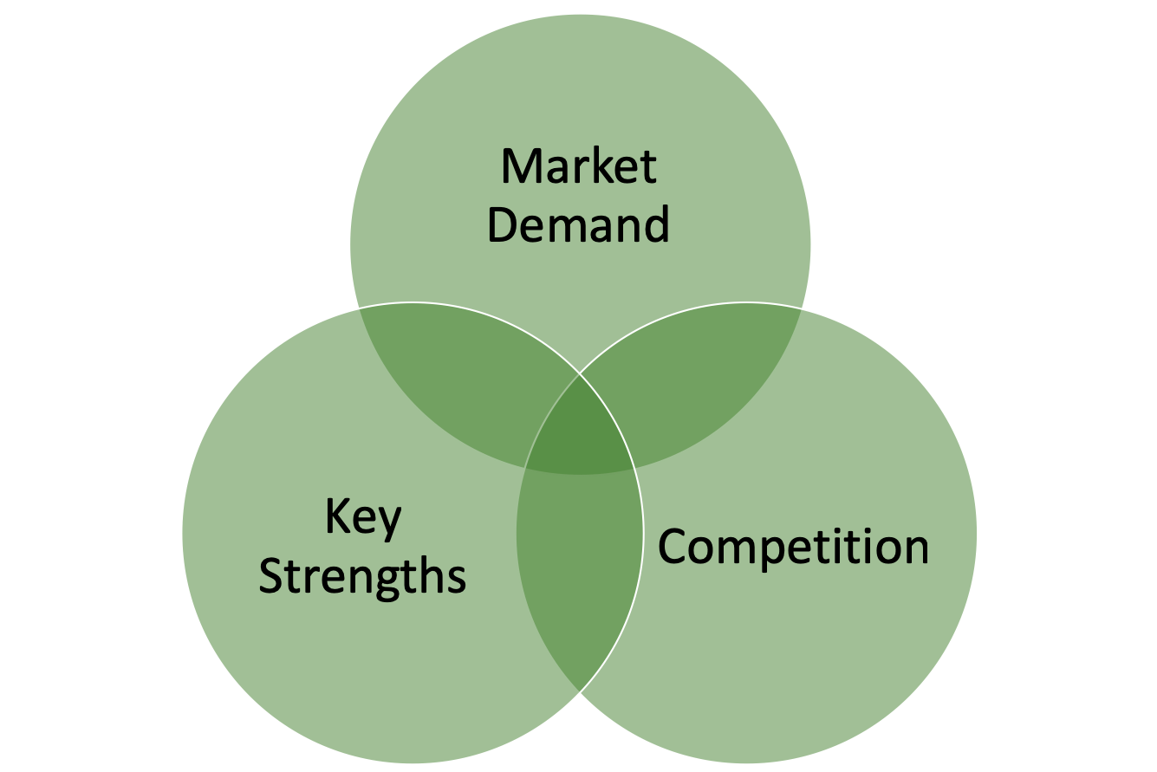
Market Positioning
What do students want
Unoccupied market positions
What the institution does best
Source: Strategic Enrollment Planning: A Dynamic Collaboration, Edited by Jim Hundrieser, PhD and Noel-Levitz
Notes:
What stu

Slide 7
Market Demand
How well does the curriculum align with developing market trends?
Which programs are likely to encounter the greatest enrollment growth opportunities or declines?
What are the preferred modes of delivery (online, hybrid, face-to-face
What course scheduling is preferred (daytime, weekend, evening)
Notes:
What is Canada's share of the market?
What are other colleges' shares?

Slide 8
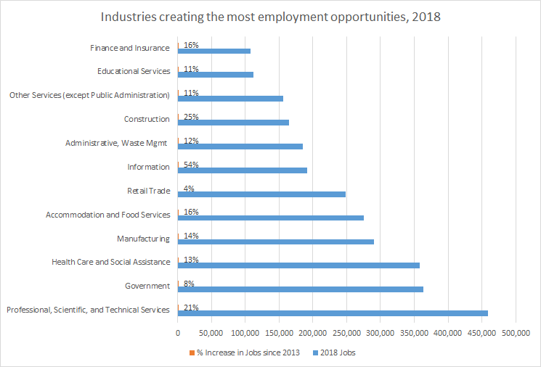

Slide 9
Occupation (SOC) | Rounded Average of Median Hourly Earnings (Jan 2019) | Degree Required | Unique Job Postings (Feb 2018 - Jan 2019)
Marketing Managers | $81.30 | Bachelor's degree | 139,728
Sales Managers | $67.30 | Bachelor's degree | 66,069
Registered Nurses | $64.50 | Bachelor's degree | 52,503
Software Developers | $62.50 | Bachelor's degree | 39,434
Computer Occupations | $55.30 | Bachelor's degree | 26,206
Industrial Engineers | $54.70 | Bachelor's degree | 24,398
Web Developers | $42.10 | Associate degree | 23,859
Accountants and Auditors | $38.50 | Bachelor's degree | 23,384
Heavy and Tractor-Trailer Truck Drivers | $21.00 | Postsec non-degree award | 23,277
Retail Salespersons | $13.40 | No formal ed. credential | 22,358

Slide 10
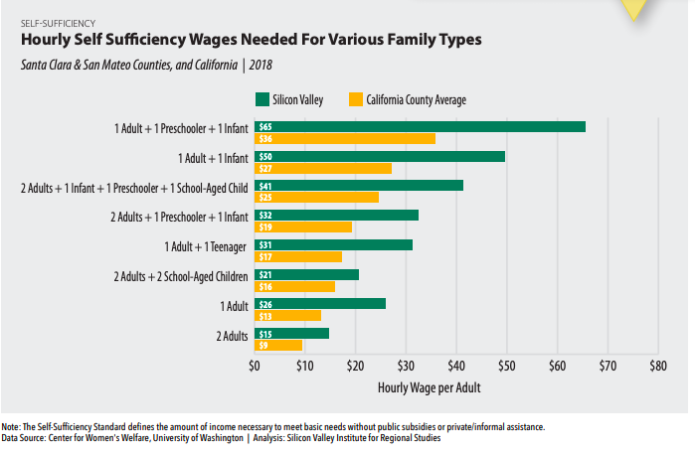
Notes:
According to the M.I.T Living Wage calculator, a family of four living in San Mateo County in 2018 would need an hourly wage for one adult of $40.30 to be self-sufficient. If both adults work, each would need to earn an hourly wage of $24.30 for the family to be self-sufficient.

Slide 11
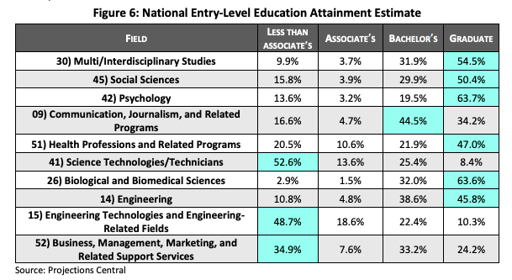
Notes:
Hanover research Project

Slide 12
Top Majors Declared 2013-18
Top Majors (2013-18) | Students | %
Undeclared Major AA/AS Degree | 4,002 | 17%
Business - Administration (2884) & Mgmt (539) | 3,423 | 14%
Education and Human Development | 2,070 | 9%
Psychology | 1,989 | 8%
Computer Science | 1,235 | 5%
Engineering | 1,143 | 5%
Allied Health | 964 | 4%
Fashion | 923 | 4%
Kinesiology | 882 | 4%
Nursing | 860 | 4%
English | 831 | 3%
Biology | 826 | 3%
Accounting | 815 | 3%
General Liberal Arts & Science | 691 | 3%
Medical Assisting | 653 | 3%
Radiology Technologhy | 588 | 2%
Multimedia Art | 586 | 2%
Interior Design | 581 | 2%
Sociology | 537 | 2%
Administration of Justice | 475 | 2%

Slide 13

Student Profiles
Traditional (18-24 year old high school graduate)
Working Adults
Transfer-seeking
Skills Builder
Career Changer
Lifelong Learner
Adult Education and ESL

Slide 14
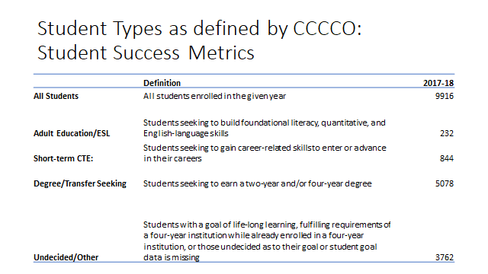

Slide 15
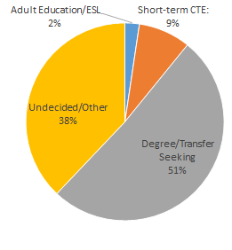
Cañada College Student by Type (2017-18)

Slide 16
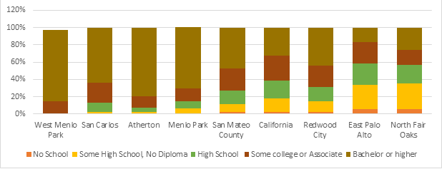
Marketplace Opportunity
Educational Attainment, 2018

Slide 17
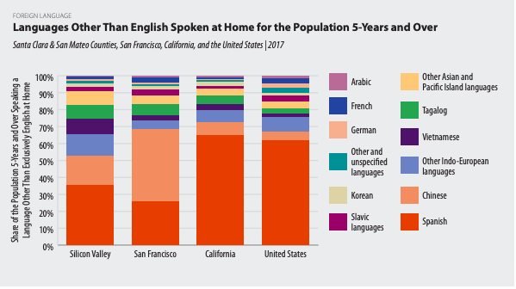
Localization

Slide 18
Competitive Landscape
Community Colleges
  Foothill, DeAnza, West Valley, CSM, Skyline, SF City College, Peralta
Four-years (CSU/UC) – public and private
  SF State, San Jose State, USF, CSU East Bay, UC Berkeley
Extension programs
  Stanford Extension, UC Berkeley Extension, Santa Cruz Extension, UC Cooperative Extension
Private Post-Secondary Schools
  Elevator Mechanics and Maintenance (for example)
Non-Profits
  Year Up
  Job Train

Slide 19

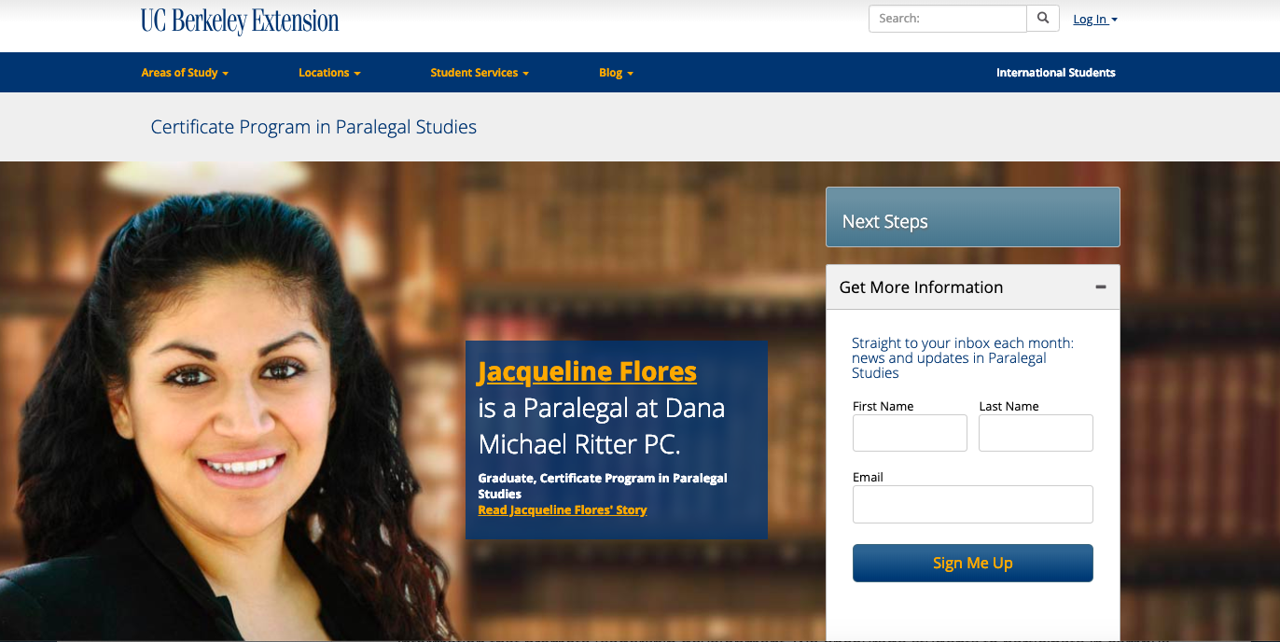
Competitor

Slide 20

Competitor

Slide 21
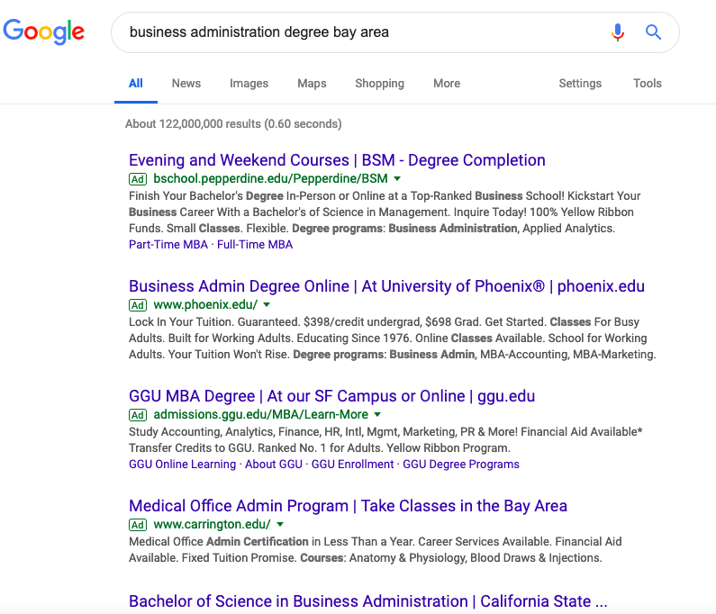
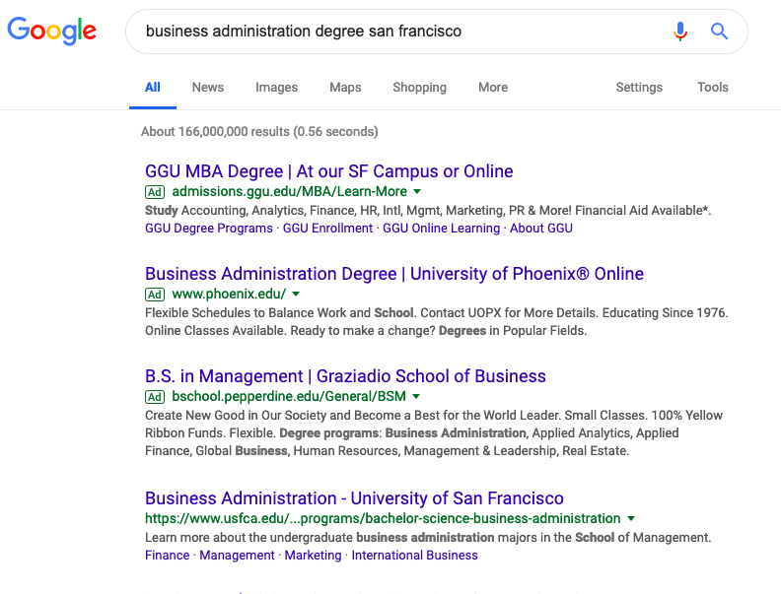
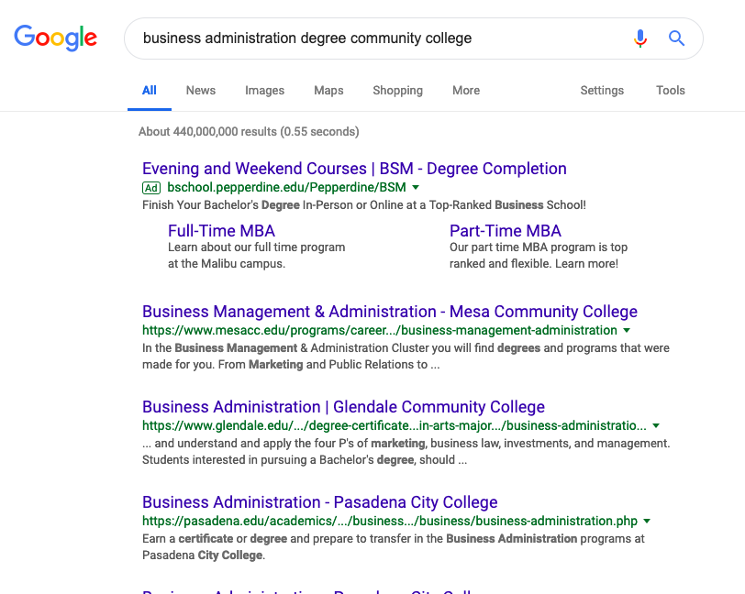

Slide 22
Program Portfolio
Accounting
Biological Sciences
Business Administration/Management
Communication Studies
Computer Business Office Technology
Computer Sciences
Digital Art and Animation
Earth Sciences
Economics
Education and Human Development
Engineering
English
Environmental Science and Technology
Fashion Design and Merchandising
General Studies
Geography
History
Interdisciplinary Studies
Interior Design
Medical Assisting
Music Nursing
Paralegal Studies
Philosophy
Political Science
And more…...

Slide 23
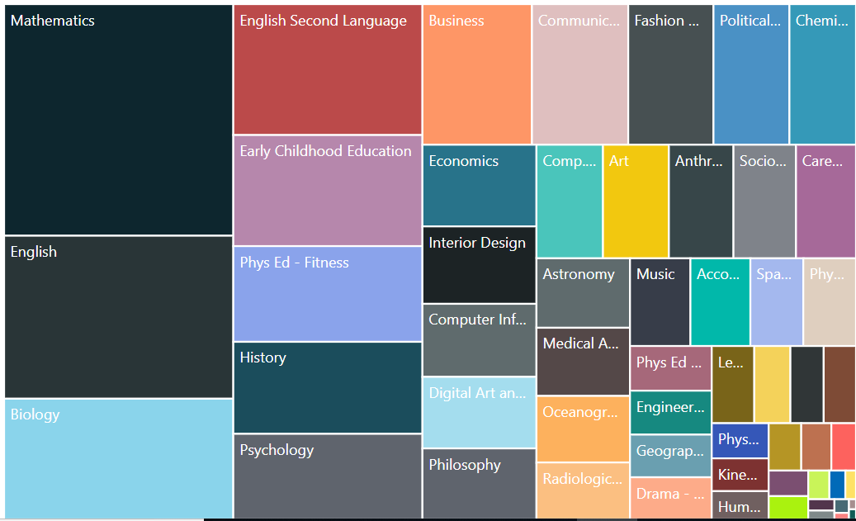
Notes:
Nearly ¾ of all enrollments (73%) are in 18 departments (27% is in the top 3 depts.)
Mathematics
English Biology
English Second Language
Early Childhood Education
Phys Ed - Fitness
History
Psychology
Business
Communication Studies
Fashion Design
Political Science
Chemistry
Economics
Interior Design
Computer Information Science
Digital Art and Animation
Philosophy

Slide 24
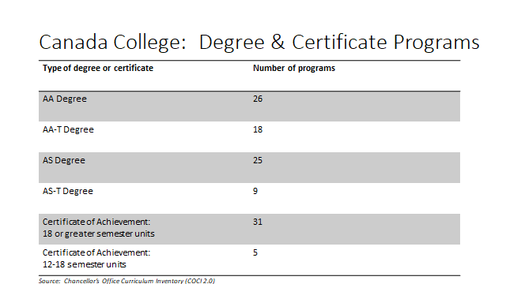

Slide 25
Supply Landscape

Slide 26
Community College Completers v. Private Post-sec Programs
Program | Community College* completers (3-year average) | Private postsecondary completers (3-year average | Net
Business Administration | 594 | 2 | 592
Child Development/Early Care and Education | 510 | 24 | 486
Automotive Technology | 488 | 29 | 459
Accounting | 402 | 3 | 399
Business Management | 380 | 9 | 371
Nursing | 255 | 2452 | 2196
Administration of Justice | 232 | 24 | 208
Emergency Medical Services | 193 | 53 | 140
Medical Assisting | 188 | 968 | 779
Computer Software Development | 186 | 0 | 186
Computer Infrastructure and Support | 153 | 24 | 129
Paralegal | 120 | 19 | 101
Fire Technology | 117 | 0 | 117
Office Technology/Office Computer Applications | 109 | 100 | 9
Physicians Assistant | 103 | 0 | 103
Digital Media | 96 | 48 | 48
Cosmetology and Barbering | 96 | 1159 | 1063
Dental Occupations | 94 | 318 | 224
Graphic Art and Design | 79 | 54 | 25

Slide 27
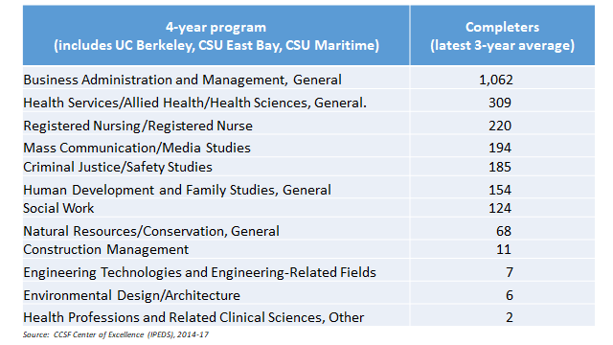

Slide 28
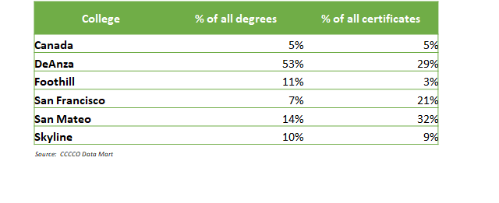
Business Management Awards 2017-18

Slide 29
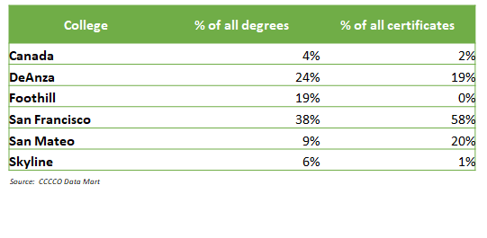
Information Technology Awards 2017-18

Slide 30

Ways To Grow
Communication Plan
Onboarding
Market Current Programs
Program Development
Associate Degrees
Certificate Programs
Partnerships
Retention
Articulation Agreements
Athletics
High School Students
Middle College
Dual Enrollment

Slide 31
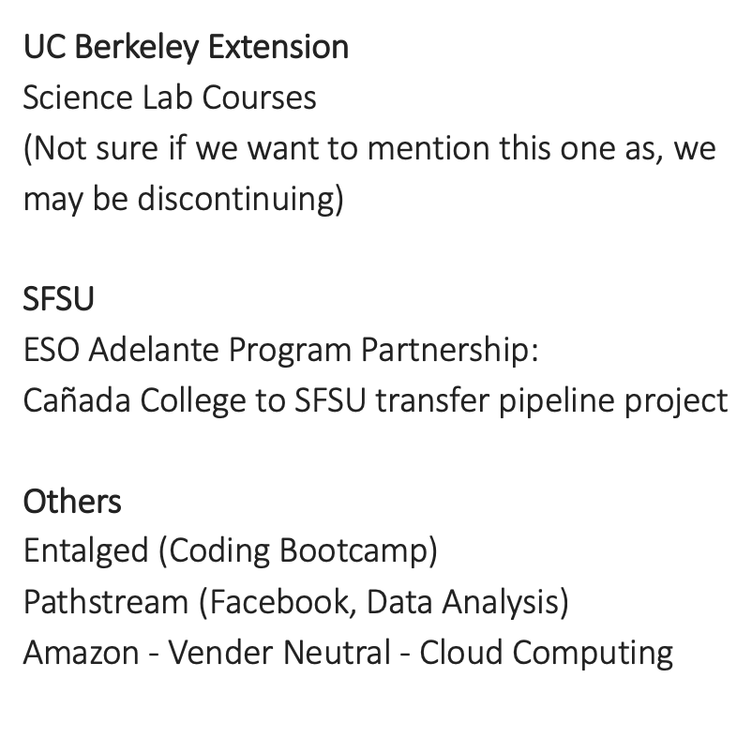
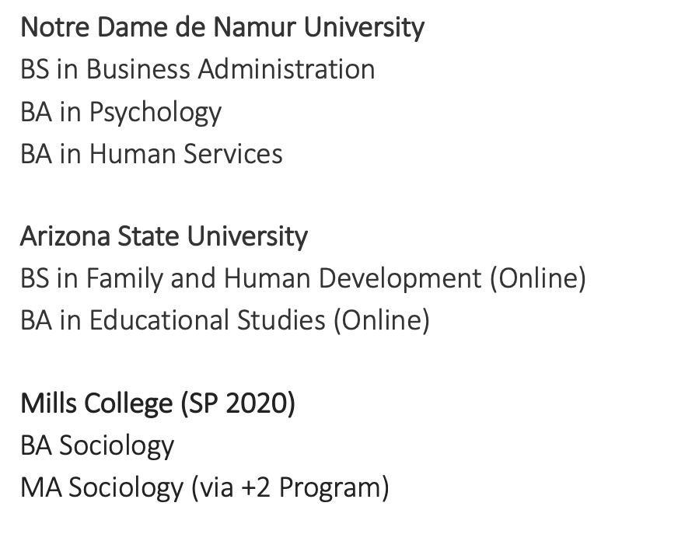
Partnerships

Slide 32
Thought Provoking Questions
Are there any policies or procedures impeding enrollment growth?
Could an increase in funding directly correlate with an increase enrollment?
Should we put more emphasis to develop dual enrollment vs adult college programs?
What idea could generate 500 FTE in three years?
What idea could generate 1,000 FTE in five years?
If we focused on retention, how much of an increase could we see?

Slide 33
Comments
-from here you can go anywhere

Slide 34
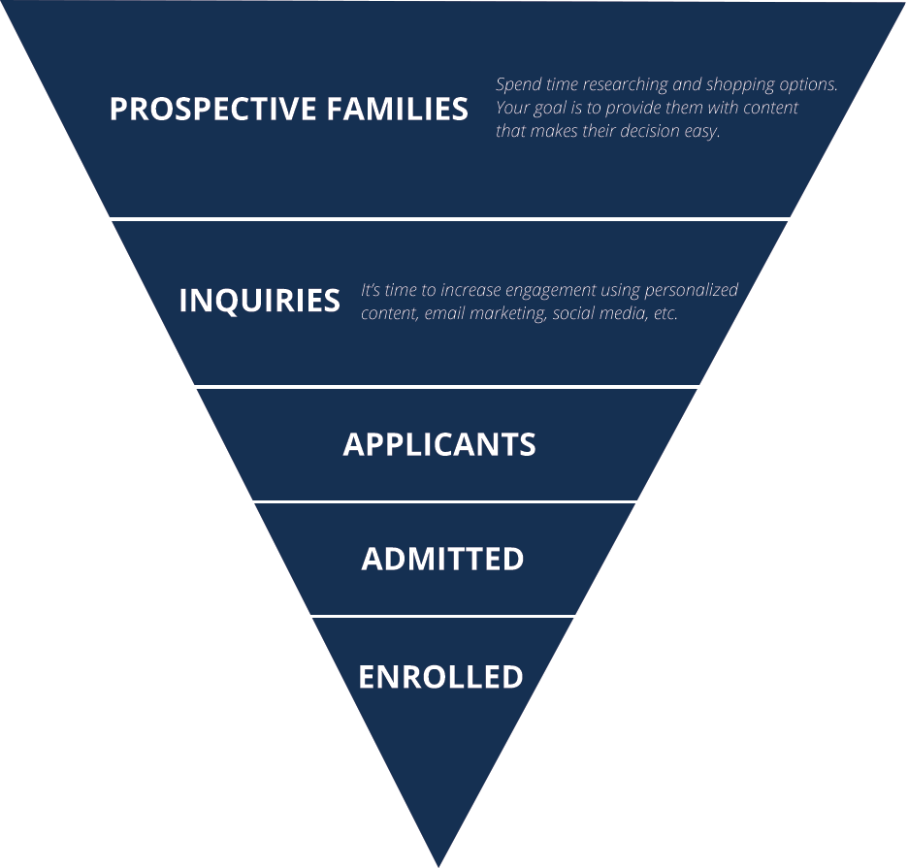
Communication Plan
how and when are we engaging with Students

Slide 35
Onboarding
01
02
03
04
Online Orientation
Traditional Orientation
Welcome Days
Support Services
Students are able to learn about their programs through a portal
Students are all brought to campus the same day and given the information they need
All hands ondeck
All of the services give presentations about what they do
Notes:
Online Orientation
Traditional Orientation
Welcome Days (assessments, placements, classes, counseling, job fair)
Connecting Support Services

Slide 36
Retention
Data extracted 10/2018 SMCCD Data Dashboard Cañada Program Review Data Packets | 2013/ 2014 | 2014/ 2015 | 2015/ 2016 | 2016/ 2017 | 2017/ 2018 | Standard for ACCJC
1. Successful course completion rate (%) | 69.3% | 70.2% | 70.8% | 72.0% | 72.4% | 70.0%
2. Fall-to-fall persistence rate (%) (First-Time Student) | 62.5% | 65.5% | 64.5% | 61.8% | 62.0% | 64.0%
3. Job Placement (Radiology Technology only) | 87.5% | 93.3% | 91.7% | 100% | 100% | 100%
4. Fall-to-spring persistence rate (%) (First-Time Student) | 77.1% | 78.7% | 75.2% | 80.1% | 75.7% | 80.0%
5. Student success rates during their first year (First-Time Student) | 59.8% | 63.6% | 63.9% | 68.5% | 63.4% | 62.0%
6. Success in GE | 66.7% | 67.0% | 67.9% | 67.2% | 69.6% | 66.0%
7. Success in DE | 57.5% | 59.3% | 61.9% | 64.5% | 67.5% | 53.0%
8. Success in CTE | 79.0% | 78.0% | 77.7% | 79.5% | 78.0% | 78.0%
Notes:
Writing Center
STEM Lab
Counselors
Food Bank

