Slide 1

Distance Education
Strategic Enrollment Management
Presentation & Discussion
March 13, 2019

Slide 2
Agenda
Enrollment in Distance Education
Distance Education course success rates
Characteristics of Online Students
How do we determine what to offer online?
How will the new, online (115th) college impact Canada?
Strategic thinking: what are our values? How do they impact our decisions when it comes to online education?
Opportunities for growth and improvement
Marketing

Slide 4
FTES by Instructional Modalities
2012-13
2017-18

Slide 5
Impact of online enrollments:
Online only students (headcount)
Notes:
Canada students who attempted online lass and have a residence of “Residence of Foreign Country or Other US State” is negligible: 34 in 2017 and 33 of those were elsewhere in CA. International students not included.

Slide 6
Includes only students who enrolled in the respective course modality
Average Total Units Enrolled Per Student Per Academic Year
 | Hybrid |  | Face to Face |  | Online
 | % of Enrollments | Average Units | % of Enrollments | Average Units | % of Enrollments | Average Units
2017-18 | 14% | 9.0 | 63% | 8.8 | 23% | 4.8
2016-17 | 14% | 8.7 | 67% | 9.3 | 19% | 4.6
2015-16 | 14% | 8.3 | 70% | 9.4 | 16% | 4.3
2014-15 | 12% | 8.5 | 72% | 9.2 | 16% | 4.3
2013-14 | 12% | 17.5 | 75% | 18.7 | 13% | 8.1
2012-13 | 12% | 17.5 | 78% | 19.0 | 10% | 7.8

Slide 7
Largest Online Courses: Summer v. Fall 2017
Summer 2017 |  |  |  | Fall 2017
Subject | Course | Course Title | Section Total FTES | Subject | Course | Course Title | Section Total FTES
MATH | 120 | Intermediate Algebra | 9.0 | MATH | 120 | Intermediate Algebra | 11.7
MATH | 120 | Intermediate Algebra | 8.5 | MATH | 110 | Elementary Algebra | 8.3
CIS | 118 | Intro. to Computer Science | 6.7 | CIS | 118 | Intro. to Computer Science | 7.9
MATH | 200 | Elem Probability & Statistics | 6.4 | MATH | 200 | Elem Probability & Statistics | 7.6
MATH | 110 | Elementary Algebra | 5.8 | HIST | 201 | U.S. History through 1877 | 6.7
MATH | 200 | Elem Probability & Statistics | 5.7 | PSYC | 100 | General Psychology | 5.4
ACTG | 121 | Financial Accounting | 5.6 | PHIL | 100 | Introduction to Philosophy | 5.2
HIST | 202 | US Hist. From 1877 to Present | 5.5 | PSYC | 100 | General Psychology | 5.2
MATH | 110 | Elementary Algebra | 5.3 | HIST | 202 | U.S. Hist. fm 1877 to Present | 5.0
ASTR | 100 | Introduction To Astronomy | 5.0 | GEOG | 110 | Cultural Geography | 4.9
PSYC | 100 | General Psychology | 5.0 | ANTH | 110 | Cultural Anthropology | 4.7
GEOG | 100 | Physical Geography | 4.9 | PSYC | 200 | Developmental Psychology | 4.7
GEOG | 110 | Cultural Geography | 4.9 | ACTG | 121 | Financial Accounting | 4.7
OCEN | 100 | Oceanography | 4.8 | HIST | 106 | World History II | 4.4
HIST | 245 | Race,Ethnicity and Immigration | 4.6 | PLSC | 210 | American Politics | 3.9

Slide 8
F2F v Online Classes - Process
Department Level
  Offer a course online because sister colleges are not offering
  Offer high demand (GE) courses online and f2f
  Offer both f2f and online (complementary)
  Rotate between f2f and online based on f2f numbers
  Ensure that there is always a f2f offering first
  As long as have at least 20 in f2f maintain it. And, online minimally because in demand
  Don’t want to lose f2f and don’t want college to be over 50% online (question: are fall, spring and summer numbers included in this calculation?)

Slide 9
F2F v Online Classes - Process
  8. Both valuable and complementary
  9. Create a critical threshold
  10. Over enroll online classes because many students drop by week 3
  11. Online strategy: offer the high demand courses and a course that meets
  certain GE requirements
  12. Want to protect certain courses from becoming online only
  13. Appreciate the smaller 20 person classes
  14. Can we balance/share enrollment numbers with more students in the
  online course and fewer in f2f class per department
  15. Offer online and f2f, but need more instructors for online and f2f

Slide 10
F2F v Online Classes - Process
  16. Currently, not offering any online classes in our department because classes are project based – requiring one on one interaction w/students
  17. Offer online and hybrid classes with highest enrollment and efficiency – also, developing a fully online certificate program
  18. Offer high enrolled GE courses online and those that meet multiple requirements (i.e. ethnic studies)
  19. Only willing to offer f2f and hybrid classes because subject matter does not support fully online
  20. Offer what the students want
  21. Increase online numbers using ZTC
  22. Based on student need
  23.Offer online to secure faculty load

Slide 11
F2F v Online Classes - Process
Division Level
  Deans – Would you like to share?

Slide 12
Online Only Students by Ethnicity
 | % of Fall 2017 Students Online Only | % of all Fall 2017 Students | Net
Asian | 19% | 12% | 7%
Black - Non-Hispanic | 4% | 3% | 1%
Filipino | 10% | 4% | 6%
Hispanic | 19% | 33% | -14%
Multi Races | 20% | 17% | 3%
Pacific Islander | 2% | 1% | 1%
Unknown | 1% | 6% | -4%
White Non-Hispanic | 24% | 24% | 0%

Slide 13
Online Only Students – Average Age & Gender
Average Age: 27
Female: 63%
Male: 35%
Unknown Gender: 2%
Fall 2017

Slide 14
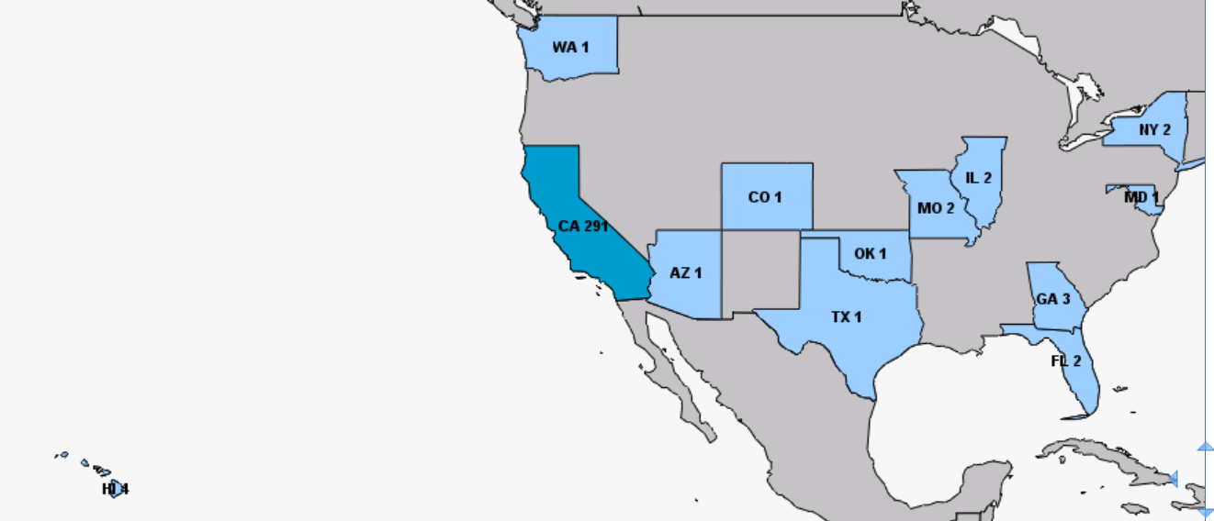
Non-resident Distance Education Enrollments District-wide 2017-18

Slide 15
Non-resident Distance Education Enrollments Cañada College 2017-18
65% of California non-residents enrolled in DE reside in our service area
(80 out of 124)
State | Students Enrolled
California | 124
Florida | 3
Georgia | 1
Hawaii | 1
Missouri | 1
TOTAL | 130

Slide 17
 | Face-to-Face Course Success Rates 2013-18 | Disproportionate Impact (% pt. gap) | Margin of Error | 100% Online Course Success Rates 2013-18 | Disproportionate Impact (% pt. gap) | Margin of Error
OVERALL | 72.9% |  |  | 62.8%
American Indian/Alaskan Native | 70.6% | -2% | 6% | 49.3% | -14% | 12%
Asian | 83.6% | 11% | 3% | 75.6% | 13% | 3%
Black - Non-Hispanic | 64.0% | -9% | 3% | 48.1% | -15% | 3%
Filipino | 75.2% | 2% | 3% | 62.1% | -1% | 3%
Hispanic | 67.6% | -5% | 3% | 56.3% | -7% | 3%
Pacific Islander | 61.6% | -11% | 4% | 43.8% | -19% | 4%
White Non-Hispanic | 79.6% | 7% | 3% | 67.7% | 5% | 3%
Multi Races | 72.0% | -1% | 3% | 59.2% | -4% | 3%
Unknown | 73.9% | 1% | 4% | 67.5% | 5% | 4%
Female | 75.0% | 2% | 3% | 63.4% | 1% | 3%
Male | 69.7% | -3% | 3% | 62.1% | -1% | 3%
Unreported | 71.2% | -2% | 4% | 58.4% | -4% | 4%

Slide 18
Equity
Support Services (Students and Faculty):
  NetTutor
  Online Video Counseling
  Screencast-o-Matic
  Proctorio*
  Faculty Training/Re-training
  Equity Data/Department
  Computer Check-out (Students & Faculty)
  OER/ZTC (LTI checks)
What type of faculty training/re-training do we offer in order to grow DE in a mindful way with quality at the center?
*coming soon

Slide 19
100% Online AA Degrees & Transfer
Anthropology
Economics
History
Political Science
Psychology
Interdisciplinary Studies: Social & Behavioral Sciences
Interdisciplinary Studies: Natural Science & Mathematics
Timeline? Program Pathways Mapper

Slide 20
DE Marketing
WebSchedule (search by DE, discipline, closed and open – all campuses)
  Additional search fields: Department, Course Type (i.e. honors, day, evening, OER & etc.), Transfer (i.e. IGETC or CSU GE), Advanced (with multiple variables including units)
  Add: GE Pathways and . . .
  Limitations: Per semester (possibly 2 depending on the date) – Guided Pathways
  Program Pathways Mapper (Bakersfield College)

Slide 21
DE Marketing Cont. . .
DE Website: Student view (support and direction)
Business Online Academy (Bus. Adm. Certificate, CSU, 12 months)
Career Education (Career Technical Education/CTE): Digital Art & Animation – Video Game Development Certificate (Fall 2019)
Flyers by department or program (Outreach Department)
DE Brochure(s) (Outreach Department)

Slide 22
DE Growth Opportunities
International Students (DE Suite – faculty & student support)
CWA (College for Working Adults) – Fall 2018 data
Out of State Limitations (US Department of Education – State Licensing (i.e. nursing & teaching), federal financial aid, clearly published refund policies and complaint procedures, military personnel)

Slide 23
DE Improvement Opportunities
Strategic Thinking
  What are our values?
  How do they impact our decisions when it comes to online education?

Slide 24
District DEAC & DAS DE Goals
Regular and Effective Contact (professor to student, student to professor & student to student)
Peer Review of Courses
Faculty DE Training/Re-training
Faculty DE Training/Re-training Stipends
Complete DE Suite: NetTutor, Screencast-o-Matic, Online Video Counseling & Proctorio
Consistency among the 3 colleges
Spring 2019

Slide 25
CXV (115th) College
Design and Participation:
  Chancellor’s Office & OEI have challenged designers to help develop this new educational experience
    Nick Demello’s Proposal
  California Virtual Campus (CVC)

