Slide 1
Districtwide Student Survey Sent via Text about Preferred Spring 2022 Modality
Sent out on August 25, 2022

Slide 2
Survey Sample
The survey was sent to all currently enrolled SMCCCD students with status is not HS student, who have a phone number on record, and who opted-in to receive text messages (per CCC Apply). In total, the text went to 7,978 students and 3,056 responses for a 38% response rate.
Overall SMCCCD Results
CAN Results
CSM Results
SKY Results
Note: primary campus was used to report on behalf of the colleges – the college where a student is taking the majority of their units and/or getting their financial aid that term.

Slide 3
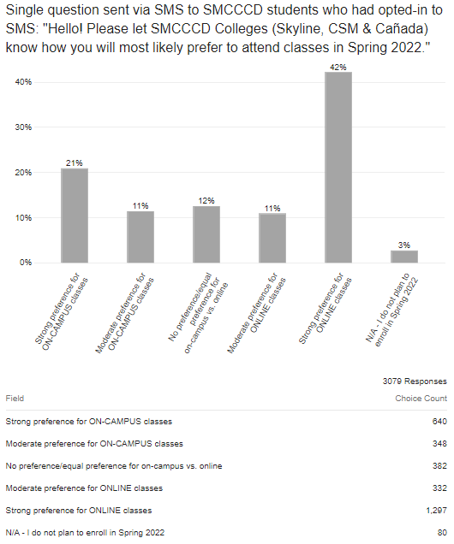

Slide 4
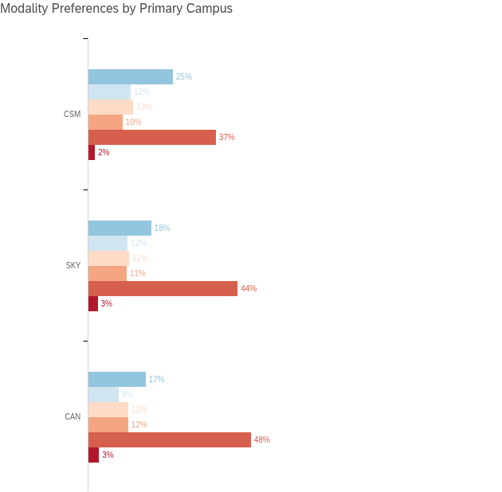

Slide 5
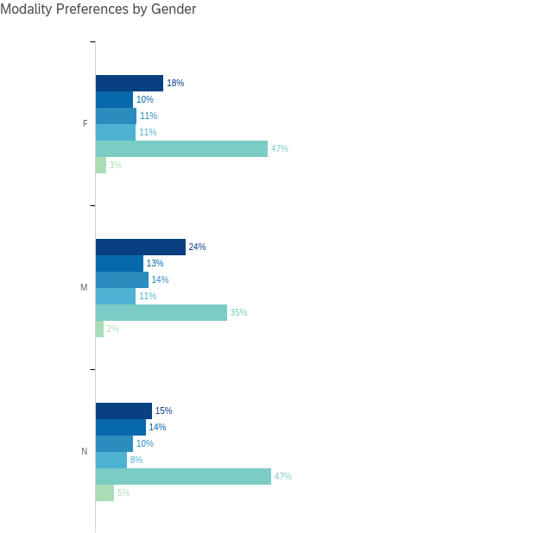

Slide 6
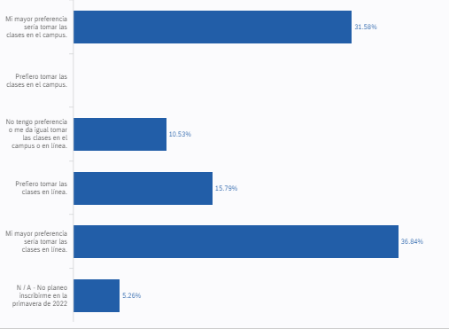
Spanish Language Text Survey

Slide 7
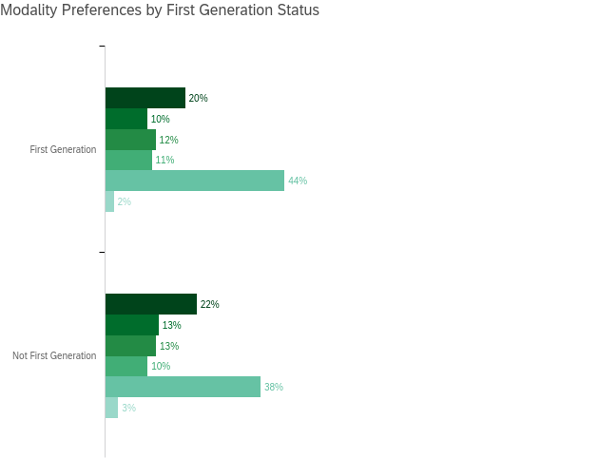

Slide 8
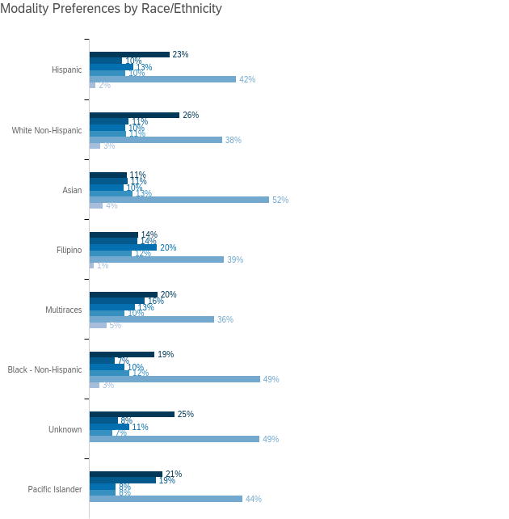

Slide 9
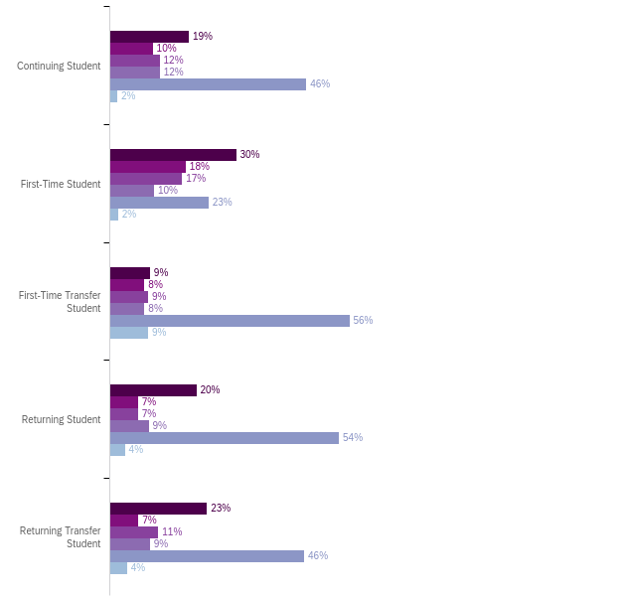

Slide 10
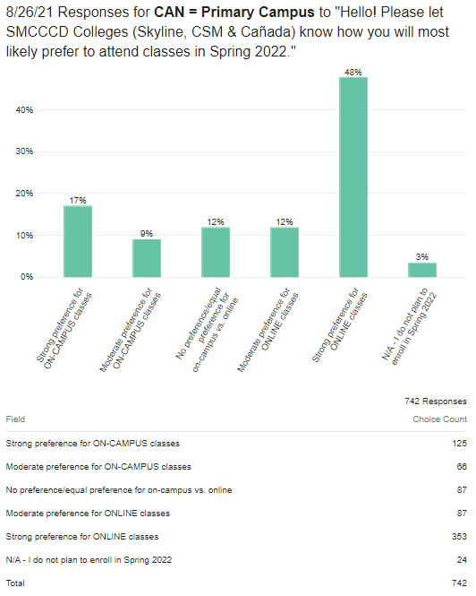

Slide 11
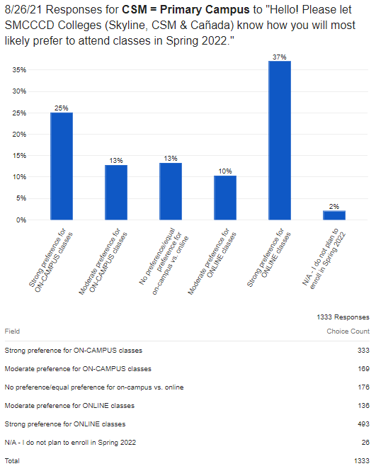

Slide 12
