Slide 1

Early College experiences and Dual Enrollment
Strategic Enrollment Management Committee
February 6, 2019

Slide 2
Types of early college enrollment
Types of Early College Enrollment* | # of students Spring 2019 | Total Enrollments
Middle College High School (on Cañada’s campus) | 107
Dual enrollment Students taking college courses at their local high school | 167 | 168
ALL concurrently enrolled students taking college courses on campus or online | 762 | 2,111
Notes:
For the Class of 2017, 54 seniors and 2 juniors completed graduation requirements (the two juniors graduated a full year early).
91% complete UC/CSU A-G requirements.
46 of the 54 were in MC for both years and earned an average of 42 college units; 10 were in MC for one year (includes the two junior grads) and earned an average of 24.5 college units.
22 of the seniors achieved Cañada College Dean’s List honors at some point in their time at MC.
One senior maintained straight A’s each semester, earning a 4.0 cumulative college gpa and weighted cumulative HS gpa of 4.31.
For 2018-19:
For this year—
Most of our seniors are waiting to hear back from UC and CSU, but we’ve had a number of students receive admission news already. This year’s seniors have received admissions from:
University of Arizona
University of Idaho
Florida International University
San Francisco State
University of San Francisco
Colorado State
Menlo College
Temple University
University of Hawaii
St. Mary’s College
University of Pennsylvania
University of Oklahoma
Holy Names University
Widener University
University of Oregon
University of Victoria
This past fall semester, 38 of our students earned straight A’s in their college classes. All students are required to take at least two college classes totaling 9 units or three classes totaling 7 units, which I think is more than what the average Cañada student is taking each semester.
Many of our students are involved in campus clubs, and at least one is in ASCC. A handful work in the Learning Center as tutors. About a third of our students participate in sports at their home high school.
I haven’t finished working on this, but so far I have 6 quotes from our grads over the years: https://www.smore.com/rwkb9-middle-college-update
Other fun facts—
Since the program began 20 years ago, we’ve had 9 staff assistants, 9 HS administrators, 6 college administrators, 8 social studies teachers, and 2 English teachers, and somewhere around 750-775 graduates.

Slide 3
2018-19 Dual Enrollment Classes
# of SECTIONS | CRN | DEPT | CN | SECTION | COURSE TITLE | SECTION LOCATION |  |  | INSTRUCTOR
 | Fall 2018
1. | 89725 | ANTH | 125 | QXH | Physical Anthropology | Offered at Cañada for Oxford Day Academy |  |  | Marshall, Jessica A.
2. | 94738 | MATH | 251 | CQH | Calculus/Analytic Geometry I | Carlmont High School |  |  | Innerst, Evan (instructor of record)
3. | 94739 | MATH | 251 | Q3H | Calculus/Analytic Geometry I | Carlmont High School |  |  | Innerst, Evan (instructor of record)
4. | 94737 | MATH | 251 | QCH | Calculus/Analytic Geometry I | Carlmont High School |  |  | Innerst, Evan (instructor of record)
5. | 93639 | MATH | 251 | QYH | Analytical Geometry/Calculus I | Sequoia High School |  |  | Bittner, Teresa L.
6. | 93604 | MATH | 253 | QDH | Analytical Geometry/Calc. III | Woodside High School |  |  | Lund, Lance M.
7. | 90238 | MATH | 253 | QGH | Analytical Geometry/Calc III | Henry M. Gunn High School |  |  | Lund, Lance M.
8. | 95035 | MATH | 253 | QYH | Analytical Geometry/Calc. III | Sequoia High School |  |  | Bittner, Teresa L.
 | Spring 2019
1. | 41535 | ANTH | 110 | QXH | Cultural Anthropology | Offered at Cañada for Oxford Day Academy |  |  |  | Marshall, Jessica A.
2. | 42717 | MATH | 252 | CQH | Calcu/Analytic Geometry II | Carlmont High School |  |  |  | Innerst, Evan (instructor of record)
3. | 31363 | MATH | 252 | Q8H | Calcu/Analytic Geom II | Carlmont High School |  |  |  | Innerst, Evan (instructor of record)
4. | 39052 | MATH | 252 | QCH | Analyt. Geometry/Calculus II | Carlmont High School |  |  |  | Innerst, Evan (instructor of record)
5. | 43192 | MATH | 252 | QYH | Calcu/Analytic Geom II | Sequoia High School |  |  |  | Bittner, Teresa L.
6. | 46618 | MATH | 270 | QDH | Linear Algebra | Woodside High School |  |  |  | Lund, Lance M.
7. | 43502 | MATH | 270 | QGH | Linear Algebra | Henry M. Gunn High School |  |  |  | Nguyen, Viet H.
8. | 43815 | MATH | 275 | QYH | Ordinary Differential Equation | Sequoia High School |  |  |  | Bittner, Teresa L.

Slide 4
Overall K12 concurrent enrollments by mode
Mode | Enrollments
FACE TO FACE | 1513
HYBRID | 81
ONLINE | 517

Slide 5
K12 concurrent enrollments by subject (2018-19)
147 enrollments are dual enrollment – advanced math classes taught at local high schools (contract ed)

Slide 6
K12 concurrent enrollments by subject (2018-19) (without math)

Slide 7
Promising practices…
Students who participate in high-quality dual enrollment programs are more likely to graduate high school, enter college, and persist in college to completion, according to research nationwide.
Most likely to benefit are the students who are most underrepresented in California community colleges: young men of color, students from low-income families, and first-generation college students.
Sources:
The Dual Enrollment Landscape in California, October 2018. A Working Paper by Career Ladders Project.
Fink, J., Jenkins, D., & Yanagiura, T. (2017). What Happens to Students Who Take Community College “Dual Enrollment” Courses in High School? New York, NY: Columbia University, Teachers College, Community College Research Center.

Slide 8
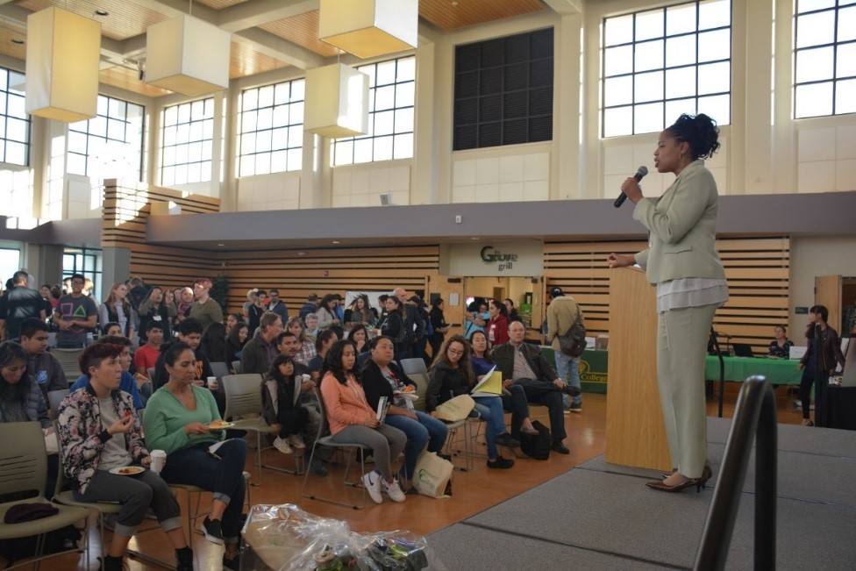
Opportunities to grow early college experiences
Expand Middle College
Increase the number of dual enrollment sections
Transport more high school students to campus via the Shuttle
Increase summer programming and enrollment
Hire a Dual Enrollment Coordinator (position)

Slide 9
Discussed with SUHSD
Dual Enrollment Coordinator Position – see JD
Expand Middle College
Redwood High School (continuation)
Tide Academy
  See sheet

Slide 10
Expand Middle College
SUHSD
  hire teachers
  figure out supports; What articulates for what? Create a guidebook
  change language for outreach and marketing of program; get extra supports
  re-consider assessment
  Consider changing their bell schedule (this could help with sharing rooms)
  12:30 – 3:05 – then they go to their home campuses for sports and activities (morning is spent taking college classes) – can we have half of the bigger cohort flipped in schedule? This not needed if they can have 4 classrooms (will need bigger office space). Some students would like 10 a.m. and 6 p.m.
Canada
  space – can we make a “home” for 150 students?
  Ideally, 4 classrooms plus the lab so having them all in the same building would be ideal. Is there a room on campus – other than the theater – that will be able to house the whole school?
  Additional space for faculty
Both: field trip to West Valley? Mission? They have separate Middle College facilities?
Research “College Advantage” – West Valley and Foothill have it. Students only take college classes to fulfill HS requirements. They’re in Middle College technically, but they really behave like college student. This is for the advanced cohort? Makes room for others? Students who need less monitoring.

Slide 11
Redwood High School
Potential partnership between Cañada and Redwood Continuation High School
  Explore possible CTE pathway programs (building trades, electrical, culinary, digital arts, farm-to-table – Ag?)
  Cañada team will visit Redwood Continuation leadership team on February 8 at 3 p.m.
  What would we propose to offer and why?

Slide 12
Tide Academy
Partnership between Cañada and T.I.D.E. Academy
  SUSD has collaborated with Foothill on dual enrollment but would like to change this to Cañada – especially if we have a shuttle.
  Possible pathways or areas of focus:
    Computer Science
    Art and Design
    Project-based learning
    Social problem-solving – focus on equity
    Student could do a senior/capstone project at Cañada
  Courses 8-3:30 – four sections/day; M-F
  Foothill is hiring adjuncts
  Challenges with HS teacher of record
  Challenge of continuity
  Can we teach the classes on the list?
  Summer programs – to help onboard in coming 9th grader
  Other activities? Music, other activities.
  Simon Pennington, Dean at Foothill (fusing GID and Art – and they have a Fab Lab)
  How can we embed Cañada at TIDE? Let’s explore commitments: joint ownership? space? shared staffing?

Slide 13
Additional slides below

Slide 14
Sequoia Union High School District | Jefferson High School
Carlmont High School | Jefferson High School
East Palo Alto Academy | Oceana High School
Menlo Atherton High School | Terra Nova High School
Redwood High School | Thornton High School
Sequoia High School | Westmoor High School
Sequoia High School Adult School
Tide Academy
Woodside High School
San Mateo Union High School District | Cabrillo High School District
Aragon High School | Half Moon Bay High School
Burlingame High School | La Costa Adult School
Capuchino High School | Pilarcitos High School
Hillsdale High School | La Honda-Pescadero High School
Mills High School | Pescadero High School
Peninsula Alternative High School
San Mateo High School
San Mateo Adult School
Design Tech High School
South San Francisco High School District | Other Charter Schools
El Camino High School | Everest High School (Charter School)
South San Francisco High School | Summit High School (Charter School)
Baden High School
Cañada College’s primary feeder high schools
32 local high schools
6 local districts
17,000+ graduates from these high schools per year - nearly 50% will attend an SMCCD college within 5 years of graduating high school
700+ current high school students enroll concurrently in Cañada College classes every year
100+ attend Middle College High School on Cañada’s campus and earn college credit while completing their high school requirements
325 College Promise Students
Cañada actively working with Sequoia Superintendent Mary Streshly to expand early college opportunities for high school students

Slide 15
Sequoia Union High Schools
Comprehensive High Schools
Others
Carlmont High School
East Palo Alto Academy
Menlo-Atherton High School
Redwood High School
Sequoia High School
Tide Academy
Woodside High School
Sequoia District Adult School

Slide 16
First Generation Status
 | Fall 2018 Dual Enrollment | Fall 2018 Middle College
No data | 201 (95%) | 62 (56%)
Both parents no college degree | 4 (2%) | 14 (13%)
At least one parent no college (including both with college) | 10 | 44
Total | 211 | 106

Slide 17
Comparative Course Success Rates - pending
 | Number of Students | Course Success Rate
Dual Enrollments | 211 | 92%
Middle College Enrollments | 106 | 89%
All students concurrently enrolled in high school | 703 | 89%
All Cañada Enrollments | 11,210 | 70%
Source: SMCCD data warehouse, fall 2018

Slide 18
Cañada College Middle College Students (headcount)

Slide 19
Middle College Students
Cañada College Students (overall)

Slide 20
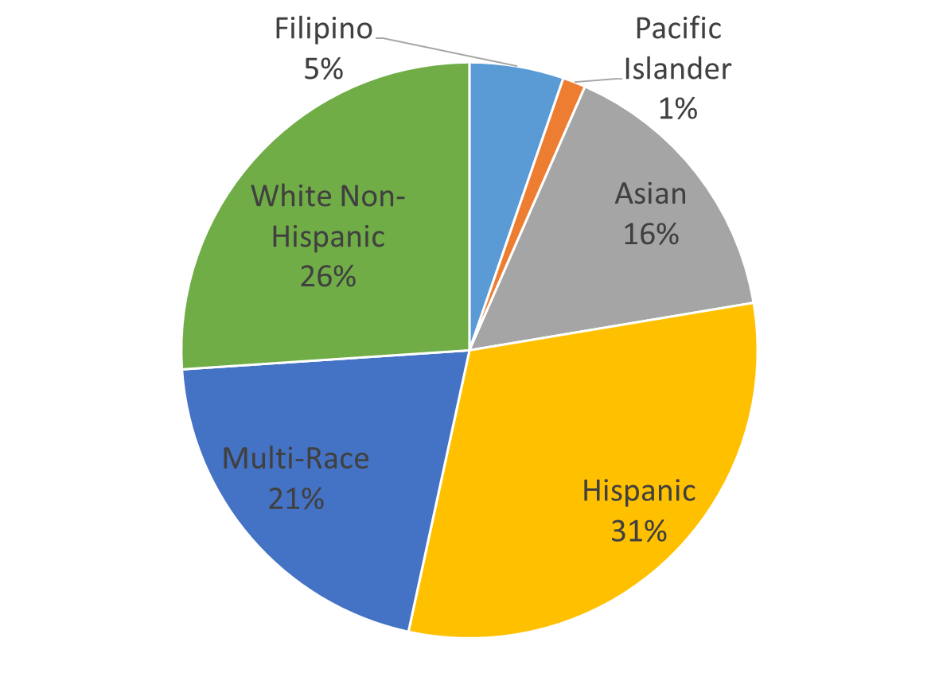
Middle College Students
Cañada College Students (overall)

Slide 21
High School Articulation Agreements (existing)
Sequoia Union School District
San Mateo Union High School
MART 314
MART 361
MART 368
ARCH 110
ECE 210
ECE 211

