Slide 1
Enrollment Management Committee
Meeting #3
December 12, 2018

Slide 2
Agenda Item | Discussion Lead | Time Allotted
Review of SEM Committee Sharing data and progress on the ERM website. Meeting Schedule for spring 2019 Timeline | Dr. Tammy Robinson, VPI Dr. Karen Engel, Dean of PRIE | 15
Guided Pathways and Enrollment Management (see IEPI crosswalk) Compare current SEM strategies with Quality Focus Essay, I CAN Start Strong plan Compare SEM to other High Impact Practices SEM activities v. Guided Pathways activities | Dr. Char Perlas, VPSS Dr. Tammy Robinson, VPI | 30
Maintaining an Equity Lens Considering disaggregated distance education course success data | Dr. Karen Engel, Dean of PRIE | 5
Other Data Requested Degrees or Certificates offered 100% online Enrollment patterns of concurrently enrolled high school students | Dr. Karen Engel, Dean of PRIE All | 5
Next Steps & Items for Future Meetings | All | 5
ADJOURN

Slide 3
Meeting schedule for spring 2019
Every two weeks?
Monday afternoons?

Slide 4
Strategic enrollment planning phases
Preparation
Identification of key performance indicators
Developing a comprehensive situation analysis (data compilation, research, the SEP dashboard, etc.)
Strategy identification
Action plan development (business plan for each potential strategy)
Strategy prioritization (mission-fit, ROI, likelihood of success)
Develop quantifiable goals and a funding strategy
Execution, evaluation, and modification
Notes:
This slide slightly recasts the previous slide and is useful as a placeholder throughout the project. During the first visit I will Bold steps 1-3, because we’ll cover a number of tasks within each of those steps. At each subsequent visit we’ll move down the list.

Slide 5
Strategic enrollment planning phases
Preparation
Identification of key performance indicators
Developing a comprehensive situation analysis (data compilation, research, the SEP dashboard, etc.)
Strategy identification
Action plan development (business plan for each potential strategy)
Strategy prioritization (mission-fit, ROI, likelihood of success)
Develop quantifiable goals and a funding strategy
Execution, evaluation, and modification
First Draft complete
Evolving
Dashboard?
SEM and Guided Pathways Strategies and Actions
Notes:
This slide slightly recasts the previous slide and is useful as a placeholder throughout the project. During the first visit I will Bold steps 1-3, because we’ll cover a number of tasks within each of those steps. At each subsequent visit we’ll move down the list.

Slide 6
Timeline
Fall 2018
Updated data and SEP
Identified team
Spring 2019
Data dashboard
Clarify details or each strategy
Fall 2019
Finalize on-going SEM processes (data monitoring, evaluation)
Revise Plan with ROI metrics
Begin implementation where possible
Spring 2020
New SEM Plan

Slide 7
ISER Quality Focus Essay:
I CAN Start Strong

Slide 8
Objective | Activities | Timeline | Responsible Person(s) | Cañada Goal
Increase by at least 20 percent the number of Cañada students annually who acquire associates degrees, credentials, certificates, or specific skill sets that prepare them for an in-demand job. | Complete-ability Increased accuracy of Student Education Plans which can inform course scheduling Grouping degree programs into ‘Interest Areas’ or ‘Meta Majors’ Optimization of the class schedule to avoid class cancelations and conflicts Alignment of support services with interest areas | Inquiry Phase – Fall 2018 Identify Strategy - Summer 2019 Implementation – Fall 2019 and Spring 2020 Collection and Data Analysis – Spring 2021 | Guided Pathway Teams: Academic Pathways Student Voices Business Process Analysis Steering Group | 1. Student Completion/Success
Increase by 35 percent the number of Cañada students transferring annually to a UC or CSU. | Implementation/expansion of various high school engagement strategies: Dual Enrollment, Summer Programs, Outreach Events, etc… Modification of the current Priority Enrollment Program (PEP) to better serve incoming students Expansion of cohorts via learning communities Expansion of Support and Instructional Programs | Inquiry Phase – Fall 2018 Identify Strategy - Summer 2019 Implementation – Fall 2019 and Spring 2020 Collection and Data Analysis – Spring 2021 | Guided Pathway Teams: Academic Pathways Student Voices Business Process Analysis Steering Group | 1. Student Completion/Succes
Decreased by at least 1.1 percent the average number of units accumulated by Cañada students earning associate’s degrees (at Cañada this would be represented by a decrease from 112 units to 101 units). | Complete-ability Increased accuracy of Student Education Plans which can inform course scheduling Grouping degree programs into ‘Interest Areas’ or ‘Meta Majors’ Optimization of the class schedule to avoid class cancelations and conflicts Alignment of support services with interest area. | Inquiry Phase – Fall 2018 Identify Strategy - Summer 2019 Implementation – Fall 2019 and Spring 2020 Collection and Data Analysis – Spring 2021 | Guided Pathway Teams: Academic Pathways Student Voices Business Process Analysis Steering Group | 1. Student Completion/Success And 3. Organizational Development
Increased the percent of exiting CTE students who report being employed in their field of study, from the most recent statewide average of 60 percent to an improved rate of 69 percent—the average among the quintile of colleges showing the strongest performance on this measure. | Expansion of Support (including Job Placement and Career assistance) and Instructional Programs Identification of job placement data tool | Inquiry Phase – Fall 2018 Identify Strategy - Summer 2019 Implementation – Fall 2019 and Spring 2020 Collection and Data Analysis – Spring 2021 | Guided Pathway Teams: Academic Pathways Student Voices Business Process Analysis Steering Group | 1. Student Completion/Success 2. Community Connections 3. Organizational Development
Reduced equity gaps across all of the above measures through faster improvements among traditionally underrepresented student groups, with the goal of cutting achievement gaps by 40 percent within 5 years and fully closing those achievement gaps within 10 years. | Streamlining the application process Proactive Registration Modification of the current Priority Enrollment Program (PEP) to better serve incoming students Providing the needed support for FAFSA completion Development of a First Year Experience program (Bridge Progs) Expansion of cohorts via learning communities | Inquiry Phase – Fall 2018 Identify Strategy - Summer 2019 Implementation – Fall 2019 and Spring 2020 Collection and Data Analysis – Spring 2021 | Guided Pathway Teams: Academic Pathways Student Voices Business Process Analysis Steering Group | 1. Student Completion/Success 2. Community Connections 3. Organizational Development

Slide 9
Objective | Activities | Timeline | Responsible Person(s) | Cañada Goal
Increase by at least 20 percent the number of Cañada students annually who acquire associates degrees, credentials, certificates, or specific skill sets that prepare them for an in-demand job. | Complete-ability Increased accuracy of Student Education Plans which can inform course scheduling Grouping degree programs into ‘Interest Areas’ or ‘Meta Majors’ Optimization of the class schedule to avoid class cancelations and conflicts Alignment of support services with interest areas | Inquiry Phase – Fall 2018 Identify Strategy - Summer 2019 Implementation – Fall 2019 and Spring 2020 Collection and Data Analysis – Spring 2021 | Guided Pathway Teams: Academic Pathways Student Voices Business Process Analysis Steering Group | 1. Student Completion/Success
Increase by 35 percent the number of Cañada students transferring annually to a UC or CSU. | Implementation/expansion of various high school engagement strategies: Dual Enrollment, Summer Programs, Outreach Events, Middle College etc… Modification of the current Priority Enrollment Program (PEP) to better serve incoming students Expansion of cohorts via learning communities Expansion of Support and Instructional Programs | Inquiry Phase – Fall 2018 Identify Strategy - Summer 2019 Implementation – Fall 2019 and Spring 2020 Collection and Data Analysis – Spring 2021 | Guided Pathway Teams: Academic Pathways Student Voices Business Process Analysis Steering Group | 1. Student Completion/Succes
Decreased by at least 1.1 percent the average number of units accumulated by Cañada students earning associate’s degrees (at Cañada this would be represented by a decrease from 112 units to 101 units). | Increase % of first-time students completing transfer-level English, math and ESL in one year. Increased accuracy of Student Education Plans which can inform course scheduling Grouping degree programs into ‘Interest Areas’ or ‘Meta Majors’ Optimization of the class schedule to avoid class cancelations and conflicts Alignment of support services with interest area. | Inquiry Phase – Fall 2018 Identify Strategy - Summer 2019 Implementation – Fall 2019 and Spring 2020 Collection and Data Analysis – Spring 2021 | Guided Pathway Teams: Academic Pathways Student Voices Business Process Analysis Steering Group | 1. Student Completion/Success And 3. Organizational Development
Increase the % of exiting CTE students who report being employed in their field of study, from the most recent statewide average of 60 percent to an improved rate of 69 percent—the average among the quintile of colleges showing the strongest performance on this measure. | Expansion of Support (including Job Placement and Career exploration assistance) and Instructional Programs Identification of job placement data tool | Inquiry Phase – Fall 2018 Identify Strategy - Summer 2019 Implementation – Fall 2019 and Spring 2020 Collection and Data Analysis – Spring 2021 | Guided Pathway Teams: Academic Pathways Student Voices Business Process Analysis Steering Group | 1. Student Completion/Success 2. Community Connections 3. Organizational Development
Reduced equity gaps across all of the above measures through faster improvements among traditionally underrepresented student groups, with the goal of cutting achievement gaps by 40 percent within 5 years and fully closing those achievement gaps within 10 years. | Streamlining the application process Proactive Registration Expand the College for Working Adults & Promise Scholars progs Providing the needed support for FAFSA completion Development of a First Year Experience program (Bridge Progs) Expansion of cohorts via learning communities | Inquiry Phase – Fall 2018 Identify Strategy - Summer 2019 Implementation – Fall 2019 and Spring 2020 Collection and Data Analysis – Spring 2021 | Guided Pathway Teams: Academic Pathways Student Voices Business Process Analysis Steering Group | 1. Student Completion/Success 2. Community Connections 3. Organizational Development

Slide 10
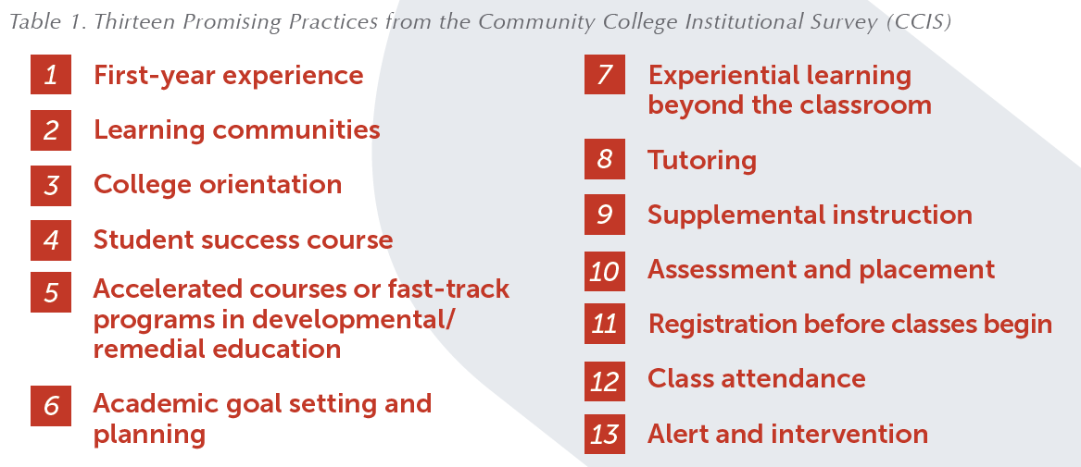

Slide 11
Missing strategies?
Marketing
Increasing the number of international students
Monitoring all data (disaggregated)
Student success or “sampler” courses
Supplemental instruction (and Writing Center) plans
Alerts and interventions – Success Teams?

Slide 12
Areas for Enrollment Management Committee focus?

Slide 13
Maintaining an Equity Lens

Slide 15
Impact of online enrollments: Online only students (headcount)
Notes:
Canada students who attempted online lass and have a residence of “Residence of Foreign Country or Other US State” is negligible: 34 in 2017 and 33 of those were elsewhere in CA. International students not included.

Slide 16
Impact of online enrollments: FTES
23% Online or Hybrid

Slide 17
100% online degrees and certificates

Slide 18
AA Degrees that could be taken 100% online
Anthropology (0)
Economics (34)
History (2)
Political Science (4)
Psychology, including AA-T (28)
Interdisciplinary Studies: Social and Behavioral Sciences (69 for all IS)
Interdisciplinary Studies with Transfer: Social & Behavioral Sciences
Interdisciplinary Studies: Natural Science and Mathematics
Interdisciplinary Studies with Transfer: Natural Science and Mathematics
New: Business Administration Certificate (19 units)
Per ACCJC Substantive Change Memo, 2014

Slide 19
Concurrent Enrollment Data

Slide 22
Students Work for Pay data

Slide 23
How much do Cañada students work?
Source: CCSSE Survey 2015

