Slide 1

Enrollment Management Committee
Meeting #1
November 7, 2018

Slide 2
Agenda
Elements of strategic enrollment management process
Purpose of the Committee
Composition of the Committee
Updating Canada’s Strategic Enrollment Plan from 2014-17 Plan
Timeline – how much time for what?

Slide 3
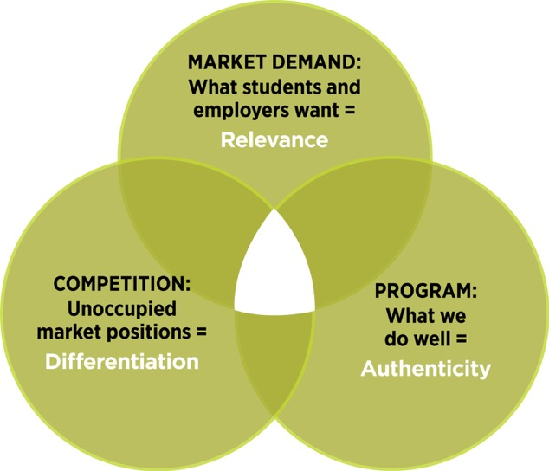
Competition, market demand, program strength
New Success Metrics focused on attainment of educational goal (by student type)

Slide 4

Tasks for the action/steering group
Determine working groups foci
Review, collate, and analyze data
Coordinate data requests from the working groups
Ensure working groups meet and collaborate
Facilitate strategy ideation
Identify priorities
Make recommendations to council
Draft overarching situation analysis
Write the plan

Slide 5
PBC’s ideal composition of an EMC
VPI
VPSS
All Instructional Deans
Dean of Counseling
Registrar
Assessment & Placement Office
Marketing & Outreach
Faculty: 1 from STEM, 1 from CE, and DE Coordinator/Humanities
PRIE Office
Students
Promise Program Coordinator
Meet Times?
  Mondays (1st and 3rd) when there is no iDeans? (1:30 – 3:30)

Slide 7
Other trends since 2014
High School enrollment stable
Impact of Promise Scholars program
Full-time enrollment is up dramatically (72%) since fall 2013. Continued equity gaps in student success metrics
Growth in on-line enrollments
KAD
International Students
Career Education

