Slide 1



ESL Department
Mission
The English as a Second Language (ESL) Program at Cañada College prepares immigrant and international students to achieve their academic, vocational and personal goals.
In alignment with the college mission, the ESL program offers classes so that students can develop language and academic skills including analytical, critical, and creative thinking, and effective communication.
https://canadacollege.edu/esl/
Notes:
Alicia-introduces the department and the student population we serve

Slide 2
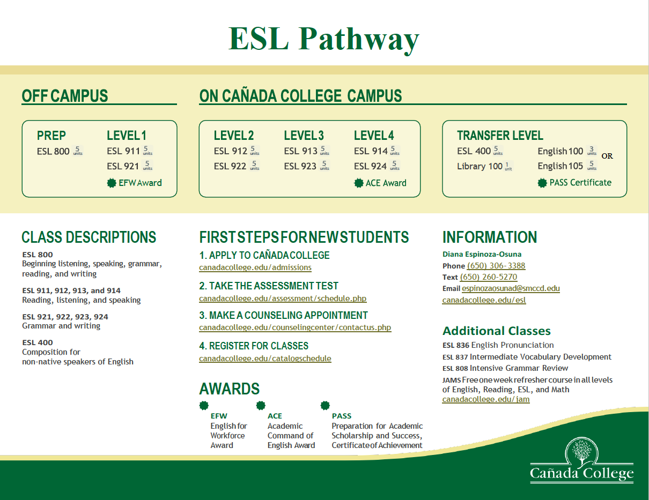
Notes:
Alicia-how is the program different from SKY and CSM

Slide 3
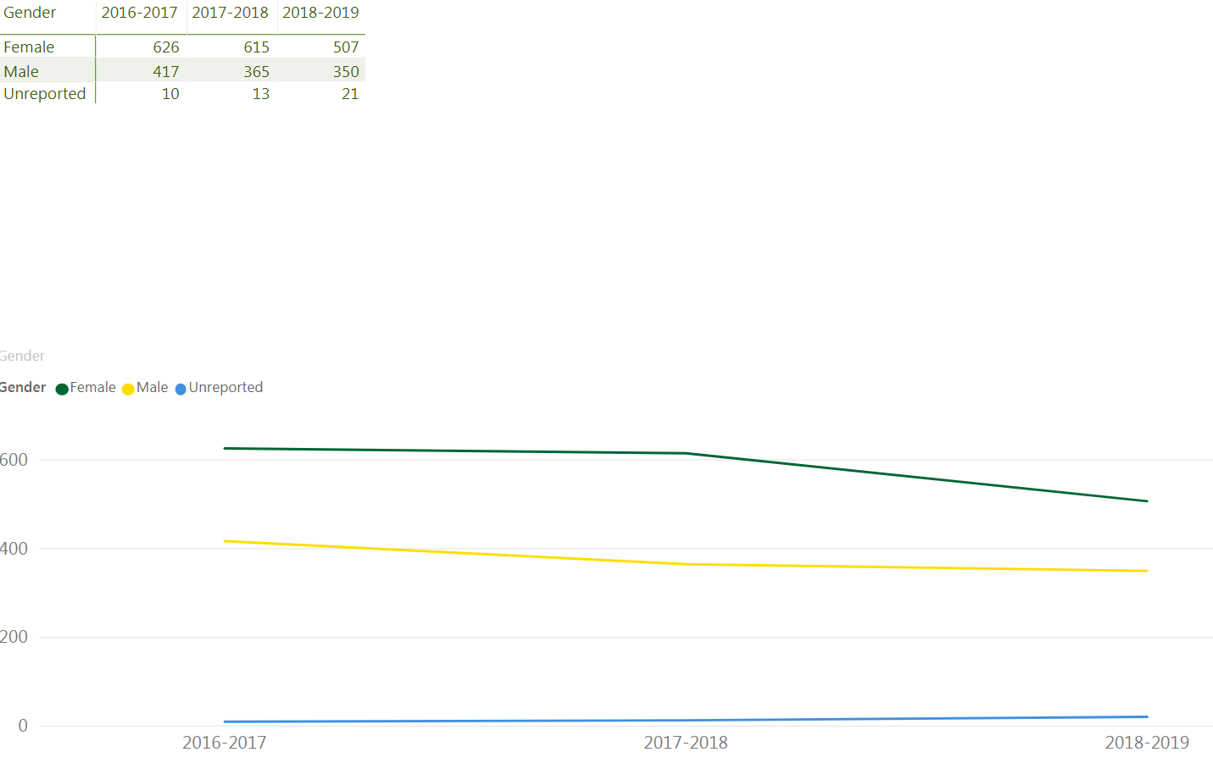
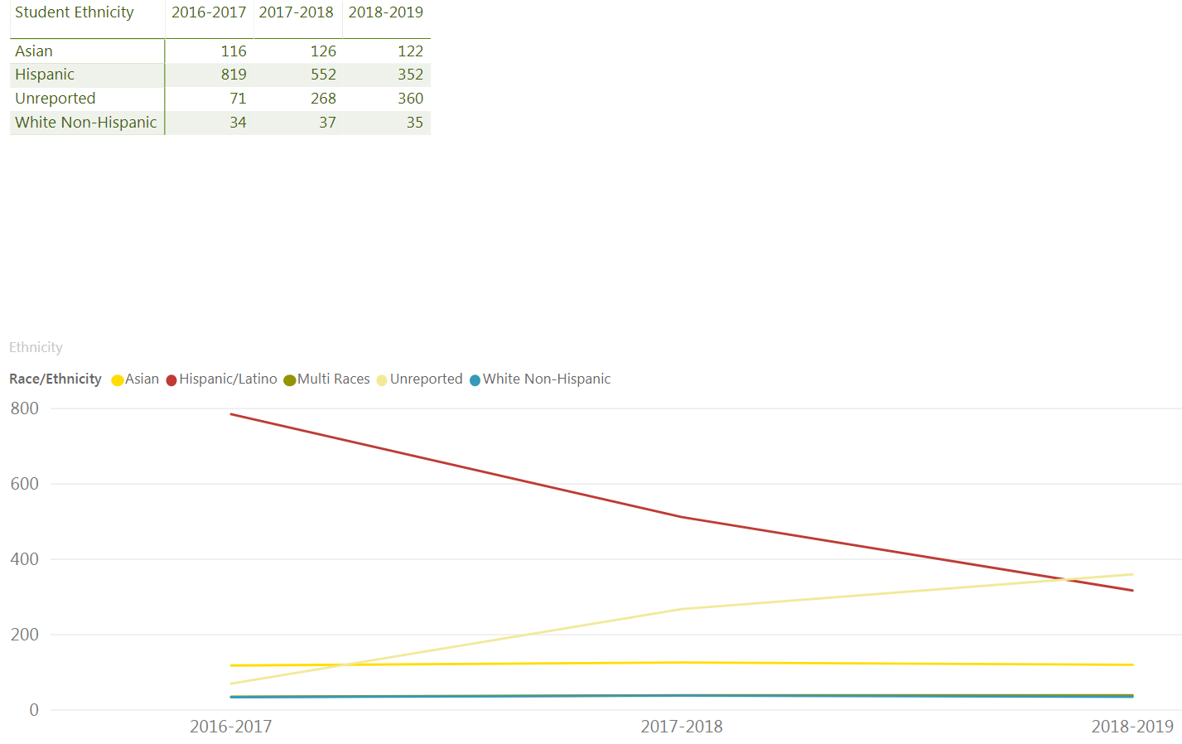
ESL Department
Student Characteristics 2016-2019
Notes:
Alicia- talks about student characteristics starting 2016 through 2019
-Gender
-Ethnicity (the unreported numbers, we are working with Admissions to identify the error)

Slide 4
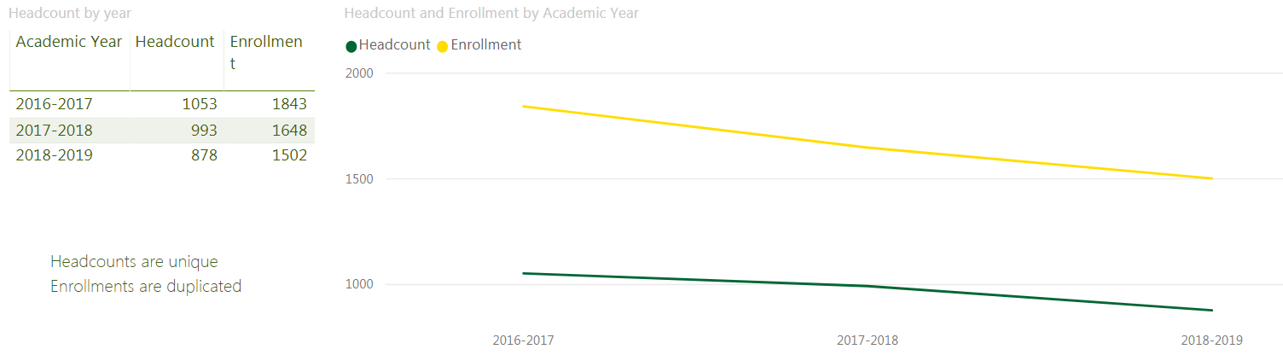
Notes:
Alicia- talks about student characteristics starting 2016 through 2019
-Enrollment (decreasing and the contributing factors)

Slide 5
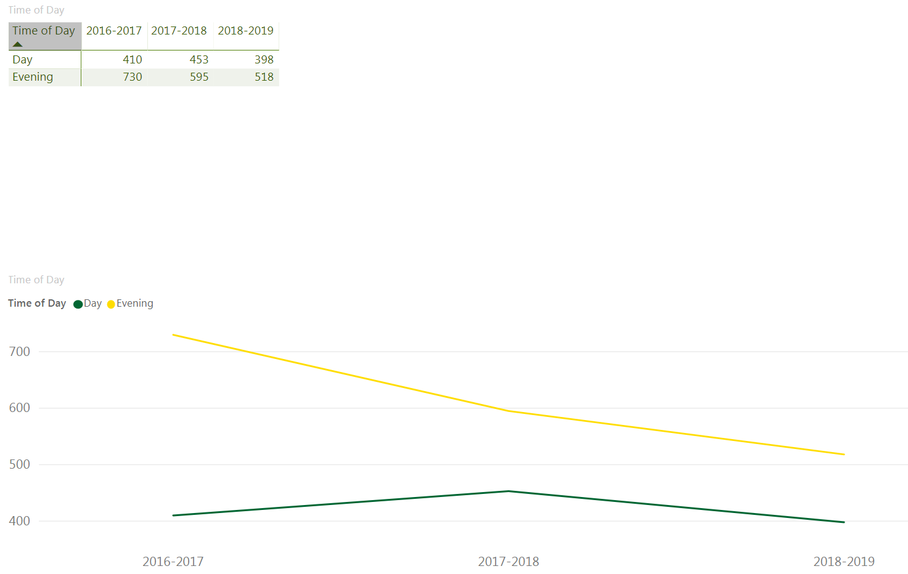
Notes:
Alicia- talks about student characteristics starting 2016 through 2019
-Time of Day students take ESL classes, majority in the evening

Slide 6
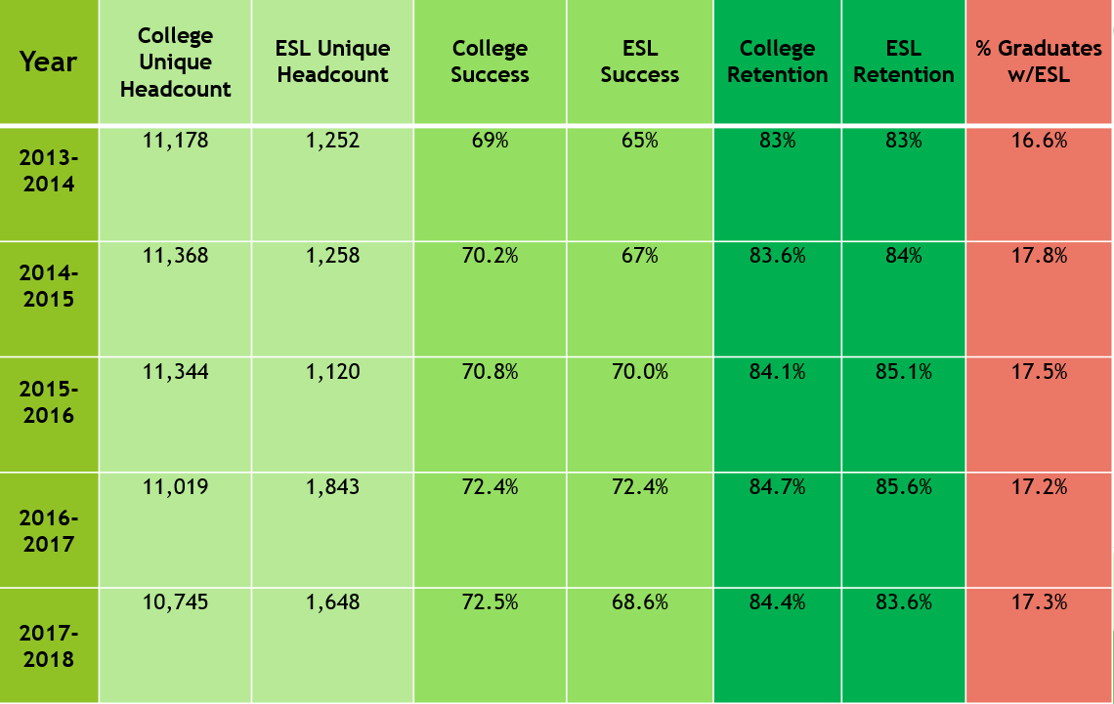
ESL Department
Success, Retention, and Completion Rates for ESL Students
Notes:
Alicia- discuss success, retention, and completion rates by comparing it with the college as a whole
% of graduates took an ESL class
Then, introduces Diana Espinoza-Osuna, ESL Department, Retention Specialist talk about the CBET program

Slide 7
ESL Department
Community Based English Tutoring Program (CBET)
CBET was funded by proposition 227 and offers beginning level English as a Second Language (ESL) classes to parents and community members throughout California who pledge to tutor school-age children. The Cañada College CBET English for the Workforce Award program is a collaboration between the San Mateo County Community College District (SMCCCD), and the Redwood City School District (RCSD).
The CBET program provides language skills classes for the workforce. The community-based classes serve as a bridge to on-campus academic and career programs. Upon completing the program, students receive the English for the Workforce Award.
https://canadacollege.edu/esl/cbet.php
Notes:
Diana -on CBET program general overview

Slide 8
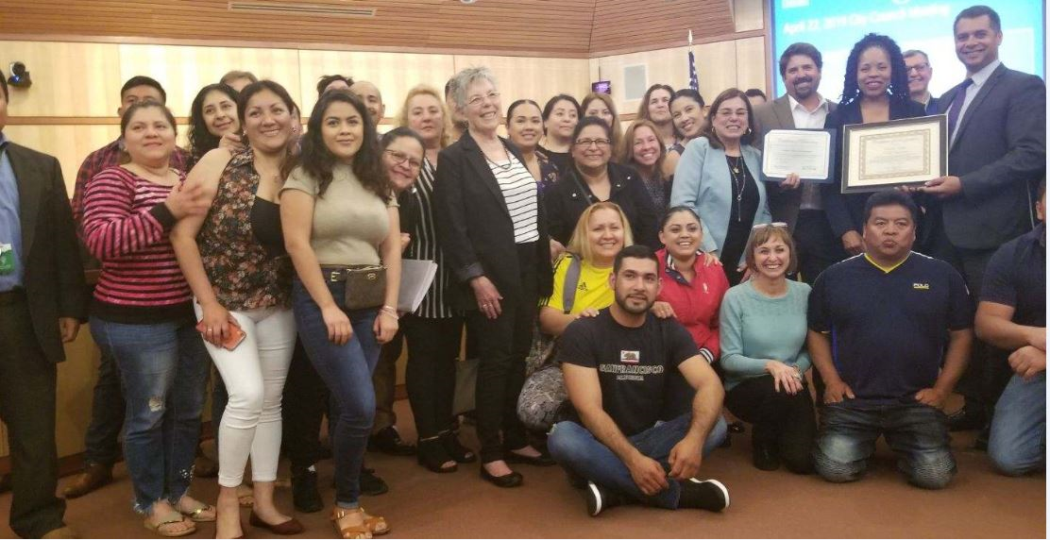
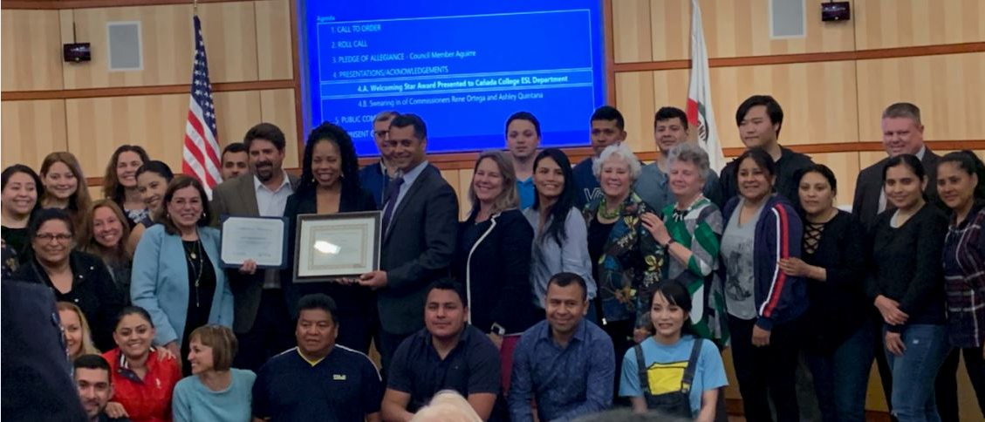
CBET Program
2019-Welcoming Star Recognition
The ESL/CBET Program was awarded the Welcoming Star Award which recognizes programs in the Redwood City and North Fair Oaks community that create a welcoming environment including treating everyone who lives, works, studies and visits Redwood City and North Fair Oaks with inclusion, understanding, and respect.
https://canadacollege.edu/esl/cbet.php
Notes:
Diana- welcoming star award in 2019 and how the CBET program makes a huge impact on the community of Redwood City and North Fair Oaks.

Slide 9
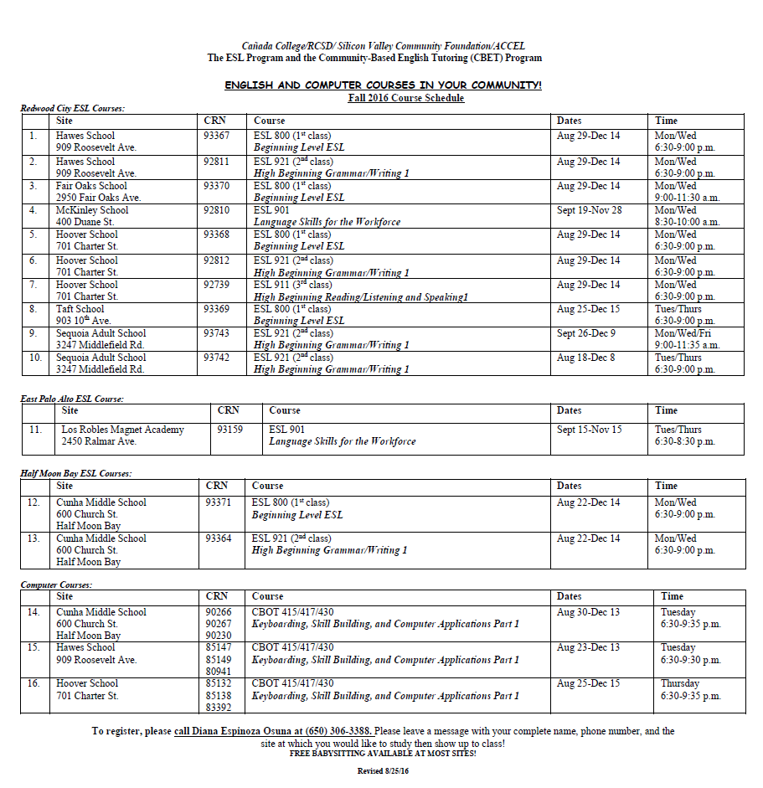
Notes:
Diana-CBET history class offerings and mention the collaboration with the CBOT department and how we plan to reestablish the collaboration

Slide 10
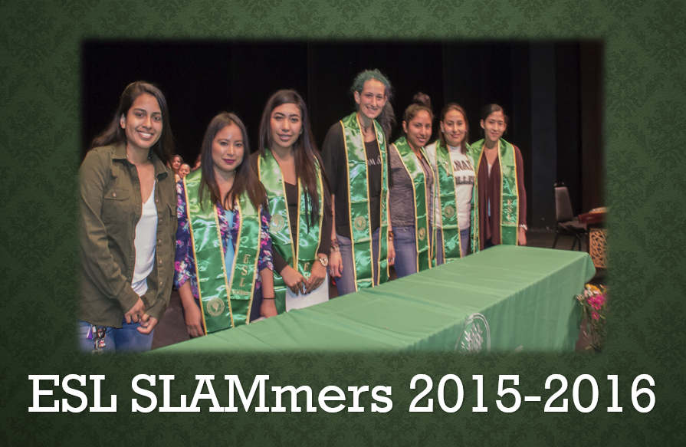
Notes:
Diana-about our ESL SLAMmers Student Learning Assistant Mentors project at our off-site ESL classes who were embedded mentor, tutors, ambassadors, and liason with the ESL office. The program ended due to funding.

Slide 11

Notes:
Diana-current ESL off-site offerings-childcare, new partnership with PAL and JobTrain

Slide 12
ESL Student Support Events
Welcoming new and returning students at our off-site locations
Promote Student Educational Plan (SEP) and Resources
Technology Workshop
  Websmart, My.smccd.edu, and Canvas
College Information and ID Event
Annual ESL Department Recognition Ceremony
Annual Careers and Majors Event
  STEM
  CWA
  RadTech
Proactive Registration
  Registration
  Financial Aid
  JAMS
  Transition to campus (ACCEL)
https://canadacollege.edu/esl/cbet.php
Notes:
Diana on CBET and ESL program student support events

Slide 13
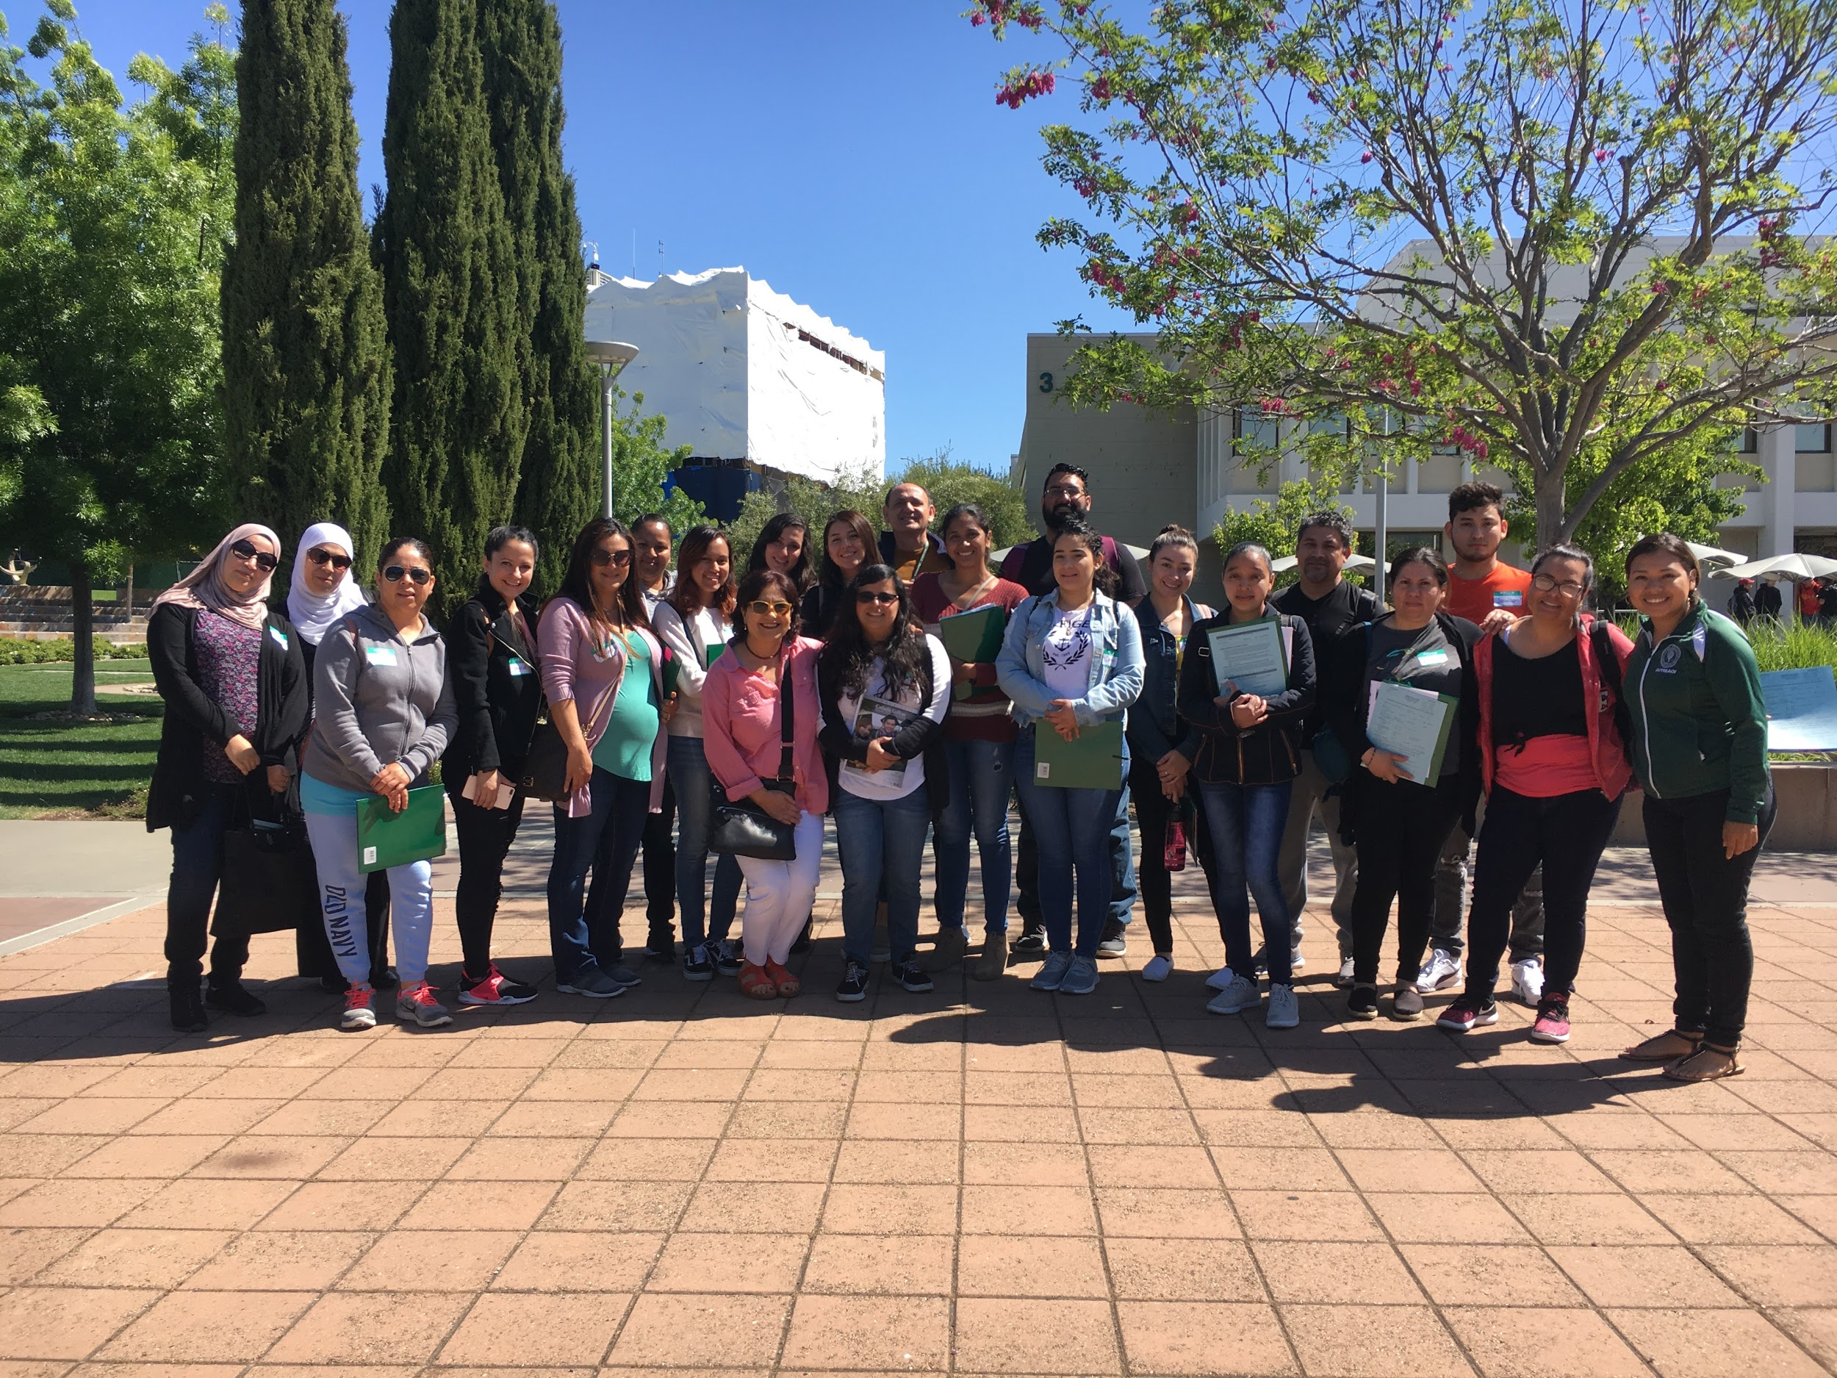
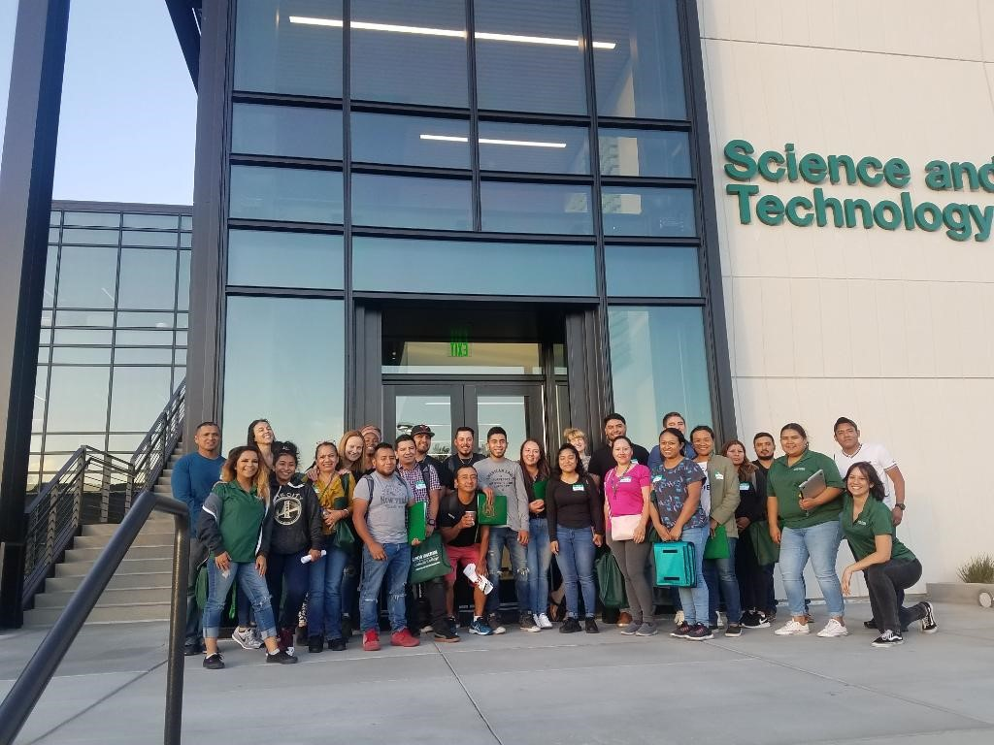
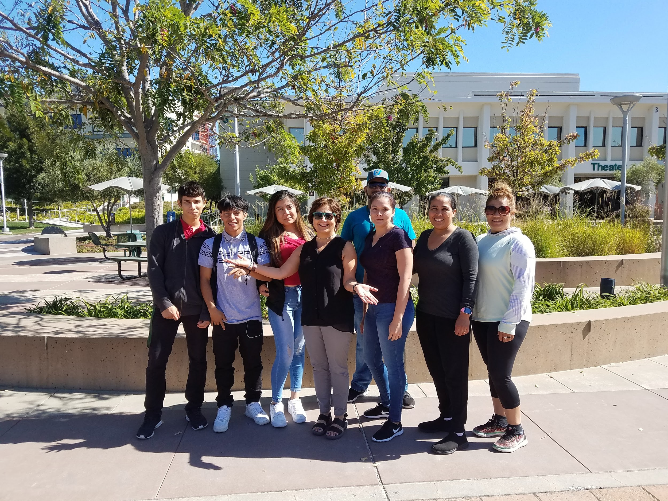
College Information and ID Event
Sequoia Adult School, ESL 921 Morning Class Sequoia Adult School, ESL 921 Evening Class Job Train, ESL 800 Morning Class
Spring 2019 Fall 2019 Fall 2019

Slide 14
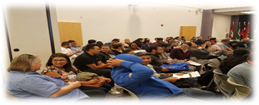
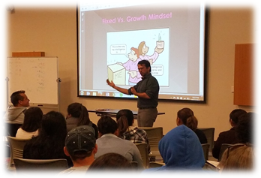
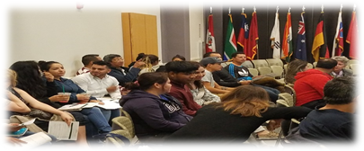
Careers and Majors Event-Fall 2018

Slide 15
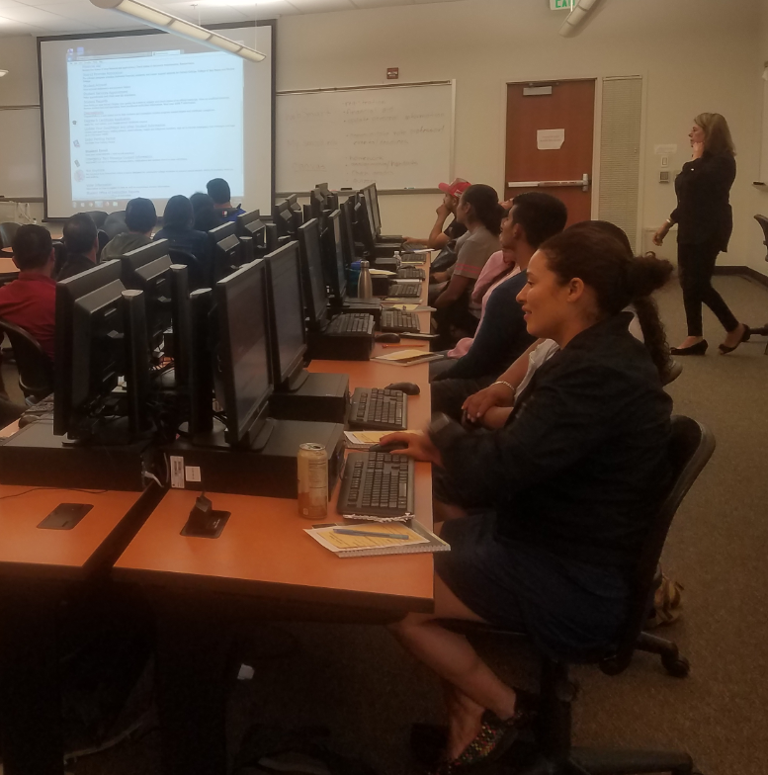
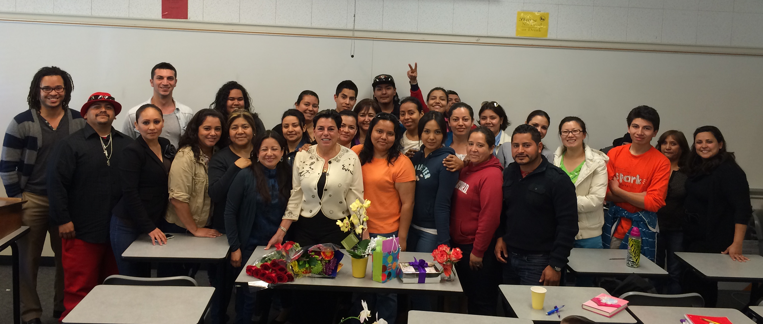
Proactive Registration

Slide 16
Notes:
ESL Awards and Annual ESL Recognition Ceremony
English for the Workforce Award
Academic Command of English Award
Important milestones to recognize our students and their families for their hard work!

Slide 17
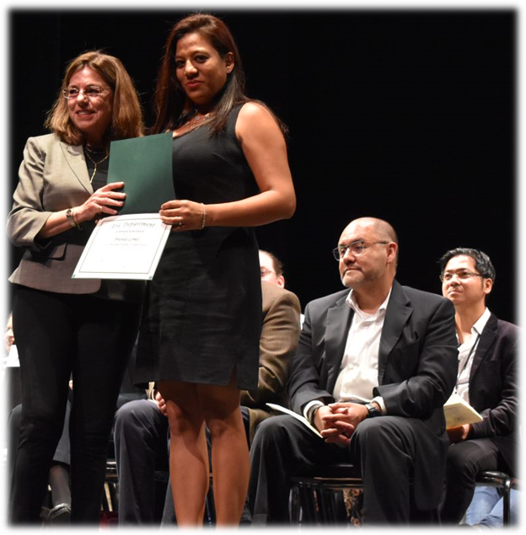
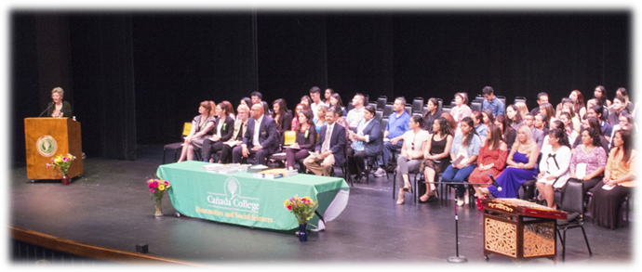
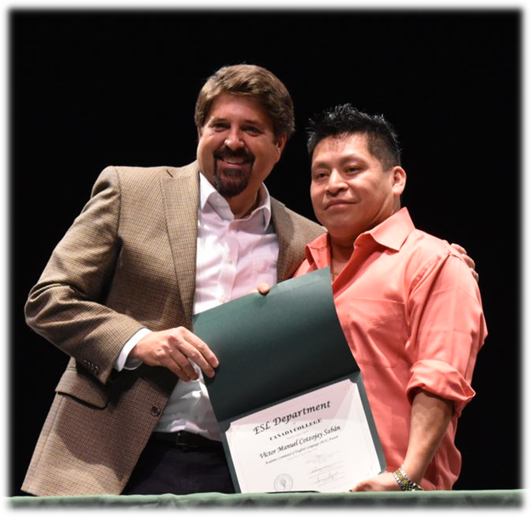
Recognition Ceremony
Notes:
Diana-Introduces Alicia to talk about the current community partners

Slide 18
Community Partners
Sequoia District Adult School/ACCEL Partners
Redwood City Elementary School District/Community Schools
Upward Scholars
Redwood City 2020/Socios for Success
Redwood City Library
Puente de la Costa Sur
Half Moon Bay Library
Rosalie Rendu Center
Nuestra Casa
JobTrain
Police Activities League (PAL)
St. Francis Center
East Palo Alto Elementary School District
Boys and Girls Club East Palo Alto
Notes:
Alicia-talks about the current partnerships and how they are key to help recruit for our program.

Slide 19
Potential Community Partners
Redwood City Charters Schools
Woodland Community Center in East Palo Alto
Oxford Day Academy (ODA) in East Palo Alto
San Mateo Adult School
La Costa Adult School, Half Moon Bay
Notes:
Alicia- talks about the potential community partners
Then, introduces Janet as ACCEL Transition Coordinator

Slide 20
ACCEL
Off Campus ESL Students Transition to Campus ESL classes
 | Number of students who successfully passed ESL 800, 911, 921 or 830 | Number of students who subsequently took an ESL class excluding ESL 800, 911, 921 or 830 | Percentage of students who subsequently took an ESL class excluding ESL 800, 911, 921 or 830
Fall 2015 | 85 | 72 | 85%
Fall 2016 | 89 | 75 | 89%
Fall 2017 | 88 | 76 | 94%
Notes:
Alicia--transition percentages from Fall 2015-Fall 2017 (working with the PRIE office to get current data)

Slide 21
ACCEL
The Adult-Education College and Career Educational Leadership (ACCEL) is the planning body for San Mateo County’s Adult Education Block Grant funding.
The consortium includes:
San Mateo Community College District
Five adult schools
K-12 district offices
Several regional community partners throughout the county
Mission
To support students transitioning from adult schools to campus programs so that they're prepared to transfer, transition to a technical/vocational/trade program, enter/move up in the workforce upon completing their studies at Cañada College.
Notes:
5 min--Janet--What is ACCEL, how does Janet’s role support student success in community college

Slide 22
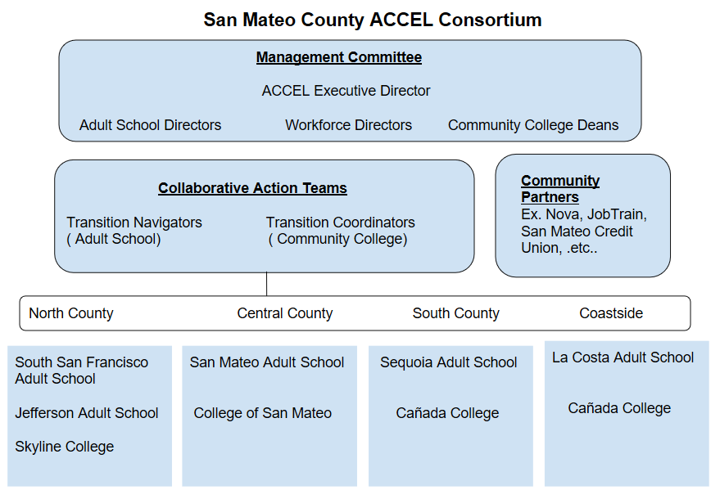
ACCEL
Notes:
5 min--Janet--What is ACCEL, how does Janet’s role support student success in community college

Slide 23
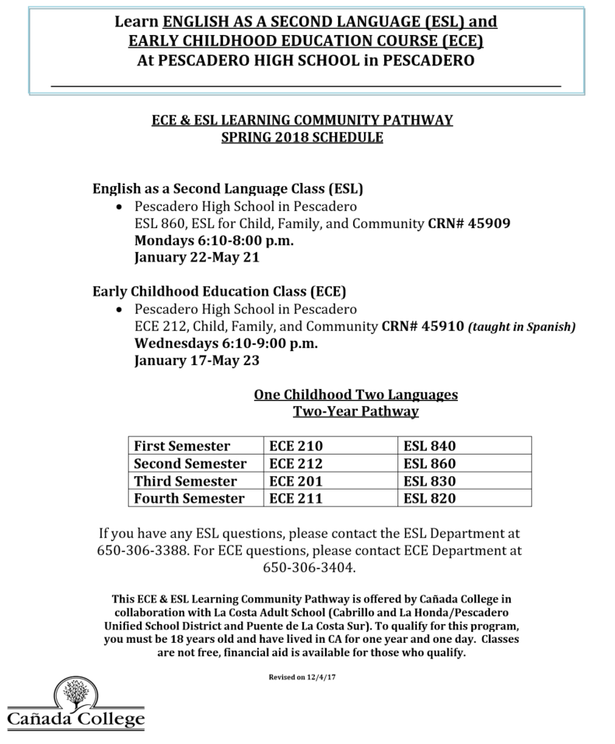
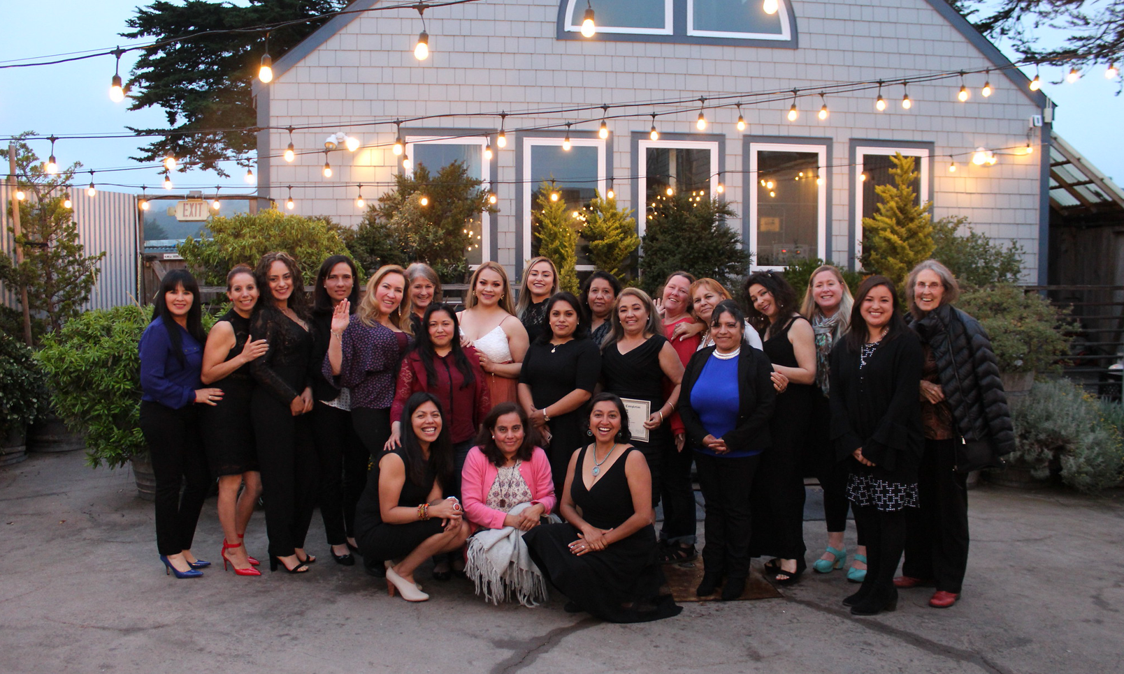
ACCEL
ECE/ESL Pescadero Cohort Fall 2017-Spring 2019
Awards Night
Notes:
5 min--Janet--What is ACCEL, how does Janet’s role support student success in community college

Slide 24
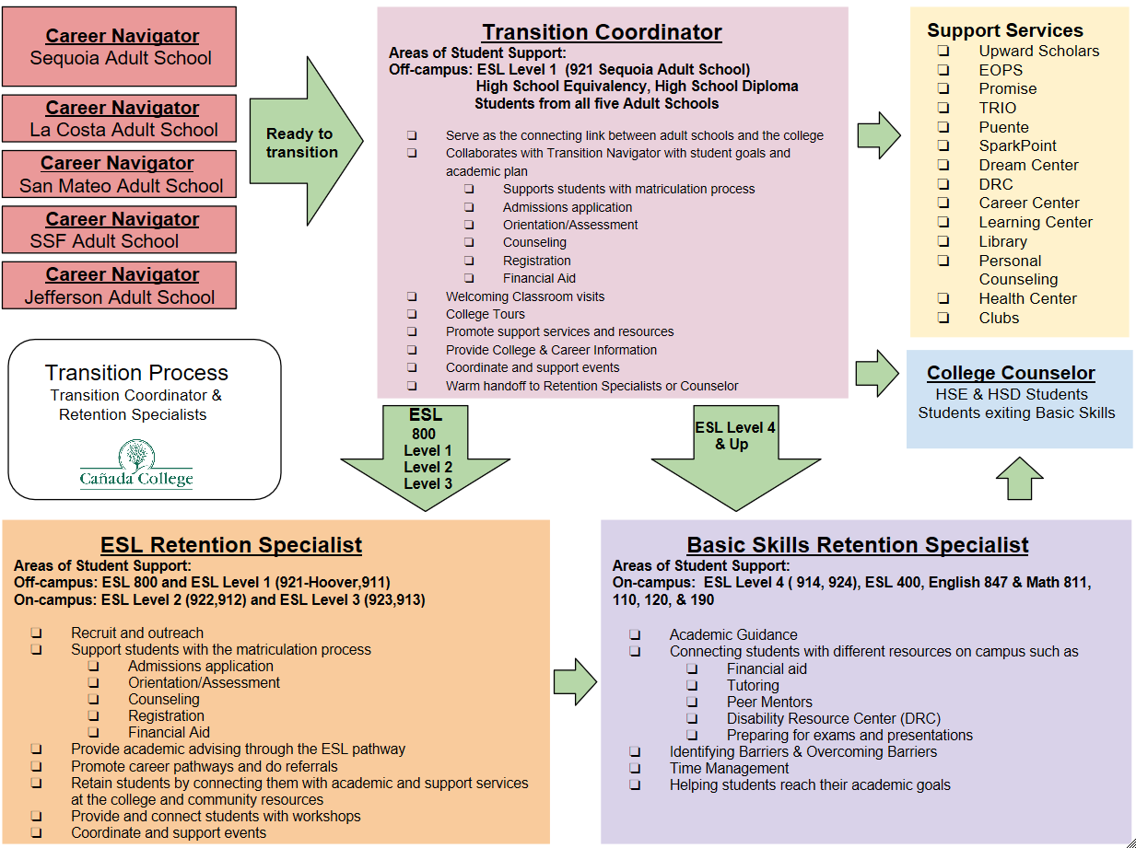
ACCEL
Notes:
5 min--Janet--What is ACCEL, how does Janet’s role support student success in community college

Slide 25
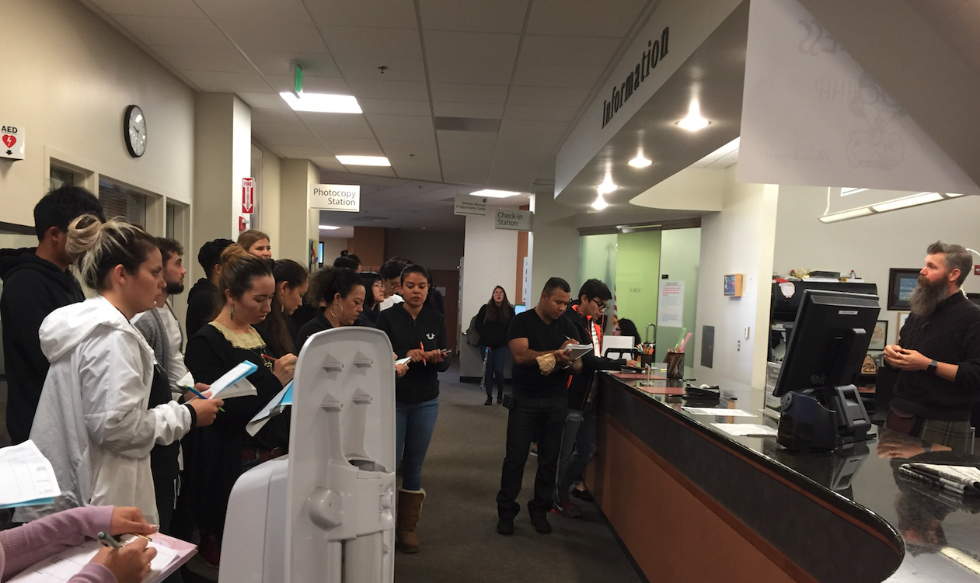
On Campus Support
ESL Coordinator
ACCEL Transition Coordinator
Retention Specialists
  ESL
  Basic Skills
ESL Counselor
ESL Faculty
Academic Support
  Learning Center
    Tutoring
Library
Upward Scholars
DREAM Center
Welcome Center
Sparkpoint Center
Notes:
Janet--On campus support (DREAM Center, Retention Specialist, Sparkpoint, faculty connections) Highlight integrating support services information into curriculum

Slide 26
Mission
Upwards Scholars
Upward Scholars empowers low-income adults, mostly immigrants, by providing them financial, academic, and community support so they can continue their education, get better jobs, and serve as role models and advocates for their children.
Legacy
We’re the first, and most likely the only, nonprofit in California providing academic, financial, and community support to adults from low-income backgrounds attending community college part-time.
Notes:
Janet

Slide 27
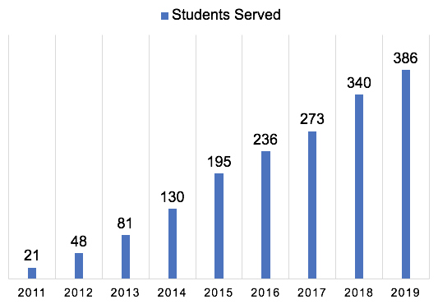
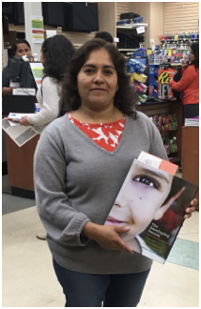
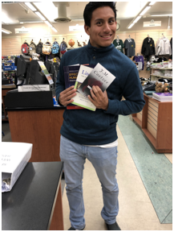
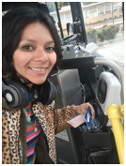
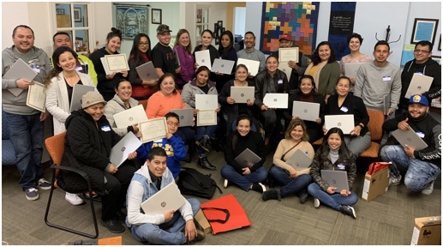
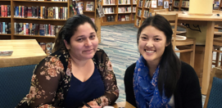
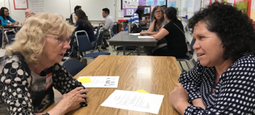
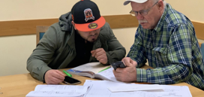
Upwards Scholars
Notes:
Janet

Slide 28
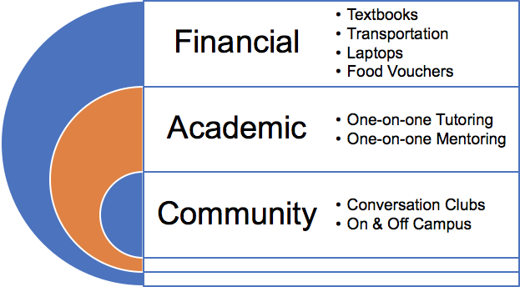
Upwards Scholars
•7 students have transferred to 4-year universities
Cal Poly, SLO; San José State University; UC Berkeley; UC Davis; UC Santa Cruz
•67 students have attained vocational certificates in areas such as
Administrative Medical Assistant, Cosmetology, Early Childhood Education/Child Development, Human Services, Medical Assistant
•61 students have completed the equivalent of freshman English
Notes:
Janet
then, introduces Alicia

Slide 29
Notes:
Alicia-talks about the on-campus ESL classes

Slide 30
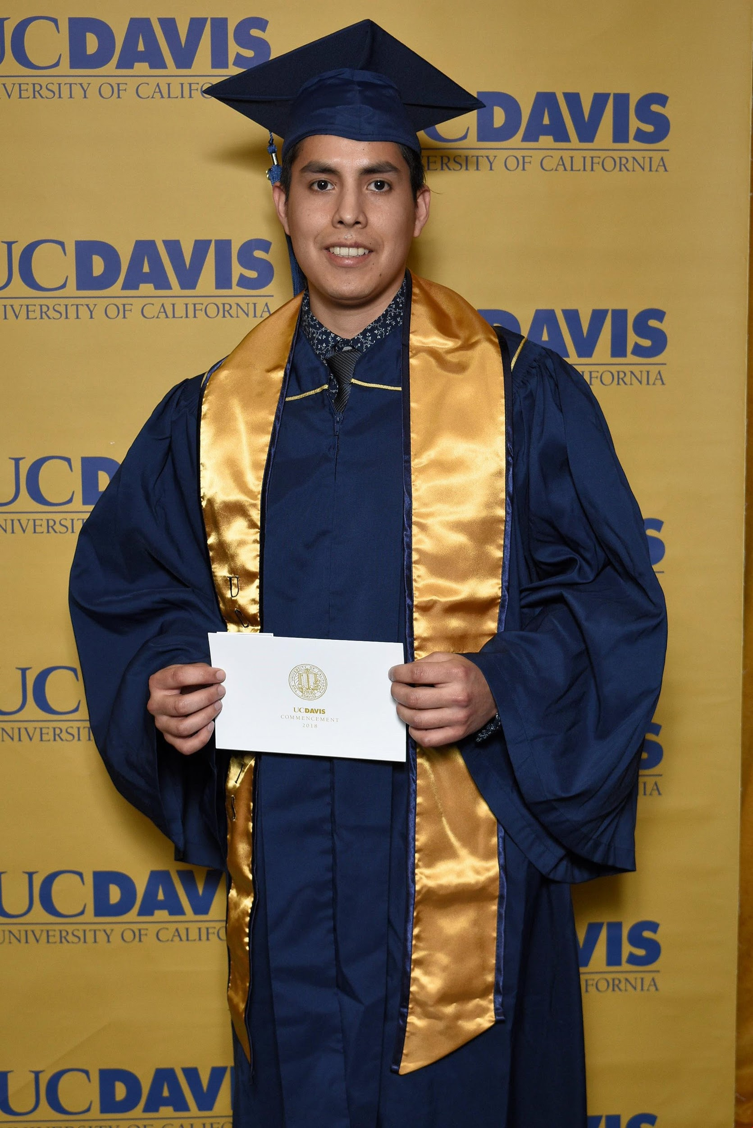
Follow Up: Where are they now?
Rick Alarcon
transferred to the University of California, Davis, graduating in December 2018 with a joint major in mathematical analytics and operations research and a minor in statistics. Currently, he is working at a startup focusing on business strategy and data analysis.
Notes:
Alicia

Slide 31
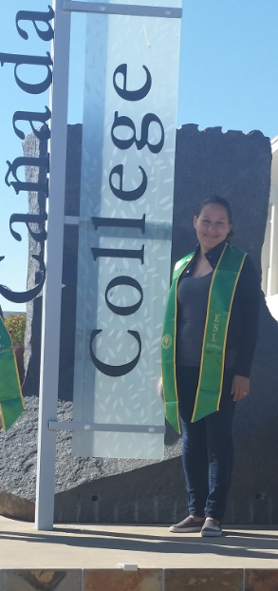
Follow Up: Where are they now?
Elizabeth Sosa-Cornelio
After earning AAs in Economics, Spanish, and Latin American Studies, and an AS in Business Administration at Cañada, Elizabeth transferred to Menlo College and earned a BS in Management Information Systems. She is currently working as a full-time employee at Phantom Cybersecurity Company.
Notes:
Alicia

Slide 32
Opportunities for Growth
Collaborate with other disciplines to align schedule and class offerings
  Math
  CBOT
  Human Development (ECE)
  STEM
  Fashion Design
  Library
Create Academic support workshops for ESL students
  Writing and Grammar
  Technology
  College and Career Readiness
  Time management
  Study Skills
Offer ESL JAMS every semester day and evening
Bring back ESL SLAMmers!
Notes:
Alicia

Slide 33
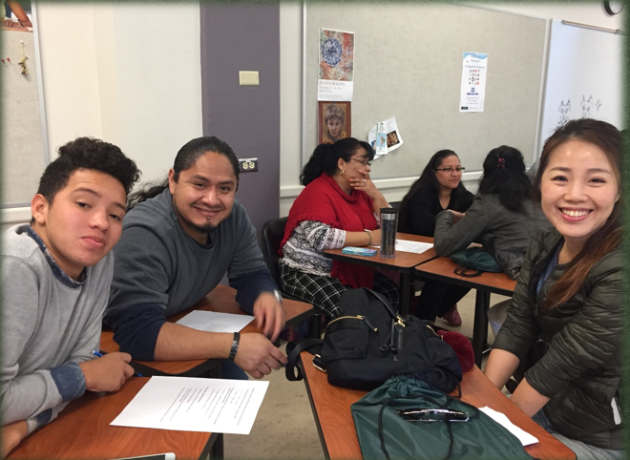
Serving the COMMUNITY in Community College!
Notes:
Alicia

