Slide 1

Fall 2019 SEM Planning
August 7, 2019

Slide 2
Members of the SEM Committee
Tammy Robinson, VPI, co-chair
Karen Engel, Dean, PRIE, co-chair
Diana Tedone-Goldstone, Librarian, Academic Senate President
Jeanne Stalker, Classified Senate President
Hyla Lacefield, Academic Senate Member
Paul Naas, CE Faculty
Marisol Quevedo, Promise Program Coordinator
Mayra Arellano, College Recruiter
Ruth Miller, Registrar and Admissions
Max Harman, Dean of Counseling
James Carranza, Dean, H&SS; Acting Dean of STEM
Leonor Cabrera, Dean, BDW
David Reed, Dean, ASLT
Megan Rodriguez-Antone, Director of Marketing and Community Relations
Manuel Perez, VPSS
Graciano Mendoza, VPA
Jamillah Moore, President

Slide 3

Agenda
Re-cap progress made, spring 2019
Committee recommendations to PBC
Summer updates (outreach, IEPI, data)
College strategic priority projects for 2019-20
Setting a course for fall 2019 SEM work
  Possible areas of focus
  Research projects
  Organizing our planning efforts

Slide 4
Re-cap Progress Made: topics explored
College for Working Adults
Dual Enrollment and Middle College
Online Education
Career Education
International Students
KAD and the new Building 1
STEM Center Innovations

Slide 5
SEM Committee Recommendations
Continue working on the plan and key performance indicators over the summer resulting in a draft SEM Plan submitted to PBC in early fall 2019
Get clearer on the distinction between the Strategic Enrollment Management and strategic initiative planning and implementation generally
A new task force for aligning outreach has been formed, with Mayra Arellano in the lead which will also meet over the summer and consider:
  How to best coordinate all of the outreach activities and contacts currently happening to maximize impact and be more efficient – resulting in a Campus-wide Outreach Plan by end of summer
  What the key messages are about the College and to which audience(s)
  How the College could conduct a thoughtful process for considering whether or not to pursue changing the College’s name

Slide 6
Summer Updates: Outreach Alignment
Data collected
Synthesis
Next steps

Slide 7
Summer Updates: Data

Slide 8
Summer Updates: Data

Slide 9
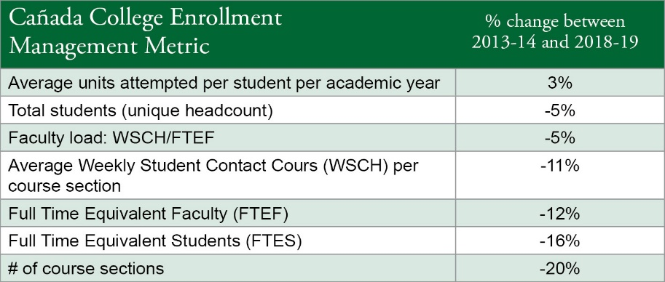
Summer Updates: Data

Slide 10
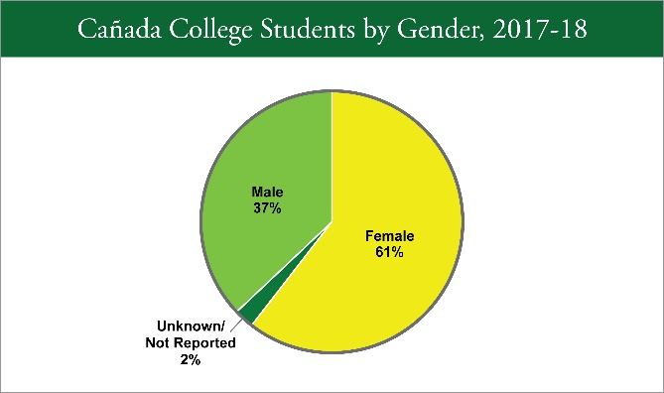
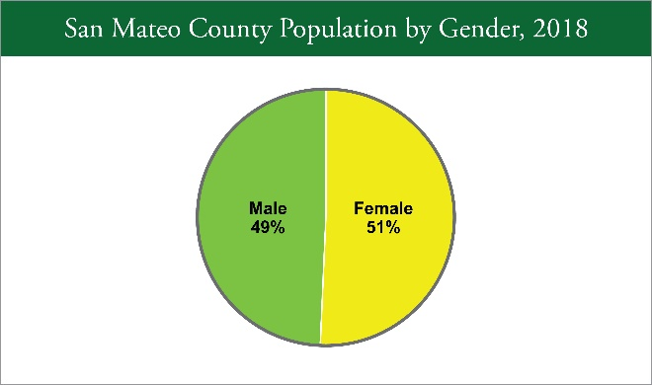
Summer Updates: Data

Slide 11
Summer Updates: Data

Slide 12
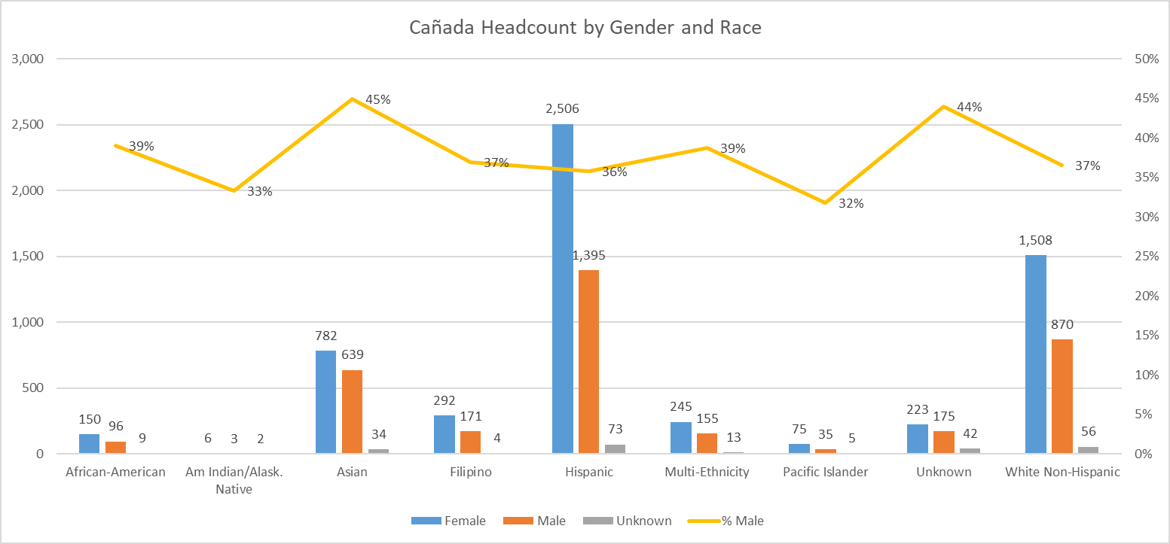
Summer Updates: Data
Notes:
The College’s student population is disproportionately female. For over 20 years, male students have comprised only 34-38% of the total student population. The primary driver behind this phenomenon is the disproportionate number of female students enrolling in some of the College’s most popular career education programs: Early Childhood Education (now Education and Human Development), Fashion Design, Interior Design, and Medical Assisting. Over 90% of enrollment in these programs is female. These four programs account for 60% of the discrepancy in total enrollment.
Other programs, such as Biology, Psychology, and English, also contribute to this phenomenon. During the 2018-19 school year, 42 programs enrolled more female than male students, while only 10 programs enrolled more male than female students. The Strategic Enrollment Management Committee is exploring possible sources of this phenomenon, including a close look at the College’s recruitment strategies.

Slide 13
Summer Updates: Data
Gender | INTD | ECE | Fashion | MEDA | PSYCH | SOC | Dance | ESL | CHEM | ENGLISH | MATH | TOTAL
Female | 209 | 717 | 316 | 132 | 678 | 314 | 127 | 615 | 311 | 1154 | 1407 | 5771
Male | 12 | 63 | 35 | 14 | 263 | 123 | 67 | 365 | 216 | 805 | 1236 | 3187
TOTAL | 221 | 780 | 351 | 146 | 941 | 437 | 194 | 980 | 527 | 1959 | 2643 | 8958
% female | 95% | 92% | 90% | 90% | 72% | 72% | 65% | 63% | 59% | 59% | 53% | 64%

Slide 14
Summer Updates: Data

Slide 15

Summer Updates: IEPI
Cañada’s application “lost”
SEM Resources
  SEM Foundational Elements and Resource Guides
  SEM Promising Practices

Slide 16
Summer Updates: IEPI
Resource Guides
A Roadmap for Strategic Enrollment Management Planning
Understanding and Calculating FTES and Efficiency
Data Tools and Metrics for Strategic Enrollment Management
Developing and Managing the Class Schedule
High Impact Retention, Persistence, and Success Practices for Strategic Enrollment Management
Support Services for Strategic Enrollment Management
Targeted Marketing and Communications for Strategic Enrollment Management
Other Tools and Resources
SEM Institutional Self-Assessment
SEM Institutional Self-Assessment Facilitator's Guide
SEM Planning FAQ
FTES Calculator

Slide 17
College Strategic Priorities for 2019-20*
Re-Design College Processes: CRM
  Streamline the matriculation process
  Organize student “Success Teams” aligned with Interest Areas
  Build data dashboards and train data coaches to support these efforts
  Scale the number of Peer Mentors aligned with Interest Areas and programs
Establish Interest Areas and Program Maps (implement Program Mapper)
  Use the program mapping exercise to optimize the course schedule for student completion
Develop Career Exploration opportunities for students that are aligned and integrated with Interest Areas
Re-design Academic Support (launch Writing Center, scale peer mentoring and EPIC supplemental instruction programs and integrate retention programs into larger academic support structure)
Build First Year Experience (FYE) programs (start at October Flex) aligned with Interest Areas
Expand opportunities for Early College experiences (dual enrollment; Middle College)
Expand College capacity to assist students with Job Placement
Create an equitable experience for Online Students to support student success
*Synthesized from the College EMP, Guided Pathways Steering Committee, Strategic Enrollment Management Committee, Student Equity & Achievement Plan, Strong Workforce goals, Chancellor’s Vision for Success, and the SMCCCD Board of Trustees (re Job Placement). Many of these are multi-year efforts/goals.

Slide 18
CRM
Interest Areas & Program Maps
High School Engagement
Online Instruction
Academic Support
First Year Experience
Career Exploration
Job Placement

Slide 19
Strategic Priority Projects - detail
CRM
Interest Areas
High School Engagement
Success Teams
Program Maps
First Year Experience
Peer Mentors
Schedule Optimization
Online Instruction
Data Coaches
Career Exploration
Job Placement
Academic Support

Slide 20
Setting a course for fall SEM work

Slide 21
Areas of focus for SEM?
CRM
Interest Areas
High School Engagement
Success Teams
Program Maps
First Year Experience
Peer Mentors
Schedule Optimization
Online Instruction
Data Coaches
Career Exploration
Job Placement
Academic Support

Slide 22
Other topics…
Menlo Park
College for Working Adults
KAD
Growing new career education programs
ESL/Adult Ed. transitions
Others?

Slide 23
Research projects
Schedule optimization
Menlo Park
Phone survey of “leavers” – here fall 2019 and gone spring 2020
CTEOS data inquiry
CCSSE data mining
Tracking Key Performance Indicators (KPIs)
  Enrollment (headcount & FTES)
  Retention
  Persistence
  Completion
  Average units to completion
  # of enrolled semesters to complete
  Program stack-ability
  Program complete-ability
  Course analysis for non-degree departments (contribution to completers in other programs)

Slide 24
Organizing our planning efforts
Planning process
  Refine committee members?
  Create work teams?
  Meeting times
Timeline
  New SEM 5-year plan to PBC by November?

