Slide 1


International Student Program
Strategic Enrollment Committee
Spring 2019

Slide 2
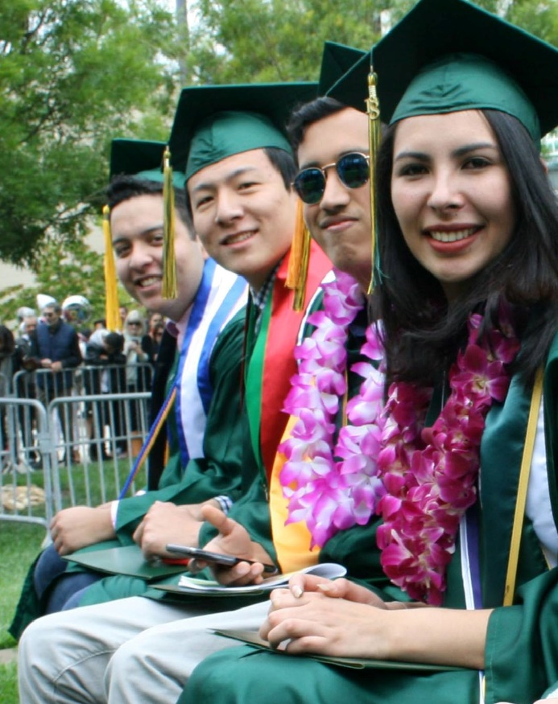
International Program Snapshot
F-1 students (non-immigrant, non-resident) visa holders
Must be enrolled in 12 units per semester (or have authorized reduced course load)
I-20 Form is given for 2.5 years for Associate’s Degree; 1.5 years for Certificate Programs (can be extended)
Average length of stay is 2 years
Must be present on campus for 9 out of 12 units
Demographics
136 Students from 39 Countries
Top Majors: 20% Business, 13% Computer Science, 11% Fashion or Interior Design, 7% Multimedia, 7% Engineering, 6% Biology
About 10% of students are Former J-1 AuPairs from the area
About 25% of each new intake matriculated from SVIEP (on-campus, non-credit Intensive English Program)

Slide 3
AY 2018-19 Enrollment

Slide 4
Historical Data
250% growth in annual headcount over 5 years, 2012-2017

Slide 5
Program Strengths
Enrollment Increase
Increase of +16% Spring 2019 vs. Spring 2018; other colleges saw decreases (-7% and -8%)
International Student Success
Transfer Rate: 55% of Spring 2018 Transfers went to UC’s
Average GPA of 3.0, highest of all campuses
Campus Leadership – 50% of student governement and Student Body President (2 years in a row) are international students

Slide 6
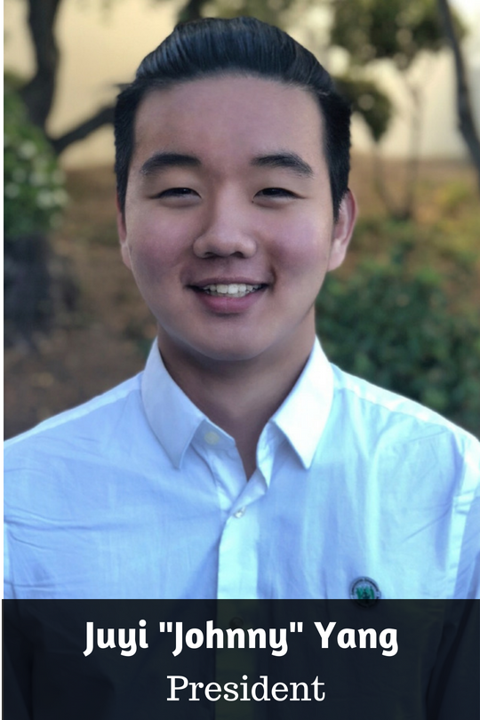
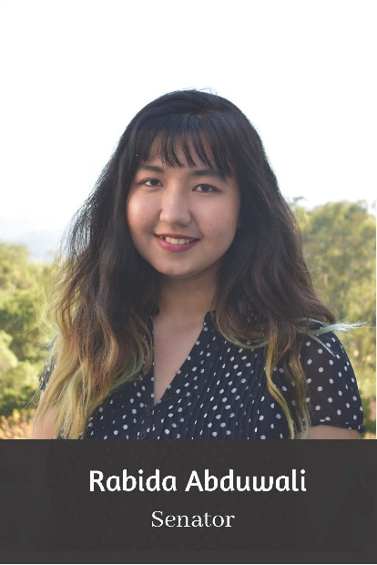
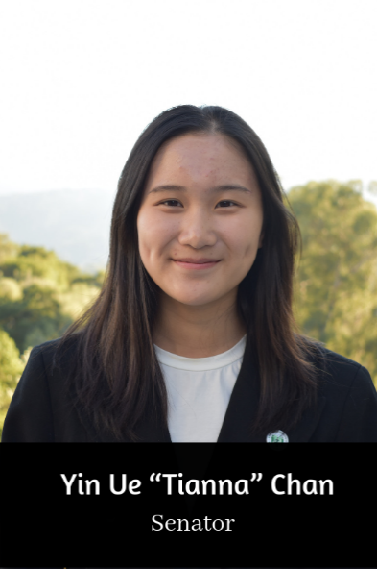


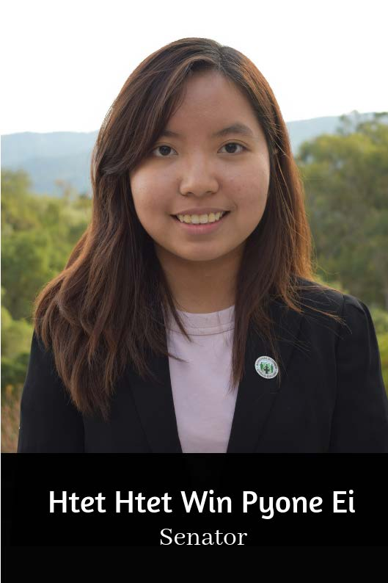
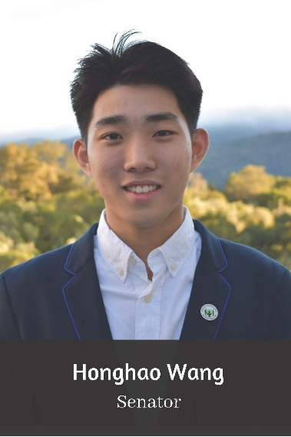

Student Leadership
AY 2018/2019
50% (7 out of 14) ASCC Student Officers were International Students, including the Student Body President
AY 2017/2018
70% (7 out of 10) ASCC Student Officers were International Students, including the Student Body President

Slide 7
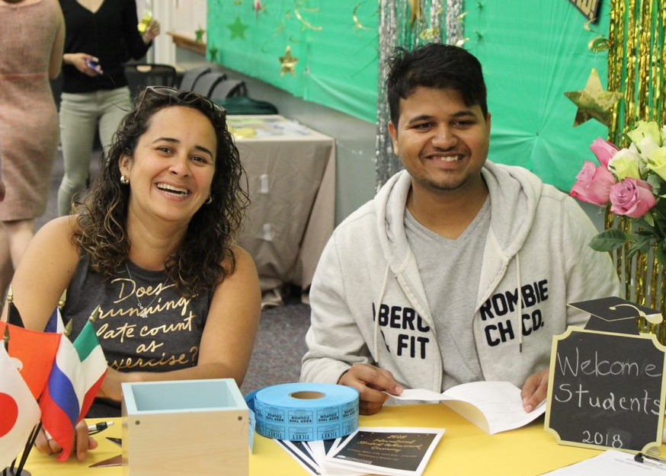
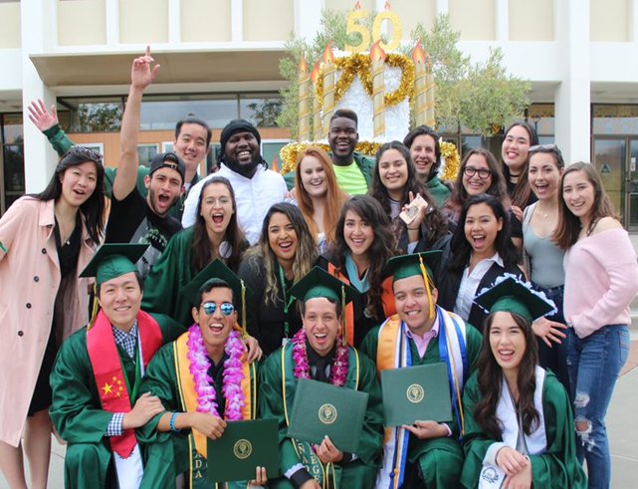
Other Program Strengths
Customer Service
Known for friendly, knowledgeable, helpful F-1 student advising and customer service
Permanent staff has 5-15+ years experience with intl students
Dedicated International Student Counselor
Since Fall 2018, full-time international counselor in place
Appointments for SEPs, Transfer Help, Retention, Graduation applications, and more
Conducts outreach and early intervention
Student Ambassador Program
4 Students per semester are selected to work in our office
and serve as ambassadors to other international students

Slide 8

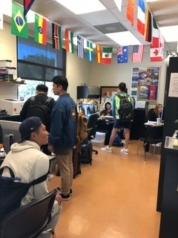
Program Challenges
Name Confusion
College name creates significant confusion in the competitive international market
Office Space
Small, cramped office space shared between 2 programs
4 Full Time Staff, plus 1 student ambassador, and 1 student computer
Personnel Resources
Managing the needs of the current international population while recruiting internationally and locally
Additional personnel resources needed for student support and retention

Slide 9
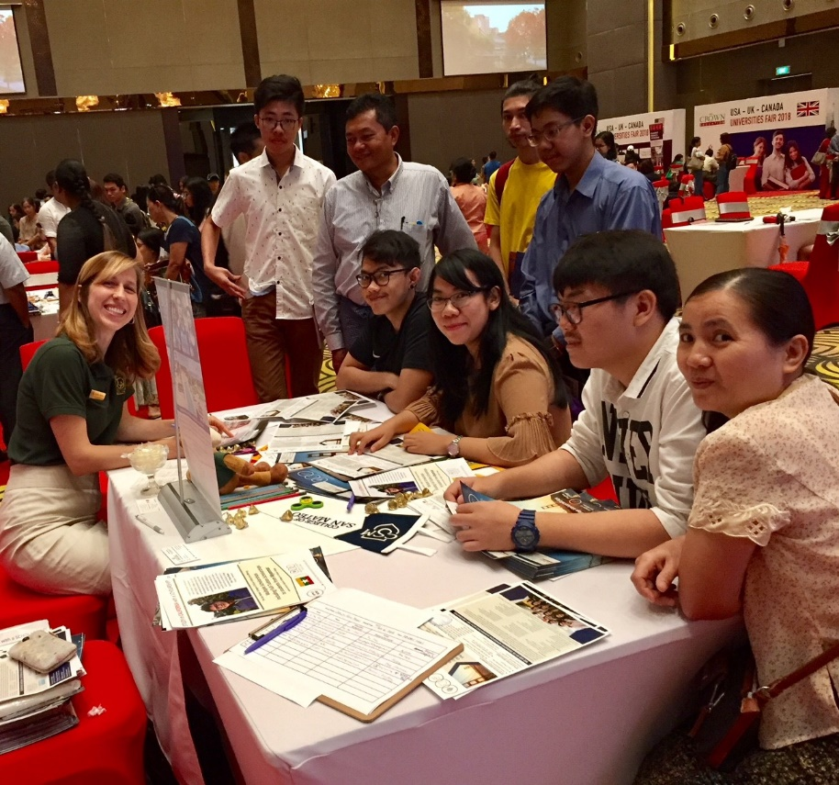
Program Threats
Federal Adminisration
Visa regulations and US foreign relations continue to be a threat to F-1 international programs
US Dollar Value
Strong US Dollar prevents students from some countries, or delays their program.
High Cost of Living in the Area
Students may choose other areas of California or the US due to housing costs

Slide 10
Areas of Opportunity and Growth
Expanded International Office Space
Expanded space needed for staff offices, student gathering area, storage and meditation/prayer room
International Recruitment Travel
Due to name confusion and smaller population, significant international exposure is necessary
International Staff completed five 10-16 day trips in 2018 to 13 countries and 24 cities. Prior to 2018, only 3 countries were visited.
Personnel Resources
Additional personnel resources needed for student support and retention, especially while staff is participating in off campus recruitment.

Slide 11
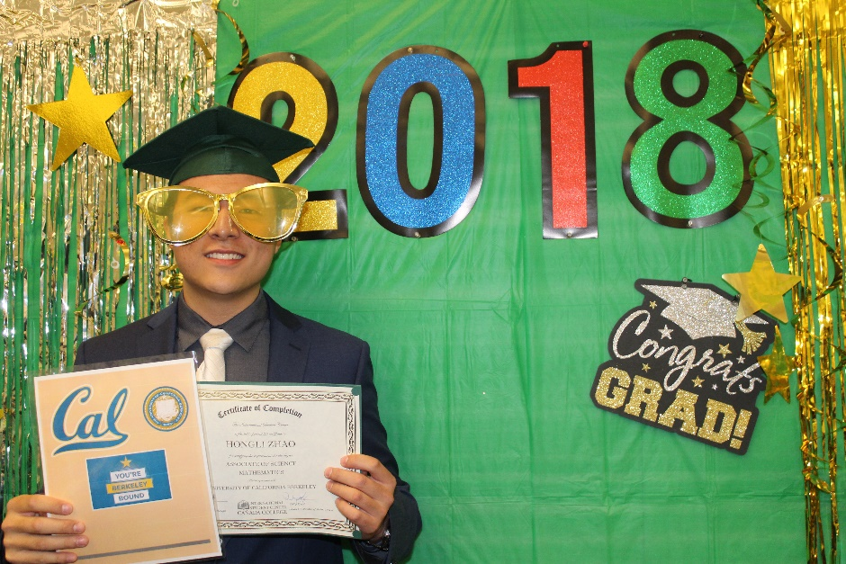
Areas of Opportunity and Growth
Local Parternships/Recruitment
Develop partnership with local AuPair Field Reps and community
Community involvement (e.g. Redwood City International and other groups) to increase word-of-mouth in local community for friends and relatives abroad
Website and Social Media
Redesigning the website to increase visual interest
Short, high quality, interesting videos needed for
website and social media
Updated, redesigned electronic and print materials needed

Slide 12
Projections AY 2019-2020
 |  | ACTUALS |  | ACTUALS |  | PROJECTIONS
 |  | FALL 2017 | SPRING 2018 | FALL 2018 | SPRING 2019 | FALL 2019 | SPRING 2020
 | Total new incoming students | 37 | 20 | 38 | 25 | 35 | 18
 | Continuing students | 80 | 94 | 85 | 111 | 82 | 99
 | Students leaving/graduating | 23 | 38 | 11 | 54 | 18 | TBD
117 | 117 | 117 | 136 | Project : 117 | Project: 117 | 117 | 117 | 117
 | ANNUAL HEADCOUNT | 137 |  | 145

