Slide 1
Kinesiology, Athletics, & Dance Department
Cañada College
If You Build It, Who Will Come?
Strategic Enrollment Management
Presentation & Discussion
Wednesday, May 1, 2019

Slide 2
Agenda
Who Is KAD?
Where Is KAD?
Why Now for KAD?
KAD Enrollment Trends (2013-2018)
How Does KAD Serve Our Students?
How Do We Further Support KAD?
Q&A

Slide 3
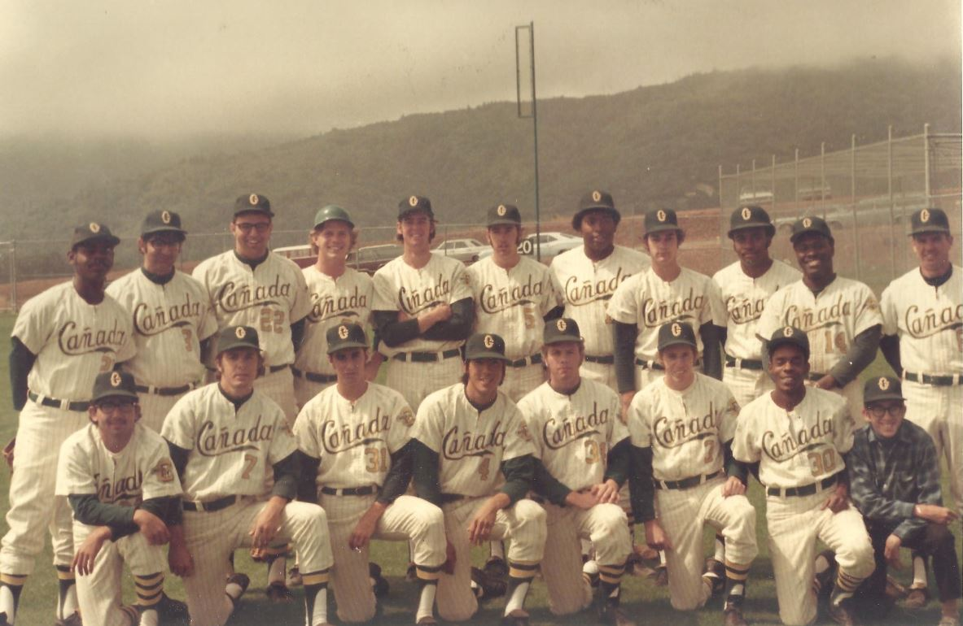
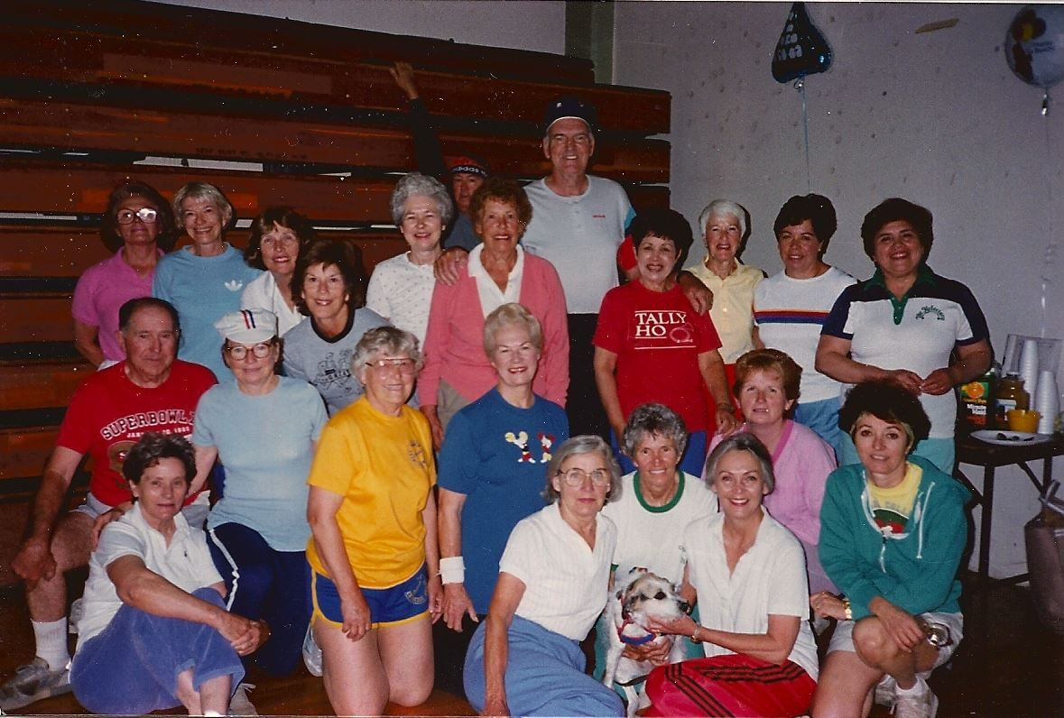
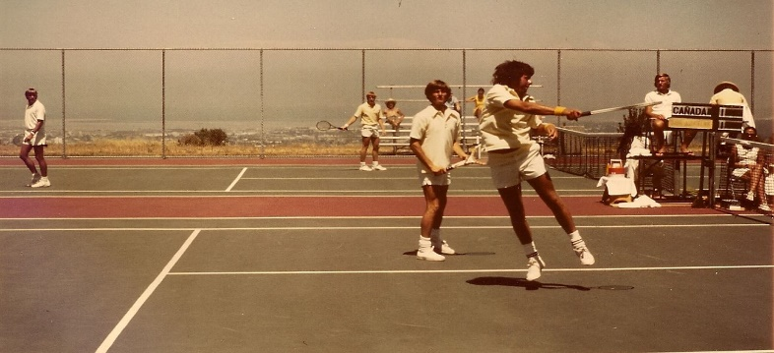
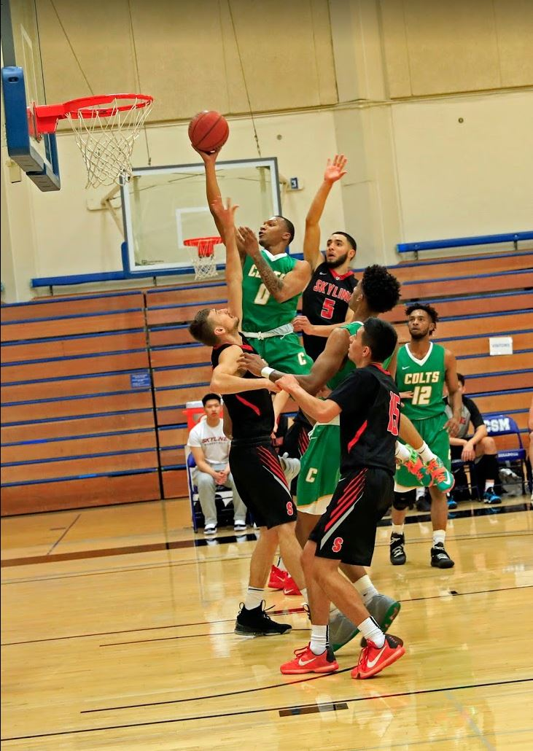
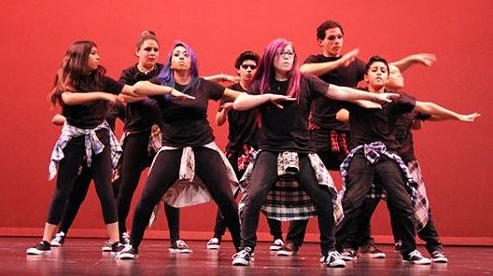
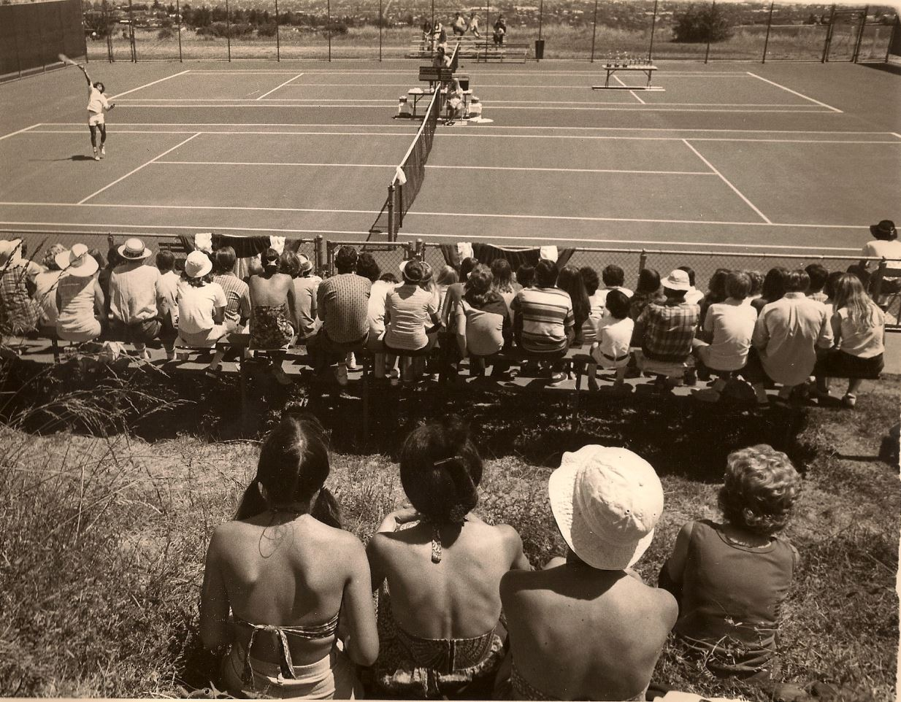
Who Is KAD?
Notes:
KINE:
Offers a variety of activity classes designed for lifetime enhancement of fitness & recreation
Classes in FITN, INDV, & TEAM are offered at various levels of performance, beginning with classes introduced as an activity; intermediate to advanced courses are designed to improve an already existing skill level.
Kinesiology Department offers a Kinesiology transfer curriculum to a four-year university, and an AS Degree and certificate in Fitness Professional. The Fitness Professional AS degree and certificate programs are designed to give students enough practical and formal training so that they can obtain a job as a personal trainer in the fitness industry. The demand for fitness professional jobs continues to remain high.
ATH:
The Cañada Athletics Department promotes excellence in athletics and prepares leaders for tomorrow by providing an excellent environment to enable student-athletes to achieve their highest academic, athletic, and personal aspirations.
DANC:
The Dance program prepares students to improve their level of body technique, performance, and expression and includes some aspect of performing arts during their studies at Canada College.
The goal of the dance department is to introduce students to the joy of movement through dance.

Slide 4
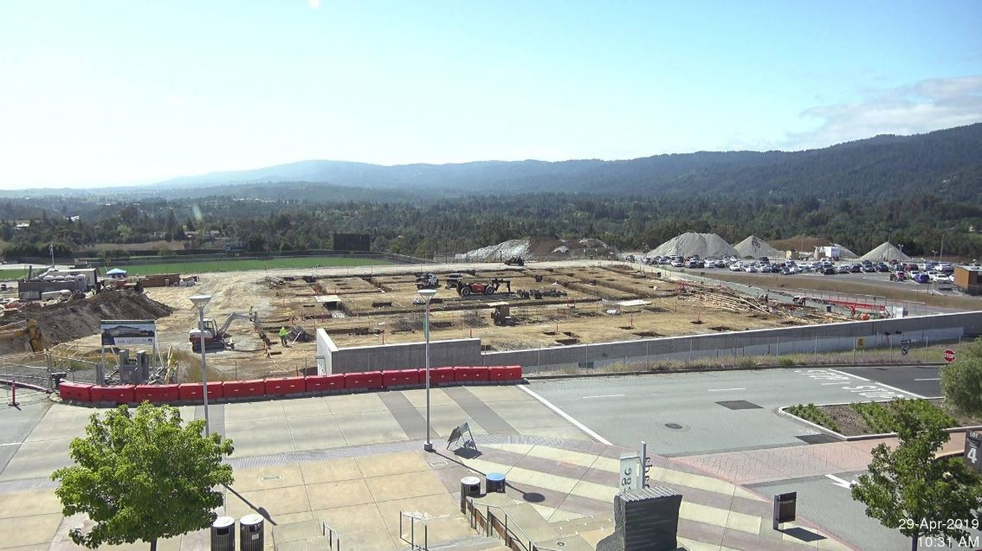
Where Is KAD?
Notes:
KAD is in swing space beginning summer 2017

Slide 5
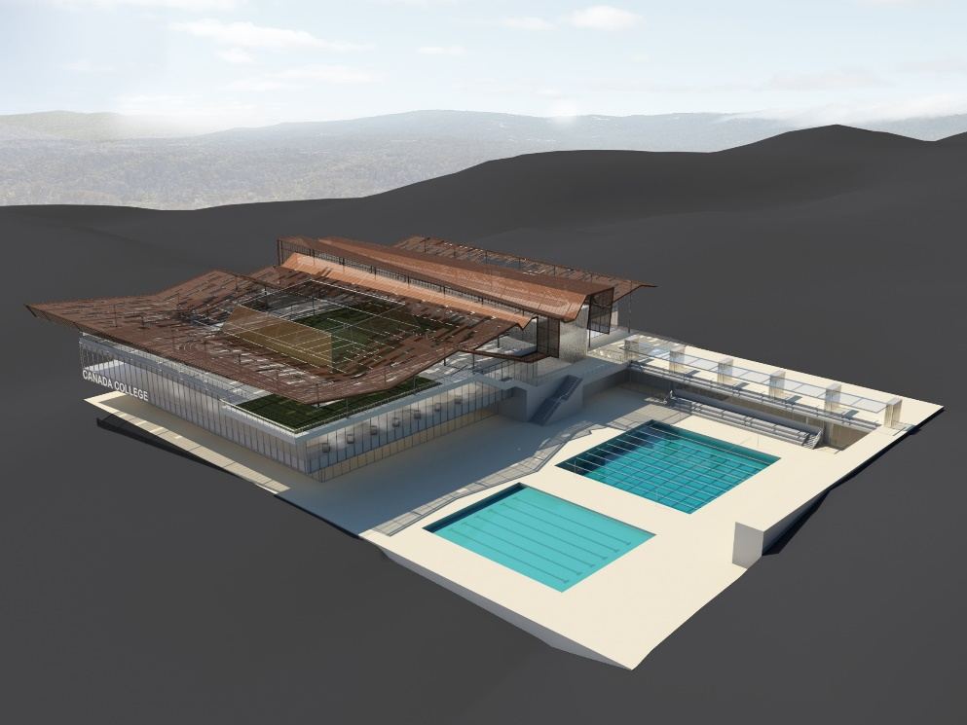
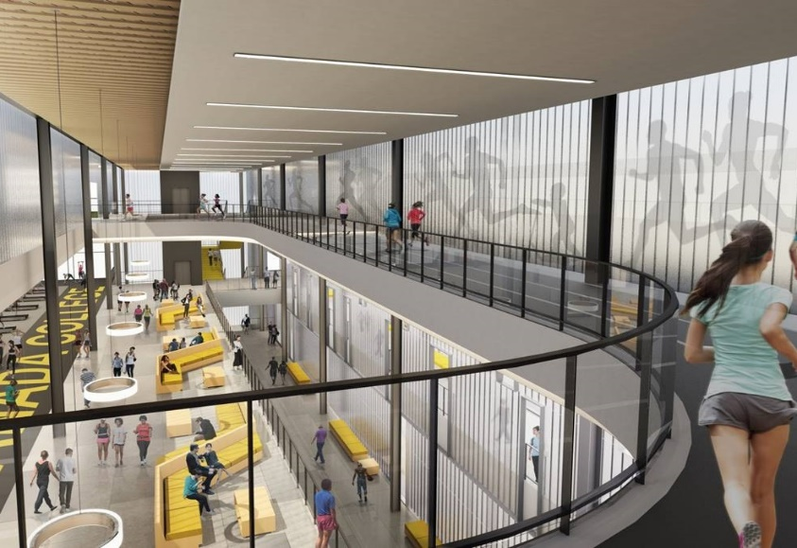
Why Now for KAD?
Notes:
The new Kinesiology & Wellness B1 will be the home for the Kinesiology, Athletics, and Dance Departments.
B1 is a 85,000 SF two-story structure with rooftop activities and will house both academic and enterprise facilities
Included are classrooms for wellness activities, an extensive area for fitness equipment, a completion basketball gymnasium, lock and shower facilities, offices and auxiliary facilities.
An instructional aquatics pool and a competition pool will be constructed on the flat part of the site to the east of the structure, complete with areas and auxiliary buildings for associated support facilities and equipment.
Live Camera Link: https://smccd.edu/facilities/projects/can/CANB1KinWell.php

Slide 6
KAD Headcounts & Enrollments Over Time – 39% Decrease from 2013 - 2018

Slide 7
KAD Trends by Program

Slide 8
KAD Enrollment Trends by Program without Fitness

Slide 9
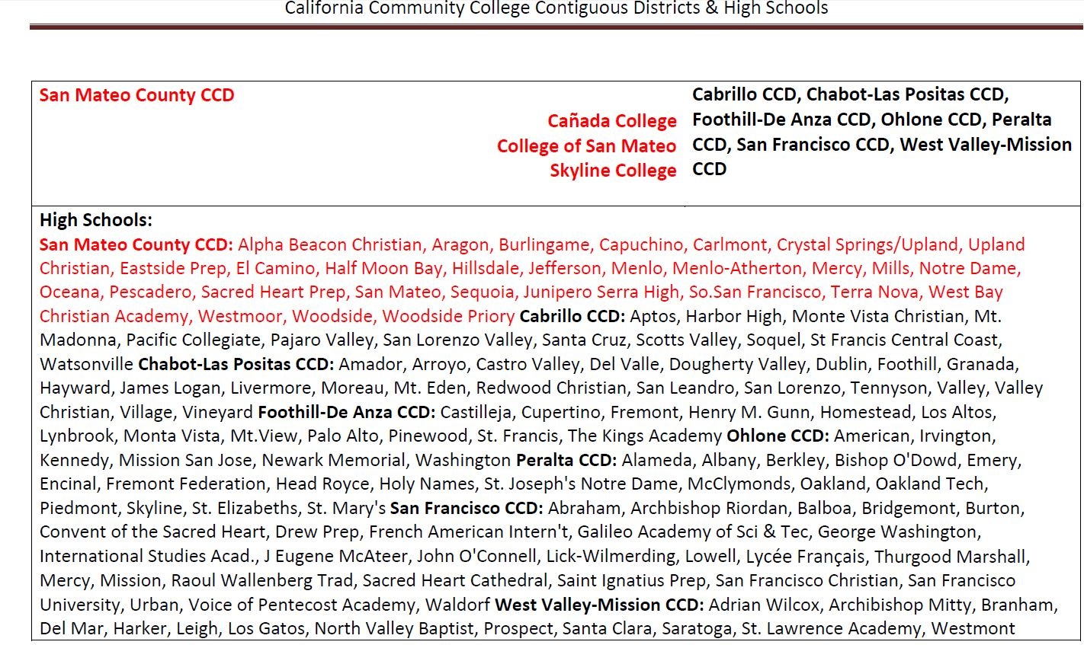
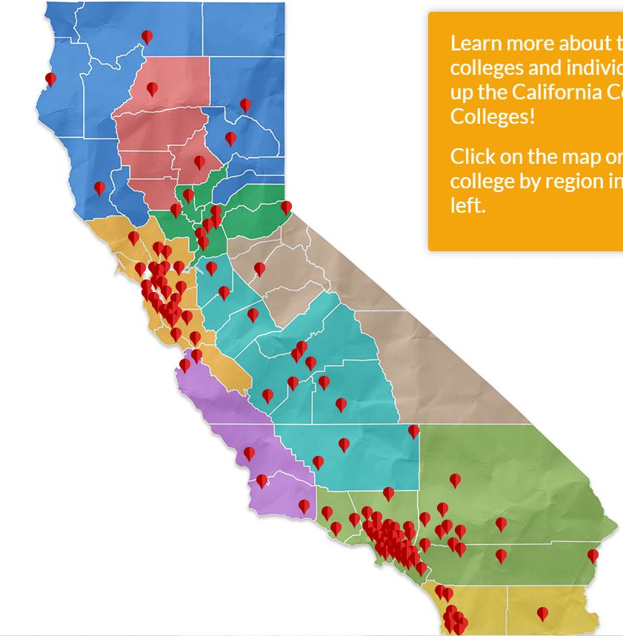
How Does KAD Serve Our Students?

Slide 10
Where Do We Further Support KAD?
Curriculum /Programming
Strengthening Personnel
Resource Allocation
Expansion of class offerings
Survey of Sports, Sports Psychology, Sports Management, First AID/CPR – AED Training, Hiking/Backpacking, Trail Running, Swing, Tap Dane, Tango, Zumba, Dance Folklorico, Badminton, Weight Training/ Body Conditioning
FT Instructors / Coaches per sport
Instructional Equipment Lists
Expansion of sport offerings
CC Athletic Interest Survey of Sports
Title IX / EADA Compliance
Athletic Field Rental Agreements
FT Instructor per Athletic Team
FT SID & Equipment Manager
KAD Department ➔ KAD Division
Notes:
-Market Demand
How well does the curriculum align with developing market trends?
Which programs are likely to encounter the greatest enrollment growth opportunities or declines?
What are the preferred modes of delivery (online, hybrid, face-to-face)
What course scheduling is preferred (daytime, weekend, evening)

Slide 11
Kinesiology, Athletics, & Dance Department
Cañada College
Thank You.
Any Questions?

