Slide 1
PBC Strategic Enrollment Management Committee
October 30, 2019

Slide 2
SEM Agenda
Agenda Item | Discussion Lead | Time Allotted
Agenda Overview Revised meeting agenda for the balance of the year | Robinson and Engel | 5
Moving towards a Plan Setting clear goals for the Strategic Enrollment Management Plan | Robinson and Engel | 25
Early work on schedule optimization Lines of inquiry Focus on Programs of Study Program complete-ability analysis pending Program Maps Student types of journies Analysis of degree completers | Karen Engel, PRIE Alex Claxton, PRIE | 25
Next Steps | All | 5
ADJOURN

Slide 3
Moving towards a Plan
What is Strategic Enrollment Management?
Strategic Enrollment Management (SEM) focuses on maximizing the probability that each student is able to achieve their educational goal(s) at Cañada within two years by:
Creating and sustaining clear degree and certificate programs that remove barriers to completion in two years
Creating and managing a course schedule focused on student completion in two years
Aligning and sustaining pro-active student support services with programs of study to ensure effective and timely student enrollment, retention, persistence and completion.
Align communications and outreach efforts to support the goals above.

Slide 4
Schedule Optimization: Lines of Inquiry
PROJECT | IDEAS/NEXT STEPS
Completer Course pattern | What patterns emerge in enrollment patterns for students who complete in two year with minimal transfer in of courses
Complete-ability analysis | Active course database compared to when its offered. Have any courses not been offered in more than 3 years and thereby make it impossible to complete a program?
Pre-requisite statistical validation
Course Pairing | Conditional probability: if a student took X course, what's the probability they also take Y. Look at this by term? By academic year?
Estimating Demand | Look at fill rates (how quickly sections fill up and by when). Student level enrollment actions (adds and drops) by day aggregated up to the section level (develop a scale?). Could also be rolled up to the Dept and Division level
SWIRL | Who takes what where. What's the magnitude in and out with SKY and CSM? Which students take which classes? Role of Fridays? What about courses students are transfering IN from outside the District?
High Unit Course Impact | 4,5, and 6 unit classes and their impact on the block schedule and how many courses students can take per term
Fridays | Impact of our not offering classes on Friday on # courses students can take per term, program complete-ability, swirl, etc
Student Attributes | Classification of subpopulations within CAN - PRIE to come back on this
GE course offering Pattern | Evaluate when GE sections have course offerings in conflict
Wait Lists
Cohorting FYE students | By Interest area? Year? FT/PT?

Slide 5
Degree Program | 2018-19 Count
Psychology | 80
Interdisciplinary Studies: Social & Behavioral Sciences Canada College Pattern | 52
Business Administration | 46
Allied Health | 43
Economics | 42
Sociology | 41
Interdisciplinary Studies with Emphasis in Social and Behavioral Sciences | 38
Early Childhood Education: Child Development | 32
Communication Studies (Associate Degree) | 30
Interdisciplinary Studies: Natural Science & Mathematics Canada College Pattern | 25
Interdisciplinary Studies with Emphasis in Natural Science & Mathematics | 22
Radiologic Technology | 19
Interdisciplinary Studies: Arts & Humanities CaÃ±ada College Pattern (Associate | 13
Accounting | 12
Interdisciplinary Studies with Emphasis in Arts & Humanities | 11
Engineering | 10
Interior Design | 10
Kinesiology | 9
Mathematics (Associate Degree-Transfer CSU or UC) | 9
Computer Science (Associate Degree-Transfer CSU or UC) | 8
Biological Sciences AS | 7
Digital Art & Animation (Associate Degree) | 5
Human Services | 5

Slide 6
Degree Program | 2018-19 Count
3D Animation & Videogame Art (Associate Degree) | 4
Medical Assisting (Associate Degree) | 4
Physics (Associate Degree-Transfer CSU or UC) | 4
Art History (Associate Degree-Transfer CSU or UC) | 3
Child & Adolescent Development (Associate Degree-Transfer CSU or UC) | 3
Early Childhood Education (Associate Degree) | 3
English (Associate Degree) | 3
Fashion Design: Custom Dress Making Small Business | 3
Medical Assisting | 3
Nutrition & Dietetics (Associate Degree-Transfer CSU or UC) | 3
Biology (Associate Degree-Transfer CSU or UC) | 2
Entrepreneurship & Small Business Management (Associate Degree) | 2
Fashion Design Merchandising (Associate Degree) | 2
Fashion Design: Fashion Merchandising | 2
Multimedia Art & Technology AA | 2
Paralegal (Associate Degree) | 2
Political Science | 2
Anthropology (Associate Degree) | 1
Art with Emphasis in Art History | 1
Business Management (Associate Degree) | 1
Computer Information Systems: Java Programming | 1
Custom Dressmaking-Small Business Oriented (Associate Degree) | 1
Fashion Design Merchandising Certificate | 1
Medical Billing Specialist (Associate Degree) | 1
Music (Associate Degree) | 1
Spanish: CSU Transfer | 1
Studio Arts (Associate Degree-Transfer CSU) | 1
Technical Apparel Industry Oriented (Associate Degree) | 1
Theater Costuming (Associate Degree) | 1

Slide 7
Certificate Program | Count
University Transfer: CSU-GE Certificate | 62
Early Childhood Education: Child Development | 31
Preparation for Academic Scholarship & Success-PASS (Certificate) | 31
University Transfer: IGETC:UC Certificate | 25
Interior Design | 14
Accounting | 10
University Transfer: IGETC: CSU Certificate | 8
Early Childhood Education (Certificate) | 7
Interior Design: Kitchen & Bath Design | 7
Accounting: Entry Level Bookkeeper | 6
Engineering | 6
Medical Assisting | 6
Human Services: Community Health Worker | 5
Medical Assisting (Certificate) | 5
Computer Science: C++ Certificate | 4
Human Services | 4
Medical Administrative Assistant (Certificate) | 4
Medical Coding Specialist (Certificate) | 4

Slide 8
Certificate Program | Count
3D Animation & Videogame Art (Certificate) | 3
Accounting: Payroll Specialist | 3
Computer Science: Java Certificate | 3
Digital Art & Animation (Certificate) | 3
Fashion Design: Custom Dress Making Small Business | 3
Home Staging (Certificate) | 3
Human Services: Promoter Education & Employment Project | 3
Multimedia: Graphic Design | 3
Technical Apparel Industry Oriented (Certificate) | 3
Early Childhood Education/Teacher | 2
Entrepreneurship & Small Business Management (Certificate) | 2
Fashion Design: Fashion Merchandising Certificate | 2
Medical Assisting: Administrative Medical Assistant | 2
Medical Billing Specialist (Certificate) | 2
Multimedia Art & Tech Cert | 2
Paralegal (Certificate) | 2
Computer Science C++ (Certificate) | 1
Computer Science Swift Certificate | 1
Fashion Design Merchandising (Certificate) | 1
Graphic Design (Certificate) | 1
Multimedia: Web Design | 1
Pathways to Student Success (Certificate) | 1
Spanish: Bilingualism & Biliteracy in English/Spanish | 1
Web Design (Certificate) | 1

Slide 9
Student Types
Home Campus | Count | Proportion
Canada | 6,775 | 64.0%
non-Canada | 3,819 | 36.0%
Ed Level | Count | Proportion
Associate Degree | 404 | 15.8%
Bachelor degree or higher | 1,334 | 52.3%
Concurrently enrolled in K-12 | 812 | 31.8%
No degree | 8,044 | 315.5%
Ed Goal | Count | Proportion
4yr stu take class for 4yr col | 496 | 4.7%
College Preparation | 608 | 5.7%
CTE Certif/Career Development | 1,002 | 9.5%
Degree/Transfer | 6,707 | 63.3%
Exploratory | 1,781 | 16.8%
First time | Count | Proportion
First-Time Student | 1,129 | 10.7%
First-Time Transfer Student | 997 | 9.4%
Not First time | 8,468 | 79.9%

Slide 10
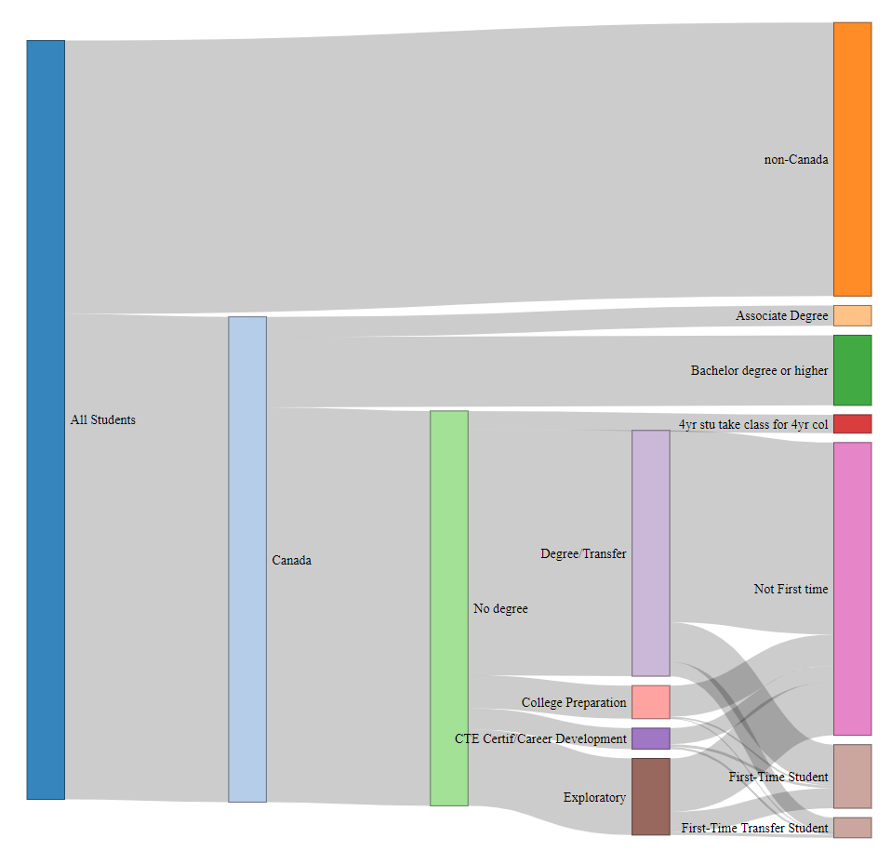
Notes:
Switch to Sankey

Slide 11
2 Year Completers and Course Fill Metrics

Slide 12
2 Year Completer Demographics
Age | 2014-2015 | 2015-2016 | 2016-2017 | 2017-2018 | 2018-2019
Age 18 - 22 | 3 | 2 | 9 | 4 | 3
Age 23 - 28 |  | 3 | 2 | 5 | 1
Age 29 - 39 |  |  | 1 | 1 | 3
Age 40 - 49 |  |  | 1 | 1
Age 50 - 59 |  |  |  | 1
Ethnicity | 2014-2015 | 2015-2016 | 2016-2017 | 2017-2018 | 2018-2019
Asian |  |  | 6 | 3 | 2
Black - Non-Hispanic |  |  | 1
Filipino |  |  |  | 1
Hispanic/Latino | 1 | 3 | 3 | 5 | 2
Multiraces |  |  |  |  | 1
Pacific Islander |  |  |  | 1
Unreported |  |  | 1
White Non-Hispanic | 2 | 2 | 2 | 2 | 2
Gender | 2014-2015 | 2015-2016 | 2016-2017 | 2017-2018 | 2018-2019
Female | 1 | 3 | 9 | 7 | 5
Male | 2 | 1 | 4 | 5 | 2
Unreported |  | 1

Slide 13
Degrees Earned (Duplicated)
Degree Cert Program Desc ITS | 2014-2015 | 2015-2016 | 2016-2017 | 2017-2018 | 2018-2019 | Grand Total
Allied Health | 2 | 1 | 1 | 2 |  | 6
Biological Sciences AS |  |  | 1 |  |  | 1
Business Administration | 1 |  |  | 1 |  | 2
Business Administration: Transfer CSU GE |  |  | 1 | 3 |  | 4
Communication Studies (Associate Degree) |  |  |  |  | 1 | 1
Communication Studies: CSU Transfer |  |  |  | 1 | 1 | 2
Communication Studies: UC Transfer |  | 1 |  | 1 |  | 2
Computer Science (Associate Degree-Transfer CSU or UC) |  |  |  |  | 1 | 1
Economics |  |  | 3 | 1 |  | 4
Economics: CSU Transfer |  |  | 1 | 1 |  | 2
Economics: IGETC CSU Transfer |  |  | 2 |  |  | 2
Engineering |  |  | 1 |  |  | 1
Fitness Professional | 1 |  |  |  |  | 1
Human Services | 1 |  |  |  |  | 1
Interdisciplinary Studies with Emphasis in Natural Science & Mathematics |  | 1 | 2 | 1 |  | 4
Interdisciplinary Studies with Emphasis in Social and Behavioral Sciences |  | 2 | 1 | 1 | 2 | 6
Kinesiology: CSU Transfer |  |  |  | 1 |  | 1
Mathematics: UC Transfer |  |  | 1 |  |  | 1
Medical Assisting: Medical Billing Specialist |  |  | 1 |  |  | 1
Political Science: IGETC CSU Transfer |  |  | 1 |  |  | 1
Psychology | 1 |  | 1 |  |  | 2
Psychology: CSU Transfer |  |  | 1 |  |  | 1
Psychology: UC Transfer | 1 |  |  |  |  | 1
Radiologic Technology |  | 1 |  |  |  | 1
Sociology:CSU Transfer |  |  | 2 |  |  | 2
Grand Total | 7 | 6 | 20 | 13 | 5 | 51

Slide 14
Students with no Transfer Units
Degree Cert Program Desc ITS | 2014-2015 | 2015-2016 | 2016-2017 | 2017-2018 | 2018-2019 | Grand Total
Allied Health |  | 1 | 1 | 2 |  | 4
Biological Sciences AS |  |  | 1 |  |  | 1
Business Administration | 1 |  |  | 1 |  | 2
Business Administration: Transfer CSU GE |  |  | 1 | 3 |  | 4
Communication Studies: UC Transfer |  | 1 |  | 1 |  | 2
Economics |  |  | 3 | 1 |  | 4
Economics: CSU Transfer |  |  | 1 | 1 |  | 2
Economics: IGETC CSU Transfer |  |  | 2 |  |  | 2
Engineering |  |  | 1 |  |  | 1
Fitness Professional | 1 |  |  |  |  | 1
Interdisciplinary Studies with Emphasis in Natural Science & Math |  |  | 2 | 1 |  | 3
Interdisciplinary Studies with Emphasis in Social & Behavioral Sci |  | 2 |  | 1 | 1 | 4
Kinesiology: CSU Transfer |  |  |  | 1 |  | 1
Mathematics: UC Transfer |  |  | 1 |  |  | 1
Medical Assisting: Medical Billing Specialist |  |  | 1 |  |  | 1
Political Science: IGETC CSU Transfer |  |  | 1 |  |  | 1
Psychology |  |  | 1 |  |  | 1
Psychology: CSU Transfer |  |  | 1 |  |  | 1
Sociology:CSU Transfer |  |  | 2 |  |  | 2
Grand Total | 2 | 4 | 19 | 12 | 1 | 38

Slide 15
Adjourn

Slide 17
Programs conferring no degrees in 2018-19
Art | 0
Chemistry | 0
Dance | 0
Earth Science | 0
Geography | 0
History | 0
International Studies | 0

Slide 18
Course Fill Metrics

Slide 19
When Courses Fill
Academic Year | Term Desc | Years | Action Date | Course Name | Count of Section
2015-2016 | Fall 2015 | 2015 | Aug |  | 83
2015-2016 | Fall 2015 | 2015 | Sep |  | 1
2015-2016 | Fall 2015 | 2015 | Oct |  | 2
2015-2016 | Spring 2016 | 2015 | Nov |  | 1
2015-2016 | Spring 2016 | 2015 | Dec |  | 3
2015-2016 | Spring 2016 | 2016 | Jan |  | 53
2015-2016 | Spring 2016 | 2016 | Feb |  | 5
2015-2016 | Spring 2016 | 2016 | Mar |  | 1
2016-2017 | Fall 2016 | 2016 | May |  | 1
2016-2017 | Fall 2016 | 2016 | Aug |  | 79
2016-2017 | Spring 2017 | 2016 | Nov |  | 3
2016-2017 | Spring 2017 | 2016 | Dec |  | 3
2016-2017 | Spring 2017 | 2017 | Jan |  | 69
2016-2017 | Spring 2017 | 2017 | Feb |  | 2
2017-2018 | Fall 2017 | 2017 | Jun |  | 3
2017-2018 | Fall 2017 | 2017 | Jul |  | 2
2017-2018 | Fall 2017 | 2017 | Aug |  | 76
2017-2018 | Fall 2017 | 2017 | Sep |  | 1
2017-2018 | Spring 2018 | 2017 | Nov |  | 2
2017-2018 | Spring 2018 | 2017 | Dec |  | 6
2017-2018 | Spring 2018 | 2018 | Jan |  | 64
2017-2018 | Spring 2018 | 2018 | Mar |  | 1
2018-2019 | Fall 2018 | 2018 | May |  | 1
2018-2019 | Fall 2018 | 2018 | Jul |  | 4
2018-2019 | Fall 2018 | 2018 | Aug |  | 67
2018-2019 | Fall 2018 | 2018 | Sep |  | 1
2018-2019 | Spring 2019 | 2018 | Nov |  | 3
2018-2019 | Spring 2019 | 2019 | Jan |  | 57
2018-2019 | Spring 2019 | 2019 | Apr |  | 1

Slide 20
Sections Filling by Term
Academic Year | Term Code | Term Desc | Count Filling | Total non-cancelled | Proportion
2015-2016 | 201505 | Summer 2015 | 21 | 160 | 13.1%
2015-2016 | 201508 | Fall 2015 | 83 | 592 | 14.0%
2015-2016 | 201603 | Spring 2016 | 63 | 600 | 10.5%
2016-2017 | 201605 | Summer 2016 | 28 | 146 | 19.2%
2016-2017 | 201608 | Fall 2016 | 80 | 558 | 14.3%
2016-2017 | 201703 | Spring 2017 | 74 | 570 | 13.0%
2017-2018 | 201705 | Summer 2017 | 21 | 171 | 12.3%
2017-2018 | 201708 | Fall 2017 | 81 | 545 | 14.9%
2017-2018 | 201803 | Spring 2018 | 71 | 528 | 13.4%
2018-2019 | 201805 | Summer 2018 | 38 | 144 | 26.4%
2018-2019 | 201808 | Fall 2018 | 72 | 517 | 13.9%
2018-2019 | 201903 | Spring 2019 | 60 | 535 | 11.2%

Slide 21
Sections Cancelled by Term
Academic Year | Term Code | Term Desc | Cancelled | All | Proportion
2015-2016 | 201505 | Summer 2015 | 15 | 176 | 8.5%
2015-2016 | 201508 | Fall 2015 | 63 | 679 | 9.3%
2015-2016 | 201603 | Spring 2016 | 49 | 672 | 7.3%
2016-2017 | 201605 | Summer 2016 | 27 | 177 | 15.3%
2016-2017 | 201608 | Fall 2016 | 68 | 647 | 10.5%
2016-2017 | 201703 | Spring 2017 | 52 | 647 | 8.0%
2017-2018 | 201705 | Summer 2017 | 12 | 184 | 6.5%
2017-2018 | 201708 | Fall 2017 | 58 | 626 | 9.3%
2017-2018 | 201803 | Spring 2018 | 53 | 609 | 8.7%
2018-2019 | 201805 | Summer 2018 | 4 | 149 | 2.7%
2018-2019 | 201808 | Fall 2018 | 34 | 570 | 6.0%
2018-2019 | 201903 | Spring 2019 | 37 | 591 | 6.3%

Slide 22
Top 25 Filling Courses
Course Name | Total Sections | Didn’t Fill | Filled | Proportion Filling
COMM140 | 4 | 0 | 4 | 100.0%
CHEM220 | 19 | 6 | 13 | 68.4%
ANTH126 | 11 | 4 | 7 | 63.6%
OCEN100 | 34 | 13 | 21 | 61.8%
COMM130 | 39 | 17 | 22 | 56.4%
COMM180 | 4 | 2 | 2 | 50.0%
ECE260 | 6 | 3 | 3 | 50.0%
ENGR261 | 4 | 2 | 2 | 50.0%
FASH133 | 4 | 2 | 2 | 50.0%
INTD150 | 4 | 2 | 2 | 50.0%
INTD260 | 4 | 2 | 2 | 50.0%
RADT428 | 4 | 2 | 2 | 50.0%
RADT438 | 4 | 2 | 2 | 50.0%
ANTH110 | 25 | 13 | 12 | 48.0%
GEOG110 | 11 | 6 | 5 | 45.5%
MEDA120 | 9 | 5 | 4 | 44.4%
ESL400 | 28 | 16 | 12 | 42.9%
COMM150 | 25 | 15 | 10 | 40.0%
BIOL240 | 29 | 18 | 11 | 37.9%
BIOL225 | 8 | 5 | 3 | 37.5%
PHYS270 | 8 | 5 | 3 | 37.5%
MATH190 | 38 | 24 | 14 | 36.8%
ENGL110 | 156 | 99 | 57 | 36.5%
ANTH125 | 26 | 17 | 9 | 34.6%
With more than 2 sections offered, over 4 year window
Notes:
With more than 2 sections offered, over 4 year window

Slide 23
Top 25 Offered Courses
Course Name | Total Sections | Didn’t Fill | Filled | Proportion Filling
ENGL100 | 179 | 123 | 56 | 31.3%
ENGL110 | 156 | 99 | 57 | 36.5%
MATH200 | 109 | 81 | 28 | 25.7%
PSYC100 | 71 | 52 | 19 | 26.8%
FITN117 | 61 | 61 | 0 | 0.0%
FITN118 | 61 | 61 | 0 | 0.0%
ECON100 | 55 | 51 | 4 | 7.3%
BIOL250 | 52 | 51 | 1 | 1.9%
FITN119 | 49 | 49 | 0 | 0.0%
COMM110 | 48 | 36 | 12 | 25.0%
BIOL130 | 48 | 43 | 5 | 10.4%
SOCI100 | 48 | 44 | 4 | 8.3%
PLSC210 | 46 | 34 | 12 | 26.1%
MATH120 | 45 | 37 | 8 | 17.8%
BUS100 | 43 | 35 | 8 | 18.6%
ENGL847 | 41 | 34 | 7 | 17.1%
BUS201 | 40 | 33 | 7 | 17.5%
COMM130 | 39 | 17 | 22 | 56.4%
HIST202 | 39 | 29 | 10 | 25.6%
MATH251 | 39 | 35 | 4 | 10.3%
MATH190 | 38 | 24 | 14 | 36.8%
CRER137 | 38 | 29 | 9 | 23.7%
PHIL100 | 37 | 29 | 8 | 21.6%
HIST201 | 36 | 28 | 8 | 22.2%
ECON102 | 35 | 31 | 4 | 11.4%
With more than 2 sections offered, over 4 year window
Notes:
With more than 2 sections offered, over 4 year window

Slide 24
Unfilled
245 Courses had 0% of sections fill
ACTG100, ACTG180, ACTG200, ACTG672, ART102, ART103, ART205, ART207, ART213, ART214, ART221, ART222, BIOL100, BUS101, BUS125, BUS180, BUS401, CBOT417, CBOT430, CBOT431, CBOT432, CBOT435, CBOT472, CBOT474, CHEM231, CIS242, CIS252, CIS262, CIS284, CIS286, CIS321, COOP670, CRER110, CRER300, CRER401, CRER430, DANC1252, DANC1253, DANC1254, DANC1501, DANC1502, DRAM3001, DRAM3002, DRAM3003, ECE211, ECE223, ECE240, ECE241, ECE242, ECE263, ECE362, ENGL161, ENGL162, ENGL165, ENGL200, ENGL827, ENGL836, ENGL849, ENGR215, ENGR230, ENGR240, ENGR270, ENGR695, ENVS115, ESL800, ESL820, ESL837, ESL901, ESL911, FASH100, FASH110, FASH111, FASH113, FASH116, FASH122, FASH123, FASH146, FASH150, FASH151, FASH162, FASH163, FASH167, FASH171, FASH178, FASH197, FASH225, FASH672, FASH880CA, FITN112, FITN117, FITN118, FITN119, FITN122, FITN152, FITN154, FITN235, FITN3041, FITN3042, FITN3341, FITN3342, FITN3343, FITN3344, FITN3351, FITN3352, FITN3353, GEOL100, GEOL101, HIST100, HIST101, HIST104, HIST242, HIST247, HMSV262, HMSV264, HMSV265, HMSV266, HMSV672, HSCI100, INDV1601, INDV1602, INDV1603, INTD115, INTD126, INTD175, INTD357, INTD360, KINE105, KINE137, KINE138, LCTR100, LCTR139, LCTR140, LCTR151, LCTR810, LCTR822, LCTR823, LCTR832, LCTR840, LCTR841, LCTR842, LCTR843, LEGL249, LEGL252, LEGL672, LING200, LIT441, LIT442, MART314, MART325, MART366, MART368, MART371, MART372, MART379, MART380, MART389, MART400, MART405, MART416, MART417, MART418, MART420, MART421, MART422, MART430, MART431, MART432, MART695, MATH125, MATH222, MATH241, MATH695, MEDA111, MEDA140, MEDA164, MEDA165, MEDA166, MEDA167, MEDA168, MEDA169, MEDA190, MEDA672, MEDA801, METE100, MUS115, MUS210, MUS240, MUS301, MUS302, MUS304, MUS371, MUS372, PHIL240, PHIL300, PHYS210, PHYS250, PHYS405, PLSC130, PLSC150, PLSC325, PSYC106, PSYC205, PSYC340, RADT400, RADT408, RADT415, RADT418, RADT430, RADT440, RADT442, RADT448, RADT450, RADT470, RADT471, RADT474, READ826, READ836, SOCI105, SOCI205, SPAN110, SPAN112, SPAN120, SPAN121, SPAN131, SPAN132, SPAN140, SPAN152, SPAN161, SPAN162, TEAM105, TEAM1111, TEAM1411, TEAM1412, TEAM1413, TEAM1414, TEAM1482, TEAM1484, TEAM185, TEAM186, TEAM187, VARS104, VARS114, VARS140, VARS170, VARS340
With more than 2 sections offered, over 4 year window
Notes:
With more than 2 sections offered, over 4 year window

