Slide 1
SMCCCD Student Survey on Return to Campus – Take 2
Conducted May 2021

Slide 2
Neary ¼ of SMCCCD Students Completed the Survey
23% Overall SMCCCD Response Rate
27% of Cañada students completed the survey
26% of CSM students completed the survey
19% of Skyline students completed the survey
Representation
Survey representation for all race/ethnicity groups is similar to student population
Women are overrepresented (64% of survey sample vs. 55% of student population)
Low-income students are overrepresented (35% of sample vs. 29% of population)

Slide 3
Survey Introduction
“The three Colleges of the San Mateo County Community College District (SMCCCD) – Cañada College, College of San Mateo and Skyline College – would like your input as we make the preparations for additional return of in-person classes for Fall 2021.”
“We understand that factors impacting COVID recovery may change in the coming months. In order to inform our recovery planning, we are asking that you respond to the questions below based on how you are feeling now.”

Slide 4
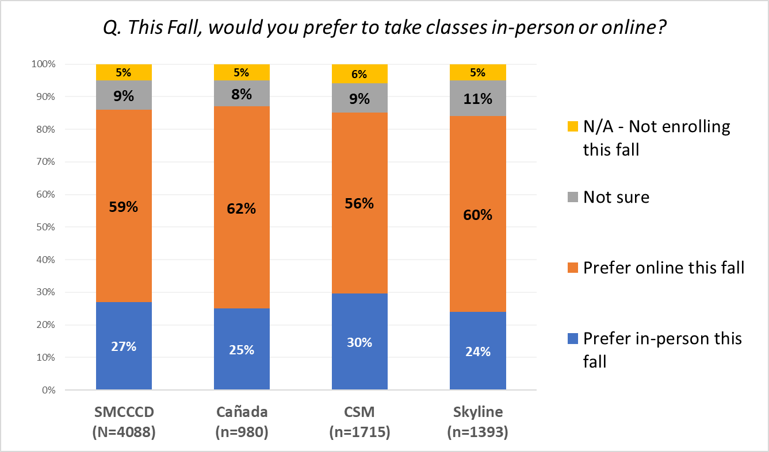
SMCCCD students are more than 2x as likely to prefer online classes than face to face classes in Fall 2021

Slide 5
Female students report a significantly higher preference for online instruction this fall, compared with male students
Q. This Fall, would you prefer to take classes in-person or online?
Notes:
Differences between male and female students are statistically significant at p<.01

Slide 6
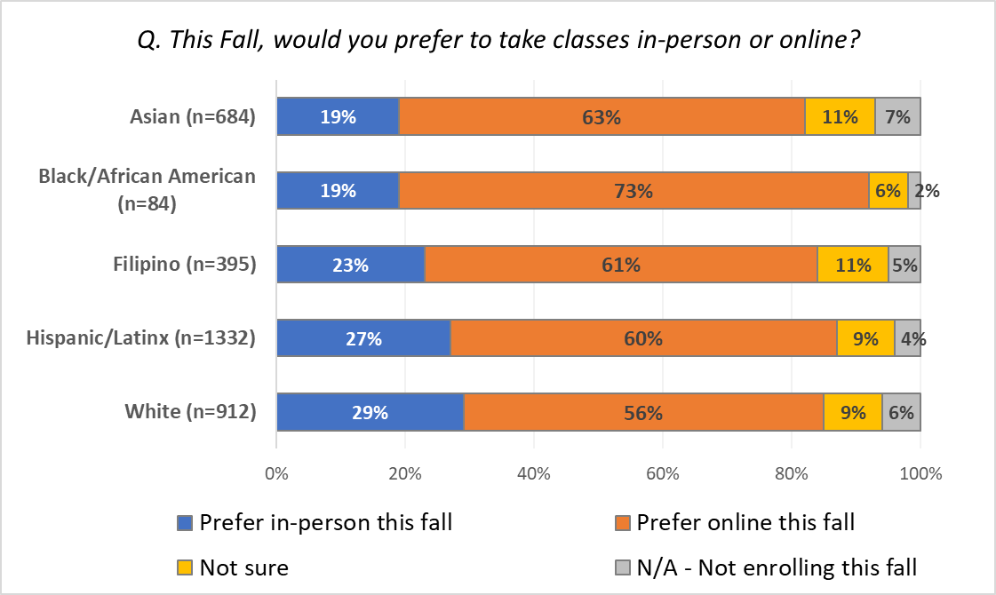
Among race/ethnicity groups, white students report the greatest preference (29%) for in-person classes in Fall 2021

Slide 7
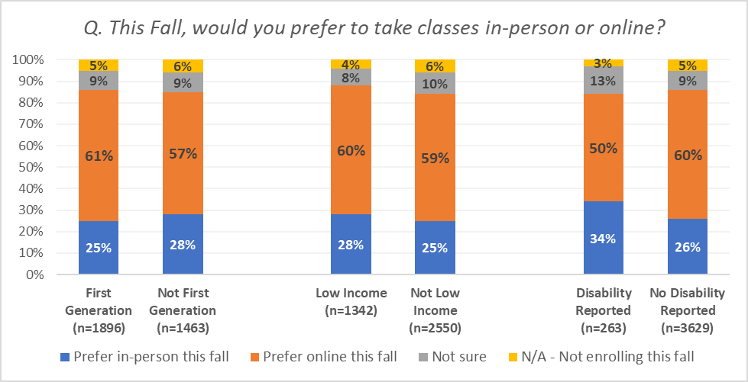
Our most vulnerable student groups report a strong preference for online instruction

Slide 8
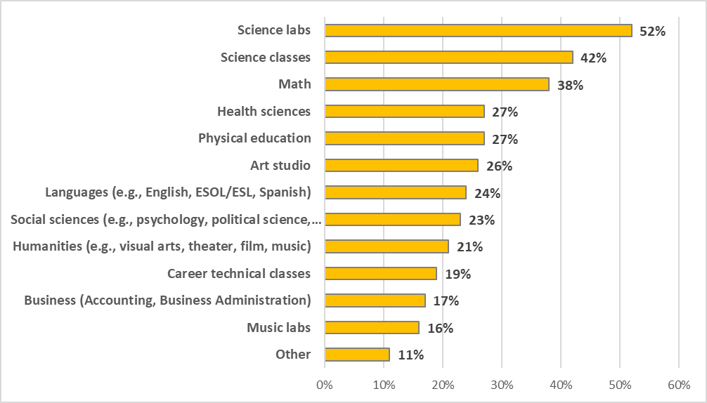
All students who planned to attend in the fall were asked to indicate “the types of courses you would most like to take in-person rather than online”

Slide 9
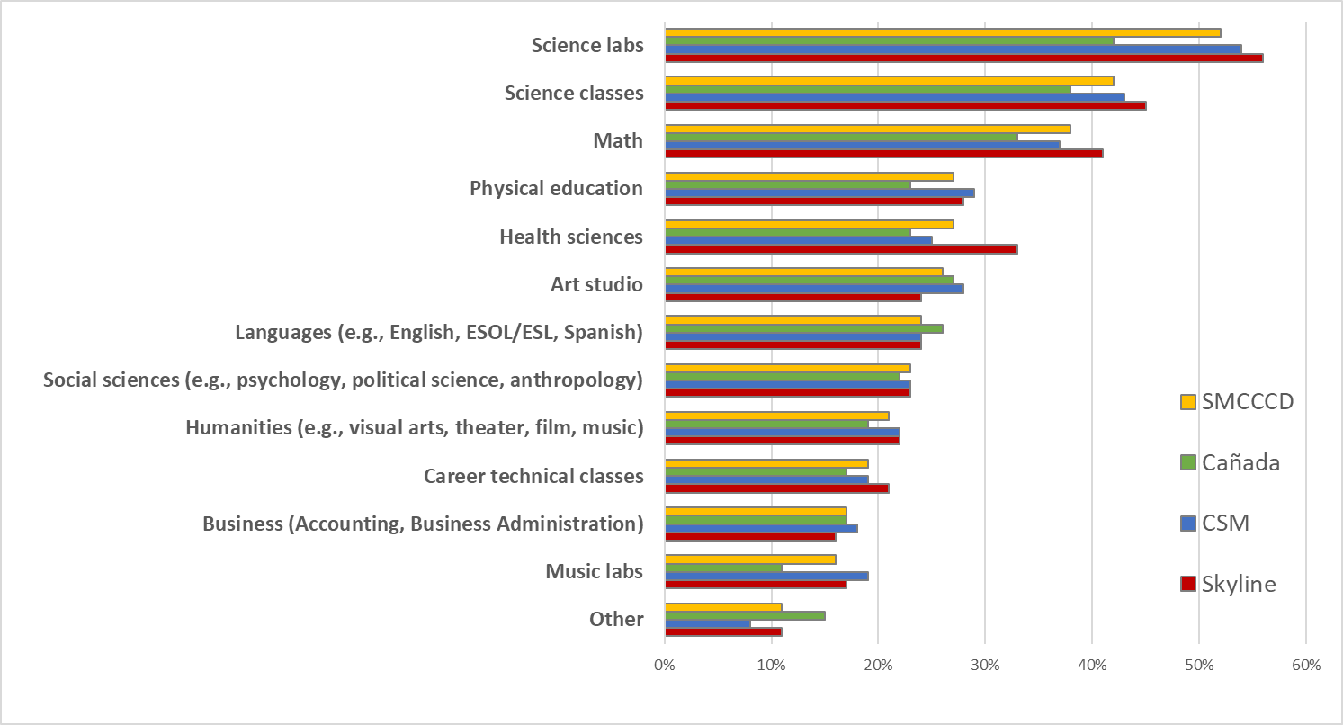
Q: Please select the types of courses you would most like to take in-person rather than online (select all that apply)

