Slide 1
San Mateo Community College District
Survey of Students Regarding
Return to Campus:
Summary of Results
Administered to all enrolled students in the District
April 17 – May 1, 2021
Reported to Cañada College Town Hall on May 20, 2021

Slide 2
Survey Response Rates
Primary Campus | Enrolled Students | Survey Respondents | Response Rate
Cañada | 3,789 | 893 | 24%
CSM | 6,009 | 1,299 | 22%
Skyline | 7,628 | 1,243 | 16%
Grand Total | 17,426 | 3,435 | 20%

Slide 3
More students are enrolling in more than one college
 | Attended Multiple SMCCCD Colleges
Spring 2020 | 17.6%
Spring 2021 | 27.2%

Slide 4
The composition of our student body has shifted during the pandemic (FA 19 to FA 20)
Cañada Students | % Change in Headcount (unique students)
Resident, Not Concurrently Enrolled | -1%
International | -32%
Domestic ESL | -46%
Low Income | -13%
Not Low Income | +43%

Slide 5
87% of respondents will either complete, or are planning to re-enroll at one or more SMCCCD colleges in Fall 2021
Q. Given that Skyline, Cañada and CSM are planning to remain mostly online in Fall 2021,
what is your current plan for the Fall 2021 semester?
 | SMCCD | Cañada | CSM | Skyline
Number of respondents | 3,435 | 893 | 1299 | 1243
Enroll at one or more of the Colleges of the SMCCCD | 71% | 75% | 71% | 69%
Transfer to another CC or Career Training | 1% | 1% | 1% | 1%
Will have graduated or transferred to 4 yr College/University* | 16% | 14% | 16% | 17%
Don't know or have not decided | 10% | 9% | 10% | 11%
Take a break from college/pause my education | 2% | 2% | 3% | 2%
*Students who said they will have completed their SMCCD education before Fall 2021 were not shown any additional survey questions.

Slide 6
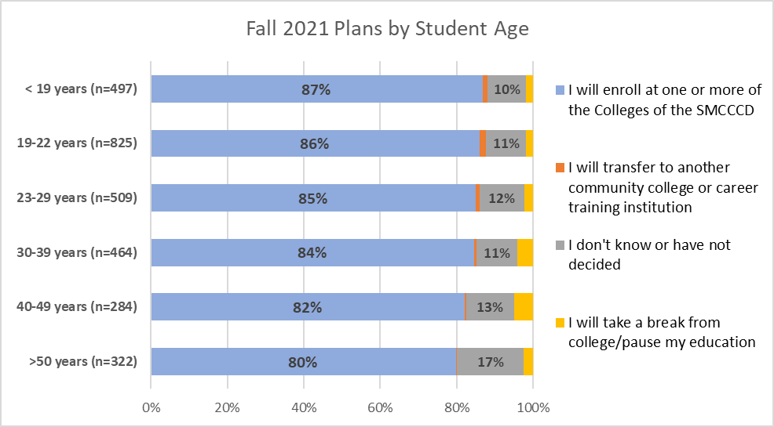
With SMCCCD classes mostly online in Fall 2021, traditional age students are the most likely to re-enroll
*Students who said they will have completed their SMCCCD education before Fall 2021 have been omitted from this and subsequent analyses.
Notes:
Differences between traditional age students (2 youngest age groups) and students >50 are statistically significant at p<.05

Slide 7
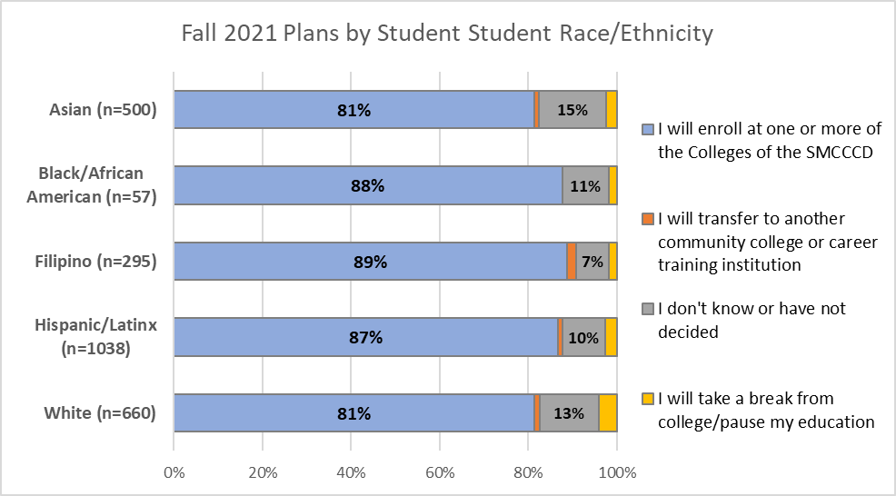
High proportions of students across race/ethnic groups plan to re-enroll at SMCCCD colleges in Fall 2021
Notes:
Differences among race/ethnicity groups are not statistically significant at p<.05

Slide 8
Q. Skyline, Cañada and CSM are planning for a limited return of in-person essential services for students in Fall 2021. Which of the following services would you most prefer to be offered in-person on campus? Please select up to three essential services that you would most like to be offered in-person rather than online.

Slide 9
Services most desired to be in-person rather than online are:
Library Borrowing, Academic Counseling and Academic Tutoring
Notes:
Full Question text:
Skyline, Cañada and CSM are planning for a limited return of in-person essential services for students in Fall 2021. Which of the following services would you most prefer to be offered in-person on campus? Please select up to three essential services that you would most like to be offered in-person rather than online.

Slide 10
 | SMCCCD | Cañada | CSM | Skyline
Number of respondents | 2,129 | 569 | 802 | 758
Library (borrowing books and materials) | 44% | 46% | 44% | 43%
Academic Counseling | 43% | 40% | 44% | 45%
Learning Center/tutoring | 37% | 37% | 41% | 32%
Financial Aid | 22% | 23% | 20% | 22%
Personal Counseling | 21% | 19% | 21% | 24%
Health Services | 21% | 21% | 21% | 21%
Admissions and Records | 19% | 19% | 18% | 21%
Student Life | 18% | 13% | 22% | 17%
Other | 7% | 6% | 8% | 7%
Assessment and Testing | 5% | 6% | 5% | 5%
Cashiers | 3% | 3% | 3% | 3%
Notes:
Full Question text:
Skyline, Cañada and CSM are planning for a limited return of in-person essential services for students in Fall 2021. Which of the following services would you most prefer to be offered in-person on campus? Please select up to three essential services that you would most like to be offered in-person rather than online.

Slide 11
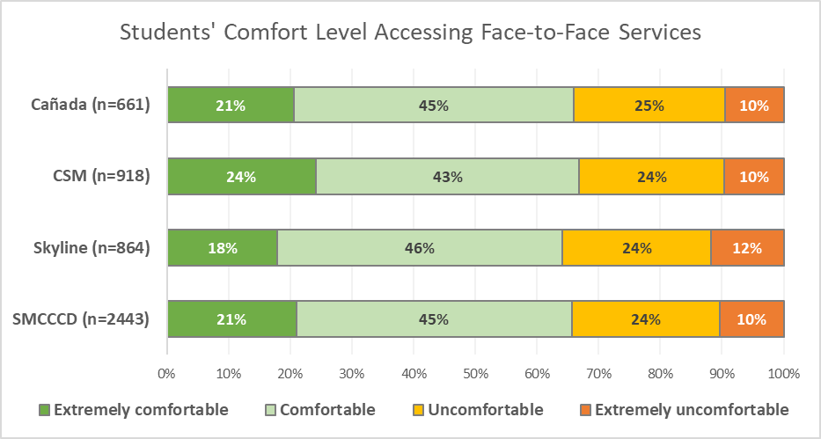
District-wide, more than one third of students report feeling discomfort accessing student services face-to-face
Q: If you do enroll in Fall 2021, how comfortable would you be to use the student services offered on campus?
Notes:
Full Question Text:
Q: All campus in-person services will follow government-issued COVID-19 health and safety regulations. With this mind, if you do enroll in Fall 2021, how comfortable would you be to use the student services offered on campus?
CSM student comfort levels for accessing services face-to-face are significantly (p<.05) greater than Skyline students’

Slide 12
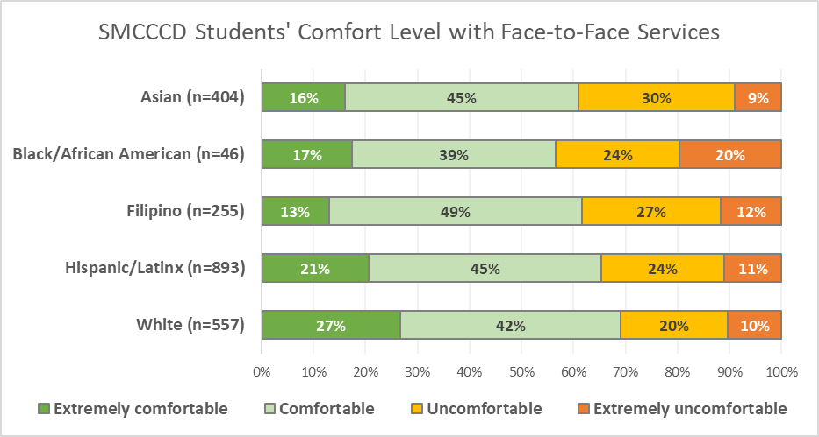
SMCCCD Students of Color report greater discomfort accessing student services face-to-face
Q: If you do enroll in Fall 2021, how comfortable would you be to use the student services offered on campus?
Notes:
Full Question Text:
Q: All campus in-person services will follow government-issued COVID-19 health and safety regulations. With this mind, if you do enroll in Fall 2021, how comfortable would you be to use the student services offered on campus?
White students report significantly (p<05) greater comfort levels with face to face services than do Asian and Filipino students. Black students expressed the greatest discomfort with face-to-face services, but this difference is not statistically significant due to the smaller sample size. Latinx vs White differences are not statistically significant.

Slide 13
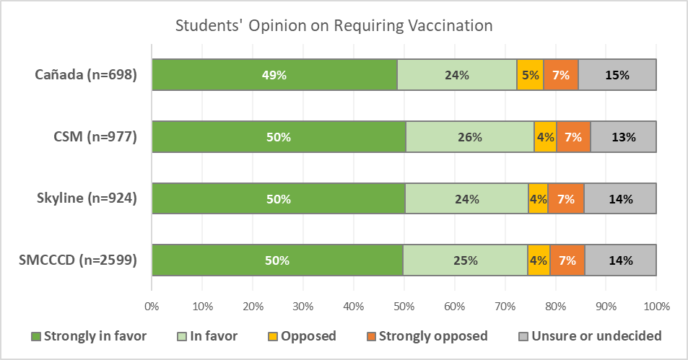
District-wide, 75% of students favor required vaccination of SMCCCD students and employees
Q: What is your opinion about whether students and employees at the SMCCCD Colleges should be required to be vaccinated for COVID-19 before returning to campus?
Notes:
Full Question Text:
Q. What is your opinion about whether students and employees at the SMCCCD Colleges should be required to be vaccinated for COVID-19 before returning to campus?

Slide 14
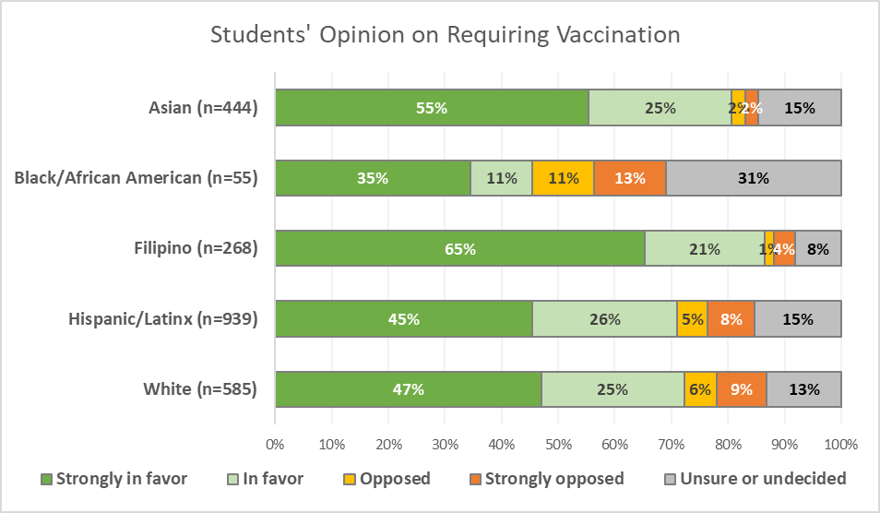
Significant differences by race/ethnicity in opinions about required vaccination of SMCCCD students and employees
Q: What is your opinion about whether students and employees at the SMCCCD Colleges should be required to be vaccinated for COVID-19 before returning to campus?
Notes:
Full Question Text:
Q. What is your opinion about whether students and employees at the SMCCCD Colleges should be required to be vaccinated for COVID-19 before returning to campus?
Differences in student opinions by race/ethnicity are statistically significant (p<.05)

Slide 15
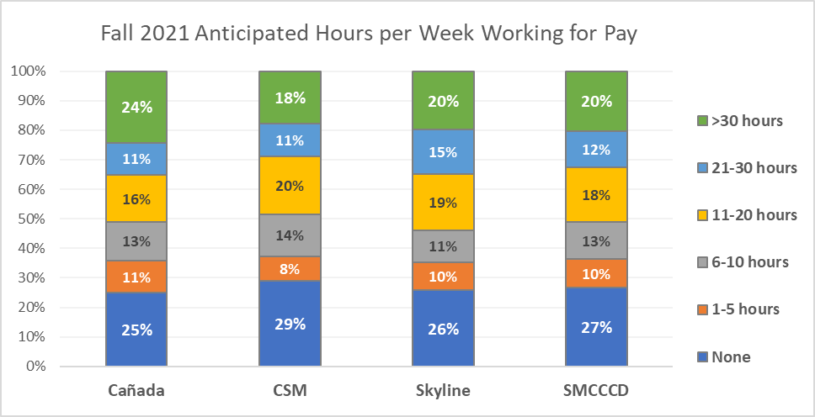
Approximately 1/3 of SMCCCD students expect to work more than 20 hours per week in Fall 2021
Q: If you do return to college in the Fall of 2021, how many hours do you anticipate working for pay?
Weekly Work for Pay

Slide 16
Student anticipated work hours are directly and strongly correlated with their preference for instructional modality.
The more students anticipate working, the more likely they are to prefer taking most of their classes online.
Similarly, the less students anticipate working, the more likely they are to prefer taking most of their classes face-to-face.

Slide 17
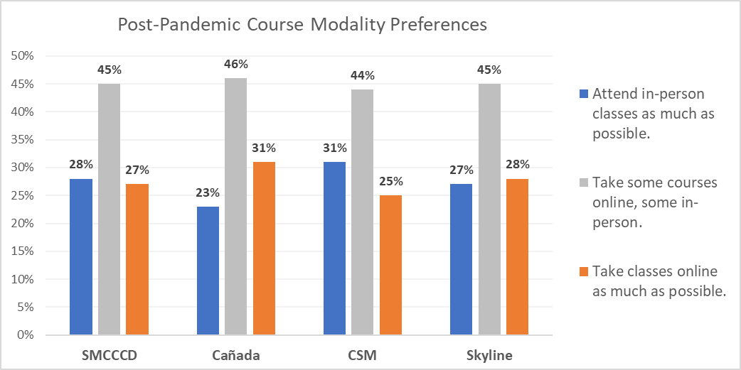
Students’ post-COVID course modality preferences are split between on-line and in person
Q: In the future, once the pandemic is behind us, which most accurately describes your preference for how to attend college?
Notes:
Differences between Canada and CSM are statistically significant (p<.05)

Slide 18
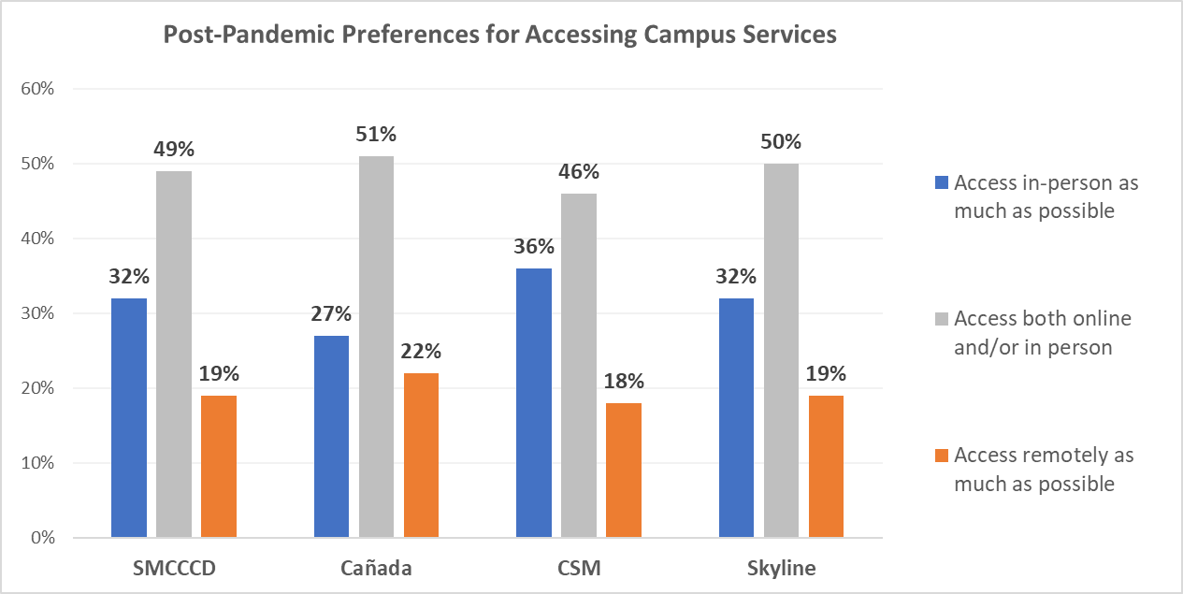
Students’ post-COVID preferences for accessing campus services vary significantly by campus
Q: In the future, once the pandemic is behind us, which most accurately describes how you would like to access campus services (such as tutoring, counseling, the registrar and cashier’s offices, etc.)
Notes:
Differences between Canada vs. CSM are statistically significant (p<.05)

Slide 19
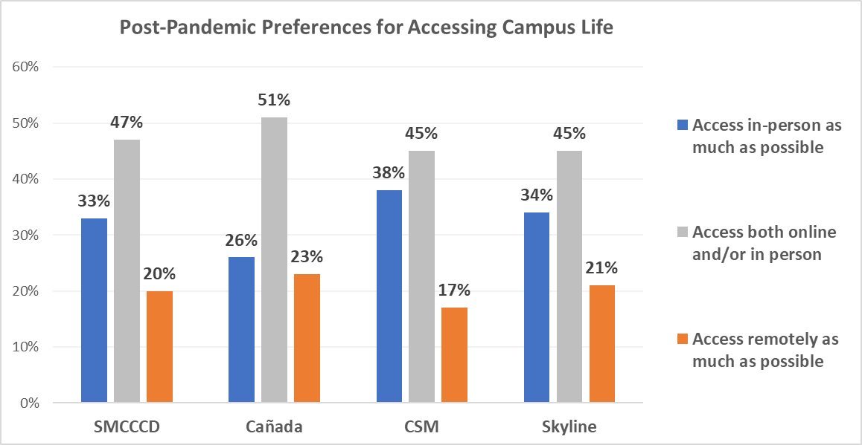
Students’ post-COVID preferences for accessing campus life vary significantly by campus
Q: In the future, once the pandemic is behind us, which most accurately describes how you would like to access campus life (such as clubs, events, social activities)
Notes:
Differences between Canada vs. CSM and Skyline are statistically significant (p<.05)

Slide 20
Open Responses
Represented in the quantitative data
Things that would make students more comfortable returning:
  Requiring vaccines
  Social distancing
  Masking
  Ventilation
More information soon regarding specific in-person course preferences

