Slide 1
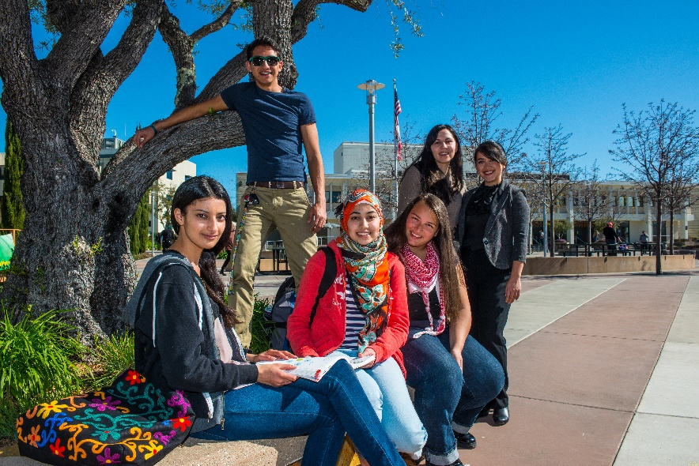
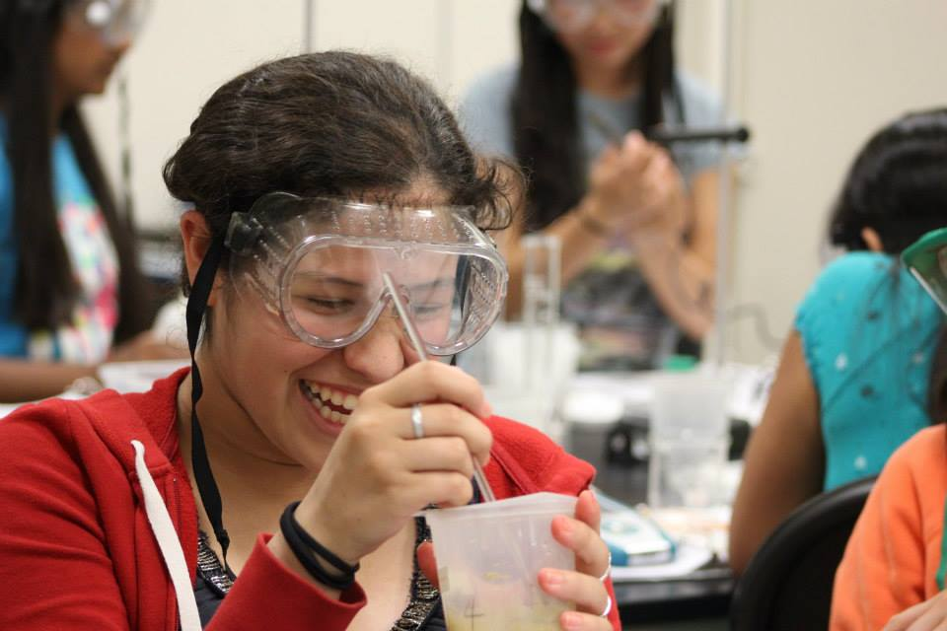
Strategic Enrollment:
Science & Technology
Programs and
Services
May 1, 2019

Slide 2
Science & Technology Division – Degrees & Certificates
5 Certificates
2 AA Degrees
8 AS Degrees
6 AS-T Degrees
STEM Majors: Biology, Chemistry,
Earth Science, Math, Physics, Computer
Science, Engineering
STEM Academy is comprised of grant-funded activities that are designed to promote recruitment, persistence and transfer in STEM Majors
Notes:
16% of students complete their degree/certificate in 3 years
52% of students complete their degree/certificate in 6 years
Students on average are attempting 118 units before earning a 60-unit Associate’s Degree
College students are more likely to complete a degree efficiently if they:
Choose an “Area of Interest”
Develop an academic plan
Follow a roadmap of the courses they need to take
Receive guidance and support to help them stay on plan
Suggestion: note that students in any health-related program, including prenursing, premed, and Rad Tech prerequisistes, are not STEM by federal definition.

Slide 3
STEM: Enrollment Management Goals
Measure | 2015-2016 | 2016-2017 | 2017-2018 | Yearly Goal
Enrollment in Transfer-Level STEM Courses | 4,019 | 4,218 | 4,220 | +1%
Retention Rate in Transfer-Level STEM Courses | 81.5% | 84% | 85.1% | +2%
Success Rate in Transfer-Level STEM Courses | 69.6% | 73.5% | 74% | +2%
Transfer in STEM Majors | N/A | N/A | 68 | +2%
Notes:
Yearly goals are based on values in GANAS grant.

Slide 4
STEM Academy Recruitment
Activity | Enrollment Status | Participation/Goal | Staffing
High School Outreach & First Year Pathway | Incoming | 66/75 students | STEM Retention Specialist
STEM Explorers | Incoming | 66/75 students | STEM Retention Specialist
STEM Speaker Series | Continuing | 73/100 students per session | STEM University Relations Manager
Notes:
16% of students complete their degree/certificate in 3 years
52% of students complete their degree/certificate in 6 years
Students on average are attempting 118 units before earning a 60-unit Associate’s Degree
College students are more likely to complete a degree efficiently if they:
Choose an “Area of Interest”
Develop an academic plan
Follow a roadmap of the courses they need to take
Receive guidance and support to help them stay on plan

Slide 5
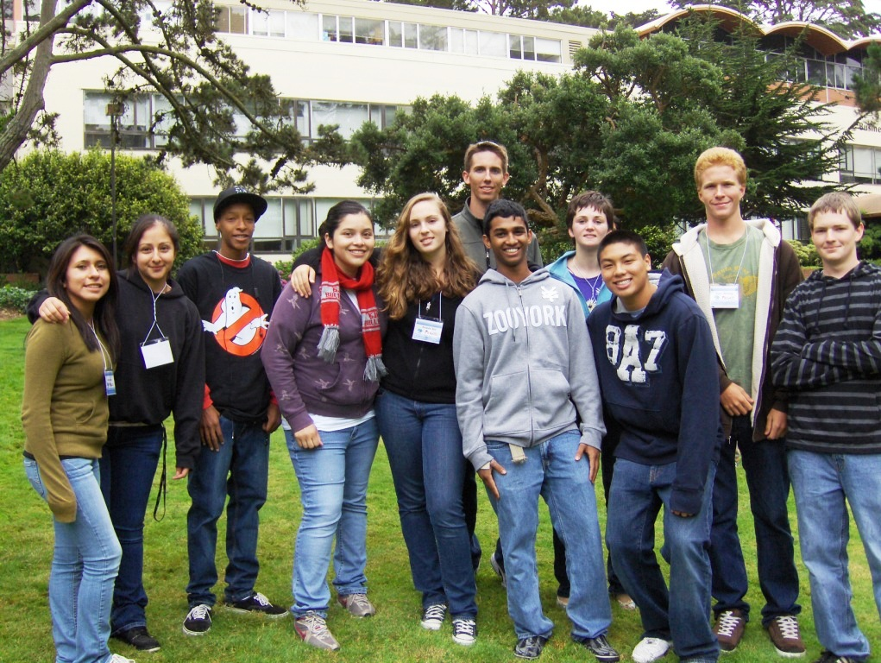
First Year STEM Pathway Courses: Pilot Cohort
RECRUITING STEM Students
Guide students in registering for
foundational STEM classes
Steer students to relevant college
resources
Create cohorts of students to
promote interconnectedness
Notes:
First pillar: clear curricular pathways. Learning community of bundled Math 225, English 100, and Student Success Course. Cohesive scheduling and enrollment.
Suggestion: change the left figure to be direct texts, with just the 3 terms of activities. It's not really legible in this format, and this committee will want the details.

Slide 6
Lessons Learned from the Pilot Cohort
RECRUITING STEM Students
LIMITATIONS:
Low participation by end of cohort (~6 students)
Unable to cohort courses with one or very few sections
Restricted to first year
Does not cover a full semester load of courses
CHALLENGES:
Scheduling challenges for some students prevented participation
Not clear to students that they were in a cohort
Additional coordination required to manage courses with cohort restrictions
Notes:
Five day is now four day.

Slide 7
STEM Explorers
RECRUITING STEM Students
Five-Day Comprehensive “Boot Camp” before fall term
Hands-on STEM workshops led by STEM faculty
Group presentations and one-on-one meetings with STEM Counselor
Introduction to campus support services
Notes:
Five day is now four day.

Slide 8
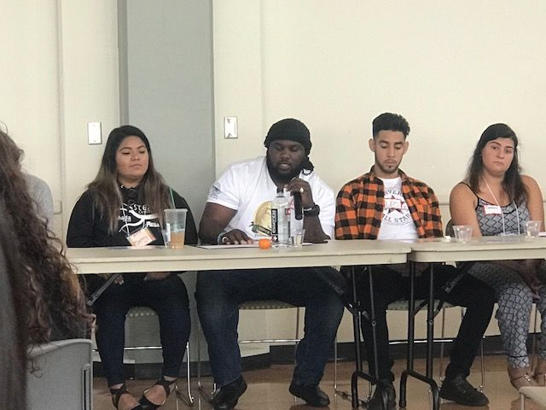
Lessons Learned from STEM Explorers
RECRUITING STEM Students
Met 80% of our recruitment goal of 75 students
Campus-wide collaboration for a single summer orientation greatly boosted participation
Opportunity for genuine exploration of STEM
"Late-start explorers" to support students that missed COLTS-Con
Notes:
Five day is now four day.

Slide 9
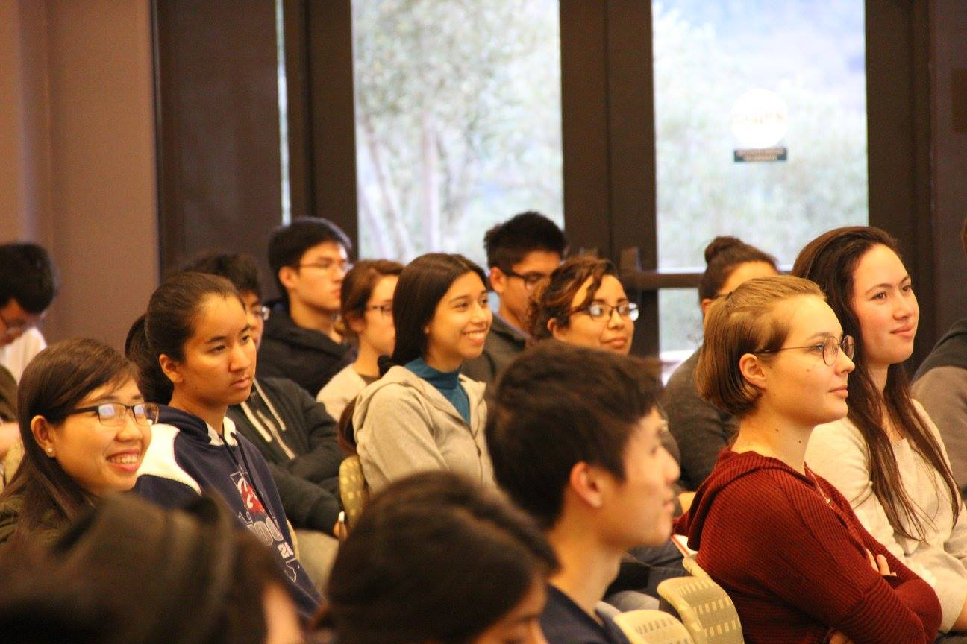
STEM Speaker Series
RECRUITING Students in STEM
Features local STEM professionals from diverse backgrounds and educational paths
7-8 weekly sessions per semester
Open to members of the community
Connects students to internships
Now visible online
Notes:
b. Speaker series
c. Internships – help with finding, applying for them; prep session in late May to teach student how to maximize their experience.
Suggestion: point out how this aspect could/should be expanded to include all majors, not just STEM. Needs support from college.
Also addresses Student Voices request for more career information.

Slide 10
STEM Academy: Persistence
Activity | Enrollment Status | Participation/Goal | Staffing
EPIC & Tutoring | Continuing | 275/100 students | EPIC Coordinator
STEM Counseling & Retention Activities | Continuing | 100 students | Retention Specialist
Shadow Program | Continuing | 18/25 students | Retention Specialist
Internships | Continuing | 53 students | Retention Specialist
Conferences | Continuing | ~30 students | Retention Specialist
Notes:
16% of students complete their degree/certificate in 3 years
52% of students complete their degree/certificate in 6 years
Students on average are attempting 118 units before earning a 60-unit Associate’s Degree
College students are more likely to complete a degree efficiently if they:
Choose an “Area of Interest”
Develop an academic plan
Follow a roadmap of the courses they need to take
Receive guidance and support to help them stay on plan

Slide 11
Helping Students PERSIST in STEM
EPIC Supplemental Instruction
and Peer Tutoring
Notes:
They have seen this before. move quickly through it. Also, add the number of students in these notes for easy reference, if anyone asks.

Slide 12
Dedicated STEM Counseling and Retention Activities
Helping Students PERSIST in STEM
Students meet with STEM Counselor periodically to monitor progress
Retention activities keep students on track:
“Early Alerts”
“Ask Me Anything”, Drop In Hours
Workshops on time management and study skills
Notes:
Provides consistent advice, steady contact with same person to build trust. Exactly what “Student Voices” asked for.

Slide 13
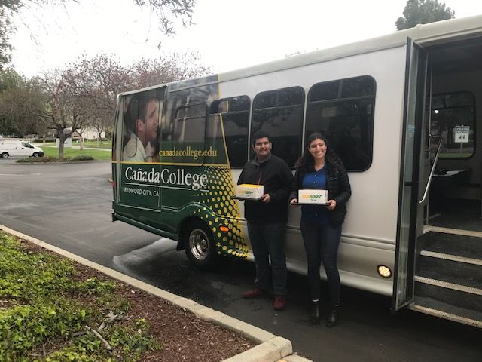
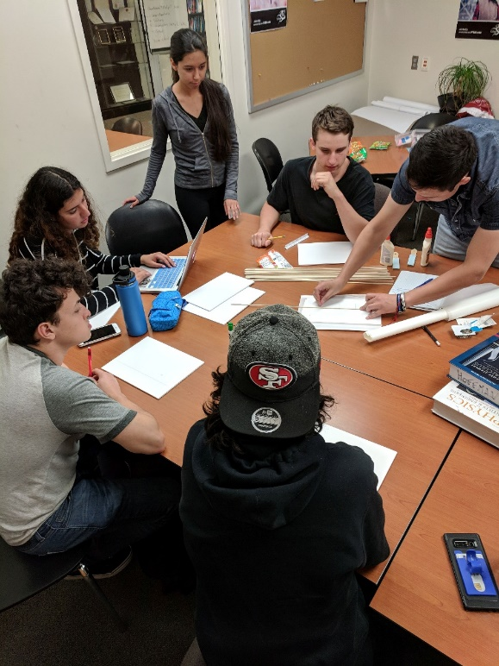
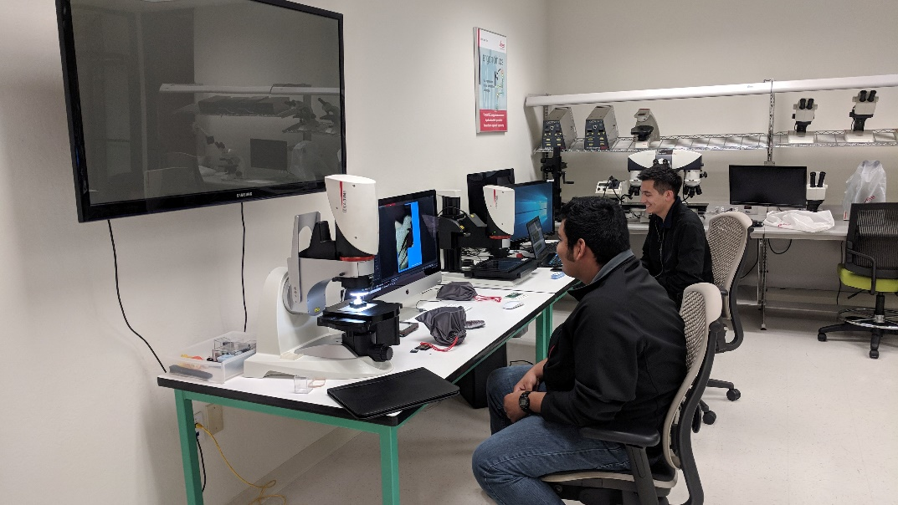
Internships
Helping Students PERSIST in STEM
STEM Clubs
Job Shadowing
STEM Clubs include: Math,
Astronomy, Engineering,
Women in STEM, Pre-Med
53 students placed in 2017-2018
18 Students at 8 Companies
Spring Break 2019

Slide 14
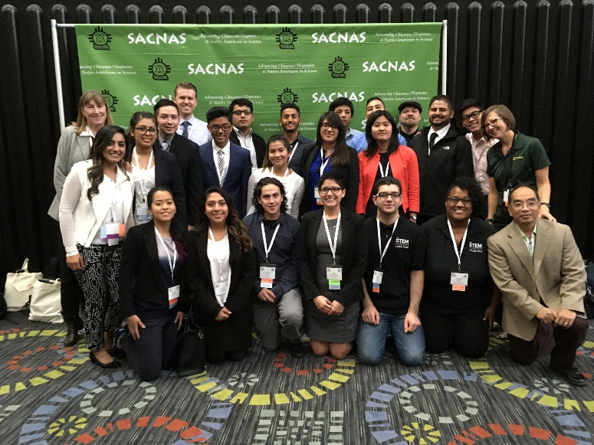
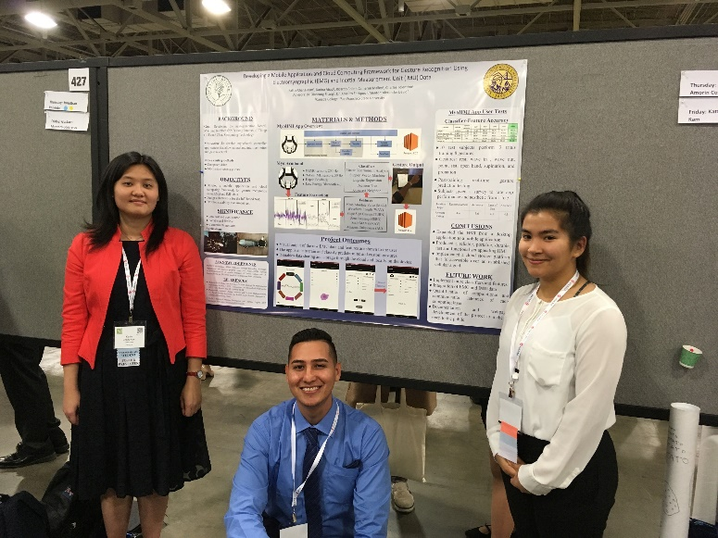
Conferences
Helping Students PERSIST in STEM
students attend and present research internship results at professional conferences
Faculty, staff coaching
Notes:
Mostly funded by grants, but many conferences are local and accessible to all students. Really opens their eyes to what’s possible in careers, great opp to practice elevator pitch, interview skills.

Slide 15
STEM Academy: Completion
Activity | Enrollment Status | Participation/Goal | Staffing
Transfer Support | Continuing | 68/100 students | STEM Counselor
University Visits | Continuing | 59/100 students | University Relations Manager
“Warm Hand-Off” | Transferring | 68/100 students | University Relations Manager
Notes:
Suggestion: mention that we are keeping a database to contact alums. gives more accurate transfer numbers, builds network for current students to connect with as they transfer.

Slide 16
Dedicated Transfer Support
Helping Students COMPLETE/TRANSFER in STEM
Honors Transfer Essentials course for second-term students
University Trips allow students to explore target universities
Two-day STEM 3 workshop helps students apply to transfer
Notes:
Suggestion: verbally point out importance of transfer course info in their second term. Keep their eyes on the goal.

Slide 17
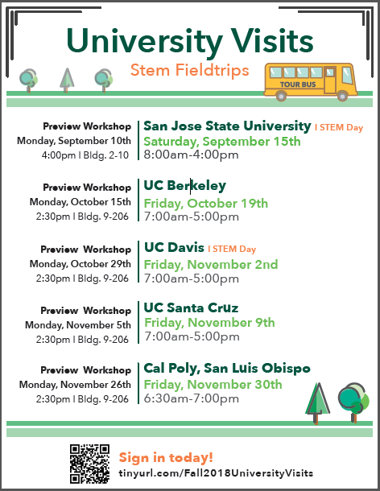
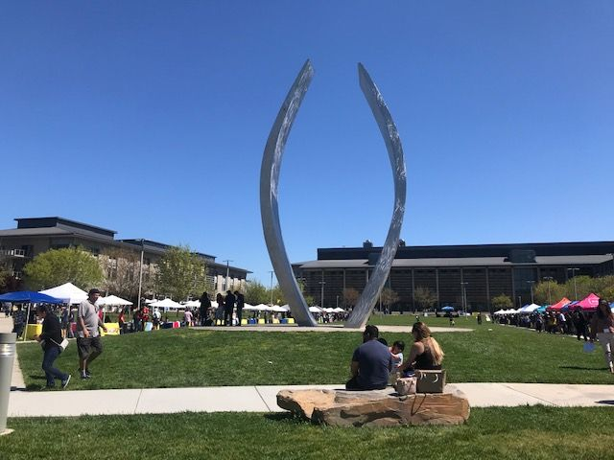
University Visits
Helping Students COMPLETE/TRANSFER in STEM
5-6 STEM-focused visits to universities per semester
Pre-trip workshops to prepare students
Participation challenges due to student availability
Notes:
Contact canada alums so they host the visiting students. Conversations have strong impact on our students.
Suggestion: if too many slides, delete this one b/c this audience is familiar with this. Give info verbally with previous slide

Slide 18
Warm-Hand Off
Helping Students COMPLETE/TRANSFER in STEM
Top 4-Year Universities | # of Students
UC Davis | 15
SFSU | 9
UC San Diego | 7
UC Santa Cruz | 6
Cal Poly/SLO | 5
SJSU | 5
UC Berkeley | 4
Top Majors | # of Students
Engineering | 19
Computer Science/Software Engineering | 11
Biology/Biochemistry | 10
Math | 7
Confirmed 2018 Transfers = 68 students

Slide 19
STEM Center Success Stories
Tamara Dorian, Burlingame HS 2015
Now: UCSC (Computer Science)
“The STEM Center campus tours and transfer days allowed me to fall in love with the UCSC campus”
Oskar Granados, Woodside HS 2003
Now: UCSD (Electrical Engineering)
“The STEM Center helped me integrate
into engineering by providing me with
support and opportunities”
Notes:
Delete for this talk.

Slide 20
Thank You!
STEM Center Staff
Georganne Morin
Cathy Lipe
Marcella Grant
Gonzalo Arrizon
Josue Alcarez
Sally Heath
Rance Bobo
Sandra Rodriguez
Milena Angelova
Maggie Baez

