Slide 1
Early College Experiences and First Year Experience (FYE)
Strategic Enrollment Management
Wednesday, October 23, 2019
Notes:
Manuel

Slide 2
Brought to you by
…your friendly, neighborhood College Redesign
Notes:
Manuel

Slide 3
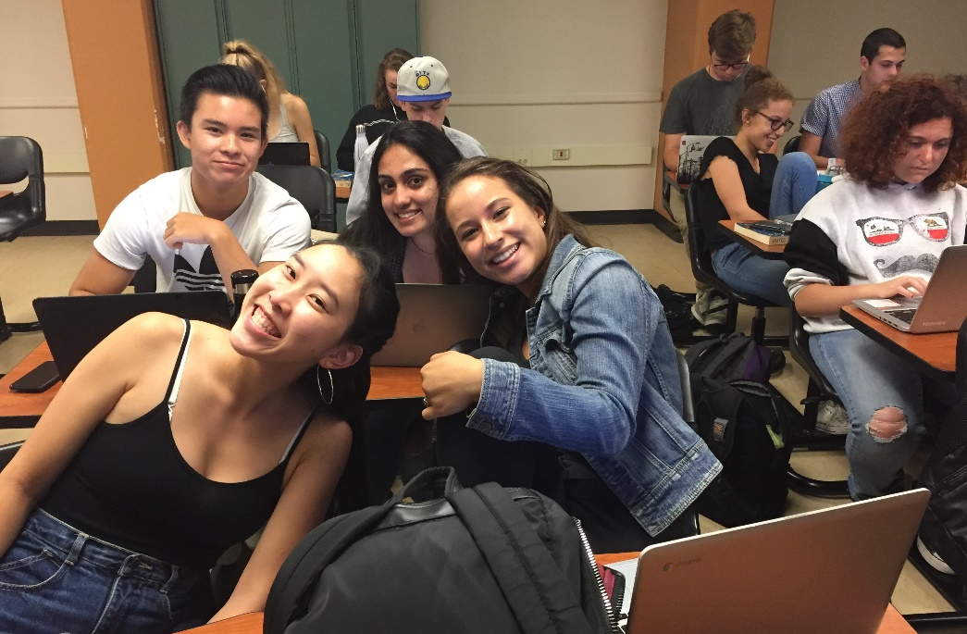
Types of early college enrollment
108
103
Types of Early College Enrollment | # of students Fall 2019
All concurrently enrolled high school students | 406
Middle College High School (on Cañada’s campus) | 103
Dual enrollment Students taking college courses at their local high school (mostly contracted classes)* | 108
*3 sections of Math 251 at Carlmont; 1 section of 253 at Sequoia HS and 1 section of 253 at Woodside
Notes:
KAREN
For the Class of 2017, 54 seniors and 2 juniors completed graduation requirements (the two juniors graduated a full year early).
91% complete UC/CSU A-G requirements.
46 of the 54 were in MC for both years and earned an average of 42 college units; 10 were in MC for one year (includes the two junior grads) and earned an average of 24.5 college units.
22 of the seniors achieved Cañada College Dean’s List honors at some point in their time at MC.
One senior maintained straight A’s each semester, earning a 4.0 cumulative college gpa and weighted cumulative HS gpa of 4.31.
For 2018-19:
For this year—
Most of our seniors are waiting to hear back from UC and CSU, but we’ve had a number of students receive admission news already. This year’s seniors have received admissions from:
University of Arizona
University of Idaho
Florida International University
San Francisco State
University of San Francisco
Colorado State
Menlo College
Temple University
University of Hawaii
St. Mary’s College
University of Pennsylvania
University of Oklahoma
Holy Names University
Widener University
University of Oregon
University of Victoria
This past fall semester, 38 of our students earned straight A’s in their college classes. All students are required to take at least two college classes totaling 9 units or three classes totaling 7 units, which I think is more than what the average Cañada student is taking each semester.
Many of our students are involved in campus clubs, and at least one is in ASCC. A handful work in the Learning Center as tutors. About a third of our students participate in sports at their home high school.
I haven’t finished working on this, but so far I have 6 quotes from our grads over the years: https://www.smore.com/rwkb9-middle-college-update
Other fun facts—
Since the program began 20 years ago, we’ve had 9 staff assistants, 9 HS administrators, 6 college administrators, 8 social studies teachers, and 2 English teachers, and somewhere around 750-775 graduates.

Slide 4
Top courses and modalities
Subject | Duplicated Enrollments Fall 2019
MATH | 226
SPAN | 65
FITN | 44
ENGL | 42
PSYC | 36
BIOL | 34
BUS. | 26
CIS | 26
MUS. | 23
Modality | Duplicated Enrollments Fall 2019 | % of Total
FACE TO FACE | 578 | 72%
HYBRID | 56 | 7%
ONLINE | 164 | 21%
Grand Total | 798
Most popular online courses: Walking Fitness 1; math various; CIS 118; Psych 100
Notes:
KAREN

Slide 5
Early College Experience
Creating accessible higher education pathways for all high school students regardless of socioeconomic status, perceived college readiness, and generational access to college via concurrent enrollment, dual enrollment, and middle college programs with an emphasis on efforts to increase enrollment for disproportionately impacted student populations.
Emerging Scholars
Partnership with Redwood High School
Targeted recruitment strategies for 4-university bound student populations
TRIO Upward Bound
Notes:
MARISOL & MARIA
TRIO Upward Bound
25% 4-5 per year- rising 9th graders, 88%, Fall of Junior Year,
Cohorted academic, skill-building, career exploration, financial literacy, summer
Pipeline program, middle school, COLTS con- Summer Bridge and Enrolled in TRIO

Slide 6
FYE Opportunities and Challenges
Academic Jams – Math, Word, Physics
Cohorts of first-time students in entry classes
Counselor, Retention Specialist by Interest Areas and Programs
Tutoring – Embedded and Drop-in
Peer Mentors
College Hour in Schedule
Notes:
CAROL

Slide 7
STEM Explorers/Colts-Con
Partnered with Promise and Learning Center to create COLTS-CON with STEM Explorer track
Late Start workshops
Notes:
CAROL

Slide 8
Critical Questions & Considerations
Are we building these experiences and support systems for full time and/or part time students?
When considering FYE/linked/blocked courses, are these possibilities available for part time students?
What FYE/linked/blocked courses would we offer?
What is the impact of the early college experience on outreach and recruitment?
What should our outreach and recruitment timeline look like in order to align with these components of the College Redesign?
How do we support reverse transfer students?
Notes:
MANUEL/ALL

