Slide 1


Annual Plan (draft) for implementing the College’s
5-year Education Master Plan
2024-25
Presented to the Planning & Budgeting Council on September 4, 2023

Slide 2
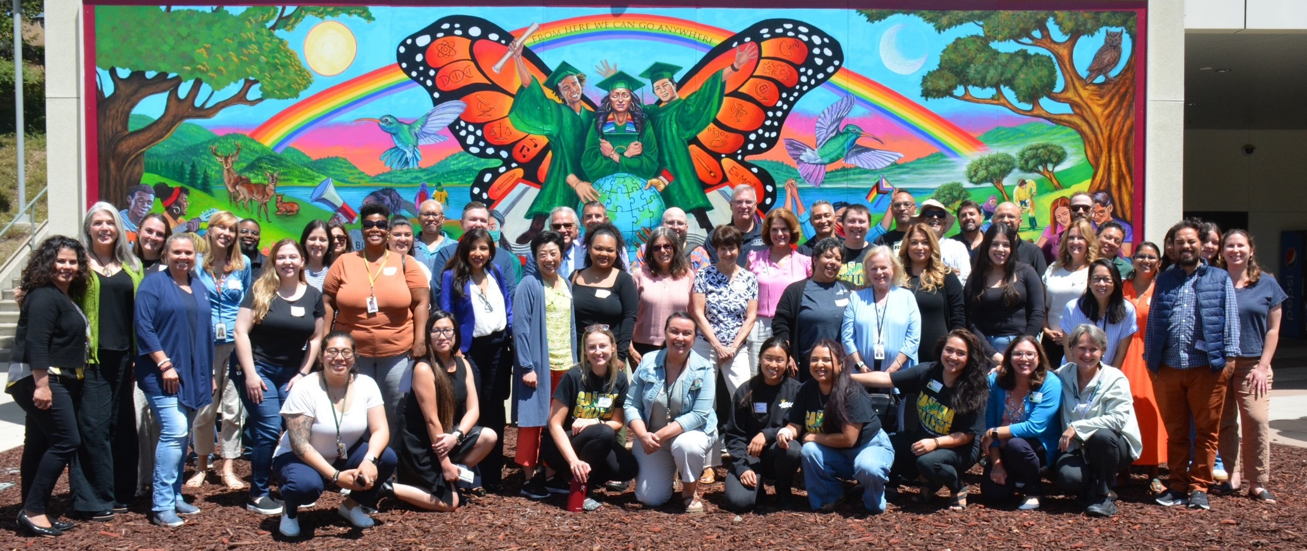
2024 Leadership Retreat Update
50+ students, faculty, classified staff and administrators participated
4 breakout sessions focused on choosing the top priorities for 2024-25
Check https://canadacollege.edu/plans/leadership-retreat.php for more info

Slide 3
EMP Goal 1: Student Access, Success, and Completion
Priorities for 2024-25
EMP Number | Strategic Initiative | Strategic Initiative - full text | Status as of Summer 2024 | Lead (Name) | Lead Committee, Council, Senate or operational group
1.2 | Build on the CWA model | Prioritize serving part-time, working students by building on the model of College for Working Adults (CWA). Add more degrees and certificates obtainable within 3 years via evening, weekend and online classes, and ensure adequate services are available in the evenings, to support at least 1,000 part-time students participating in CWA, particularly low income, BIPOC students, per term by 2027. | In Progress | James Carranza Jose Zelaya & Wissem Bennani (combined with EMP 4.3: Evening Hub) | iDeans
1.7 | Increase degree and certificate programs available in Menlo Park and East Palo Alto | Increase the number of degree and certificate programs and general education courses at the Menlo Park site and/or other off-campus locations (East Palo Alto) to help students access needed courses and support services closer to home. | Not Started | Alex Kramer Jasmine Jaciw | iDeans
1.15 | Create and scale the First Year Experience Program | Create (by 2023) and scale (by 2025) the First Year Experience program for all incoming students, including default course schedules for some first-time cohorts. | In Progress | Ron Andrade, Faculty Leadership | Cabinet

Slide 4
EMP Goal 2: Equity-Minded and Antiracist College Culture
Priorities for 2024-25
EMP Number | Strategic Initiative | Strategic Initiative - full text | Status as of Summer 2024 | Lead (Name) | Lead Committee, Council, Senate or operational group
2.7 | Provide comprehensive on-boarding for all new employees | Provide a comprehensive orientation and on-boarding for all newly hired faculty, staff and administrators each term that includes module(s) in antiracism shared language, resources for equitable pedagogy and practices, and how to connect with a mentor or personal support via the Cultural Center and/or Offices of Instruction, Student Services, and Administrative Services. | In Progress | Anniqua Rana/Michiko Kealoha | EAPC and Professional Development Planning Committee (PDPC)
2.10 | Transform college participatory governance processes | Reimagine and transform college participatory governance processes and structures to: (1) address equity and antiracism in all integrated planning and resource allocation decisions; (2) increase student voice in college processes, including program review; and (3) ensure classified staff have adequate time to contribute to the committees and councils on which they serve. | In Progress | Michiko Kealoha, Gampi Shankar, Alex Claxton | Planning & Budgeting Council and Equity and Antiracism Planning Council, and ASCC
2.14 | Evaluate academic support programs and practices | Regularly evaluate all academic support programs and practices to ensure they are effective in closing equity gaps in access, student success and completion. These include but are not limited to: Interest Area Success Teams, the Learning Center, Tutoring (online and in person), the Writing Center, and Peer Mentoring, Library, Math, Word and all other JAMS. | In Progress | Karen Engel | IPC and EAPC
Notes:
Continuing priorities are highlighted in the paler color

Slide 5
EMP Goal 3: Community Connections
Priorities for 2024-25
EMP Number | Strategic Initiative | Strategic Initiative - full text | Status as of Summer 2024 | Lead (Name) | Lead Committee, Council, Senate or operational
3.2 | Reach new community members in N. Fair Oaks, Belle Haven, and East Palo Alto, especially BIPOC communities | Transform where we share what Cañada has to offer by identifying and reaching new outreach audiences that help strengthen our ties to BIPOC communities (particularly those communities our recruitment maps indicate might be underserved, such as North Fair Oaks, Belle Haven, and East Palo Alto).Recruit more BIPOC students, including more students who identify as Black/African American. | In Progress | John Fraire Wissem Bennani | SSPC
3.8 | Strengthen transfer support services to increase transfers | Strengthen transfer support services by, (1) building University pathways and expanding the University Center, (2) increasing by 35% the number of Cañada College transfer-seeking students who achieve transfer readiness and the number of students who apply to a 4-year University ­­­between 2022 and 2027 (adjusted for enrollment fluctuations) and, (3) reduce transfer equity gap for low-income, first generation, and Black, Indigenous, and People of Color (BIPOC) students. | In Progress | Max Hartman | Transfer Advisory Group and SSPC
3.11 | Create and expand career exploration experiences for students | Create and expand career exploration experiences (such as work-based learning, internships, and job shadow opportunities) for students during their time at Cañada, particularly during their First Year (in each Interest Area), as they choose a program of study and refine their education goals. Close racial equity gaps in access to career development and job placement opportunities. | In Progress | Alex Kramer Ron Andrade Bob Haick | IPC and SSPC
3.12 | Double the number of alumni connected to Cañada’s Alumni Organization by 2027 | Strengthen the emerging Cañada College alumni organization by doubling the number of alumni connected to it by 2027, as well as involving more of them in campus activities that strengthen the campus as a center of community life, provide career exploration for existing students, and develop new resources and connections for the College. | In Progress | Megan Rodriguez Antone | Office of the President and the SMCCCD Foundation
Notes:
Continuing priorities are highlighted in the paler color

Slide 6
EMP Goal 4: Accessible Infrastructure and Innovation
Priorities for 2024-25
EMP Number | Strategic Initiative | Strategic Initiative - full text | Status as of Summer 2024 | Lead (Name) | Lead Committee, Council, Senate or operational
4.1 | Improve access to campus via public transit, rideshare | Improve access to campus via public transit, shuttles, and additional partners such as Lyft and Cruise. | In Progress | Ludmila Prisecar Adolfo Leiva | Cabinet, ASCC
4.2 | Build student housing and a Childcare Center | Build student housing on campus, as well as a Childcare Center to serve students with families. | In Progress | Focus on the CDC with Chialin Hsieh and Alex Kramer as leads | PBC and a CDC Implementation Task Force (to be named)
4.3 | Create a hub for evening and weekend students | Create a hub for evening and weekend students to support their social connections, access to nutritional food and beverages, as well as learning support services (an Evening One Stop). | In Progress | Wissem Bennani James Carranza (combined with EMP 1.2: Build on CWA model) | SSPC
4.9 | Update and implement sustainability initiatives | Update and implement the College and District sustainability initiatives in response to climate change to reduce the environmental impact of campus-based activities while ensuring uninterrupted, quality instruction at all times. | Not Started | Ludmila Prisecar Susan Mahoney Karen Pinkham | Office of Administrative Services
Notes:
Continuing priorities are highlighted in the paler color

Slide 7
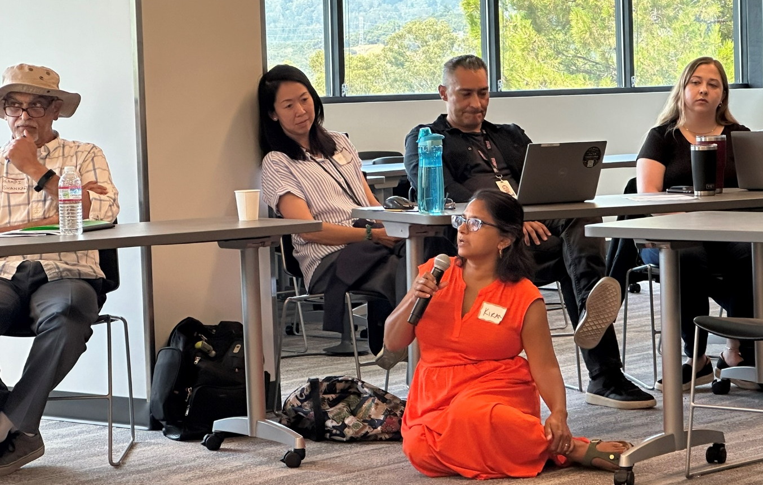
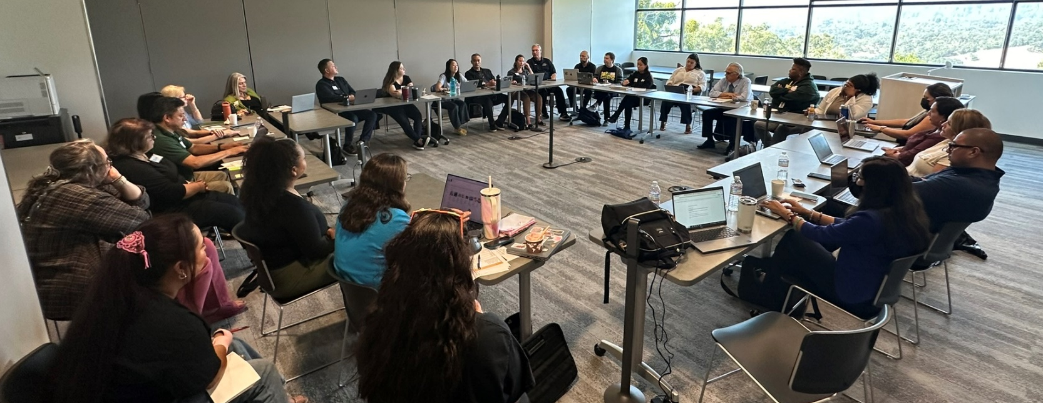
2024 Leadership Retreat: Next Steps
The Planning & Budgeting Council will review and approve our next steps for operationalizing the proposed EMP priorities for this year.
Insert photo of Roz
Responsible individuals and College Councils, Senates, Committees and operational groups will move to action and report back to PBC.
Moving to action – see the Cañada Collaborates website for more details

Slide 8
All materials, slides, and notes from the College Leadership Retreat on August 8, 2024 are available at:
https://canadacollege.edu/plans/leadership-retreat.php

