Slide 1
Multiple Measure Assessment Project (MMAP)
Cañada Pilot Study
Report to Board of Trustee
From Cañada MMAP Team
November 2015

Slide 2
What is MMAP?
Multiple Measures Assessment Project (MMAP) is to study:
  Quantify students’ likelihood of passing any given course in the English and/or math sequence based on academic history/multiple measures
  Look at noncognitive variables (NCVs) as possible predictors of student success, as well as other downstream uses for NCVs
  Evaluate CCCApply data
  Exam utility (reliability, validity, predictive power) of other survey questions and history indicators as multiple measures

Slide 3
Assumptions behind MMAP
Tests are not always the best measures
Tests alone are terrible measures
The goal of placement is to predict success
More information provides better placement

Slide 4
Common Assessment Initiative (CAI)
Common Assessment
Multiple Measures
English
Math
ESL
Transcripts
Noncognative factors
Survey
Etc.
Common assessment: (fall 2016)
College’s decision on cut score.
College’s decisions weight on Common Assessment and Multiple Measure.
College has to use Common Assessment to get SSSP funding.

Slide 5
MMAP Pilot Process at Cañada
Established a College wide MMAP Team in Spring 2015
Discussed the concept and adoption of MMAP model
Reviewed the retrospective analysis and validated rule sets
Provided input for piloting MMAP
Drafted a research plan that includes initial implementation strategies
Continually share knowledge and information campus constituents of MMAP and CAI

Slide 6
Tentative Timeline
February 2015: Establish Pilot Group; Study data
March 2015: Establish possible multiple measures; Establish research plan
April 2015: Implement multiple measures (control group vs. intervention group)
May-August 2015: Continue collecting data including course success
January 2016: Analyze the results of two groups (control group vs. intervention group)

Slide 7
Cañada MMAP Team
Team Members:
  Math faculty (1), Dean
  English Faculty (4), Dean
  Assessment Office, VPSS
  Researcher, Dean
English Faculty: Yolanda Valenzuela, David Clay, Kim Huynh, Susan Gangel
Math Faculty: Denise Hum
Assessment Office: Jeanne Stalker
Researcher: Tracy Huang
Deans:, Janet Stringer, David Johnson, and Chialin Hsieh
VP: Kim Lopez

Slide 8
Data and Literature Review
Office of Planning, Research and Institutional Effectiveness conducted retrospective analysis in Spring 2015 using SMCCD student data and CalPASS data to test the local predictive validity of the MMAP model.
Worked with CalPASS to implement the pilot in Spring 2015.
The Team reviewed Other Community Colleges’ data and experiences
The Team reviewed MMAP pilot colleges and Research and Planning Group’s (RP Group) recommendations
The Team did literature review

Slide 9
Data Summary
  Cohort groups were from 2009-2011 (CalPass Plus)
  Average length between HS graduation and enrolling at Cañada: 4 years
  Majority of HS students came to us with GPA of C or lower.
  Majority of HS students took English or math in their first semester.

Slide 10
Determine Target Population and Transcript Indicators
New college student
Most recent high school graduates past 3 years
Cumulative high school GPA
High school grade in English/Math

Slide 11
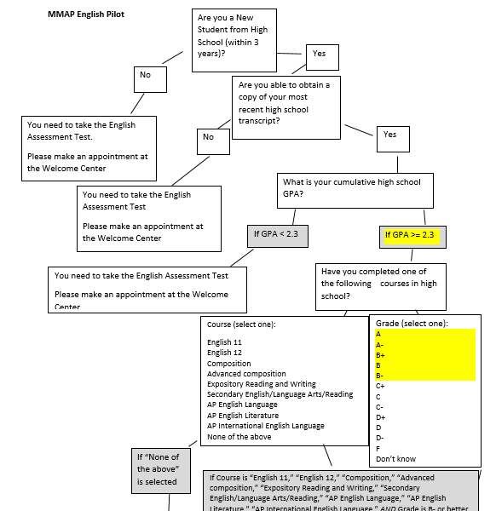
Decision Trees--English
New student from high school within 3 years
GPA >=2.3
High school English course grade equal or higher than B-

Slide 12
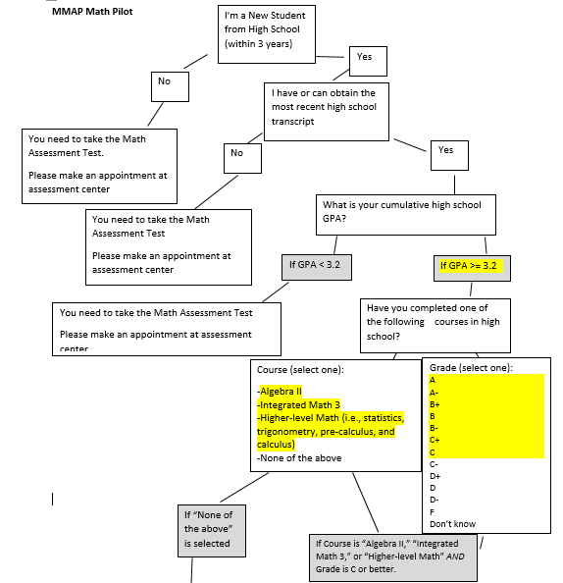
Decision Trees--Math
New student from high school within 3 years
GPA >=3.2
High school English course grade equal or higher than C

Slide 13


Web Application for the Decision Trees
Development of the Web application
  English Questionnaire
  Math Questionnaire

Slide 14
Implementation of the transcript placement
Assessment Center staff validate HS transcripts in fall 2015
Clear the prerequisites for students to enroll in fall 2015
Example for students’ feedback: Jeanne.

Slide 15
Evaluation of the Outcomes on the MMAP
Compare the # of enrollment in college level English/math in 2015 with the # of enrollment in college level English/math in 2014.
Compare the # of enrollment in basic skills English/math in 2015 with the # of enrollment in basic skills English /math in 2014.
Compare college level English/math success rates of the April 2015 recent HS graduates using transcripts with the college level English/math success rates of the March 2015 and 2014 recent HS graduates using COMPASS.

Slide 16
Expected Findings
Outcomes | Control Group |  | Treatment Group
Enrollment in college English/Math | 2014 enrollment | < | 2015 enrollment
Enrollment in basic skills English/Math | 2014 enrollment | > | 2015 enrollment
College level English/math Course Success Rate | 2014 recent HS graduates using COMPASS placed in college level English/math | < | 2015 recent HS graduates using transcripts placed in college level English/math

Slide 17
Findings

Slide 18
College Level English and Math Placements (COMPASS & MMAP)
Summer &Fall 2015
 | COMPASS Placement at College level (A) | MMAP Placement at College Level (B) | Combined both | Percent Difference (B/A)
English | XXX | 136 | XXX
Math | XXX | 58 | XXX

Slide 19
College Level English and Math Enrollment (COMPASS & MMAP)
Summer & Fall 2015
 | COMPASS Placement at College level (A) | MMAP Placement at College Level (B) | Enrolled into College Level (A+B) | Percent Difference (B/A)
English | XXX | 136 | xxx + 111
Math | XXX | 58 | Xxx + 40

Slide 20
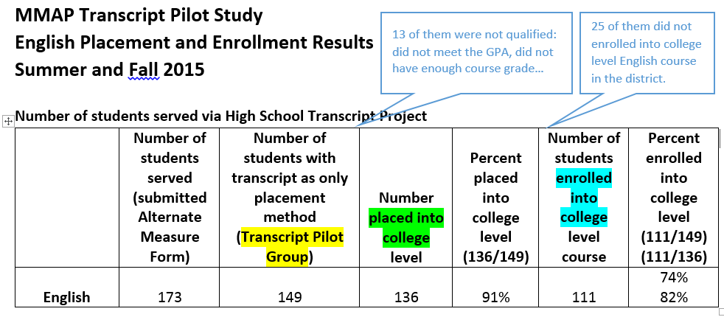
MMAP Transcript--English

Slide 21
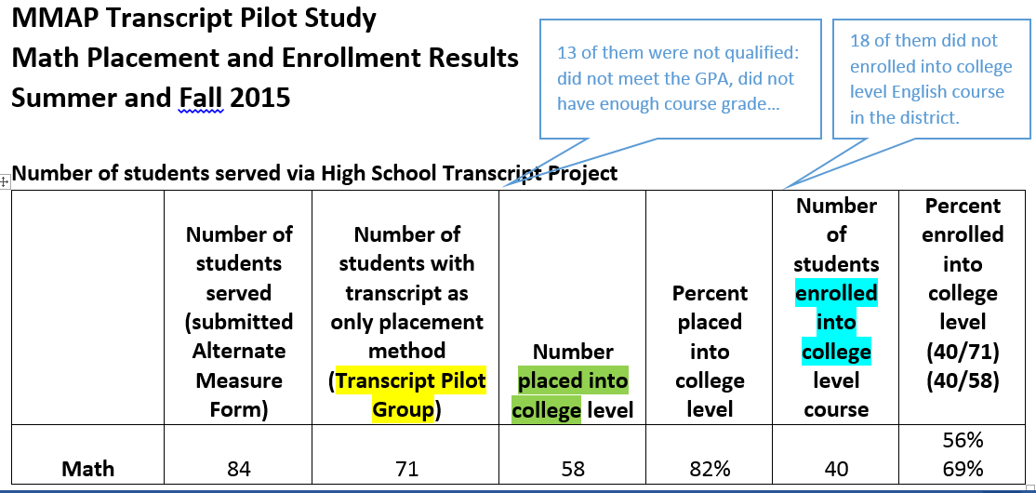
MMAP Transcript--Math

Slide 22
MMAP Transcript—English by Ethnicity
Summer & Fall 2015
 |  |  |  | First time and First Time Transfer Students enrolled in College Level
 | Access (N=148) | Placed into College Level (N=134) | Enrolled in College Level (N=111) | Summer & Fall 2015 (N=298) | Summer & Fall 2014 (N=150)
American Indian | - | - | - | - | 2%
Asian | - | - | - | 8% | 6%
Black | 3% | 2% | 1% | 3% | 3%
Filipino | 2% | 2% | 3% | 5% | 3%
Hispanic | 42% | 41% | 42% | 30% | 25%
Multi Races | 24% | 26% | 26% | 25% | 25%
Pacific Islander | 2% | 1% | 2% | 1% | 3%
Unknown | 1% | 1% | 1% | 2% | 3%
White | 25% | 26% | 26% | 25% | 31%
Total | 100% | 100% | 100% | 100% | 100%

Slide 23
MMAP Transcript—Math by Ethnicity
Summer & Fall 2015
 |  | College Level Including: 125, 130, 200, 222, 225, 241, 251, 252, 253 |  | First time and First Time Transfer Students enrolled in Math 200 Only
 | Access (N=70) | Placed into College Level (N=53) | Enrolled in College Level (N=40) | Summer & Fall 2015 (N=100) | Summer & Fall 2014 (N=104)
American Indian | - | - | - | - | 1%
Asian | - | - | - | 7% | 8%
Black | 4% | 3% | 5% | 3% | 6%
Filipino | 9% | 8% | 9% | 2% | 5%
Hispanic | 27% | 20% | 25% | 29% | 24%
Multi Races | 26% | 34% | 25% | 23% | 17%
Pacific Islander | - | - | - | 2% | 1%
Unknown | - | - | - | 3% | 2%
White | 34% | 34% | 36% | 31% | 37%
Total | 100% | 100% | 100% | 100% | 100%

Slide 24
Demographics and Enrollment
Review report for details

Slide 25
Cañada Assessment Plan
Engagement Strategies
Enrollment Strategies
Engaging key stakeholders
Professional development
Engaging special program populations
Class offerings
Implementation process
Communication Strategies
Informing stakeholders
Informational materials
Engagement Strategies
Evaluation Strategies
Research
Non-cognitive measures
Contingency plans
Snapshot analysis
Longitudinal analysis

Slide 26
Next Steps
Share the Assessment Plan and outcomes broadly and collect feedback to refine strategies—Fall 2015
Continue pilot in Spring 2016 using revised implementation logistics—November 2015
Evaluate outcomes of fall and spring cohorts, and refine placement rule sets if needed—Spring 2016 and Summer 2016
Review, select, and pilot non-cognitive measure—Fall 2016??

Slide 28
Comparison of the Target Population Demographics and Enrollment
Outcomes | Control Group | Treatment Group
Enrollment in college English/Math | 2014 enrollment | 2015 enrollment
# of students Ethnicity
Enrollment in basic skills English/Math | 2014 enrollment | 2015 enrollment
# of students Ethnicity

Slide 29
Comparison of the Target Population Demographics and Enrollment
Outcomes | Control Group | Treatment Group
College level English/math Course Success Rate | 2014 recent HS graduates using COMPASS placed in college level English/math | 2015 recent HS graduates using transcripts placed in college level English/math
# of Students
Ethnicity
Rate of enrolling in English/math
College level English/math Success Rate | NA | NA

Slide 30
Why is this information important?
Title 5 §53200 gives academic senates the responsibility for making recommendations about academic and professional matters concerning:
“standards or policies regarding student preparation and success.”
The intent behind prerequisites and placement processes, including the selection and application of multiple measures, is to ensure or enhance student success through proper preparation. Therefore, academic senates must be directly involved and play a leading role in facilitating and developing recommendations about assessment processes and the use of multiple measures at both local and state.

Slide 31
Title 5 state requirements that guide assessment policy
Title 5 Section 55520. Required Services.
  (b) assessment for all nonexempt students pursuant to section 55522
  Title 5 Section 55522. Assessment.
  (a) The Chancellor shall establish and update at least annually, a list of approved assessment tests for use in placing students in English, mathematics, or English as a Second Language (ESL) courses and guidelines for their use by community college districts. When using English, mathematics, or ESL assessment for placement, it must be used with one or more other measures to comprise multiple measures.
  Title 5 Section 55502. Multiple Measures.
  (i) Multiple measures are a required component of a district’s assessment system and refer to the use of the more than one assessment measure in order to assess the student. Other measures that may comprise multiple measures include, but are not limited to, interviews, holistic scoring processes, attitude surveys, vocational or career aptitude and interest inventories, high school or college transcripts, specialized certificates or licenses, education and employment histories, and military training experience.

Slide 32
How do we currently assess and place students?
COMPASS ACT for reading, writing, ESL and math
Multiple-choice items
Online test component is computer adaptive
Cut scores are locally validated
Assessments from other colleges, college transcripts, AP scores, EAP results, IB Credits, CLEP credits
Use the following multiple measures:
High school GPA, grade in last math/English course
General proficiency in reading, writing, and or math (daily use)
Refer to Challenge Petition process

Slide 33
What do CSM and Skyline do?
College of San Mateo & Skyline:
  Compass ACT for math and ESL
  Accuplacer for reading and writing
  We do not use the same assessments, but need to accept each others results.
  What do other Community Colleges do?
  Chancellor’s Office Approved Assessment Instruments:
    Compass, Accuplacer, CELSA, MDTP, CTEP, CASAS, McCann Associates
    Locally Developed Assessment Instruments:
      ESL/English Writing Samples, Geometry assessment, math assessments, chemistry, diagnostic tests

Slide 34
What are the state assessment initiatives?
Student Success Act (SB 1456) & Assemby Bill 743 to develop a:
  “common assessment to be used as one of multiple measures,…for the purposes of community college placement and advisement.”
  The Common Assessment Initiative (CAI)
  http://cccassess.org/about
Multiple Measures Assessment Project (MMAP)
http://rpgroup.org/projects/multiple-measures-assessment-project
  This project will result in a the development of data warehouse a comprehensive analytical model, an fully-developed user tools to support college-level analysis of multiple measure for assessment and student placement.
  Cañada is one of 14 pilot colleges. Pilot begins in Fall 2015.

Slide 35
What are Multiple Measures?
High school transcript data
High school testing data
Noncognitive variables (NCVs)/psychometric data
Survey questions/self-reported data
----------------------------------------------------------
Historically, multiple measures were not required to be validated
Does not really make sense to ignore them as they impact placement
Need to validate impact of entire placement system on students

