Slide 1
Multiple Measures Assessment Project (MMAP) Cañada Pilot Study
Flex Presentation
March 2016

Slide 2
Multiple Measures Pilot Project
Piloting a model for placement that utilizes high school GPA and grades in most recent high school math and/or English courses.
Established the MMAP Team; studied the data, established measures and research plan and implemented in spring, 2015.

Slide 3
What is MMAP?
Multiple Measures Assessment Project (MMAP) is:
Part of the Common Assessment Initiative
A statewide initiative with about 20 pilot colleges (Cañada is one of them)
Using high school transcript as one of the multiple measures
Notes:
Kim
MMAP is a statewide initiative with about 20 pilot colleges and we are one of them.
We are only focus on the multiple measures (first one)

Slide 4
MMAP Pilot Process Timeline
February 2015: Established the MMAP Team; Studied data
March 2015: Established measures and research plan
April-August 2015: Implemented multiple measures, including validating high school transcripts and placement in college level courses
January 2016: Will analyze the results in terms of student demographics and course success
Notes:
Kim

Slide 5
Cañada MMAP Team
Team Members:
English Faculty: Yolanda Valenzuela, David Clay, Susan Gangel, and Kim Huynh
Math Faculty: Denise Hum
Assessment Coordinator: Jeanne Stalker
Researcher: Tracy Huang
Deans: Janet Stringer, David Johnson, and Chialin Hsieh
Interim VPSS: Kim Lopez
Notes:
Kim

Slide 6
Data Summary
Cohort groups were selected from 2009-2011 (CalPass Plus)
Average time elapsed between HS graduation and enrolling at Cañada: 4 years
Majority of HS students came to us with GPA of “C” or lower.
Majority of HS students took English or math in their first semester at Cañada
Notes:
David

Slide 7
Target Population for MMAP
New college students
Recent high school graduates (within 3 years)
Students with above average cumulative high school GPA
Students with above average grades in high school English/Math courses
Notes:
David

Slide 8
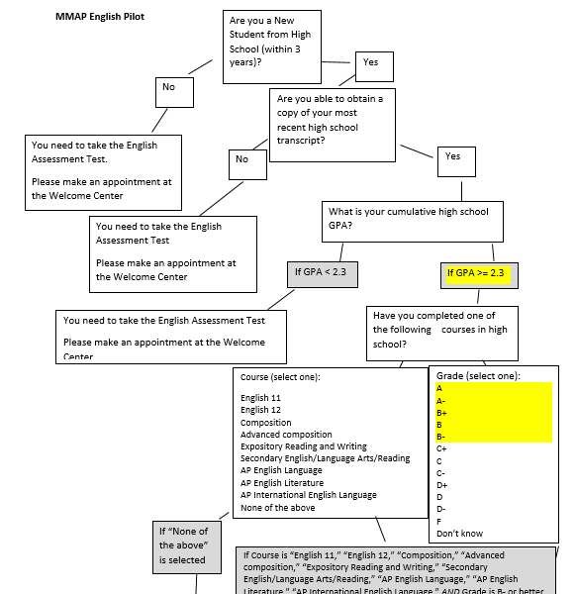
Decision Trees--English
New student from high school within 3 years
Cum GPA >=2.3
High school English course grade equal or higher than B-
Notes:
David

Slide 9
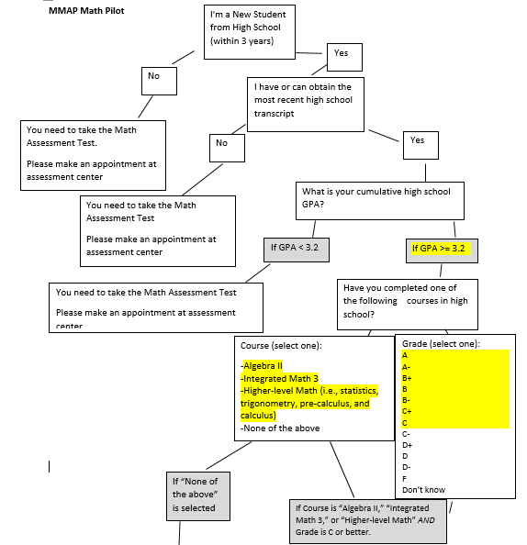
Decision Trees--Math
New student from high school within 3 years
Cum GPA >=3.2
High school Math course grade equal or higher than C
Notes:
David

Slide 10


Web Application for the Decision Trees
Development of the Web application
English Questionnaire
Math Questionnaire
Notes:
Jeanne
May want to show the questionnaire. Make sure acknowledge Jaz and Allan’s involvement and support.

Slide 11
Implementation of the transcript placement
Assessment Center staff validated HS transcripts in fall 2015
Waived the prerequisites for students to enroll in fall 2015
Notes:
Jeanne
Make sure also mention how Kim works with HS
Example for students’ feedback
counselors to prepare HS students for this.

Slide 12
Evaluation of the MMAP
Analyzed the # of students placed and enrolled in college level English/math in 2015 with the # of students placed and enrolled in college level English/math in 2014.
Will compare college level English/math success rates in college level English/math in 2015 with the success rates in college level English/math in 2014.
Notes:
Chialin

Slide 13
Notes:
Chialin
Not only the amount of students increased in 2015 for both placed and enrolled, but also the rate from placement to enrollment increased in 2015 after we implemented high school transcript placement.

Slide 15
Increase 109%
(Total 259)
Increase 158%
Notes:
Chialin
Let’s focus on English placement and English enrollment one at a time.
Placement: 123 in 2014 to 259 in 2015➔109% increase
Enrollment 66 in 2014 to 170 in 2015➔ 158% increase

Slide 16
Notes:
Chialin
How does it impact ethnicity?
For Hispanic:
Placement: 23 in 2014 to 80 in 2015➔248% increase
Enrollment 10 in 2014 to 59 in 2015➔ 490% increase
Be aware of the small number.
For White:
Placement: 48 in 2014 to 86 in 2015➔79% increase
Enrollment 28 in 2014 to 50 in 2015➔ 79% increase
Be aware of the small number.
The results suggested that not only the highs school transcript placement positively impact Hispanic students but also impact white students. The rest of the ethnicities has smaller numbers that are less than 10 students.

Slide 18
Notes:
Chialin
How about Math?
Let’s focus on Math placement and Math enrollment one at a time.
Placement: 191 in 2014 to 245 in 2015➔28% increase
Enrollment: 70 in 2014 to 116 in 2015➔ 66% increase

Slide 19
Notes:
Chialin
How does it impact on ethnicity and gender?
For Hispanic:
Placement: 57 in 2014 to 69 in 2015➔21% increase
Enrollment 17 in 2014 to 32 in 2015➔ 88% increase
Be aware of the small number.
For Female:
Placement: 91 in 2014 to 117 in 2015➔29% increase
Enrollment 22 in 2014 to 51 in 2015➔ 132% increase
Be aware of the small number.
For math placement and enrollment, the results suggested that not only the highs school transcript placement positively impacts Hispanic and White students but also impacts Female students. The rest of the ethnicities has smaller numbers that are less than 10 students.

Slide 21
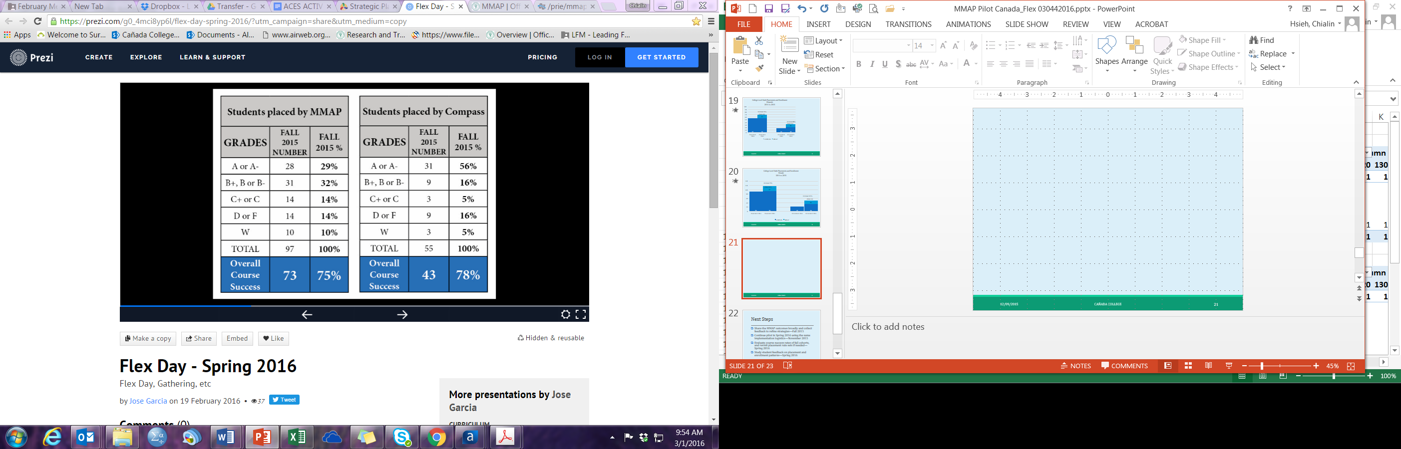
English 100 Course Outcomes by Grade Distribution

Slide 22
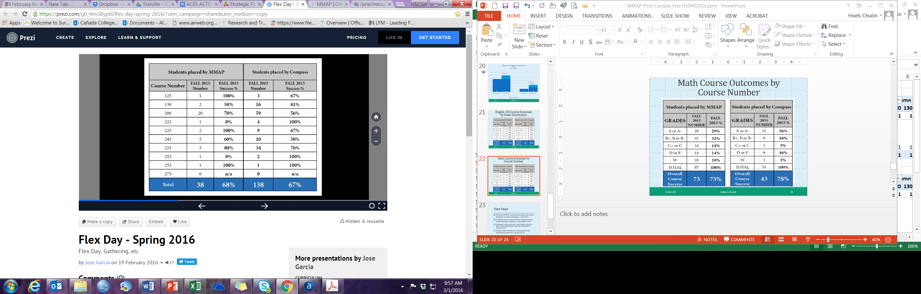
Math Course Outcomes by Course Number

Slide 23
Students Feedback on MMAP

Slide 24
Next Steps
Share the MMAP outcomes broadly and collect feedback to refine strategies—Fall 2015/Spring 2016
Continue pilot in Spring 2016 using the same implementation logistics
Evaluate course success rates of fall cohorts, and revisit placement rule sets if needed—Spring 2016
Study student feedback on placement and enrollment patterns—Spring 2016
Notes:
David Clay

Slide 25
Questions

