Slide 1

TAIR 2011
CCSSE and SENSE for Accreditation

Slide 2
April Juarez
College Liaison
Center for Community College Student Engagement
512-232-3744
juarez@ccsse.org
www.cccse.org
Center for Community College Student Engagement
Community College Survey of Student Engagement (CCSSE)
Community College Faculty Survey of Student Engagement (CCFSSE)
Survey of Entering Student Engagement (SENSE)
Community College Leadership Program
The University of Texas at Austin
Notes:
2

Slide 3
Session Agenda
Talk about student engagement and share learning from a decade of research
Discuss preparing for the self-study within a culture of evidence
Introduce CCSSE and SENSE Accreditation Toolkits
Hear example of a college using CCSSE/SENSE in accreditation processes

Slide 4
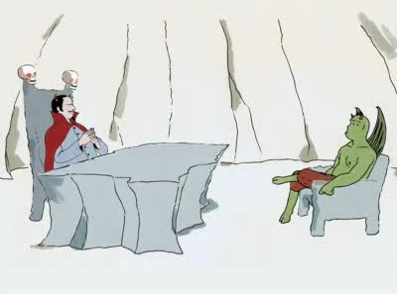
“I need someone well versed in the art of torture…
Do you know PowerPoint?”

Slide 5
What is Student Engagement?
The amount of time and energy students invest in meaningful educational practices…
…the institutional practices and student behaviors that are highly correlated with student learning and retention.
Notes:
5
Question for group: What is student engagement? How would you define it?
We define student engagement as the time and energy students invest in meaningful educational practices AND the institutional practices and student behaviors that are highly correlated with student learning and retention.

Slide 6
Why focus on Student Engagement?
Decades of research show that the more students are engaged—both in and out of the classroom—the more likely they are to persist, achieve success, and finish what they start.
Independent validation research on CCSSE data confirms positive relationship between engagement behaviors and outcomes: CCSSE measures extent to which students are engaged in activities empirically linked to student success.
Focus group work confirms that engagement matters.

Slide 7
Students are more likely to persist and learn if they…
  Establish
  meaningful
  relationships
  with faculty,
  staff, and
  peers.
  Successfully
  navigate through
  college systems,
  processes, and
  procedures.
  Make a
  connection
  between where
  they are now
  and their future
  goals.
Notes:
If we know that the more engaged students are in their educational experience, the more likely they are to be successful in college, what does this mean for institutions?

Slide 8
A focus on Student Engagement behaviors…
…gives community and technical
colleges systematic evidence they can
use to improve students’ educational
experiences, thereby improving student
outcomes.

Slide 9
One thing we KNOW about community college student engagement…
It’s unlikely to happen by accident.
It has to happen
by design.

Slide 10


Tools that help:
  Assess the quality of your work
  Identify and grow successful educational practices
  Identify areas in which to improve
  Shift the focus to institutional locus of control
Notes:
CCSSE—Community College Survey of Student Engagement—administered in the spring term to primarily returning students
CCFSSE—Community College Faculty Survey of Student Engagement—is a companion to CCSSE and is administered online to faculty at the college
SENSE—Survey of Entering Student Engagement—administered in the fall and is designed to capture the experiences of entering, or first-time-in-college students.

Slide 11
Using Student Engagement
Data for Accreditation

Slide 12
What’s the point of accreditation?
Assures constituents of the quality and integrity of higher education institutions and programs
Eligibility for Title IV funds (federal financial aid)
Important for transferability of courses/credits
Helps institutions and programs improve
Notes:
Helps institutions and programs improve – draw parallel to CCSSE’s mission

Slide 13
What do accrediting agencies expect?
Familiarity with criteria/standards
Use of information and data to support the self-study
Thoughtful analysis of evidence
Easily identified and clearly stated priorities for improvement
An honest evaluation
Institutional commitment to student learning
Notes:
Becoming increasingly more important is thoroughly measuring student learning, and demonstrating that processes are in place to assess and enhance learning outcomes and institutional effectiveness on an ongoing basis.

Slide 14

Building a Culture of Evidence:
Understand the facts
Share the facts
Act on the facts
Have the courage to see

Slide 15
How can we prepare for a review within a culture of evidence?
Study and understand criteria/standards
Ensure that mission and goals are attainable and measurable
Engage faculty, staff, and trustees in understanding the accreditation process
Ratchet up IR function for data gathering
Assessment plan must be “in action,” not “planning to plan”
Notes:
So, how can we prepare for an accreditation review?

Slide 16
The CCSSE / SENSE Accreditation Toolkits
Intended to be utilized as an approach to mapping CCSSE and SENSE data to accreditation criteria/standards
Recommended for using in conjunction with other types of data
Notes:
When it comes to using CCSSE and SENSE data in the process, we can help! The Center developed the Accreditation Toolkits to:

Slide 17
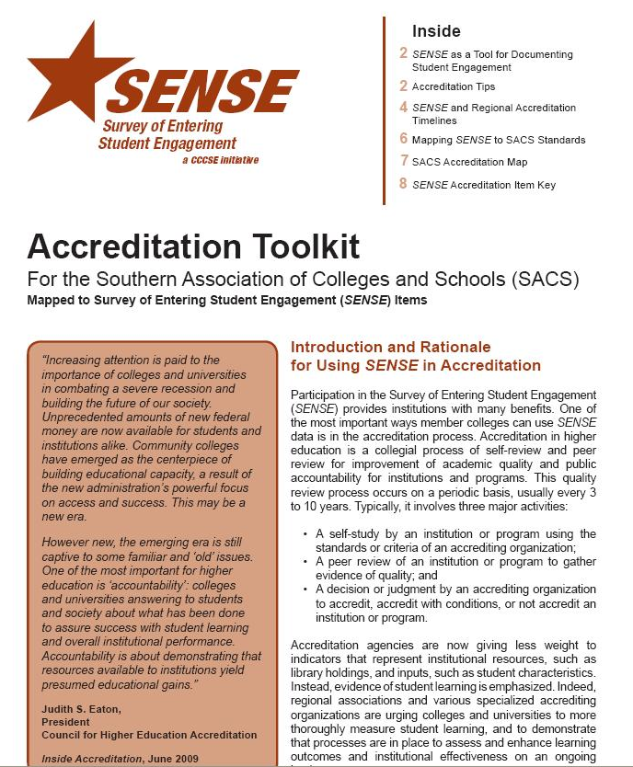
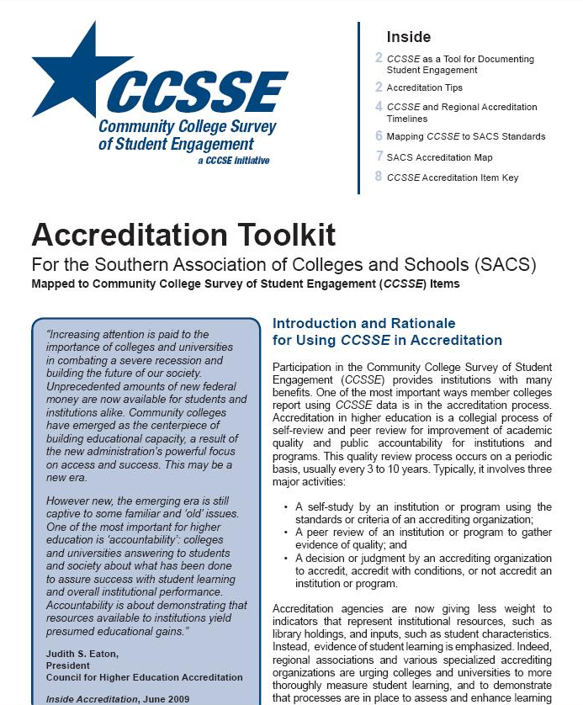

Slide 18
Each toolkit is comprised of three components:
Narrative
Accreditation Map
Accreditation Item Key

Slide 19
The Toolkit Narrative
Includes:
Introduction to accreditation and rationale for using student engagement data
Tips for implementing CCSSE/SENSE into accreditation processes
Example timelines for administering CCSSE/SENSE in short and long accreditation cycles
Explanation of Accreditation Map and Accreditation Key

Slide 20
Accreditation Map
Tailored to each of the six regions
Displays full text of criteria/standards relevant to CCSSE/SENSE
Lists survey items that align with relevant accreditation criteria/standards
Highlights key concepts

Slide 21
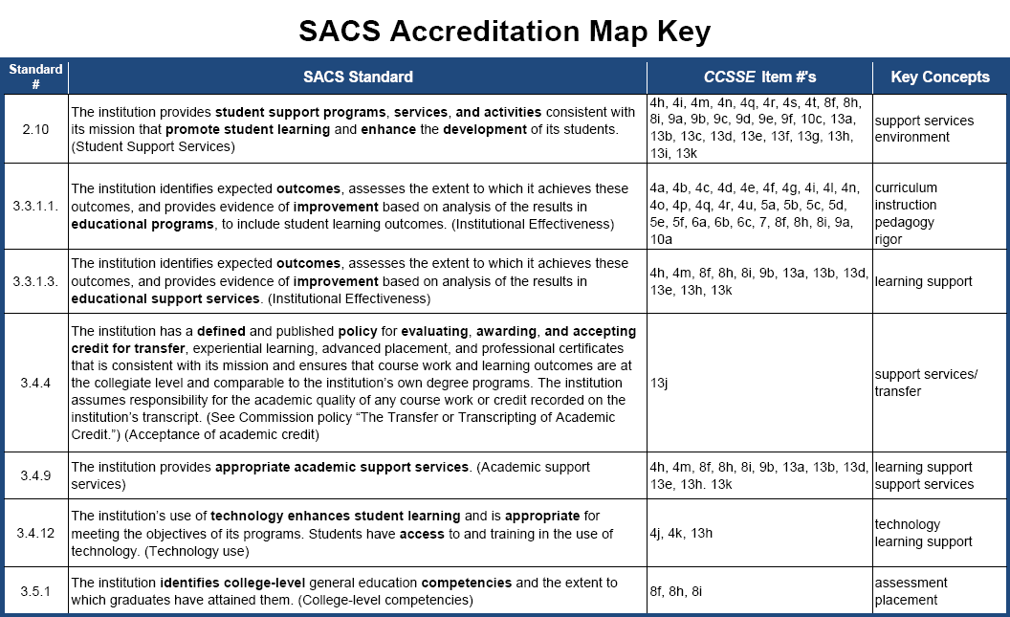

Slide 22
Accreditation Item Key
Displays the full text of the survey items
Highlights key concepts
Shows items mapped to criteria/standards for all regions
Items are organized by benchmarks
Items not associated with benchmarks appear at end
Shaded items appear on both CCSSE and SENSE

Slide 23
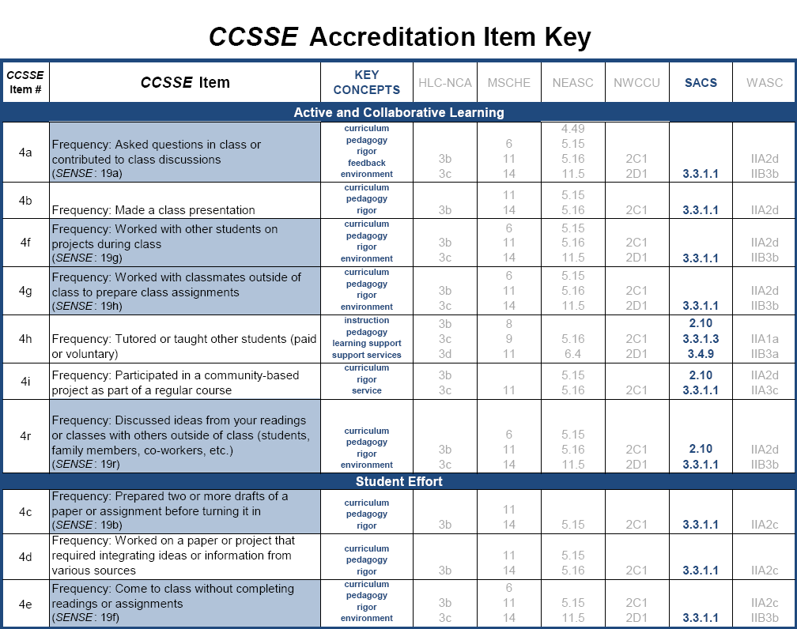
Notes:
Second presenter stops

Slide 24
Accreditation Toolkits in action
Examples of survey items mapped to criteria/standards
Southern Association
of Colleges and Schools (SACS)
Commission on Colleges
The Principles of Accreditation:
Foundations for Quality Enhancement (2010)

Slide 25
SACS Principles of Accreditation
Which do
CCSSE & SENSE support?
ü
Section 1: The Principle of Integrity
Integrity, essential to the purpose of higher education, functions as the basic contract defining the relationship between the Commission and each of its member and candidate institutions. It is a relationship in which all parties agree to deal honestly and openly with their constituencies and with one another.
Section 2: Core Requirements
Core Requirements are basic, broad-based, foundational requirements that an institution must meet to be accredited with the Commission on Colleges. They establish a threshold of development required of an institution seeking initial or continued accreditation by the Commission and reflect the Commission’s basic expectations of candidate and member institutions. Compliance with the Core Requirements is not sufficient to warrant accreditation or reaffirmation of accreditation. Accredited institutions must also demonstrate compliance with the Comprehensive Standards and the Federal Requirements of the Principles, and with the policies of the Commission.
Section 3: Comprehensive Standards
The Comprehensive Standards set forth requirements in the following four areas: (1) institutional mission, governance, and effectiveness; (2) programs; (3) resources; and (4) institutional responsibility for Commission policies. The Comprehensive Standards are more specific to the operations of the institution, represent good practice in higher education, and establish a level of accomplishment expected of all member institutions.
Section 4: Federal Requirements
The federal government mandates the Commission to review an institution in accordance with criteria outlined in the regulations of the 1998 Higher Education Amendments developed by the U.S. Department of Education. As part of the review process, institutions are required to document compliance with those criteria and the Commission is obligated to consider such compliance when the institution is reviewed for initial membership or continued accreditation.
ü
Notes:
Simply the practice of administering CCSSE and/or SENSE and analyzing data can answer to Section 2. However, it’s in Section 3 that individual CCSSE and SENSE items can be mapped to standards.
These summaries are paraphrased.

Slide 26
SACS Principles of Accreditation
Section 3: Comprehensive Standards
Which do
CCSSE & SENSE support?
3.1 Institutional Mission
3.2 Governance and Administration
3.3 Institutional Effectiveness
3.4 All Educational Programs
3.5 Undergraduate Programs
3.6 Graduate and Post-Baccalaureate Professional Programs
3.7 Faculty
3.8 Library and Other Learning Resources
3.9 Student Affairs and Services
3.10 Financial Resources
3.11 Physical Resources
3.12 Substantive Change Procedures and Policy
3.13 Compliance with Other Commission Policies
3.14 Representation of Accreditation Status
ü
ü
ü

Slide 27
CCSSE Accreditation Toolkit for SACS
3.3: Institutional Effectiveness
3.3.1 The institution identifies expected outcomes, assesses the extent to which it achieves these outcomes, and provides evidence of improvement based on analysis of the results in each of the following areas:
3.3.1.1 educational programs, to include student learning outcomes
10a Time spent per week preparing for class (studying, reading, writing, rehearsing, doing homework, or other activities related to your program)
5c Synthesizing and organizing ideas, information, or experiences in new ways
Note: This standard maps to the entire Academic Challenge benchmark (items 4p, 5b-5f, 6a, 6c, 7, 9a)
Notes:
This is one example of how a SACS standard has been aligned with CCSSE data points.
Using the Accreditation May Key for SACS, this is how we identified these alignments.

Slide 28
Notes:
And, now we can do the same mapping process with the Accreditation Item Key as our starting point…

Slide 29
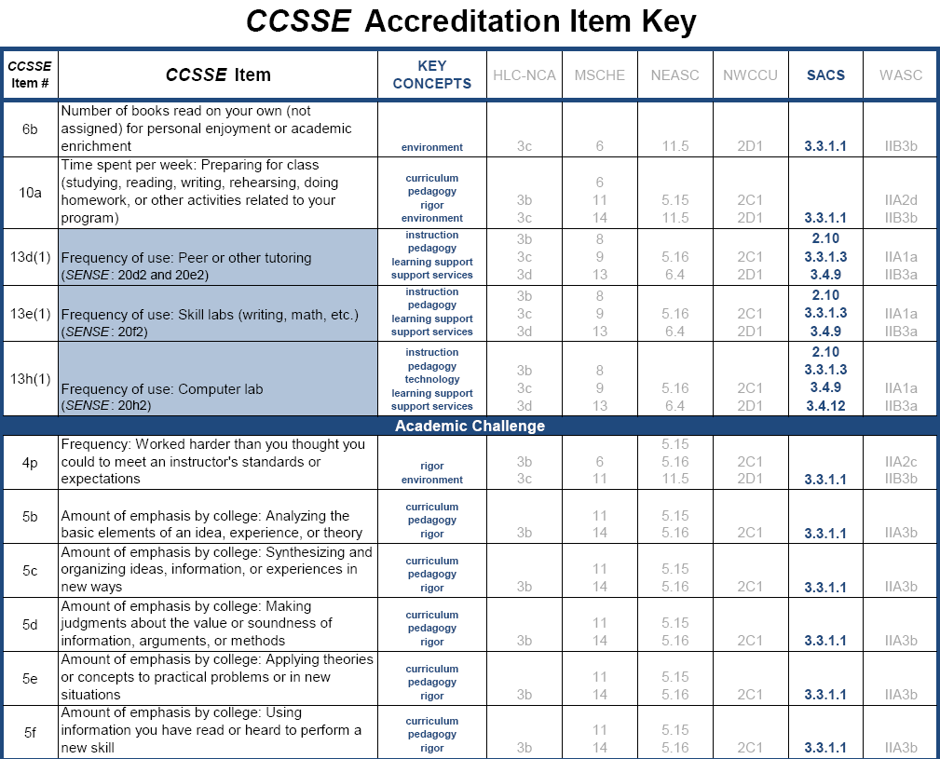

Slide 30
SENSE Accreditation Toolkit for SACS
3.4: All Educational Programs
3.4.9 The institution provides appropriate academic support services
18f An advisor helped me to set academic goals and to create a plan for achieving them
18h A college staff member talked with me about my commitments outside of school (work, children, dependants, etc.) to help me figure out how many courses to take
Note: Many times, criteria/standards map to an entire benchmark. In this case, it would be Clear Academic Plan and Pathway (items 18d-18h)
Notes:
Here is another example using SENSE data…

Slide 31
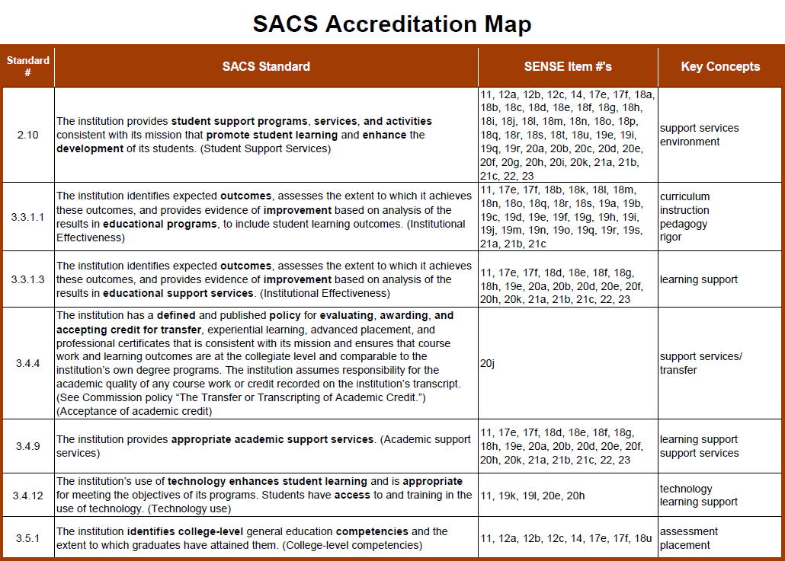
Notes:
This is how we identified the alignment on the Map.

Slide 32
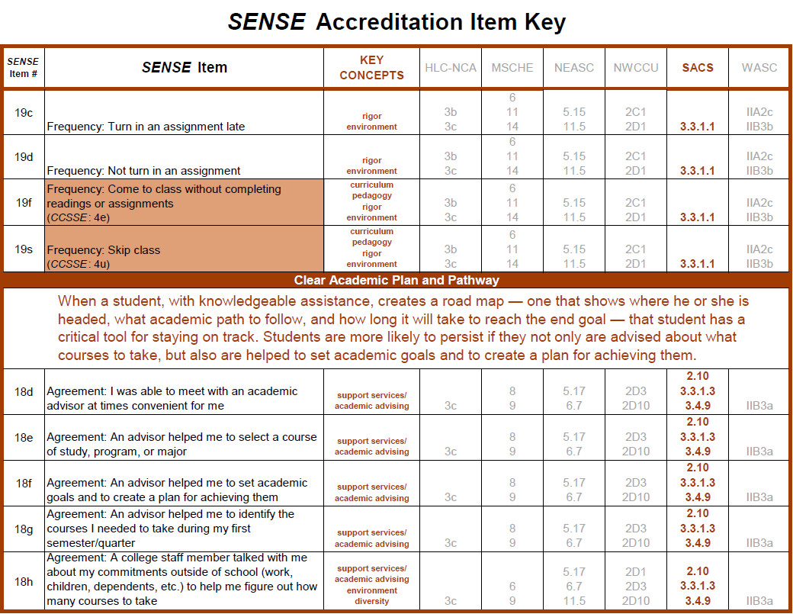
Notes:
And, on the Key.

Slide 33

The real deal…college example
Lamar Institute of Technology
Notes:
Lamar Institute of Technology is small college located in Beaumont, TX. LIT provides a curriculum consisting of more than 50 degree and certificate programs covering a wide range of career and technical educational opportunities. The college has been a member of the Center since 2004.

Slide 34
Partnership in Achieving Student Success (PASS Program)
Implemented program as part of college’s Quality Enhancement Plan (QEP) in 2005 SACS reaffirmation process
Program goal is to improve the quality of student life and learning for first-time-in-college students at LIT
Program Strategies
College Success Skills Course (CSSC)
Faculty development in Academic Advising

Slide 35
LIT participated in its initial administration of CCSSE in 2004, prior to implementation of its PASS program
Between 2004 and 2008, the college significantly increased item scores in the benchmark areas of Active and Collaborative Learning, Student Faculty Interaction, and Support for Learners
The college also improved fall to spring student retention in 2007-2008 by 5.5% and by 3% in 2008-2009.
Notes:
LIT participated in its initial CCSSE administration in 2004, just prior to the implementation of the PASS Program. This administration served as a baseline for where the college was at in terms of student engagement benchmarks.
The college then participated in CCSSE in 2006 and in 2008—seeing a significant increase in item scores in three of the five CCSSE student engagement benchmark areas, including Active and Collaborative Learning, Student-Faculty Interaction, and Support for Learners.
In analyzing other institutional data, the college also saw improvements in fall to spring student retention (see slide).

Slide 36
As a result of the QEP implementation process, LIT determined that increasing student engagement could significantly improve both the academic experience of students and the likelihood of their persistence.
In order to capitalize on gains already made from PASS, in 2009 LIT took an even closer look at the engagement levels of its first-time-in-college students by participating in SENSE.

Slide 37
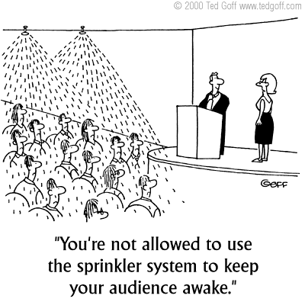

Slide 38
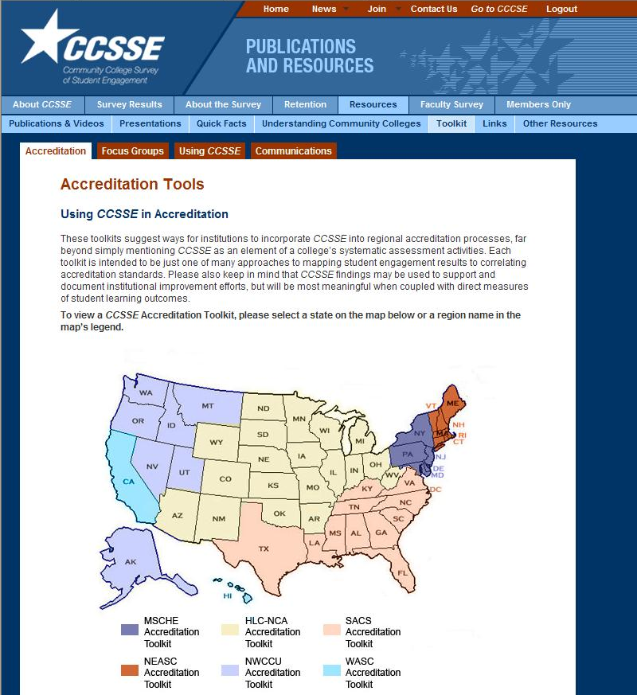
Find it online
Go to www.ccsse.org (or www.enteringstudent.org)
Click on the Resources tab, then on the Toolkit tab (automatically navigates to Accreditation, one of four toolkits)
Select your state or region

Slide 39
Please take a few moments to complete
the session evaluation.
Thank you!

