Slide 1
Perceptions of the Appropriateness of
Student Placement in English, Math, Reading, and ESL Courses at Cañada College
CAÑADA College
Planning, research, and institutional effectiveness

Slide 2
Purpose
The following describes a qualitative study in which faculty and students were surveyed to determine their perceptions of the appropriateness of students’ placement in English, ESL, Math, and Reading courses.

Slide 3
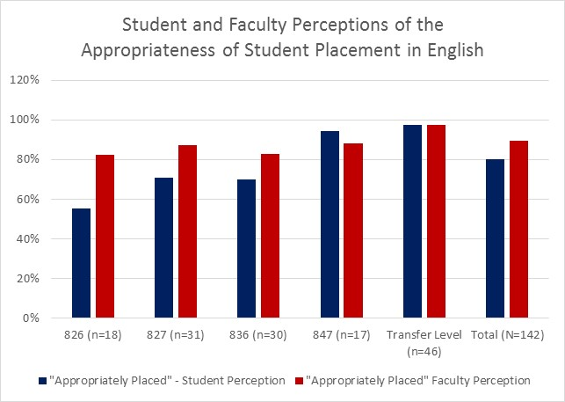
Results - English
Students indicated they were appropriately placed 80% of the time while faculty indicated students were appropriately placed 89% of the time.
Students were less likely to indicate they were appropriately placed in the lower level courses such as English 826 (56%).
2 Below Transfer
1 Below Transfer

Slide 4
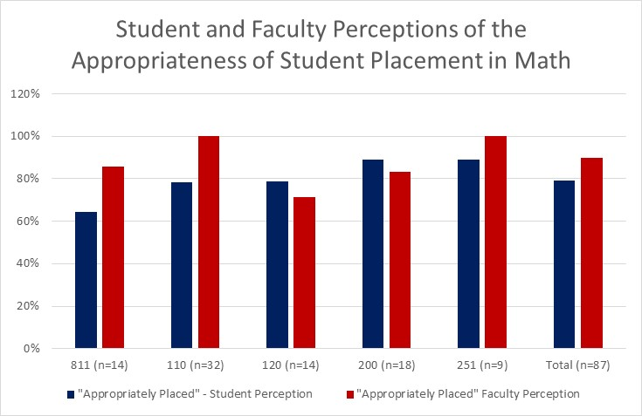
Results - Math
Students indicated they were appropriately placed 82% of the time while faculty indicated students were appropriately placed 91% of the time.
Students were less likely to indicate they were appropriately placed in the lower level courses such as Math 811 (64%). However, the samples were very small.
3 Below Transfer
2 Below Transfer
1 Below Transfer

Slide 5
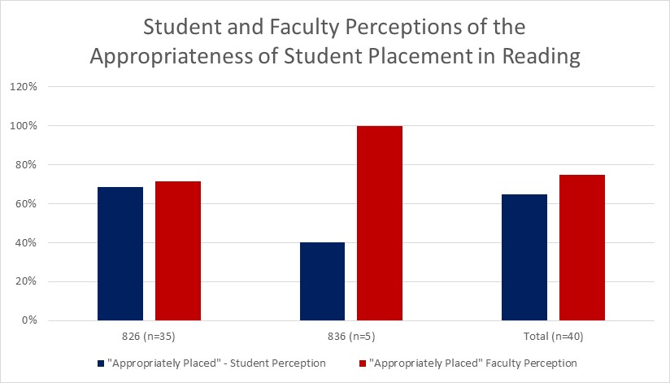
Results - Reading
Students indicated they were appropriately placed 65% of the time while faculty indicated students were appropriately placed 75% of the time.
In approximately 30% of the responses for Reading 826, faculty and students indicated students were not appropriately placed.
2 Below Transfer
1 Below Transfer

Slide 6
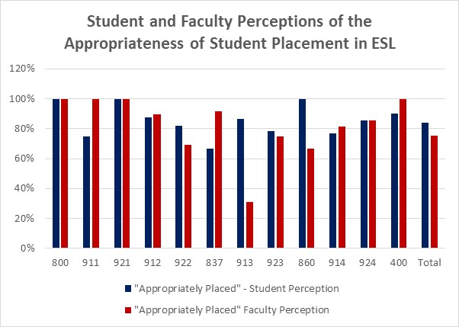
Results - ESL
Students indicated they were appropriately placed 84% of the time while faculty indicated students were appropriately placed 75% of the time.
However, the difference in perception is due in large part to results from a single course in which faculty indicated that the majority of the students were inappropriately placed.
6 Below
5 Below
4 Below
3 Below
2 Below
1 Below

Slide 7
Results
In the instances in which faculty indicated students were inappropriately placed in their English or Math course, faculty were more likely to indicate students should have been placed in a more advanced course.
In the instances in which faculty indicated students were inappropriately placed in their ESL course, faculty were more likely to indicate students should have been placed in a less advanced course.
However, if data from ESL 913 is omitted, ESL faculty were equally likely to indicate students should have been placed in a more advanced ESL course as a less advanced ESL course.

Slide 8
Recommendations
Additional quantitative research to be conducted.
  Examine correlations between test scores and success in courses.
  Compare outcomes of students who “placed” in courses to students who advanced into courses.
  Explore methods for improving placement process including the use of high school data.
  Review literature related to additional placement options.

