Slide 1
Faculty Learning Program
Ray Lapuz
Flex Day, 8/15/2020

Slide 2
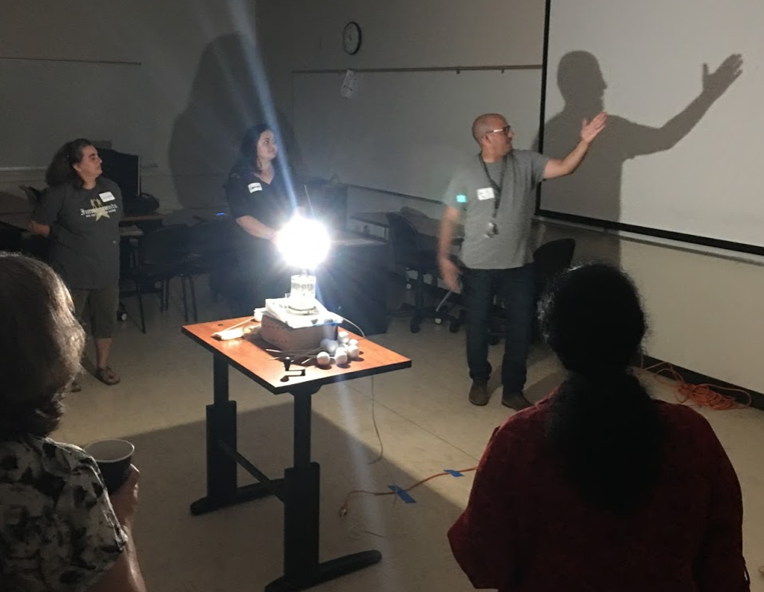
The program has the following objectives:
Deepen faculty’s understanding of how people learn
Change teaching behavior to support student learning
Engage STEM faculty in habits of reflection
Nurture a tradition of continued learning about teaching
Build a faculty learning community
Notes:
A short history:
STEM had a couple of grants where we needed to find some ideas for faculty PD. Carol Rhodes found this Faculty Learning Program from UC Berkeley and suggested that we find out more about it. Georganne got Micheal and I signed up to a “Train the Trainers” workshop.
FLP was designed to be a collaboration among STEM faculty with a hosting UC or CSU institution and some participating community college. As part of our on-ramping the program, we found some faculty to participate as we helped facilitate the workshops. I worked with CSU East Bay, and more closely with San Jose State.
The following year, we finally brought the whole program to run solely in our college. We invited non-STEM faculty to participate. We had faculty who participated with the CSU’s help facilitate.
Last year, we had our second run by Candice Nance and David Eck.

Slide 3
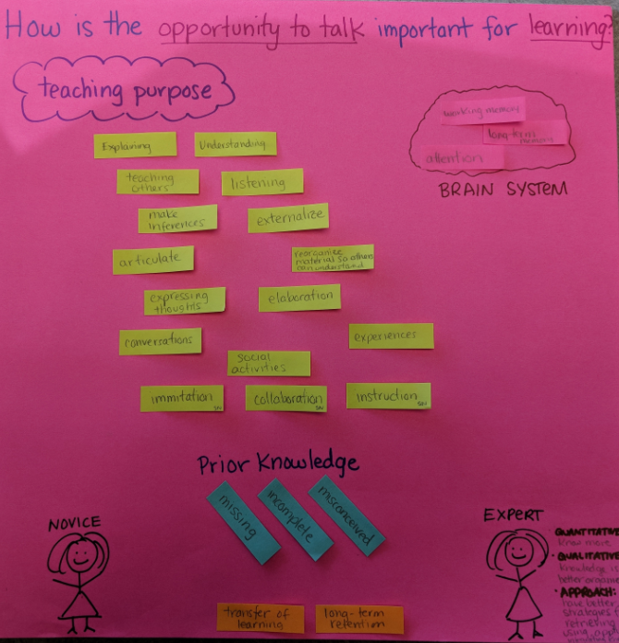

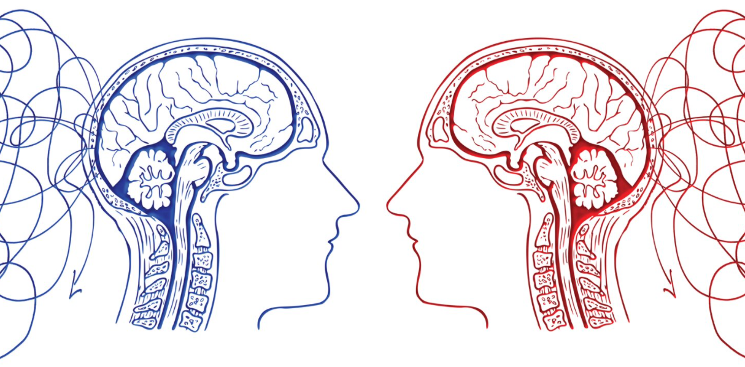
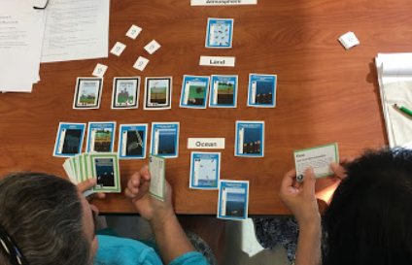
The FLP is organized into two parts that are implemented over a 10-month period during the academic year. In this way, learning activities are situated within faculty’s everyday work.
Part I: Focus and activities
Explore and discuss current research on how people learn and how to support learning
Try out and become familiar with teaching routines for active learning in your classes
New curriculum is in the designing phase to address equity issues, especially in the STEM fields.
Notes:
Module 1: Learning Conversations
Module 2: Patterns, Rhythms, and Questions
Module 3: Students’ Explanations
Module 4: Developing Expertise
Module 5: Motivational Factors in Learning
Module 6: Mindset, Help, and Stereotype
Module 7: Synthesis and Sharing

Slide 4
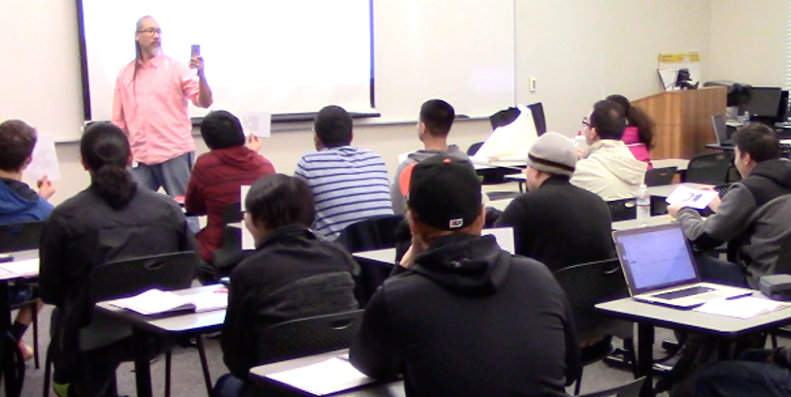
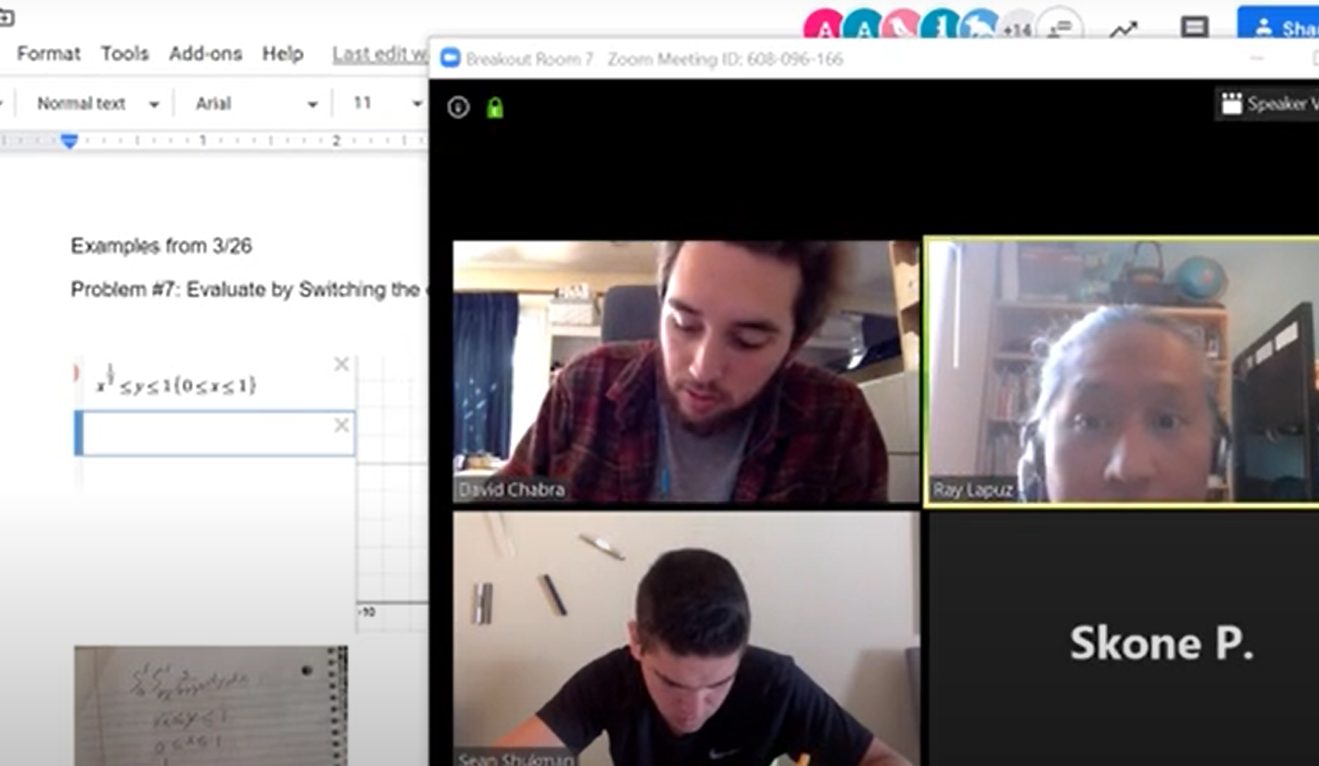
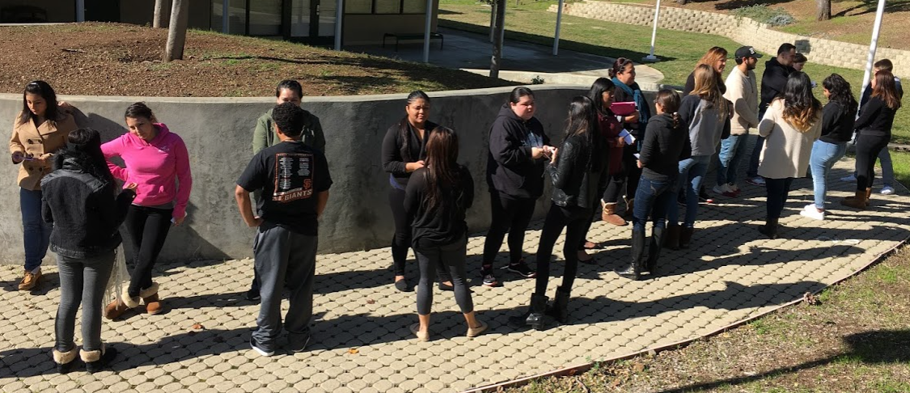
The FLP is organized into two parts that are implemented over a 10-month period during the academic year. In this way, learning activities are situated within faculty’s everyday work.
Part II: Focus and activities
Apply research on learning and teaching into redesigned course
Learn and practice skills in observing and providing feedback on teaching
Reflect on one’s teaching practice through peer observations with peers
Notes:
Backward Design
Actually Apply What You Learned to Your Own Class
Observe Other Instructors (Get ideas)
Beyond “One and Done” PD workshops

Slide 5
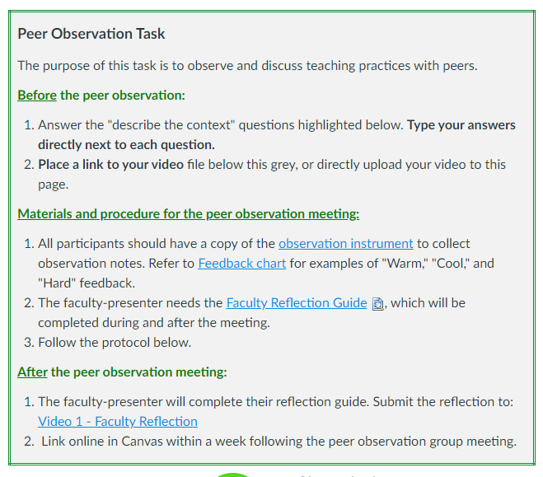
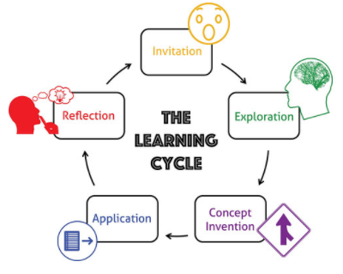
Peer Observations
Notes:
Peer Observations
Non-Evaluative Observation Process
Following Protocol
Planning, Research/Develop Lesson, Apply Lesson (video record), Evaluation, Reflect… and try again.
Conversations with Colleagues are Valuable!
Intentional Improvement

Slide 6
