Slide 1
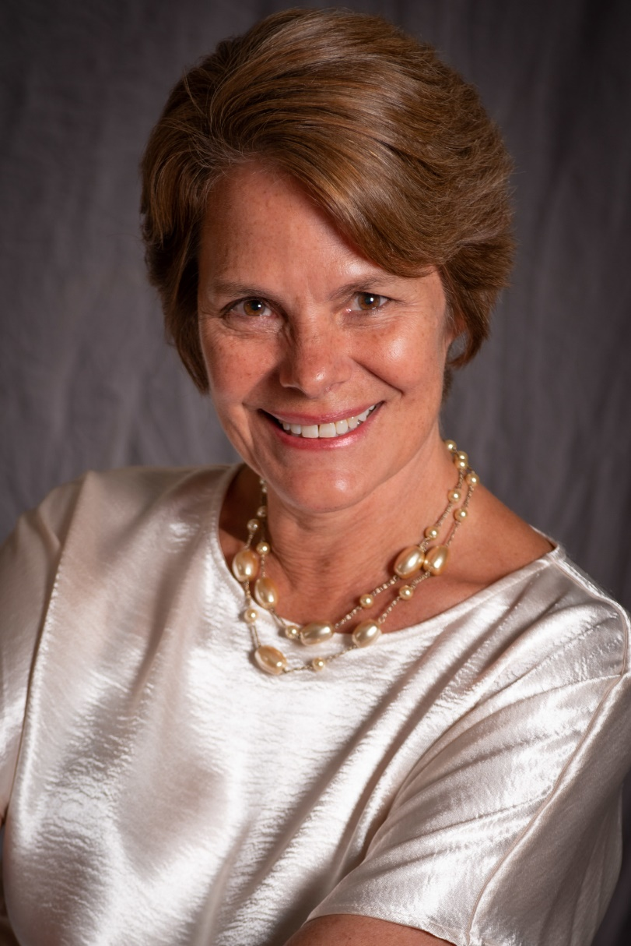
President’s Welcome
Kim Lopez
Interim College President

Slide 2
Welcome New Faculty & Staff
Claudia Alvarado - Career Resources Counseling Aide
Dr. Wissem Bennani - Interim Dean, Enrollment Services & Support Programs
Breanna Castro - Financial Aid Technical Support Specialist
Marcos Chacon, Jr. - Personal Counselor
Olivia Cortez-Figueroa - College Recruiter
Dr. Damany Fisher - Regional Director, Special Projects
Vincent Fitzgerald - Learning Center Instructional Aide II
Andrea Garcia-Rittgers - Interim Director of Financial Aid Services
Nallely Gonzalez – Welcome Center Office Assistant II
Eddy Harris - Head Men’s Basketball Coach/Kinesiology Instructor
Nicole Kelly - Regional Director, Global Trade
Kenna Klass - STEM Retention Specialist
Maria Lara-Blanco - Interim Registrar
Michael Limm - Biology Instructor
Betzaida Lomeli Lopez - Financial Aid Technician
Kristi Longoria - SparkPoint Coordinator
Kim Lopez - Interim President
Kiran Malavade - English Instructor
Jose Manzo - EOPS Counselor
Rosa Moncada – VROC/Welcome Center Program Services Coordinator
Nicolette Navarrete – DRC/PCC Office Assistant II
Jannet Rios - Dream Center Program Services Coordinator
Alessandro Riva - Web Programmer Analyst
Mercedes White - Program Services Coordinator

Slide 3

New Employee Orientation now in Canvas!
https://smccd.instructure.com/courses/33551

Slide 4
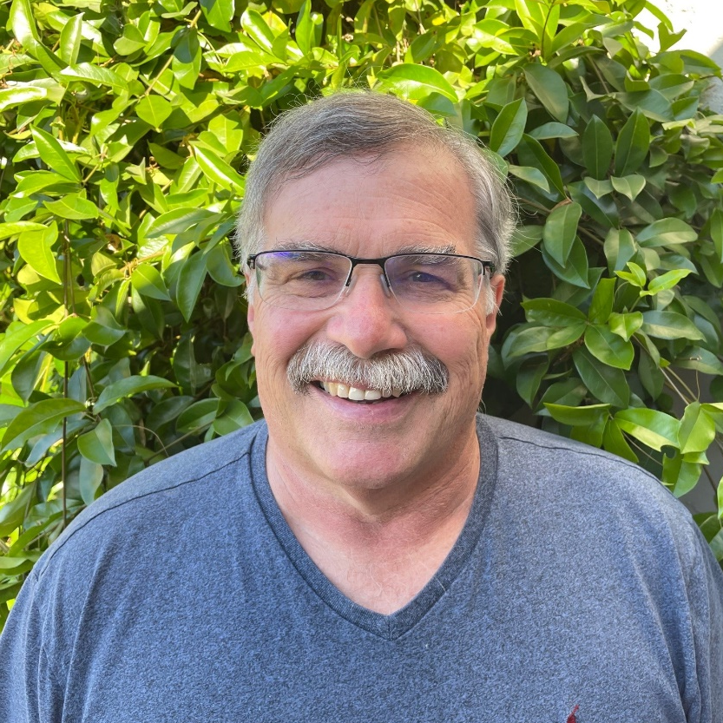
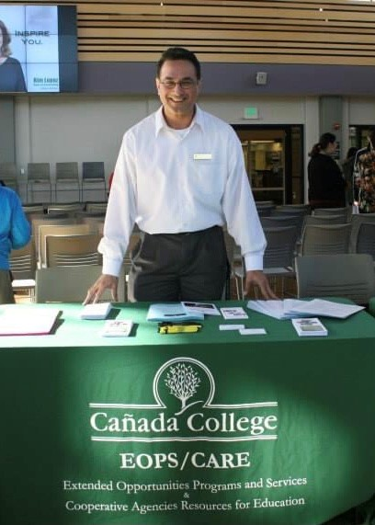
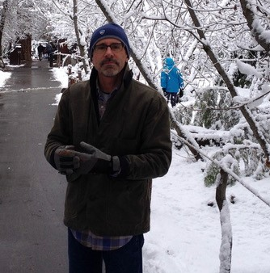
Cañada College – 30 Years Service Awards
Evan Innerst
José Romero
Paul Roscelli
Professor, Mathematics
Program Services Coordinator, EOPS/CARE/CalWORKs
Professor, Economics and Advisor, Phi Theta Kappa

Slide 5
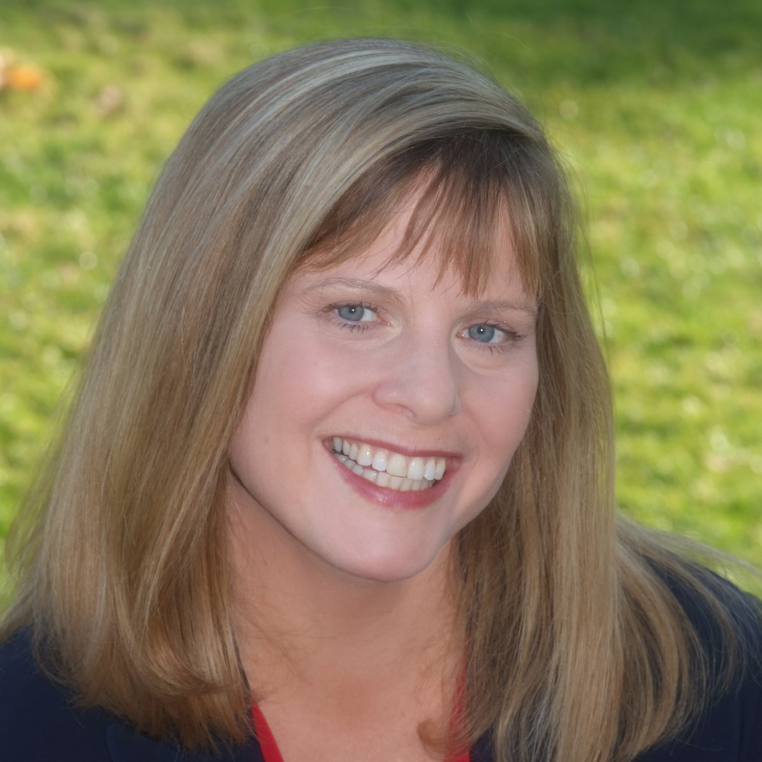
Cañada College – 25 Years Service Awards
Althea Kippes
Associate Professor, Business/Paralegal and Paralegal Program Coordinator

Slide 6
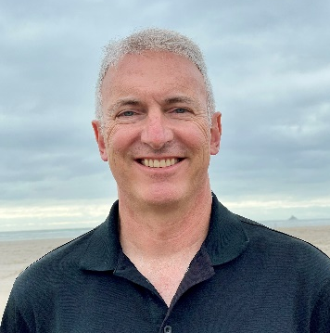
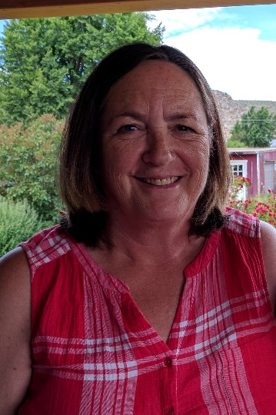
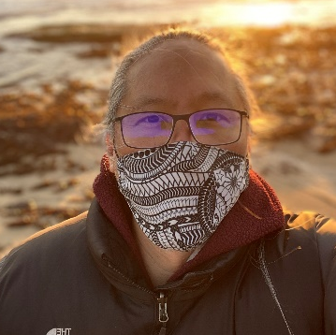
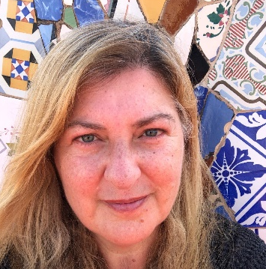
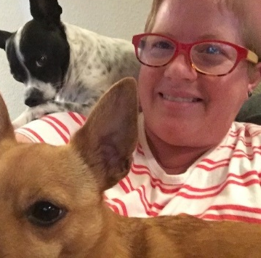
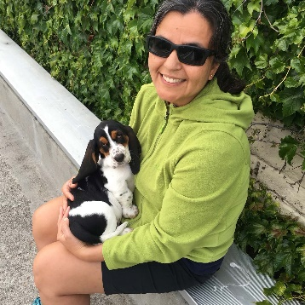
Cañada College – 20 Years Service Awards
Douglas Hirzel
Deborah Joy
Raymond Lapuz
Professor, Biology
Executive Assistant, Office of the Vice President of
Student Services
Professor,
Mathematics
Monica Malamud
Katherine Schertle
Yolanda Valenzuela
Professor,
Spanish and Linguistics
Professor, ESL
Professor, English

Slide 7

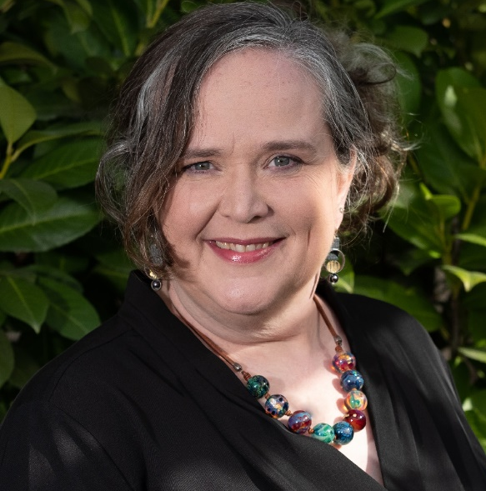
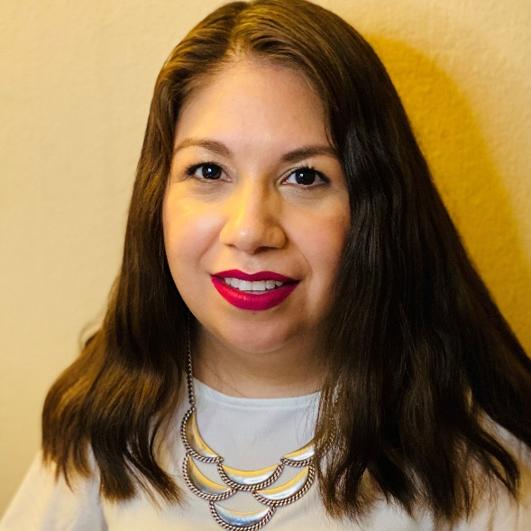
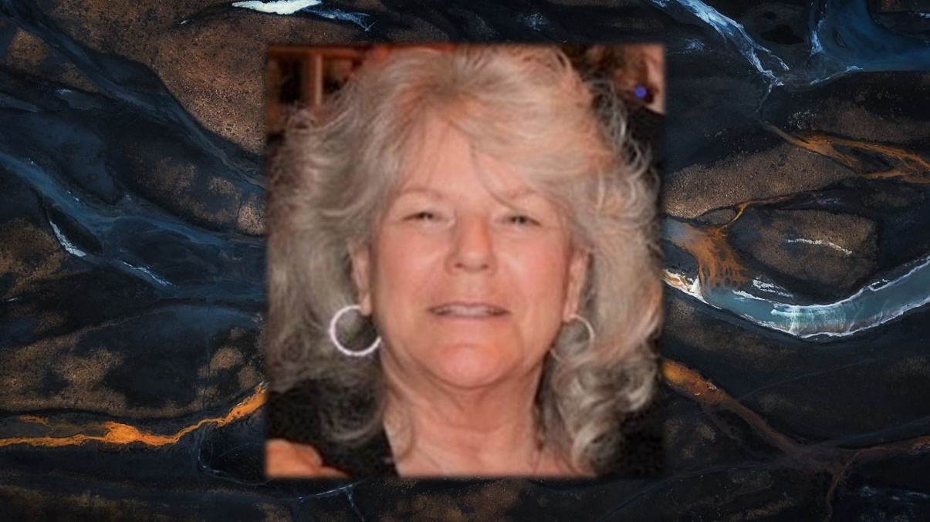
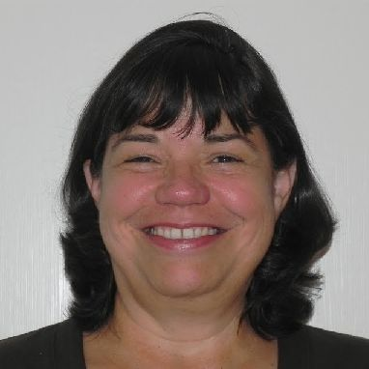
Cañada College – 10 Years Service Awards
Aricka Bueno
Hyla Lacefield
Sandra Mendez
Elsa Torres
Counselor, College for Working Adults
Dean, Business, Design and Workforce Division
Counselor
Associate Professor, Interior Design

Slide 8
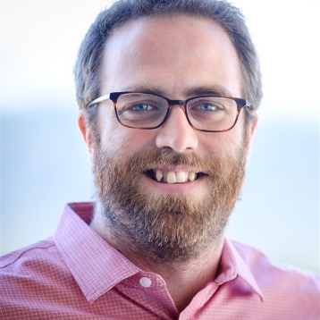
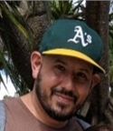
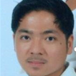

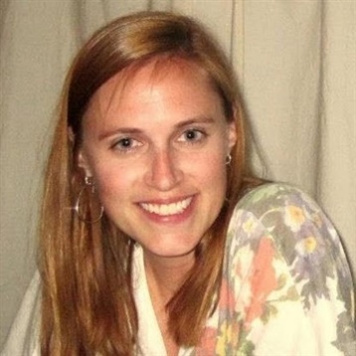
Tenured Faculty: 2020 & 2021
2020
David Eck
David Monarres
Chris Rico
Humanities and Social Sciences
Science, Technology, and Math
Counseling
2021
Sumathi Shankar
Maureen Wiley
Science, Technology and Math
Humanities and Social Sciences

Slide 9
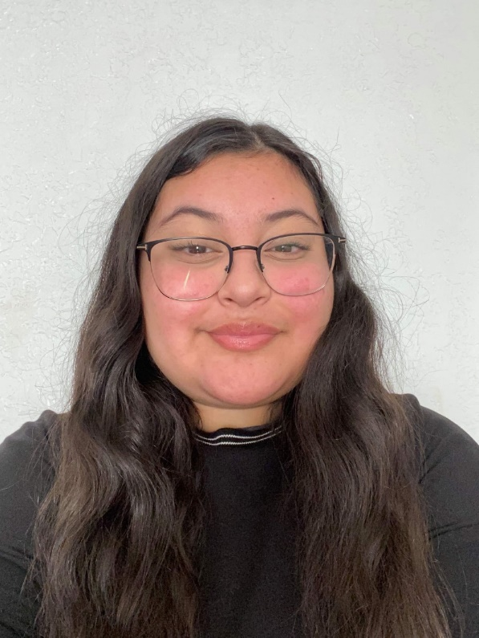
ASCC President Welcome
Xitlali Curincita
Student Senate President
Middle College Student

Slide 10

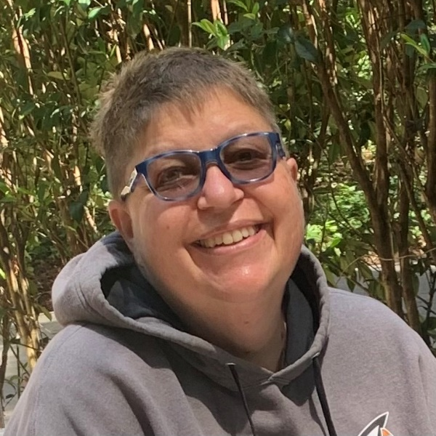
Academic & Classified Senate Presidents Welcome
& 2020-21 Highlights and Progress
Insert photo of Roz
David Eck Academic Senate President Professor, Philosophy | Roslind Young Classified Senate President Lab Technician (Sciences)

Slide 11
Total Graduates: 2020 & 2021
Note: The number of degree and certificate awards for 2020-21 are not yet final. Some award petitions are still under review. Therefore the number of graduates may still change slightly.

Slide 12
Degree Awards
Degree and Certificate Awards: 2020 & 2021
Certificate Awards

Slide 13
2020-21 Priority | Status | Highlighted Accomplishments
Improve Student Completion |  | CRM live for counseling. All support services now online.
K-12 & Adult School Partnerships |  | Two CRER and 3 ECE sections will be offered at high schools this fall.
Enhance Marketing |  | Student-led website redesign. Enrollment campaigns in two languages.
Implement Professional Learning Plan |  | 72 faculty completed QOTL. 21 faculty and staff participated in USC Racial Equity Alliance e-convenings and shared learnings at Flex. CORA Learning.
Promote a Climate of Inclusivity |  | Monthly Community Read events. New Employee Orientation. Interest Area Success Team pilot.
Institutionalize Effective Structures to Reduce Obligation Gaps |  | Interest Area Success Team pilot. Colts Con expansion. Retention Specialists formed a “community of practice” to align supports.

Slide 14
Additional Highlights: 2020 & 2021
Ethnic Studies program
  All submitted courses were transfer approved
  FT Faculty search re-starting this Fall semester
  Special thanks to Profs. Gaines, Iyenagar, Ware, Palmer, and Tedone-Goldstone. And also to former President Moore and VPAS Mendoza.
Umoja program
  Flex Day session (August 17, 1-2:30pm): Tom Dewit on “How to Umoja-ify Your Teaching”
  Special thanks to Profs. Ware, Hoffman, Terzakis, and Aranyukal. And also to Dean Carranza and VPI Robinson.
Notes:
Faculty led the launch of a new Ethnic Studies program of study and CSU approved courses for transfer
Faculty led the launch of a new Umoja program which is actively enrolling students now

Slide 15
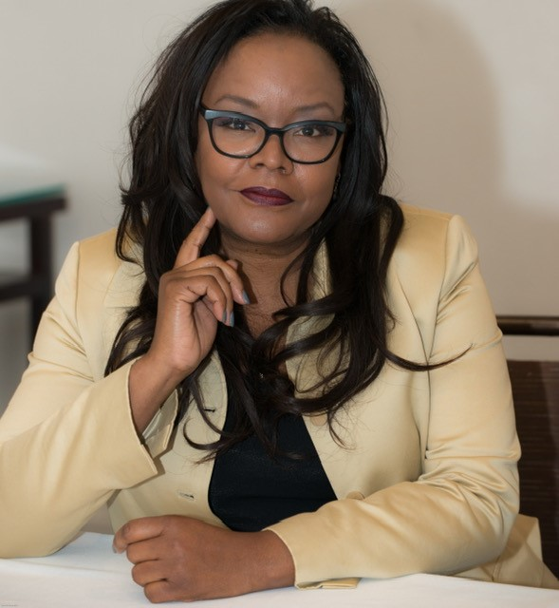
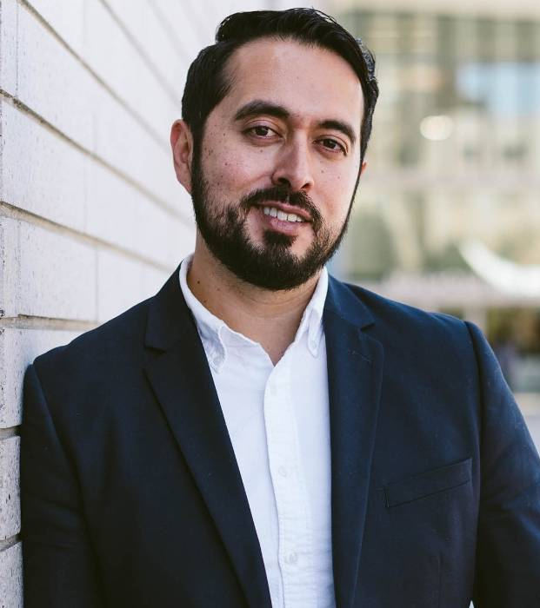
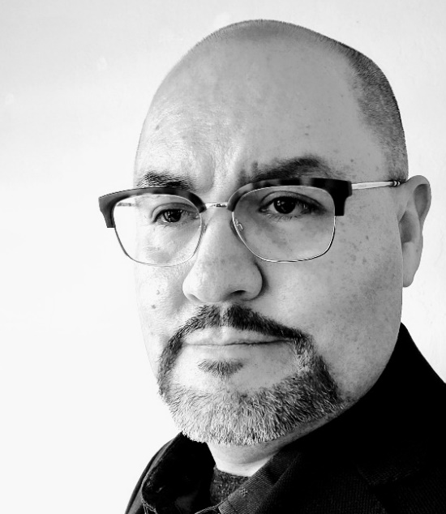
Return to Campus
Tammy Robinson Vice President of Instruction | Manuel Alejandro Pérez Vice President of Student Services | Graciano Mendoza Vice President of Administrative Services

Slide 16
Return to Campus
Returning On-site.
  Administrators, Managers and Supervisors
  Classified Personnel
  Faculty
Vaccines are Required.
Face Coverings are Required.
Buildings are Cal/OSHA Compliant and Clean.
Personal Protective Equipment available from the campus Public Safety Office.
Requesting Accommodations.
DISTRICT Return to Campus website:
https://smccd.edu/return-to-campus/index.php

Slide 17
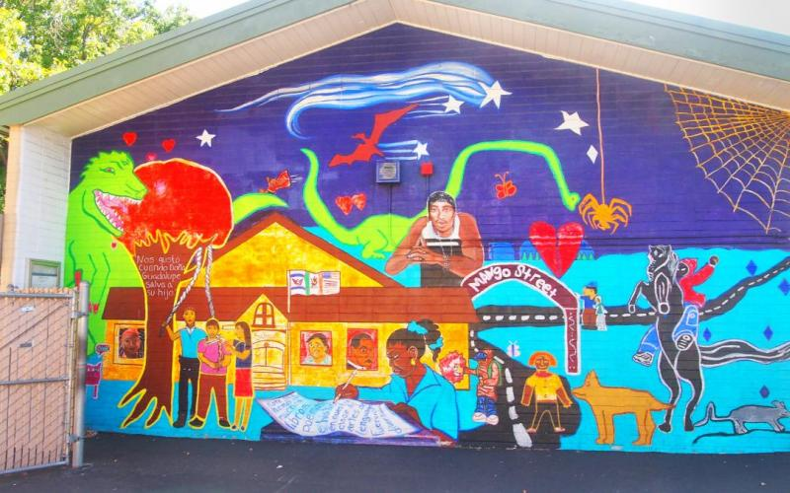
Recovery with Equity: Our Community
A two-tiered pandemic
  Upper income workers mostly remained employed and are now seeing dramatic wage increases
  Lower income workers saw steep employment declines and now more modest wage increases
  13.7% of San Mateo County rental households were behind on paying rent as of early July.
  San Mateo County has experienced the largest increase in food stamp enrollment in the state since January 2020, with a 41 percent jump in the number of people here relying on CalFresh.
North Fair Oaks Mural depicting the history of the area
Sources: https://patch.com/california/sanbruno/time-bomb-ticking-see-rental-arrears-san-mateo-county; https://www.nytimes.com/2021/08/10/us/bay-area-hunger-problem.html

Slide 18
Redwood City & North Fair Oaks Community Needs Assessment: Key Takeaways
HEALTHCARE INSECURITY
Always has been high (20-25%) but has not increased as much as other unmet needs since COVID.
FOOD INSECURITY
Increased dramatically and remains relatively high (15%), despite widespread awareness of multiple services.
HOUSING INSECURITY
Affects one-third of renters (30-35%), with a small but meaningful portion (7%) under eviction threat.
Spanish language respondents are six times as likely to be food insecure and twice as likely to be housing insecure
Source: Community Survey conducted spring 2021

Slide 19
Equity & Antiracism: Guided Pathways
Creating a sense of belonging and connection
DIGITAL DIVIDE
Most pronounced for high-quality technology, for example:
Lack of installed internet (15-30%)
Lack of a home computer (20-40%)
DISTANCE LEARNING
Top challenges include:
Lack of private workspace (22%)
Insufficient support from teachers or school staff (20%)
Source: Community Survey conducted spring 2021

Slide 20

Equity & Antiracism: Guided Pathways
Creating a sense of belonging and connection
SECOND SHIFT
Most full-time workers (55%) are caring for children more than 8 hours a day.
INCOME
Unemployment and furlough rates have doubled since COVID.
Source: Community Survey conducted spring 2021

Slide 21
Cañada: changing enrollment patterns during COVID…
Of our home campus students, changes from Fall 2019 to Fall 2021:
ESL | 3% down from 12% (149 total in Fall 21)
Low Income | 36% down from 48%
First Time | 13% down from 16%
Continuing | 66% up from 55%
Female | 66% up from 60%; Male: 30% down from 37%
Degree/Transfer Seeking | 66% up from 60%
Exploratory | 15% down from 22%
K-12 Students | 6% down from 8%
Overall, no significant shifts or disproportionate impact by age or race/ethnicity.
However, our low income students are disproportionately Black and/or Latinx
Home campus is defined by the SMCCCD college from which the student is seeking a degree or certificate.

Slide 22
Recovery with Equity: Guidance
State & System Guidance
Cañada College Guidance
Recovery with Equity
Vision for Success: Call to Action
Diversity, Equity & Inclusion Integration Plan
Guided Pathways: more $$ and time
Student Equity & Achievement Program:
  more $$
  Center for Urban Education (CUE) feedback for our 2022-25 SEAP
College Mission, Vision & Values
Guided Pathways implementation
Student Equity & Achievement Plan
College Antiracism Task Force Recommendations
Cultural Center Focus Group Recommendations
Faculty, Staff, Student Survey Results
National Assessment of Collegiate Campus Climates (NACCC) student survey results (expected September)

Slide 23
Equity & Antiracism Area of Focus | Recovery with Equity (CA) | Chancellor’s Call to Action | College & District Antiracism TF Recs | Cultural Center Focus Group Recs | Guided Pathways | Student Equity & Achvmnt Plan | EMP Strategic Initiative | Progress last year
Hiring | X | X | X | X |  |  |  | X
Professional Development | X | X | X | X |  |  |  | X
Create a sense of belonging | X |  |  | X | X | X |  | X
Ensure channels for safe reporting and addressing instances of microaggression, harassment or discrimination | X |  | X | X
Re-envision curricula across disciplines to be antiracist and equity-centered | X | X | X
Integrate work-based learning throughout the disciplines | X |  |  |  | X | X
Work with our K12 partners to identify and dismantle barriers to A-G and early college course completion for all learners | X |  |  |  | X | X | X | X

Slide 24
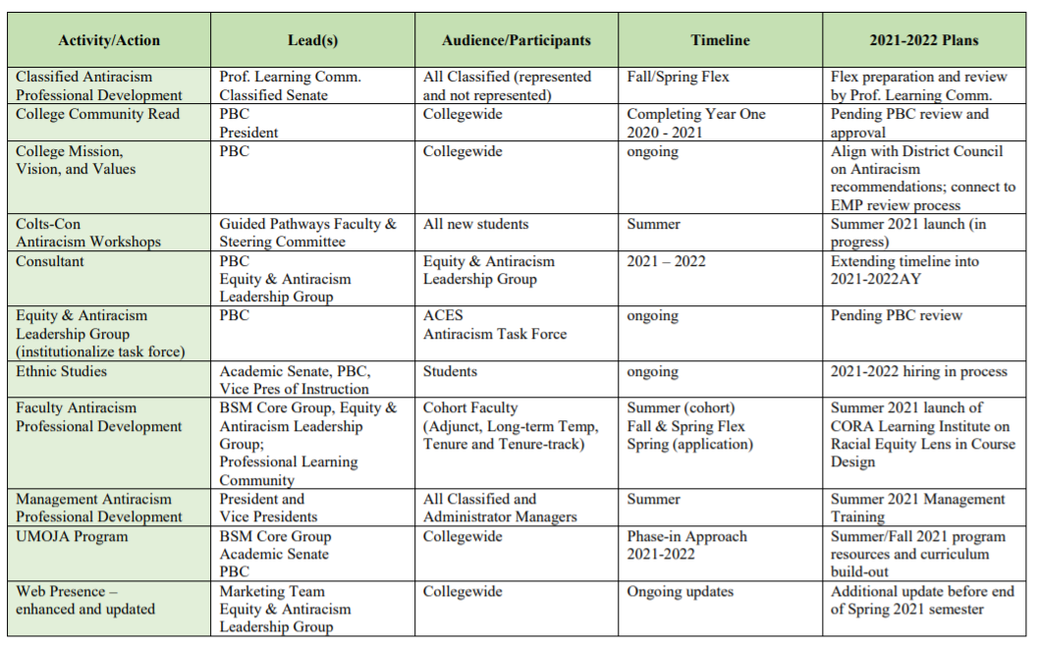
Cañada Antiracism Task Force Recommended Actions
(approved by PBC)

Slide 25
District Antiracism Council
The SMCCCD Antiracism Council is focusing on three areas:
District Policies and Procedures like the District’s mission, vision statement and common antiracism glossary.
Curriculum, infusing cultural relevant teaching in curriculum, audit of curriculum courses.
Equal Employment Opportunity focusing on antiracism professional development courses for employees known as IDEAL – Inclusion, Diversity, Equity, Antiracism Leadership. Employees will be able to take courses that enrich their understanding of the above areas and how to incorporate them into practice.

Slide 26
Other Campus Efforts
Antiracism Foundational Workshop for Students (Colts Con 2021)
ACES Professional Development Cohort about “Course Design on Racial Equity” by Center for Organizational Responsibility and Advancement (CORA)
To build a culture of inclusion:
  Latinx Heritage Month month-long programming (2020 and 2021)
  Black Heritage Month programming (Dr. Cornel West)
  Personal pronouns updates for rosters and Banner platforms
  Antiracism Community Read
  Expanded Safe Zone to include student sessions in addition to faculty/staff/managers, and intentional focus on antiracism
New Ethnic Studies program and faculty hire
New Umoja program
Antiracism Task Force at College; Connection to District Antiracism Council
Year-long participation (2020-21) in the California Community College Race and Equity Alliance organized by USC Race and Equity Center: e-convenings in which 35 faculty and staff participated

Slide 27


Cultural Center Focus Groups
Cañada College
August 17, 2021
Speakers
Michelle Simotas, CLP
Luis Chavez, CLP
Julian West, CLP

Slide 28
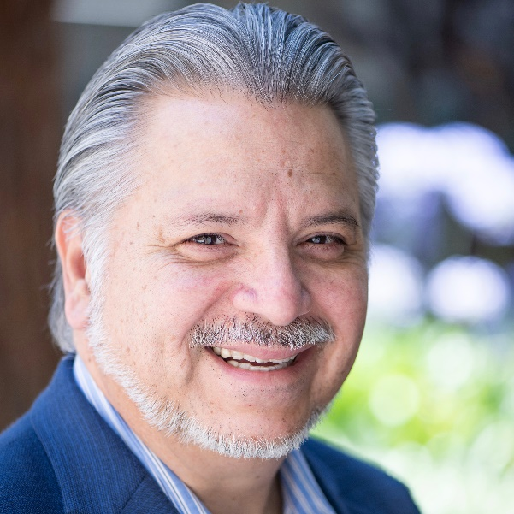
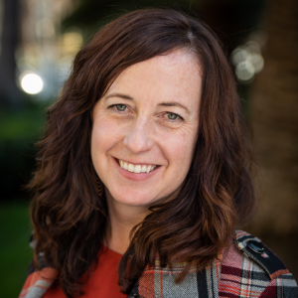
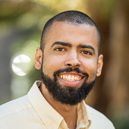
CLP Team
Luis Chavez
Senior Director
Michelle Simotas
Director
Julian West
Director

Slide 29

About CLP
Career Ladders Project promotes equity-minded
community college redesign.
We collaborate with colleges and their partners to
discover, develop, and disseminate effective practices. Our policy work, research, and direct efforts with colleges lead to system change—and enable more students to attain certificates, degrees, transfers, and career advancement.

Slide 30
Purpose of the Focus Groups
The goals of the focus group were to develop a better understanding of the needs of the college community
This will support the college to move forward to:
Create a cultural center on campus
Be more supportive of racial and ethnic groups represented in the community
Be more intentional in the anti-racist work at the college

Slide 31
Focus Groups
Hispanic/LatinX
Black/African American
Asian American/Asian American/Pacific Islander
LGBTQI
Immigrant/Migrant/ International
General/non-specific
24 students
3 faculty
10 staff

Slide 32
Key Findings
Black/African American students, students, faculty, and staff
Shared feelings of disenfranchisement, lack of community, and lack of representation.

Slide 33
Key Findings
Immigrant/Migrant/International
Shared feelings of exclusion for a lack understanding around events, words, or phrases considered racist.

Slide 34
Key Findings
Hispanic/LatinX
Expressed a need to develop cultural competency in the college community around mixed race and intersectional identities

Slide 35
Key Findings
Asian American, Native American, and Pacific Islander
Expressed concern that their culture is overshadowed, especially Native American culture, by those with larger representation

Slide 36
Recommendations for the Cultural Center
Dedicate resources to support the Black/African American community
Plan programming, speakers, and events that address issues of racial bias and racial discrimination
Hire and train a diverse team of student ambassadors and mentors
Hire dedicated staff to make the cultural center a warm and welcoming place on campus

Slide 37
Recommendations for the Cultural Center
Provide all staff with diversity and inclusion training the equips them to manage situations where anti-blackness and microaggressions occur.
Leverage the cultural center as a place to develop student leaders.
Gather more input and feedback on the visual representations of cultures for the cultural center and campus.
With a cross-functional and racially diverse team of students, faculty, and staff, explore cultural centers at other colleges to gather ideas about aesthetic, programming, values, and management.

Slide 38
General Recommendations
Explore ways to make the college campus more visually welcoming and inviting to the diverse community through murals and activities that represent and appreciate the cultures of the student body.
Dedicate resources for faculty professional development on supporting diverse students in the classroom.
Explore ways to revise faculty and staff hiring practices that recognize both traditional and nontraditional experiences and qualifications to ensure a diverse pool of faculty and staff applicants.

Slide 39




LChavez@careerladdersproject.org
MSimotas@careerladdersproject.org
Thank you!
www.careerladdersproject.org

Slide 40
Thank you to the more than 40 faculty, staff and student leaders who participated in our Leadership Retreat this year!
Held on Zoom on August 11 & 12, 2021
All materials are posted here: https://canadacollege.edu/plans/leadership-retreat.php
Leadership Retreat Report Out

Slide 41
This year we propose a focus on
“Recovery with Equity” that, with equity and antiracism as our overarching priority, builds on and helps fully implement our existing strategic initiatives
Leadership Retreat Report Out

Slide 42
Proposed priority…
supports these EMP strategic initiatives
Improve our internal policies and processes
Promote a climate of inclusivity
Institutionalize effective structures to reduce obligation gaps
Fully implement all aspects of Guided Pathways
Implement Guided Pathways
Develop clear pathways
Focus on key aspects of strategic enrollment management to enhance equity in access and completion
Improve student completion
Institutionalize effective structures to reduce obligation gaps
Implement professional learning plan
Improve student completion
K-12 & Adult School partnerships; Partner with 4-year colleges & universities
Institutionalize effective structures to reduce obligation gaps
Create process for innovation
Connect students with Internships, etc; Build relationships with employers
EMP Goal 3
EMP Goals 1,2,3
EMP Goals
1 & 3

Slide 43
Equity and Antiracism: Internal Policies and Processes
PRIORITY ACTION 1: Address diversification of faculty and staff hiring practices that recognize both traditional and nontraditional experiences and qualifications and reach out to a broader pool of applicants to ensure a diverse pool of faculty and staff applicants.
PRIORITY ACTION 2: Support faculty to re-envision curricula and pedagogy across disciplines to be antiracist and equity-centered in order to support diverse students in the classroom.
PRIORITY ACTION 3: Create an Equity and Antiracism Leadership Group to help monitor and support the implementation of the Antiracism Task Force and Cultural Center focus group’s recommendations and to remove barriers to students’ registration and enrollment, with a strong emphasis on BIPOC, LGBTQIA+, low income, disabled, undocumented and historically marginalized/minoritized students.

Slide 44
Equity & Antiracism: Guided Pathways
Creating a sense of belonging and connection
PRIORITY ACTION 1: Fully implement the Success Teams and the ability of lead faculty, retention specialists, counselors and others to ensure all students with a strong emphasis on BIPOC, LGBTQIA+, low income, disabled, undocumented and historically marginalized/minoritized students (communities disproportionately impacted during the pandemic) get consistent support and messaging across special programs and Interest Areas
PRIORITY ACTION 2: Reimagine pathways for our part-time students to ensure they feel as connected and supported as full-time students
PRIORITY ACTION 3: Support a variety of student journeys and adopt a student-centered approach to defining access and success.

Slide 45
Equity & Antiracism: Guided Pathways
Pathways from K-12 to Careers
PRIORITY ACTION 1: Orient more Cañada, K-12 and community partners about the benefits of early college experiences and dual enrollment and scale opportunities for both.
PRIORITY ACTION 2: Develop dual enrollment and early college outreach campaigns and courses to match the needs of our feeder school districts with high concentrations of Black, Indigenous and People of Color communities.
PRIORITY ACTION 3: Bring more folks to campus: Kindergarteners, Middle School students, High School students, and community members. Programs such as KinderCaminata, Cal Day, and other community oriented events build connections to the community.

Slide 46
Equity & Antiracism:
Strategic Enrollment Management
PRIORITY ACTION 1: Create a student-first course schedule that creates course taking options and flexibility (and reduces course conflicts so that students can get the courses they need). Explore course modality choices; explore moving to two, 8-week sessions per term rather than one, long 17.5 week term).
PRIORITY ACTION 2: Create more degree and certificate programs available nights, weekends, and 100% online/hyflex for cohorts of students who we support like we do College for Working Adults students
PRIORITY ACTION 3: Bolster our ability to increase the number of our home campus students who receive Pell grants. (We have about 2500 CCPG B students (2500 low income students) yet only 800 receive Pell grants).

Slide 47
2021-22 Annual Plan Next Steps
PBC to consider this set of priority actions for 2021-22 at their meetings in September
Upon approval, we move to implementing our Annual Plan!

Slide 48
Educational Master Plan Process & Timeline
Education Master Plan: 2017-2022
Year 1
2017-18
Year 2
2018-19
Year 3
2019-20
Year 4
2020-21
Year 5
2021-22
Strategic Enrollment Planning Strategic Enrollment Management Plan: 2020-23
Year 1
2020-21
Year 2
2021-22
Year 3
2022-23
College Committee Planning
Align 3-year planning as appropriate per committee
Annual Strategic Plan
(operational)
Annual Strategic Plan
(operational)
Annual Strategic Plan
(operational)

Slide 49
Educational Master Planning Process & Timeline
PBC names EMP Task Force Members
EMP Task Force evaluates 2017-22 EMP
SCUP Training in Strategic Planning
Mission, Vision, Values Update
Educational Master Plan Timeline
EMP TF considers “Internal Scan”
EMP TF considers “External Scan”
College Councils provide input on challenges and opportunities
Town Hall
Winter 2021
Spring 2021
September 2021
October 2021
EMP Retreat: Set goals and new strategies
Campus constituents provide input on draft EMP
PBC considers draft EMP
PBC adopts new EMP for 2022-27
October 2021
November 2021
December 2021
February 2022
February 2022
March 2022
April 2022
May 2022

Slide 50
EMP Task Force Information
All meetings open to everyone
Agendas, Zoom links, meeting materials and minutes are posted here: https://canadacollege.edu/emp/meetings.php
Data and other resources EMP Task Force will be considering are posted here: https://canadacollege.edu/emp/emp-data.php

Slide 51
Connecting with Our Students and Colleagues
It’s never been easier to lose sight of what matters most to us as educators
Possible goals for you to consider:
  Write a recommendation letter for one of your students.
  Write one more recommendation letter for students than you did last Fall
  Convince a student to join one of our Honors Programs
  Convince a student to become a tutor
  Convince a student to join a college community, such as ASCC or a Club
  Nominate a colleague for a statewide award or a college award
  Tell your Academic and Classified Senate officers how good of a job they’re doing

Slide 52
Campus-wide Discussion
Q&A

Slide 53

Flex Day

