Slide 1

Enrollment and Student Rosters: A Joint Effort of Student Services and Faculty

Slide 2
Outline
Context
Financial Aid Process
Census Verification
Enrollment Services Strategies to mitigate fraud
Best practice to remove inactive enrollment: faculty perspective
Q&A
  Share your questions in the chat at any point during the meeting

Slide 3
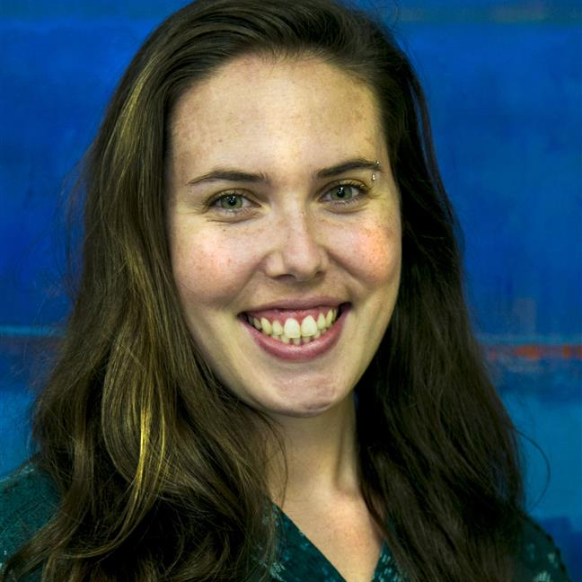
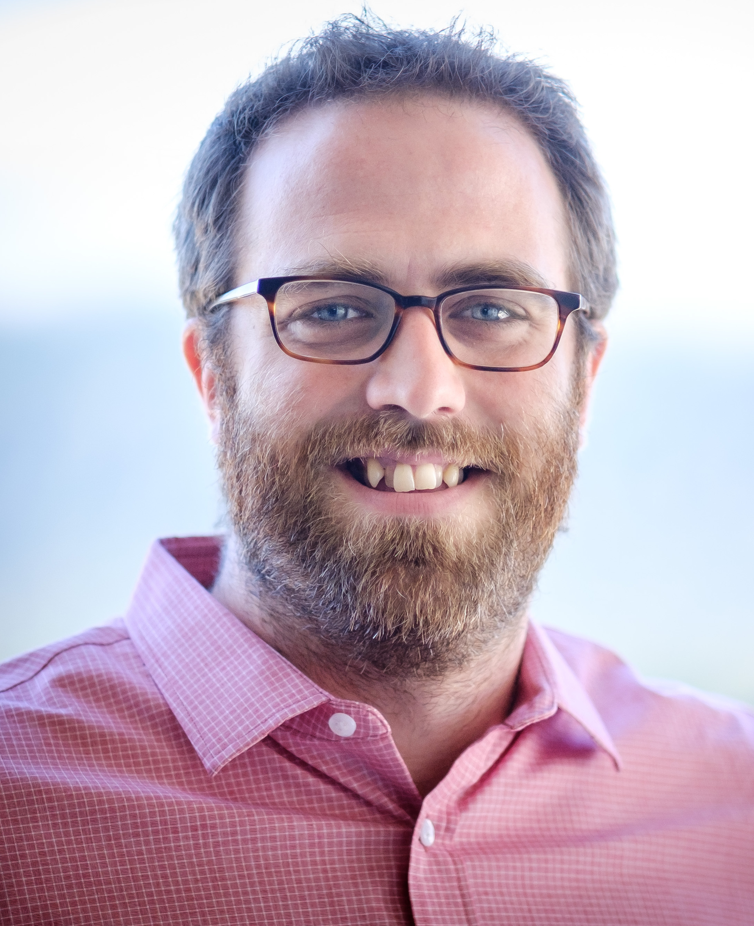
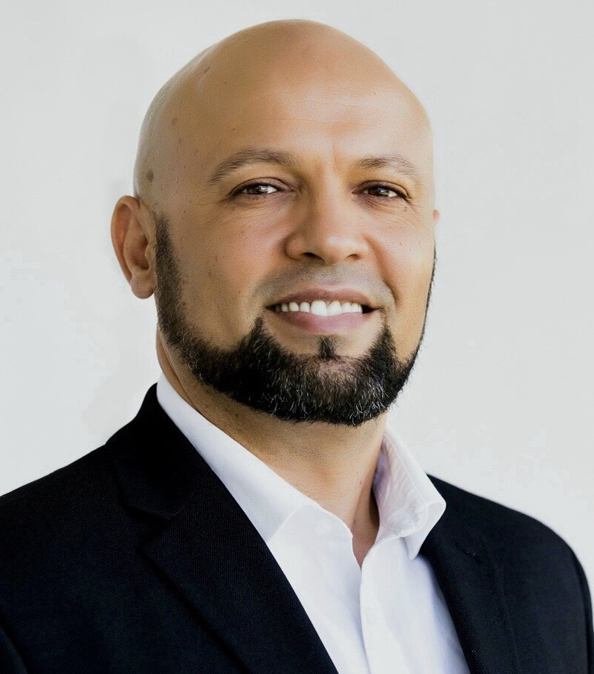
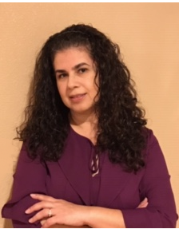
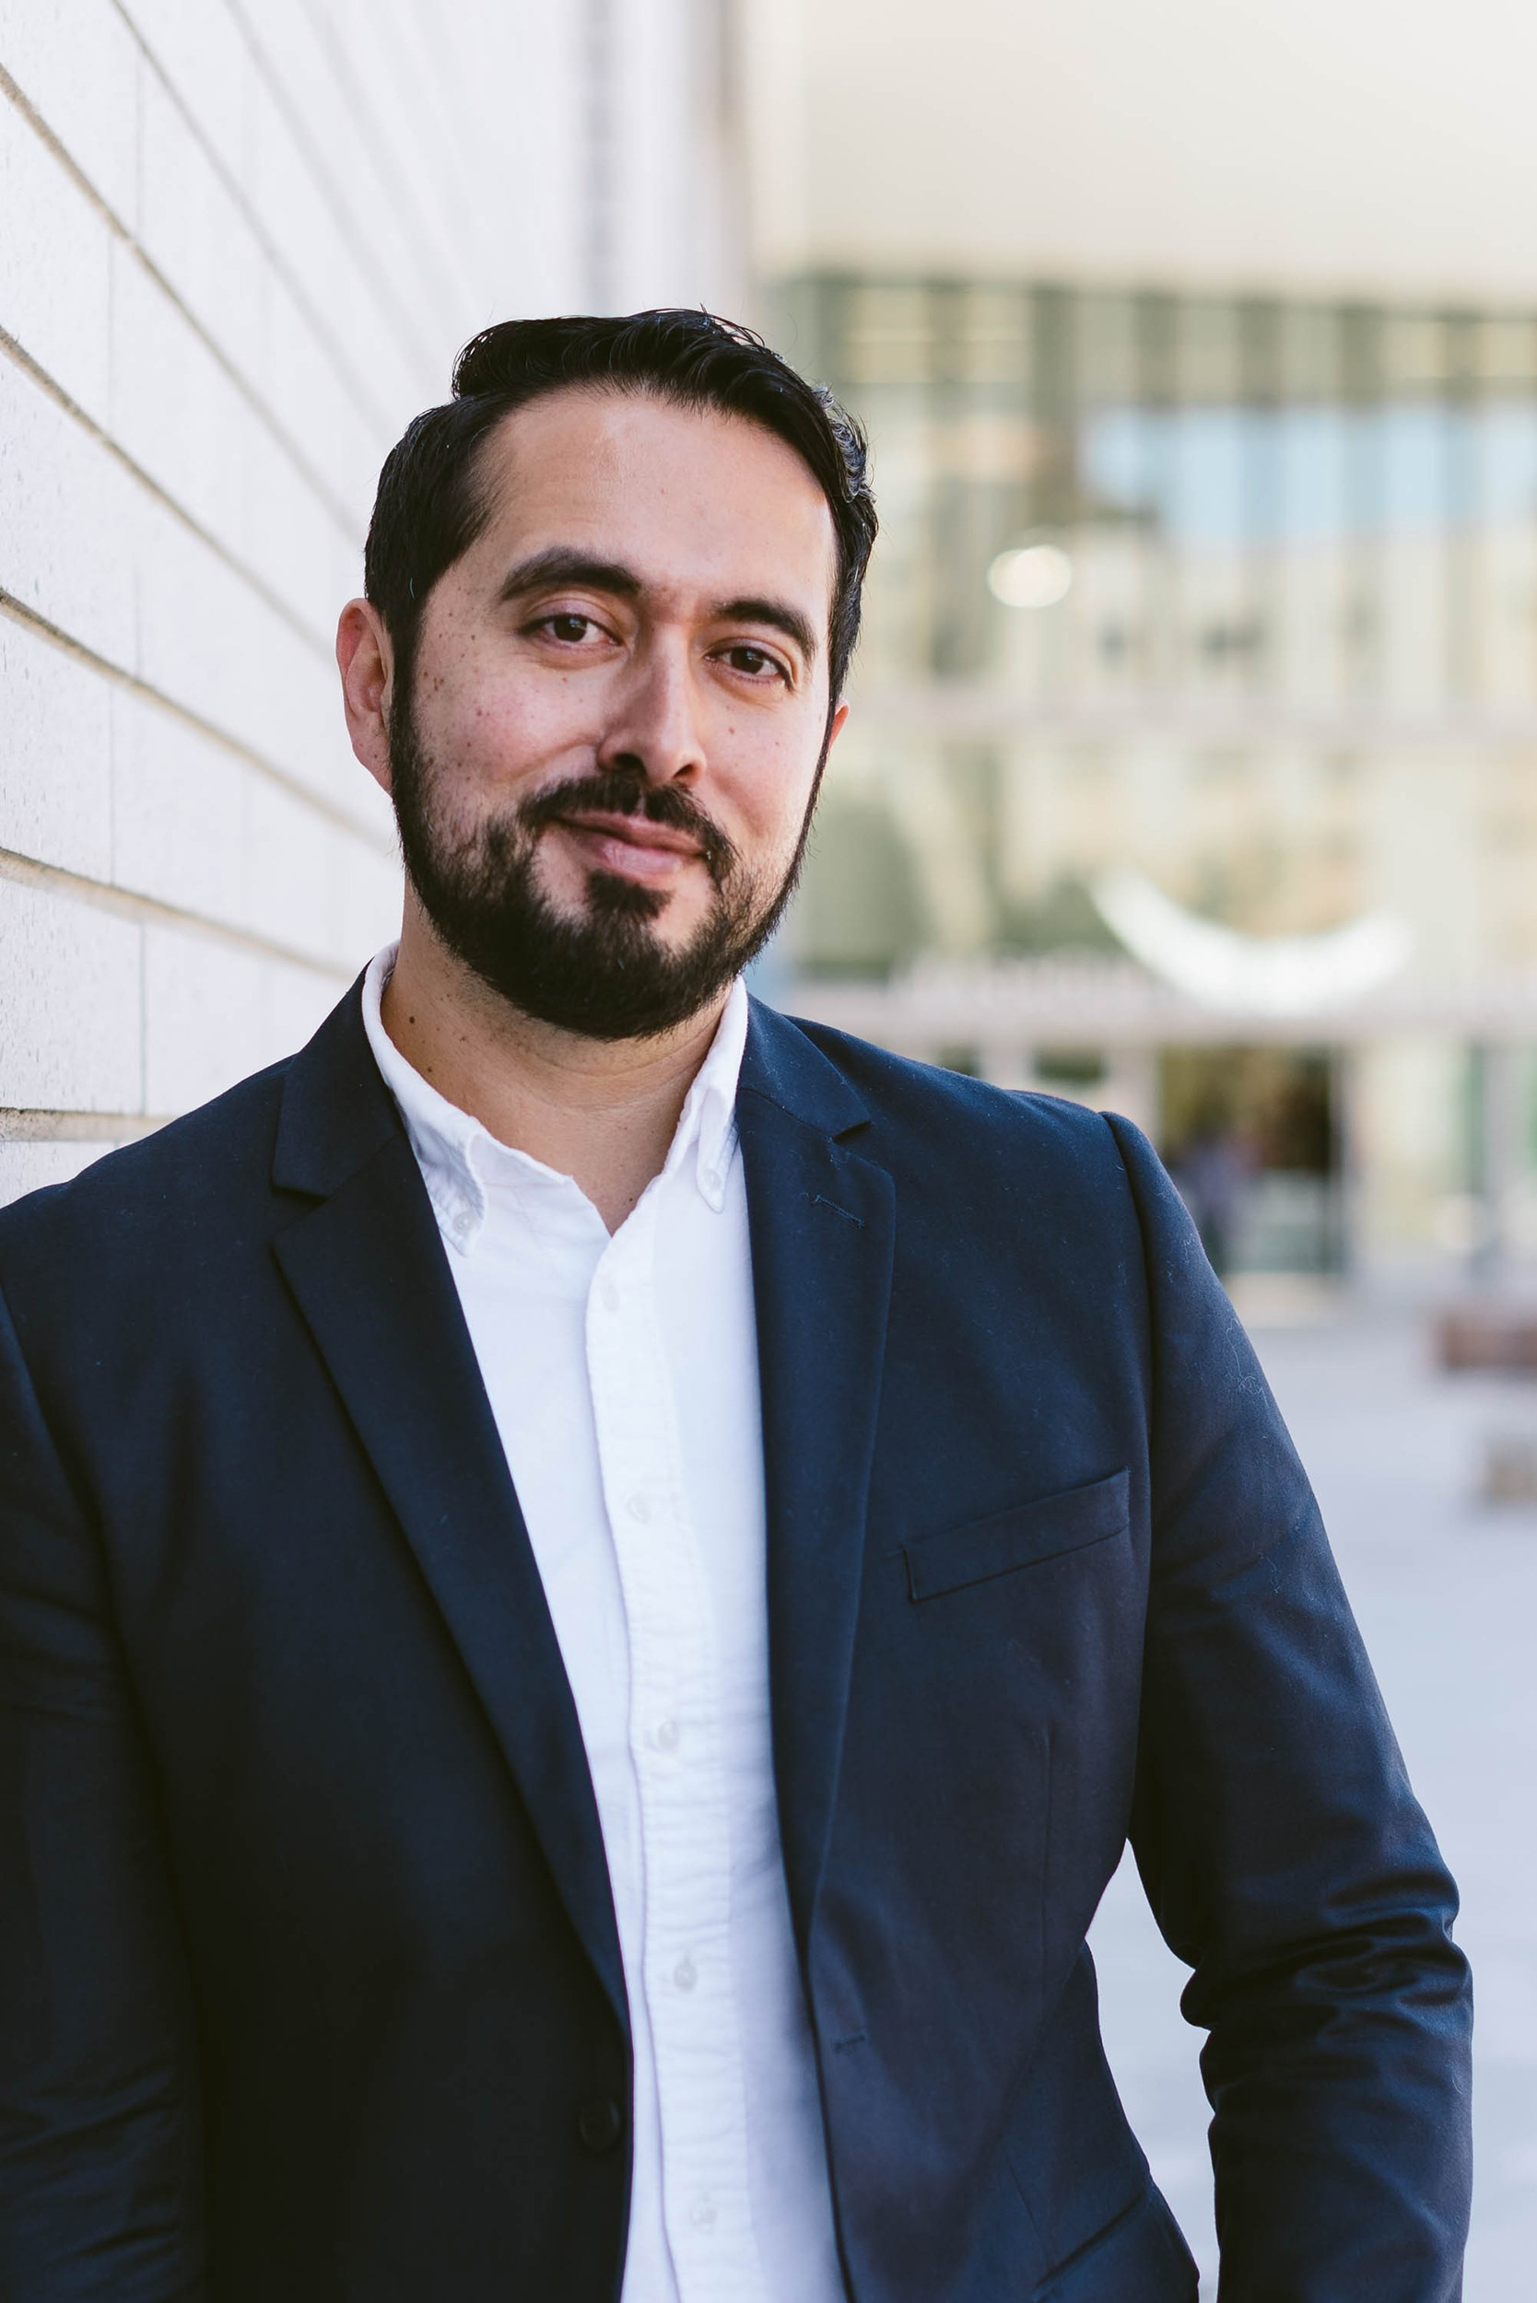
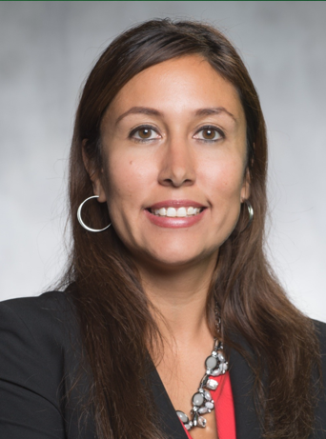
Presenter Information
 | Allison Hughes Instructional Technologist hughesa@smccd.edu
 | Dave Eck Academic Senate President, Philosophy Professor eckd@smccd.edu
 | Wissem Bennani Interim Dean, Enrollment Services and Support Programs bennaniw@smccd.edu
 | Maria Lara-Blanco Interim Registrar A&R Office lara@smccd.edudu
 | Manuel Alejandro Pérez Vice President of Student Services perezma@smccd.edu
 | Andrea Garcia-Rittgers Interim Director of Financial Aid garciarittgers@smccd.edu

Slide 4
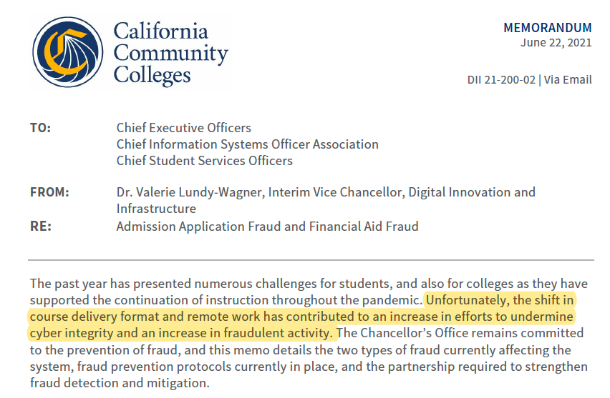
Context
Fraud Type:
Admission application fraud can occur during the creation of CCCApply
  Financial aid-related fraud can occur after the student is admitted
  Financial aid fraud is not the same as student email discrepancy from past years

Slide 5

Financial Aid Process
Steps for students to receive Financial Aid:
1. Student submits application (FAFSA or Dream Act)
2. FAO downloads their file & requests any necessary required documents
3. Student submits required documents
4. FAO reviews documents and make any necessary corrections
5. FAO Runs Satisfactory Academic Progress (SAP)
6. Student signs up for refund preference through BankMobile
7. FAO Awards students and sends award letter
8. FAO verifies units and disburses funds to students
9. Students receive refund through their preferred method with BankMobile

Slide 6

Financial Aid Disbursements
How do we disburse funds to students?
FAO Partners with BankMobile to disburse funds to students
Disbursement methods include:
1. Direct Deposit (Preferred Method)
2. BankMobile debit card
3. Paper check (Default method – don't recommend)
When are funds disbursed to students?
Disbursements depends on the funding source (1-2 times per semester)
https://canadacollege.edu/financialaid/disbursement.php

Slide 7
Importance of Census
Helps FAO identify fraud!
Minimizes the amount of funds a student may have to repay!
Minimizes the amount of institutional liabilities!

Slide 8
Census Verification
What is “Census”?
The California Code of Regulations, Title 5, requires districts to “clear the rolls of inactive enrollment” as of the day before the census day for all students.
What is my role as faculty in monitoring enrollment?
As faculty, you play an important role in determining which students are not active or no longer active in your course, especially at the start of the term or session. It is vital you remove non-attending students by census day.
According to Title 5, 58004: “Inactive Enrollment" in a course, as of each census day or date, is defined as any student who, according to published college regulations, has
Been identified as a no show, or
Officially withdrawn from course, or
Been dropped from course. A student shall be dropped if no longer participating in the course, except if there are extenuating circumstances.”

Slide 9

Need to reinstate your student?
Don't Panic! It is as easy emailing Maria Lara.
Just include the following information:
  Student Name
  Student G number
  Course Number
Lara@smccd.edu

Slide 10
Strategy to mitigate admission application fraud
Spam Filter Web Service
  Applications set with “Checked Fraud” are sent to the Suspension folder (User Interface) awaiting confirmation by A&R Staff
A&R staff review the applications in the SPAM folder
  Request additional documentation if necessary to confirm the status of the application
  Confirm the fraud status for each application

Slide 11
Strategy to mitigate financial aid-related fraud
ITS extracts data and looks for "identifiers”
example: out of area address, no phone number, no home address, G# in certain sequence, no emergency address…
ITS adds holds to stop disbursement and future registration
Financial Aid email students to confirm identity prior to the release of funds and registration holds
Report suspected Title IV (FA) fraud to the U.S. Department of Education’s Office of Inspector General (OIG)
Faculty drop inactive students
  It is vital that faculty remove non-attending students by the Census date to significantly reduce the likelihood that financial aid is disbursed fraudulently.

Slide 12
Summer/Fall data
 | Summer 2021 | Fall 2021
Total student enrollment by term Y (headcount) | 2,763 | 4,891
Unconfirmed records not registered for courses | 234 | 250
Unconfirmed records registered for courses | 72 | 69
Students required to submit additional identification records | 12 | 7

Slide 13
Best practice to remove inactive enrollment: faculty perspective (5 min)
Start of semester email/message
  Communicate importance of "showing up" for the course
Identify Active Students
  Asynchronous classes: Create an introductory assignment due no later than second week
  Synchronous classes: Sign-in sheet, student SMCCD email login to a Zoom class, or intro assignment
Drop any inactive students by Census date
  When providing an add code to a student, emphasize importance of "showing up" for the course
After Census: Monitor class roster for non-attending students by Withdraw date
  In this context, non-attending = no longer completing any assignments or other course activities
  If a student disappears, email them a drop warning 5-7 days before dropping them

Slide 14
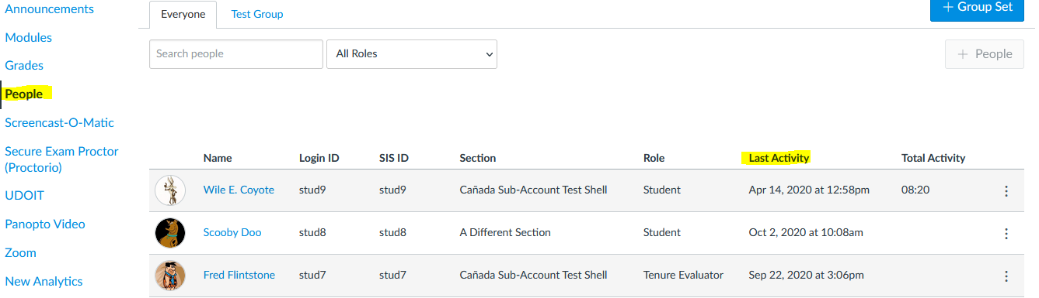
Canvas: Check Last Activity Date
In your Canvas course, click on People on the left and check a student's last activity in the Last Activity column. If the column is blank, the student hasn't logged in to the course yet.

Slide 15
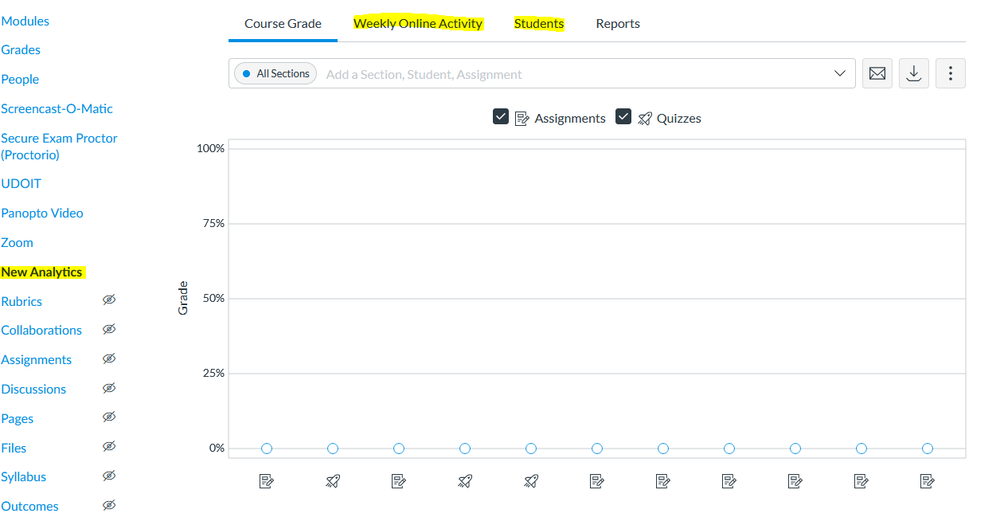
Canvas: See Participation in New Analytics
If you don't see New Analytics in your course navigation, go to Settings > Navigation to enable New Analytics in your course.
Click on New Analytics on the left to see detailed reports of students' participation in your course. Click on the 'Weekly Online Activity' and 'Students' tabs to see more information.

Slide 16
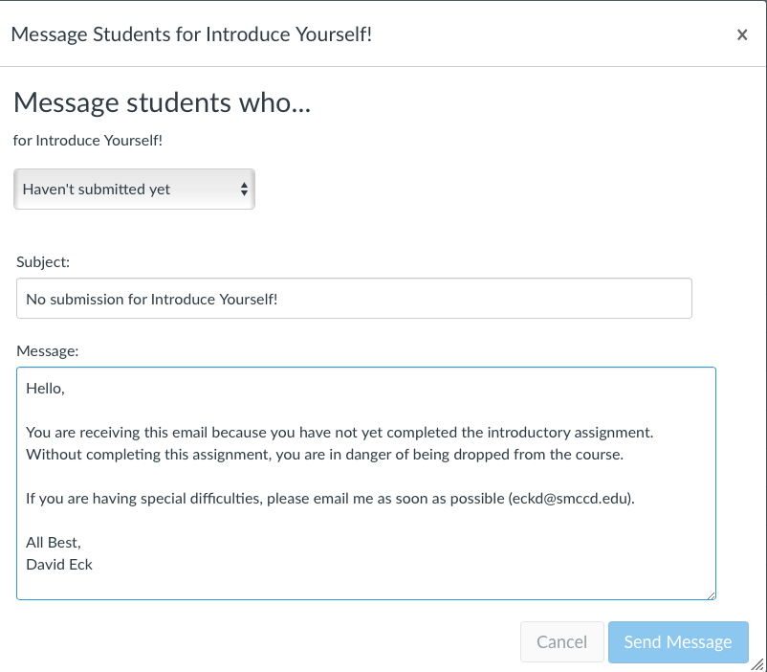
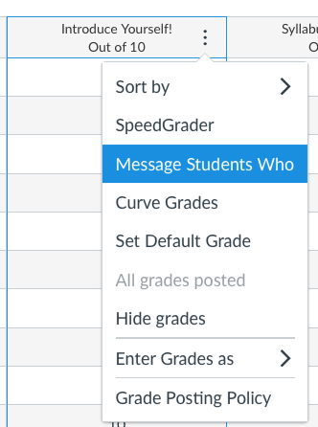
How to Quickly Message a Group of Students
If you are using an introductory assignment to establish attending/active students, you can use Canvas Gradebook to quickly message any students who haven't completed the assignment.
This is in the Grades section of your Canvas course

Slide 17
Q&A

