Slide 1

Professional Development Needs Assessment Results
Summarized by the
Office of Planning, Research & Institutional Effectiveness on behalf of the Professional Development Planning Committee
Presented at Flex Day, April 20, 2023

Slide 2
Three, distinct surveys were administered in March-April, 2023 to assess the professional development needs of the following college constituents:
Classified Staff
Faculty
Administrators
The results of these surveys will be considered by the College Professional Development Planning Committee in developing a new, college-wide professional development plan for 2023-26. For more information about that planning process see: https://canadacollege.edu/professional-dev/plplanprocess.php

Slide 3
Classified Professional Development Needs
Summary
Survey Administered March 2023

Slide 4
Response Rate
43 out of 126 staff responded
  34% Response rate
Response by Time with SMCCD:
  0-2 Years: 7%
  3-5 Years: 14%
  6-10 Years: 14%
  11-20 Years: 23%
  21+Years: 7%
  No response: 35%
Classified Staff PD Needs Assessment Results

Slide 5
The District’s IDEAL program has very low awareness and the new employee orientation and College Flex day have low satisfaction
Classified Staff PD Needs Assessment Results

Slide 6
Most staff do not find value in either the district or Cañada’s current professional development opportunities
Classified Staff PD Needs Assessment Results

Slide 7
The personal growth and development category was generally of more interest than others – especially leadership skill development
Classified Staff PD Needs Assessment Results

Slide 8
Delivery Modality Preference
#1 Hands-on workshops (where I get to practice what I learn)
#2 In-person presentation followed by discussion
#3 Attending Conferences
#4 Web-based classes (asynchronous)
#5 Brown Bag lunches
Classified Staff PD Needs Assessment Results
Notes:
Hands on workshop was staggeringly higher ranked than any other. The subsequent 3 were relatively clumped and Brown bags were staggeringly low ranked

Slide 9
Take Away
86% of respondents were able to engage in at least 1 hour of PD in the past year
  31% engaged in 11 or more hours
Classified PD has low satisfaction with current options
  Perception of PD for classified being an afterthought
Providing PD across multiple times provides more flexibility for student facing and short staffed departments
“Because we each have unique jobs and skill sets, a one size fits all solution
for PD is unlikely”
Classified Staff PD Needs Assessment Results

Slide 10
Faculty Professional Development Needs Summary
Survey Assessment administered March 9 – April 14, 2023
Results aggregated April 14, 2023

Slide 11
Response Rate
54 out of 261 faculty responded (full time and part time)
21% response rate
Respondents by Division*:
Humanities & Social Sciences (HSS) | 13
Business, Design and Workforce (BDW) | 12
Science & Technology | 7
Academic Support & Learning Technologies (ASLT) | 6
Counseling | 1
Kinesiology, Athletics, and Dance (KAD) | 0
*Not every respondent indicated which Division they were part of. Not every respondent answered every question.
Faculty PD Needs Assessment Results

Slide 12
Which of the following professional development opportunities for faculty are you aware of?
(check all that apply)
42 total respondents
Faculty PD Needs Assessment Results

Slide 13
In which of the following areas do you need professional development most?
(please select up to four - you will not be able to return to this page)
46 total respondents
Faculty PD Needs Assessment Results

Slide 14
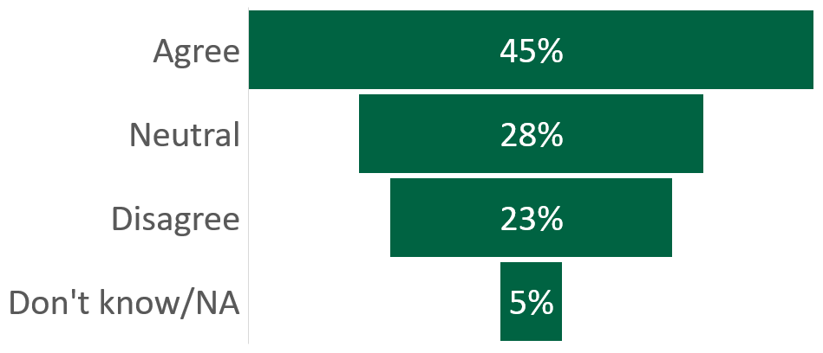
Please indicate how much you disagree or agree with the following statement:
In general, the professional development opportunities offered at Cañada College meet my needs as an educator.
40 total respondents
Faculty PD Needs Assessment Results

Slide 15
What’s working well?
Flex Day gets mixed reviews (some love it; some find it lacking)
Strong interest in being able to choose external PD opportunities in addition to things on offer at the college/district
Appreciation for increased and improved offerings [via the Faculty Teaching & Learning Center and Lounge], especially variety of topics, including antiracism, student mental health, and technology, among others
Faculty PD Needs Assessment Results

Slide 16
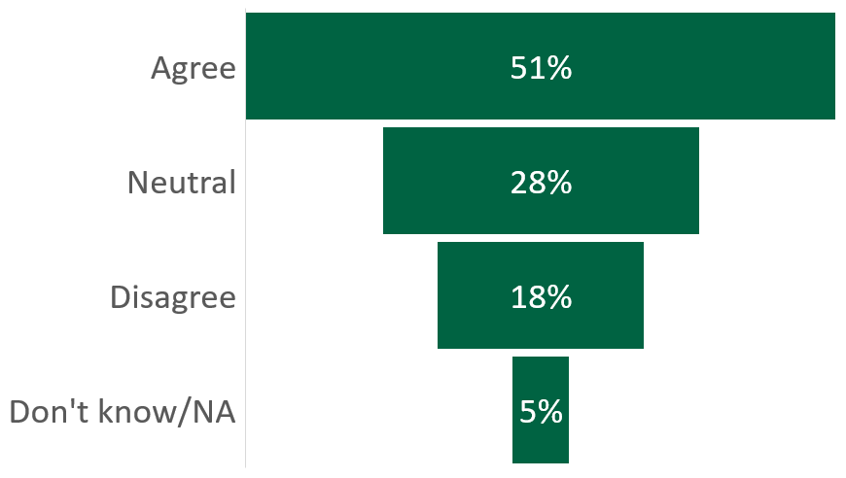
Please indicate how much you disagree or agree with the following statement: In general, the professional development opportunities offered at Cañada College are relevant to my work.
39 total respondents
Faculty PD Needs Assessment Results

Slide 17
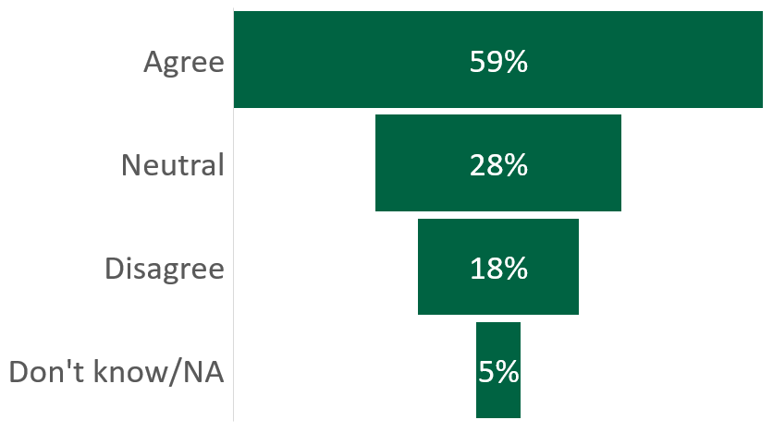
Please indicate how much you disagree or agree with the following statement: In general, the professional development opportunities offered at Cañada College positively impact my instructional practice.
39 total respondents
Faculty PD Needs Assessment Results

Slide 18
What can be improved?
Need to improve awareness of PD funds
Need to minimize the paperwork to apply for PD funds
Provide more recordings of sessions/asynchronous classes
Vary the days trainings/sessions are offered
More support on specific issues: working with students with disabilities, accessing technology,
More time for collaboration on similar classroom issues/pedagogy/andragogy (less time on compliance)
Participation in equity and antiracism PD is voluntary/optional and, as such, participation is uneven – make it required?
Faculty PD Needs Assessment Results

Slide 19
What were the primary reasons you did not participate in professional development activities during the last year?
(select up to three reasons)
Faculty PD Needs Assessment Results
39 total respondents
Responses to “Other”: not relevant; I always participate, whether I have time or not; New Hire, Didn’t work year last year

Slide 20
What is your preferred mode of delivery for professional development (select up to three options)
40 total respondents
Faculty PD Needs Assessment Results

Slide 21
Administrator Professional Development Needs Summary
Survey Assessment administered March 9 – 24, 2023
Results aggregated April 5, 2023

Slide 22
Response Rate
13 out of 13 administrators
100% response rate
Administrator PD Needs Assessment Results

Slide 23
Administrator participation in and satisfaction with existing Professional Development opportunities
Administrator PD Needs Assessment Results

Slide 24
Please indicate your level of agreement with the following statement:
“In general, the professional development opportunities offered for administrators…”
Administrator PD Needs Assessment Results

Slide 25
What is your preferred mode of delivery for professional development? Please rank order, with #1 as your top choice.
Administrator PD Needs Assessment Results

Slide 26
Open responses
Managing the pressures of the job
Managing difficult people
When work demands feel like they do not leave any time for professional development
Desire for mentoring/support
Better collaboration with Human Resources (District)
Need to systematize "regular" college operationalize processes semester to semester and year to year. Develop "learning opportunities" aligned with emerging or new technologies or software the district is adopting. For example, we currently have people using various platforms to share documents--Sharepoint, OneDrive, Drop Box, and Google Drive. Is there one that we all should use?
Administrator PD Needs Assessment Results

