Slide 1
Culturally Responsive Teaching and Learning (CRTL) 11:15-12:15 Fri. Jan. 12, 3-104
Rebekah Taveau, Julie Carey, Kiran Malavade,
and Michael Hoffman
Notes:
11:15 plus 5 minutes for late comers

Slide 2
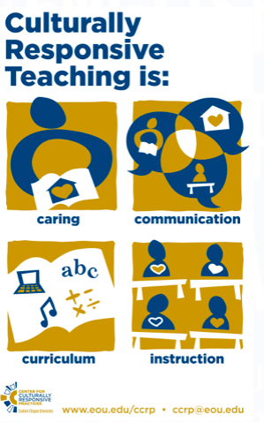
Agenda
Discuss key aspects of the CRTL definition
View examples from:
  ESL
  English
  Math
Apply: How can you use these ideas to your classes?
Image from: https://www.eou.edu/ccrp/
Notes:
11:20

Slide 3
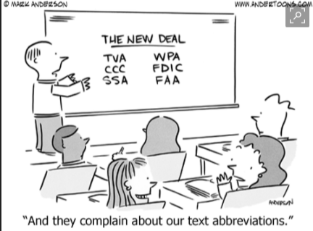
Note about the Name
Original Term: Culturally Responsive Teaching
Newer version: Culturally Responsive Teaching and Learning
Abbreviation: CRTL avoids confusion with Critical Race Theory (CRT)
CRT recognizes inequitable distributions of power and resources in our society. It challenges Eurocentric values and prevailing systems of oppression that are often invisible but entrenched in our history (Solorzano & Yosso, 2002; 2000; McCoy & Rodricks, 2015).
CRTL: aware of the historic marginalization, employ a wide repertoire of CRT strategies to honor, validate, support, and create a safe place for diverse students (Kozleski, 2000).

Slide 4
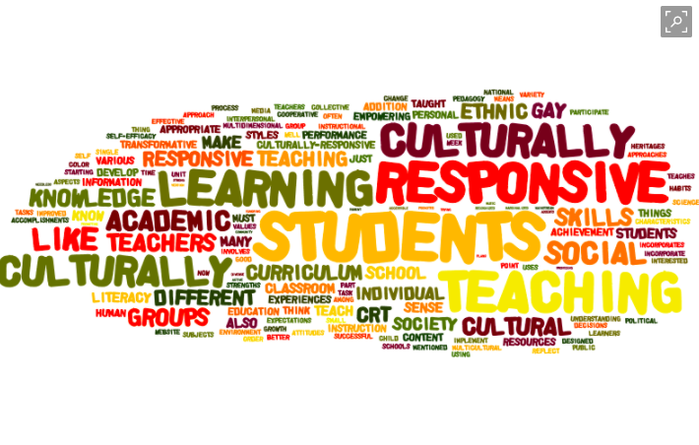
What aspects of the CRTL Definition do you feel are most meaningful and why?

Slide 5
Culturally Responsive Teaching Definitions
uses “the cultural characteristics, experiences and perspectives of ethnically diverse students as conduits for teaching them more effectively” (Gay, p.106, 2002).
“is about building the learning capacity of the individual student.” Focuses on “leveraging the affective and the cognitive scaffolding that students bring with them.” (Hammond, 2015)
Notes:
Not multicultural or social justice learning- some overlaps but not the same thing (Hammond).
Multicultural education celebrates diversity so that students can see own cultures reflected in community and feel a sense of pride and belonging as well as be enriched by learning about other cultures but does not address the cognitive component.
Social Justice education focuses on building a lens for the student to be able to look at the world and seeing where things aren’t fair or where injustice exists, but does not focus on learning capacity.
Learning Partnerships. To succeed in school, diverse learners need to feel as if they are in partnership with their teachers. To create these relationships, we need to build trust with students, help them develop positive mindsets, and give them the language to talk about their learning.
Information Processing. Teachers need to understand how to expand students’ intellective capacity so they can engage in deeper, more complex learning. This requires teachers to learn brain-based information processing strategies common to oral cultures like metaphors, rhythmic mnemonics, and “story-ifying” the content.
Community Building. Culturally responsive teachers work to create supportive, welcoming environments, places that feel socially and emotionally safe, so that students are comfortable enough taking the risks required to stretch their brains.

Slide 6
Culturally Responsive Teachers
Demonstrate respect and set high expectations
Provide differentiated scaffolding
Use student centered approaches
Are knowledgeable and appreciative of student cultural values, customs, beliefs, communication styles, learning styles, assets, and contributions
Embed ethnically and culturally diverse content into their curriculum

Slide 7
Culturally Responsive Teachers
Critically evaluate curriculum design for misrepresentation or gaps in representation of diverse students
Build relationships with students and demonstrate caring
Create supportive, welcoming environments, places that feel socially and emotionally safe, so that students are comfortable enough taking the risks required to stretch their brains.
Continuously reflect on their actions and interactions to improve (Kozleski, 2000)

Slide 8

What aspects of the CRTL Definition do you feel are most meaningful and why?
Image from http://ontariomedic.ca/2016/09/27/critical-thinking/
Notes:
11:35ish

Slide 9

My favorite
Continuously reflect on their actions and interaction to improve
  Cultural humility
“Do the best you can until you know better. Then when you know better, do better.”
(Maya Angelou)
http://supereval.com/blog/reflective-practice-theory-theoretical-framework-supereval/

Slide 10
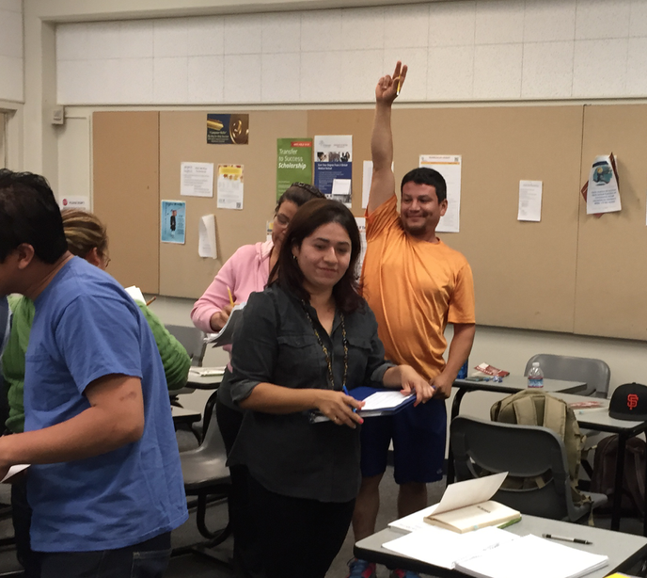
CRTL in ESL: Caring about the Whole Learner
Facing historical deficit view of the learner in ESL. In your field?
CRT “Continuously reflect on their actions and interactions to improve”
  Practicing self-reflective teaching
    Noticing when/where/why the breakdown happened and noting changes for next semester
    If we’re not sure how well a lesson or part of a lesson went, ask the students for written feedback
Notes:
11:50

Slide 11
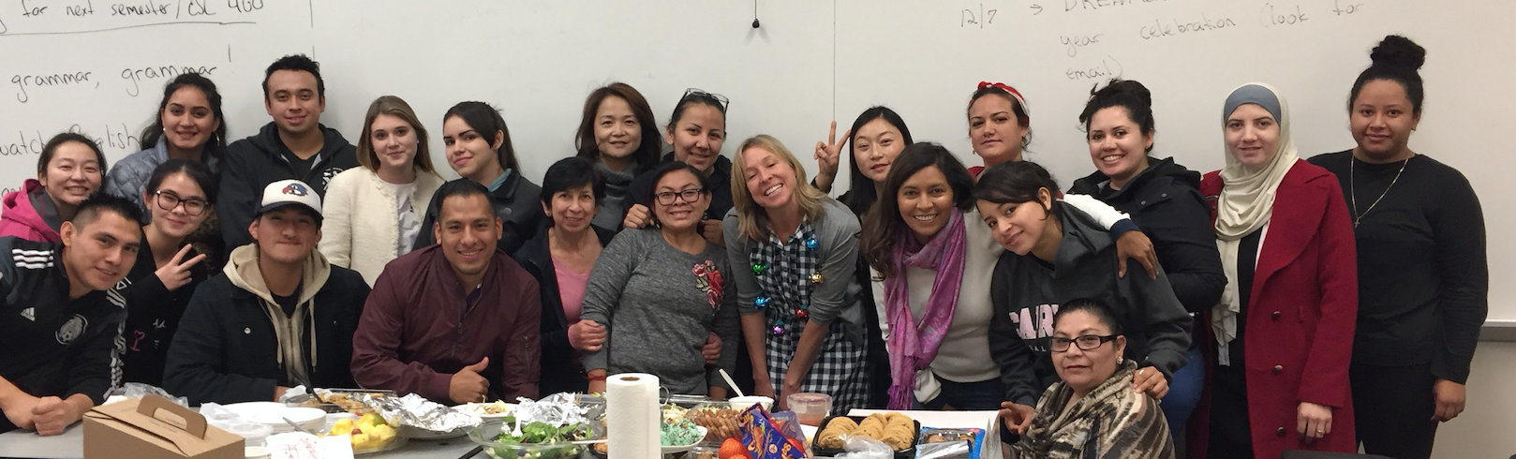
CRTL in ESL
Examples and Resources
CRT “Build relationships with students and demonstrate caring” and “Create supportive, welcoming environments, places that feel socially and emotionally safe, so that students are comfortable enough taking the risks required to stretch their brains.”
    Day one activity and diagnostic
    Closing community activity
CRT “Embed ethnically and culturally diverse content into their curriculum”
    Guest lecture unit with Gerardo Pacheco

Slide 12
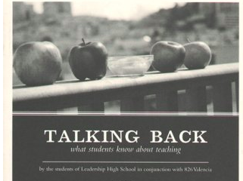
English: Students as Voices of Authority
First day activities lesson plan
Read aloud from Talking Back: What Students Know About Teaching by the Students of Leadership High School
  Models annotation and reading strategies
  Raises real-life issues relevant to CRTL & students
  Diagnostic writing sample: summary & response
Syllabus Activity
  Reflection on past experience: drawing on their expertise
  Students collaborate to add to syllabus

Slide 13
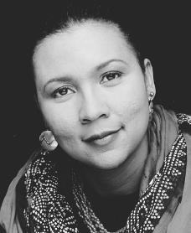

Building relationships with students:
“Teaching with Love”
“I defined love as a combination of care, commitment, knowledge, responsibility, respect, and trust….When these basic principles of love form the basis of teacher-pupil interaction, the mutual pursuit of knowledge creates the conditions for optimal learning.” -bell hooks
“Love” = high expectations
“Love” = giving individual feedback (in writing or in person)
Notes:
Most colleges and universities organized around the principles of the dominant culture: hierarchies of power and control, students operate from fear-based learning, competition, so called “objectivism”
Love does not mean go easy on, but rather the opposite. Also, allows you to see other factors that contribute or inhibit learning. WRITING FEEDBACK!!!also a way to provide differentiated scaffolding

Slide 14

English: Student-Centered Classroom
Consider the classroom’s physical set-up, move around a lot
Collaboration: student-student and student-teacher
Student-led facilitations and projects
  recognize their authority and have high expectations
  often culture and community driven (ex: EPA gentrification)
Authentic writing tasks
  Ex: letters to Congress about DACA
Being flexible: when issues arise, be willing to adjust
Notes:
Physically sitting down next to a student often elicits information and questions from them that wouldn’t come out otherwise. “Can you read this, but don’t judge me because I haven’t been in school for 4 years”
student-teacher collaboration: feedback to change teaching methods, ERG project, etc
Demanding written homework that will lead them into facilitations, ERG project
Students need more time with this essay, or DACA is on everyone’s minds, so let’s add that as an essay topic choice.
Less is more, so if you need to cut something, learn to be okay with that.

Slide 15
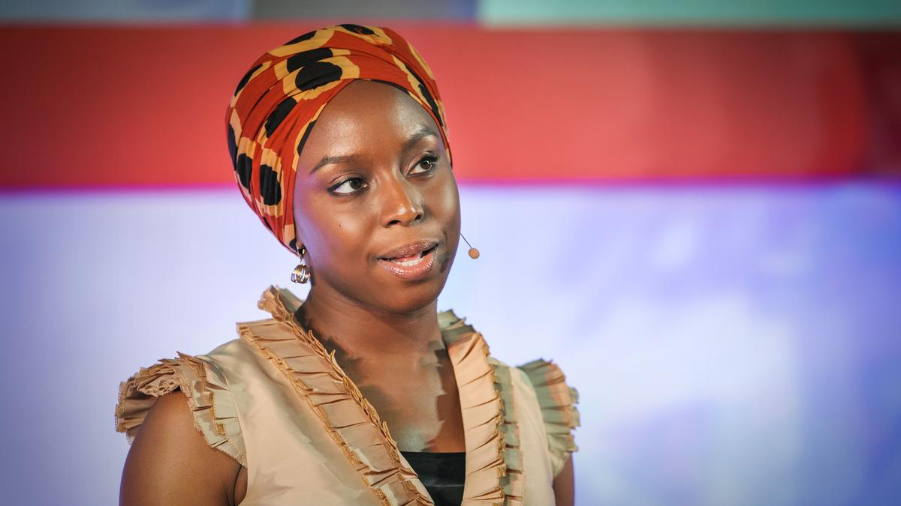
Appreciating Students’ Backgrounds:
Adichie’s “The Danger of a Single Story”
Other texts I’ve used that bring in culturally diverse perspectives--Add yours!
Learning outside the classroom: events on campus, field trips, etc.
Recognizing and discussing educational inequality/institutional racism and countering this with respect and high expectations
Notes:
Adichie: the power of some voices to tell only a single story that creates stereotypes, and that we must counter this by telling and seeking out “many stories”
engaging at both developmental and transfer levels
Educational inequality curriculum: tracking, testing, remediation, etc.

Slide 16

Math: Focus on Process
Create collaborative environment focusing on thinking process (vs. getting the right answer)
  have students share how they solve a problem, practice justifying their reasoning, and discuss possible answers
Break down status stereotypes by focusing on diversity of solutions
Recognize different ways to solve a problem that students from different countries or backgrounds may have learned and credit good process
Notes:
11:55

Slide 17
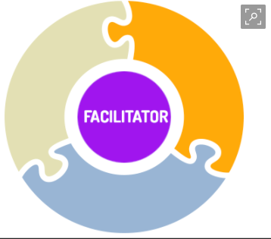
Culturally Responsive Math Teacher
Professor Role
Facilitator asks open ended questions and facilitates process discussions
Not always all knowing answer giver (IRC)
Affective Attitudinal Domain
Publicly praises good process
Emphasizes Growth Mindset
coach
Model
Guide

Slide 18
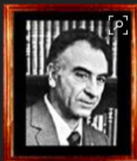

Culturally Embedded Content in Math
Use examples for word problems or concepts that students can relate to
  A Mathematician Reads the Newspaper (Paulos)
Relate math concepts to everyday life: analogies, metaphors, visuals
  Damned Lies and Statistics: Untangling Numbers from the Media, Politicians…(Best)
Highlight famous mathematicians of diverse backgrounds
Highlights relevant cultural accomplishments
José Ádem
Mayan Zero

Slide 19

Reading Apprenticeship in Math
Personal, social, cognitive elements of learning
Example: intentionally modeling cognitive practices like reading a textbook.
Take a page from a text and model by thinking aloud how you process the text, go between diagram and text, analyze how symbols relate to graphs, and words etc.
Focus on surfacing strategies student might use
Clip art.com
Notes:
Buying and selling a horse and net financial impact: bought 50, sold 60, bought 80, what was the net impact
Introduce new element to solve strategy
Grouped transactions and got answer quickly
Draw a picture to figure out the answer
Rule of three - Mexico

Slide 20
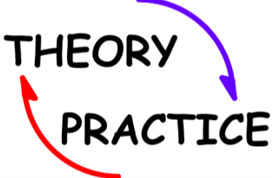
Application
Which idea will you try or do more of in your classes or what other examples do you have?
Notes:
12:05

Slide 21

What questions do you have?
What points would you like to add?
Notes:
12:10

Slide 22
References
Hooks, B. (2003). “Chapter 11: Heart to Heart: Teaching with Love.” Teaching Community: A Pedagogy of Hope. Routledge.
p.127-138. Print.
Delpit, L. (2006). Other People’s Children: Cultural Conflict in the Classroom. New Press.
Gay, G. (2002). Preparing for Culturally Responsive Teaching. Journal of Teacher Education,53(2), 106-116. doi:10.1177/0022487102053002003
Kersaint, G., Thompson D, & Petkova, M. (2009). Teaching Mathematics to English Language Learners.
Kozleski, E. (2000). Seven principles for training a culturally responsive faculty. Equity Alliance. Retrieved from http://www.equityallianceatasu.org/sites/default/files/Website_files/CulturallyResponsiveTeaching-Matters.pdf
Ladson-Billings, G. (1994). The dreamkeepers: Successful teachers of African American children.
Jossey-Bass.
Mccoy, D. L., & Rodricks, D. J. (2015). Critical Race Theory in Higher Education: 20 Years of Theoretical and Research Innovations. ASHE Higher Education Report, 41(3), 1-117. doi:10.1002/aehe.20021
Solorzano, D., Ceja, M., & Yosso, T. (2002). Critical race methodology: Counter-storytelling as an analytical framework for educational research. Qualitative Inquiry, 8(1), pp.23-44.
Solorzano, D., Ceja, M., & Yosso, T. (2000). Critical race theory, racial microaggressions, and campus racial climate: The experiences of African American college students. Journal of Negro Education, 69(1/2), 60.
Notes:
12:15

