Slide 1
“…best political voice for community college faculty in the state.”
~ Sacramento News & Review

Slide 2


President Donald Trump’s moral compass isn’t working.
Sasha Abramsky, August 14, Sacramento Bee

Slide 3
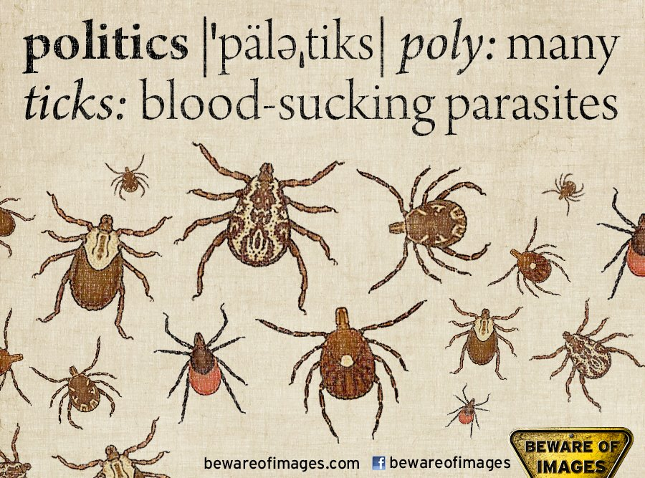
Why Americans
Hate Politics

Slide 4
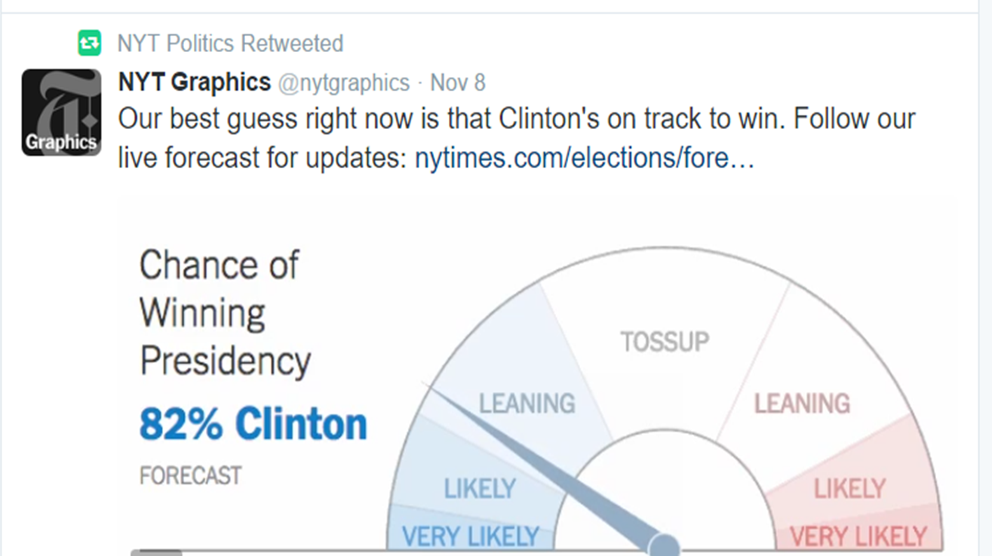
Election Day

Slide 5
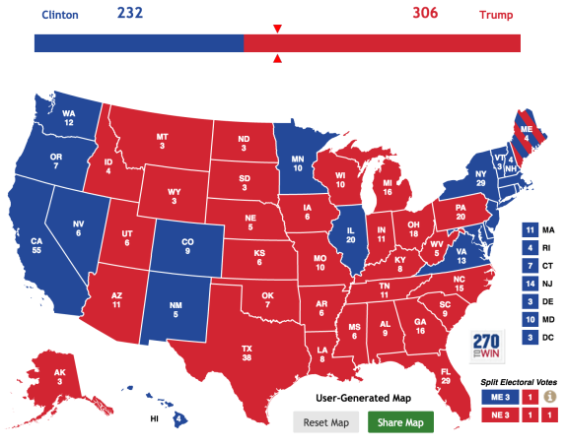
What Happened?

Slide 6
Three Keys to a
Successful Campaign
M
M
M
oney
essage
obilization

Slide 7
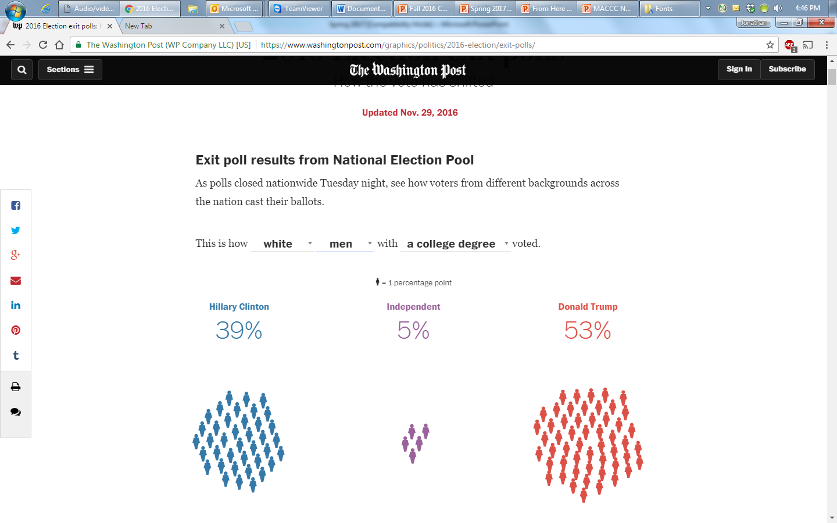
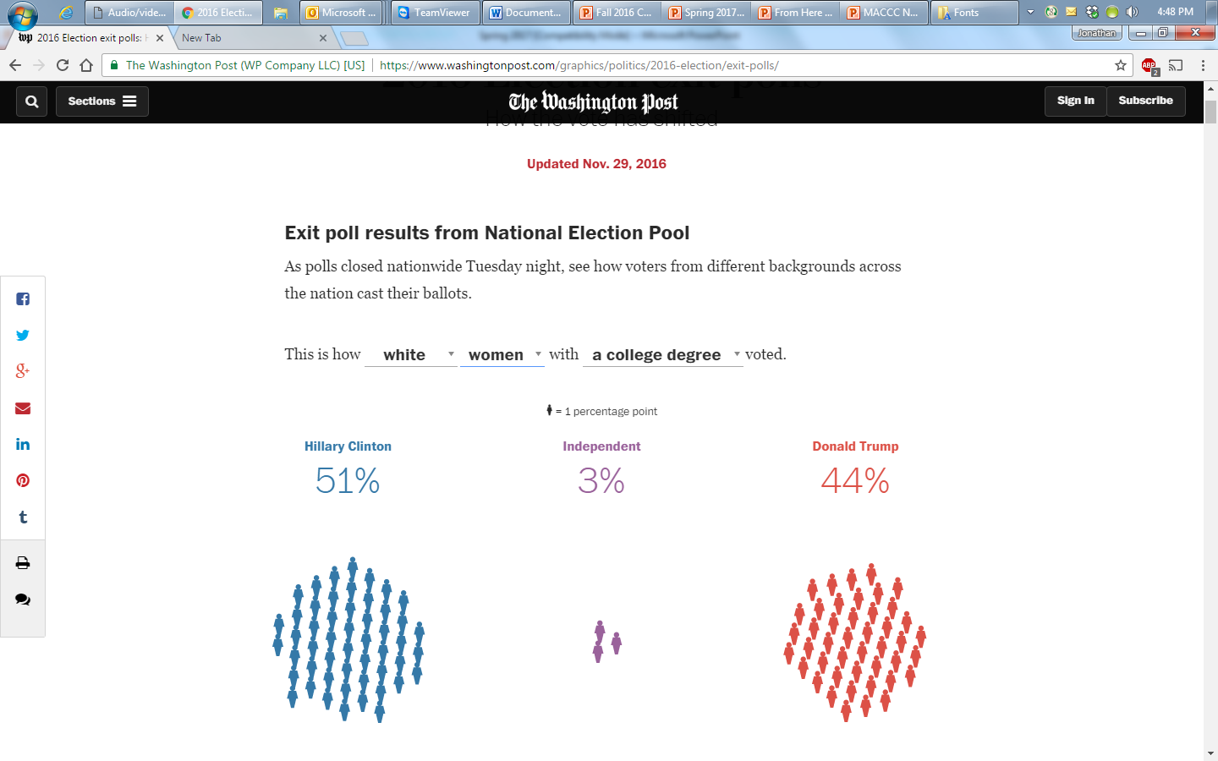

Slide 8
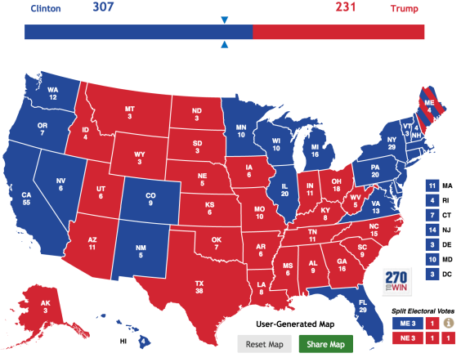
If One Out of 100
Had Flipped?

Slide 9


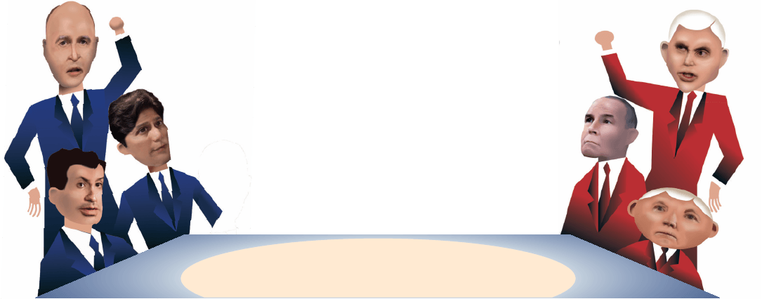


Trump v. California

Slide 10
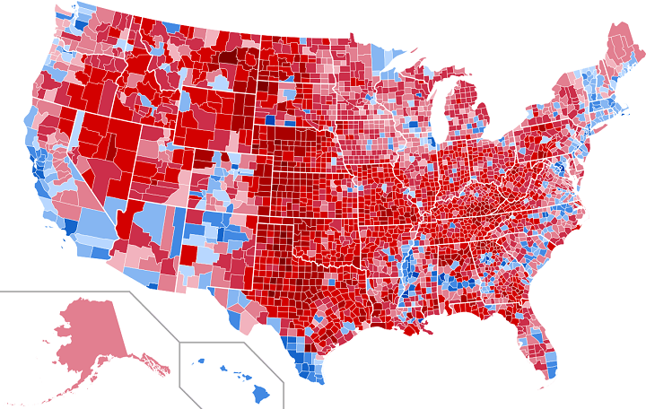
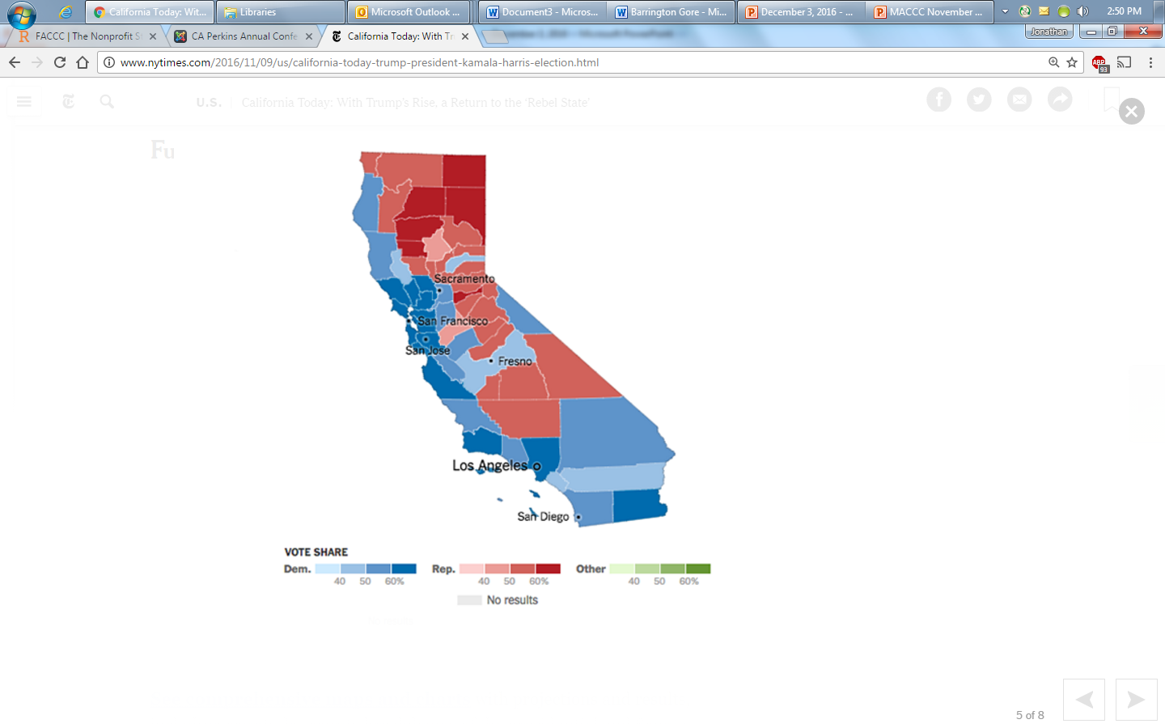
American Political Map by County, 2016
California Political
Map by County
2016

Slide 11
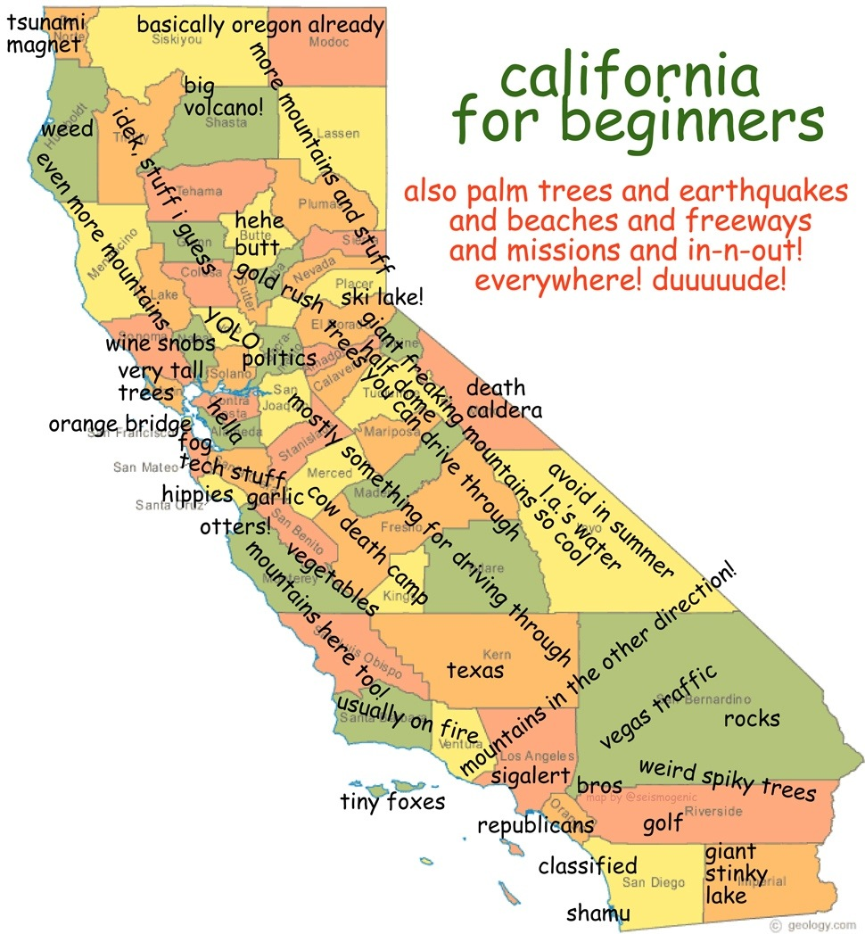

Slide 12

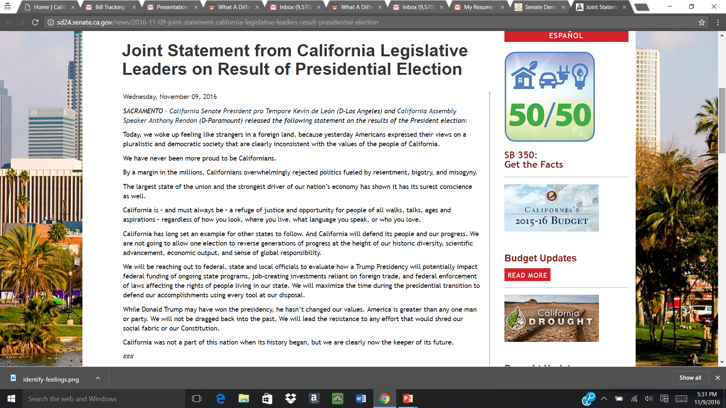

Slide 13
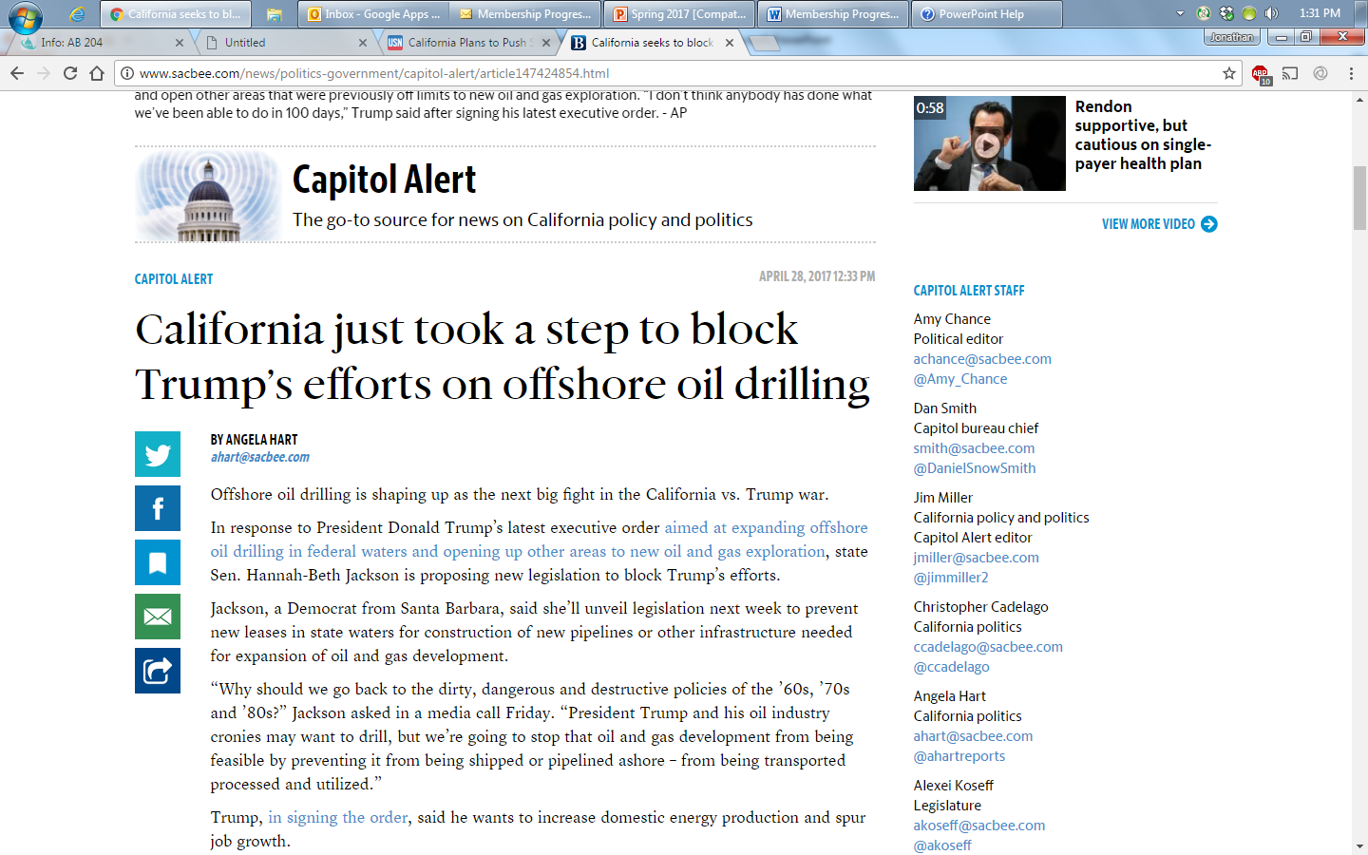
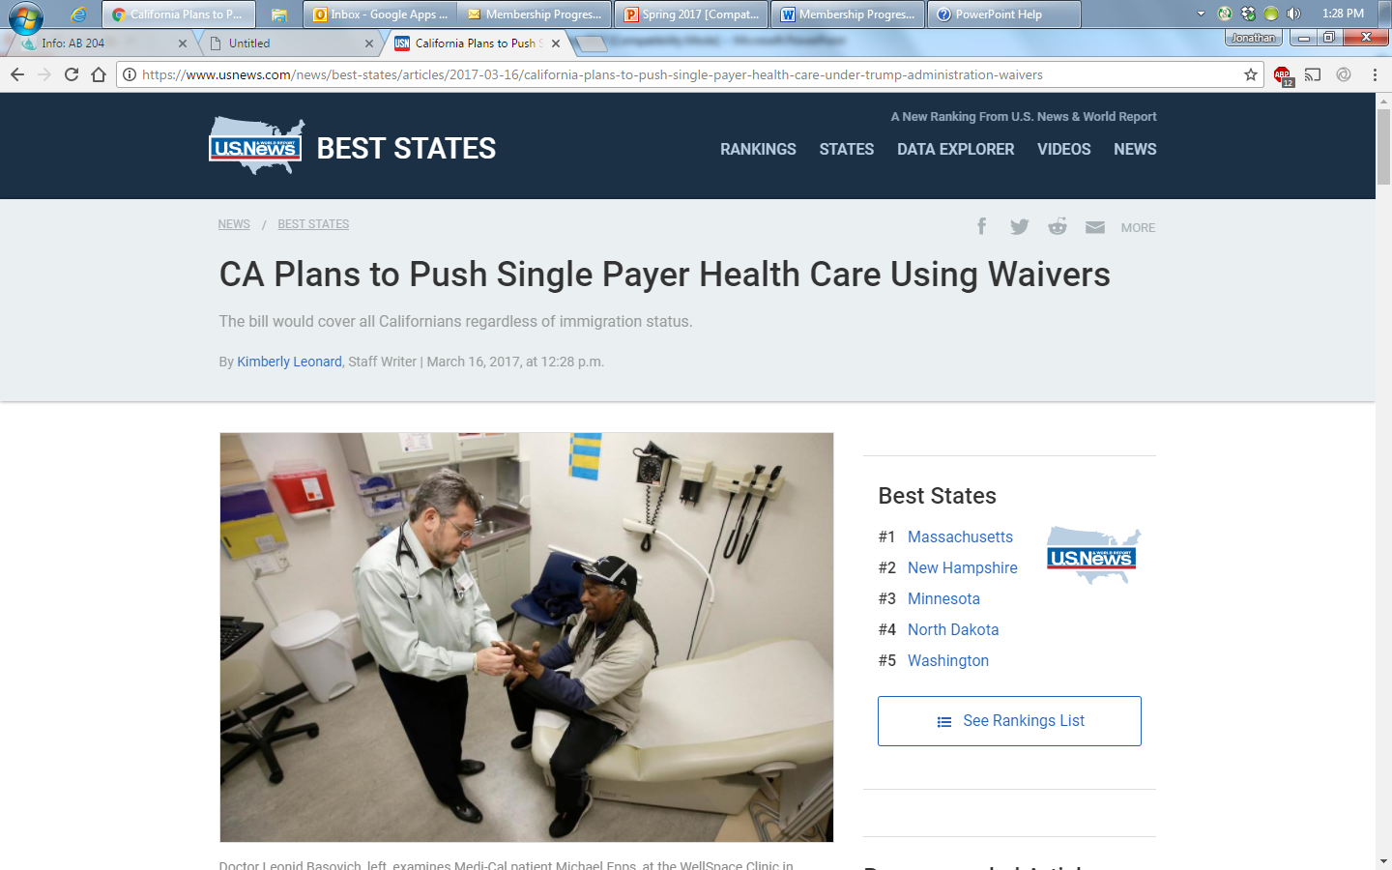
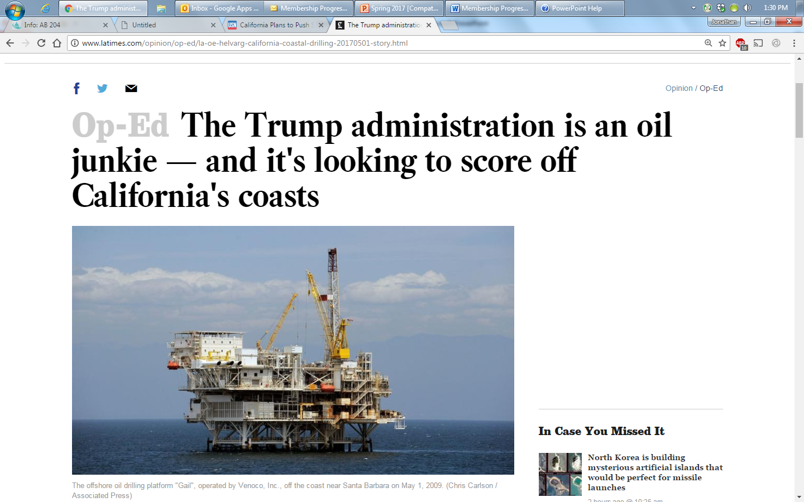
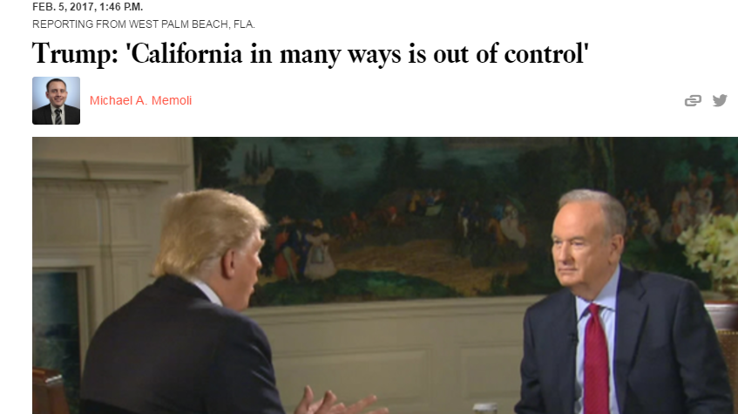
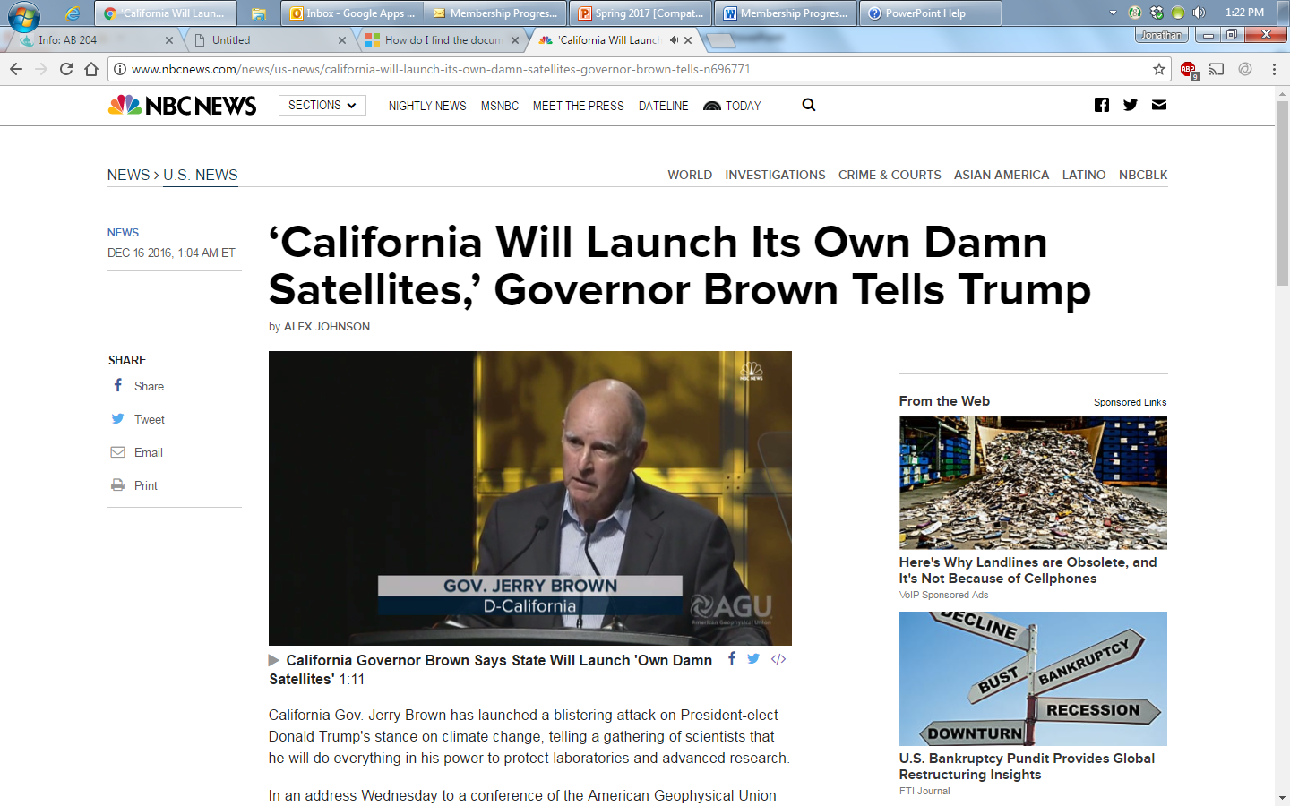
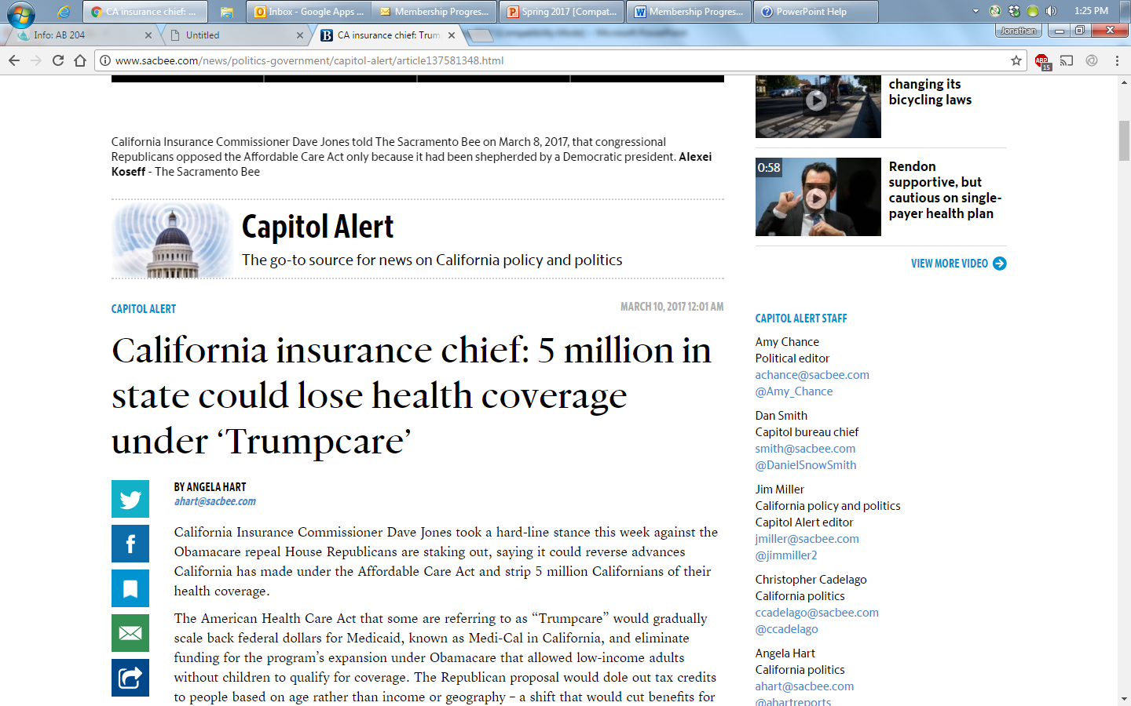
Back and Forth

Slide 14
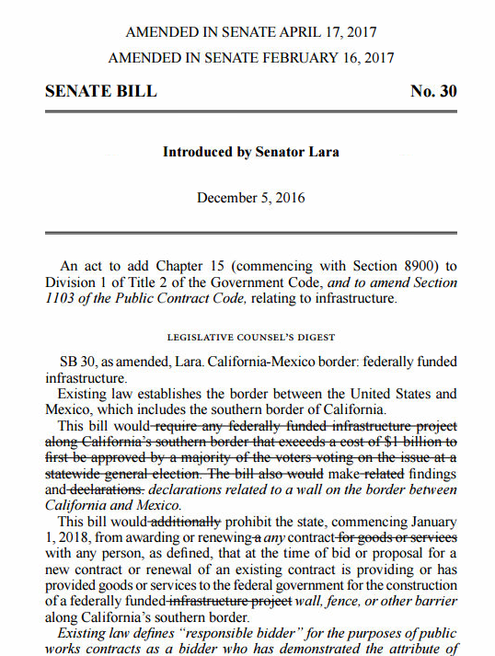
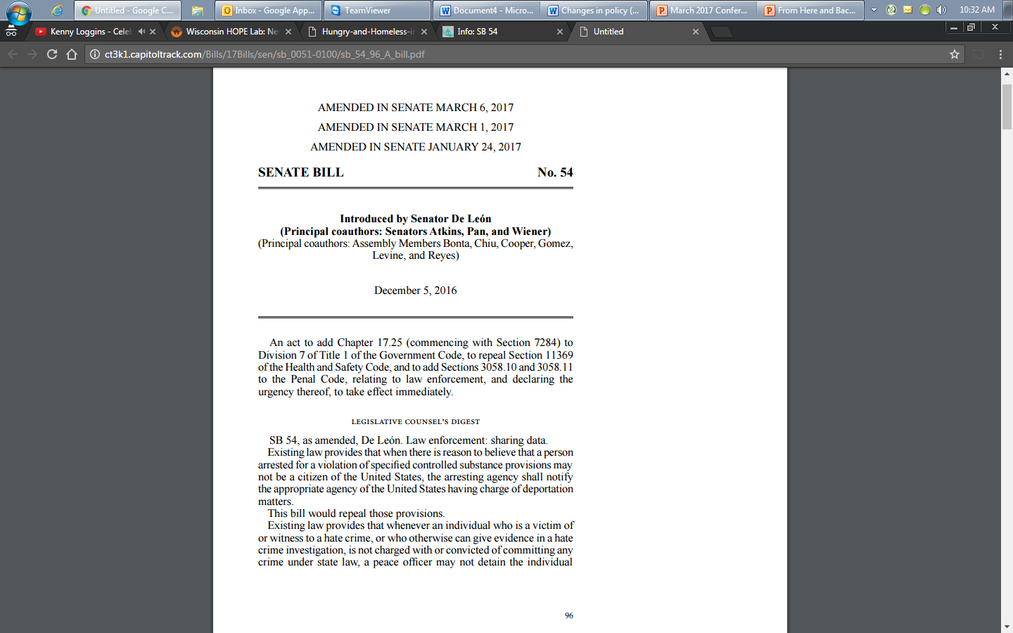
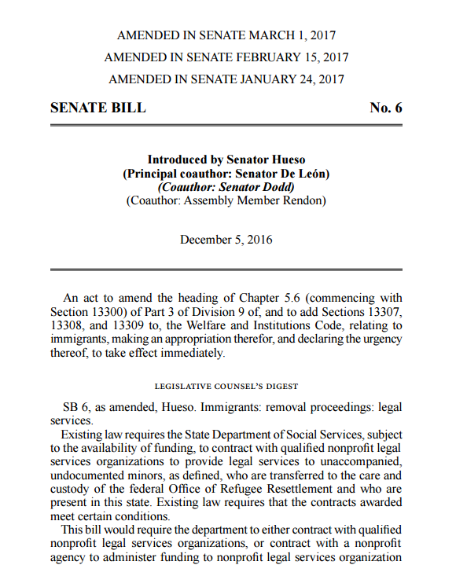
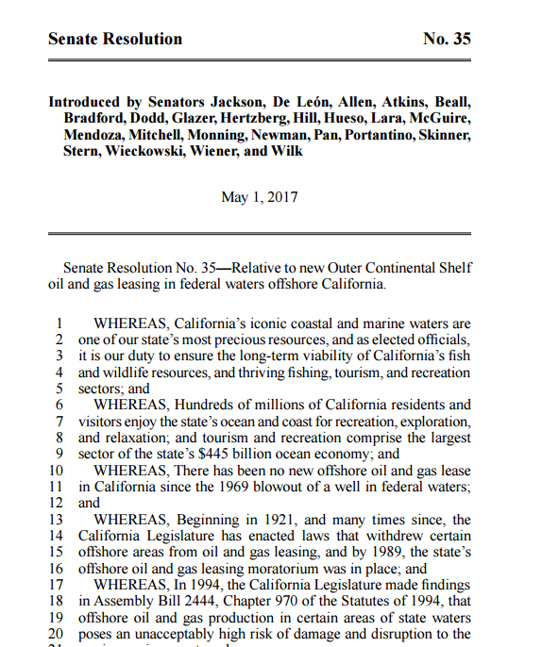
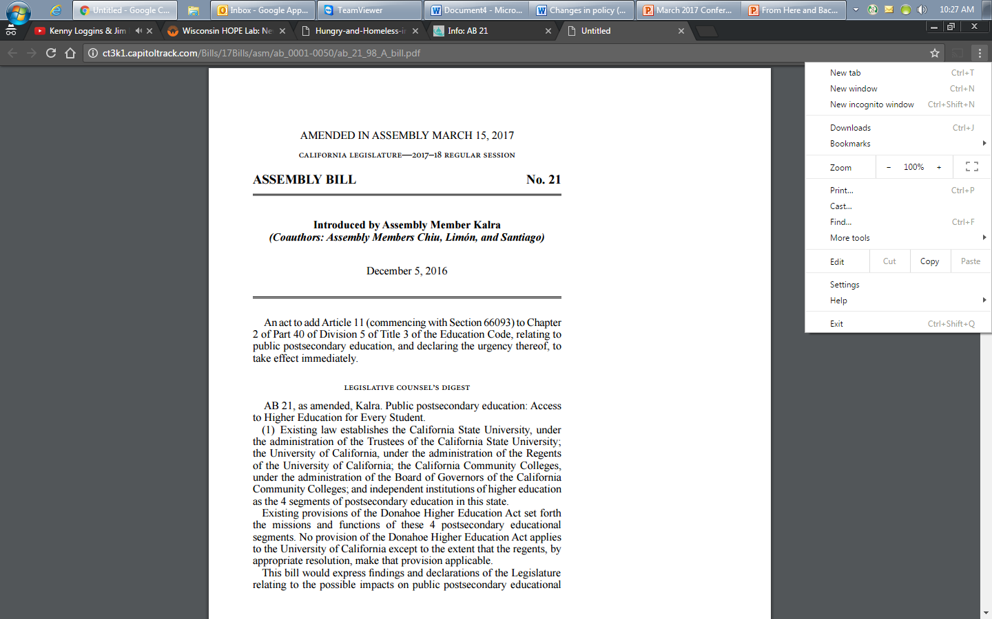
Words Into Action

Slide 15
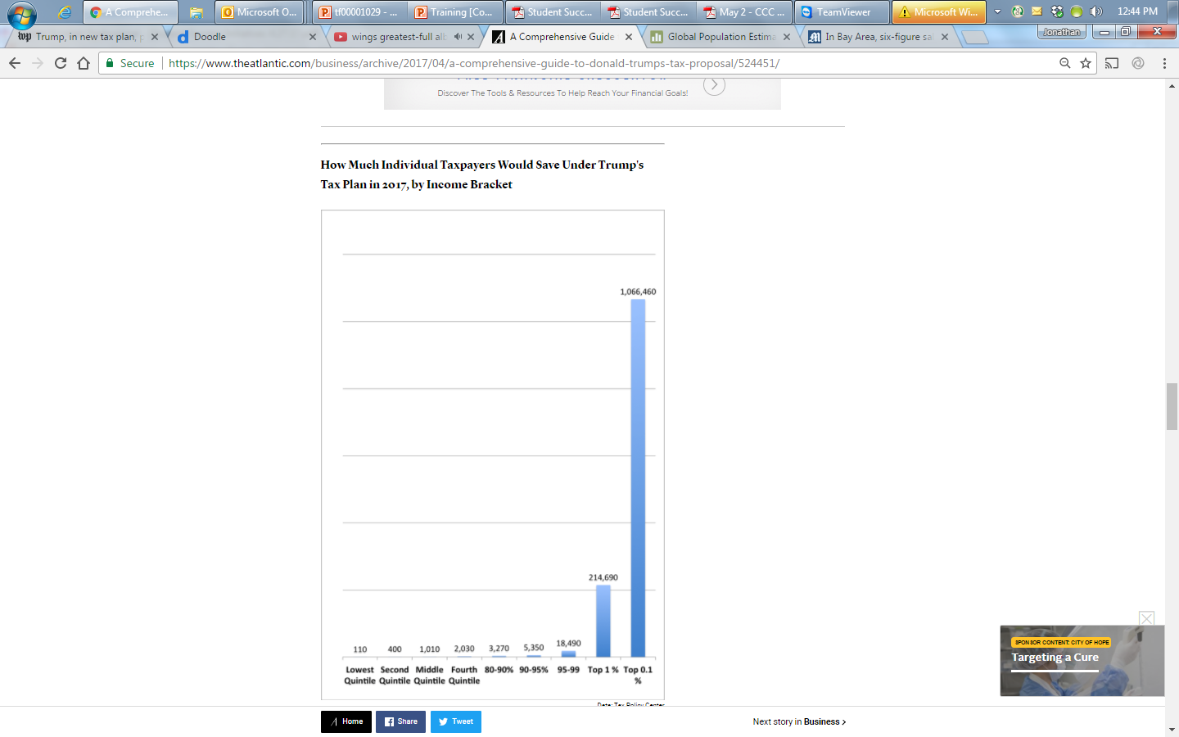
What individual taxpayers would save under the latest Trump tax proposal, by bracket.

Slide 16

Next Battle

Slide 17
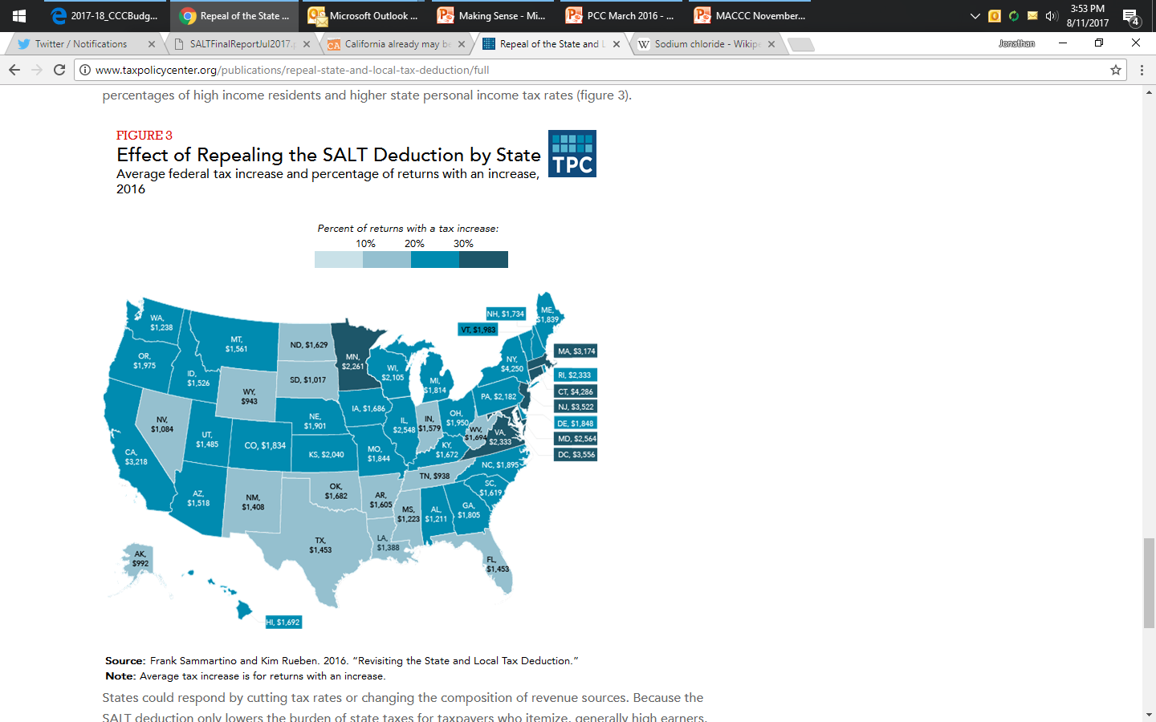

Slide 18
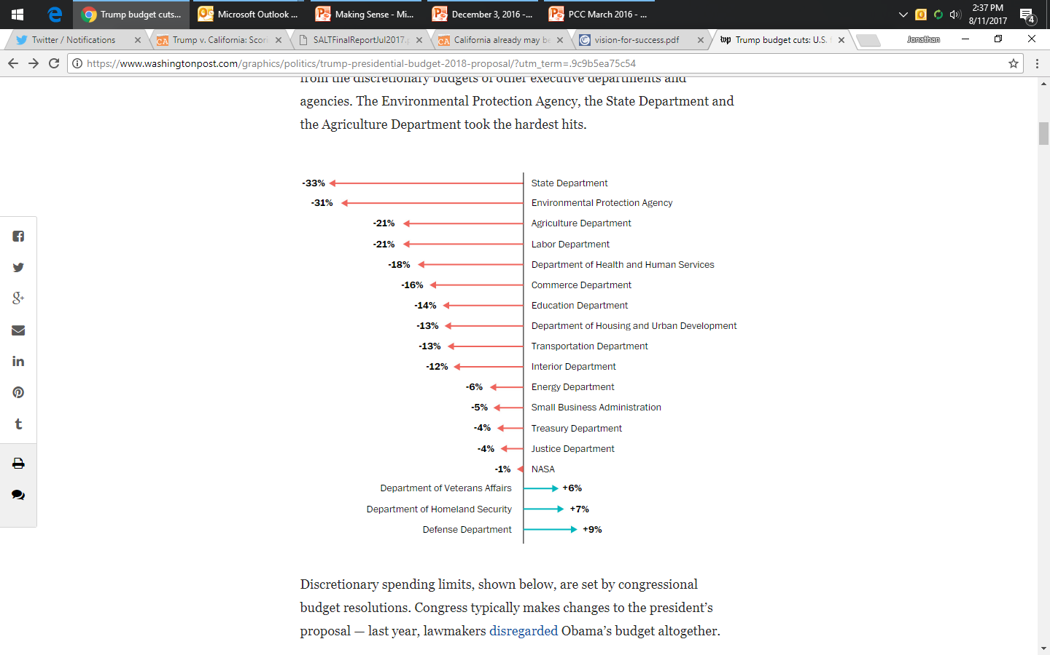
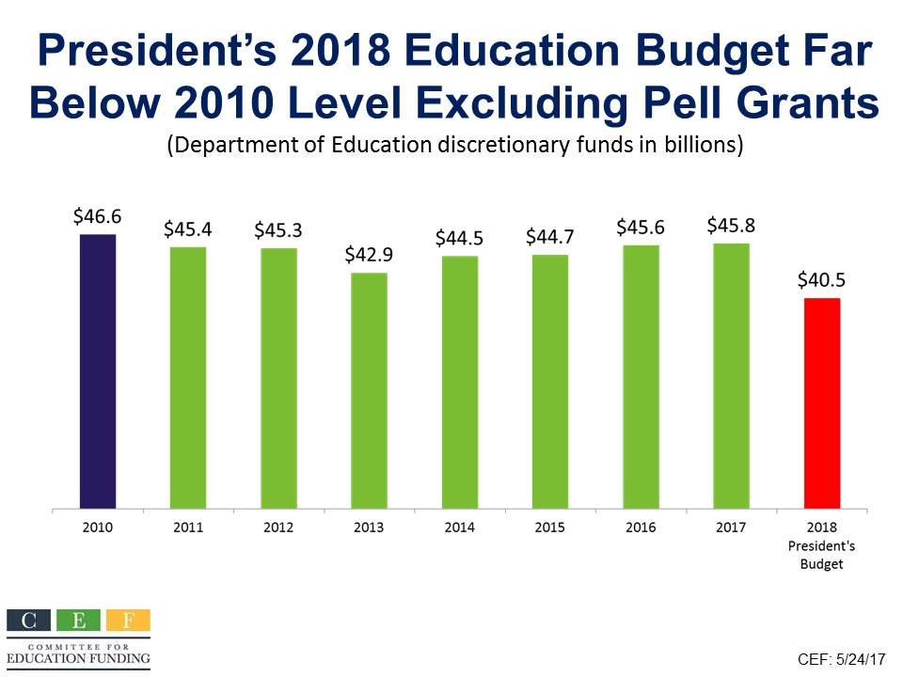
President’s
Proposed
Budget

Slide 19
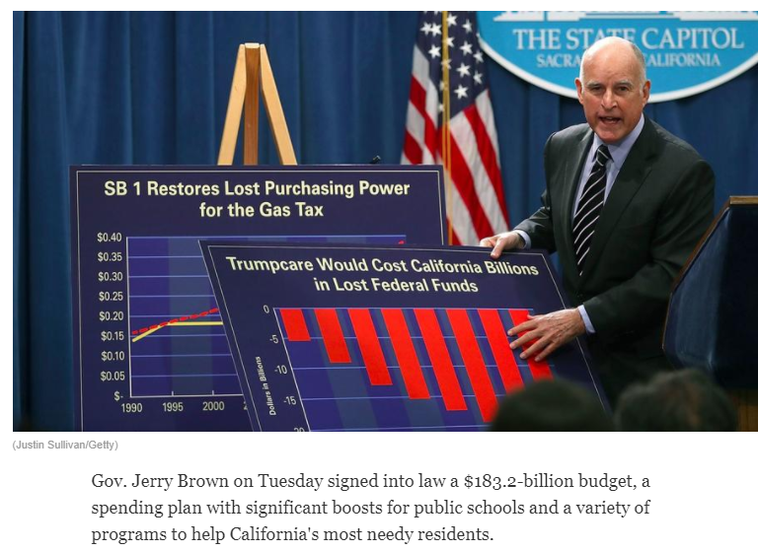

Slide 20
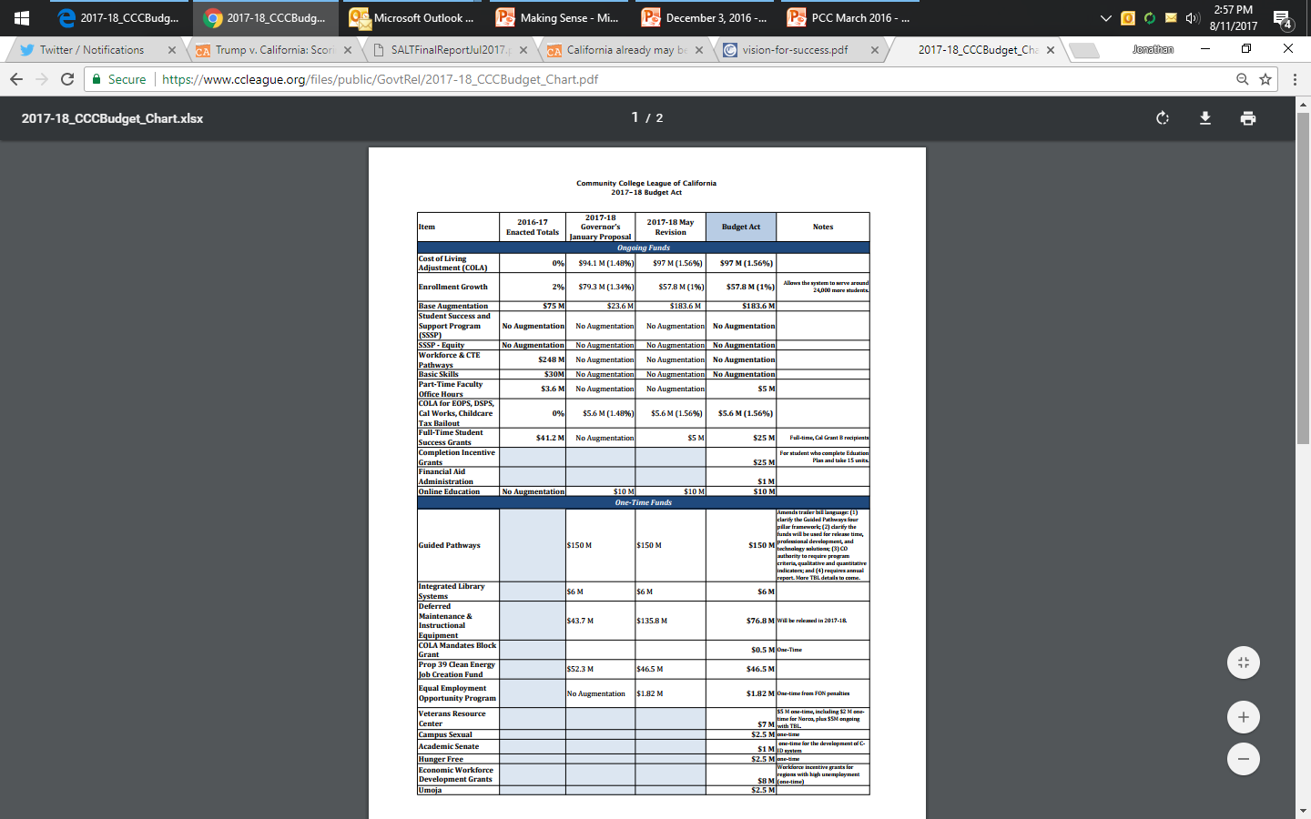
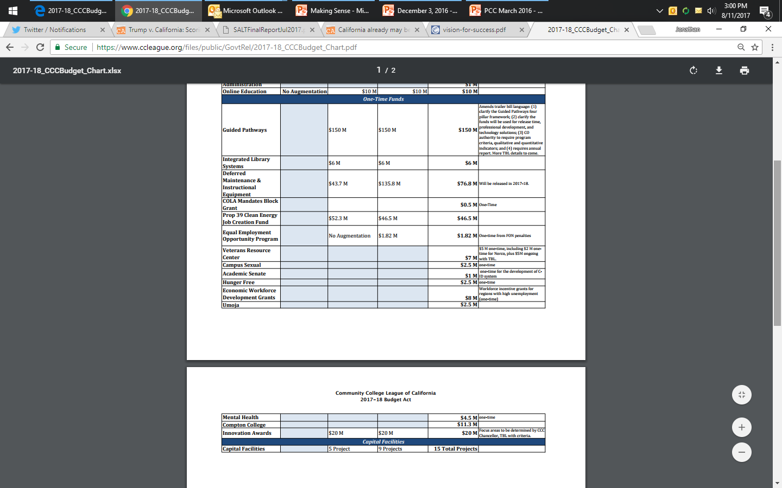
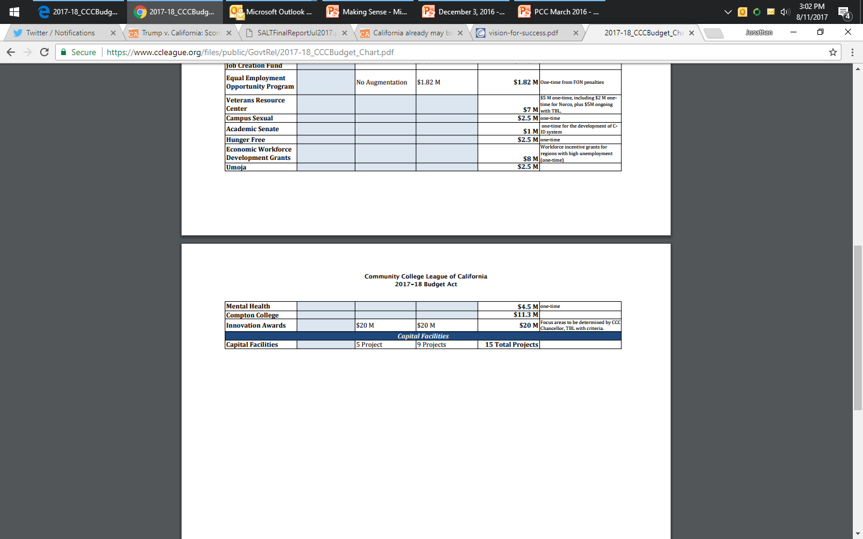

Slide 21
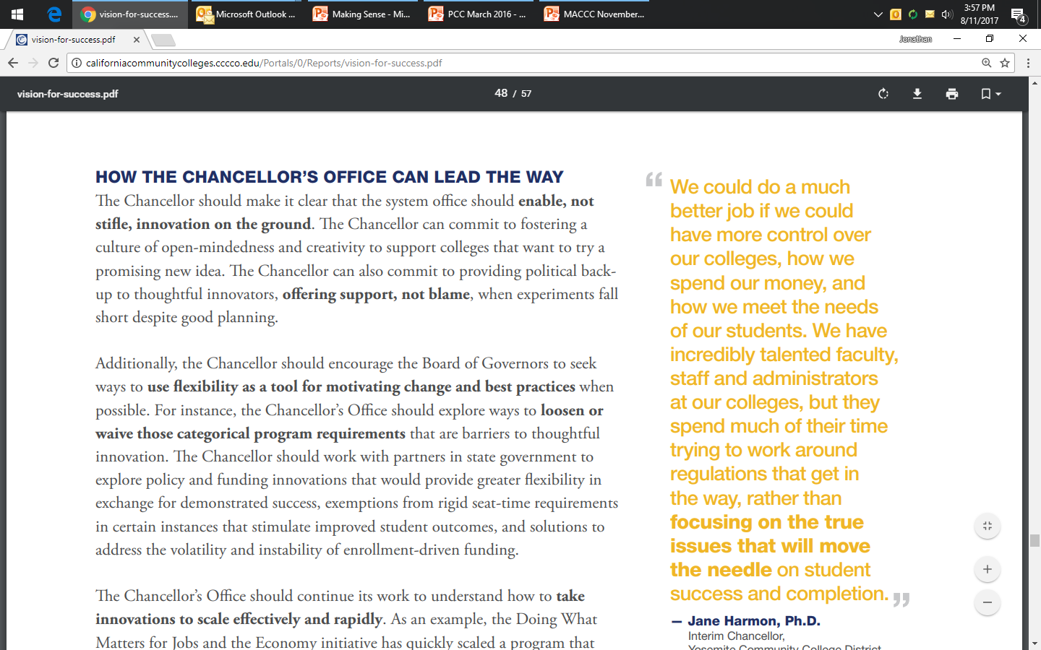
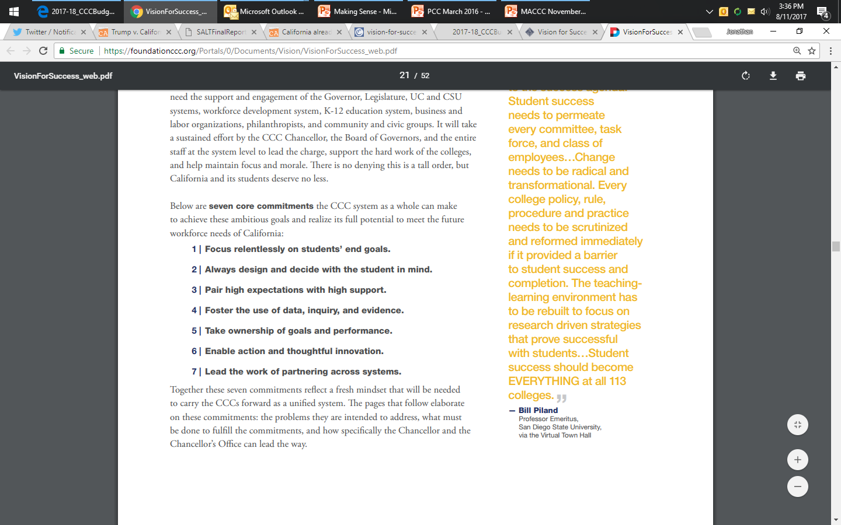
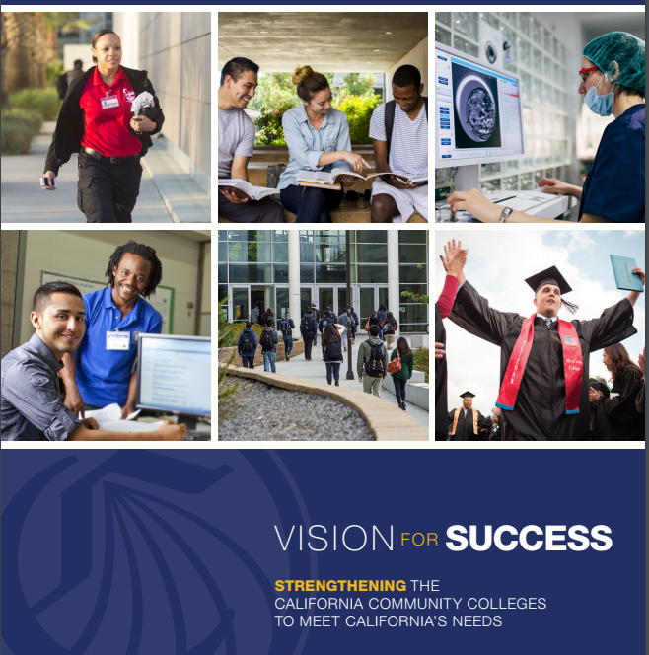

Slide 22

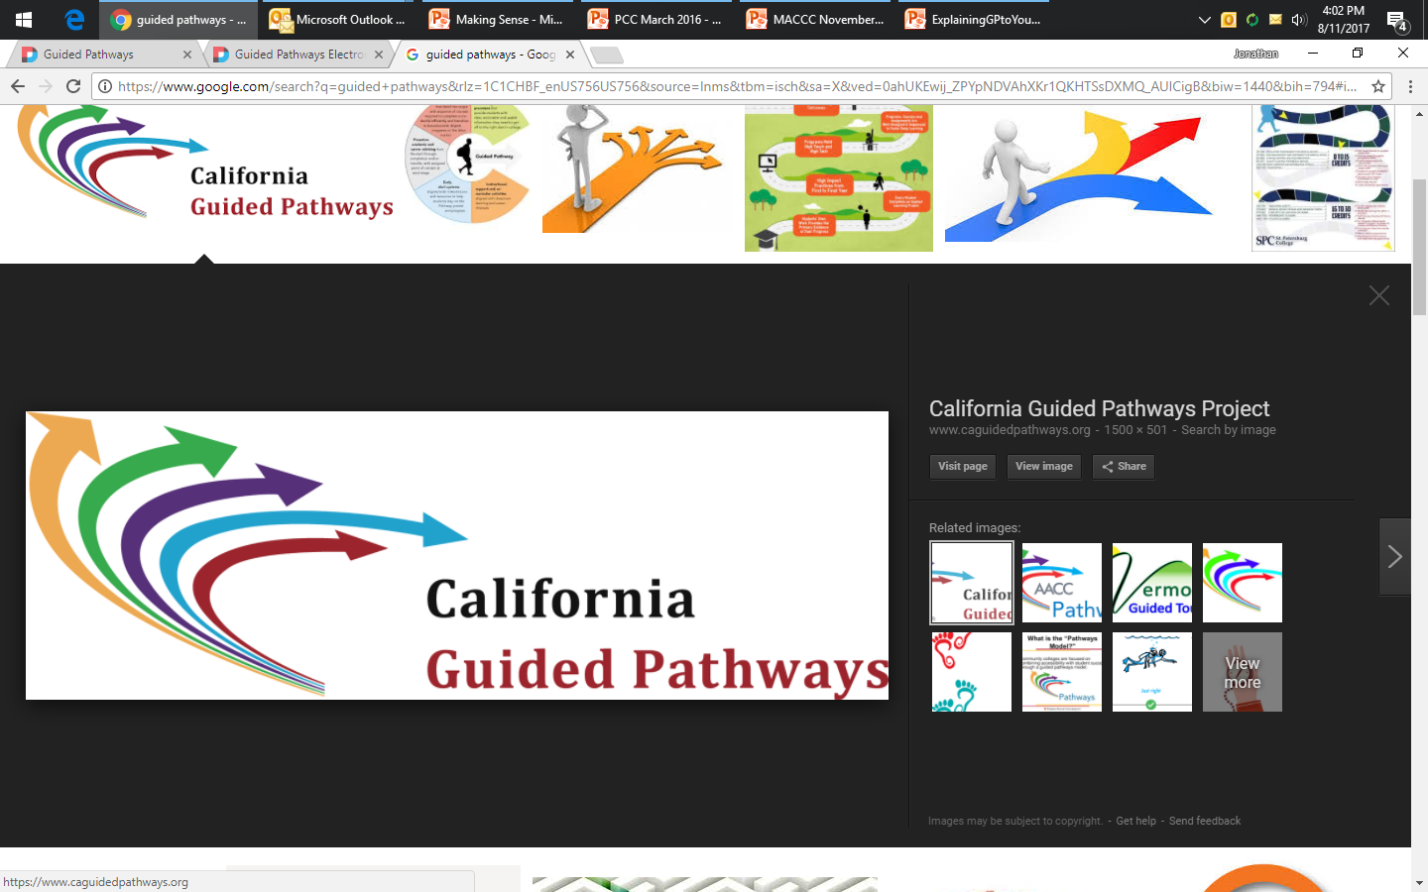

Slide 23


Four Pillars of Guided Pathways
Create clear
curricular
pathways to
employment
and further
education.
Help students
choose and
enter their
pathway.
Help students
stay on
their path.
Ensure that
learning is
happening
with
intentional
outcomes.

Slide 24
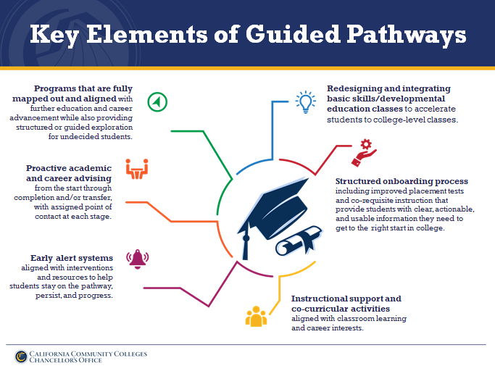

Slide 25
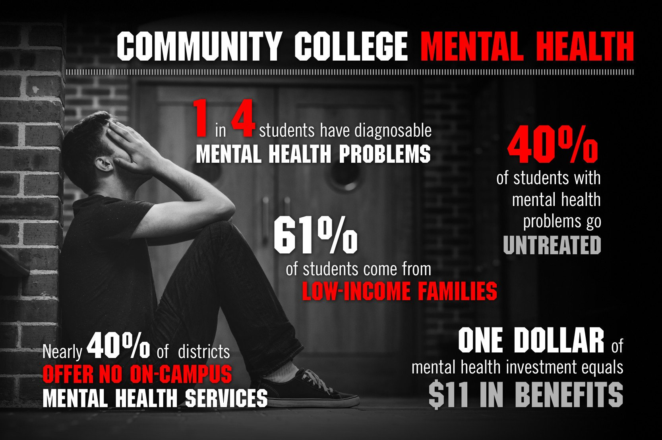
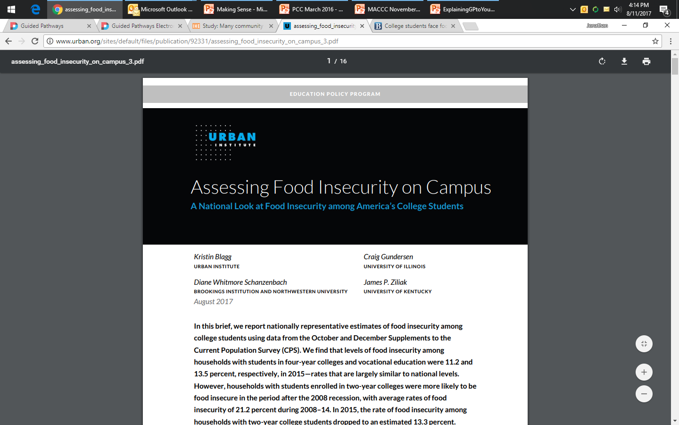
Legislative Interest
From 2008-4, 21.2% percent of households including two-year college students reported experiencing food insecurity.

Slide 26
Percent of Credit Classroom Instruction Taught by Full-Time Faculty

Slide 27
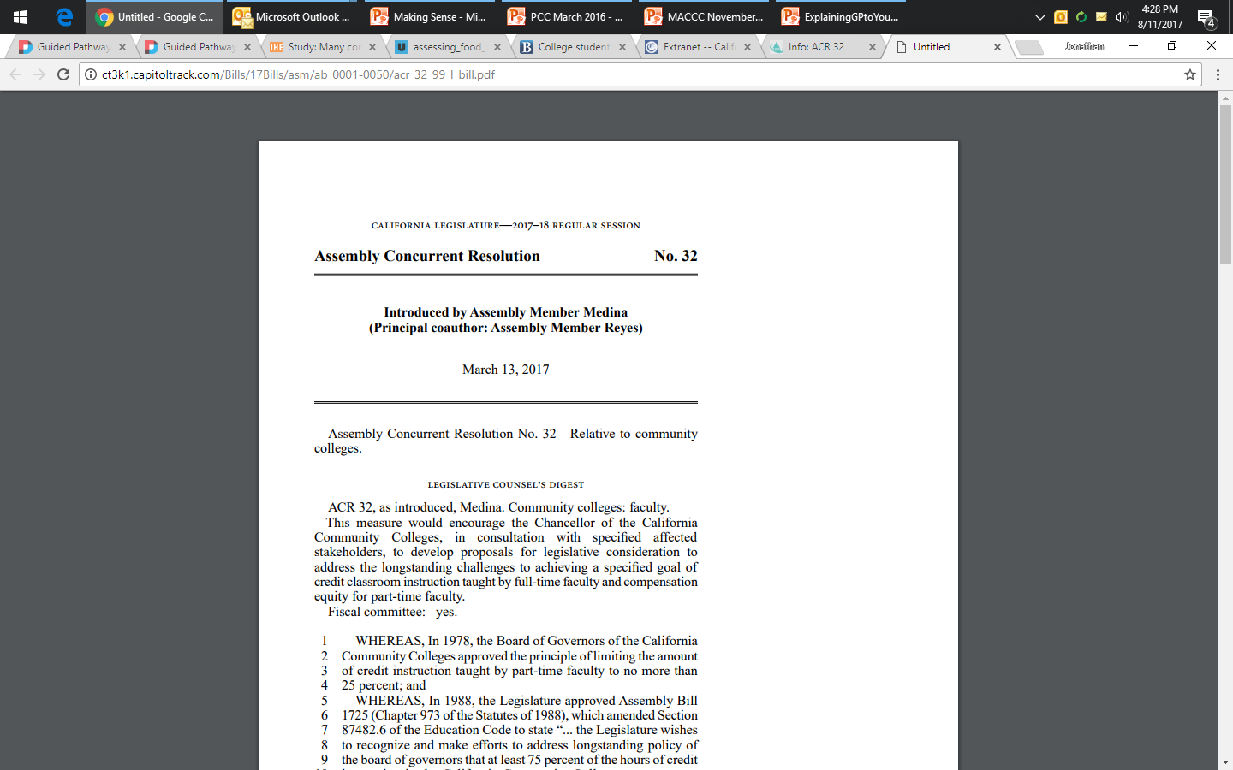

Slide 28
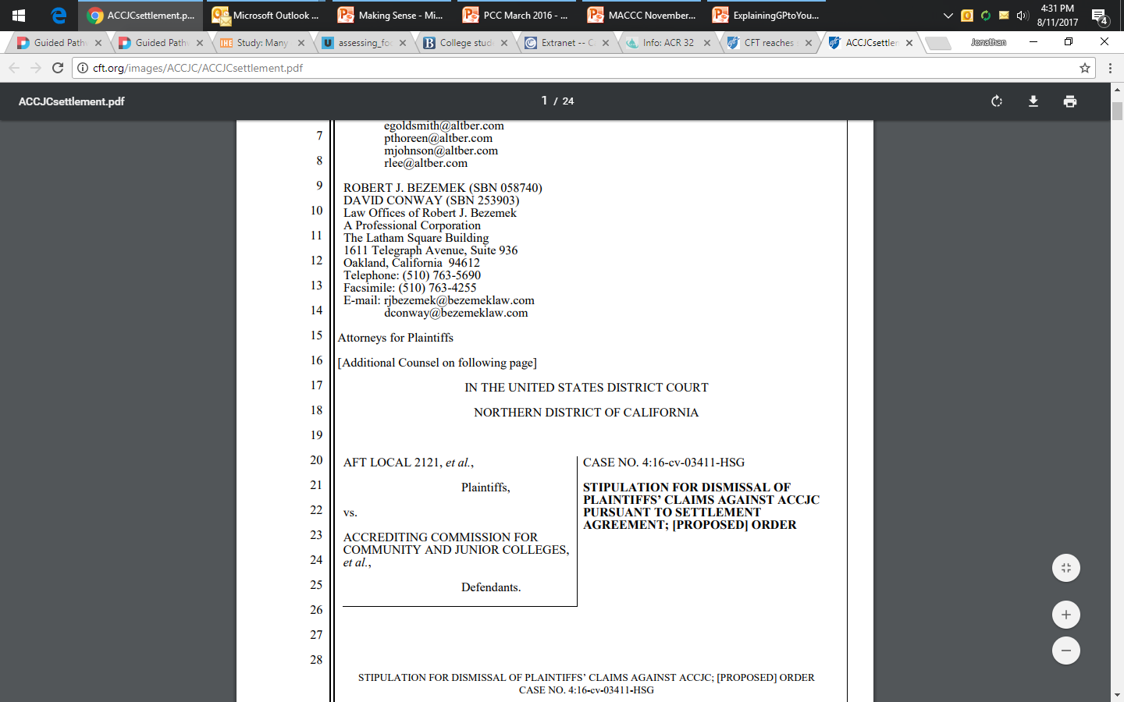
SETTLEMENT REACHED

Slide 29


Slide 30


Two Paths Forward
The whole idea of Red States and Blue States is PowerPoint fiction based on simplistic depictions and stereotypes. The fact is, states aren't Red or Blue; communities aren't;
even individuals aren't.
So now is the moment to reach into these supposedly irredeemable places, because millions of people in those Red States are reaching out in pursuit of tests, challenges, and progress no matter what their throwback legislators say.
Daily Kos
California vs the Rest of the Country:
Which Way Forward?

Slide 31
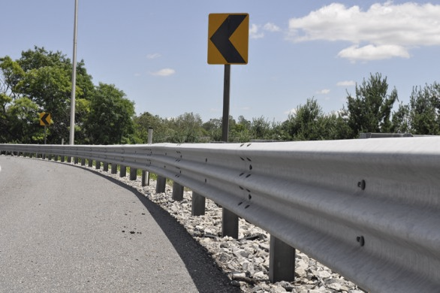
Beyond anything else, we must rebuild the guard rails of democracy for a brighter and more stable future.
Notes:
David Frum, The Atlantic, How Donald Trump exploited the seven broken guard rails of democracy

Slide 32

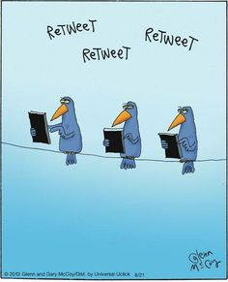
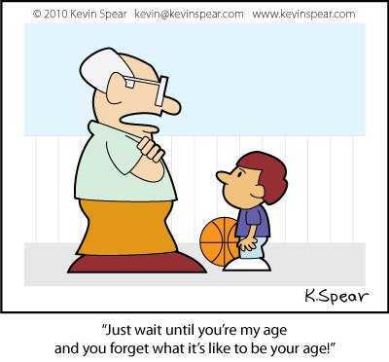
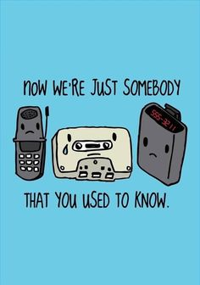

Slide 33
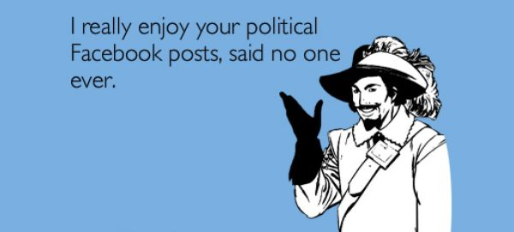

Slide 34
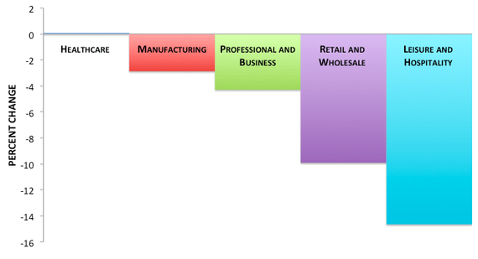
Young People's Wages Fell Across Industries Between 2007-13

Slide 35
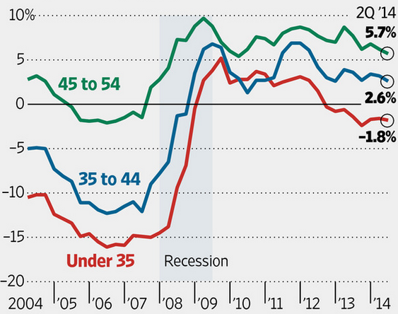
Savings Rates by Age, 2004-14

Slide 36
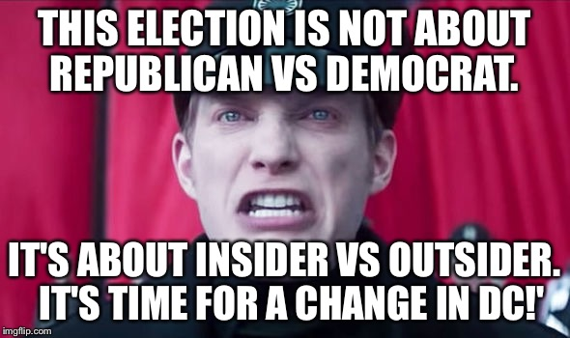

Slide 37
Characteristics of Millennials
(Born After 1980)
Distrust
Trust
Institution of Marriage
Friends
Organized religion
Friends
Politics
Friends

Slide 38
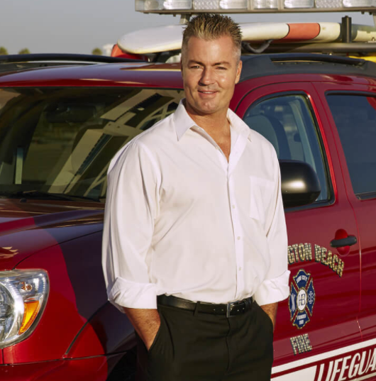
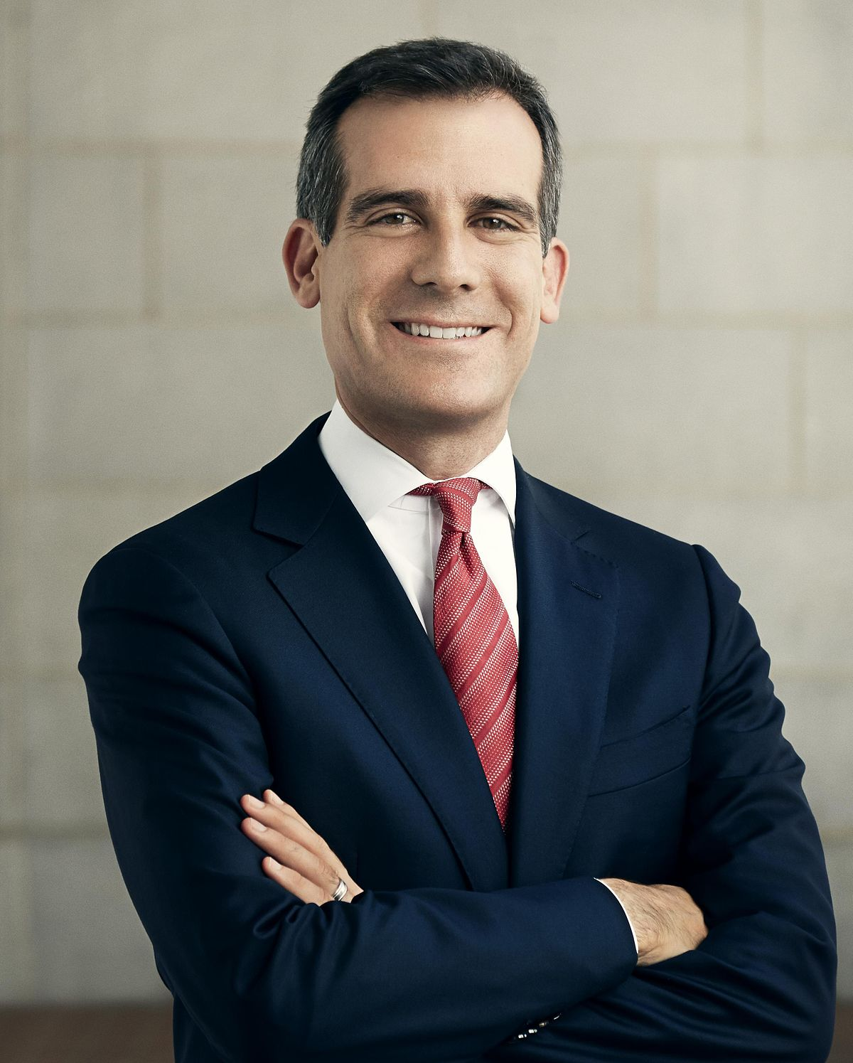
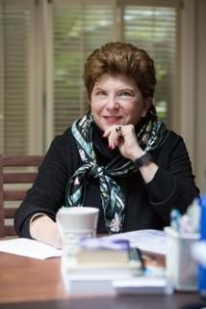





Next Election
State

Slide 39


Looking Ahead
Federal

Slide 40



From Here and Back

Slide 41

Understanding Our State
Understanding Our Students

Slide 42

California’s changing Population

Slide 43
California’s aging population

Slide 44






Slide 45









Five Californias
Struggling California = Next 38 Percent
Shangri La’s = Top One Percent
Main Street = Next 38 Percent
Metro Coastal = Next 18 Percent
Forsaken Five = Bottom Five Percent

Slide 46



Slide 47
America’s Disappearing
Economic/Social Mobility
“The odds that a young person will be in higher education
if his or her family has a low level of education are
particularly small in the U.S.”

Slide 48

Who in the OECD
has the greatest
return on investment in
postsecondary education?

Slide 49


Slide 50
“…best political voice for community college faculty in the state.”
~ Sacramento News & Review

