Slide 1


Slide 2
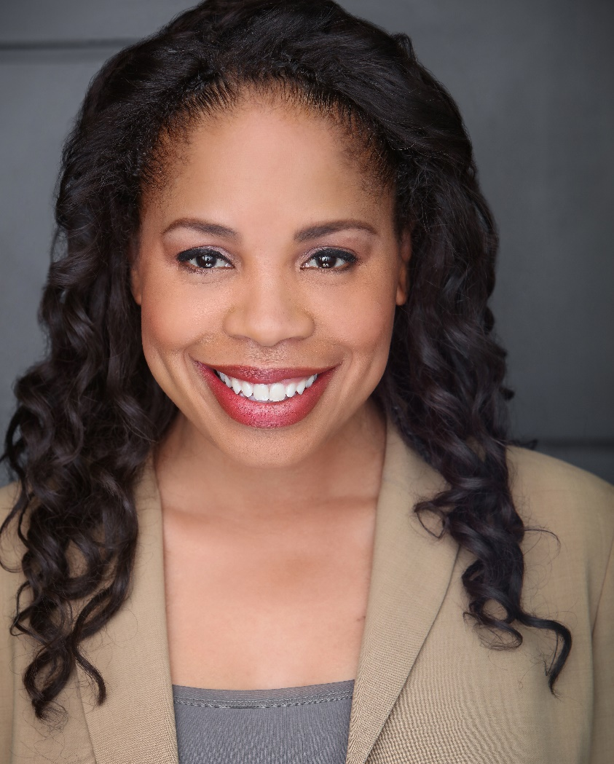
President’s Welcome
Dr. Jamillah Moore
College President

Slide 3
Welcome
Diana Tedone-Goldstone
Academic Senate President
Jeanne Stalker
Classified Senate President

Slide 4
Welcome New Faculty & Staff
Aricka Bueno - Counselor-CWA, Humanities
Mahitha Rao - Retention Specialist, Student Services
Ramakrishnan Kalyanaraman - Science Instructor,
Science & Technology
Matais Pouncil - Interim Dean of Enrollment Services, Student Services
Linda Bertellotti - Executive Assistant, President’s Office
Celia Arceo - Financial Aid Technician, Enrollment Services
Janette Linares - Temporary Promise Counselor, Student Services
Hyla Lacefield - Interim Dean of Business, Design, & Workforce,
Office of Instruction
Ameer Thompson - Dean of Science and Technology,
Office of Instruction
Esha Pillay - Instructional Aide-CWA, Humanities
Joel Sanchez Cortez - Instructional Aide-CWA, Humanities
Autumn McMahon - Retention Specialist, Humanities
Ariackna Soler - Financial Aid Director, Financial Aid
Mayra Arellano - Director of High School Transitions,
Student Services
Bettina Lee - Director of DRC, DRC Department
Kiran Malavade - Humanities Instructor, Humanities
Jose Zelaya - Project Director, Humanities
Julie Luu, Science Instructor, Science
Krystal Martinez - Division Assistant, Science & Technology
Damany Fisher - Regional Director, Office of Instruction
Olivia Cortez-Figueroa – Interim College Recruiter, Student Services

Slide 5
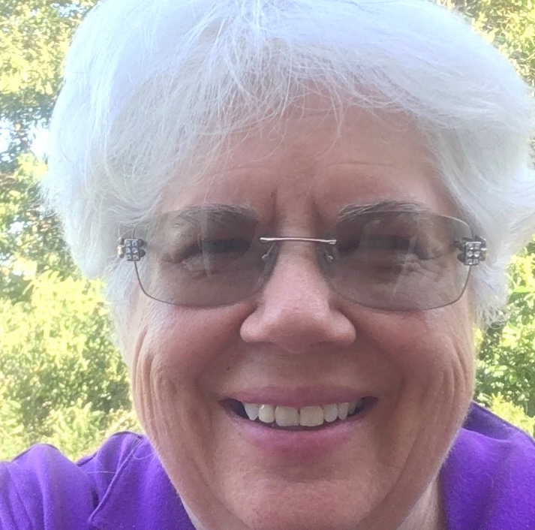
Cañada College – 30 Years Service Awards
Anne Nichols
Professor, Cooperative Education

Slide 6
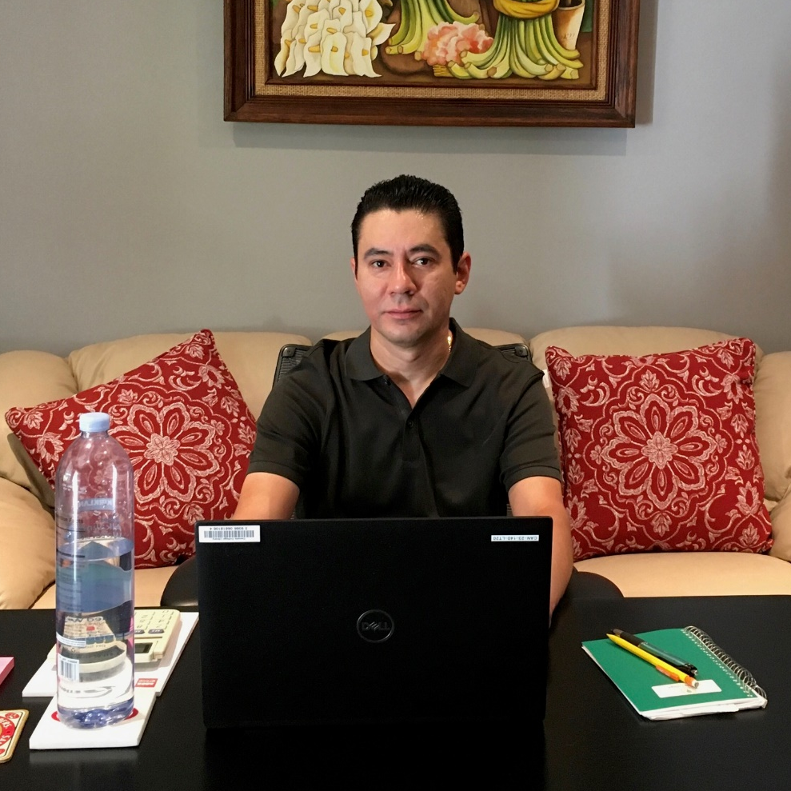
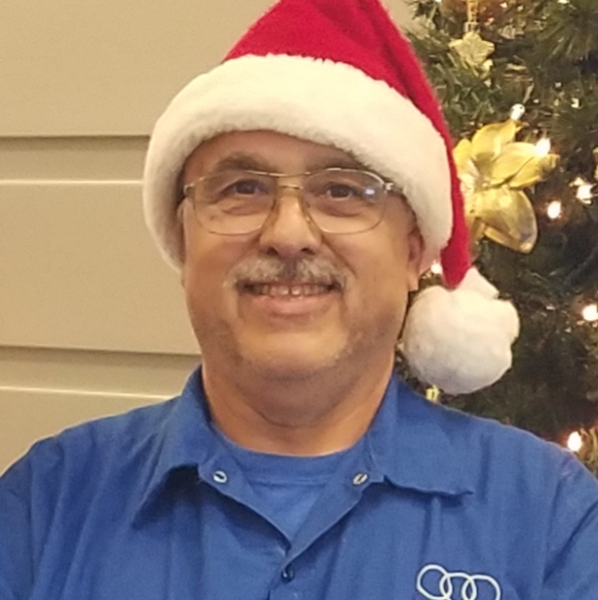
Cañada College – 25 Years Service Awards
Mario Peña
Joe Rodrigues
Accounting Technician
Custodian

Slide 7
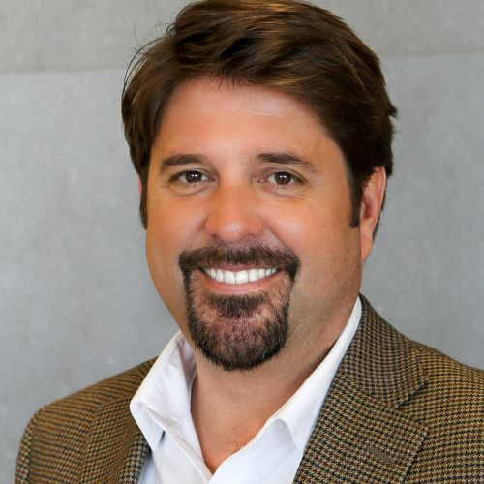
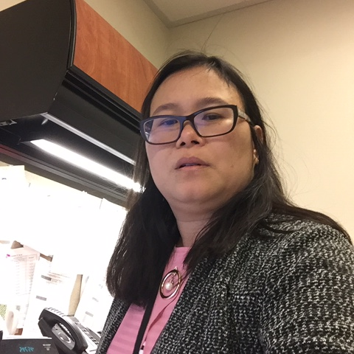
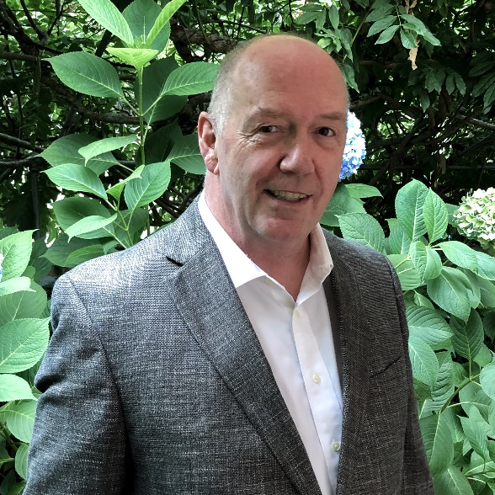
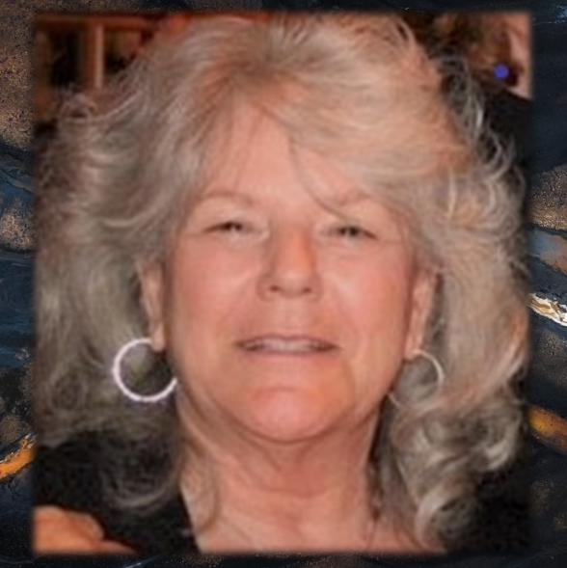
Cañada College – 20 Years Service Awards
James Carranza
Christine Huynh
Martin Partlan
Charlene Suda
Dean, Humanities and Social Sciences
Payroll Technician
Professor, Physics
Instructional Aid II, Computer Business Office Technology

Slide 8
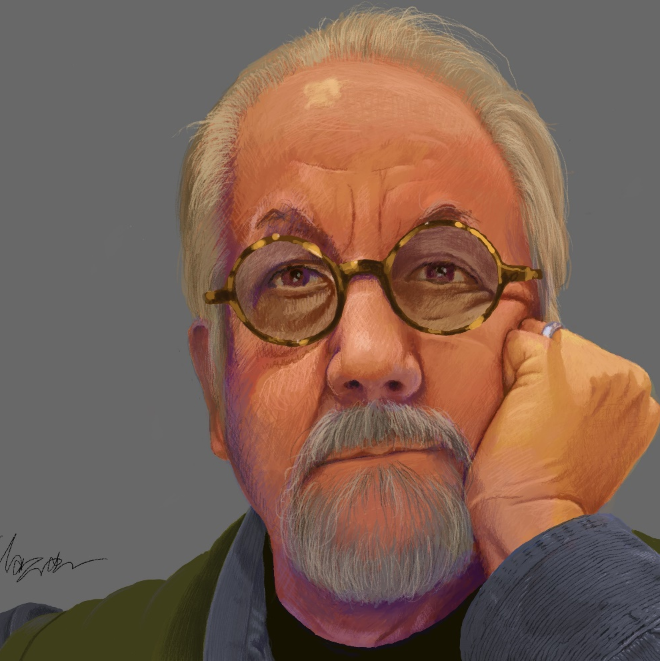
Cañada College – 10 Years Service Awards
James Khazar
Assistant Professor, Digital Art and Animation

Slide 9


Cañada College – Leadership Retreat
50+ student, faculty, classified staff leaders and administrators came together for two days last week for our 2nd annual Leadership Retreat
Developed a draft Anti-Racist Framework for the College
Refined our top 6 strategic priorities for 2020-21
Join a discussion on these topics at 12:30 today!
See more information at: https://canadacollege.edu/prie/canada-collaborates.php

Slide 10
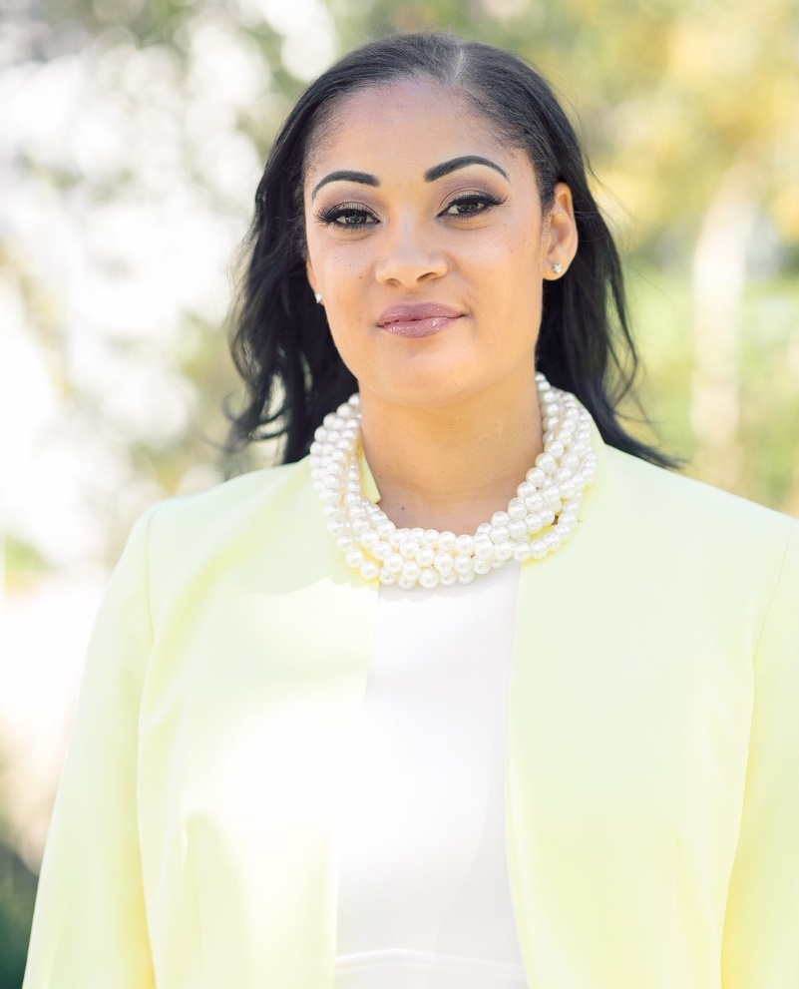
Keynote Speaker
The Honorable
Antoinette Morris

Slide 11
9:30 am - 10:45 am | Explore the Functionality of Microsoft Teams Victor Quintanilla | Navigate the Educational Transitions Affected by COVID-19 [CARES] Manuel Pérez | Online Tutoring with the Learning and STEM Centers Josue Alcaraz & Julian Taylor
 | Webinar link: https://smccd.zoom.us/j/99461864428 | Webinar link:: https://smccd.zoom.us/j/92103661012 | Webinar link: https://smccd.zoom.us/j/97862770241
 | Break
11:00 am - 12:15 pm | Combined session from 11:20am – 12:50pm Tips and Tricks for Zoom meetings & Maximize your Adobe Cloud Tools Daman Grewal and Chris Smith Webinar link: https://smccd.zoom.us/j/98387611579 | Supporting Your Asian/Asian American Students and Colleagues During COVID-19 Chili Montian, Mary Ho, Michiko Kealoha, and | Program Review Update Alex Claxton & Allison Hughes
 |  | Pisith Keo | Webinar link:
 |  |  | https://smccd.zoom.us/j/91727711016
 |  | Webinar link:
 |  | https://smccd.zoom.us/j/94805877836
12:15 pm– 12:30 pm | Break
12:30 pm - 1:45 pm | Continued Discussion: an Anti-Racism Framework and 2020-21 Strategic Priorities for Cañada College Karen Engel & Manuel Pérez https://smccd.zoom.us/j/92783838274?pwd= VUdycTl3VHRiQi9qM243OFZvMFFaZz09 | Assessment Training and Drop-in Support (includes Canvas & TracDat) Jessica Kaven & Allison Hughes | Faculty Evaluation Procedures Orientation Elizabeth Terzakis
 |  | Webinar link: https://smccd.zoom.us/j/92830203393 | Webinar link: https://smccd.zoom.us/j/98929004446
1:45 pm – 2:15 pm | Break
2:15 pm - 3:30 pm | Distance Education Addendums Candice Nance & Nick DeMello | District-wide speaker: Dimensions of Gender Joel Baum, Gender Spectrum | Stress Management & Tai Chi Marina Noel Webinar link: https://smccd.zoom.us/j/94332283668
 | Webinar link: https://smccd.zoom.us/j/99720342762 | Webinar link: https://smccd.zoom.us/j/97909904182?pwd= N1RnbGQ3Y3VjUFQyem1yZFlMTXlIdz09
 |  | This session is 2:15pm – 3:45pm

Slide 12

Flex Day

