Slide 1

Supporting Our Undocumented Community

Slide 2
Today’s Outcomes
Acknowledge the challenges and opportunities facing our undocumented community
Describe the current policies affecting our students: AB 540, CA DREAM Act, and DACA
Identify strategies to support students and create institutional change
Notes:
UndocuAlly is a term used to identify campus allies for undocumented students. The UndocuAlly training is designed to provide the basic knowledge, skills, and resources needed to serve and work alongside undocumented students. Participants will receive an overview of current laws and policies affecting undocumented students in California, reflect on culturally proficient allyship, identify practices for serving undocumented students, and commit to making their support visible on campus.

Slide 3
Today’s Agenda
Introductions
Testing Our Knowledge
Our Undocumented Community
Political and Legal Context
Educational Access in California
Updates on DACA
Becoming An Ally
Effectively Supporting Students
Creating Institutional Change
Notes:
Testing our knowledge: federal, state, local, campus

Slide 4
New Staff Member
Brenda Martinez, Cañada Dream Center Staff Assistant
Location: Dream Center (9-219B)
Hours:
Monday: 10:30am-6:00pm
Thursday: 9:30am-3:30pm
Friday: 9:30am-3:30pm

Slide 5
Testing Our Knowledge

Slide 6
Our Undocumented Community

Slide 7
Our Undocumented Community
“Undocumented” refers to a foreign national who entered the US without authorization OR entered legally as a nonimmigrant but remained without authorization
3 million undocumented immigrants in CA
57,000 undocumented people in SMC
A “mixed-status family” is a family whose members include people with different citizenship or immigration statuses
Example: a family in which the parents are undocumented and the children are U.S.-born citizens
Notes:
Source: Migration Policy Institute (MPI) analysis of U.S. Census Bureau data from the 2014 American Community Survey (ACS)
Undocumented can mean a lot of different things; there is no one profile for an undocumented student (could be any race or nationality; may have over-stayed a visa, entered the country without authorization or fallen out of status for any one of a number of reasons).
Number of undocumented students is unknown and notoriously difficult to count. However, based on county statistics we know that one in three SMC residents is foreign born and an estimated one in four immigrants is undocumented, so perhaps one in seven people.

Slide 8
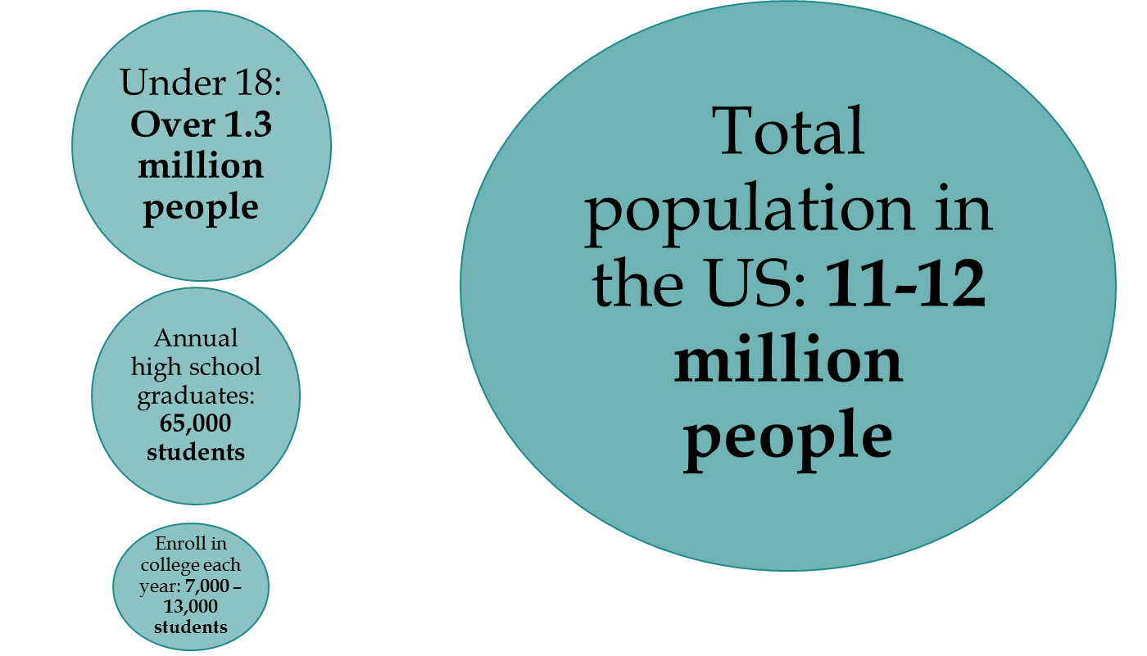

Slide 9
Undocumented Immigrants in the U.S.
About 11 million undocumented
4.5M citizen children have at least one undocumented parent
1.3M undocumented Asian immigrants
400,000-600,000 undocumented immigrants of African, Afro Latino and West Indian descent
Source: Pew Hispanic Center and Department of Homeland Security
Notes:
Of the 40.4 million immigrants it is estimated that about 11.4 million are undocumented. Of the undocumented group approximately 1.5 are ages 15 to 30. Another .4 million are ages 5 to 13.

Slide 10
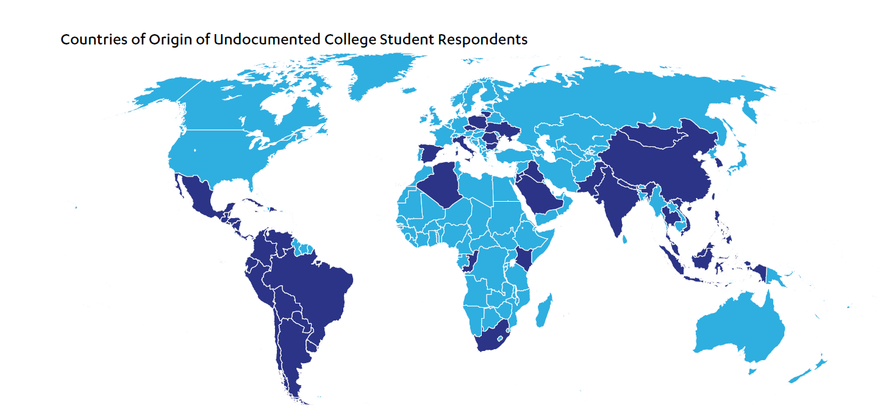
Recognize Diversity
In the Shadow of the Ivory Tower, 2015, UCLA
Notes:
While the undocumented include people from across the world, the largest groups are from Mexico, the rest of Latin America and Asian. Among Asians, the largest groups are Chinese, Filipino, Indian, and Korean. One in 7 Koreans in the U.S. are estimated to be undocumented
National breakdown of the undocumented children birth counties is 56% Mexican, 22% Latin America, 13% Asian, 6% Europe and Canada, 3% Africa and other regions of the world.
Talk about reasons why 60% from Mexico -- geography, economic conditions in Mexico

Slide 11
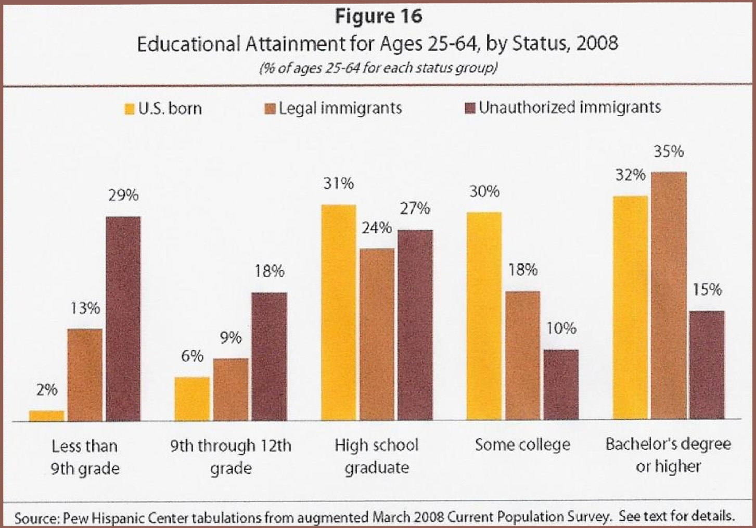

Slide 12
College-Going Undocumented Students
Factors that influence college decision**
Cost: 87.9%;
Location: 64.1%;
UndocuFriendly Climate: 49.8%
Other: 38.2%
College Ranking: 34%
Class Size: 24.9%
**The UndocuScholars Project, The Institute for Immigration, Globalization, & Education, UCLA, In the Shadows of the Ivory Tower: Undocumented Undergraduates and the Liminal State of Immigration Reform, 2014

Slide 13
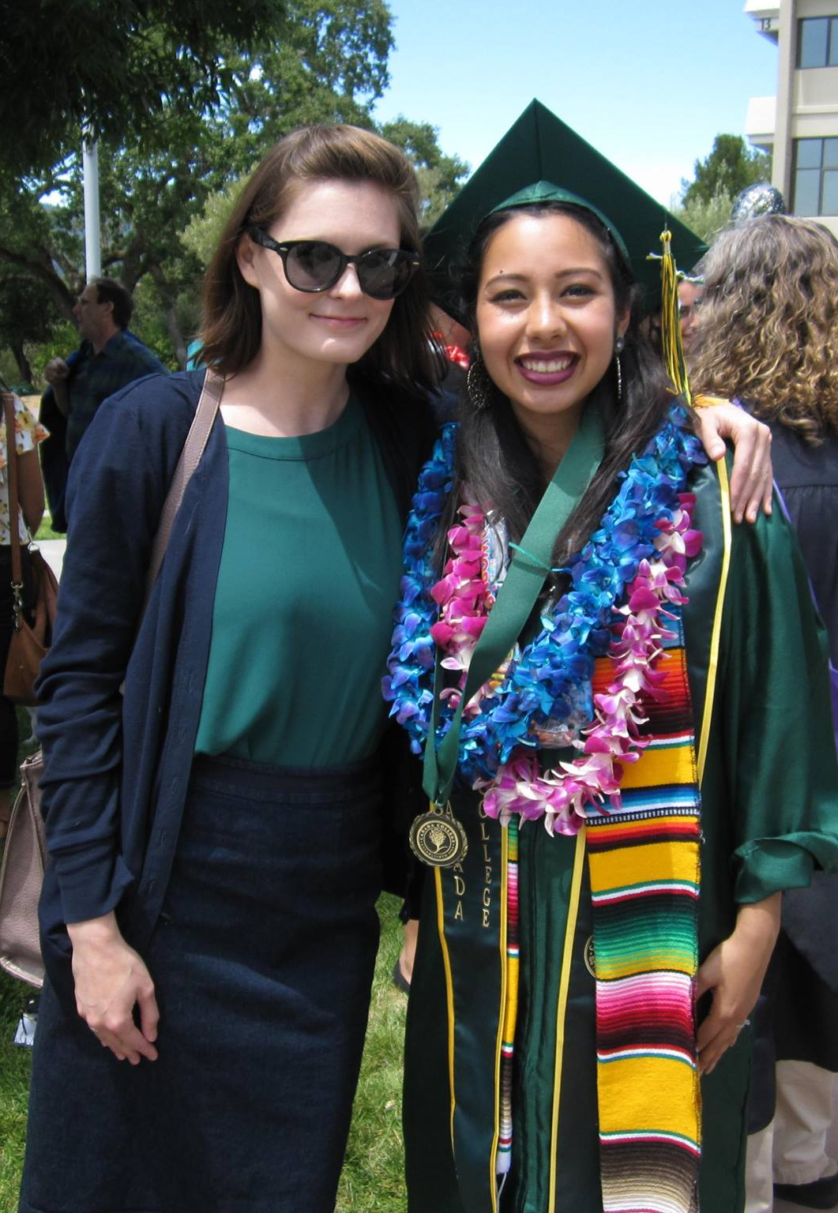
Our Students
Courageous, resilient & resourceful
285 AB540 students enrolled at Cañada (Fall 2017)
Most were brought to the US at a young age
Attended elementary, middle or high school in US
Many more are part of mixed status families

Slide 14
Common Challenges Faced by Undocumented Students
Lack a way to become legal residents/US citizens
Predominantly first generation & low-income
Secrecy vs. need for support
Difficulty accessing institutional support
Inability to receive federal financial aid
Lack of familiarity with financial aid process

Slide 15
Institutional Deterrents
In a UCLA study of 909 students across 34 states, they reported experiences of being treated unfairly as follows:
Professors - 32.1%` Counselors - 34%
Other students - 55.6% Fin Aid Officials - 47.9%
Campus Admin - 36.5% Security/Police - 30.6%
Source: The UndocuScholars Project, The Institute for Immigration, Globalization, & Education, UCLA, In the Shadows of the Ivory Tower: Undocumented Undergraduates and the Liminal State of Immigration Reform, 2014
Notes:
2 min.
Bring awareness to these that can impact student’s ability to succeed and graduate from college
Fall under two categories: lack of knowledge and unwelcoming attitude
__________________
Pew Research Center estimates that there are 200,000 to 225,000 undocumented students in college, but estimates are based on selective four year colleges or within specific states. Ultimately colleges can not assume they do not have undocumented students.”
UCLA Study by Robert Teranishi, Marcelo Suarez-Orozco, Carola Suarez-Orozco, In the Shadows of the Ivory Tower: Undocumented Undergraduates and the Liminal State of Immigration Reform, 2014
“Teranishi hopes that those in higher education can look at this information not as part of a politicized debate about immigration, but as information to help serve students. These students have been admitted, he say, so colleges should make it a priority to help them succeed.” “Colleges should review policies such as financial aid, admissions and internships, and offer training for faculty and staff. Colleges could also create support groups or centers specifically for undocumented students, so they have a place to go to share concerns and seek resources.”

Slide 16
Transition to a Nightmare
2.1 million have been in the US since childhood
Protected Status
Transition to Adulthood
Awake to a Nightmare
K-12 education is free and legal
Most institutions in childhood do not require legal status
Immigration status rarely limits activities
Late adolescence triggers legal limitations due to immigration laws
-Working
-Driving
-Education
-Financial Aid
-Socializing
Succession of blocked opportunities
Fear, stigma, changed social patterns
Forced decisions—reveal or conceal
Physical/ emotional manifestations
Gonzalez, Roberto G., Learning to be Illegal: Undocumented Youth and Shifting Legal Context in the Transition to Adulthood, Sage, American Sociological Review, 2011.
Notes:
1. Plyler allows K- 12 children to live normalized lives, free from knowing that he or she is undocumented. Some children grow up not knowing they have no papers, and come to believe they have the same future as US citizen children will have—They learn that hard work and educational achievement will garner rewards in their future and are rewarded for accepting that notion.
2. The surprise comes when they apply for work, driver’s license and find that they cannot legally work or drive because they lack a SSN.
Many students do not know that they are undocumented. Many of those that find out and have no school support leave school as they find no purpose to pursue education and family obligations and expectations of helping to support the family take precedence.

Slide 17
Living in fear
Immigrants face new challenges and trauma under Trump administration
Increased deportations/ICE agents
Muslim ban
Threats against sanctuary cities
DACA rescission
Scapegoating in the media
Students have reported increased discrimination as a result of the above (The Psychological Harm of Anti–Immigration Policies: webinar slides--start at 16)

Slide 18
Political & Legal Context

Slide 19
Stay informed about changing laws and policies
Identify key laws affecting undocumented students
Federal: DACA
State: AB 540, AB 130/131, SB 1159
Review district policies and FAQs
Take advantage of professional learning opportunities

Slide 20
Undocumented Students: AB 540 and DACA
Undocumented
Students
DACA
Students
AB 540 Students
Notes:
AB 540 is a CA state law that went into effect in 2001. It allows a qualifying student who would otherwise not be eligible for in-state tuition to pay in-state tuition fees at any UC, CSU, or CA community college. Not all AB540 students are undocumented, but many are.
DACA is a federal program that allows for temporary relief from the threat of deportation or detention.

Slide 21
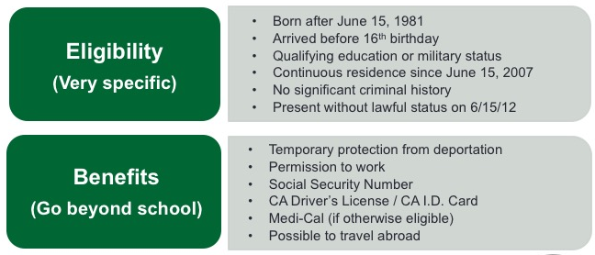
Federal Policy: Deferred Action for Childhood Arrivals (DACA)

Slide 22
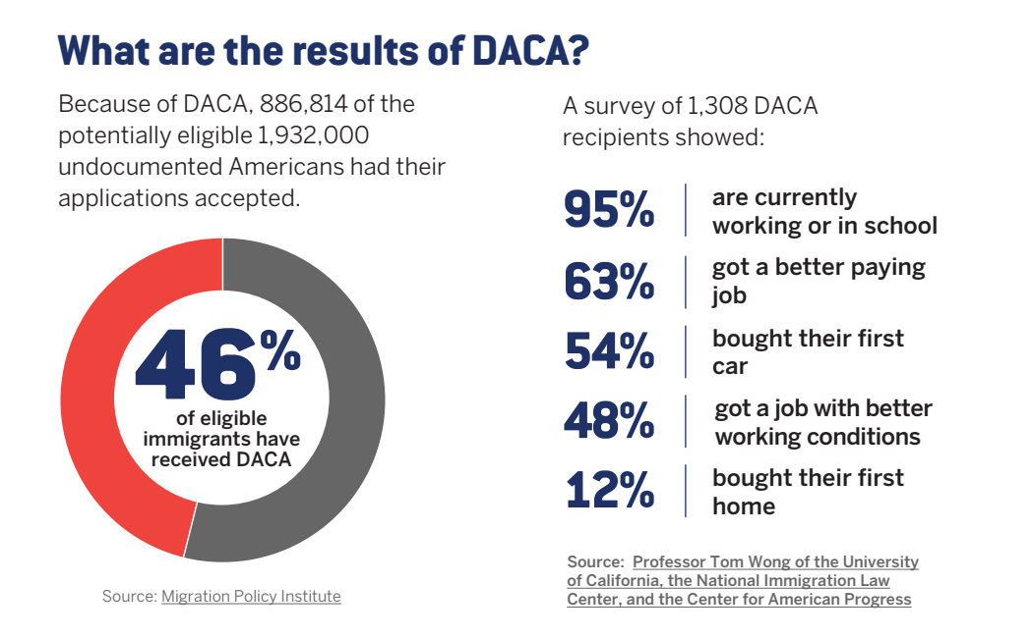
DACA Fact Sheet defineamerican.com
Notes:
25% in CA
est. 7,000 in San Mateo County

Slide 23
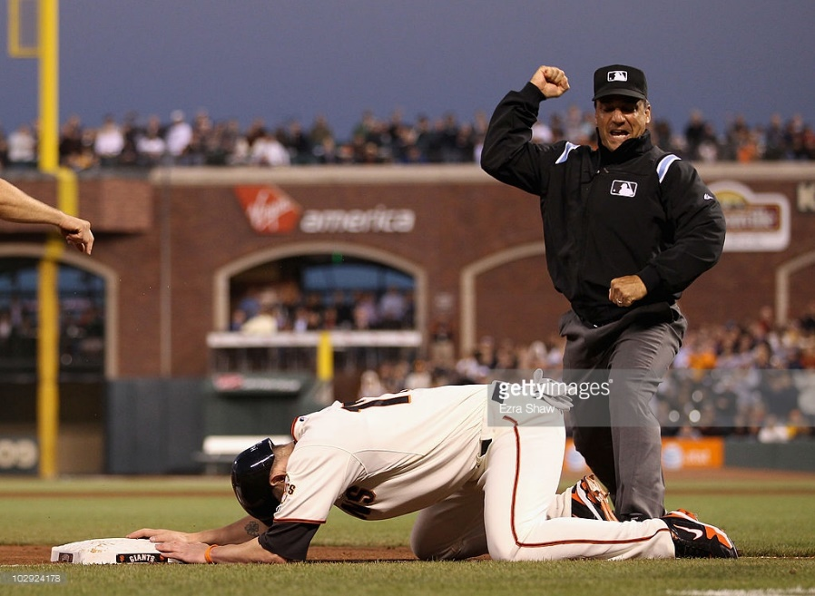

September 5, 2017: DACA Rescission
DACA
AB 540
Notes:
“The questions we’re getting from these students are about trying to make decisions about whether they should stay in school,” Perez said. “Should they leave school and work for the next six months? And our message has been really clear that we want students to be here. We want them to really be invested in their education because we know that getting their education is going to be the best thing for them moving forward.”

Slide 24
Federal Policy: The End of DACA
Notes:
Currently 122 people lose DACA every day. That is more than 12,000 since the announcement on Sept. 5, 2017.
(The logic behind these numbers is straightforward: The 22,000 eligible DACA recipients who did not successfully apply to renew their DACA will, as a result, see their DACA protections expire in the 181 days between September 5, 2017 and March 5, 2018.)

Slide 25

State Policy
CA community colleges are open access institutions and serve all students regardless of immigration status
http://www.cccco.edu/ResourcesforUndocumentedStudents.aspx
Notes:
We are lucky to be in California, and part of a statewide community college system that has clearly articulated support for undocumented students. “the Chancellor’s Office has reassured colleges that no changes have been made with regard to admissions or financial aid; informed students that financial aid for undocumented students is protected by state law; called on President- elect Donald J. Trump to preserve DACA”

Slide 26
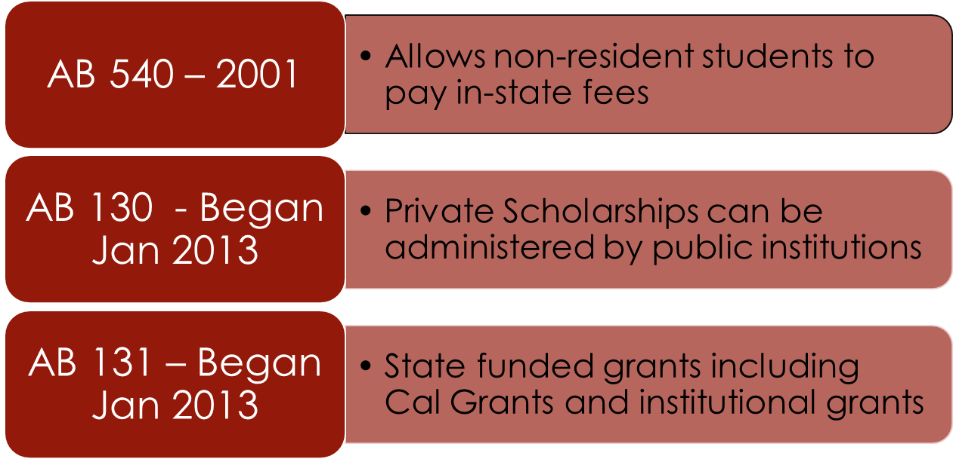
State Policy: California Legislation
Notes:
PAM

Slide 27
AB 540 Overview
Provides support for some, but not all undocumented immigrant students
Came to U.S. at an early age
Raised in U.S.
Often do not find out until high school graduation that they are undocumented
Some are not covered as AB 540 students because of the requirements

Slide 28
WHY AB 540 is SO IMPORTANT Resident vs. Non Resident Fees
Full Time Tuition/Fees 12 units per Semester | SMCCD | San Francisco State University | Eligibility for CA Dream Act Financial Aid
Resident, AB 540 or 2000 | $552 | $3,190 | YES
Non-Resident, Undocumented or International | $3,320 | $7,654 | NO
Notes:
Resident/AB 540 Fees
$46 per unit
Non-Resident Fees
$228 per unit (plus $8 per capital outlay fee plus $46 per unit enrollment fee)
A standard 3 unit class = $846
A full time (12 unit semester) = about $3,384

Slide 29
Who is Eligible for AB 540?
“Any student, except a person in nonimmigrant status, who meets the specific requirements shall be exempt from paying nonresident tuition at all public colleges and universities in California”
What does nonimmigrant status mean?*
Current nonimmigrant visa holders are not eligible for this tuition exemption: Tourist (F visas) and Student (B visas), etc.*

Slide 30
California Student Aid Commission Promises to Protect Dream Act Students
“CSAC promises not to share information with federal authorities and DACA status is not required to apply for CA Dream Act.”
-Executive Director Lupita Cortez Alcalá
Ed Source Article 11/28/16

Slide 31
California Law: SB 1159 (2014)
SB 1159: Effective no later than January 1, 2016, expands immigrants access to professional and occupational licenses by prohibiting state licensing boards within the Department of Consumer Affairs from denying licensure to an other-wise qualified applicant because of his or her citizenship or immigration status. Allows applicants for a professional or occupational license to provide an Individual Taxpayer Identification Number (ITIN) in lieu of a Social Security number

Slide 32
California Law: SB 4 (2015)
SB 4 (Lara) - HEALTH CARE COVERAGE REGARDLESS OF IMMIGRATION STATUS The 2015-2016 State Budget includes investments to expand eligibility to Medi-Cal to all children and youth ages 0-19, regardless of immigration status

Slide 33
California as a Sanctuary State
SB54, by Senate President Pro Tem Kevin de León, D-Los Angeles, bars law enforcement officers in the state from asking about a person’s immigration status or participating in any joint task force with federal officials for the purpose of enforcing immigration laws
Also bars local jails from holding immigrants for any reason if they are cleared for release on their state criminal cases
Law went into effect Jan 1st 2018

Slide 34

District Policy
SMCCD “supports, promotes, values, respects and protects all students and employees of the District, irrespective of their immigration status, or that of their families”
Our colleges are “safe havens”
“Resolution Affirming the San Mateo County Community College District’s Commitment to Supporting Undocumented Students and Student Privacy” (Jan. 2017)

Slide 35
District Policy
Additional guidance for staff and faculty (Spring 2017)
Undocumented & International Students Rights
How to Respond to Requests for Student Information or Whereabouts

Slide 36
Review
What is AB 540?
Will U.S. immigration know where to find a student after enrolling under AB 540?
What are the difference between AB 540, CA Dream Act, and DACA?

Slide 37
Creating an Undocu-Friendly School
“A school that is inviting and public about their support for undocumented students and invests resources in their students by providing information, scholarships and programs.”
#HeretoStay K-12 Toolkit for Educators

Slide 38
Becoming An Ally

Slide 39
Becoming An Ally
How do I create a welcoming, inclusive and equitable environment?
How can I increase support for undocumented students in my office, program, and/or department?
How can I contribute to a conversation about increasing campus-wide capacity to support undocumented students?
How can I be an effective ally and advocate?
What commitment can I make today?
Notes:
2 min.
This is homework to do on your own

Slide 40
Characteristics of an Ally
Allies are knowledgeable, empathic, and willing professionals who:
Provide a safe, nondiscriminatory environment for undocumented students
Respond to incidences of discrimination and harassment
Understand, stay apprised of, and act upon policies that support students
Assist colleagues to understand the fears, needs, concerns of students
Support the academic, professional, personal and social growth of students
Notes:
2 min.

Slide 41
5 Things You Can Do to Support Our Undocumented Community
Stay informed about changing laws and policies 
Know campus resources
Communicate your support effectively to students
Make your support visible
Review policies in your work area

Slide 42
2. Know campus resources
Familiarize yourself with the services and programs available to undocumented students
Post flyers and share information in workshops, orientations, etc.

Slide 43
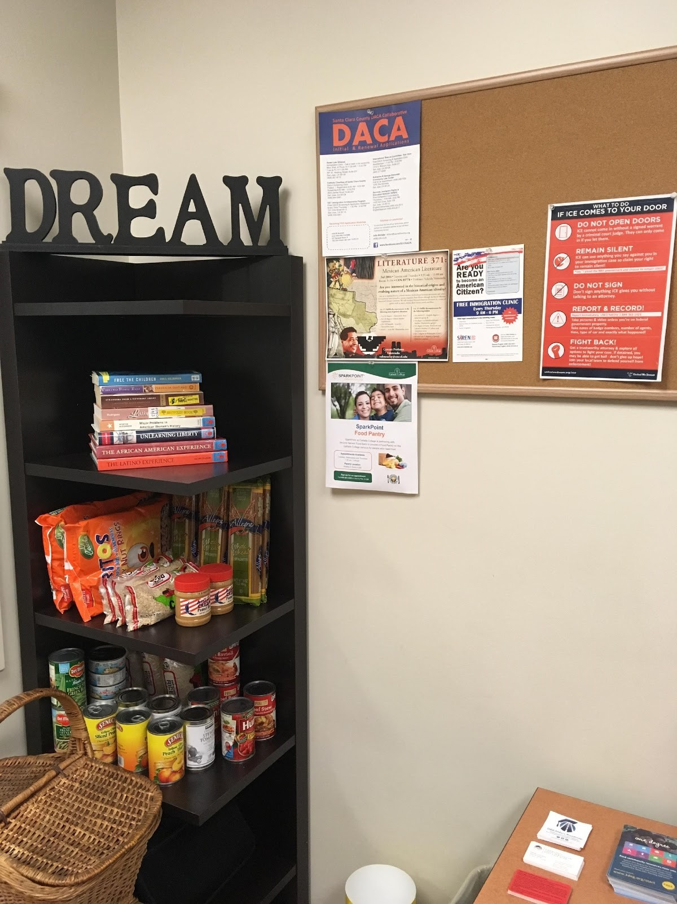
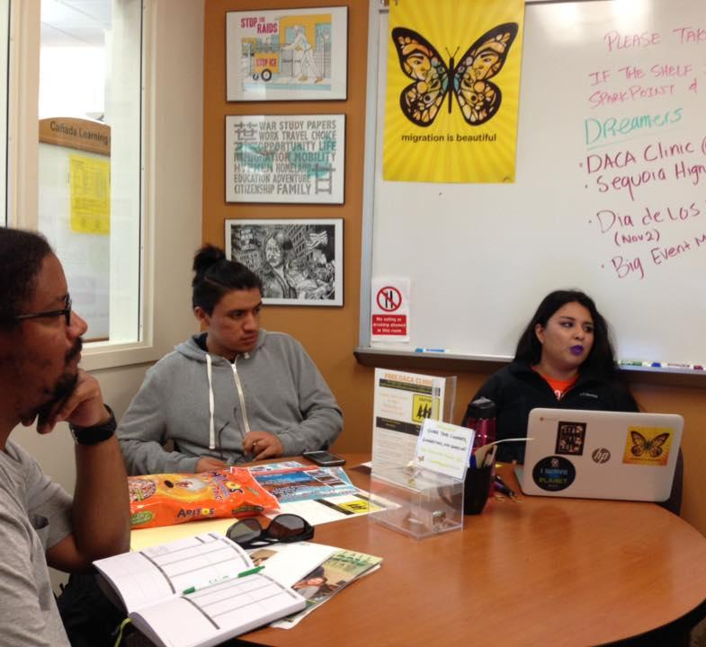

Cañada DREAM Center (9-219B)
Notes:
Services include: free printing, free legal consultations, mini food pantry, DREAMers student club

Slide 44
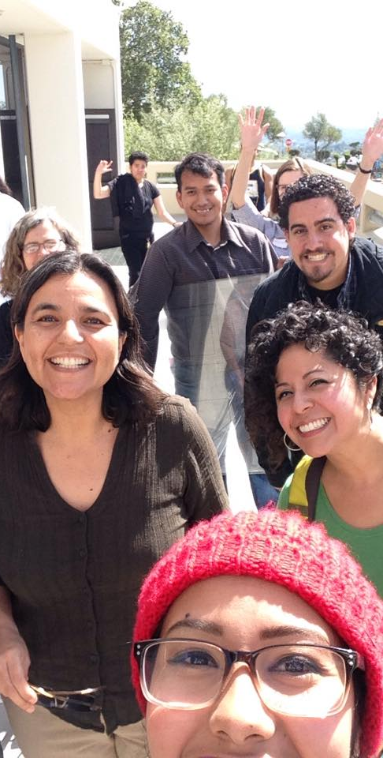
DREAMers Task Force
Part of ACES (Academic Committee for Equity and Success)
Group of faculty, staff, students and administrators
Founded to institutionalize equitable pathways for undocumented students

Slide 45
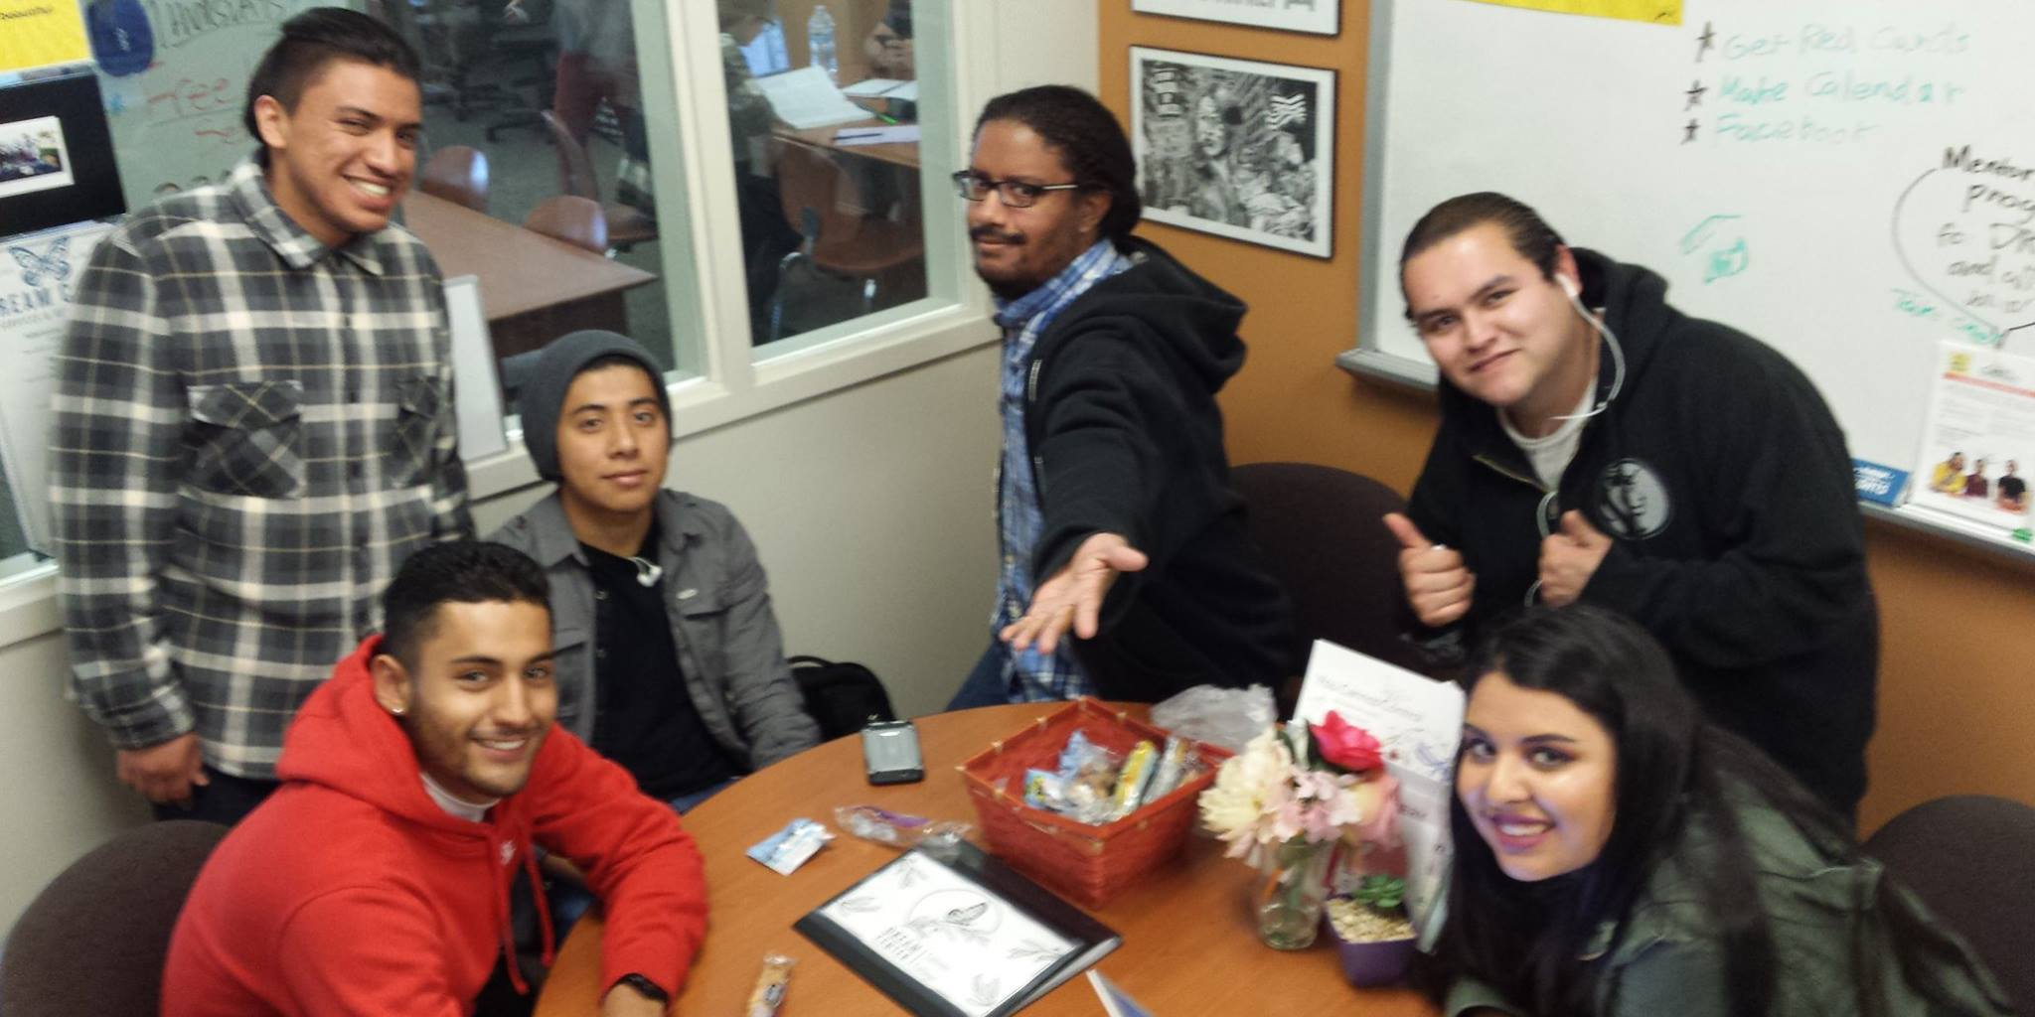
DREAMers Student Club

Slide 46
3. Communicate your support effectively
Remember that political stances on immigration and supporting all of our students regardless of immigration status are two very different things
It is our job to support ALL students
Use affirmative language (“everyone is welcome here”)
Do not attempt to single out or identify undocumented students; instead, make resources for undocumented students available to everyone

Slide 47
3. Communicate your support effectively
Never ask a student to reveal their immigration status or that of a family member
If a student does reveal their status:
Tell them that they are not alone (There are an estimated 11 million undocumented immigrants in the US)
Ensure them that they have rights, and that their privacy is protected (District FAQs)
Connect them with resources

Slide 48
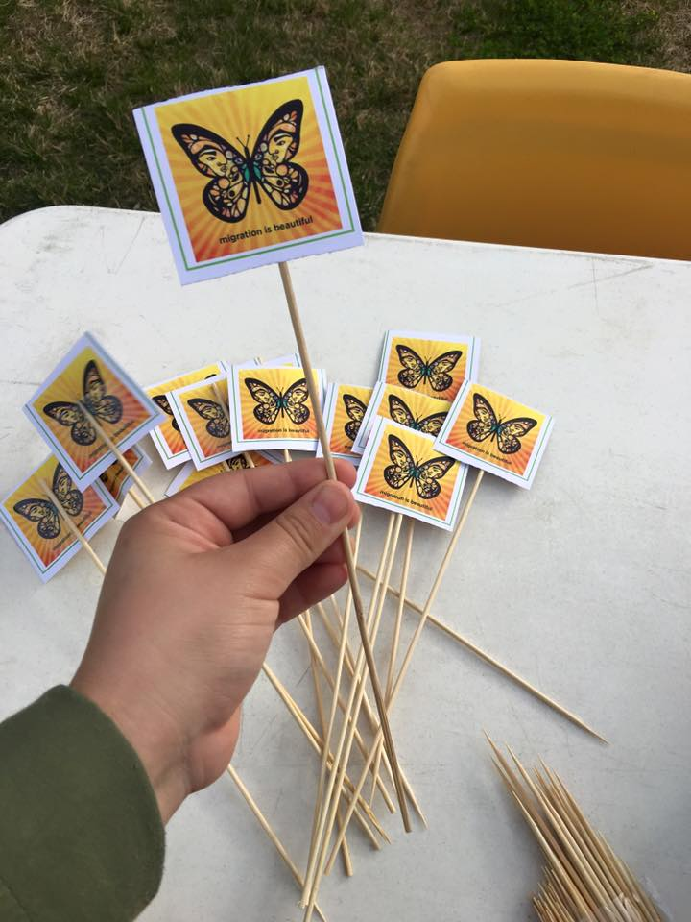
4. Make your support visible
Post a “migration is beautiful” butterfly sticker
Display an unafraid educator sign (see following slides for images)

Slide 49
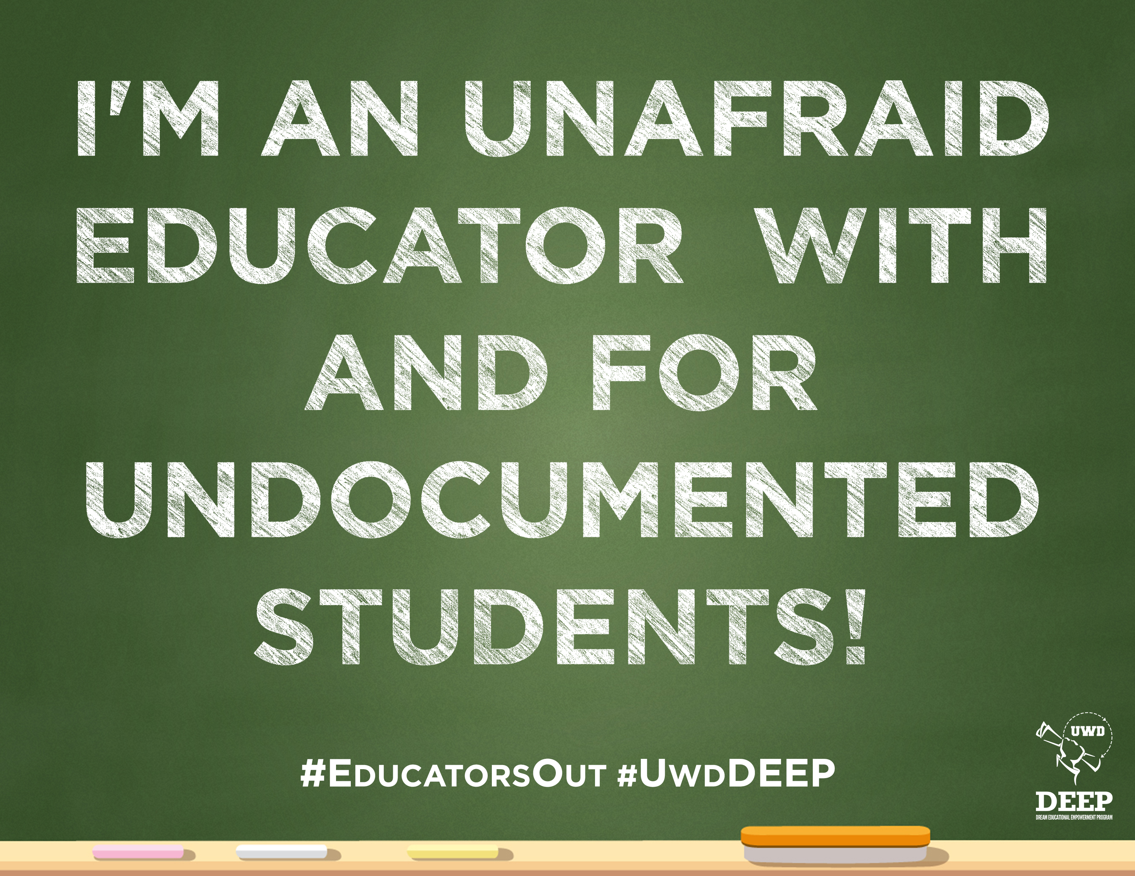

Slide 51
5. Review policies in your work area
Review policies and procedures in your work area from the perspective of an undocumented student to identify barriers and opportunities for improving student access and outcomes
Clarify procedures for undocumented students and always include that information for all students

Slide 52
Putting It Into Practice
After you read the scenario, discuss:
What would you say to this student?
What resources would you give to this student?
Who and/or where would you go to find additional information or support for this student?

Slide 53
What Would You Do?
You observe that some of the undocumented students you know are visibly distraught, depressed, or absent after a recent legislative setback to a bill that would have given DACA recipients a path toward legalization. After asking them about it, some of them tell you that they feel like giving up on getting their degrees and exclaim, “It’s pointless!”
How could an ally respond to the students?
Notes:
Going to college gives you access to benefits (health, legal, etc.); your status may changes, you can’t predict future opportunties.

Slide 54

Want to Learn More?
DREAMers Task Force: email Kristen Parks at parksk@smccd.edu to join the Task Force
DREAMers Student Club: Follow the club on Facebook at fb.com/CanDreamers

