Slide 1
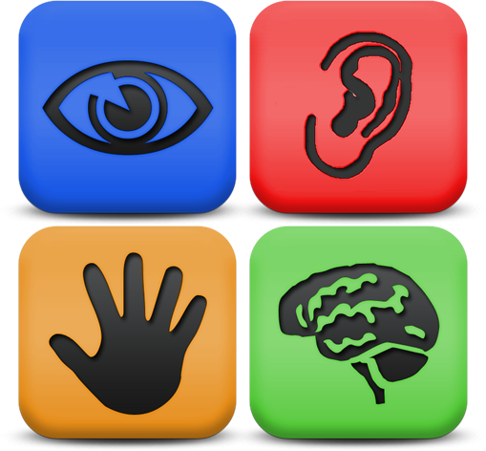
Accessibility, Universal Design, and Our Classes

Slide 2
But first…an introduction…

Slide 3
When you hear the topic of accessibility…
…what first comes to mind?
…what do you think it will require from you?
…how much time do you think it will add to your already maxed work-load?

Slide 4
What does it mean to have your course shell and documents ‘accessible’?
Use of programmed styles in documents
Writing descriptions in Alt-Text for documents, and in all activities and resources in the course shell
Using PDFs that are readable
Videos are captioned
Basically, that anyone can use your material, regardless of their abilities

Slide 5
Do I always have to do this? What if I don’t have any students who need accommodation?
Yes, it’s a very good idea to do this ahead of time.
It takes a lot of time to do it after the fact.
These measures help all students, not just those who need accommodation.
Organization will set you right!

Slide 6

Programmed styles in documents: How do I do this?
Microsoft Office and Adobe products have programmed styles
Use these to create headings in your document
They also help you format your document quickly!

Slide 7
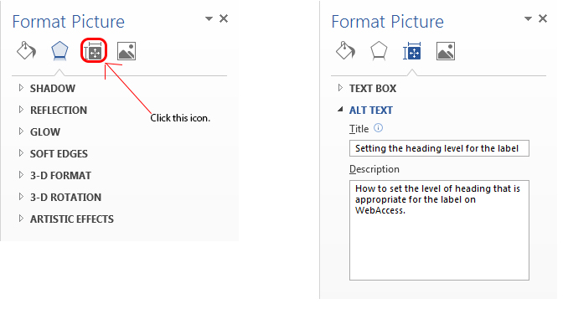
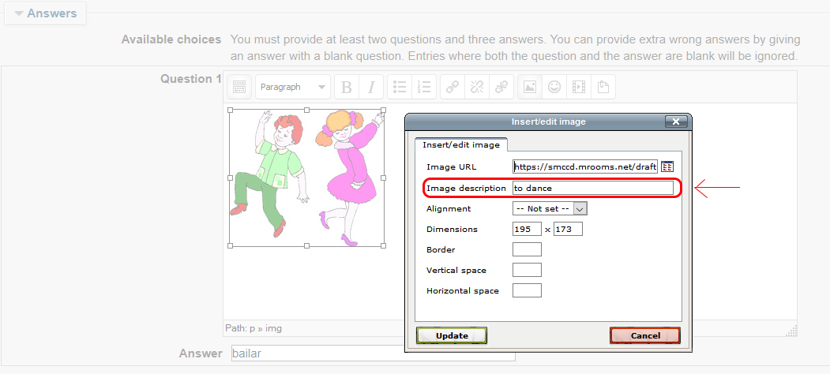
Adding Alt-Text: How do I do this?
In a document, right-click on the image and then click on ‘Format picture….’
In the course shell, when you upload the image, fill in the information in the dialog box.

Slide 8
How do I make sure my PDFs are scanable and readable?
Write documents in Microsoft Word, and then save as PDF.
Don’t scan documents from a copy machine.
If you use a scanner, make sure that the OCR function is set.
Search for digitalized PDFs of articles and books from library databases.

Slide 9
How do I make sure that my videos are captioned?
Use videos that are produced by production companies.
Caption your own videos using Camtasia or similar movie making software.
Use online videos that are captioned.

Slide 10

And now for something completely different…

