Slide 1



Slide 2
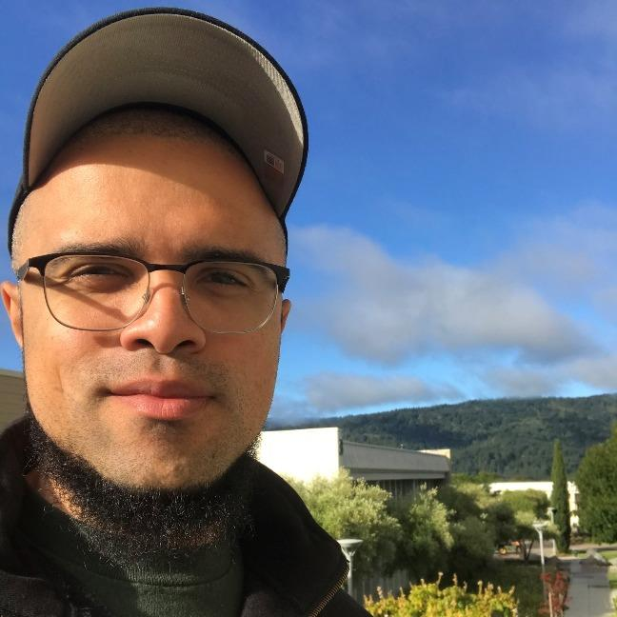



Financial Aid Services
Christopher Wardell
Program Services Coordinator
Jackie Flores-Diaz
Program Services Coordinator

Slide 3

Learning-Aligned Employment Program
Program available until June 2031
Serve underrepresented students
STEM students are given priority

Slide 4

LAEP Underrepresented Criteria
FIRST-GENERATION STUDENT
VETERAN
FOSTER YOUTH
DISABILITY RESOURCE CENTER (DRC) STUDENT
AB540 (UNDOCUMENTED) STUDENT
LOW INCOME
HOMELESS
DISPLACED
FORMERLY INCARCERATED
Further priority will be given to eligible students majoring in STEM.

Slide 5
LAEP Eligibility
Enrolled in 6+ units AND eligible program of study
Good SAP, or be approved for SAP appeal
California resident
Financial need via FAFSA or CADAA
Eligibility to work in United States

Slide 6


LAEP Proposals
Submit Proposal
Approve or Redraft

Slide 7
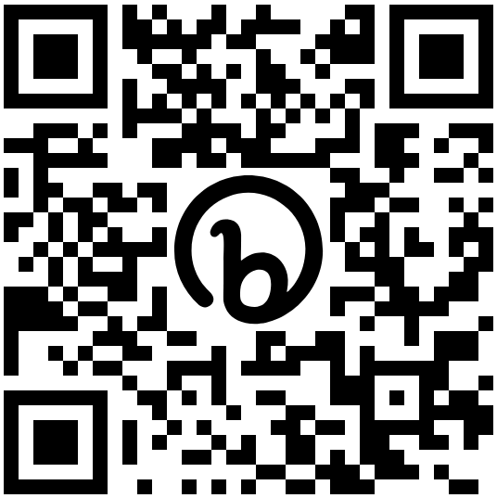
LAEP Proposals (cont.)
Link to submit:
https://bit.ly/canlaep

Slide 8
LAEP Proposals (cont.)
Proposal approved
Research tracked and documented
Hours tracked for payment

Slide 9
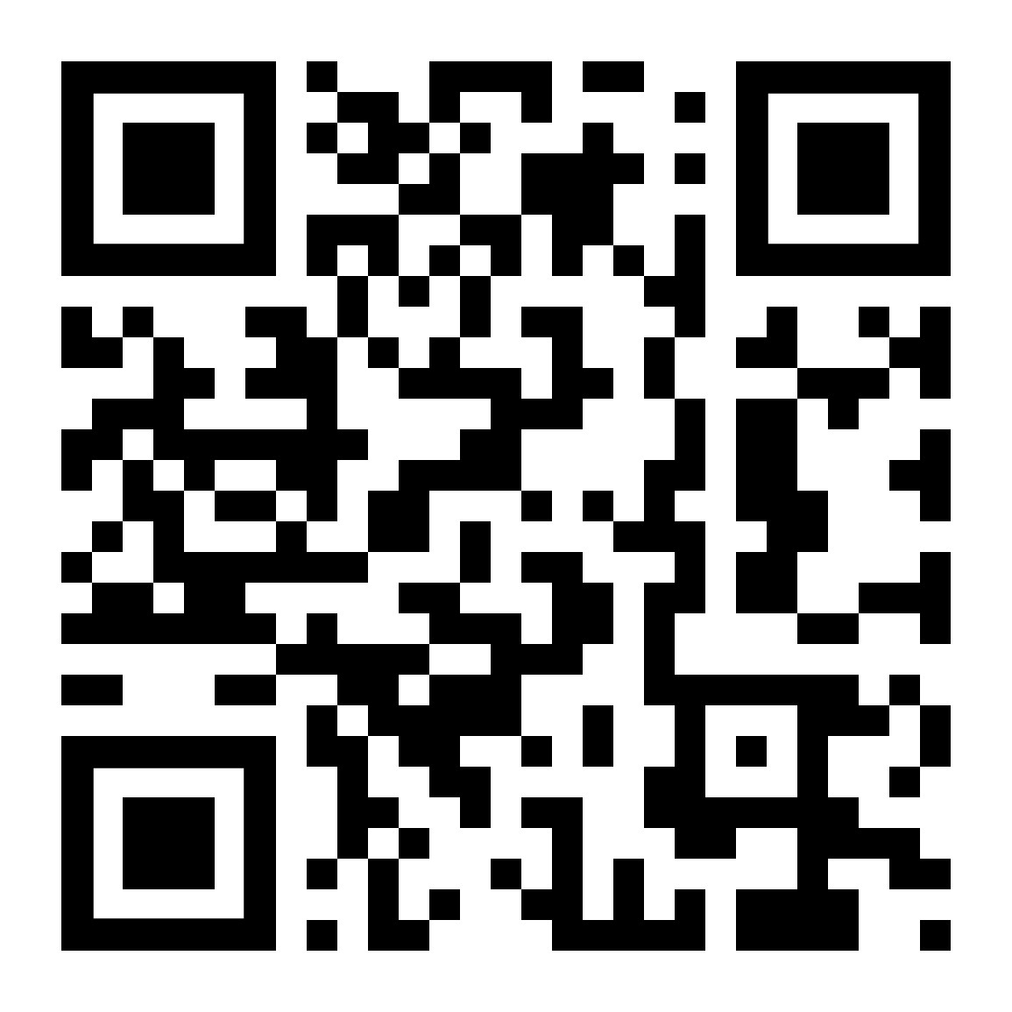
Contact Me!
LAEP Questions?
Christopher Wardell
calendly.com/wardellc
(650) 306-3308
verad@smccd.edu
wardellc@smccd.edu

