Slide 1
Cañada College
Flex Day: Morning Session
Guided Pathways
12 January 2018

Slide 2
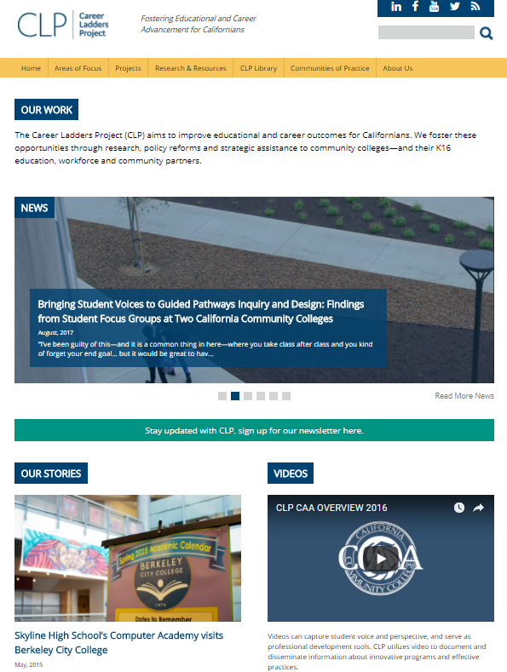
Career Ladders Project fosters educational and career advancement through research, policy initiatives and direct assistance to community colleges and their partners.

Slide 3
Cañada College’s Pathway To Date
Spring Joint Division Meeting Workshop
IEPI Fall Guided Pathways Workshop
Cañada College Self Assessment
Guided Pathways Design Team Meeting
Spring 2018 Flex Day Workshop
Guided Pathway Design Team Meetings and Workshops
Notes:
Answer the following questions:

Slide 4
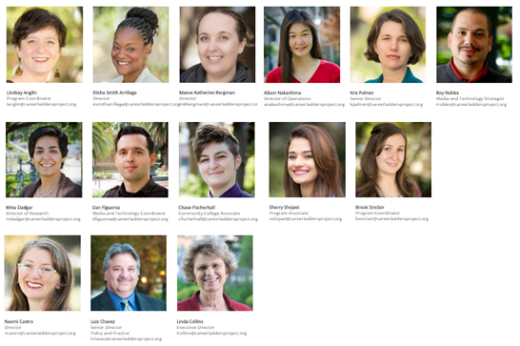
Our SMCCCD Team
Kris Palmer
Dr. Mina Dadgar
Chase Fischerhall
Sia Smith-Miyasaki
Maeve Katherine Bergman
Our SMCCCD Work
Multiple Measures/Placement
Dual Enrollment
Guided Pathways
Joint Division Meeting
Fall IEPI workshop
Fall GP team support

Slide 5
Our Path: This Morning
Why guided pathways?
What are guided pathways?
Are they working for students?
How are faculty and staff creating Guided Pathways?
What resources and discussion might be helpful to the Cañada community?
& Later Today:

Slide 6
But first, burning questions!
Please find a FAQ on your table, and please add to the large post-its on your tables what you wonder about guided pathways redesign?
Design team to answer!

Slide 7
Why Guided Pathways?
Notes:
What problem are we solving?

Slide 8
From the Student’s Perspective:

Slide 9
New CC students tell researchers they want to know:
What are my career options?
What are the education paths to those careers?
How do I get a bachelor’s degree?
What will I need to take?
How long will it take and how much will it cost?
How do I pay for it?

Slide 10
62%

Slide 11
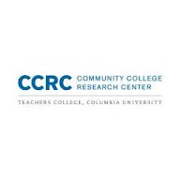
Completion Crisis
81% of entering community college students indicate they want to earn a bachelor's degree or higher
33% of entering students actually transfer to a four-year institution within six years
Of those transferring, 42% earn a bachelors degree.
14% of the entire cohort of entering community college students earns a bachelor's degree within six years
Horn & Skomsvold, 2011; Jenkins & Fink, 2016
Of first-time college students who enrolled in a community college in the fall of 2009, 38.1% earned a credential from a two- or four-year institution within six years
National Student Clearinghouse Research Center, Shapiro & Dundar, 2015
Notes:
Of first-time college students who enrolled in a community college in the fall of 2009, 38.1 percent earned a credential from a two- or four-year institution within six years
National Student Clearinghouse Research Center, Shapiro & Dundar, 2015

Slide 12
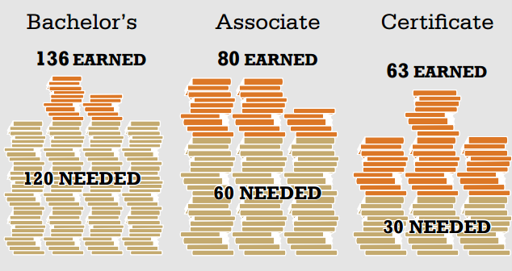
Student Credit Accumulation: Excess Credits?
Guided Pathway to Success: Boosting College Completion Complete College America
http://completecollege.org/docs/GPS_Summary_FINAL.pdf
Notes:
Surprised to find that courses taken do not count towards credentials (Nodine et al 2012)

Slide 13
Excess Credits: Impact on Student Learning & Resources
Student Learning
Degree and Transfer
Students are surprised to find that courses taken do not count towards credentials (Nodine et al 2012)
Completion
Students are not able to complete upon transfer because of loss of financial aid (Federal Aggregate Student Loan Limit=Associates +Bachelors)
Student Resources
Time
Longer time to complete increases cost of attendance (school and living expenses)
Money
Additional credits Cost Students additional $8 billion
Cost to government $11B, potential federal student loan changes
Matthew Zeidenberg, Valuable Learning or "Spinning Their Wheels"? Understanding Excess Credits Earned by Community College Associate Degree Completers http://ccrc.tc.columbia.edu/publications/understanding-excess-credits.html

Slide 14
For the student who is not sure about program of study
How clear are our offerings?
College Student Profile: Jake
First Generation College Student
Interested in Computers
Working Part Time
Notes:
And requirements can appear simple—but it’s a tangled web of prerequisites

Slide 15
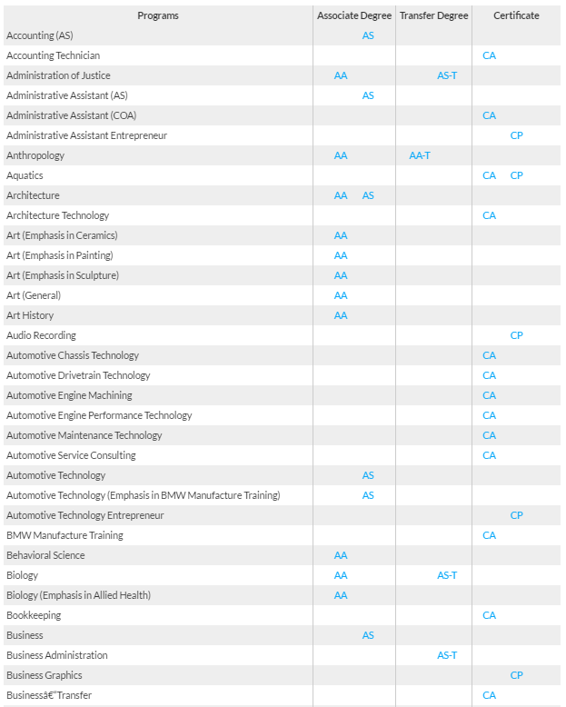
However, from the Major Selection:
Notes:
Overwhelming and Unstructured Choice (Scott-Clayton)
Unclear Program Requirements
Many Program/Transfer Options

Slide 16
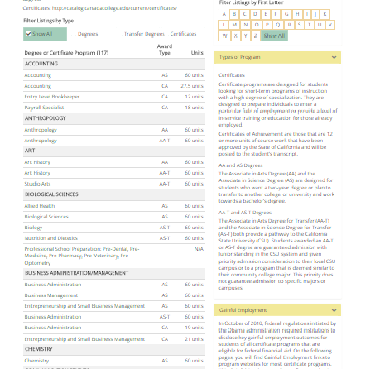
Cañada College Certificates and Degrees

Slide 17
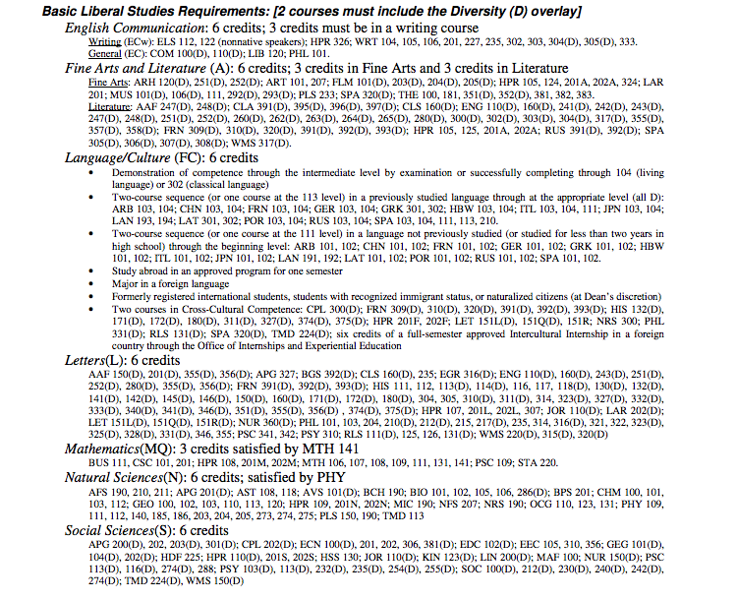
…to General Education Requirements clarity is needed.

Slide 18
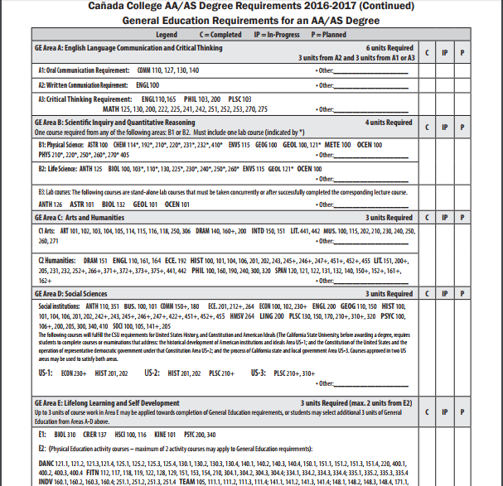
Cañada College General Education

Slide 19
For the student who knows where
she wants to focus…
How clear are our programs?
College Student Profile: Ellen
Seeks an AA in business
Working Part Time
Responsible for care of elder parent
placed into two levels below transfer math
Notes:
And requirements can appear simple—but it’s a tangled web of prerequisites

Slide 20
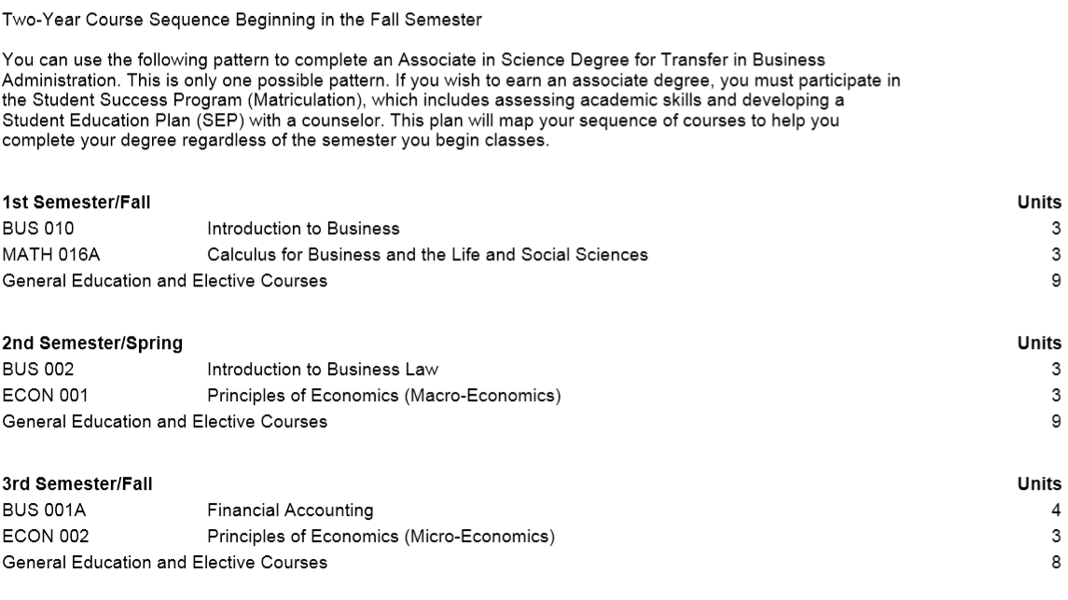
Notes:
The course schedule says that for AA in Business he needs to take Calculus for Business during the first semester and then each semester the Business, Econ and Stats…

Slide 21
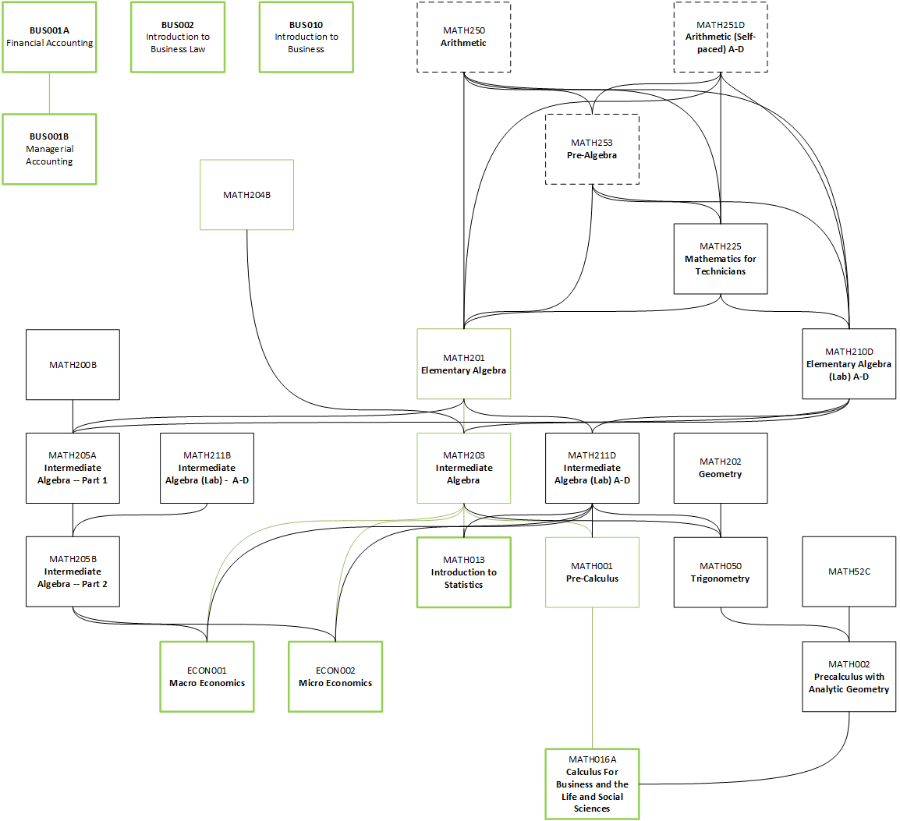
COURSE SEQUENCE FOR AA IN BUSINESS- CALIFORNIA CC
Notes:
Course based pre-req
No big picture, priority

Slide 22
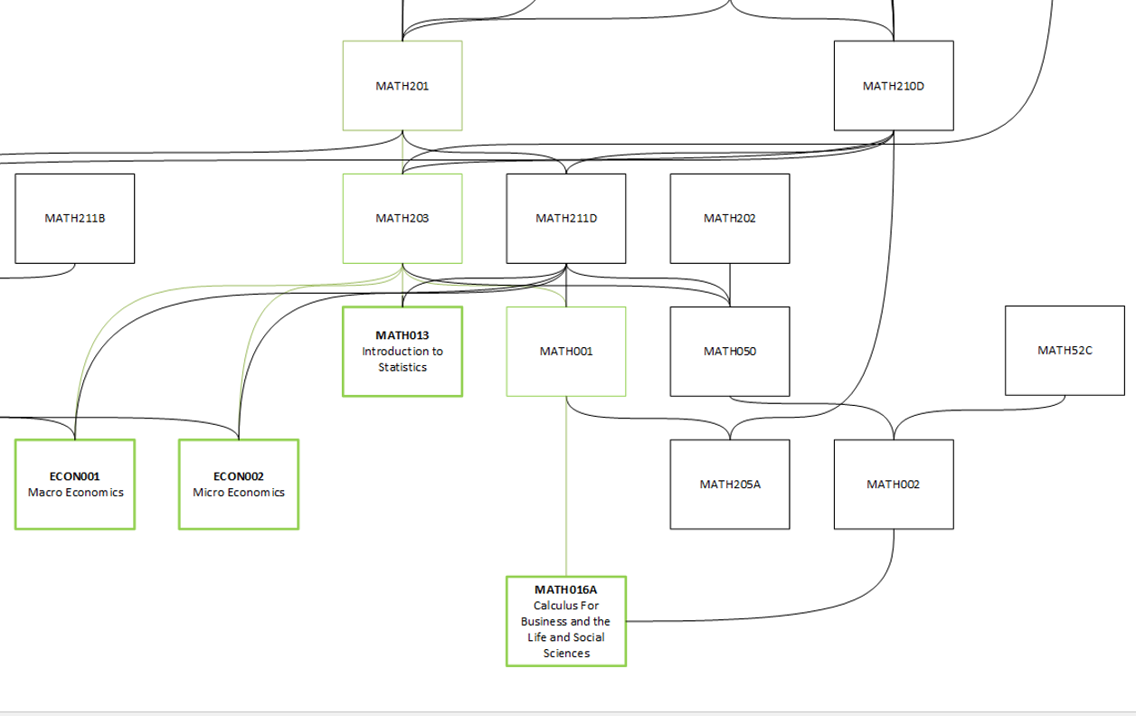
10% of students majoring in Business reached Math 016A within 5 years
Notes:
Good example of how focusing pre-requisits on course success in siloes

Slide 23
Local Business Math Case Study is not Anecdotal: CC Students tell Researchers…
More than 50% Concerned about making a mistake when choosing classes (Moore & Shulock, 2014)
42% don’t have enough information about requirements (Rosenbaum et al, 2006)
Surprised to find that courses taken do not count towards credentials (Nodine et al 2012)

Slide 24
For the student who knows where she wants to focus, but places into the developmental sequence.
How clear is the developmental sequence and programs?
College Student Profile: Ellen
Seeks an AA in business
Working Part Time
Responsible for care of elder parent
placed into two levels below transfer math
Notes:
And requirements can appear simple—but it’s a tangled web of prerequisites

Slide 25
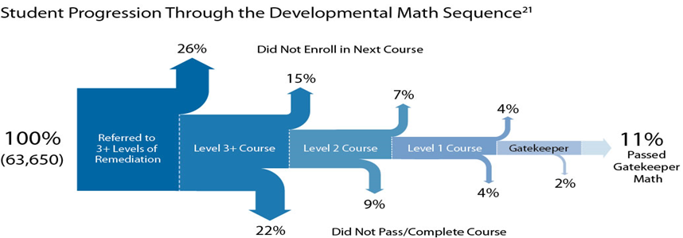
Dev Ed Placement and Throughput
Federal BPS (Beginning Postsecondary Students) data from 2009 indicate 68% of students beginning at public two-year colleges in 2003–2004 took one or more remedial courses in the six years after their initial college enrollment.
At four-year public colleges, it was 40 percent.
Chen & Simone, 2016
Source: CCRC
Notes:
This is again from national data sample. It shows nationally only 11% in 3 levels of Math remediation complete their first math sequence. We lost most students because of issues unrelated to instruction

Slide 26
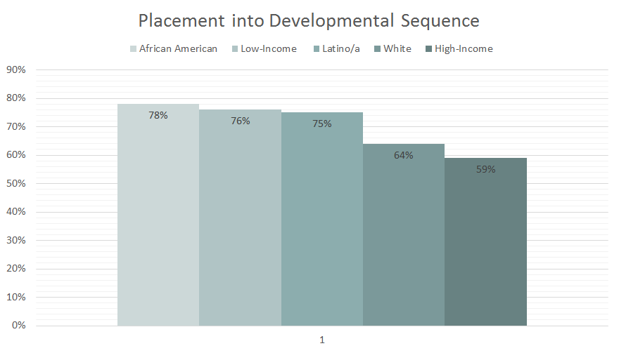
Placement Rates by Race at 2-year Colleges
Chen & Simone, 2016
Notes:
And we know that the students being placed in remediation are disproportionately students of color, especially black and latino.
At public two-year colleges, 78 percent of Black students, 75 percent of Hispanic students, and 64 percent of White students take remedial courses. Of students in the lowest income group, 76 percent take remedial courses, compared with 59 percent in the highest income group (Chen & Simone, 2016).
At public four-year colleges, 66 percent of Black students, 53 percent of Hispanic students, and 36 percent of White students take remedial courses. Of students in the lowest income group, 52 percent take remedial courses, compared with 33 percent in the highest income group (Chen & Simone, 2016).

Slide 27
Why are community college faculty and staff engaged in guided pathways redesign?
For their students:
Many not completing
Difficulty in selecting degrees and certificates
Exploration is complicated
Most told they are not “college ready”
Programs can be difficult to navigate
Complete with more credits than they need

Slide 28
For Our Teams! And, ourselves!

Slide 29
Many college communities are facing initiative fatigue:
Randy Tillery, Senior Dean, CCCCD

Slide 30
CA Community Colleges
72 Districts (112 Colleges, 76 Centers); 15 Regions
7 Workforce & Econ Dev Regional Consortia
Basic Skills Initiative
Career Advancement Academies
Enhanced Non-Credit
SB1440 Assoc. Degrees for Transfer
Student Success Act of 2012
Online Education Initiative
Common Assessment Initiative
Multiple Measures Assessment Project
Education Planning Initiative
Doing What Matters
ARCC; Scorecard and System Completion Goals
Salary Surfer; Launchboard; CTE Data Unlocked
CTE Enhancement Fund
SB850 CCC Bachelor’s Degree Pilots
Student Equity Plans
Basic Skills Student Outcomes and Transformation Program
Institutional Effectiveness Partnership Initiative (IEPI)
California College Promise
Strong Workforce Program
CCC Guided Pathways Program (proposed)
K12
1000+ School Districts; 58 County Offices of Ed
Local Control Funding Formula (LCFF)
Local Control and Accountability Plan (LCAP)
Common Core State Standards
Smarter Balanced Assessment
Next Generation Science Standards
CTE Standards and Framework
CA Office to Reform Education (CORE) Waiver Districts
CA Partnership Academies
Linked Learning District Initiative
AB790 LL Pilot Districts
Career Technical Education Incentive Grant
CCC/K12
SB1070 CTE Pathways Program
AB86: Adult Ed/CCC Regional Consortia
AB86: CA Career Pathways Trust (CCPT)
AB288: College and Career Access Pathways (CCAP) Partnerships
Notes:
A Plethora of Reforms, Initiatives and Structures
All well meaning and pointing in same direction – BUT Can be overwhelming if not aligned and integrated
Many siloed WITHIN institutions themselves – as well as ACROSS institutions
We can build on these initiatives – and some of the solid work being accomplished
But, need to build on existing efforts, using data and evidence-based practice – and an overarching framework and vision that can integrate the many funding streams, efforts and structures
Notice growing focus on regionalism – across many of these.

Slide 31
CA Workforce Development Board
48 Local Workforce Development Boards (47 areas)
From WIA to WIOA
CA Strategic Workforce Dev Plan 2013-17
Local Strategic Workforce Plans 2013–17
CA Unified Strategic Workforce Development Plan 2016-2020 (WIOA)
Local Boards Strategic Workforce Dev Plan - TBD
SB 118 Sector Strategies
Prop 39 Clean Energy Job Creation Training Grants
Workforce Accelerator Fund
“Slingshot” Initiative (Regional Coalitions)
ForwardFocus (AB2060 Recidivism Reduction Funds)
Federal Initiatives & Grant Programs
Perkins Career & Technical Education Act
TAA Community College Training Grants
Dislocated Worker Nat’l Emergency Grants
Health and Human Services Grants
SNAP Employment and Training Funds
Apprenticeship USA State Expansion Funds
Career Pathways for Youth
Re-entry Demonstration Projects
America’s Promise: American Tech Training Fund
ETC.
Other Related Agencies/Services in CA
Governor’s Office of Business & Econ Dev (GO-Biz)
Cities, Counties
Other Workforce Programs: CalWorks; Rehabilitation; Corrections; Veterans Affairs, Apprenticeship; Health and Human Services; Social Services; Job Corps; Employment Training Panel; Public Utilities Commission; etc.
Other Regional Entities, Partnerships
& Initiatives
Examples include:
LA County Econ Development Corporation (LAEDC)
LA Chamber
LA Compact/UNITE-LA
United Way Los Angeles
Aspen Forum for Community Solutions Opportunity Youth Incentive Fund (7 CA sites, incl. LA)
James Irvine Foundation “Regional Hubs of Excellence”
Notes:
Similarly, there has been rapid and successive introduction of new initiatives, legislation and grant funding streams in the federally funded workforce development system, which exists often alongside, rather than integrated with our major education institutions – as well as alongside other federal competitive funding streams.
Co-existing, but largely disconnected economic and workforce development and support programs are offered by a host of other CA agencies, all with separate funding streams, metrics and reporting requirements
These various programs are often aimed at the same populations, but offered in isolation from one another.
There have also been in this timeframe, a proliferation of regional initiatives, and structures—as well as “collective impact” efforts—working (and often overlapping and sometimes competing) to provide regional coherence and relevance to the regional economy.
Each region has it’s own array of efforts and “tables.” Here we detail just a few examples from the LA region for purposes of illustration.
Note that in many regions, these generally are not generally connected to the range of regional education efforts and consortia funded by the K12 and CCC systems.
Figuring out whether and how to bridge, align, blend and leverage these diverse funding streams and efforts is a huge issue – yet one that could better direct resources to develop California’s talent base, provide skilled labor for CA employers, open opportunities for continuing educational and career advancement, and support diverse as well as low-income communities and populations in achieving credentials that matter in the workplace.
At the policy level, simplifying funding streams and providing overarching vision for talent development would help.

Slide 32
What if guided pathways could be a North Star for all of these initiatives?

Slide 33
Case Study: Bakersfield College
Initiative Assessment for Integrated Planning
College communities in California are finding Guided Pathways provides a framework for California’s improvement efforts.
Clarity
Intake
Support
Learning
C-ID/ADT, CCPT, Strong Workforce Program, AEBG
Educational Planning Initiative
Common Assessment Initiative
Basic Skills Initiative,
Basic Skills Transformation
Equity Initiative, Online Education Initiative
Accreditation, Program Review, Planning, IEPI
These college communities are focusing on students’ experiences rather than college structures or specific funding streams.
Adapted from the work of Kathy Booth, CCCCO and Dr. Sonia Christian, President, Bakersfield College

Slide 34
Integrated Planning to Foster Student Success
SSSP
Academic Senate
Strong Workforce
Program Review
S4S
Business Services
ASG
Institutional Effectiveness & Inclusive Excellence
College of the Canyons
Institutional Effectiveness & Inclusive Excellence (IE)² committee coordinates student success data and supporting activities
Title V
Equity
Performance Indicators
PAC-B
Curriculum Committee
HR/ Prof. Dev.
Non-credit
CASL

Slide 35
What are Guided Pathways?
Notes:
What problem are we solving?

Slide 36
Guided Pathway: College Community Efforts to Nourish Success & Equity
Improved Placement and Developmental Sequence
Integrated and Proactive Student Supports
Guided Exploration for Un/Decided Students
Clustering of Programs of Study into Meta Majors
Clearly Delineated Program Requirements (Default Sequences)
Early Career and College Exploration (K12, adult school, career counseling, survey/contextualized courses, etc)
Notes:
Meat of the work---learning

Slide 37
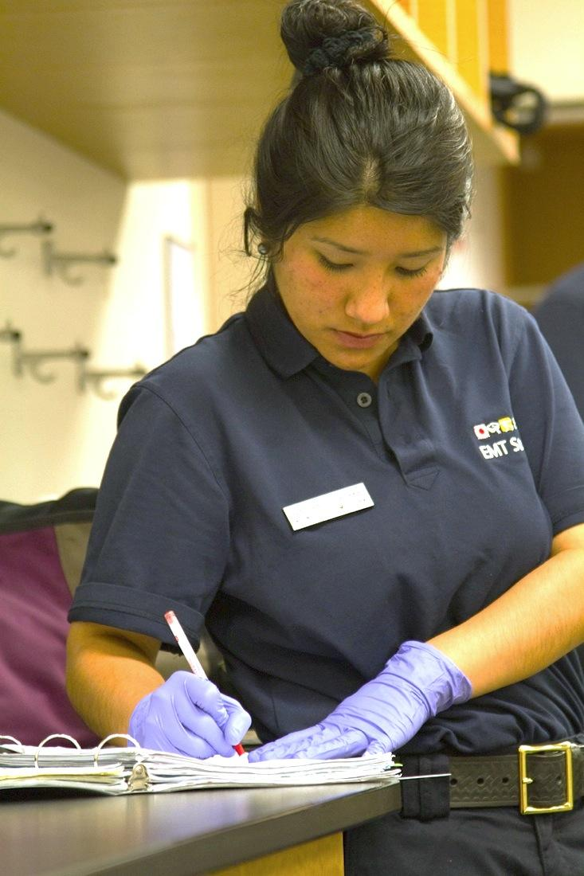
Integrated and Proactive Student Supports

Slide 38
Proactive and Integrated Student Supports
Academic Supports
Instructional
Counseling
Non-Academic Supports
Social
Economic
When counseling resources are not part of classroom requirements or otherwise integrated into students’ educational experience, that the first generation and minority community college students who are most in need of accessing career counseling resources are least likely to approach them. (Karp et al 2011; Cox 2008).

Slide 39
Clustering of Degrees and Certificates into Meta Majors

Slide 40
Meta major
Counseling
Career Guidance
Academic Support
Connect to Non-Academic Support
Key Foundational Courses
Program 12
Program 14
Program 1
Program 2
Program 3
Program 4
Program 5
Program 2
Program 7
Program 13
Program 1
Program 6
Program 3
Program 8
Program 4
Program 5
Program 9
Program 10
Program 11
1. Clustering of Degrees and Certificates into Meta Majors

Slide 41
Clear degree path
Default course sequence
Predictable schedules
Program 1
Program 2
Program 3
Program 4
Program 5
1. Clustering of Degrees and Certificates into Meta Majors

Slide 42
Notes:
This is a visual representation of meta majors—this is what we mean.

Slide 43
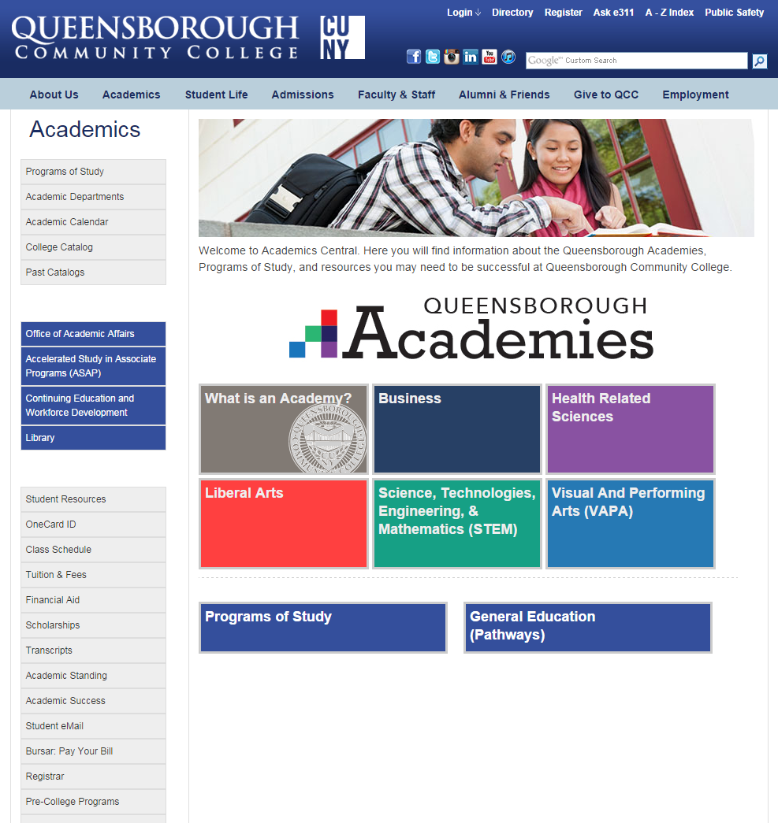

Slide 44
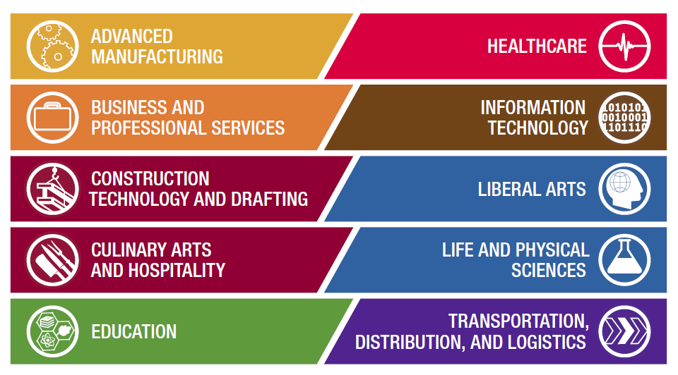
City Colleges of Chicago, IL
Notes:
Here’s an example from City Colleges of Chicago—10 meta majors
Name other examples
Analysis of other colleges meta-majors

Slide 46
Mt SAC Career Clusters
To begin this project, students across Mt. SAC divided our programs into 8 groups, called career clusters. Then the English Department developed ENGL 68 courses in the interest of those 8 career clusters. For example, if you're interested in art, but you need to complete your English courses first, you can choose the ENGL 68 under Arts & Design. This will allow students to be exposed to ideas related to art while completing an English course.The 8 career clusters are:
Arts & Design
Aviation, Electronics, & Manufacturing
Business & Information Technology
Health, Wellness, & Public Service
Humanities & Communication
Plants & Animals
Sciences
Teaching & Education

Slide 47
Sierra College DRAFT Interest Areas

Slide 49
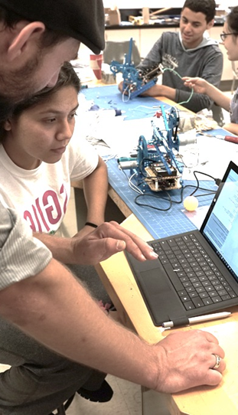
CLEARLY DELINEATED PROGRAM REQUIREMENTS (DEFAULT SEQUENCE)

Slide 50
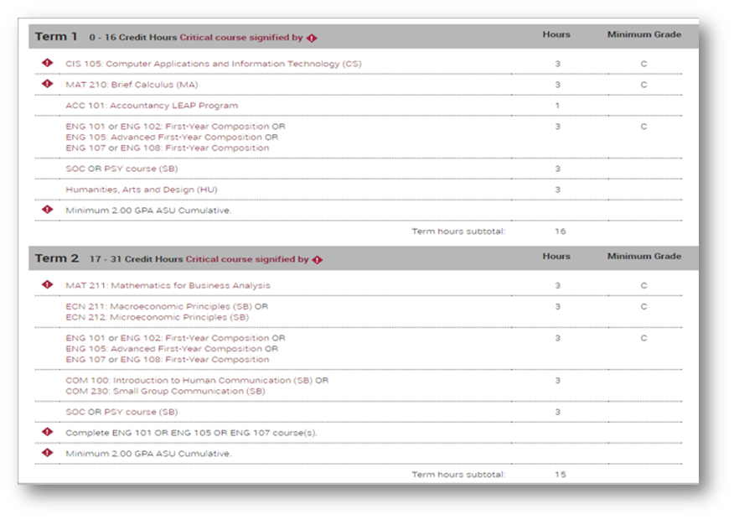
2. CLEARLY DELINEATED PROGRAM REQUIREMENTS (DEFAULT SEQUENCE)

Slide 51
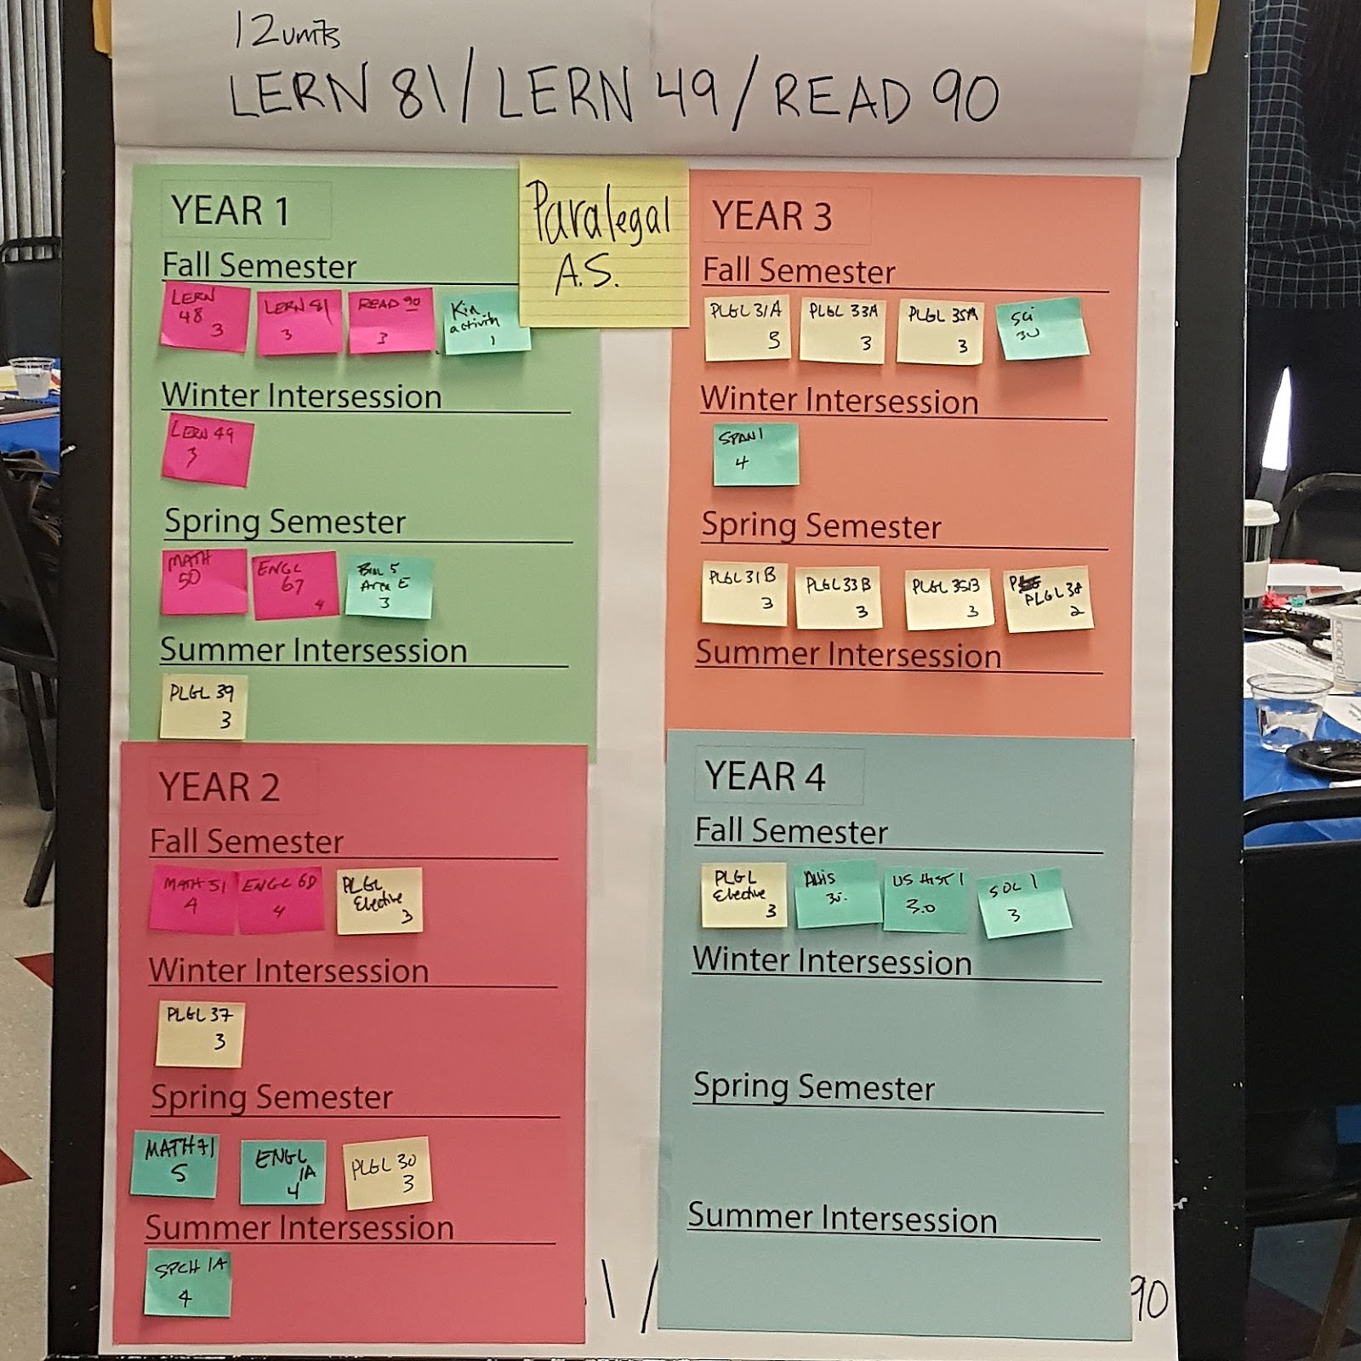
Case Study: Mt. San Antonio Course Sequencing
Ordering of courses for each degree and certificate, including:
For each of their students (FT, PT, developmental sequence)
Mt. SAC Adult Ed Non Credit and HS pathways to sequencing work

Slide 52
Case Study: Sierra College
Mechanics
Champions created a template
Outline the recommended sequence of courses a student must complete in order to earn a degree, certificate or transfer with ADT
Provides recommended choices for General Education (GE) and electives
Mapping Days
Department faculty, counseling faculty, and team members completed over 150 award map templates

Slide 53
Case Study: DRAFT Sierra College Allied Health Interest Area Pathway Recommendation

Slide 54
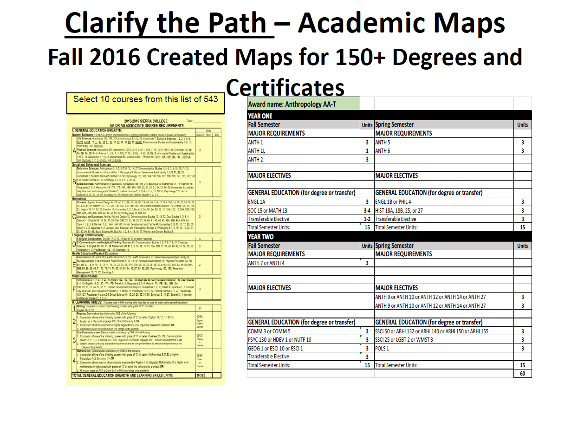

Slide 55
But, are Guided Pathways working for students?

Slide 56
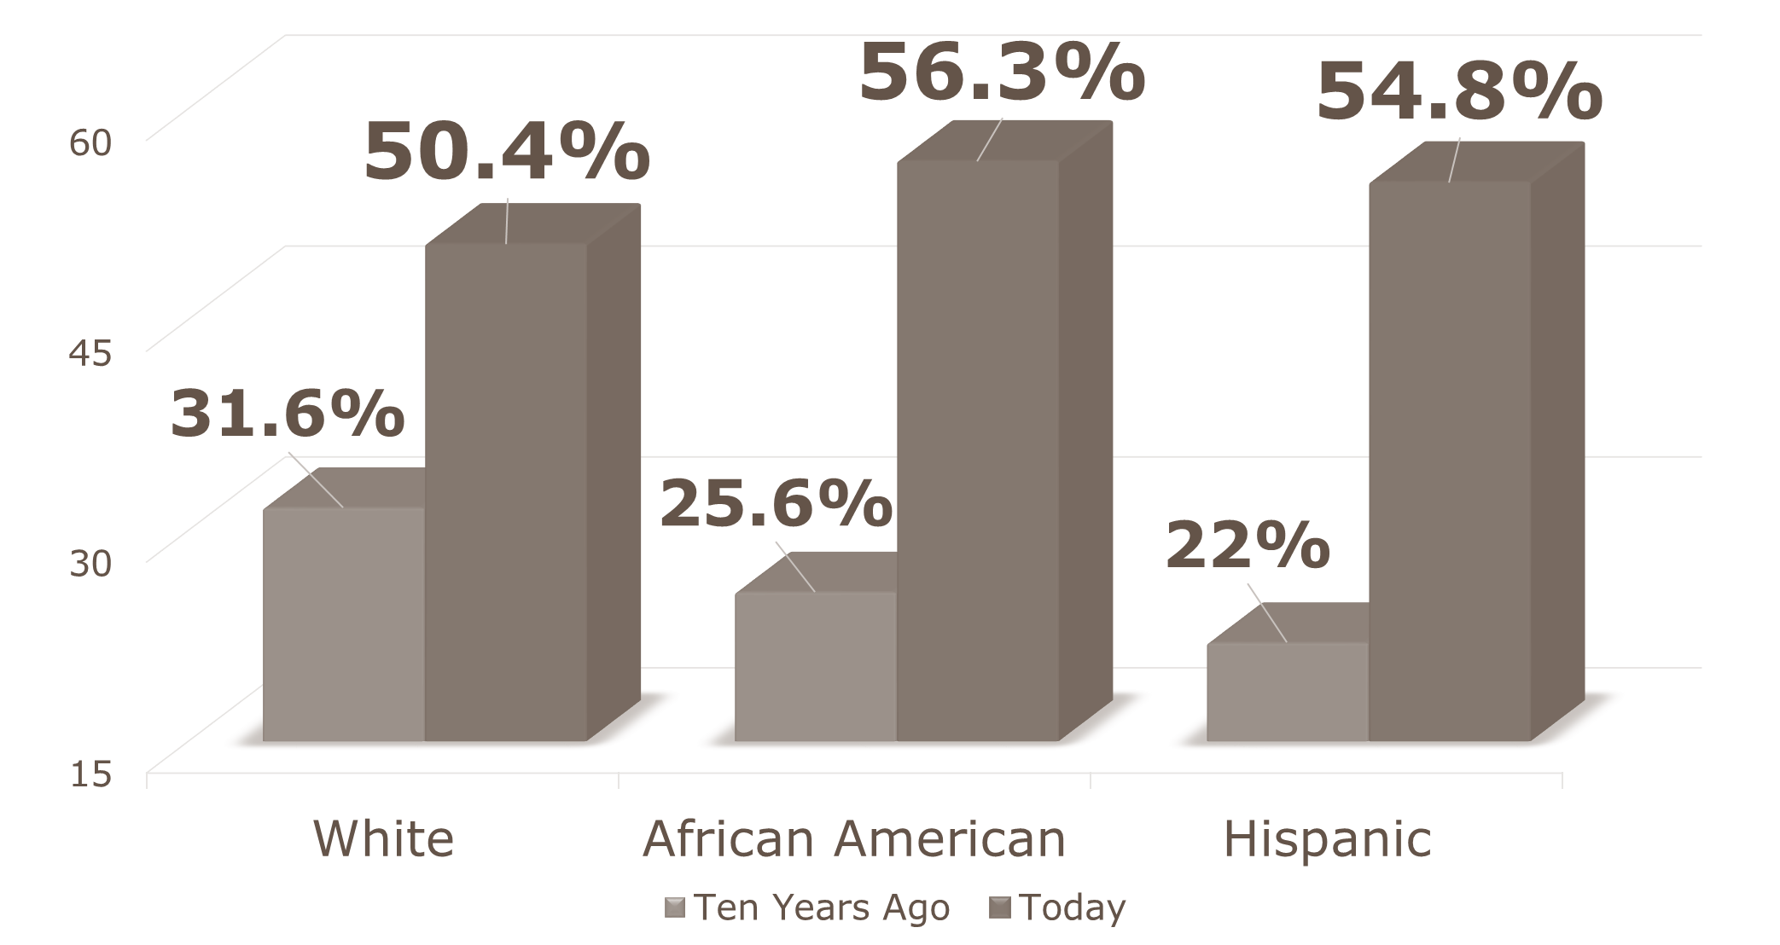
Guided Pathways Case Study: GSU
Georgia State University Completion Rates
GSU Implemented Guided Pathways
Meta-Majors
Default Sequences
Improved Developmental Education
Integrated Student Supports
Guided Exploration
Source: http://www.aacc.nche.edu/Resources/aaccprograms/pathways/Documents/DeployingGuidedPathways%20at%20Scals_TimRenick_IngridThompsonSellers.pdf

Slide 57
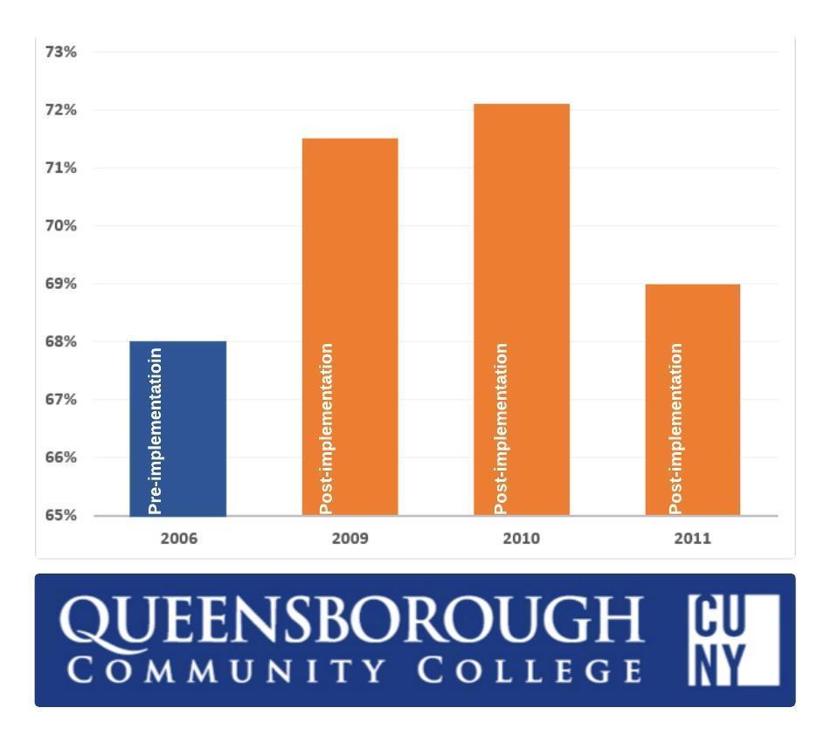
Guided Pathways Case Study: Queensborough Community College
Queensborough Fall to fall Retention
With Guided Pathways, Queensborough Community College faculty and staff, increased fall retention by more than 30%

Slide 58
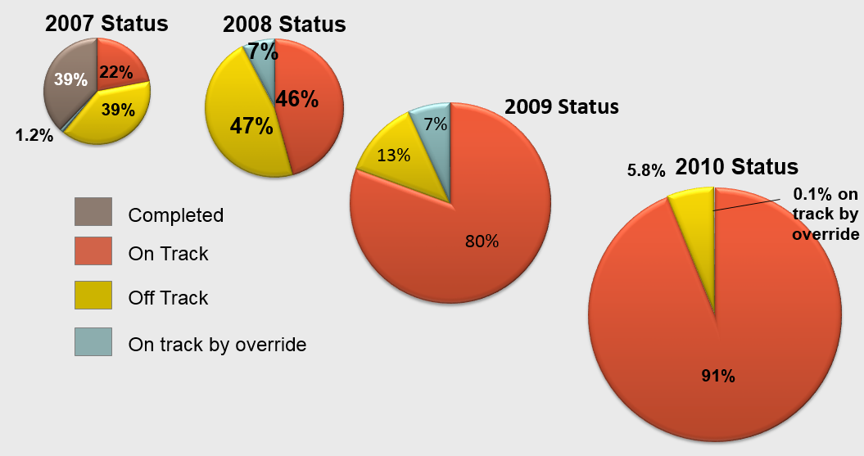
Guided Pathways Case Study: ASU
Cohorts are defined by the academic year that the student enters ASU as a full-time freshman
Notes:
We continue to improve the process and get students on the right track. Through critical tracking, more than 80% of our students are off to a good start and registered for the right courses.

Slide 59
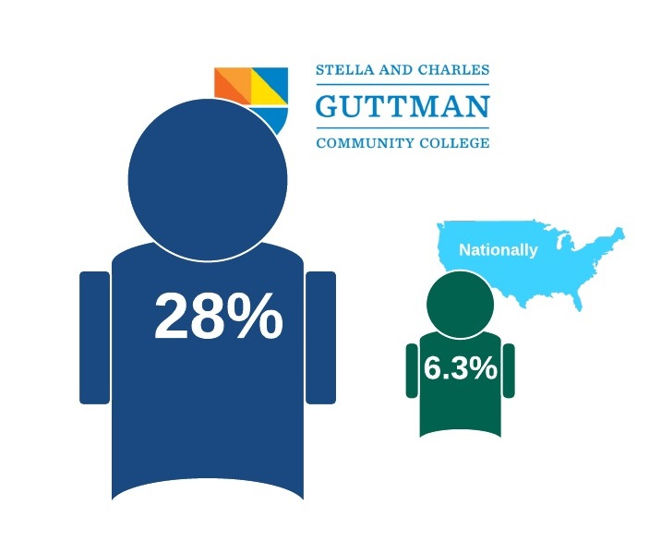
Guided Pathways Case Study: CUNY Guttman Community College
Percentage of students graduating with an Associate’s Degree within 2 years
Notes:
Guttman Community College enrolled its first class of 289 students in fall 2012 with the goal of achieving a three-year graduation rate of 35% for its first cohort. After two years, approximately 80 students from the College’s inaugural class (around 28%) will graduate on August 27, which is significantly higher than the two-year national graduation rate at Large City community colleges (6.3%, IPEDS Graduation Rate Survey). In addition, the College is on track to meet or exceed its three-year graduation goal, which will be considerably higher than the three-year national graduation rate at Large City community colleges (14.6%, IPEDS Graduation Rate Survey).

Slide 60
What can I expect at Cañada?

Slide 61
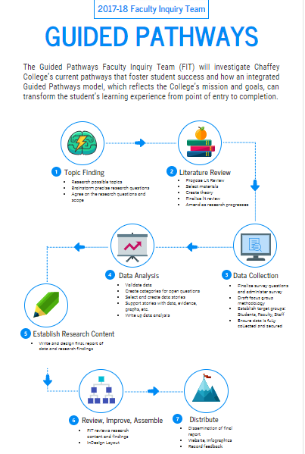
Case Study: Chaffey College
Faculty Inquiry Team (FIT)
Misty Burruel, Chaffey College
https://infograph.venngage.com/s/FRCr8Zp0mJU
Notes:
Putting the design principle ingredients together

Slide 62
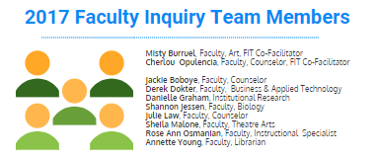
Case Study: Chaffey College
Faculty Inquiry Team (FIT)

Slide 63
Questions?
Concerns?
Want to join the conversation? Team?
Join your GP team next to learn more!
Notes:
Should we list for the AM session? College Design team, inquiry (student focus groups, data, etc.)?

Slide 64
Redesigning America’s Community Colleges Tom Bailey, Shanna Jaggers, and Davis Jenkins, Community College Research Center (2015)
http://ccrc.tc.columbia.edu/publications/redesigning-americas-community-colleges.html
This book synthesizes a decade of research pointing to how most community colleges are currently organized creates barriers to student success. The book describes the key design features of the guided pathways model, and gives examples of progress colleges have made in creating and implementing guided pathways.
What We Know About Guided Pathways:
Tom Bailey, Shanna Jaggers, and Davis Jenkins, Community College Research (2015)
http://ccrc.tc.columbia.edu/media/k2/attachments/Implementing-Guided-Pathways-Tips-Tools.pdf
A series of brief articles that summarize the book, a case study, and a self-assessment and planning tools to help colleges begin planning for guided pathways.
What is the Pathways Model?
By American Association of Community Colleges
http://www.aacc.nche.edu/Resources/aaccprograms/pathways/Documents/PathwaysModelDescription1021.pdf
Redesigning Community Colleges for Student Success - Overview of the Guided Pathways Approach
By Davis Jenkins, Community College Research Center (2014)
https://www.irsc.edu/uploadedFiles/FacultyStaff/Redesigning-Community-Colleges-For-Student-Success.pdf
This brief article provides an overview of the design principles for guided pathways.
The Structure of Student Decision-Making at Community Colleges
By Judith Scott Clayton (2011)
http://ccrc.tc.columbia.edu/media/k2/attachments/structure-student-decision-making-brief.pdf
This brief article applies research on student choice and decision-making. It explains how unstructured choice can hinder an entering student’s ability to successfully navigate perquisites and course choices, and how interventions such as clearer degree pathways can reduce confusion for students and improve outcomes.
Recommended Resources to Provide an Overview of Guided Pathways
These resources provide a good overview of the key elements of Guided Pathways, and some of the research pointing to why these elements are necessary for large increases in college completion. We believe this list contains some of the best available resources to date for those in the beginning phases of thinking through and planning for Guided Pathways.
Notes:
May not need. Add to the back of the FAQ?

Slide 65
Recommended Resources to Provide an Overview of Guided Pathways (page 2)
Guided Pathways: Planning, Implementation, Evaluation (infographic):
American Association of Community Colleges
http://www.aacc.nche.edu/Resources/aaccprograms/pathways/Documents/AACCPathways_Planning_Implementation_Graphic_FINAL.pdf
Provides a visual framework for planning, implementation, and need for evaluation of efforts to create Guided Pathways.
Principles of Redesign: Promising Approaches to Transforming Student Outcomes
By Priyadarshini Chaplot, The RP Group, Elisa Rassen, The RP Group Rob Johnstone, The RP Group & Davis Jenkins, the Community College Research Center
http://completionbydesign.org/sites/default/files/site-uploads/main-site/pdf/ncii-inquiry-guides-principles-of-redesign.pdf
Provides an in-depth discussion of the eight pathways principles of Completion by Design. This publication is particularly helpful because it includes guiding discussion questions administration and faculty can explore to help flesh out the status quo at their respective institutions and how the principle might help improve things.
These resources provide a good overview of the key elements of Guided Pathways, and some of the research pointing to why these elements are necessary for large increases in college completion. We believe this list contains some of the best available resources to date for those in the beginning phases of thinking through and planning for Guided Pathways.
Notes:
May not need. Add to the back of the FAQ?

Slide 66
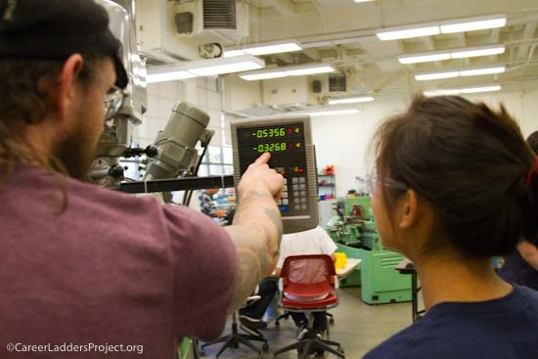
Questions?
mkbergman@careerladdersproject.org
cfischerhall@careerladdersproject.org

Slide 67
AM Deck ENDS HERE
DRAFT PM DECK BEGINS
Notes:
What problem are we solving?

Slide 68
Cañada College
Flex Day: Afternoon Session
Guided Pathways
12 January 2018
Notes:
Linda and Kris - 5 minutes

Slide 69
Career Ladders Project fosters educational and career advancement through research, policy initiatives and direct assistance to community colleges and their partners.

Slide 70
Our SMCCCD Team
Kris Palmer
Dr. Mina Dadgar
Chase Fischerhall
Sia Smith-Miyasaki
Maeve Katherine Bergman
Our SMCCCD Work
Assessment
Dual Enrollment
Guided Pathways
Joint Division Meeting
Fall IEPI workshop
Fall GP team support

Slide 71
Cañada College’s Path To Date
Spring Joint Division Meeting Workshop
IEPI Fall Guided Pathways Workshop
Cañada College Self Assessment
Guided Pathways Design Team Meeting
Spring 2018 Flex Day Workshop
Guided Pathway Design Team Meetings and Workshops
Notes:
Answer the following questions:

Slide 72
Our Path: This Morning
Why guided pathways?
What are guided pathways?
Are they working for students?
How are faculty and staff creating Guided Pathways?
What resources and discussion might be helpful to the Cañada community?
& Now:
Notes:
Answer the following questions:

Slide 73
But first, burning questions!
Please find a FAQ on your table, and please add to the large post-its on your tables what you wonder about guided pathways redesign?
Design team to answer!

Slide 74
How are colleges engaging in Guided Pathways redesign?
Notes:
What problem are we solving?

Slide 75
Guided Pathways DESIGN PROCESS
WHO? COMMON DESIGN STRUCTURES
Broad campus-wide participation, vetting, input, cross-functional teams
Cross-functional design team
Integrated planning - inclusive of college initiatives
WHAT? COMMON DESIGN ELEMENTS
Inquiry
Meta-major creation (clustering of certs and degrees)
Reworked course sequencing
Backward mapping from competencies
Developmental education integration
Student support integration
Notes:
Cross-disciplinary meta major teams map majors, cluster and sequence courses (administrators, counseling and instructional faculty, staff across departments)
Student input: student meta-major mapping
Backward mapping from competencies
Look at gateway courses
Look at co-requisite possibilities

Slide 76
Okay, how exactly have California faculty and staff made this journey?
Notes:
What problem are we solving?

Slide 77
Case Study: Chaffey College
Faculty Inquiry Team (FIT)
Misty Burruel, Chaffey College
https://infograph.venngage.com/s/FRCr8Zp0mJU
Notes:
Putting the design principle ingredients together

Slide 78
Case Study: Chaffey College
Faculty Inquiry Team (FIT)

Slide 79
College Community Efforts to Nourish Success & Equity via Guided Pathways
Improved Placement and Developmental Sequence
Guided Exploration for Un/Decided Students
Clustering of Programs of Study into Meta Majors
Clearly Delineated Program Requirements (Default Sequences)
Early College Credit
Integrated Student Supports
Notes:
Putting the design principle ingredients together

Slide 80
Clustering of Degrees and Certificates into Meta Majors

Slide 81
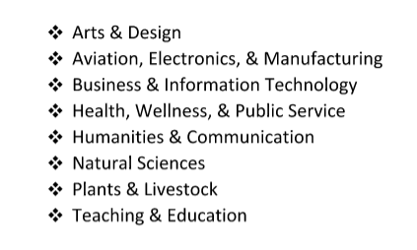
CA Guided Pathway Redesign Case Studies: Mt. San Antonio
Mt. SAC:
Faculty and staff teams reviewed existing degrees and certificates.
Then, sorted them into career clusters
After, Faculty and staff looked at the outcome and process, decided a voice was missing!
60 groups of students (cross-section of the college’s students) completed the same exercise
Students had fun and questions!
Students helped clarify the clusters AND name them!

Slide 82
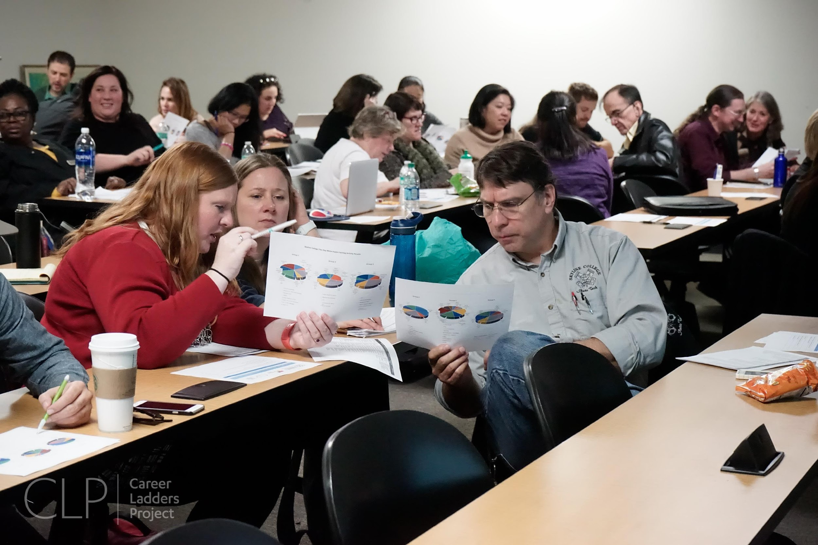
CA Guided Pathway Case Studies: Skyline College
164 Degrees and Certificates
Fall 2016 Test Drive Process
Spring 2017
Over two day period in January, 10 college-wide, cross-functional teams sorted the degrees and certificates
The Most Common Clusters
Health Science & Wellness
Business, Entrepreneurship, & Professional Services
STEM (Science, Technology, Engineering, & Mathematics)
Social/Behavior Sciences & Public Service
Arts, Humanities, & Communication
Faculty and staff Design Team and Work Groups spent early spring refining, including naming and student voices

Slide 83
CA Guided Pathway Redesign Case Study: Sierra College
Interest Areas
Sierra College community worked to determine their Interest Areas:
Engaged in a number of sorting activities reaching out to everyone at the college (and to our feeder high schools)—over 175 participants
The, small group with representatives from all constituencies met to use input and data to draft interest areas

Slide 84
Sierra College DRAFT Interest Areas

Slide 85
Activity: Do these examples of meta majors support students with what they want to know:
What are my career options?
What are the education paths to those careers?
How do I get a bachelor’s degree?
What will I need to take?
How long will it take and how much will it cost?
How do I pay for it?

Slide 86
CLEARLY DELINEATED PROGRAM REQUIREMENTS (DEFAULT SEQUENCE)

Slide 87
Case Study: Mt. San Antonio Course Sequencing
Cross-functional faculty and staff teams
ordering of courses for each degreed and certificate, including:
For each of their students (FT, PT, developmental sequence)
Teams included Counseling, Student Support, and Instructional faculty (content area, English, math, ESL, reading, library, etc.)

Slide 88
Case Study: Mesa Community College
MCC faculty and staff created “mapping sequence teams,” cross-functional teams of instructional faculty and counseling faculty to clarify course sequence for each program.
Work begins with competencies, teams work together to determine which GE, content courses meet the competencies for meta majors and what needs to be developed
Lessons Learned:
Cross Functional Mapping Sequence Teams
Start with the End in Mind
2. CLEARLY DELINEATED PROGRAM REQUIREMENTS (DEFAULT SEQUENCE)
Notes:
MINA--“Cross-functional” was the key phrase. It was very helpful to have faculty from across instructional departments collaborating with counseling faculty on designating and finalizing required courses and sequence for each program.
“Start with the end in mind.” Begin with learning outcomes and create consensus around those learning outcomes, and then see which courses meet those competencies. That early work helped faculty decide which GE courses would meet the competencies of each Meta Major. Next, address capstone courses that touch on several competencies.

Slide 89
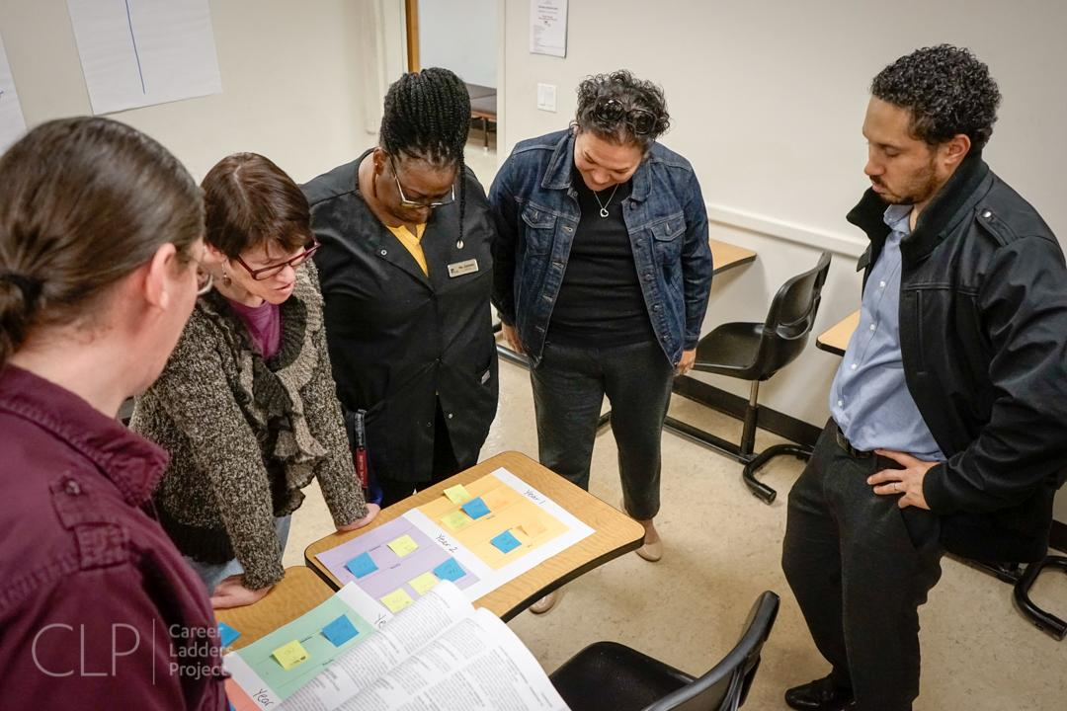
Case Study: Skyline College
CLP supported with models from colleges
Skyline VPs and Deans began the process
In Spring after MM drafting, developing process roles and responsibilities:
Design Team
I/SS Deans
Counseling, Student Support, and Instru
Meta Major Work Groups
Faculty and staff from across the campus funded to participate

Slide 90
Do these examples of sequencing support students with what they want to know:
What are my career options?
What are the education paths to those careers?
How do I get a bachelor’s degree?
What will I need to take?
How long will it take and how much will it cost?
How do I pay for it?

Slide 91
Integrated and Proactive Student Supports

Slide 92
Activity: Do these examples of meta majors support students with what they want to know:
What are my career options?
What are the education paths to those careers?
How do I get a bachelor’s degree?
What will I need to take?
How long will it take and how much will it cost?
How do I pay for it?

Slide 93
CLEARLY DELINEATED PROGRAM REQUIREMENTS (DEFAULT SEQUENCE)

Slide 94
Case Study: Mt. San Antonio Course Sequencing
Cross-functional faculty and staff teams
ordering of courses for each degreed and certificate, including:
For each of their students (FT, PT, developmental sequence)
Teams included Counseling, Student Support, and Instructional faculty (content area, English, math, ESL, reading, library, etc.)

Slide 95
Case Study: Mesa Community College
MCC faculty and staff created “mapping sequence teams,” cross-functional teams of instructional faculty and counseling faculty to clarify course sequence for each program.
Work begins with competencies, teams work together to determine which GE, content courses meet the competencies for meta majors and what needs to be developed
Lessons Learned:
Cross Functional Mapping Sequence Teams
Start with the End in Mind
2. CLEARLY DELINEATED PROGRAM REQUIREMENTS (DEFAULT SEQUENCE)
Notes:
MINA--“Cross-functional” was the key phrase. It was very helpful to have faculty from across instructional departments collaborating with counseling faculty on designating and finalizing required courses and sequence for each program.
“Start with the end in mind.” Begin with learning outcomes and create consensus around those learning outcomes, and then see which courses meet those competencies. That early work helped faculty decide which GE courses would meet the competencies of each Meta Major. Next, address capstone courses that touch on several competencies.

Slide 96
Case Study: Skyline College
CLP supported with models from colleges
Skyline VPs and Deans began the process
In Spring after MM drafting, developing process roles and responsibilities:
Design Team
I/SS Deans
Counseling, Student Support, and Instru
Meta Major Work Groups
Faculty and staff from across the campus funded to participate

Slide 97
Do these examples of sequencing support students with what they want to know:
What are my career options?
What are the education paths to those careers?
How do I get a bachelor’s degree?
What will I need to take?
How long will it take and how much will it cost?
How do I pay for it?

Slide 98
Integrated and Proactive Student Supports

Slide 99
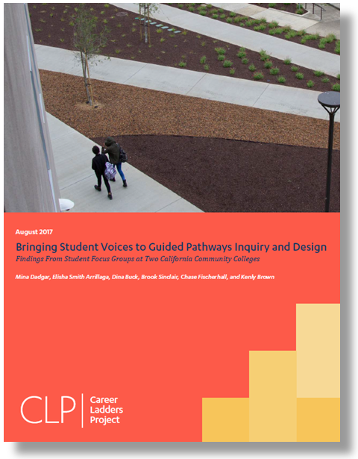
Case Study: SMCCCD Student Voices in Pathways

Slide 100
With CSM and Skyline faculty and staff, CLP conducted a series of focus groups with students to explore how we can best serve our students.

Slide 101
CSM Case Study: Seven focus groups with 78 CSM students representing...
Sought to reflect diversity of campus, including but not limited to learning communities and adult schools graduates
Students attending evening and day classes
Students aged 15 - 61 (roughly 50% were 25 and under)
Race/Ethnicity: White (32.4%), Hispanic (20.6%), Multi Races (20.6%), Asian (14.7%), Pacific Islander and Filipino (7.4%), Black (2.9%), and Unknown (1.5%)
64 % women and 36% men

Slide 102
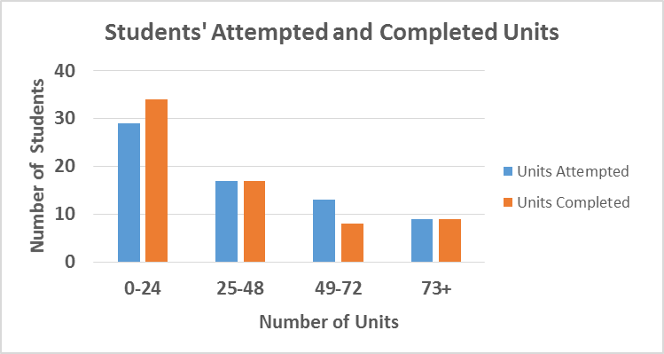
Focus group participants:
Attempted and completed units:
43% 0-24 units attempted
50% 0-24 units completed
(equivalent to 1 year or less full-time coursework)
Length of enrollment: ranged from 1st semester students to those who first enrolled in 1986
50% enrolled after 2016
25% enrolled between 2013 and 2015

Slide 103
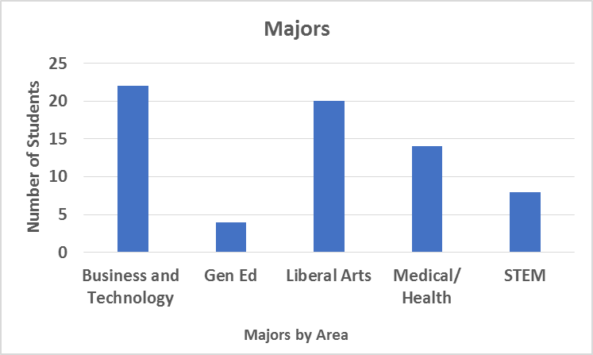
Focus group participants:
Educational goals:
68% seeking a degree (associates and/or transfer)
28% other educational & job skills related goals
4% undecided
Majors: range of majors represented, which (for the purpose of visual representation) CLP clustered into 5 major areas

Slide 104
What we asked students:
How do you choose a major?
How do you choose courses each semester?
Which supports are helpful or would be helpful to you?

Slide 105
Synthesis of Findings:
Most students found choosing a major to be a daunting task.
Choosing courses and getting into the right class was challenging.
Students found available supports helpful, but many were unaware of the different types of supports that exist.
Some students yearn for a sense of community and peer connection.
Students valued counseling faculty and desired long-term relationships.

Slide 107
“I’ve been guilty of this—and it is a common thing in here—where you take class after class and you kind of forget your end goal… but it would be great to have something tangible like a shadowing program or something else that would get you excited about picking a major.”
– California Community College Student

Slide 108
“What would have been great for me is for somebody to say, "This percentage of people, with this degree, don't get jobs in their field when they graduate, this percent of people do.”

Slide 109
“I know a lot of people who have been here for 5 or 7 years, and they switched their major so many times, and that is why they are here for so long… and I think that happens so often because there isn’t really someone to sit down with them and say “Here , these are your strengths, these are careers that would be good for you, and these ones aren’t,”… so that is why they keep jumping around.”
- California Community College Student

Slide 110
“This is the third time that I came back, and this time, I took the career assessment. I wish that I would have taken that the very first time because it would have set my path and maybe things wouldn't have been so out of reach.”

Slide 111
“At least for me, it was about not knowing where to go. Like Communications, Okay, where do you go from there? Do I become a professor? Do I work in TV? What kind of jobs do people have? It sounds corny, but are they happy in those job?”
- California Community College Student

Slide 112
Most students found choosing a major to be a daunting task:
Difficulty in choosing a major was identified as a barrier to finishing on time.
Student attributed the difficulty in choosing a major to there being few opportunities to explore careers, and link how majors connect with those careers.
Most students felt taking courses was not a helpful strategy for career exploration.

Slide 113
Students’ Questions about Choosing a Major:
What are my career options? How do I get more information about those careers?
What are the different types of jobs that various majors lead to?
Is the major I am pursuing “practical” in terms of my ability to find a job with a decent salary later on?

Slide 114
Students’ suggestions for what resources would help them choose a major:
Learning about different careers including:
Guest speakers, daylong seminars, workshops, career fairs
Shadowing/ internship opportunities
Opportunities to be around students with similar areas of interest
A class that would provide overview of different majors and link them with careers.
Having all students take MBTI personality and Strong Interest Inventory assessment at the beginning of college.

Slide 116
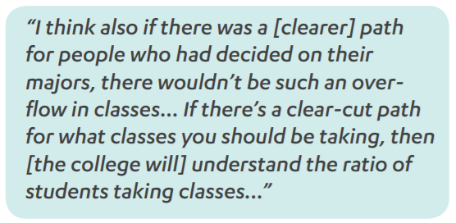
Quotes from California Community College Students:
“I found it really hard to find classes because I’m a big fan of not wasting time. So, I was like, I’m not going to take anything I don’t need to take. It was really hard.”

Slide 117
Choosing courses
Choosing courses and getting into the right class was often challenging, sometimes because a class was full, other times because the time the class was offered did not work with the students’ academic or work schedule.

Slide 118
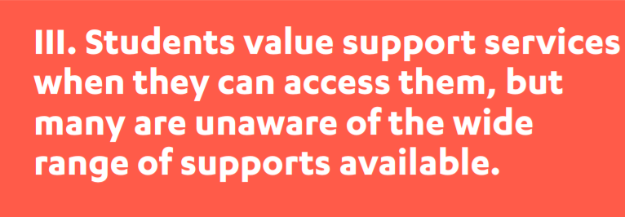

Slide 119
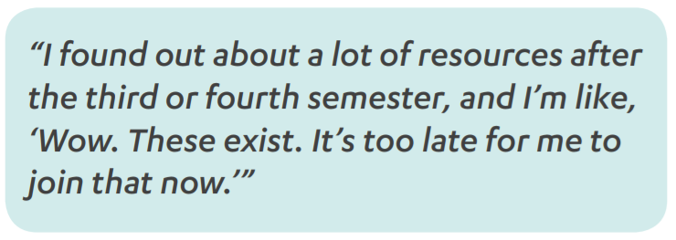
Quotes from California Community College Student’s:
“ …though my learning community I got to know about so many resources here on campus, like TRIO, Spark Point, EOPS.”

Slide 121
Quotes from California Community College Student’s:
“One thing that I think would help me, I think is to set up study groups… or even a classmate that is at your level to help you along– somebody you can communicate with and deal with to try to keep you motivated”
“I feel like one of the biggest things that’s missing at college is a celebration of culture. Not just ethnic culture, but I mean even with in each major there’s a certain kind of unity… people just come in and out, and of course they’re not going to run into these services like TRIO or EOPS, because they’re not looking at bulletin boards or their email.”

Slide 122
Counseling:
Students wished they could see the same counselors every time.
Students wished counselors had more specialized knowledge about a program.
Students wanted more time with counselors and for them to be available during the evenings.
Students appreciated SEP (student education plans) however found choosing a major difficult without
answering questions about careers
work experience

Slide 123
CSM Case Study: Student Education Planning Data
For Spring 2017
6715 students identified at least one educational goal
3753 (55.9%) of those students DID NOT have a comprehensive SEP on file
2227 (33.2%) did not have a current SEP on file.
Based on State Chancellor’s Office data, 56.7% of CSM students who identify an educational goal actually complete it with in 6 years

Slide 124
Small Group Discussion: Faculty & Staff Inquiry
Please join a table, try to sit with those you don’t get to work with often.
Please select a leader and a note taker for your table.
Work to answer all the questions.
Allow roughly 10 minutes for each question.
Chart paper is available to capture your table’s responses.
Responses will be synthesized to share back with the college community.

Slide 125
Table Team Activity:
Are these student voices reflective of your students?
What else do your students say?
What else should we ask?

Slide 126
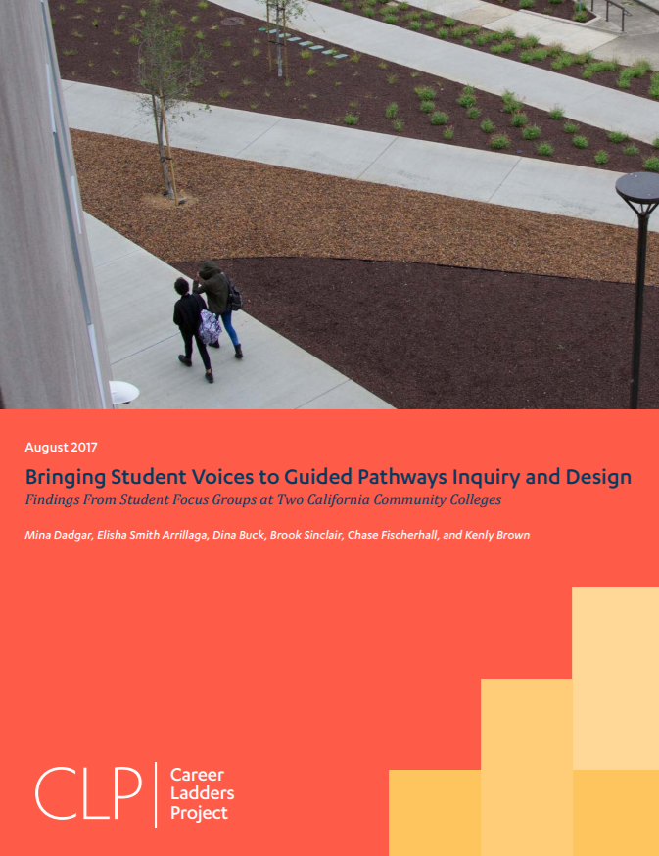
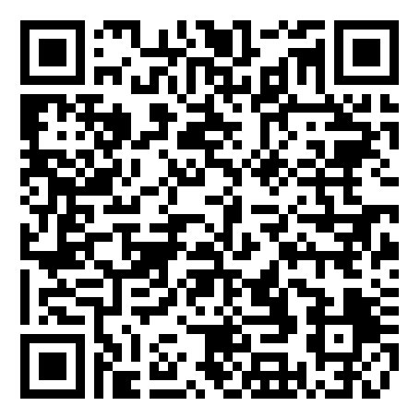
BRINGING STUDENT VOICES TO GUIDED PATHWAYS DESIGN

Slide 127
Who?
Notes:
What problem are we solving?

Slide 128
Cross-Functional Teams: Rich Experience & Perspective
Instructional, Counseling & Student Support Faculty and Staff
Public Safety
Facilities
IT
Finance
IR
AND, most importantly…Students!

Slide 129
Case Study: Skyline College, Campus-Wide Participation
CLP supported with models from colleges
Skyline VPs and Deans began the process
In Spring after MM drafting, developing process roles and responsibilities:
Design Team
I/SS Deans
Counseling, Student Support, and Instru
Meta Major Work Groups
Faculty and staff from across the campus funded to participate

Slide 130
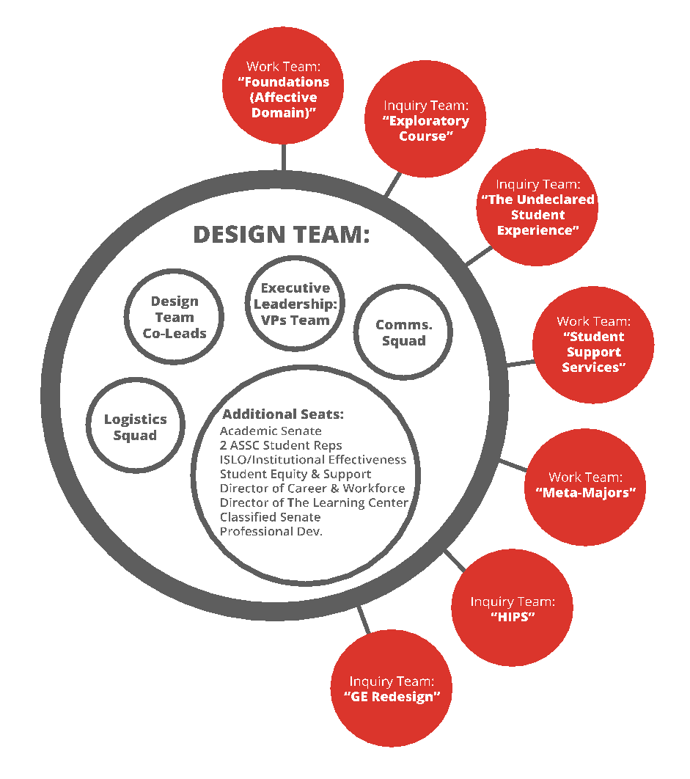
Create an inclusive
inquiry
and work infrastructure

Slide 131
Case Study: Sierra College
The task force is primarily comprised of instructional and special services faculty and educational administrators, selected for their roles and perspectives at the college; however, that body will employ full collaboration practices to ensure stakeholders are engaged, informed, and have every opportunity to provide input and feedback as the work unfolds. To support and inform its work, the task force will be evaluating effective practices around the state and the country and will bring best practices back to discuss with the college community at large.
The task force has a two-year charter. Spring 2016 will primarily be spent researching and seeking input from the college; it expects to start making recommendations by 2016-17 and implementing changes as they are approved with a full rollout in 2017-18.

Slide 132
Case Study: CoC Integrated Planning
Integrated Planning to Foster Student Success
SSSP
Academic Senate
Strong Workforce
Program Review
S4S
Business Services
ASG
Institutional Effectiveness & Inclusive Excellence
Institutional Effectiveness & Inclusive Excellence (IE)² committee coordinates student success data and supporting activities
Title V
Equity
Performance Indicators
PAC-B
Curriculum Committee
HR/ Prof. Dev.
Non-credit
CASL
Notes:
Rebecca
In addition to those recently named in the philanthropic project, several in CA leading their own transformation.

Slide 133
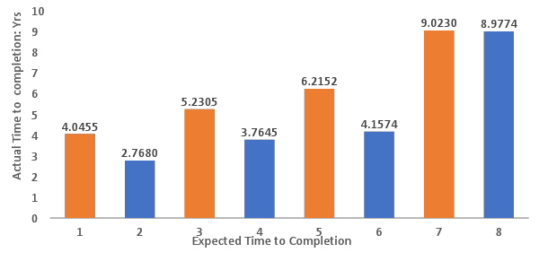
Q8: When you started at COC, how long did you think it would take to complete your education goal?
Time to Completion: Expected vs. Actual
Answered: 642 Skipped: 7

Slide 134
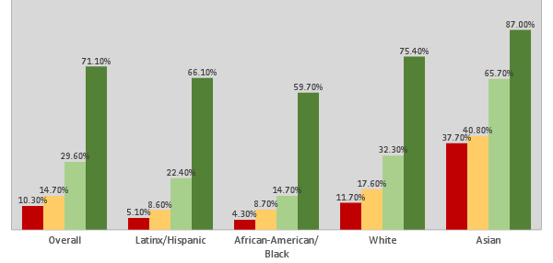
College of the Canyons Math Placement

Slide 135
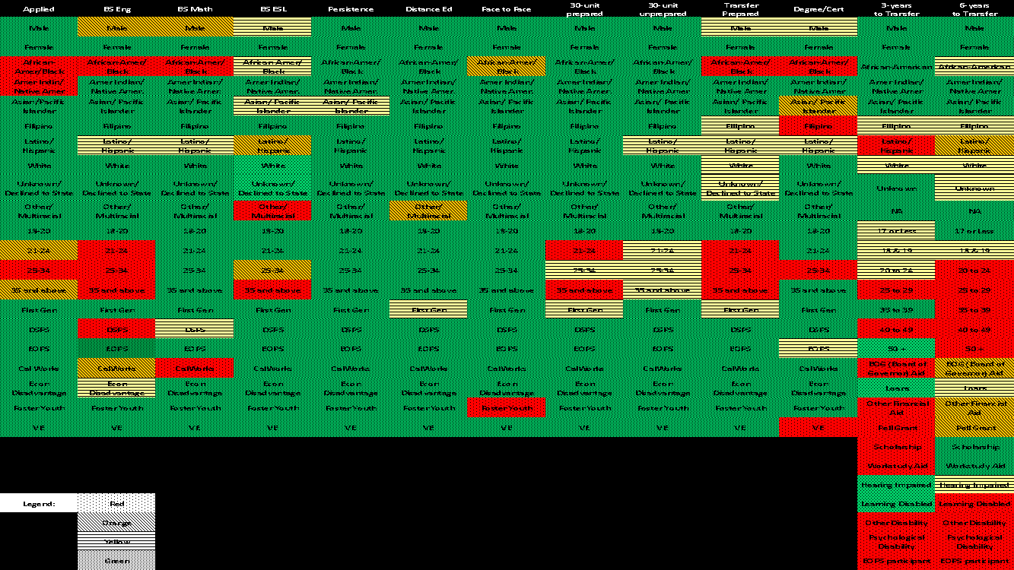
Integrated Planning to Foster Student Success
Year 1 – Focus was on the Data
Result: Canyons Completes
Year 2 – Lost Momentum Framework & identifying areas to focus
Result: 7 major areas for our 3-year work plan
Notes:
Rebecca
Another example – organic development from college work, but also “looking outside for brilliance” _ Lost Momentum Framework from Completion by Design
Heat map of Data – needed to present data in a visual way to improve understanding
7 Major areas of focus developed on Jun 7 Retreat:
Implement Peer Check-ins (phone calls to students)— examples include phone calls to applicants who apply but don’t register, “At Risk” students, students registered in the Fall and didn’t come back in the Spring.
Re-Engineer Early Alert Program - combined outreach program to students for behavioral/emotional/academic needs
Increase Career Exploration – including presenting students with career clusters to help them make more informed major choices, workshops, outreach to students with educational goal of Liberal Arts & Sciences, etc.
Develop and Expand Guided Pathways – helping students get on a path, stay on a path and reach their educational goals.
Develop Equity Minded Practitioners professional development for faculty and staff, including addressing implicit bias and helping faculty and staff develop a college mindset that supports Canyons Completes.
Enhance Noncredit program– aligned with the Innovation and Effectiveness Plan developed through the College’s Partnership Resource Team process.
Improve communication to students (electronic, in-person and print) – notification of important dates, deadlines and other important information to help students throughout their time at College of the Canyons (e.g., drop dates, petition to graduate, etc.).
Skyline Promise launched 2016: Scholarship; laptop/tablet; transportation and food assistance as needed. Student contracts to go full-time, keep on track and in good standing. In exchange, college promises to “get it’s act together” --
Grew out of “comprehensive diversity framework” systematic look at causes of inequitable student outcomes.
Note: lots of pre-work – particularly on leadership – widening the circle.
A broadly inclusive, iterative approach that uses cross functional, interdisciplinary teams for the design work (discipline, GE, counseling, math and English faculty for example on design teams for each meta major)
Note need for development of technology infrastructure: Student retention, analytics for course scheduling, manage relations with students and keep them on track, and so students know where they are on pathway/what need to do.
This is also part of a district initiative at SMCCCD –
MM across the whole district
District approach to dual Enrollment
All three colleges, CSM, Cañada College and Skyline College working on guided pathways, in varying stages of development.

Slide 136
Case Study: Chaffey College
Faculty Inquiry Team (FIT)
Misty Burruel, Chaffey College
https://infograph.venngage.com/s/FRCr8Zp0mJU
Notes:
Putting the design principle ingredients together

Slide 137
Case Study: Chaffey College
Faculty Inquiry Team (FIT)

Slide 138
Cañada College Who!
Meet your GP Team

Slide 139
Activity: Cañada College Who?
Your GP Team
Who is missing?
Take a cross-functional team inventory
You?
How to join!
How would you like the team to communicate with you?

Slide 140
Questions?
mkbergman@careerladdersproject.org
cfischerhall@careerladdersproject.org

