Slide 1

Supporting Our Undocumented Community

Slide 2
Overview
Profile of our undocumented community
Ways you can help support our undocumented students & students from mixed-status families

Slide 3
Our Undocumented Community
“Undocumented” refers to a foreign national who entered the US without authorization OR entered legally as a nonimmigrant but remained without authorization
  3 million undocumented immigrants in CA
  57,000 undocumented people in SMC
A “mixed-status family” is a family whose members include people with different citizenship or immigration statuses
  Example: a family in which the parents are undocumented and the children are U.S.-born citizens
Notes:
Source: Migration Policy Institute (MPI) analysis of U.S. Census Bureau data from the 2014 American Community Survey (ACS)
Undocumented can mean a lot of different things; there is no one profile for an undocumented student (could be any race or nationality; may have over-stayed a visa, entered the country without authorization or fallen out of status for any one of a number of reasons).
Number of undocumented students is unknown and notoriously difficult to count. However, based on county statistics we know that one in three SMC residents is foreign born and an estimated one in four immigrants is undocumented, so perhaps one in seven people.

Slide 4
Living in fear
Immigrants face new challenges and trauma under Trump administration
  Increased deportations/ICE agents
  Muslim ban
  Threats against sanctuary cities
  DACA rescission
  Scapegoating in the media
Students have reported increased discrimination as a result of the above (The Psychological Harm of Anti–Immigration Policies: webinar slides--start at 16)

Slide 5
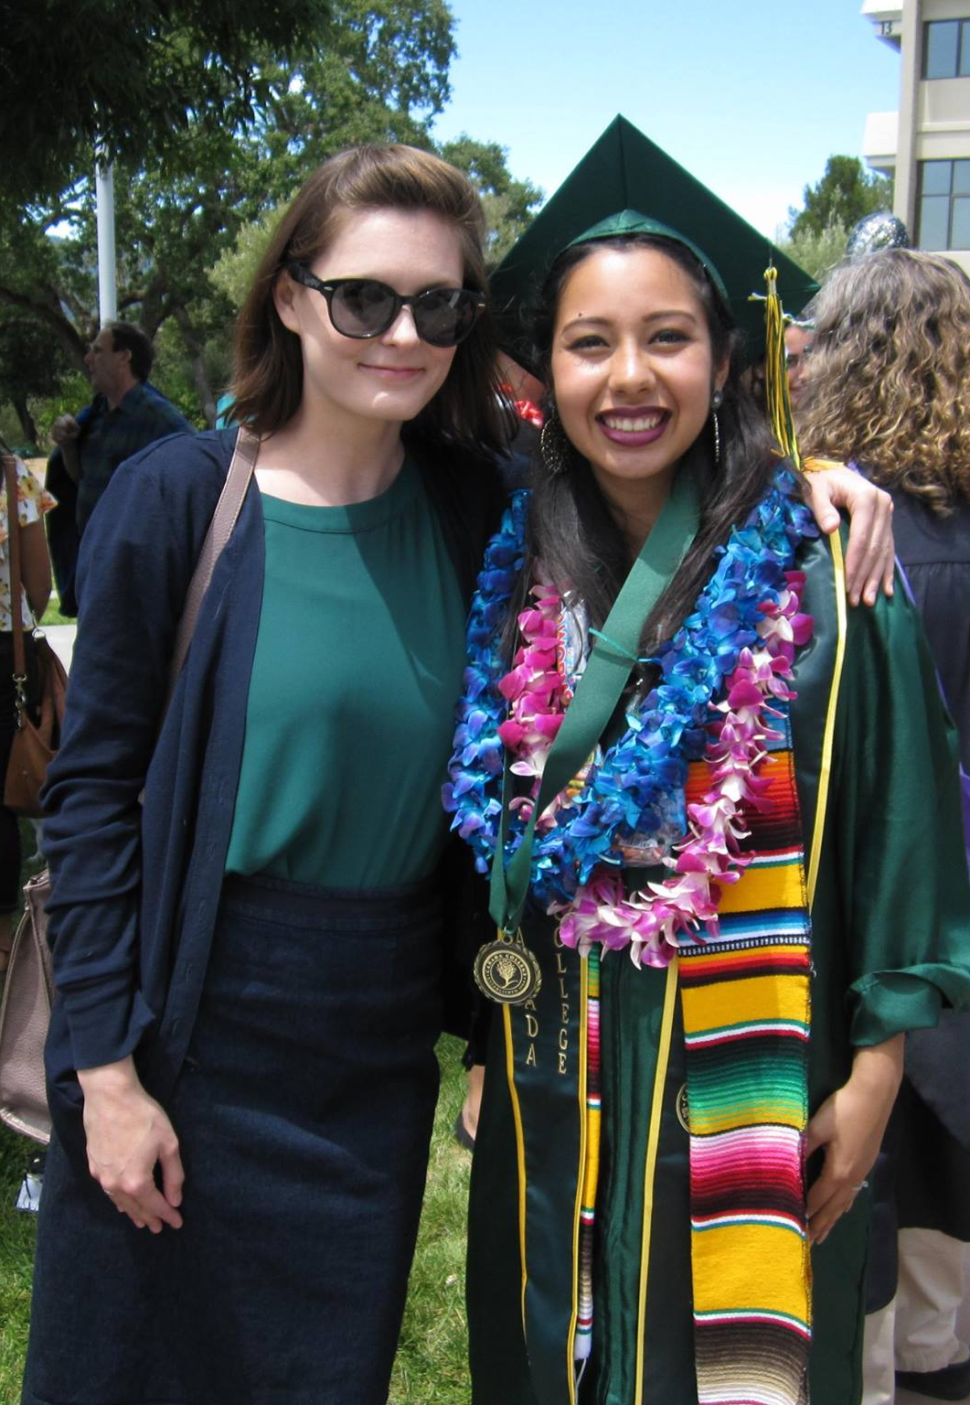
Our Students
Courageous, resilient & resourceful
285 AB540 students enrolled at Cañada (Fall 2017)
  Most were brought to the US at a young age
  Attended elementary, middle or high school in US
Many more are part of mixed status families

Slide 6
Common Challenges Faced by Undocumented Students
Lack a way to become legal residents/US citizens
Predominantly first generation & low-income
Secrecy vs. need for support
Difficulty accessing institutional support
  Inability to receive federal financial aid
  Lack of familiarity with financial aid process

Slide 7
5 Things You Can Do to Support Our Undocumented Community
Stay informed about changing laws and policies
Know campus resources
Make your support visible
Communicate your support effectively to students
Review policies in your work area

Slide 8
Stay informed about changing laws and policies
Identify key laws affecting undocumented students
  Federal: DACA
  State: AB 540, AB 130/131, SB 1159
Review district policies and FAQs
Take advantage of professional learning opportunities

Slide 9
Undocumented Students:
AB 540 and DACA
Undocumented
Students
DACA
Students
AB 540 Students
Notes:
AB 540 is a CA state law that went into effect in 2001. It allows a qualifying student who would otherwise not be eligible for in-state tuition to pay in-state tuition fees at any UC, CSU, or CA community college. Not all AB540 students are undocumented, but many are.
DACA is a federal program that allows for temporary relief from the threat of deportation or detention.

Slide 10
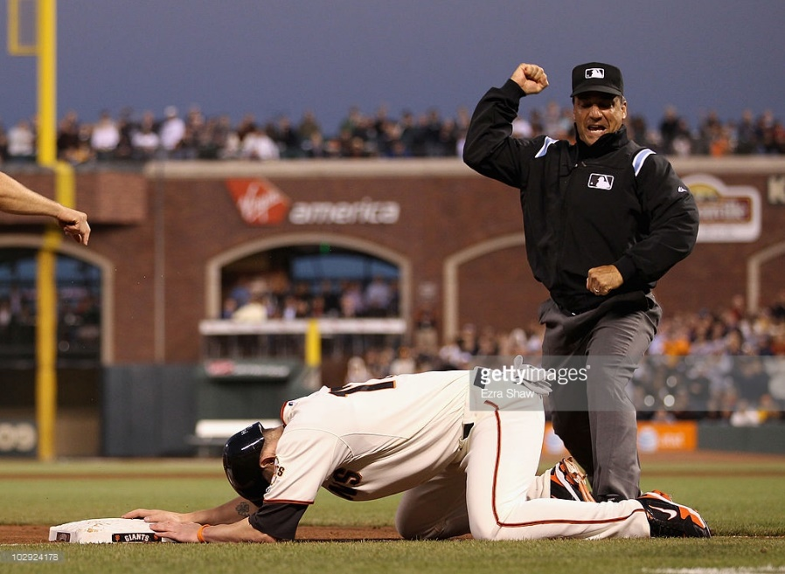

September 5, 2017: DACA Rescission
DACA
AB 540
Notes:
“The questions we’re getting from these students are about trying to make decisions about whether they should stay in school,” Perez said. “Should they leave school and work for the next six months? And our message has been really clear that we want students to be here. We want them to really be invested in their education because we know that getting their education is going to be the best thing for them moving forward.”

Slide 11
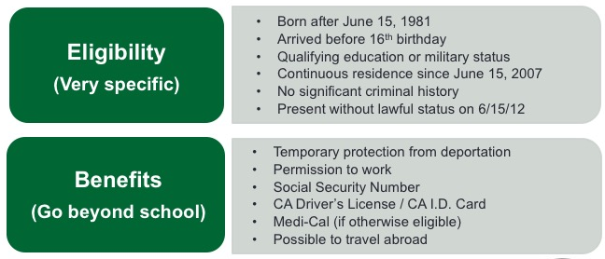
Federal Policy: Deferred Action for Childhood Arrivals (DACA)

Slide 12
Federal Policy: DACA
800,000 DACA beneficiaries nationwide
  25% in CA
  est. 7,000 in San Mateo County

Slide 13
Federal Policy: The End of DACA
Notes:
Currently 122 people lose DACA every day. That is more than 12,000 since the announcement on Sept. 5, 2017.
(The logic behind these numbers is straightforward: The 22,000 eligible DACA recipients who did not successfully apply to renew their DACA will, as a result, see their DACA protections expire in the 181 days between September 5, 2017 and March 5, 2018.)

Slide 14

State Policy
CA community colleges are open access institutions and serve all students regardless of immigration status
http://www.cccco.edu/ResourcesforUndocumentedStudents.aspx
Notes:
Kristen - We are lucky to be in California, and part of a statewide community college system that has clearly articulated support for undocumented students. “the Chancellor’s Office has reassured colleges that no changes have been made with regard to admissions or financial aid; informed students that financial aid for undocumented students is protected by state law; called on President- elect Donald J. Trump to preserve DACA”

Slide 15
State Policy: Resident vs. Non-Resident Fees
Resident/AB 540 Fees
  $46 per unit
Non-Resident Fees
  $228 per unit (plus $8 per capital outlay fee plus $46 per unit enrollment fee)
A standard 3 unit class = $846
A full time (12 unit semester) = about $3,384
Notes:
PAM

Slide 16
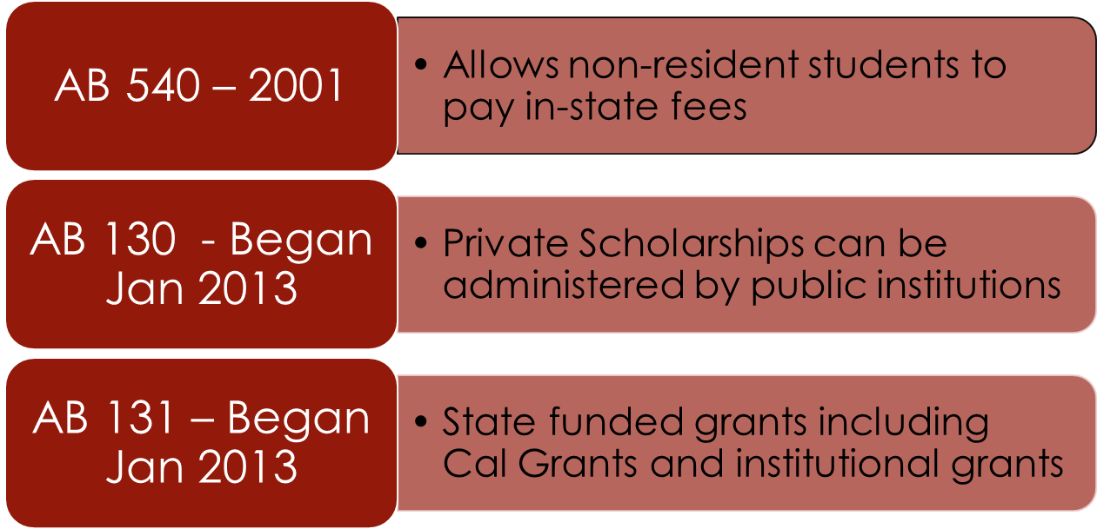
State Policy: California Legislation
Notes:
PAM

Slide 17
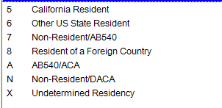
Residency Codes

Slide 18
Residency Codes
Nonresident Tuition
Nonresident Tuition
Nonresident Tuition

Slide 19

District Policy
SMCCD “supports, promotes, values, respects and protects all students and employees of the District, irrespective of their immigration status, or that of their families”
Our colleges are “safe havens”
“Resolution Affirming the San Mateo County Community College District’s Commitment to Supporting Undocumented Students and Student Privacy” (Jan. 2017)

Slide 20
District Policy
Additional guidance for staff and faculty (Spring 2017)
Undocumented & International Students Rights
How to Respond to Requests for Student Information or Whereabouts
Notes:
Kristen

Slide 21
Know campus resources
Familiarize yourself with the services and programs available to undocumented students
Post flyers and share information in workshops, orientations, etc.

Slide 22
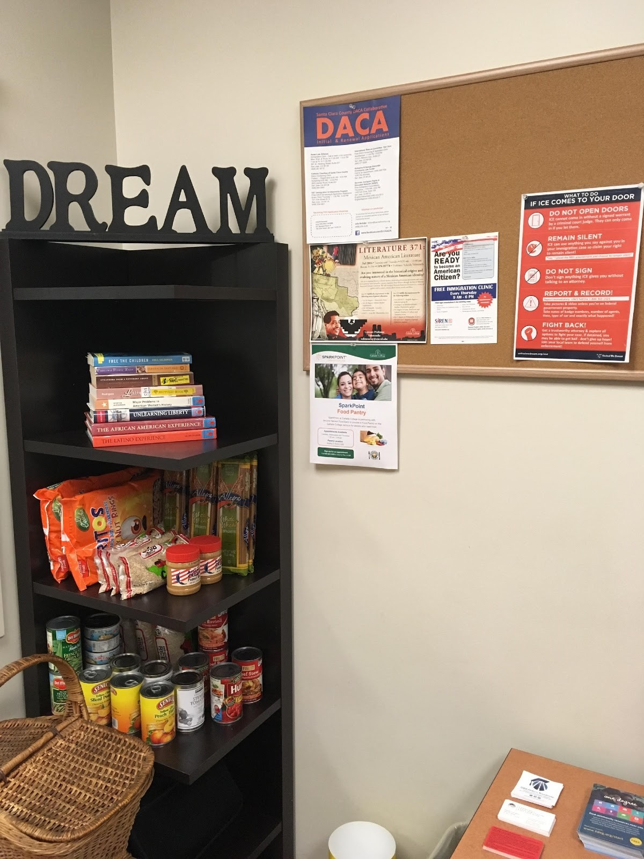
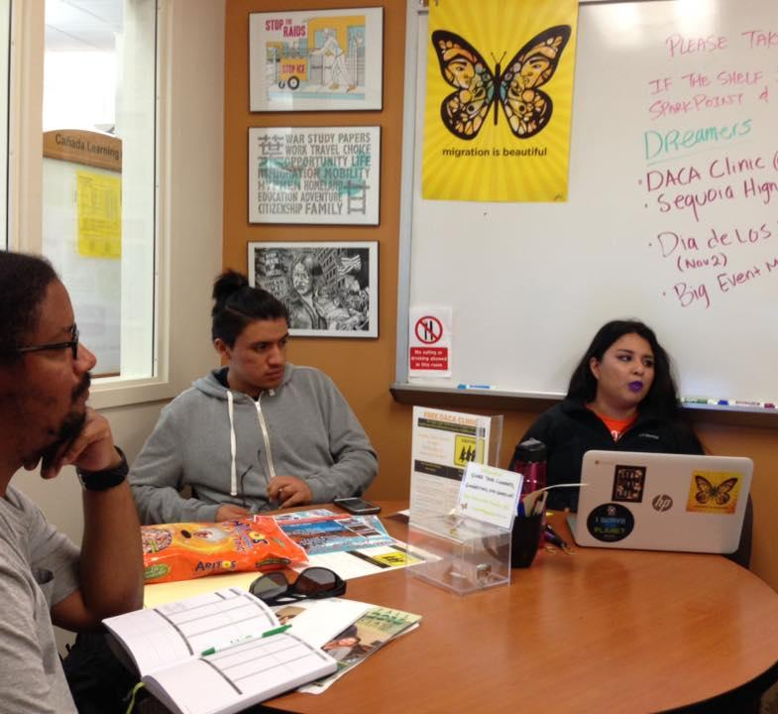

Cañada DREAM Center (est. 2016)
Notes:
Services include: free printing, free legal consultations, mini food pantry, DREAMers student club

Slide 23
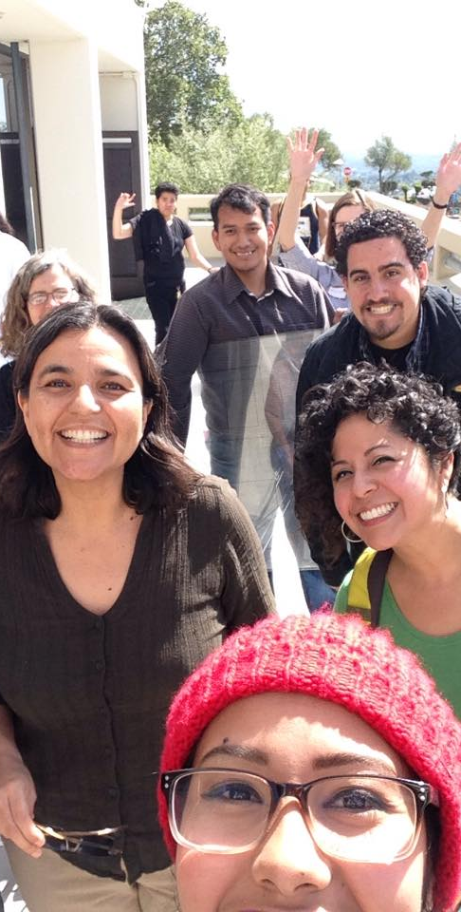
DREAMers Task Force
Part of ACES (Academic Committee for Equity and Success)
Group of faculty, staff, students and administrators
Founded to institutionalize equitable pathways for undocumented students

Slide 24
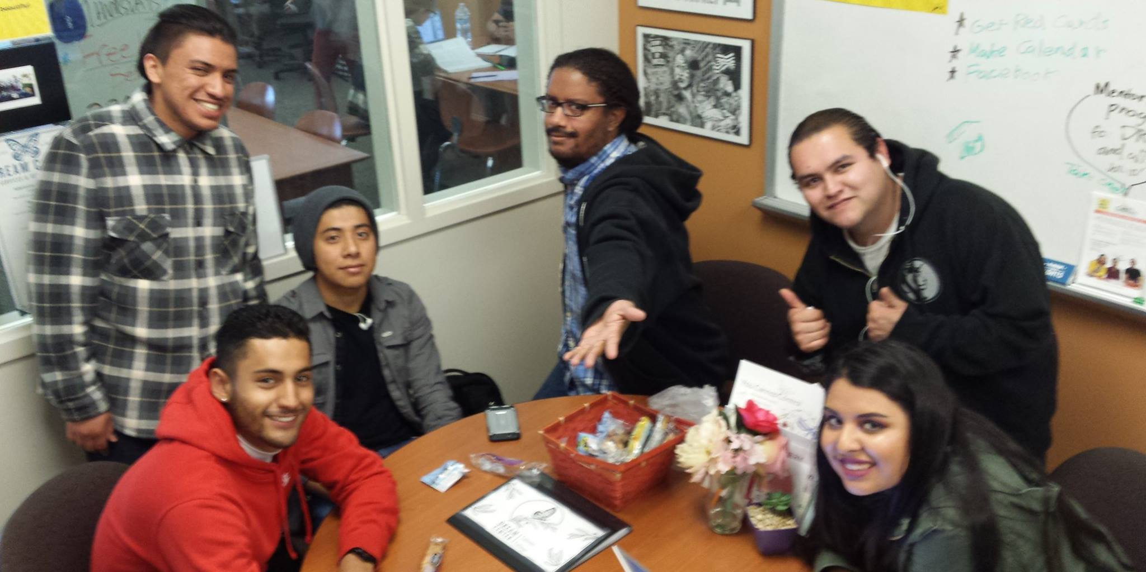
DREAMers Student Club

Slide 25
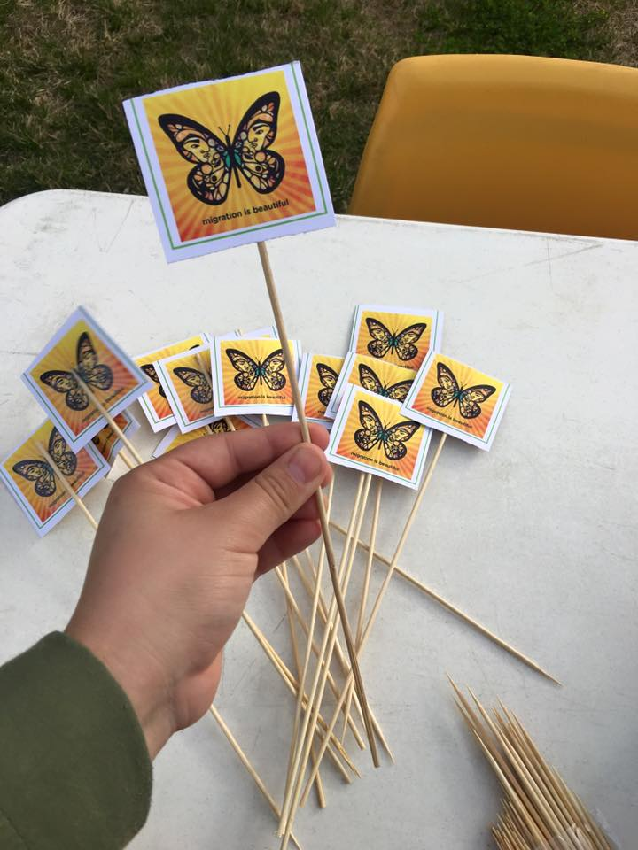
Make Your Support Visible
Post a “migration is beautiful” butterfly sticker
Display an unafraid educator sign

Slide 26
Communicate your support effectively
Use affirmative language (“everyone is welcome here”)
Never ask a student to reveal their immigration status or that of a family member
If a student does reveal their status:
  Tell them that they are not alone (There are an estimated 11 million undocumented immigrants in the US)
  Ensure them that they have rights, and that their privacy is protected (District FAQs)
  Connect them with resources

Slide 27
Don’t Be Afraid!
Remember that political stances on immigration and supporting all of our students regardless of immigration status are two very different things
It is our job to support ALL students

Slide 28
Review policies in your work area
Review policies and procedures in your work area from the perspective of an undocumented student to identify barriers and opportunities for improving student access and outcomes
Clarify procedures for undocumented students and always include that information for all students

Slide 29
Want to Learn More?
Flex Day UndocuAlly Training
Friday, January 12, 2018
9:30 – 11:00 AM
Building 3, Room 142
DREAMers Task Force: email Kristen Parks at parksk@smccd.edu to join the Task Force
DREAMers Student Club: Follow the club on Facebook at fb.com/CanDreamers
Notes:
UndocuAlly is a term used to identify campus allies for undocumented students. The UndocuAlly training is designed to provide the basic knowledge, skills, and resources needed to serve and work alongside undocumented students. Participants will receive an overview of current laws and policies affecting undocumented students in California, reflect on culturally proficient allyship, identify practices for serving undocumented students, and commit to making their support visible on campus.

